Slide 1
Civil Rights:
Where are
we now?

Slide 2
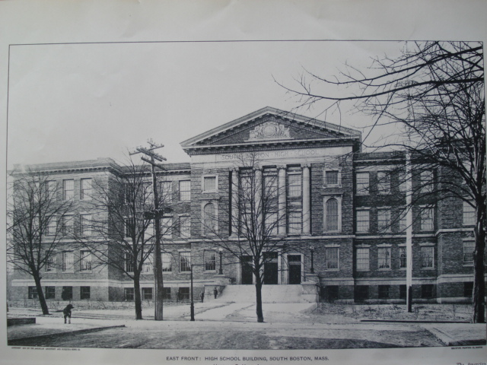
Largely because of poverty and socio-economic issues, the public school system in Boston in the 1960’s was segregated.

Slide 3
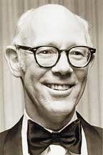
To force the city of Boston to follow the wishes of the Supreme Court of the United States, in the case of Brown v. Board, U.S. District Court judge W. Arthur Garrity ordered the schools in Boston to be integrated. How was this integration going to happen?

Slide 4
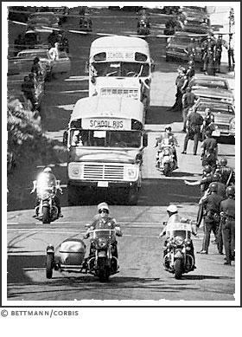
Garrity ordered that some students from all white schools would be bused to African-American schools, and that some students from African-American schools would be bused to white schools.

Slide 5
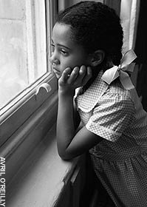
Remember, many African-Americans argued that inequality and de facto segregation was a result of poverty, and that poverty itself was a result of poor education for African-Americans.

Slide 6
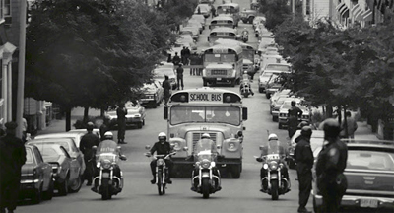
Given all that, how was Garrity’s forced busing order supposed to help solve inequality and poverty for African-Americans?

Slide 7
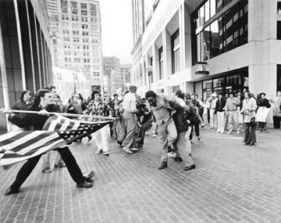
For the most part, school integration in Boston went peacefully. In some cases, however, violence and bloodshed broke out.

Slide 8
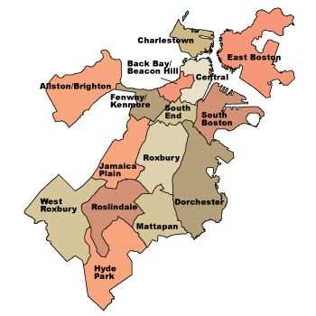
The worst violence occurred in the white neighborhood of South Boston.
White students were bused from South Boston to the African-American neighborhood of Roxbury, and vice versa.

Slide 9
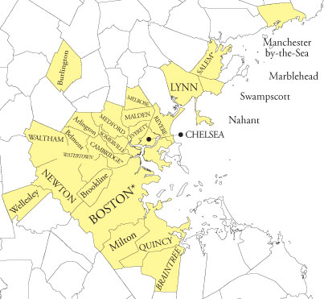
Busing happened all over the city. Why did the worst violence happen there?

Slide 10
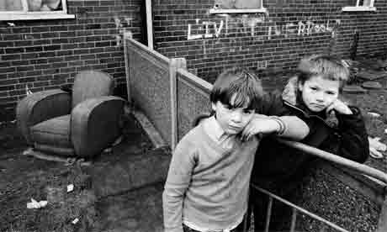
Poor whites, who lived in Boston’s inner city neighborhoods had one thing in common with Boston’s middle and upper classes:
They were white.

Slide 11
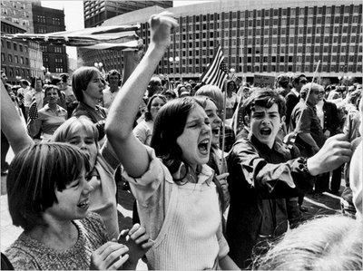
Racism, then, totally played a part. Poor whites believed, that while they might not have been as good as upper and middle class residents of Boston, at least they were better than the African-Americans.

Slide 12
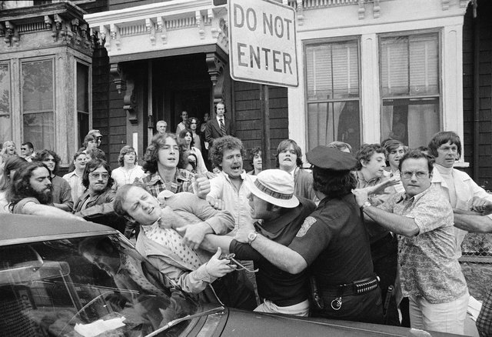
Forced busing, and the integration of schools, threatened that social status. As such, they fought to protect it.

Slide 13
In the end, what did forced busing accomplish?
It forced whites and black to interact with each other, to deal with one another on a daily basis.
As a result, the two grew to accept one another, slowly over time.

Slide 14
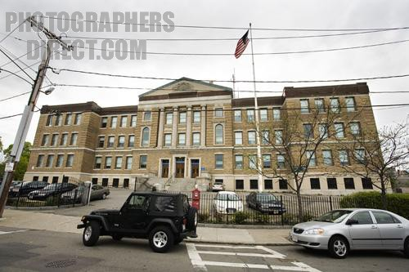
It also slowly improved the quality of education in Boston’s inner city schools.

Slide 15
So,
where are
we now?

Slide 16
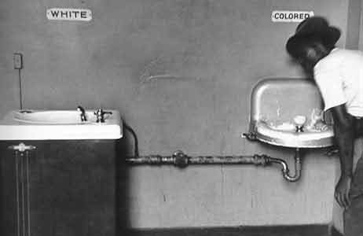
De jure segregation is no more and African-American voting rights are, in theory, protected by the U.S. government.

Slide 17
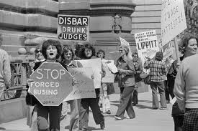
De facto segregation is still here.

Slide 18
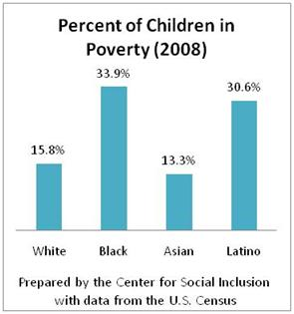
Little has changed economically.

Slide 19
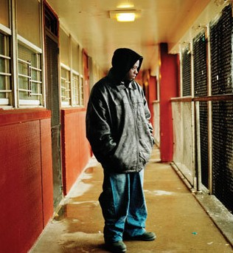
In 2010, only 15% percent of whites were in poverty, compared to the 27% percent of African Americans.

Slide 20
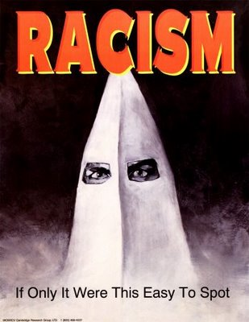
Racism hasn’t gone away. Has it gotten any better?

Slide 21
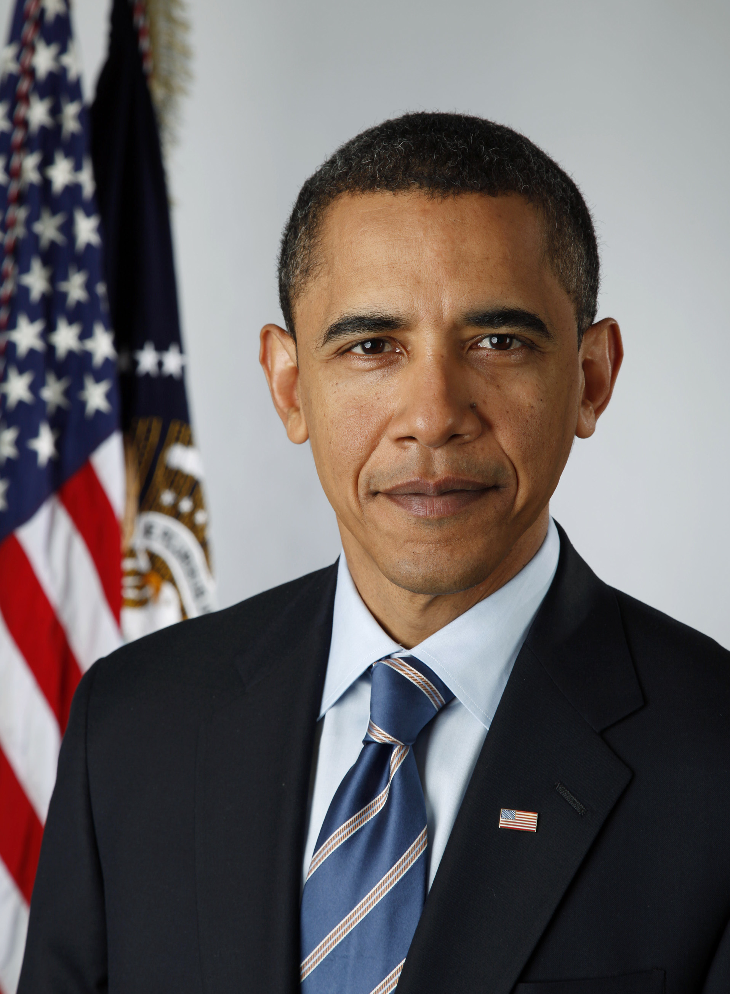

Slide 22
Fin.

