Slide 1
Origins of
American
Political
Philosophy

Slide 2
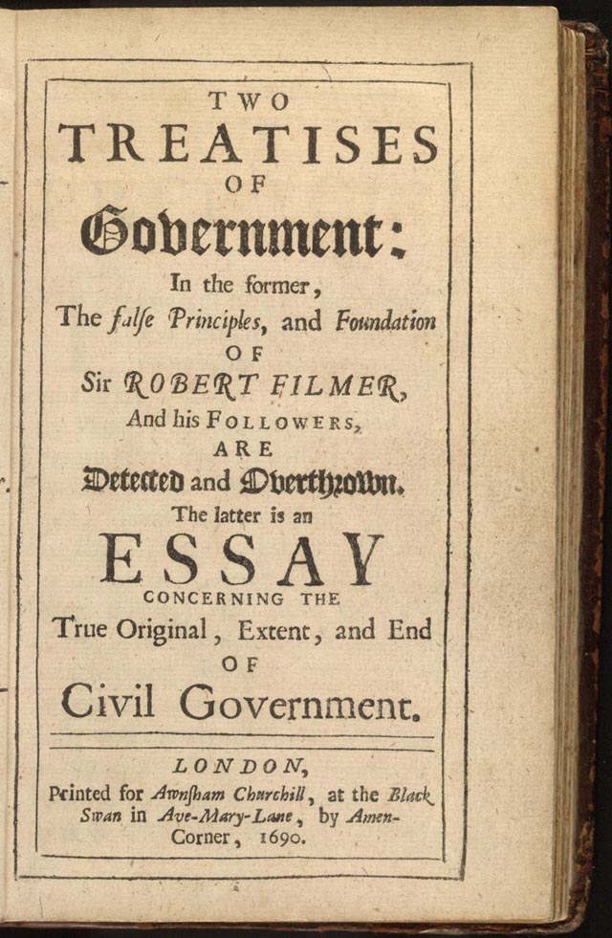
Descended from the philosophy of the Enlightenment (mid 1600’s – mid 1700’s)

Slide 3
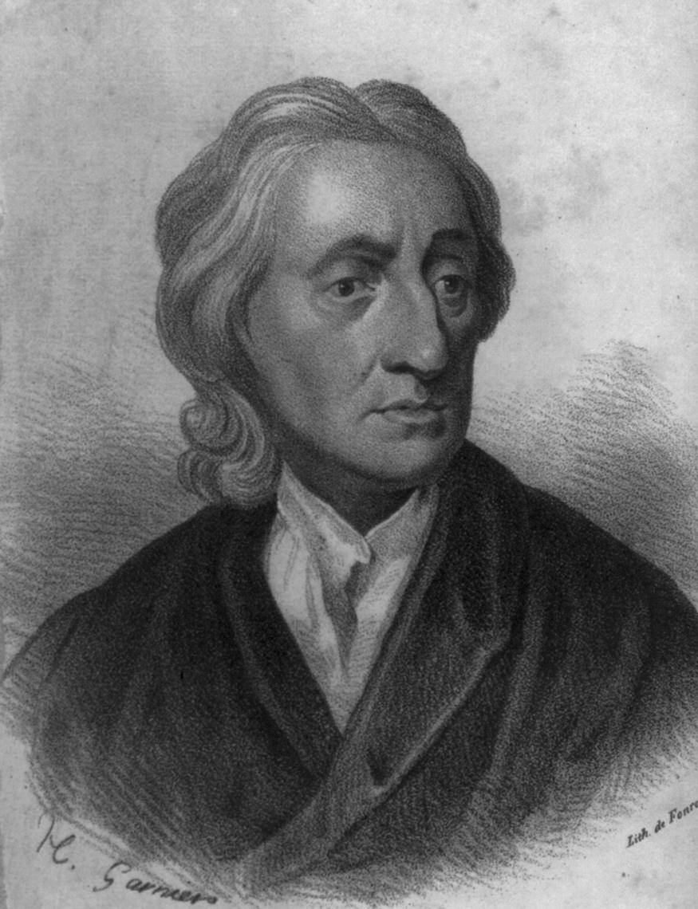
John Locke
1. All humans inherently possess, and should be free to enjoy, the rights of life, liberty, and property. (Natural Rights)
2. People form governments to ensure that those rights are protected.
3. Thus, the main job of any government is to allow people to enjoy their natural rights and protect those rights from infringement, either by other people or other nations.

Slide 4
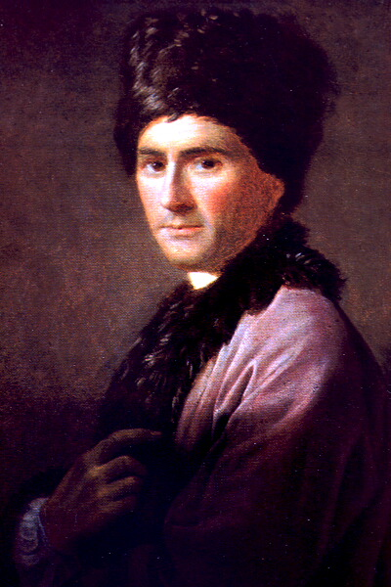
1. A social contract exists between the government and the people.
2. People give their support to the government in the form of taxes, loyalty, military service, voting, etc…
3. In exchange for this support, the government gives people protection. (Protection from invasion, protection from crime, protection of rights etc…)
Jean Jacques Rousseau

Slide 5
4. If one side violates, or does not uphold their side of the contract, the other can and should take action.
Jean Jacques Rousseau
5. Thus, if the government does not protect the rights of its’ citizens, those citizens have the right and the duty to rebel.

Slide 6
By 1776, the American colonists believed the British government had violated the social contract and had denied them their natural rights of life, liberty and property.

Slide 7
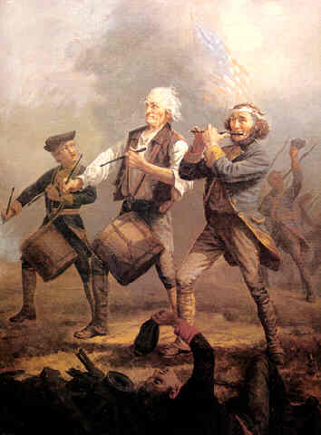
1. They had no representative in the British Parliament.
2. As a result, they were taxed without their consent. (No taxation without representation!)
3. Their homes were searched and they were arrested without warrants.
4. They were denied the right to a jury trial

Slide 8
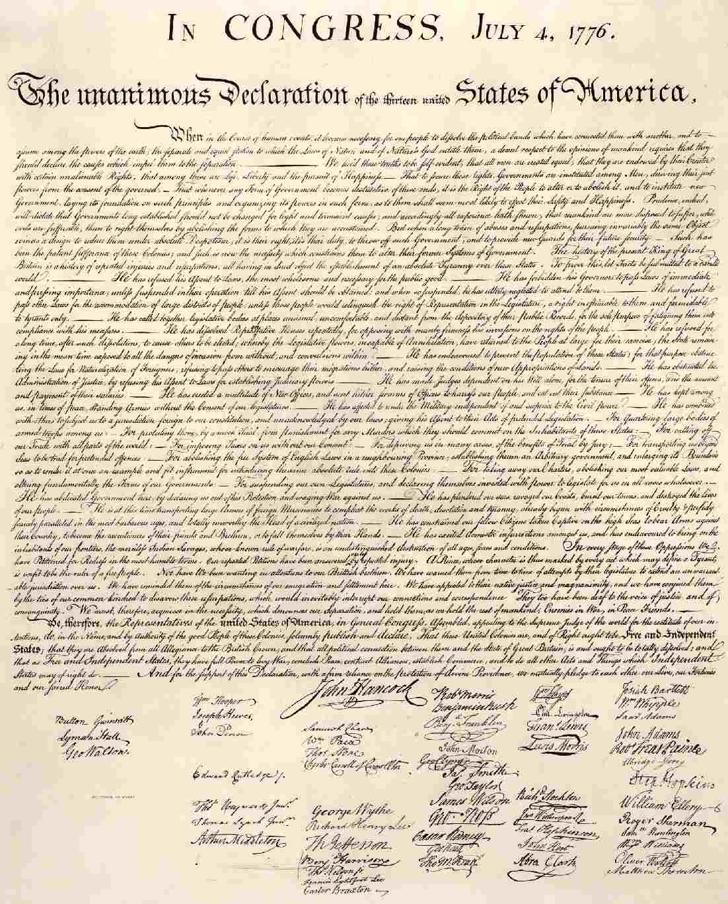
As a result, the American colonists felt they had the right and the duty to rebel.

Slide 9
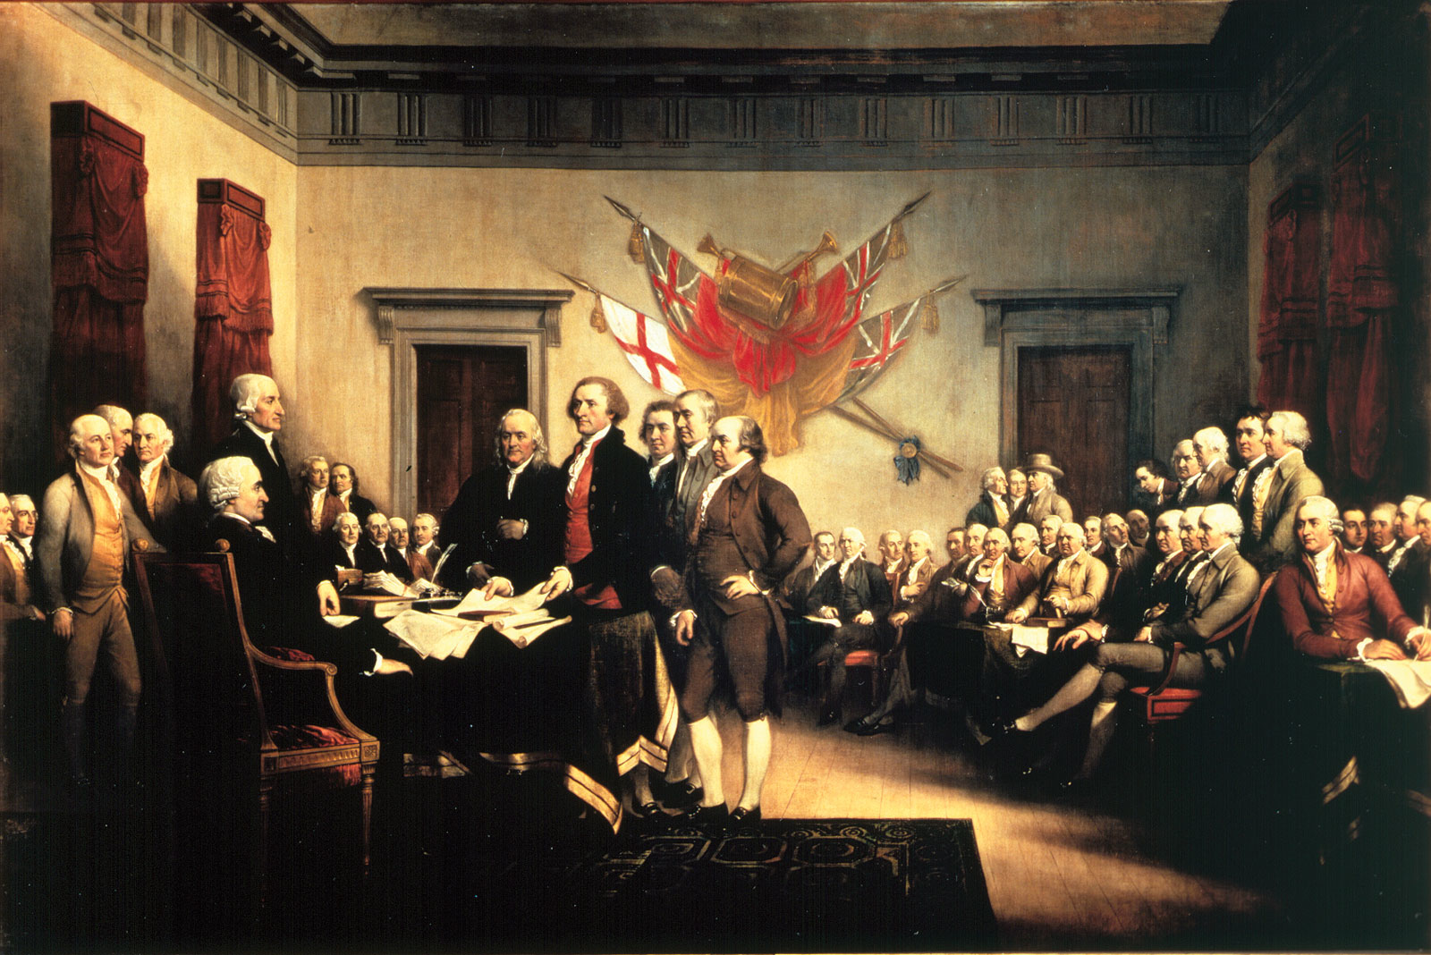
Having made the choice to split from England, the elected government of the American colonies, the Second Continental Congress, wanted to explain their decision.

Slide 10
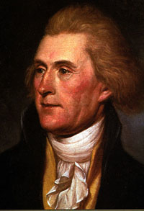
To that end, they appointed Thomas Jefferson to write a formal explanation as to why the American colonies were splitting from Great Britain.

Slide 11
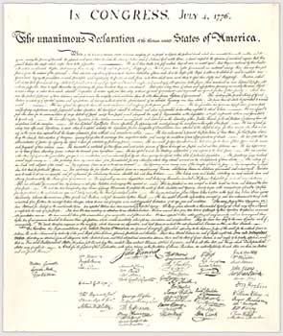
The name of the document he wrote?
The Declaration of Independence

Slide 12
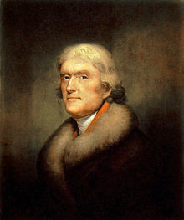
In the Dec. of Independence, Jefferson did two things:
1. Listed the reasons why the American colonists were upset with the British government.
2. Began to explain what the new nation of America stood for.

Slide 13
Here’s exactly what he said (don’t write this down!):
“ We hold these truths to be self evident: that all men are created equal; that they are endowed by their Creator with certain unalienable rights; that among these are life, liberty, and the pursuit of happiness. That to secure these rights, governments are instituted among men, deriving their just powers from the consent of the governed.”

Slide 14
Thus, according to Jefferson, in the Dec. of Independence, the new nation of America would stand for:
- life
- liberty
- the pursuit of happiness
- equality for all (men?)
- protection of these things by the government.

Slide 15
The question that we need to address is this:
- life
- liberty
- the pursuit of happiness
- equality for all (men?)
- these things would be protected by the government.
What exactly are these things?

Slide 16
Take 5 minutes to chat with each other and come up with a definition for the following:
- life
- liberty
- equality

Slide 18
Following America’s move to revolution, the Founding Fathers next had to set up a government that would protect life, liberty, and equality.

Slide 19
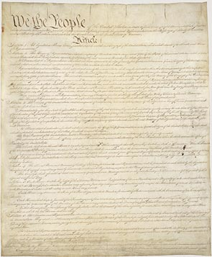
After some trial and error they came up with the following:
- a representational democracy
- three branches in a powerful national government
Legislative (Congress)
Executive (President)
Judicial (Supreme Court)
- representative state governments that have less power than the national government

Slide 20
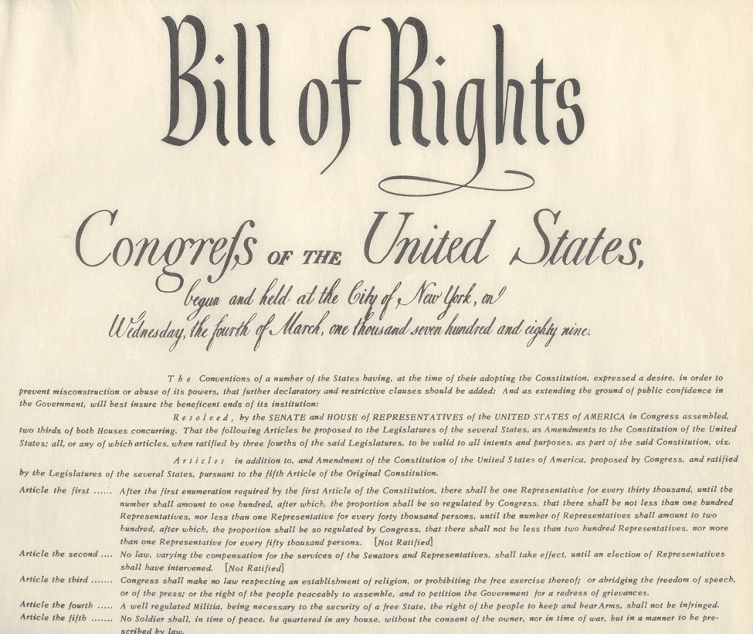
- a listed set of rights (Bill of Rights)

Slide 21
As a result, today most Americans believe that this nation stands for:
Equality
Liberty
Democracy
Rights

Slide 22
Fin.

