Slide 1
War
in
Afghanistan

Slide 2
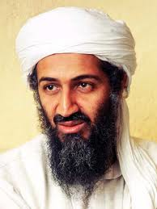
It very quickly became clear to the U.S. government that Osama Bin Laden and Al-Qaeda were responsible for the attacks on America.

Slide 3
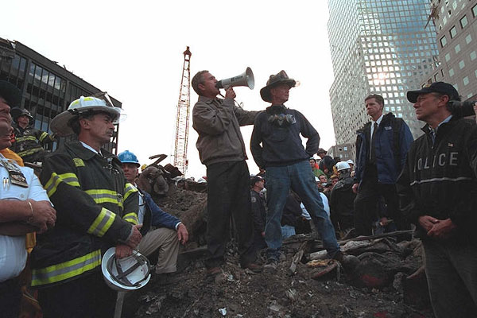
President Bush travelled to what had come to be known as “Ground Zero” in New York on September 14th.

Slide 4
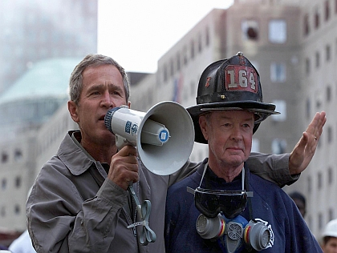
There, he promised the firemen of NYC, and the people of America, that those responsible would be punished.

Slide 5
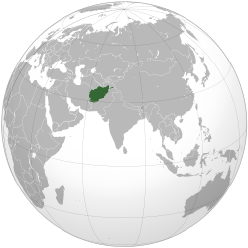
Remember that in 1996 Afghanistan had been taken over by the radical Islamist group the Taliban.

Slide 6
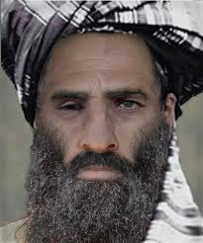
The Taliban, and thus Afghanistan was led by Mullah Mohammad Omar.
Omar and the Taliban ruled Afghanistan by a very strict interpretation of Islamic law.

Slide 7
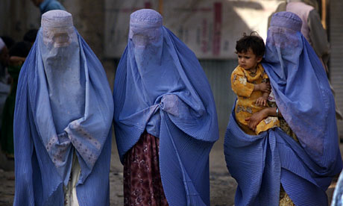
During this time, women had virtually no rights and received no education.

Slide 8
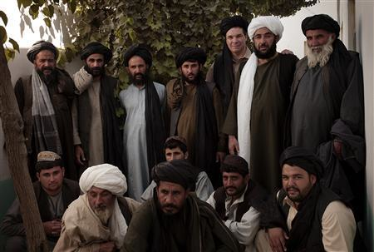
Watching television and listening to music were forbidden, as were playing games and sports.

Slide 9
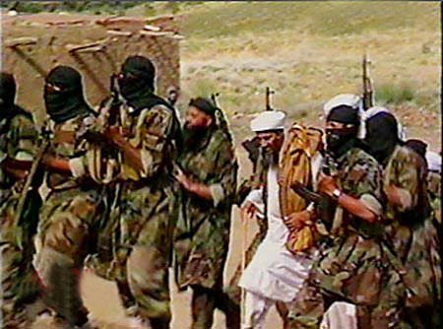
Bin Laden and Al-Qaeda were supported and protected by the Taliban. From an American perspective, they all had to pay.

Slide 10
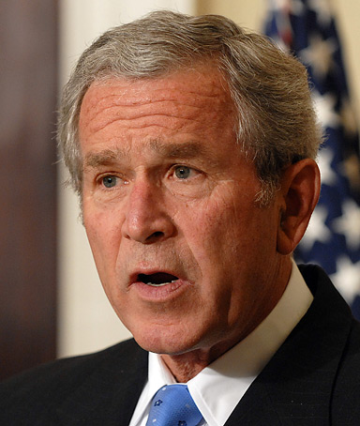
The U.S. government, and President Bush began to put together a coalition of countries to help invade, and then change Afghanistan.

Slide 11
Eventually American forces would be joined by Britain, India, Germany, Turkey, Poland, and Australia.

Slide 12
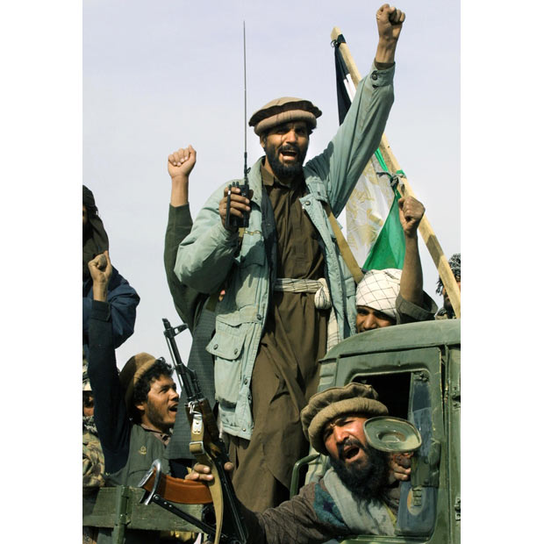
These countries would be helped by the Northern Alliance.
- A loose organization of Afghani tribes and military groups that opposed the Taliban.

Slide 13
On October 7, 2001 the U.S. military launched Operation Enduring Freedom.

Slide 14
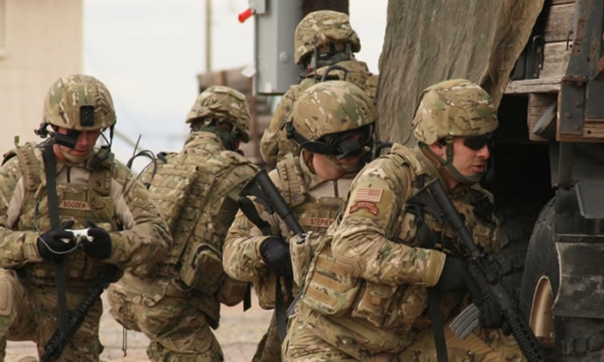
U.S. and British forces, along with the Northern Alliance, began strikes on the Taliban throughout Afghanistan. The main target was the capital of Kabul.

Slide 15
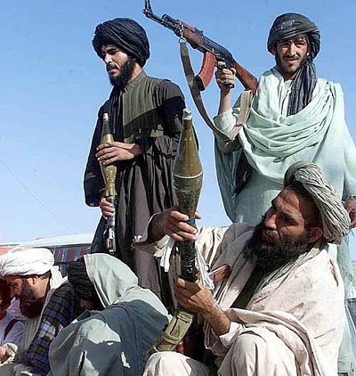
America, and its allies, had two main goals:
- Remove the Taliban, liberate the Afghani people, and bring democracy to the nation.
- Hunt down and capture or kill Al-Qaeda and Bin Laden.

Slide 16
By December, 2001 the Taliban had fallen. They didn’t rule Afghanistan any more.
That did not mean that they had been defeated.

Slide 17
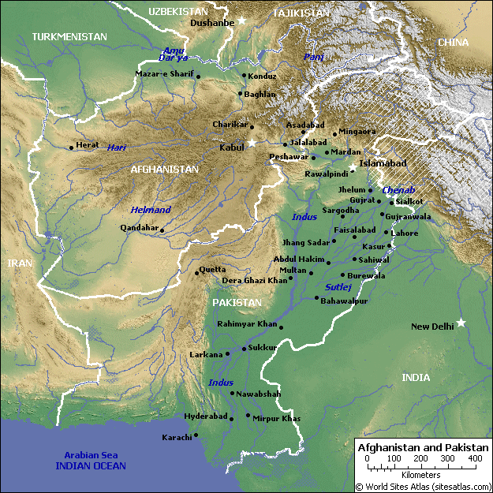
Many members of both the Taliban and Al-Qaeda had fled either into the mountainous, hard to reach area of Afghanistan, or into neighboring Pakistan.

Slide 18
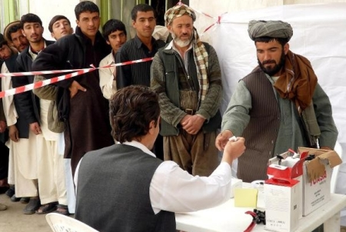
With the fall of the Taliban, the United States helped to set up a democratic government in Afghanistan.

Slide 19
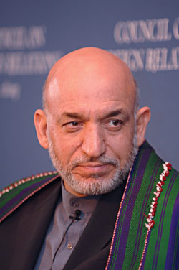
The Islamic Republic of Afghanistan was formally established in December 2001.
- It was led by President Hamid Karzai.
- The Afghani government received support from the United Nations and was protected by the U.S. military and NATO.

Slide 20
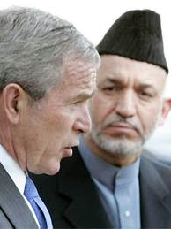
Karzai, and his U.S. supported government had a number of huge problems to deal with:
- gaining control of the various regions and tribes of Afghanistan.
- providing the people of Afghanistan with basic human necessities.
- dealing with the growing drug trade (opium, heroin).

Slide 21
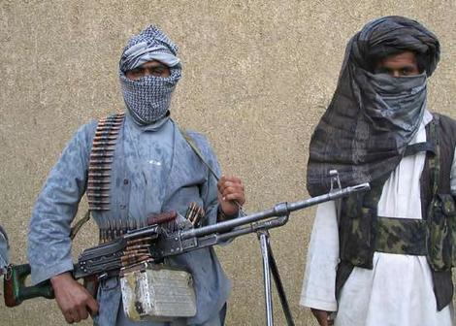
The biggest problem, was that the Taliban and Al-Qaeda weren’t dead.

Slide 22
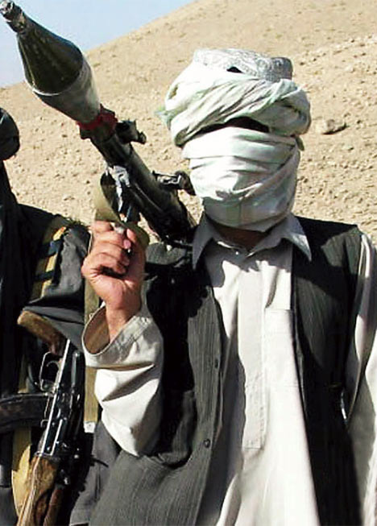
By 2002, surviving members of the Taliban began to organize an insurgency against Karzai’s government.

Slide 23
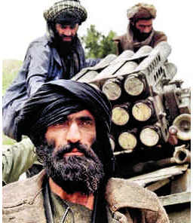
What is an insurgency?
- Underground, guerilla war against and more dominant, powerful group.
- The Viet Cong are a good example.
- They don’t have to win, they simply have to make those in power tired of fighting.

Slide 24
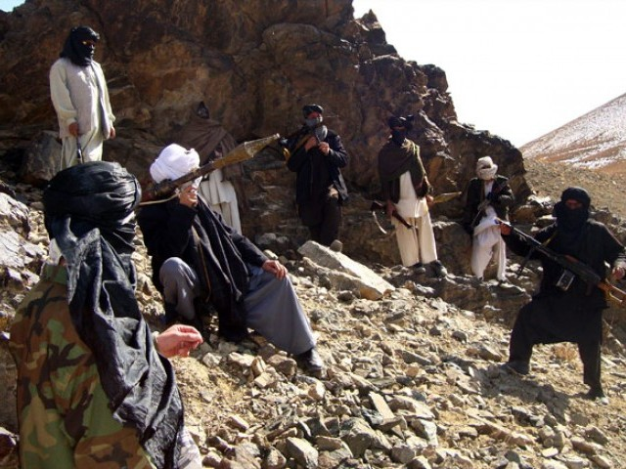
Small groups of the Taliban, and Al-Qaeda, began to attack American forces. Their goal was to make the United States tired of the fighting.

Slide 25
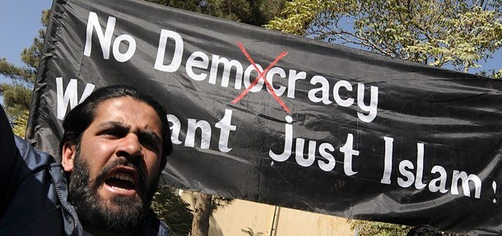
They also began to receive help from more radical Muslims who did not like America’s western presence in their nation.

Slide 26
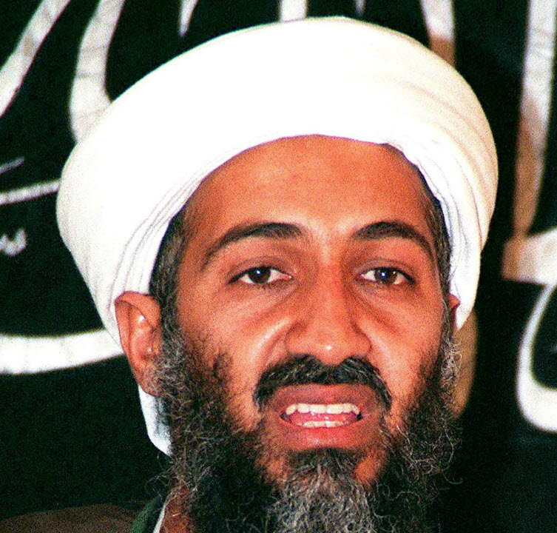
At the same time, American forces were attempting to find Bin Laden and the other members of Al-Qaeda responsible for 9/11.

Slide 27
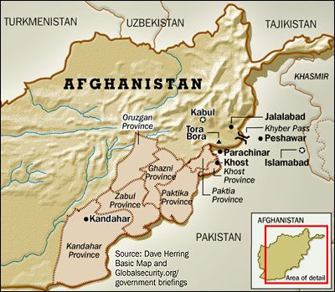
In December, 2001 informants suggested that Bin Laden was hiding out in the rugged, mountainous area on the Pakistani border known as Tora Bora.

Slide 28
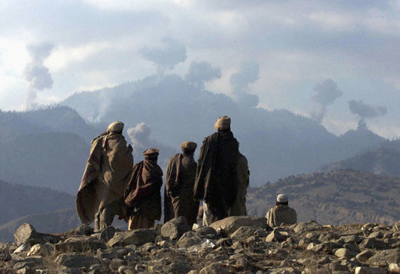
An intense hunt got under way in Tora Bora. The problem was that the region was full of Taliban and Al-Qaeda fighters.

Slide 29
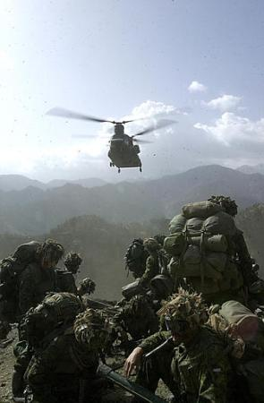
The ensuing battle resulted in the deaths and capture of many members of the Taliban and Al-Qaeda. However, Bin Laden remained at large.

Slide 30
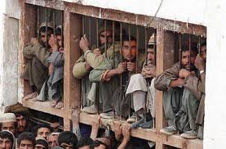
The American government faced the question of what to do with captured members of Al-Qaeda.

Slide 31
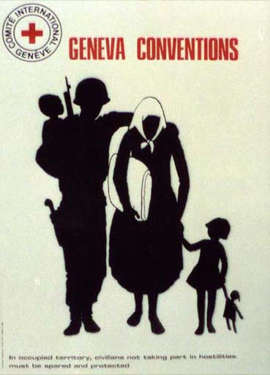
Under various international agreements, nations like the U.S. agreed to very strict rules of war that established what could and what could not be done to prisoners of war.

Slide 32
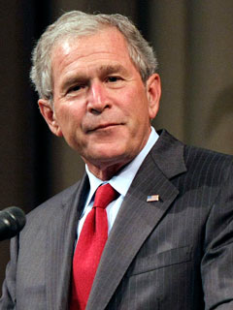
It became the policy of President Bush and the U.S. government that captured members of Al-Qaeda were not official prisoners of war.
They were terrorists and criminals, and thus the rules of war did not apply.

Slide 33
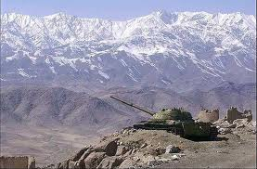
As a result, two things began to happen.

Slide 34
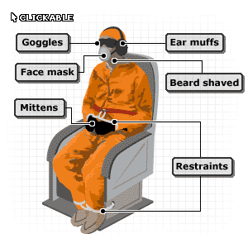
1. The American government wanted to know what other attacks Al-Qaeda might be planning and where Bin Laden was.
The best way to get information from prisoners was to find ways to convince them to tell what they knew.

Slide 35
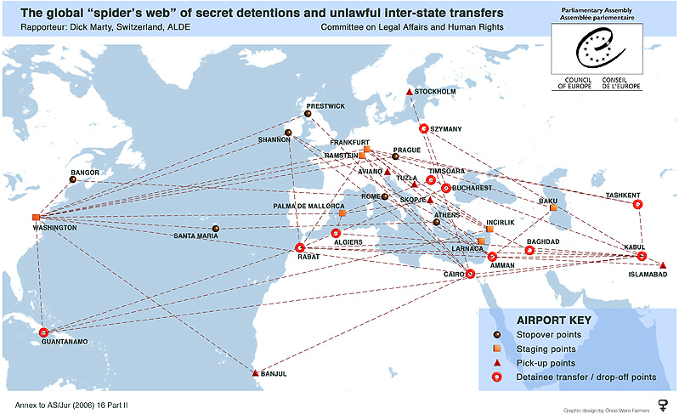
To that end, the U.S. government worked with Middle Eastern, African, and Eastern European nations and began to engage in “extraordinary rendition.”

Slide 36
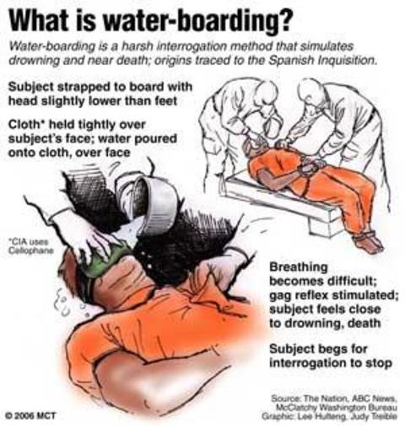
Under this policy, prisoners were taken by the CIA to prisons and other undisclosed locations around the world.
There, they were tortured by a variety of methods, until they told the government what they knew.

Slide 37
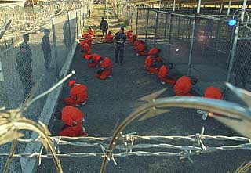
2. After they had been interrogated, prisoners were sent to a military prison located at Guantanamo Bay in Cuba.

Slide 38
There they were held, where they awaited a military trial on charges of terrorism and murder.
The first prisoners arrived in February 2002.
The first of these military trials started last year.

Slide 39
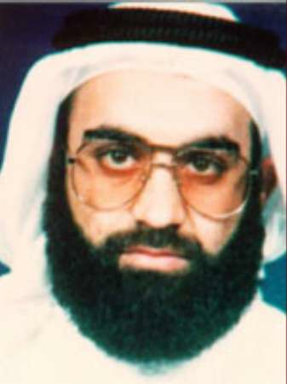
The most important person captured by the United States was the mastermind of the 9/11 attack, Khalid Sheik Mohammed.

Slide 40
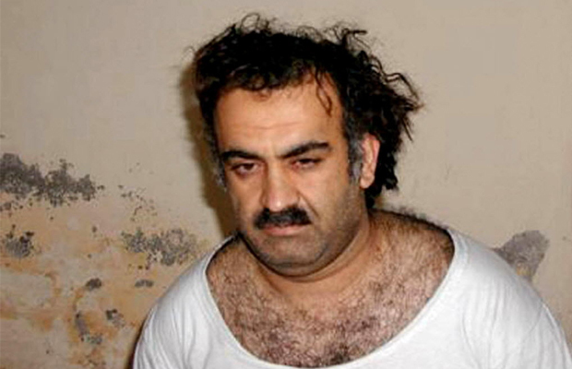
He was captured by U.S. and Pakistani forces in Pakistan in March, 2003.

Slide 41
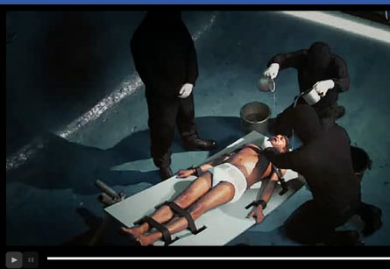
He was then taken to secret prisons in the Middle East and Europe and tortured for information.

Slide 42
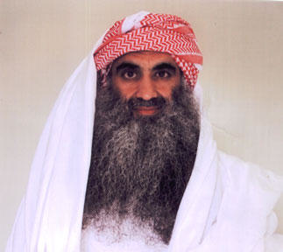
He is currently awaiting trial at Guantanamo in Cuba.

Slide 43
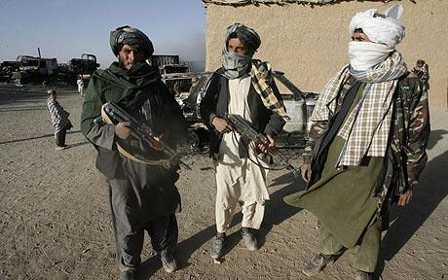
By 2006 the Taliban had regrouped in Pakistan and began to push back into Afghanistan.

Slide 44
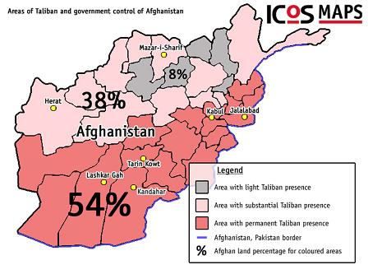
According to one report, they controlled almost half of Afghanistan by 2007. Why?

Slide 45
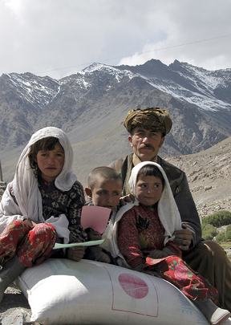
- Afghanistan is complex. It’s full of different tribes and groups that do not always support the official government.
- Popular opinion in Afghanistan began to turn against America, especially after the # of civilian deaths began to grow.

Slide 46
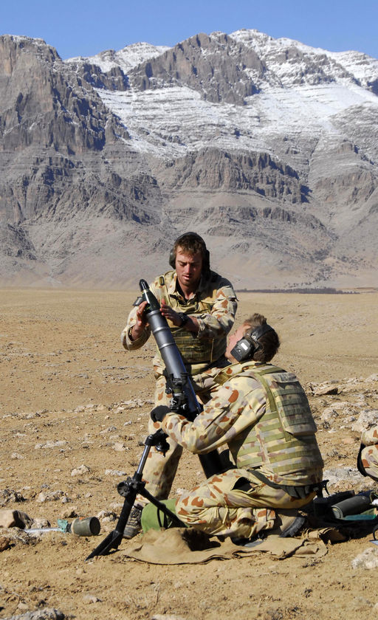
- The military had to split its attention between Afghanistan and Iraq.
- The U.S. never had enough troops on the ground to get the job done.

Slide 47
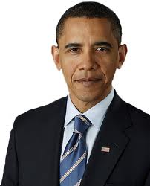
In 2009, President Obama ordered 30,000 additional American troops to the region, bringing the total to 100,000. Their mission was simple:
Push back the Taliban, and restore order to the country.

Slide 48
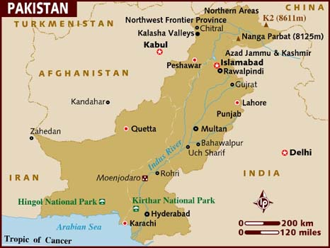
Perhaps the biggest reason for the resurgence of the Taliban, is Pakistan.

Slide 49
While the government of Pakistan repeatedly told the American government that it would support U.S. efforts in Afghanistan, the evidence suggests that was not necessarily the case.

Slide 50
Taliban leader Mullah Omar is still believed to be hiding in Pakistan.
Osama Bin Laden was living in Pakistan, 50 miles outside of the capital of Islamabad.

Slide 51
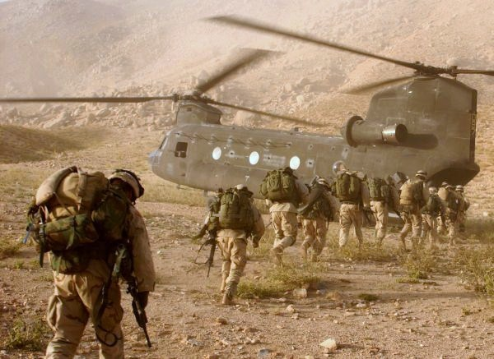
In June, 2010 the war in Afghanistan became the longest war in American history.

Slide 52
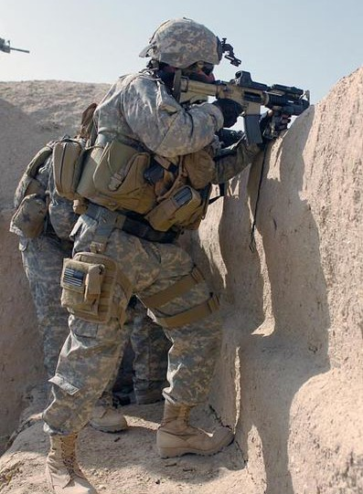
If current plans hold, American forces will be totally withdrawn by 2014. The question then becomes, what happens next?
- Will democracy remain?
- Will the Taliban come back?

Slide 53
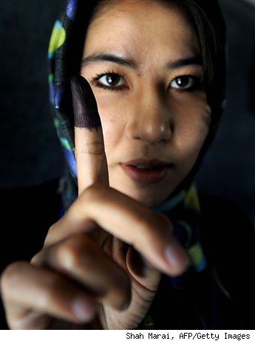
What’s been accomplished?
- The Taliban was removed from power.
- Freedom and rights have begun to spread.
- Hundreds of Al-Qaeda members were killed, including Osama Bin Laden.
- Democracy rules in Afghanistan.

Slide 54
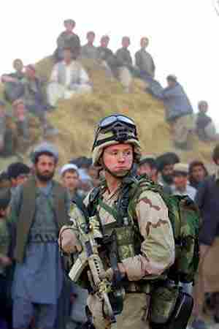
The Cost?
- $527,000,000,000
- 2,853 American soldiers have died.
- 15,460 have been wounded.
- Estimates suggest that the suicide rate amongst veterans is extremely high.
-12,000 – 20,000 Afghanis dead.

Slide 55
Fin.

