Slide 1
Attacking
Poverty

Slide 2
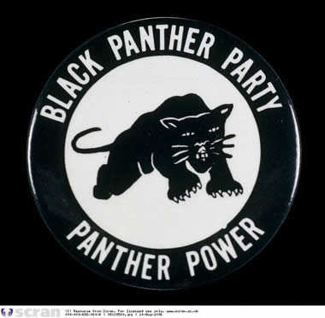
The most famous group to emerge from the inner city was the Black Panther Party for Self Defense.

Slide 3
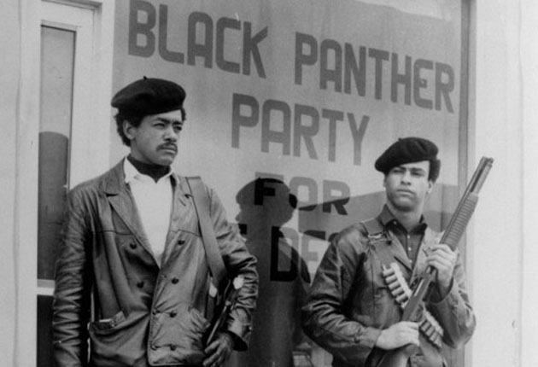
The Panthers had a two part agenda.

Slide 4
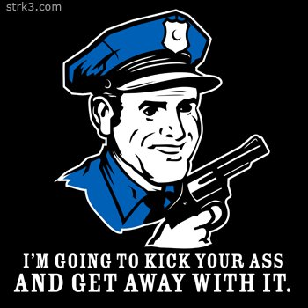
1. Ensure that African-American rights weren’t being violated by racist cops.

Slide 5
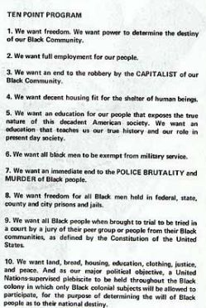
But, they weren’t just about violence.
2. They also proposed programs to build strong African-American communities through education and social welfare programs.
Not only were they fighting “the man,” they were fighting poverty in their communities.

Slide 6
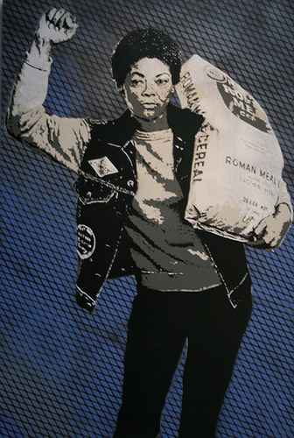
As such, they built food programs, held clothing drives, set up low cost medical care programs, etc...

Slide 7
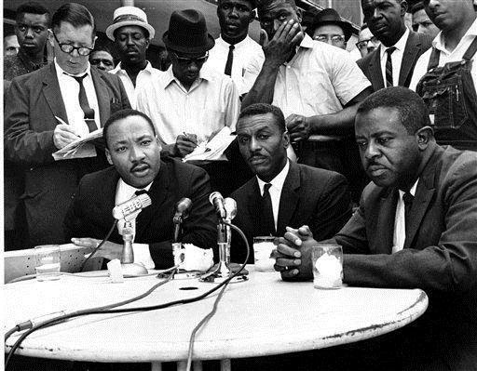
Martin King and the SCLC also turned their attention to the problem of poverty, in part due to the rioting that had taken place in Detroit and other northern cities.

Slide 8
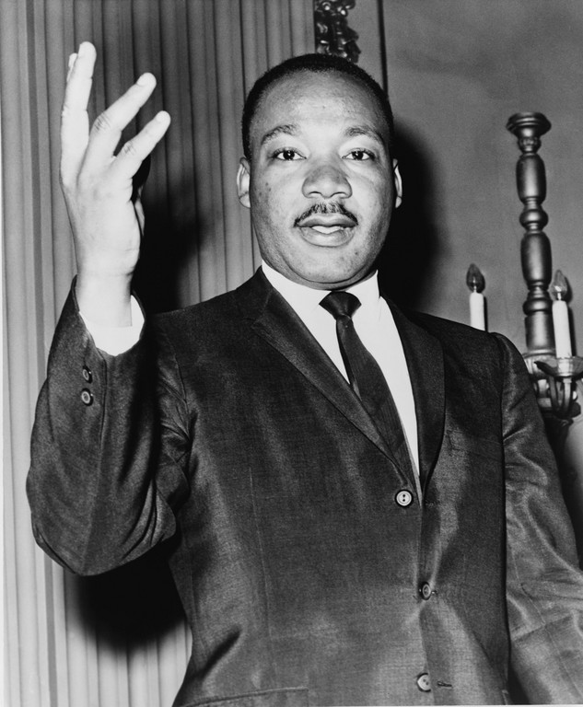
In February, 1968 King and the SCLC demanded that the U.S. government:
1. Commit $30 billion to the war on poverty.
2. Use some of that money to radically increase employment for African-Americans.
3. Use some of that money to guarantee a minimum income for those living in poverty.
4. Use the rest of that money to begin constructing affordable housing.

Slide 9
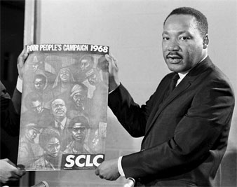
To draw attention to these demands, and the issue of poverty, King introduced the idea of a massive rally to be held in Washington D.C. to pressure the U.S. government into passing an “Economic Bill of Rights.”

Slide 10
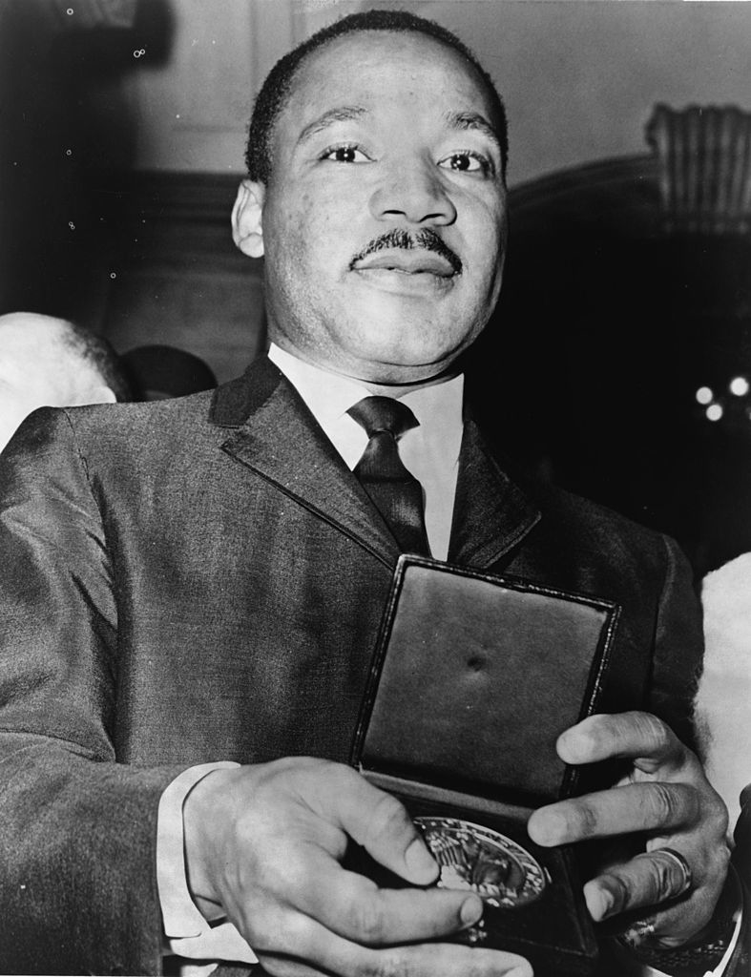
Because this was King’s plan, what type of tactics do we know he was going to use?

Slide 11
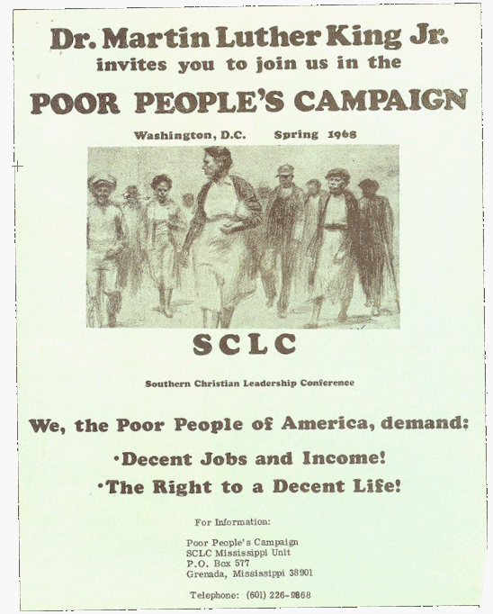
The SCLC found it increasingly difficult to gather protestors who were willing to go to the nation’s capital, partly due to their continued insistence on non-violence.

Slide 12
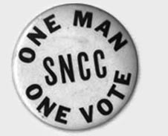
SNCC refused to fully commit to assisting with the demonstration.

Slide 13
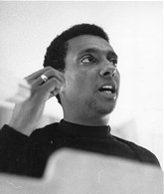
SNCC saw a change in leadership in 1966, with Stokely Carmichael taking the lead.

Slide 14
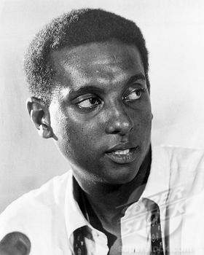
Carmichael began to suggest that non-violence might not be the most effective approach to solving the problems facing the African-American community.

Slide 15
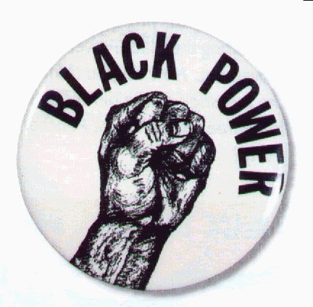
Carmichael began to call for “black power.”
Echoing parts of the idea of the black nationalism advocated by Malcolm X, SNCC began to push for African-Americans taking power over their economic and political affairs.

Slide 16
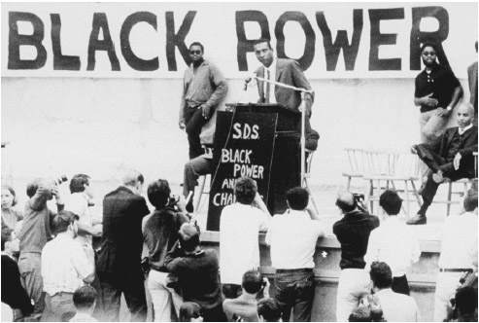
Thus, SNCC changed its name to the Student National Coordinating Committee in 1967.

Slide 17
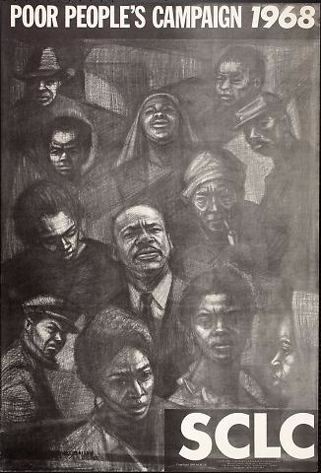
King and the SCLC continued to work hard to lay plans and find supporters for the Poor People’s Campaign, as it came to be known.

Slide 18
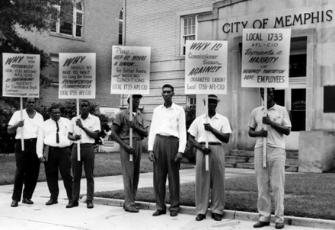
In the midst of the continued preparations, King and the SCLC also got involved in a strike in Memphis, TN regarding sanitation workers.

Slide 19
Fin.

