Slide 1
Tuesday
September 11th
2001
All times are approximate and in Eastern Daylight Time

Slide 2
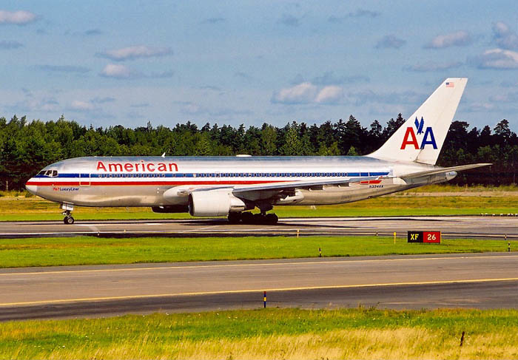
7:59 AM
American Airlines Flight 11 took off from Boston’s Logan Airport for Los Angeles.

Slide 3
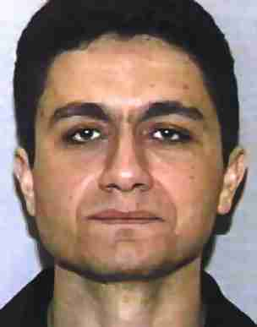
- 81 Passengers, 11 Crew members
- Mohamed Atta and 4 other hijackers were on board.

Slide 4
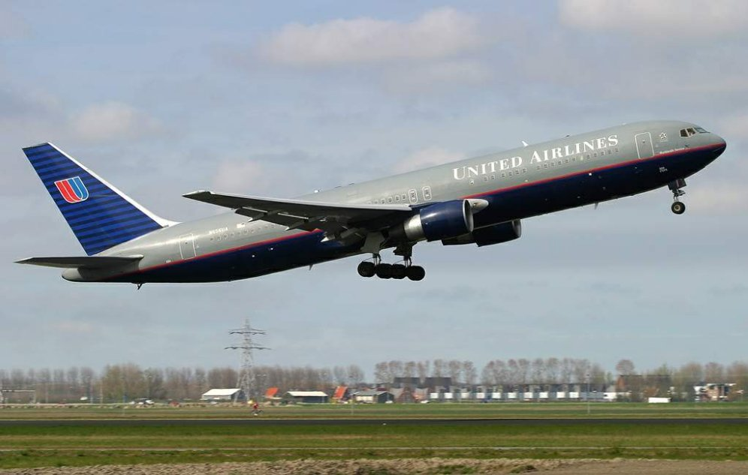
8:14 AM
United Airlines Flight 175 also took off from Boston’s Logan Airport for Los Angeles.

Slide 5
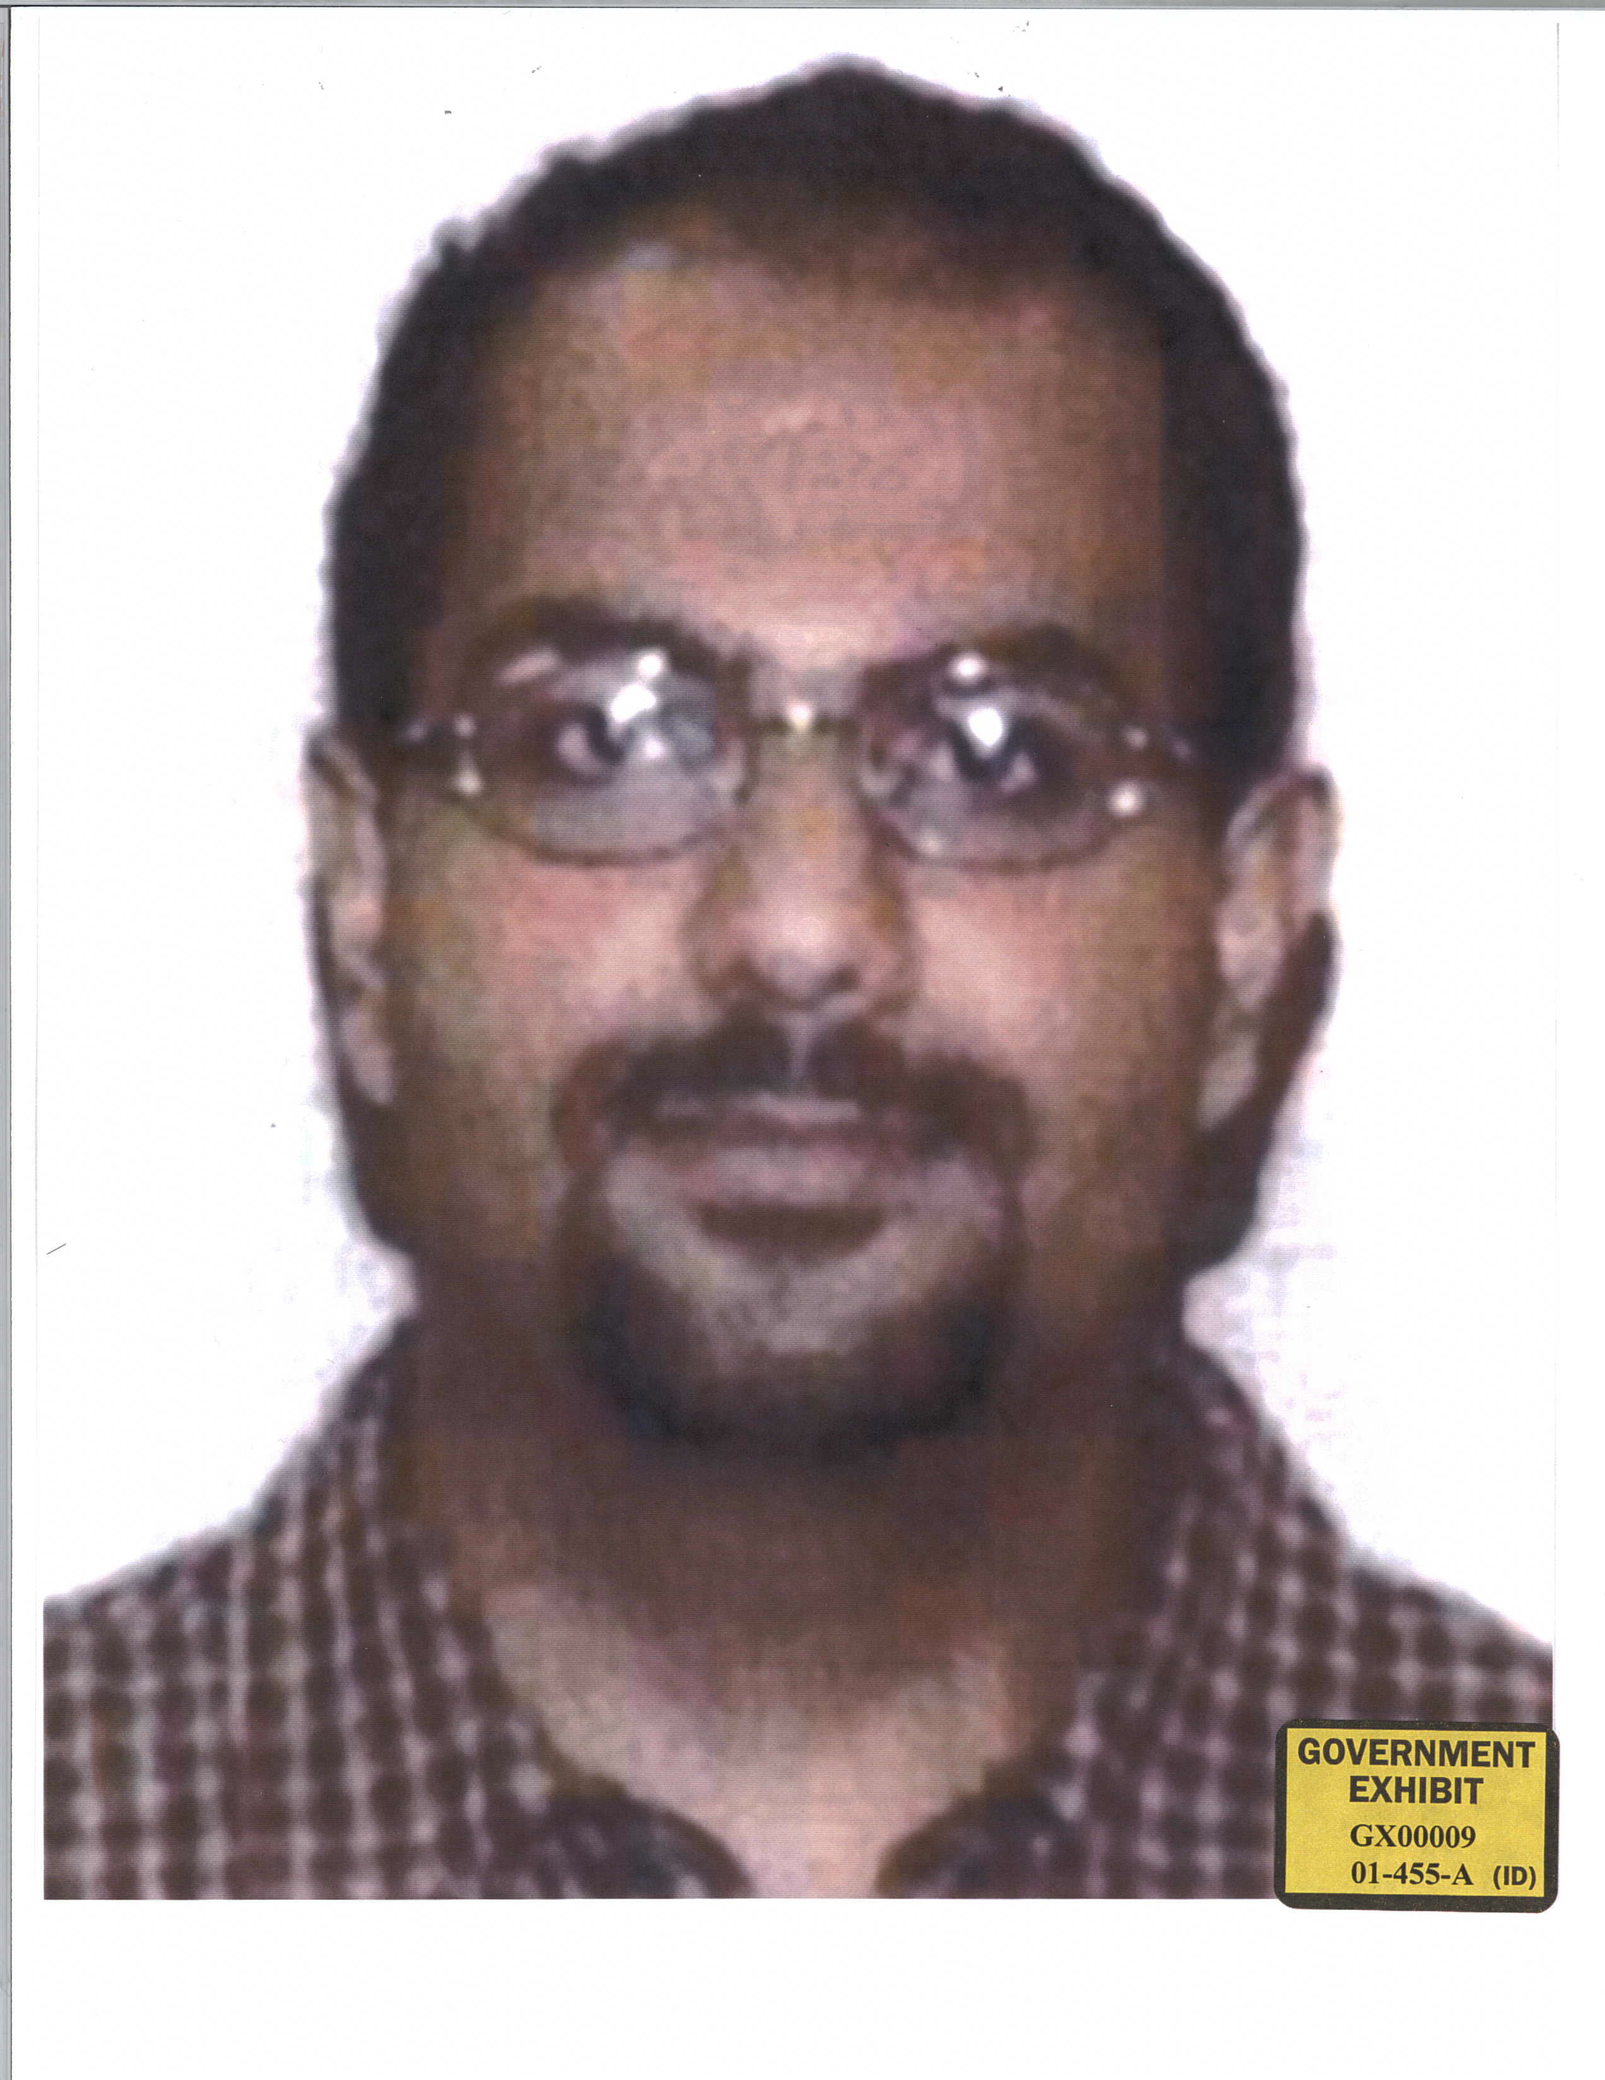
- 56 Passengers, 9 Crew members
- Marwan al-Shehhi and 4 other hijackers on board.

Slide 6
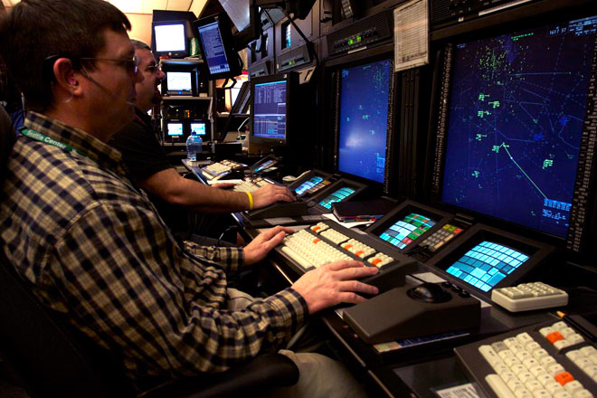
8:14 AM
American Flight 11 failed to make radio contact or follow the directions of air traffic controllers. It had been hijacked.

Slide 7
8:24 AM
Air traffic controllers heard Atta attempting to talk to the passengers on board American Flight 11.
“We have some planes. Just stay quiet, and you’ll be okay. We are returning to the airport.”

Slide 8
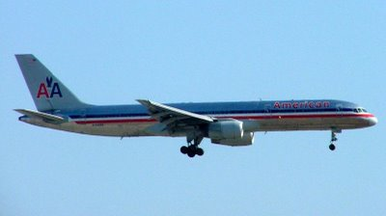
8:20 AM
American Airlines Flight 77 took off from Dulles International Airport outside Washington D.C. bound for Los Angeles.

Slide 9
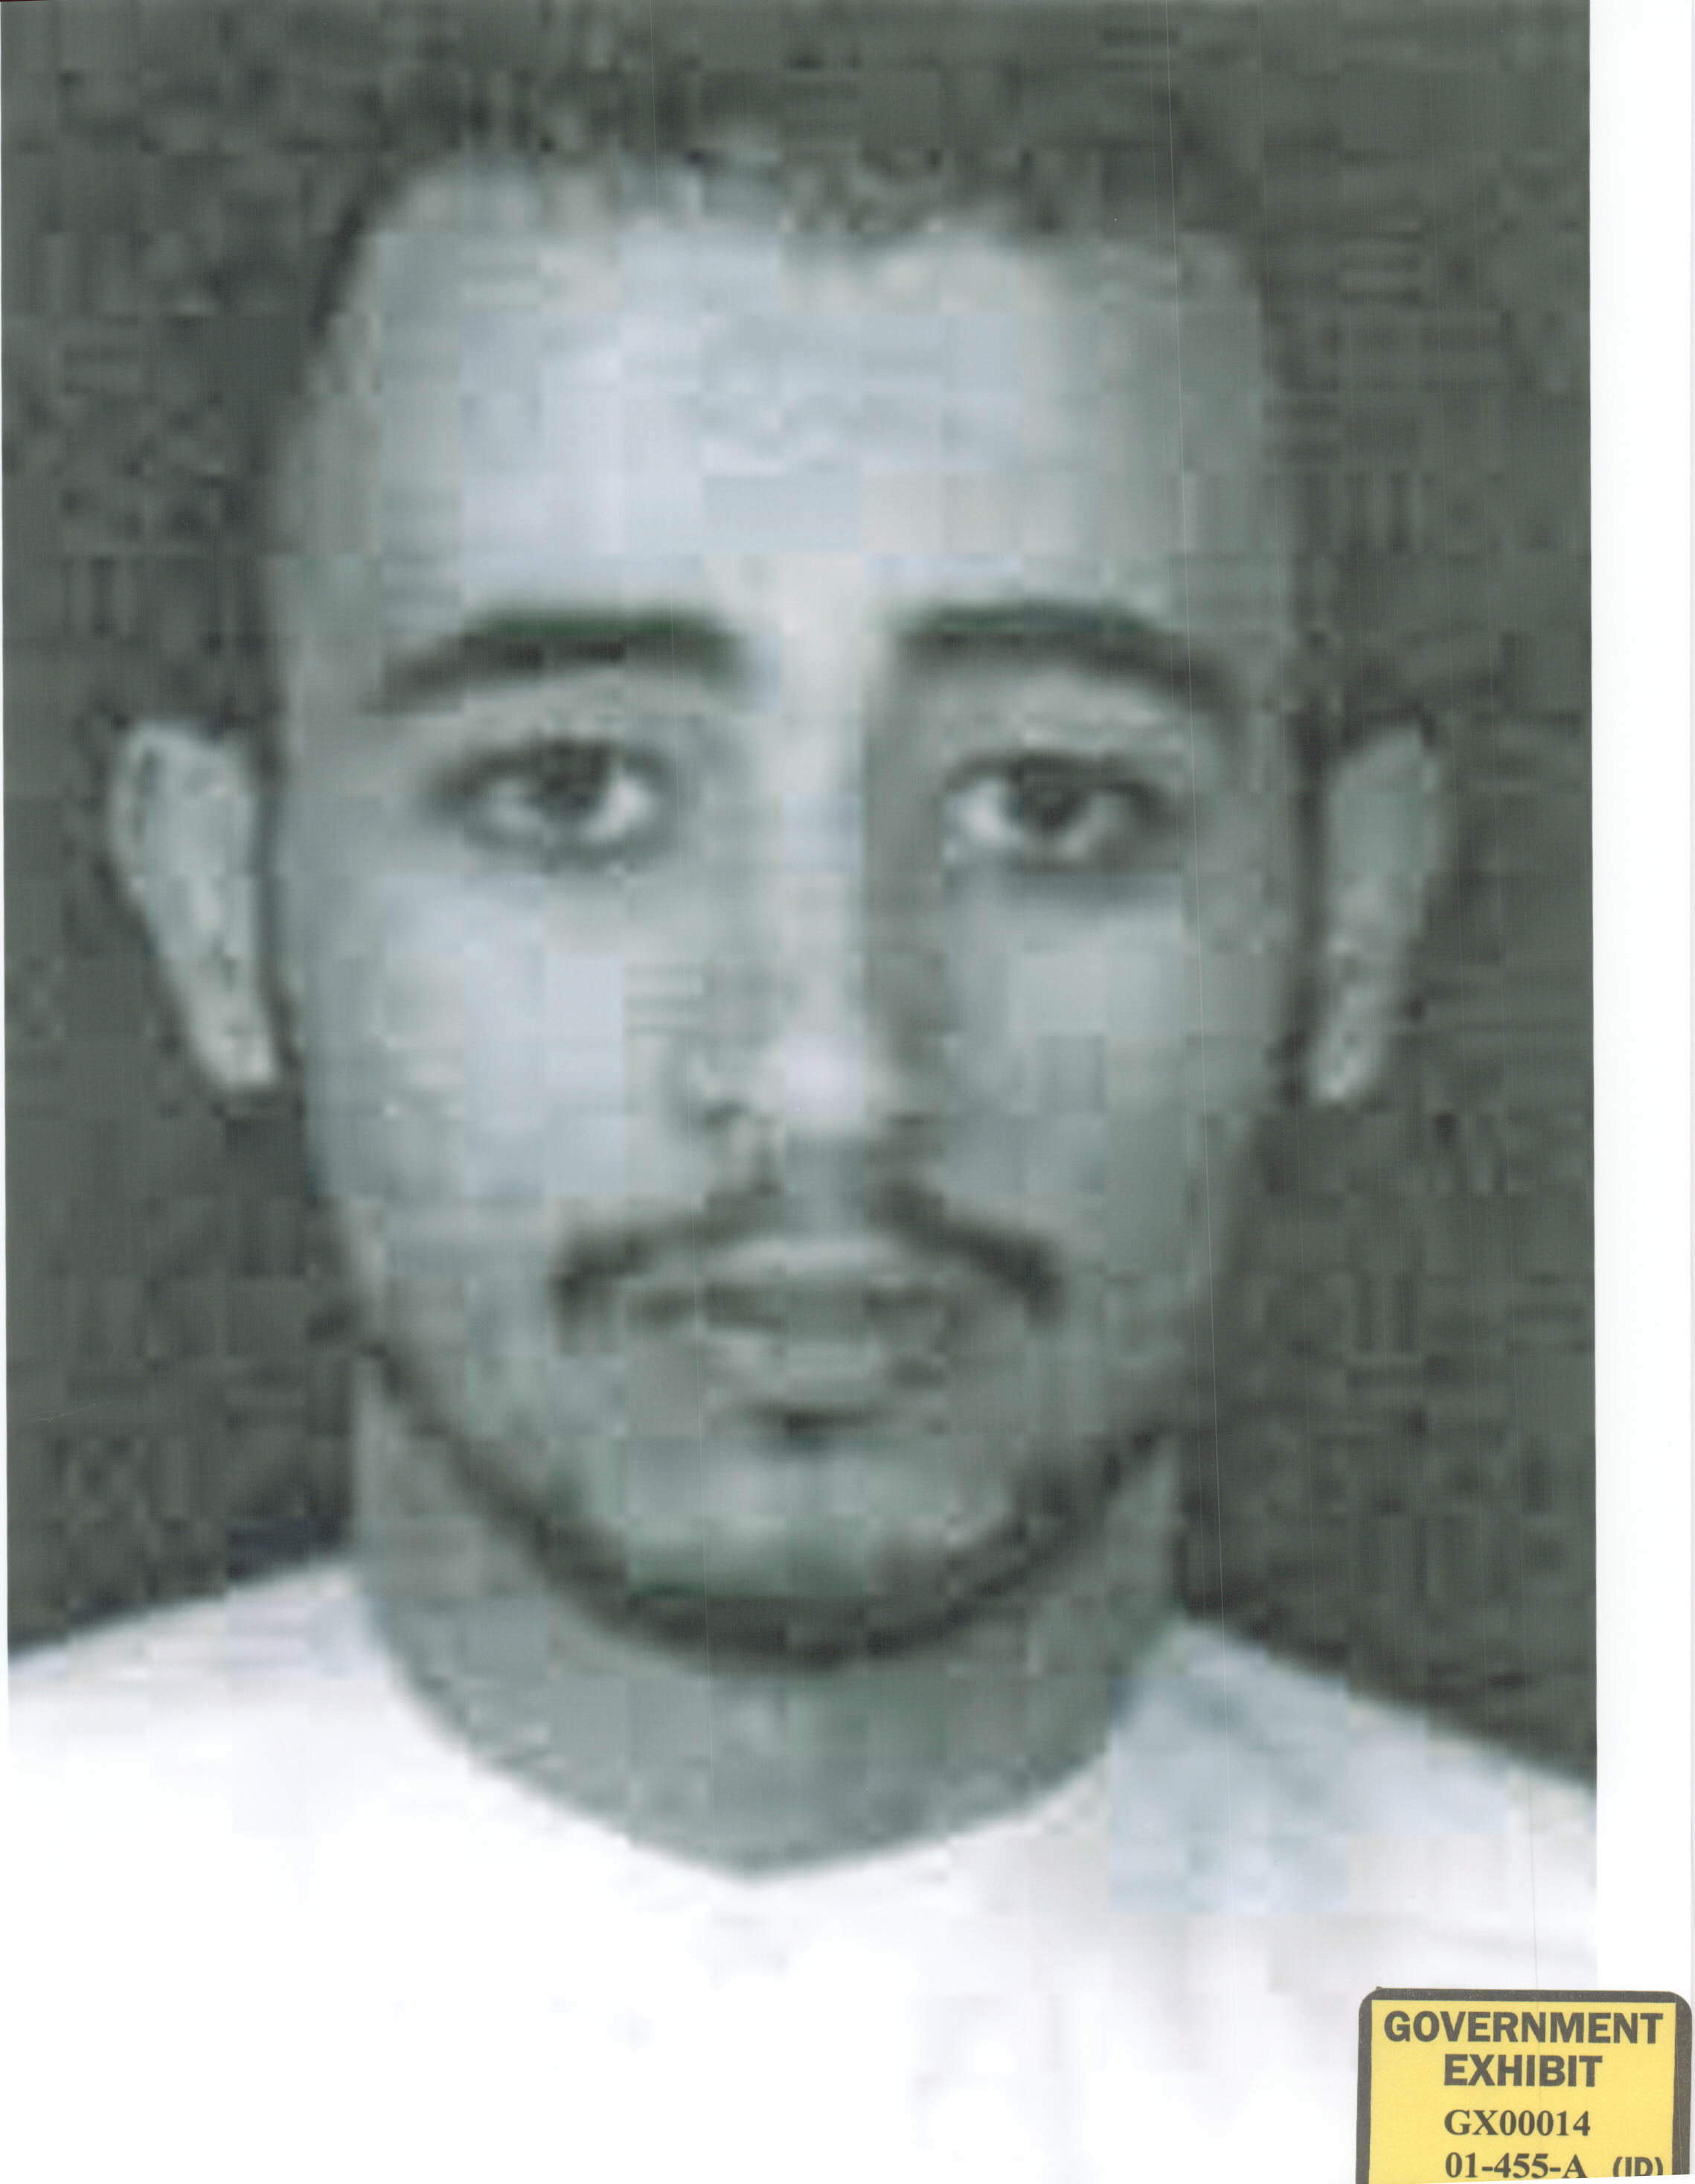
- 58 passengers, 6 crew members
- Hani Hanjour and 4 other hijackers on board.

Slide 10
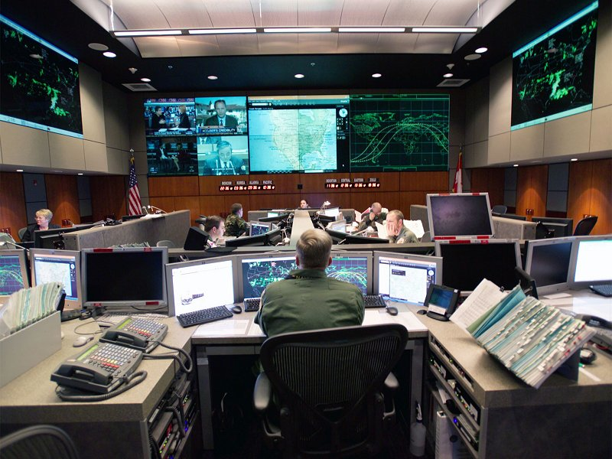
8:37 AM
Air traffic controllers alerted NORAD that American Flight 11 had likely been hijacked.

Slide 11
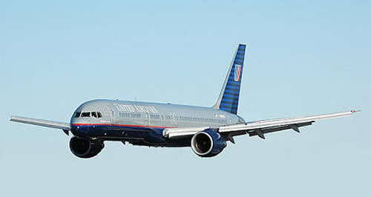
8:42 AM
United Airlines Flight 93 took off from Newark International Airport, outside New York City, bound for San Francisco.

Slide 12
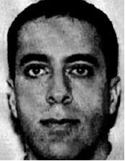
- 37 passengers, 7 crew members
- Ziad Jarrah and 4 other hijackers on board.

Slide 13
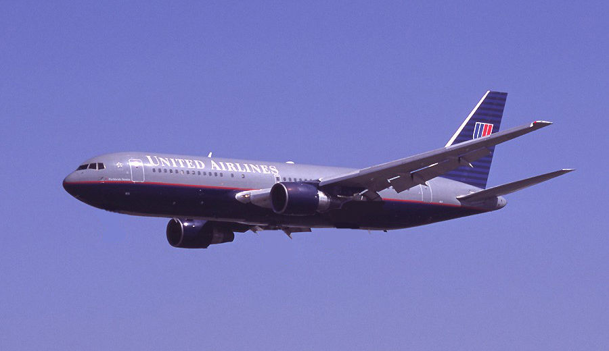
8:44 AM
United Flight 175 was taken over by the hijackers.

Slide 14
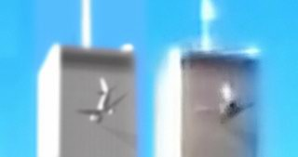
8:46 AM
American Airlines Flight 11 slammed into the North Tower of the World Trade Center in New York City.

Slide 15
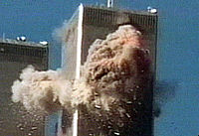
The plane hit between the 93rd and 99th floors.

Slide 16
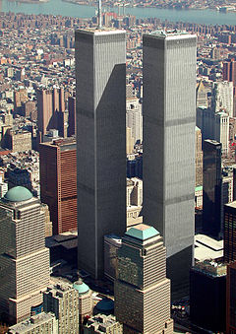
The plane managed to hit the central core of the building.

Slide 17
The towers of the World Trade Center were designed in a way that left lots of open space to be used as offices.

Slide 18
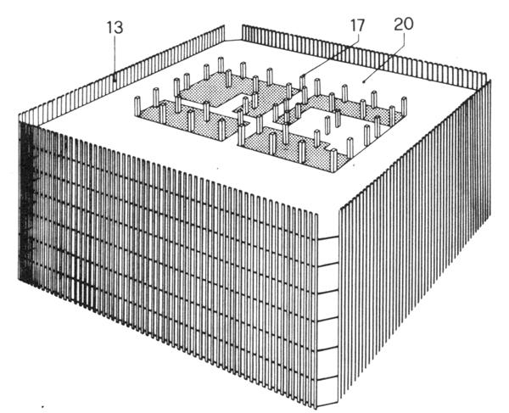
This meant that the weight of the building was held up by the central core and by the steel bands on the outside of the building.

Slide 19
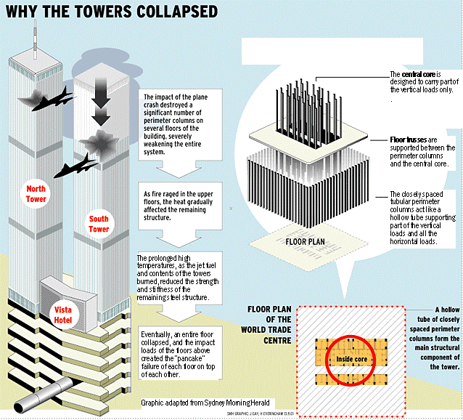
Flaming jet fuel poured down the elevator shafts in the central core and the plane snapped hundreds of the outside steel bands.
With such severe damage to its weight bearing parts, the structural integrity of the entire building was in jeopardy.

Slide 20
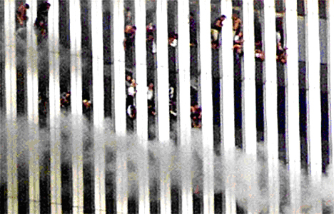
No one in the building above the 93rd floor at the time of the impact was able to get out.

Slide 21
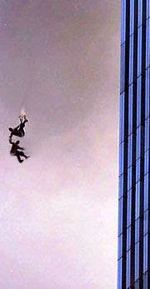
8:48 AM
Two minutes after impact, people trapped on the floors hit by the plane began to jump.

Slide 22
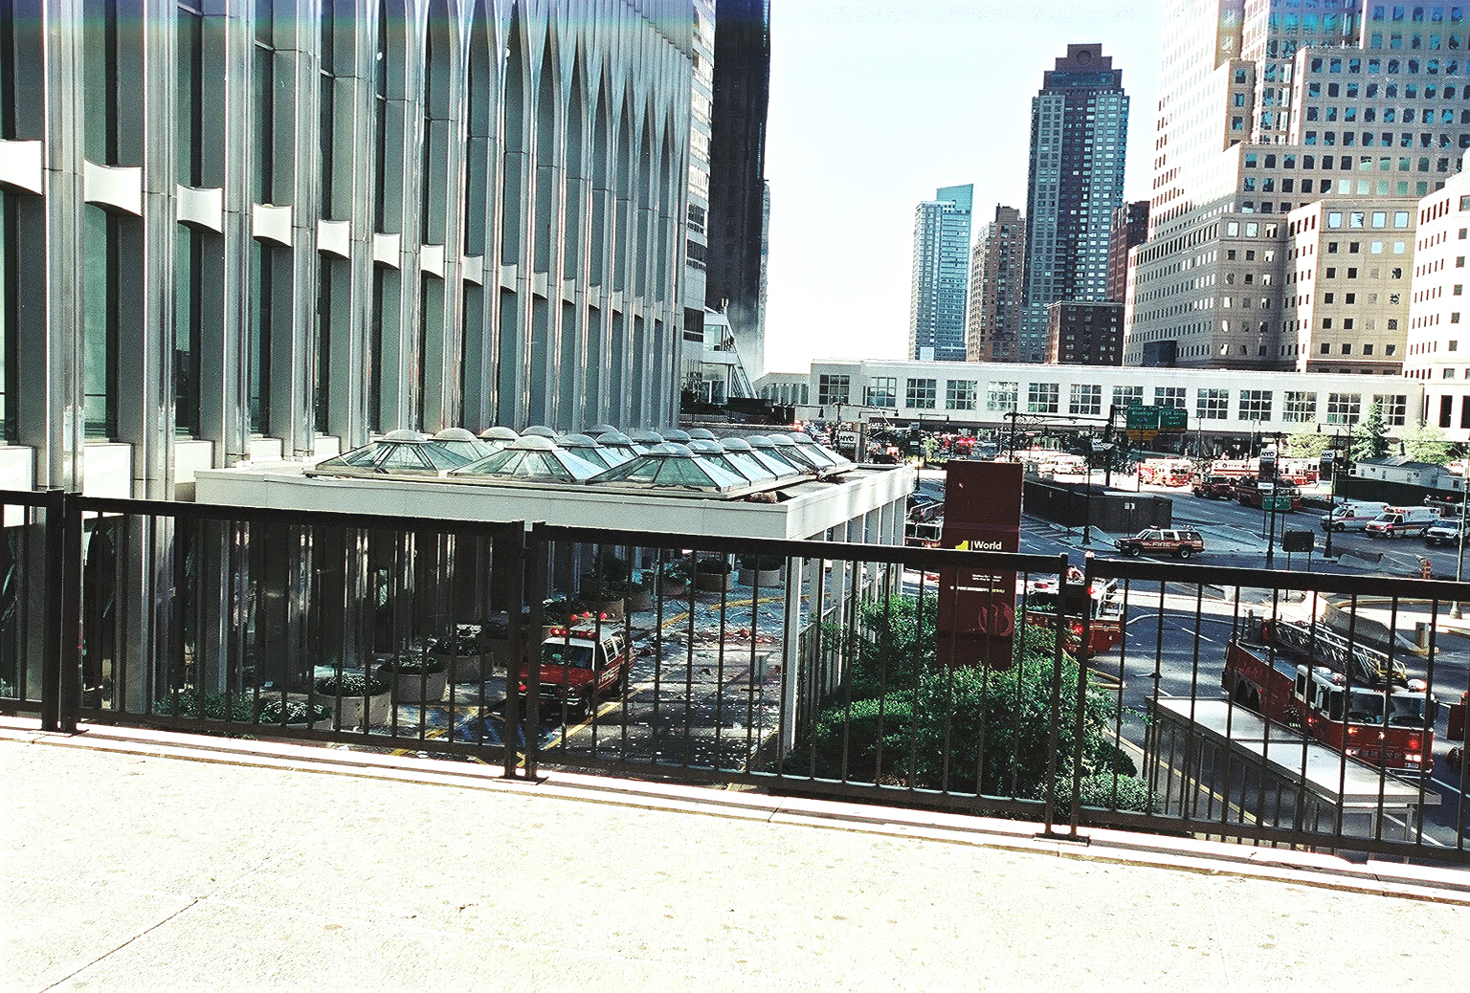
Many landed on top of the entrance plaza of the building where firemen had begun to gather and where the NYC Fire Dept set up its command post.

Slide 23
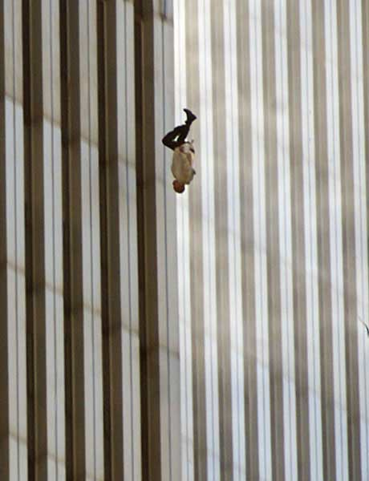

Slide 24
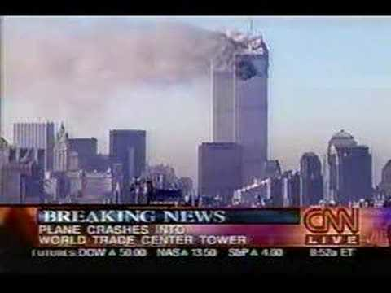
8:49 AM
CNN was the first national network on the air with coverage of the situation in New York City.

Slide 25
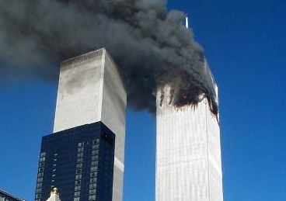
8:55 AM
The New York Port Authority, the agency in
charge of the World Trade Center site announced to the people in the South Tower that the building was secure and that they should return to work.

Slide 26
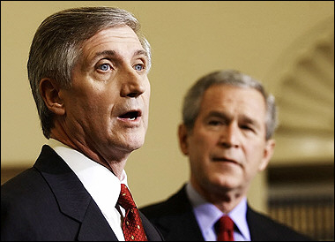
8:55 AM
Andrew Card, the White House Chief of Staff, informed President Bush of the crash in New York.

Slide 27
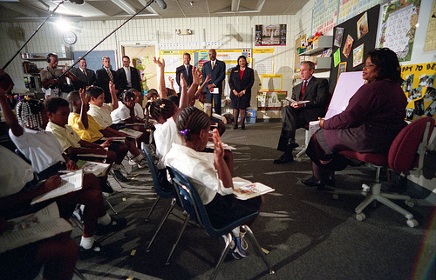
The President was at the Emma E. Booker Elementary School in Sarasota, FL. He was there to meet with students and teachers, and to talk about education reform.

Slide 28
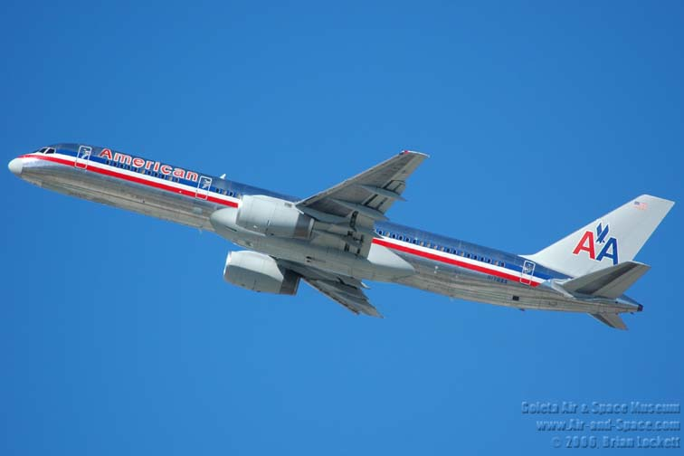
8:50 AM
Hijacking of American Flight 77 began.

Slide 29
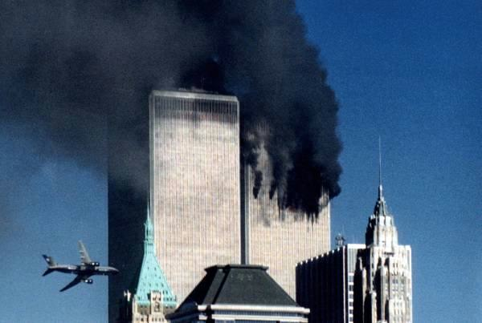
9:03 AM
United Flight 175 hit the South Tower of the World Trade Center between the 77th and 85th floors.

Slide 30
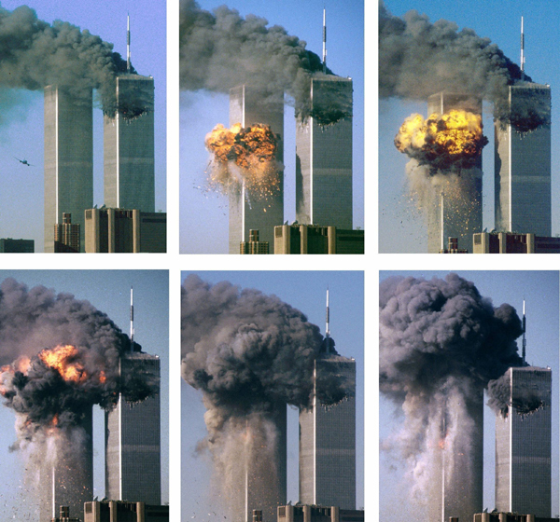
Millions of people saw it happen live.

Slide 31
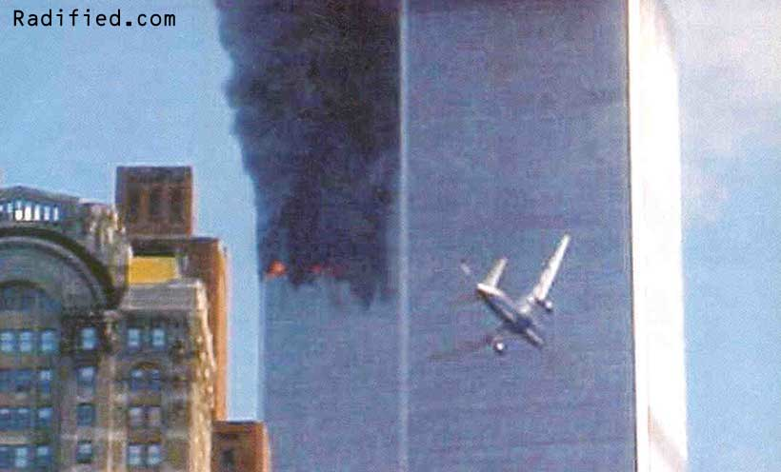

Slide 32
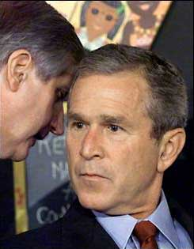
9:05 AM
As President Bush prepared to read a story to the school children, Andrew Card informed him of the second crash in New York.
“A second plane hit the second tower. America is under attack.”

Slide 33
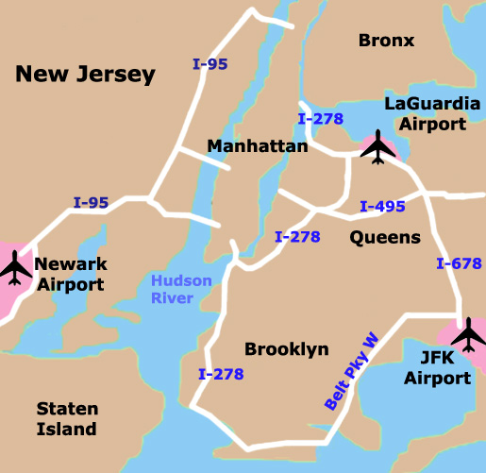
9:06 AM
The Federal Aviation Administration stopped or rerouted all flights headed to or through New York City.

Slide 34
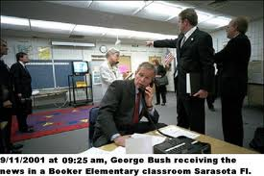
9:14 AM
President Bush was escorted by the Secret Service to a secure location at the school. There he made contact with Vice President Cheney, National Security Advisor Condoleezza Rice, New York Governor George Pataki, and FBI Director Robert Mueller.

Slide 35
9:17 AM
All New York City area airports were closed.

Slide 36
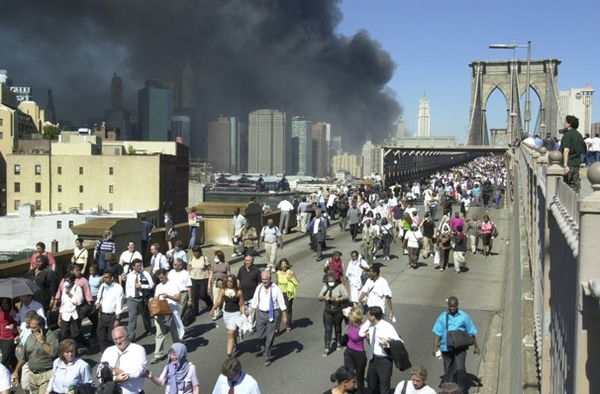
9:21 AM
All bridges and tunnels onto the island of Manhattan were closed. People had to walk off over various bridges.

Slide 37
9:24 AM
The FAA notified NORAD about the likely hijacking of American Flight 77, and shortly thereafter United Flight 93.

Slide 38
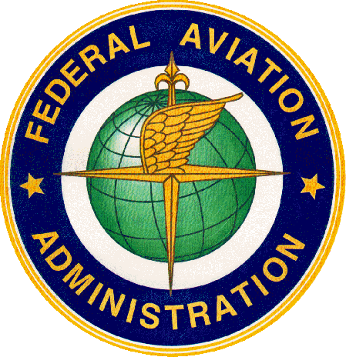
9:26 AM
The FAA banned the takeoff and departure of all non-military aircraft nationwide.

Slide 39
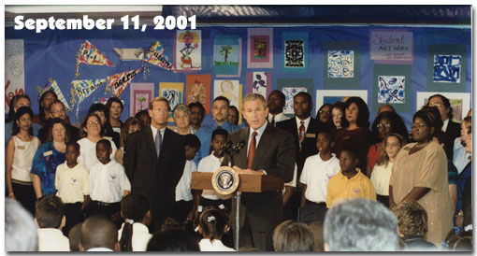
9:29 AM
President Bush made his first public comments on the situation. “We’ve had a national tragedy.”

Slide 40
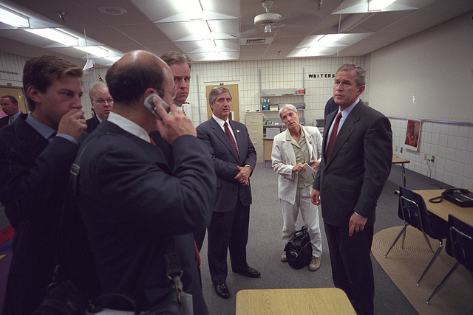
Neither he, nor anyone in his travelling group, knew about the two other hijacked planes.

Slide 41
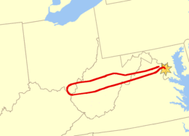
9:33 AM
The Secret Service was notified that American Flight 77 was approaching Washington D.C.
Vice President Cheney was escorted to a “secure location.”

Slide 42
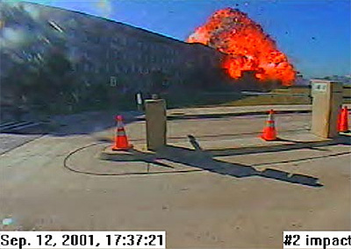
9:37 AM
American Flight 77 crashed into the Pentagon.

Slide 43
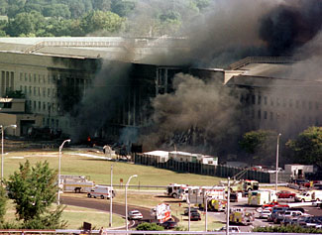

Slide 44
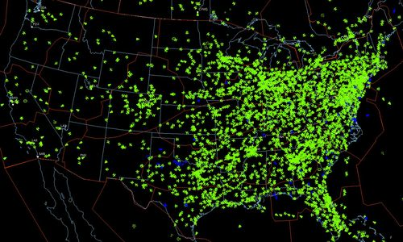
9:42 AM
The FAA suspended all air travel over the United States.

Slide 45
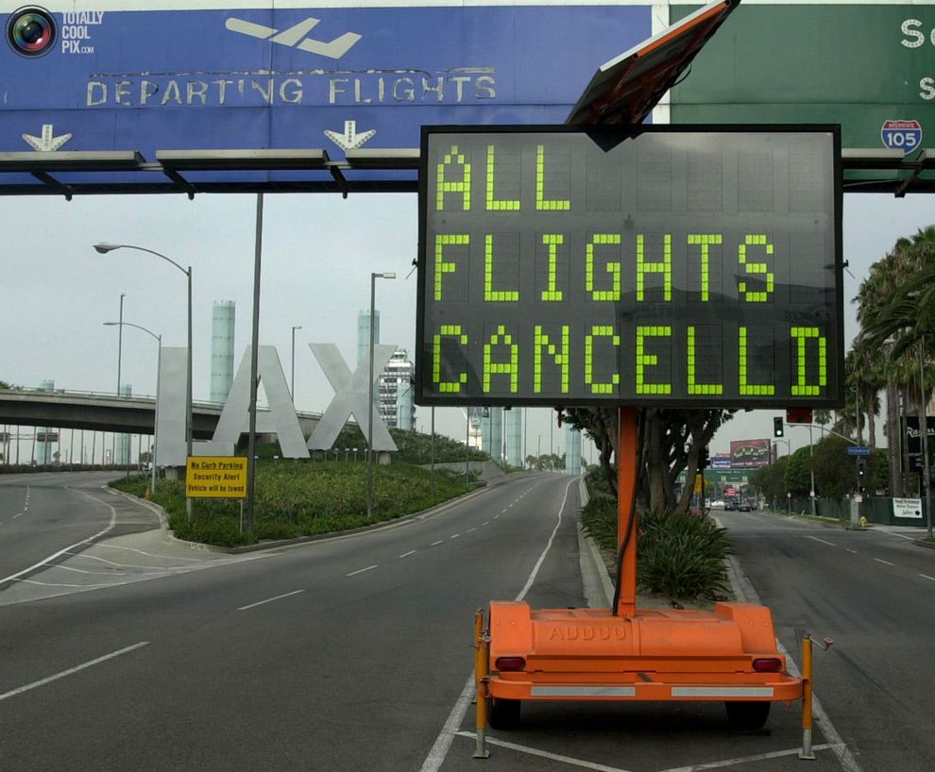
International flights headed to the U.S. were diverted, mostly to Canada.
Flights were not allowed to resume until September 14th.

Slide 46
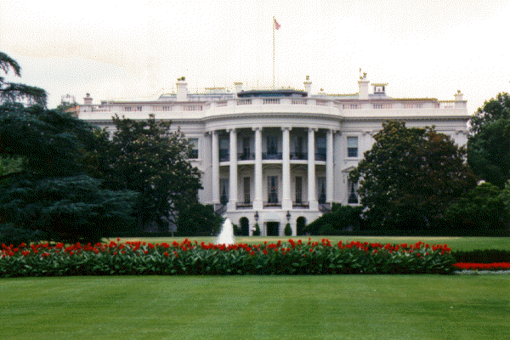
9:43 AM
The White House and the U.S. Capitol were closed and evacuated.

Slide 47
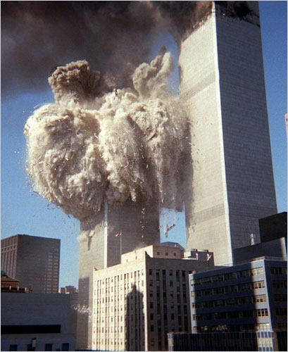
9:58 AM
Even though it had been hit second, the South Tower of the World Trade Center collapsed.

Slide 48
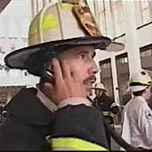
10:00 AM
NYC Fire Dept. commanders gave the order to firemen in the North tower to abandon the building.

Slide 49
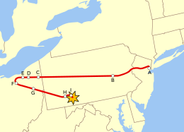
10:03 AM
United Flight 93 crashed outside of Shanksville, Pennsylvania.

Slide 50
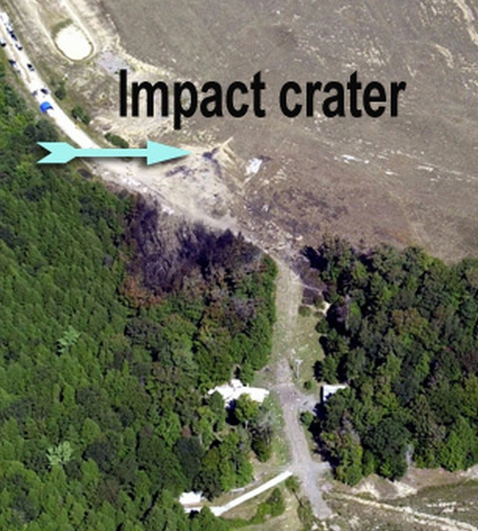
- Passengers on board had been in contact with family members via cell phone and had learned of the other planes.
- They attempted to enter the cockpit and take control of the plane.
- Rather than give up control the hijackers crashed the aircraft.

Slide 51
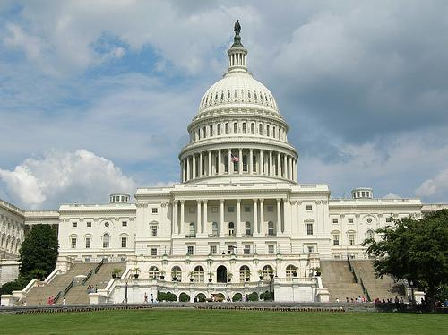
The official 9/11 investigation concluded that United 93 was likely headed to either the White House or the U.S. Capitol building.

Slide 52
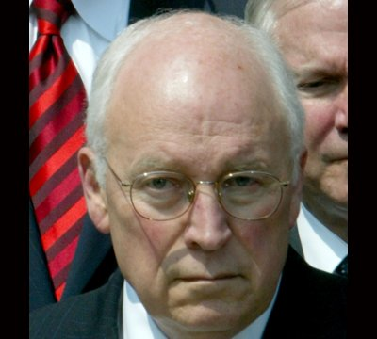
10:10 AM
Unaware that flight 93 had crashed, Vice President Cheney authorized fighter jets to shoot down the plane as it approached Washington.

Slide 53
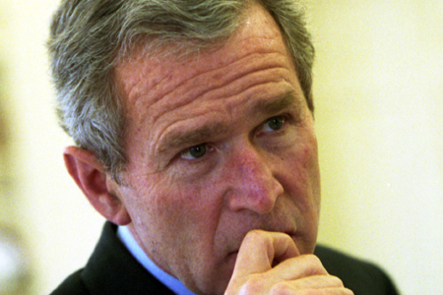
10:20 AM
President Bush confirmed Cheney’s order to shoot down hijacked aircraft if necessary.

Slide 54
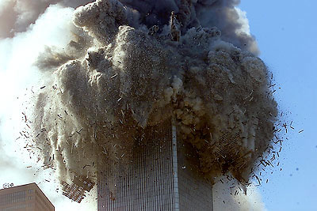
10:28 AM
1 hour and 42 minutes after it was hit by American Flight 11, the North Tower of the World Trade Center collapsed.

Slide 55
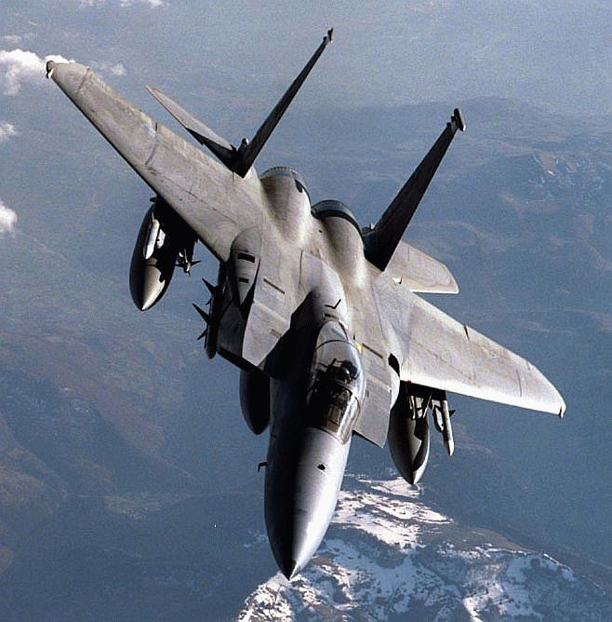
10:30 AM
F-15 fighter jets patrolled the airspace over New York City and Washington D.C.

Slide 56
10:50 AM
5 stories of the Pentagon collapsed following the impact of American Flight 77.

Slide 57
12:15 PM
All non-military flights over the U.S. had landed.

Slide 58
5:20 PM
Due to damage and fires caused by the collapse of the North and South towers, 7 World Trade Center collapsed.

Slide 59
The building had long since been evacuated and no one was killed in the collapse.

Slide 60
8:30 PM
President Bush addressed the nation.

Slide 61
2,605 people died in the collapse of the World Trade Center.

Slide 62
Of that number, 343 were NYC Firemen.

Slide 63
147 people were killed on American Flight 11 and United Flight 175.

Slide 64
125 people were killed in the Pentagon in Washington D.C.

Slide 65
64 people were killed on board American Flight 77.

Slide 66
44 people were killed on United Flight 93.

Slide 67
Fin.

