Slide 2
Last quiz
of the
unit!

Slide 3
Affirmative Action
- What is it?

Slide 4
Race
and
Poverty

Slide 5
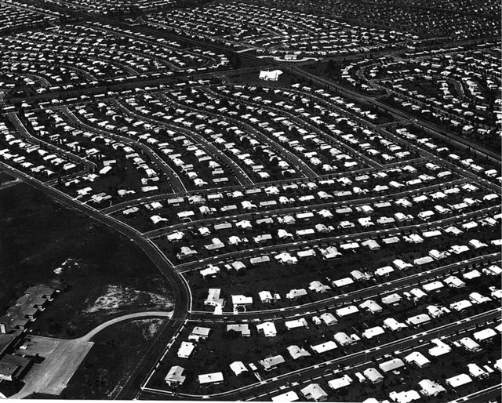
With the advent of car culture and the interstate highway system of the 1950’s, the phenomenon of white flight began to grow.

Slide 6
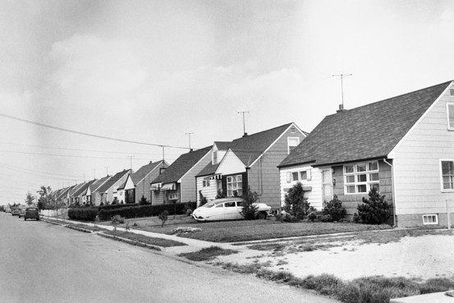
Upper and middle class families increasingly moved from the center of America’s cities, to their edges and suburbs.

Slide 7
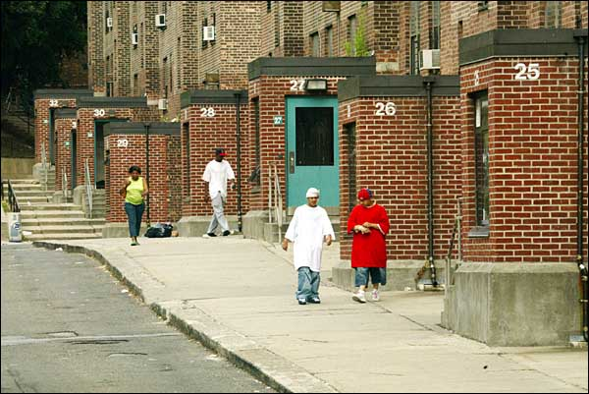
As a result, those left in inner city areas were often poor and often from minority groups.

Slide 8
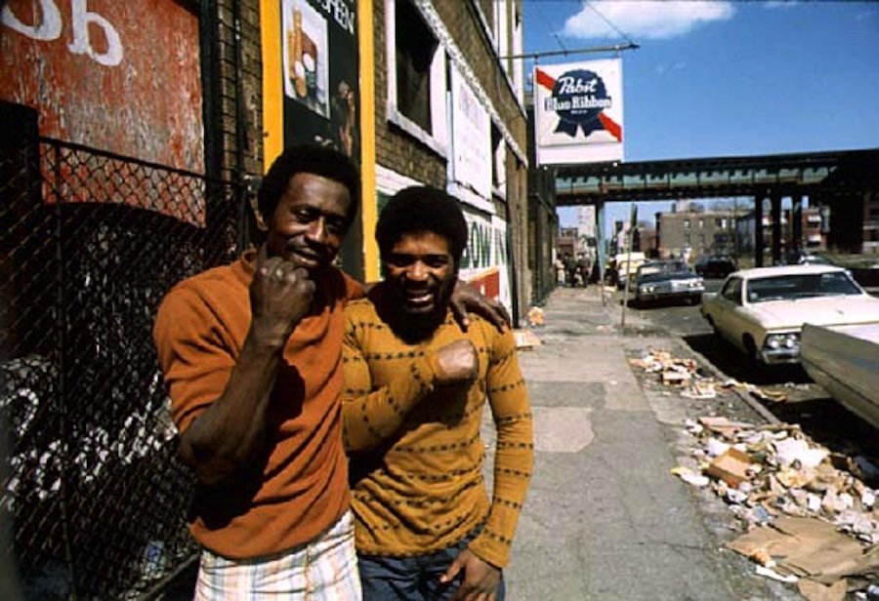
The struggle to end de facto segregation thus grew out of inner city, extremely poor, African-American neighborhoods.

Slide 9
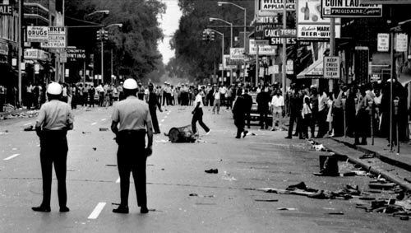
This story played out in Detroit. Remind me, what happened there in 1967?

Slide 10
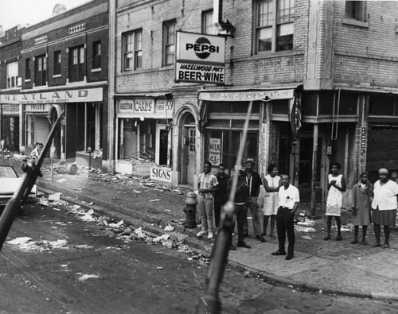
The question that we need to deal with is “Why did all of this happen?”

Slide 11
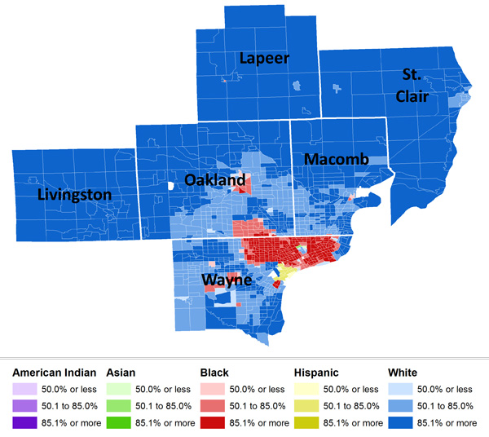
Living areas in Detroit were highly segregated, not by law, but because of poverty.

Slide 12
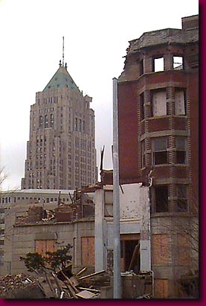
Economics conditions in African-American neighborhoods were usually not very good:
- Unemployment amongst African-Americans was more than double that of whites.
- The jobs available to most African-Americans were usually the most physically demanding, dangerous, and unhealthy jobs available.
- For those jobs, they often received less pay.

Slide 13
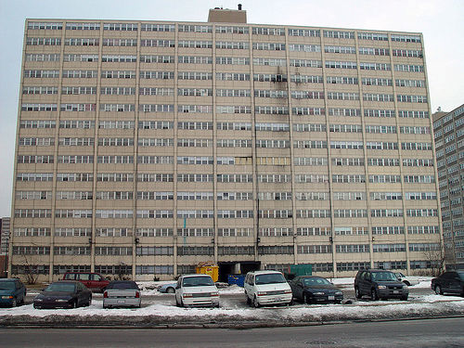
Affordable housing in Detroit was very limited. Houses in the suburbs surrounding the city were far too expensive for most African-Americans.

Slide 14
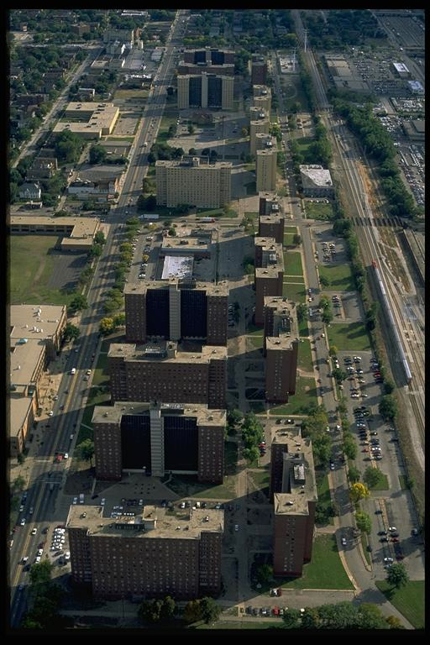
As such, most African-American families were forced to live in the inner city, the only place they could afford.
This then, led to overcrowding in inner city neighborhoods. The population density in African-American neighborhoods was twice that of the rest of the city.

Slide 15
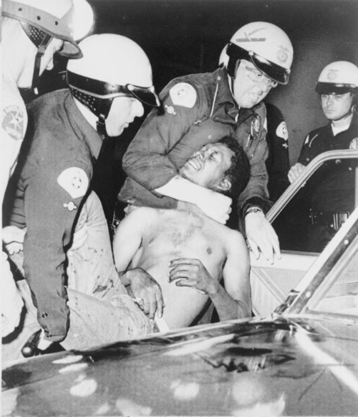
At the end of the day, the African-American community in Detroit believed they had little control over their daily lives and their community.
Specifically, they argued that whites in Detroit had all of the power in three key areas:
- The economy of the city.
- Political control of the city government.
- The police force.

Slide 16
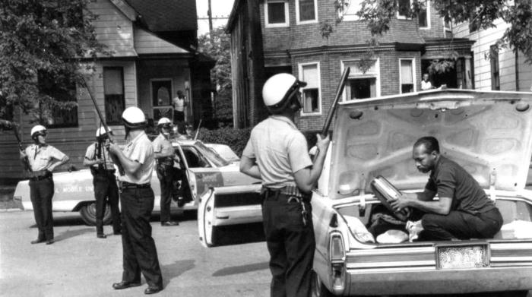
While African-Americans comprised 30% of the city, they only comprised 4% of the city’s police force.

Slide 17
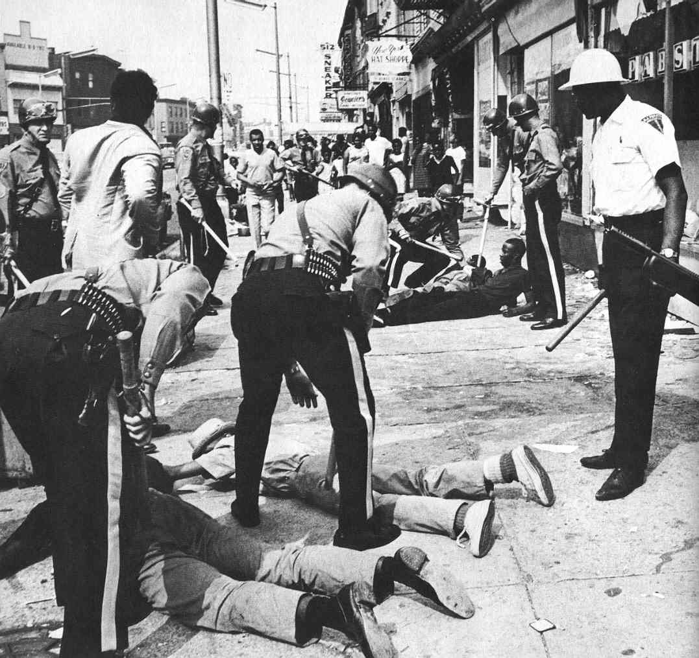
Furthermore, the white Detroit police were frequently accused of overt acts of racism in African-American neighborhoods.

Slide 18
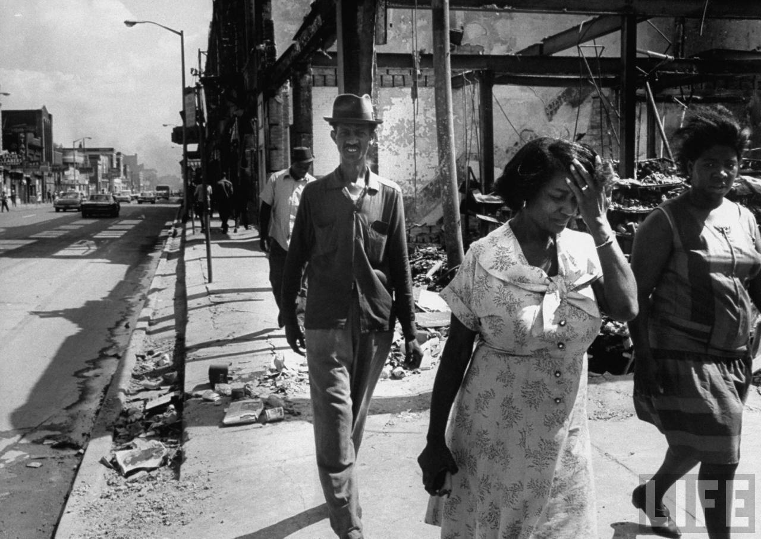
At the end of the day then, African-Americans in Detroit, and in other cities across America:
- felt they had very little power over their lives.
- believed they were trapped in inner city neighborhoods which were full of crime.
- lived in poverty.

Slide 19
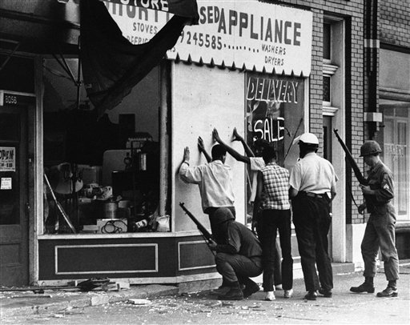
The question for African-Americans, whites who wanted to help, and the U.S. government became: “What’s the best way to solve these problems?”

Slide 20
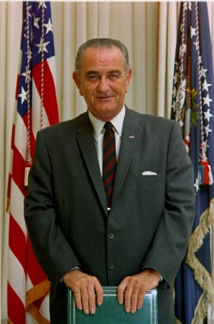
President Johnson’s solution was to wage a “War on Poverty” in America.
The goal was to use the money and power of the United States government to lift those living in poverty out of it.

Slide 21
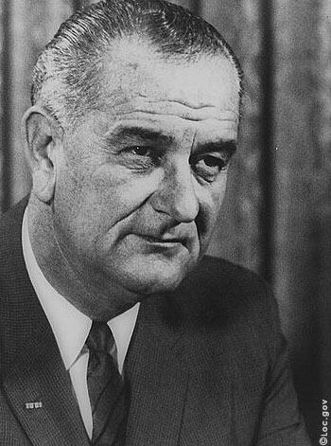
To that end, Johnson worked with Congress to create a number of important government programs.

Slide 22
The Great Society
Head Start: Pre-school education for poor / minority children, paid for by the government.
Job Corps: Job training for poor / minority youth, paid for by the government.
Food Stamp Act of 1964: U.S. government assistance in purchasing food.
Extension of Social Security: Expanded who could quality for benefits, and increased the amount of money given to those who qualified.
Medicare: Health insurance for the elderly, funded by the U.S. government.
Medicaid: Health insurance for the poor, funded by the U.S. government.

Slide 23
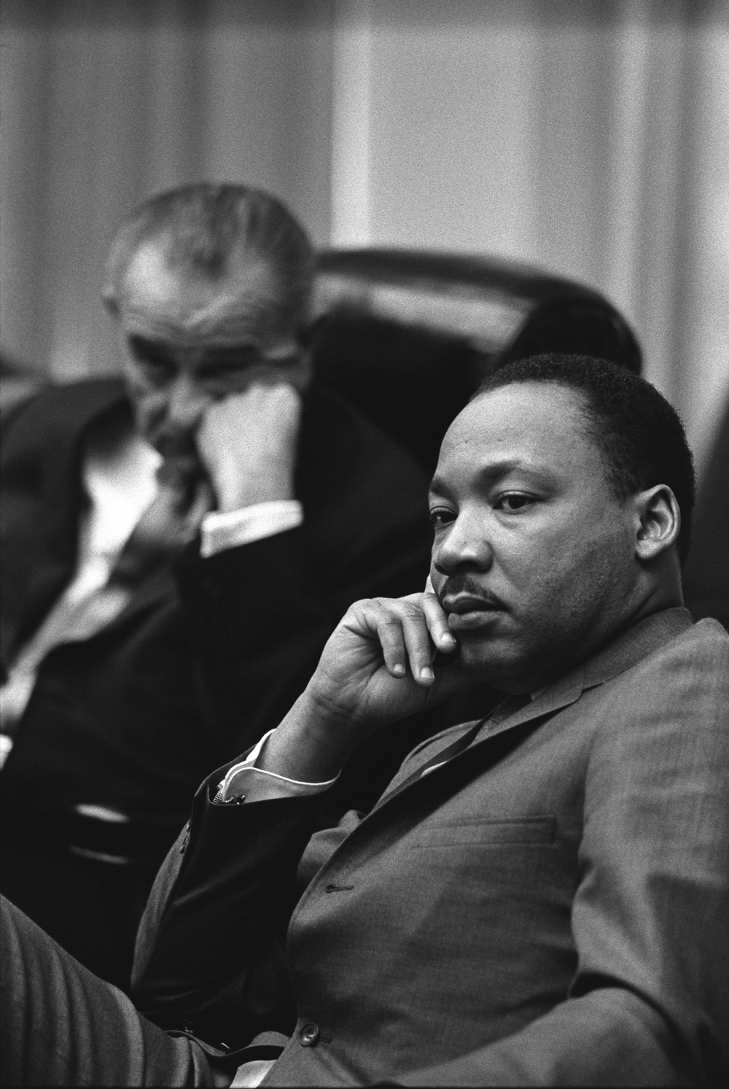
These programs did have some impact:
1960: 55% of African-Americans lived in poverty.
1970: 27% of African-Americans lived in poverty.
However, by comparison:
1960: 22.2% of whites lived in poverty
1970: 12.6% of whites lived in poverty.

Slide 24
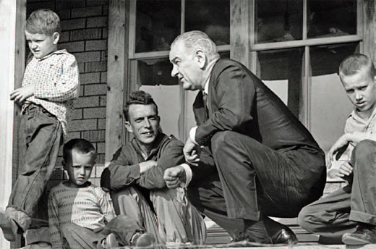
And while these programs had been somewhat successful, they were not as helpful as the were intended to be.

Slide 25
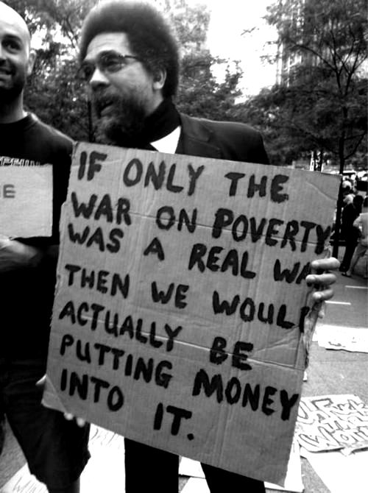
Johnson really wanted to spend a lot of money on the “war on poverty.”
Instead, he found himself spending more and more of that money on the war in Vietnam.

Slide 26
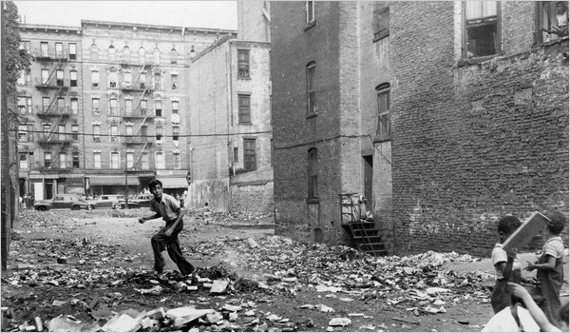
Poverty still remained a problem, especially in African-American communities.

Slide 27
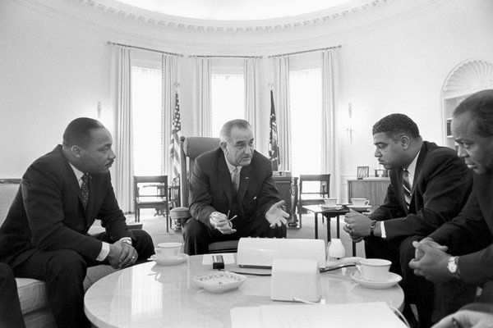
Another effort to tackle this poverty came through the government effort known as “affirmative action.”

Slide 28
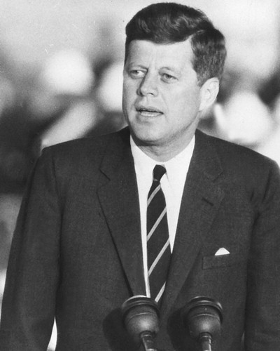
Affirmative Action was first used by President Kennedy in 1961.
Through an executive order, he demanded that any company or business that worked with the U.S. government had to be unbiased in hiring and continued employment practices.

Slide 29
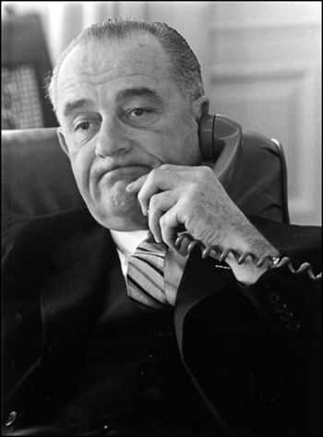
President Johnson further expanded the program in 1965, to include not just race, but also socio-economics and gender.

Slide 30
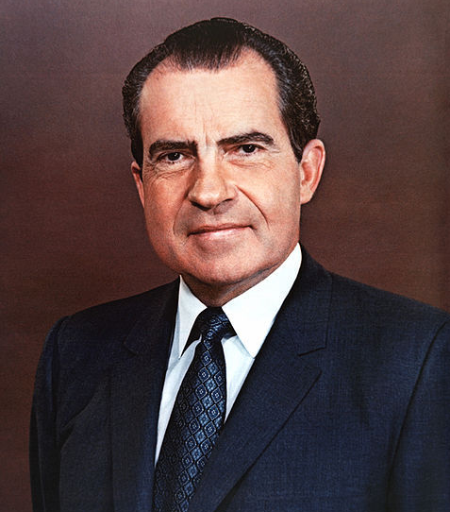
More importantly, President Richard Nixon expanded affirmative action with the “Philadelphia Plan” in 1969.
Kennedy and Johnson had demanded that companies approach hiring and firing in an unbiased way. Nixon took things to another level.
Contractors in Philadelphia were required to hire a specific number of African-American employees, a quota, within a very specific time frame.

Slide 31
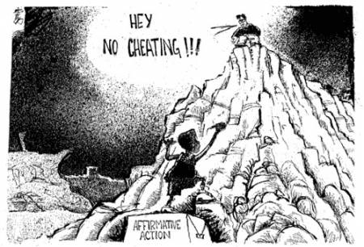
The purpose was to allow African-Americans to access high paying jobs that they had traditionally been kept out of.

Slide 32
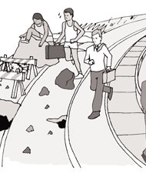
This quota type system was expanded throughout many other areas of the nation and the economy.

Slide 33
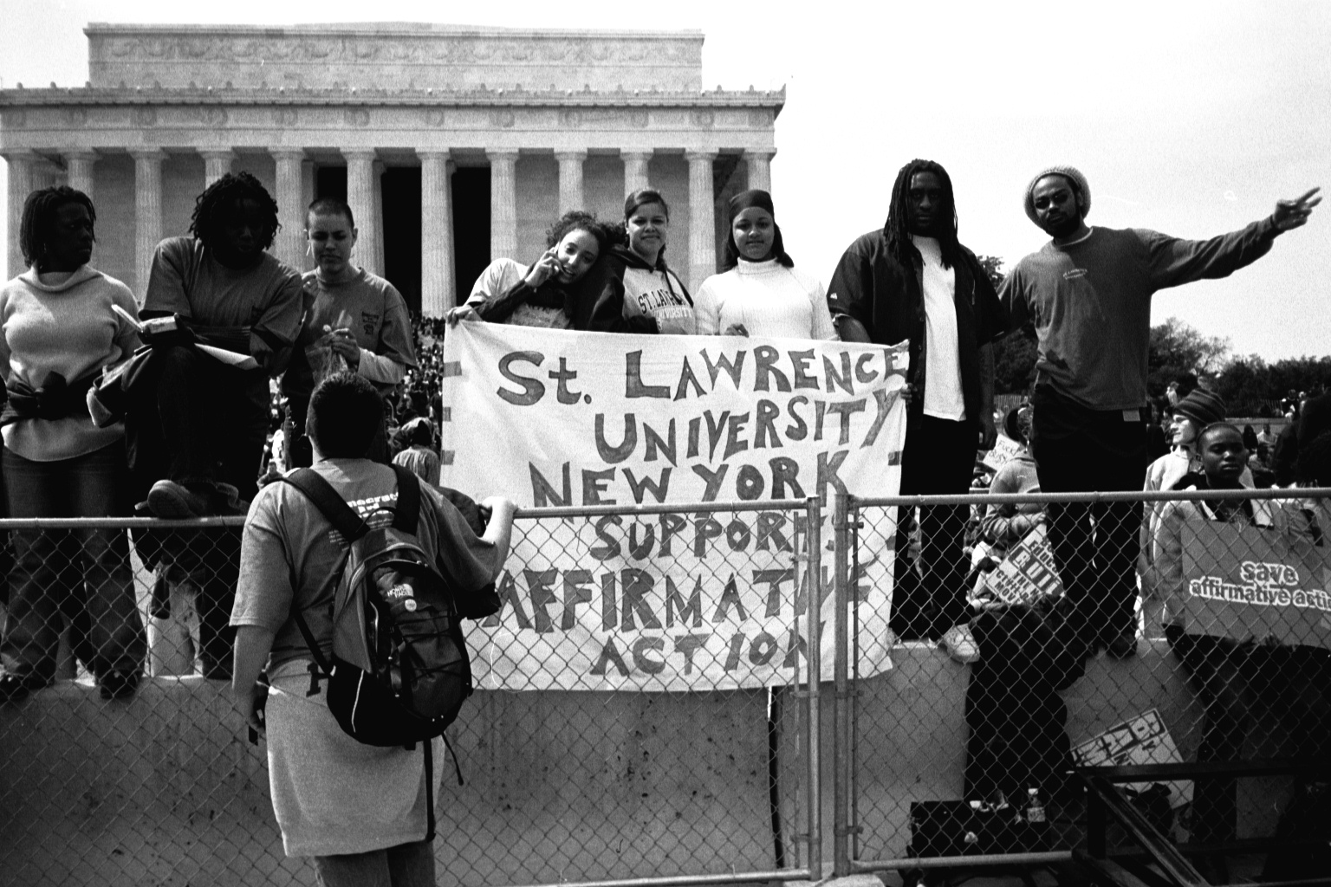
It was also widely used in terms of college admission and scholarship decisions.

Slide 34
On a piece of paper, that you will turn in today, complete the following:
- Quickly jot down your immediate thoughts about the program of affirmative action.
- What makes sense to you? What do you like about this program?
- What is confusing, or problematic for you? What do you not like so much?
Write at least half a page and be prepared to share what you have.

Slide 35
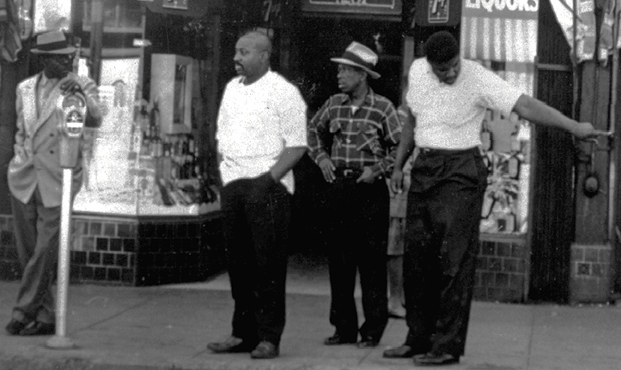
Other groups in the late 1960’s and early 1970’s advocated a different approach to dealing with poverty and discrimination in their communities.

Slide 36
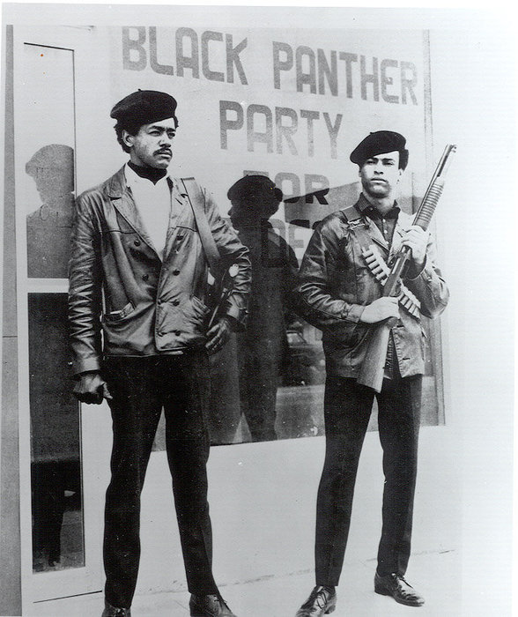
They began to call for “black power” and black control of their communities.

Slide 37
Fin.

