Slide 1
Why did
9/11
happen?

Slide 2
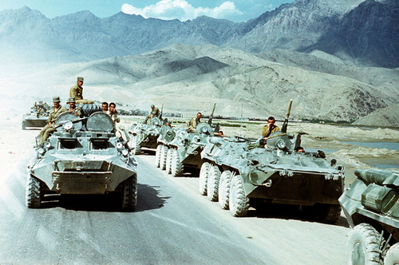
Remember that in 1979, the Soviet Union invaded the nation of Afghanistan.

Slide 3
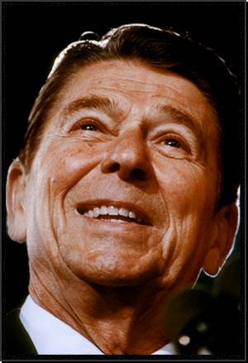
Ronald Reagan wanted to take action to make things very difficult for the Soviets to succeed.

Slide 4
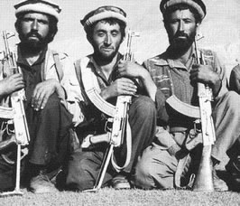
Through the CIA, the U.S. provided billions of dollars of weapons and military training to a group known as the Mujahedeen, Afghanis fighting against the Soviets.

Slide 5
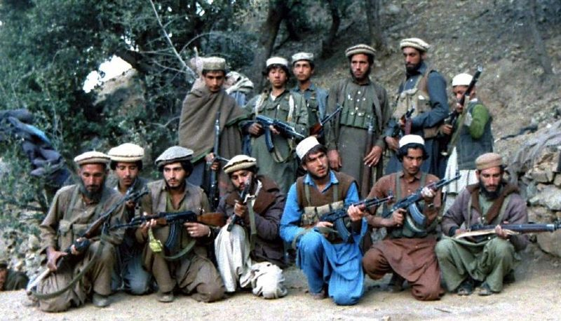
Some Muslims throughout the world were concerned about the impact the Soviet invasion would have on Afghanistan's Islamic population. They went to join the fight against the Soviets.

Slide 6
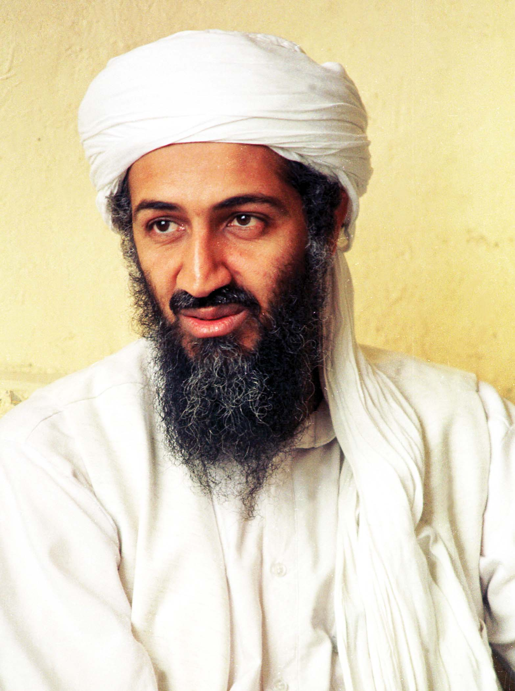
One such Muslim left his wealthy life in Saudi Arabia, joined the Mujahedeen and received weapons from the U.S.
His name?
Osama Bin Laden

Slide 7
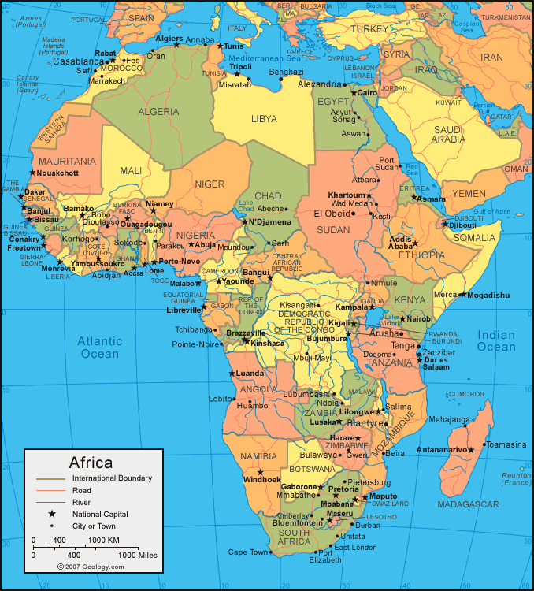
Following the Afghan victory in 1988, bin Laden relocated to Sudan where he began to build up a network of radical Muslims dedicated to protecting Islam and fellow Muslims around the world.

Slide 8
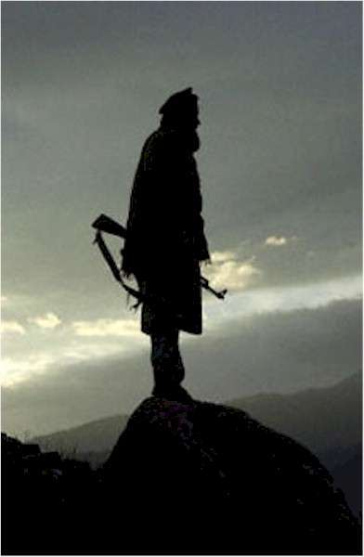
Some time in 1988 or 1989, bin Laden organized the group known as Al-Qaeda in Sudan. His goal was to spread his radical view of Islam.

Slide 9
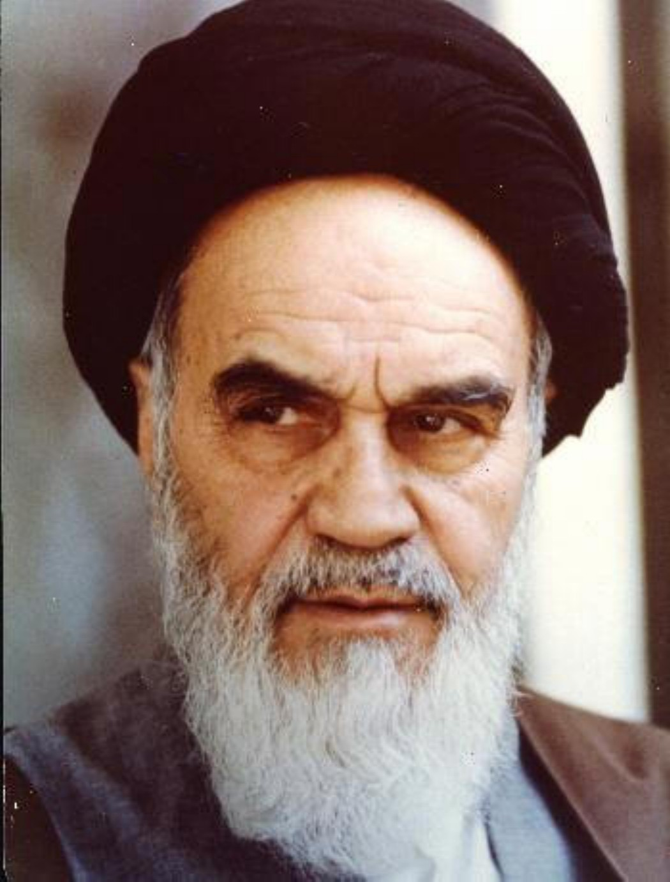
Remember also, that in the same year the Soviets invaded Afghanistan, 1979, the Shah of Iran was overthrown and replaced by the Ayatollah Khomeini, a radical Shiite Muslim who set up an Islamic government in Iran.

Slide 10
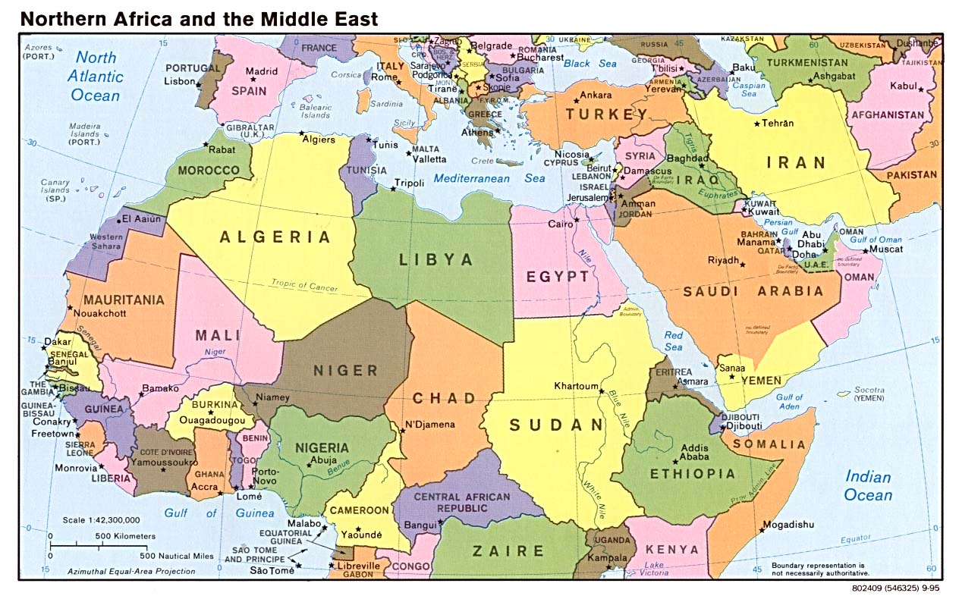
This revolution had a huge impact throughout the Middle East, especially in Iraq.

Slide 11
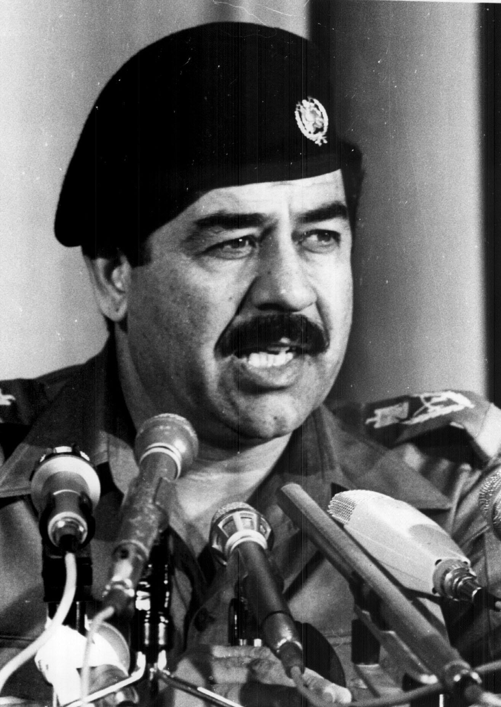
In 1968 the Ba’ath party took control of Iraq. Saddam Hussein rose to become the leader of that party, and of Iraq in early 1979.
The Ba’ath party ran the government free from the control of Islam, however…

Slide 12
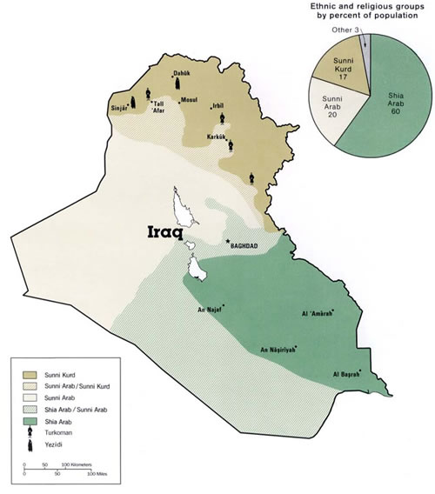
While 60% of Iraq’s population was Shiite, the Ba’ath party and the Iraqi government were dominated by Sunnis.

Slide 13
When Khomeini established an Islamic state in Iran, one dominated by Shiites, Hussein and the Ba’athists worried about a similar possible revolution in Iraq.
In part to prevent such a thing from happening, Iraq invaded Iran in September 1980.

Slide 14
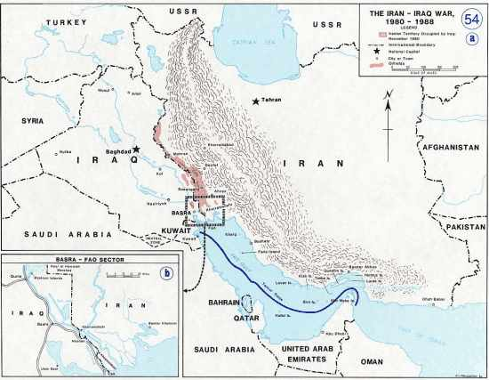
The 8 year war was brutal for both sides and resulted in little land lost or gained. What it did result in was massive debt for Iraq.

Slide 15
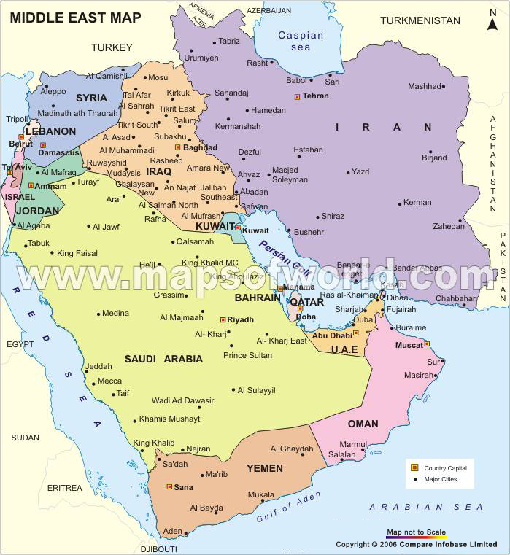
Iraq owed over $14 Billion to the small, oil rich country of Kuwait.

Slide 16
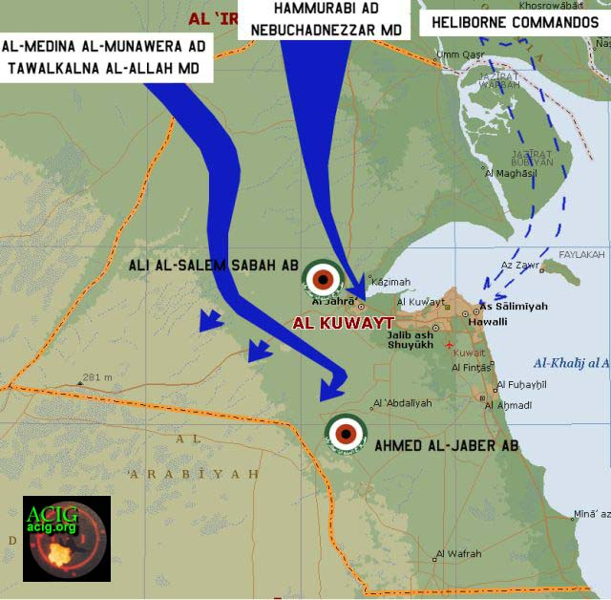
In hopes of not having to pay this debt, amongst other things, Iraq invaded Kuwait on August 2, 1990.

Slide 17
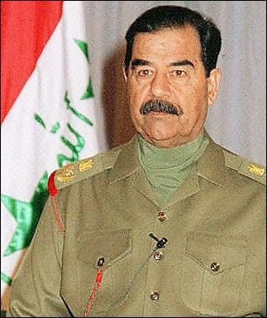
Saddam Hussein believed that the rest of the world would not interfere. However, the invasion of Kuwait was very disturbing to the U.S. Why?

Slide 18
The U.S. economy depended upon oil imported from Saudi Arabia.
Iraq owed the Saudis $26 Billion from their war with Iran.

Slide 19
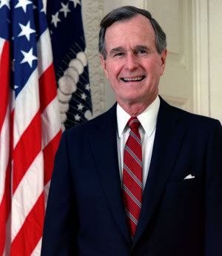
President George H.W. Bush was very concerned that Iraq would also invade Saudi Arabia. To prevent that from happening, he asked the Saudi government for permission to station U.S. troops in Saudi Arabia.

Slide 20
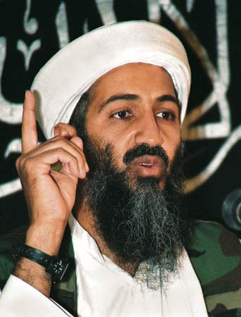
Osama bin Laden left Sudan for Saudi Arabia where he proposed using the army he had been building to defend Saudi Arabia instead of allowing the United States into the country. Why?

Slide 21
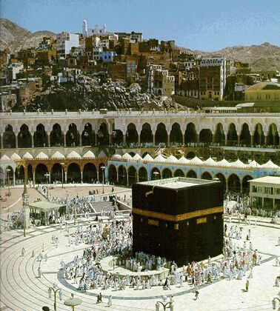
Bin Laden believed that U.S. presence and influence in Saudi Arabia would defile / dirty the most sacred country in Islam.

Slide 22
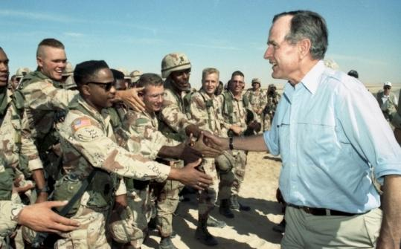
The Saudi government accepted U.S. help. President Bush launched Operation Desert Shield on August 7, 1990.

Slide 23
Bin Laden’s criticism of this decision caused the Saudi’s to kick him out of the country. He returned to Sudan.

Slide 24
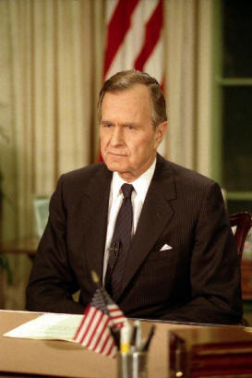
President Bush put together a coalition of 50 countries that contributed to the defense of Saudi Arabia, while plans were crafted to push Iraq out of Kuwait.

Slide 25
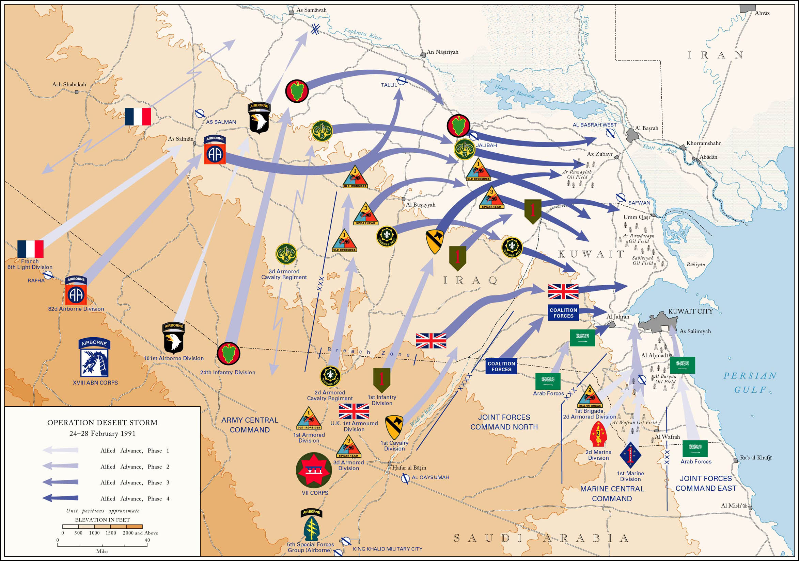
Operation Desert Storm was launched February 24, 1991. Kuwait was freed from Iraqi control by the 28th.

Slide 26
Pres. Bush refused to invade deep into Iraq or attempt to remove Saddam Hussein from power.

Slide 27
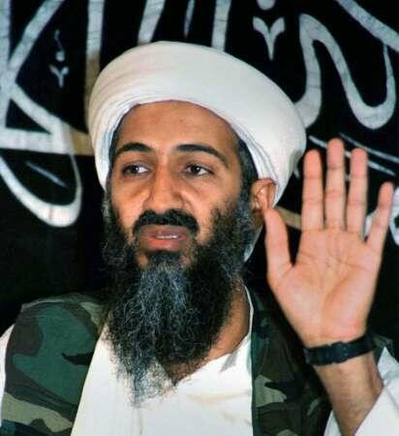
In Bin Laden’s mind, the damage had been done. The sacred sites of Islam in Saudi Arabia had been defiled by western, American presence. He believed the U.S. had to be punished.

Slide 28
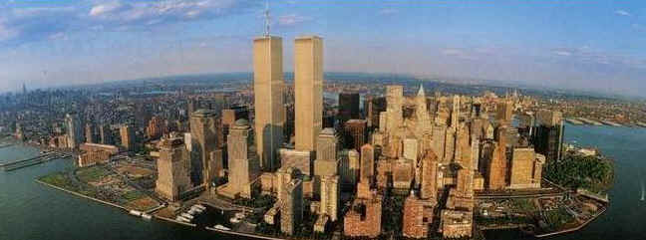
In 1993 Al-Qaeda attempted its first attack against the United States, targeting the World Trade Center in New York.

Slide 29
Al-Qaeda member Ramzi Yousef exploded a 1,500 lb. truck bomb in the parking garage of the north tower.

Slide 30
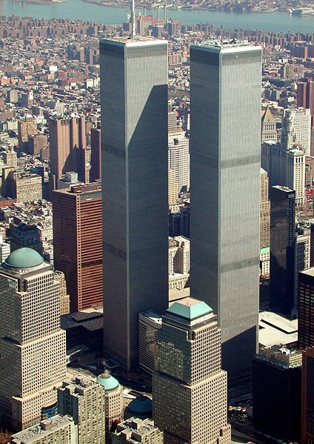
His plan was to blow out the supports in the north tower, knocking it into the south tower, destroying both buildings.

Slide 31
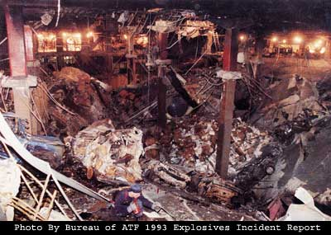
His plan didn’t work, but he did kill 6 and injured 1,042 more.

Slide 32
Three years later in 1996, a group known as the Taliban took control of the country of Afghanistan, establishing a radical Islamic state.

Slide 33
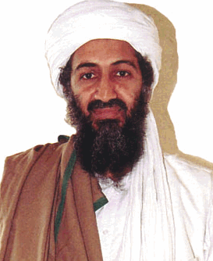
Bin Laden and Al-Qaeda relocated to Afghanistan. From there he issued a decree that “it is the individual duty for every Muslim who can do it” to kill Americans.

Slide 34
To that end, Al-Qaeda agents bombed the U.S. embassies in Kenya and Tanzania in August 1998.

Slide 35
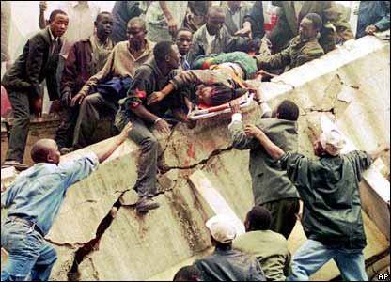
212 people, including 18 Americans were killed. An additional 4,000 were injured.

Slide 36
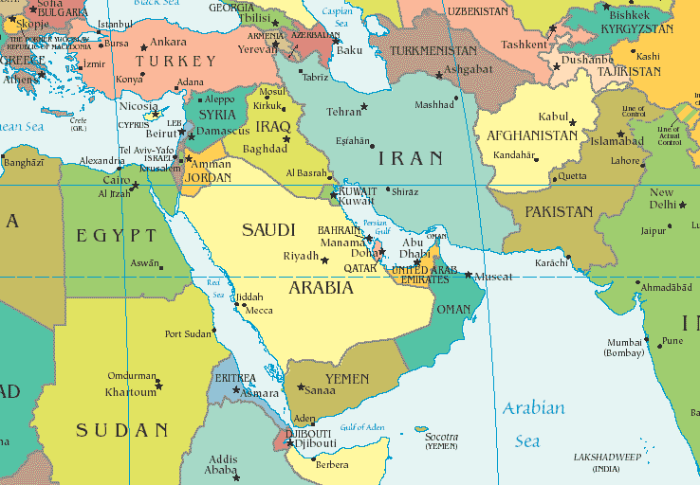
In October 2000 Al-Qaeda agents attacked a U.S. navy ship stopped in the country of Yemen.

Slide 37
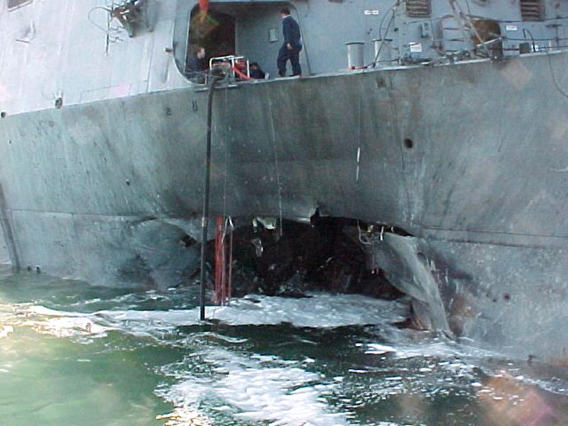
The attack on the U.S.S. Cole killed 17 American sailors.

Slide 38
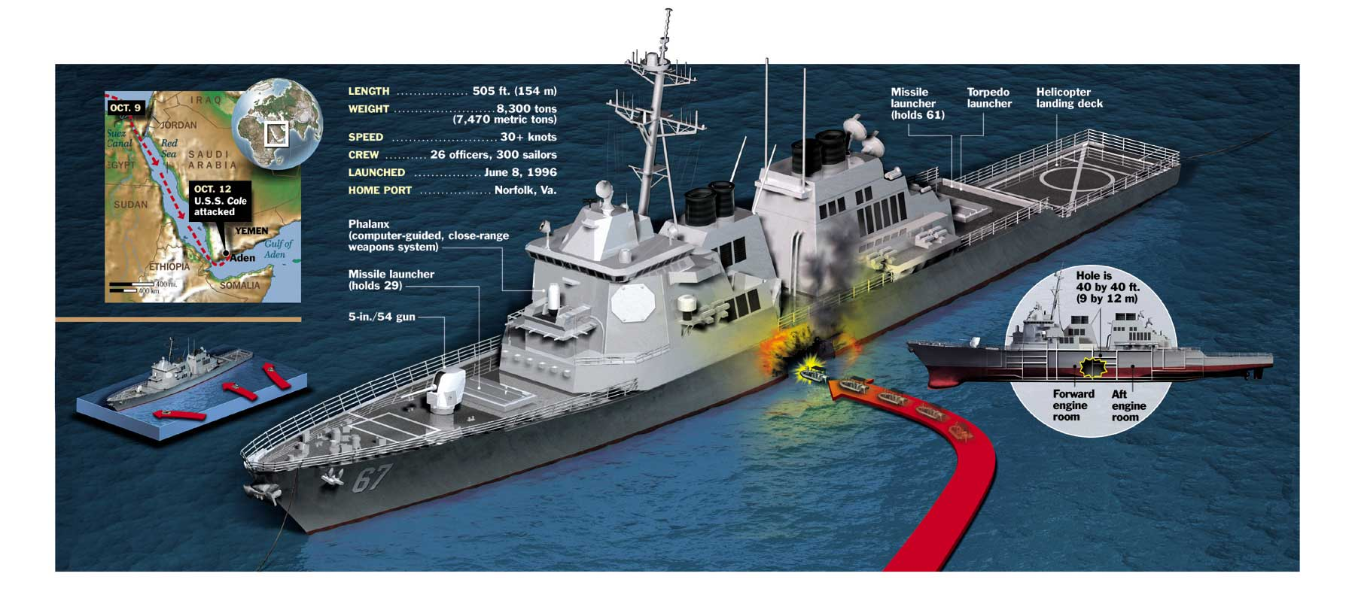

Slide 39
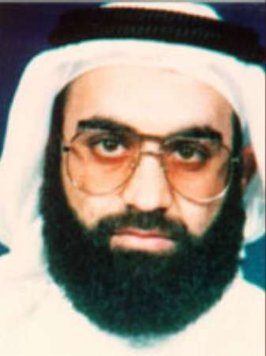
While all of this was going on, Al-Qaeda leader Khalid Sheikh Mohammad and others were planning an even bigger attack on the U.S. itself.

Slide 40
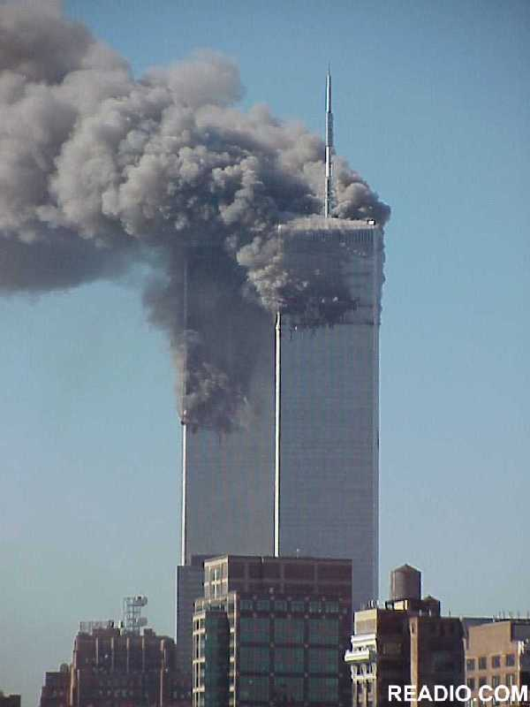

Slide 41
Fin.

