Slide 1
The
Struggle
Moves
North

Slide 2
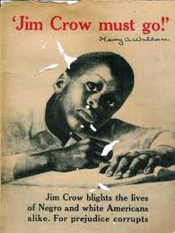
One of the things that civil rights leaders realized early on, was that, like it or not, the success of the movement to end de jure segregation needed help from white people.

Slide 3
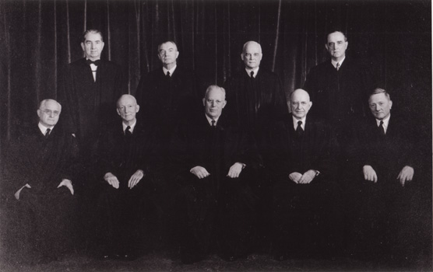
For anything to have a chance of changing, the nine white justices of the U.S. Supreme Court had to overturn the Plessy decision.

Slide 4
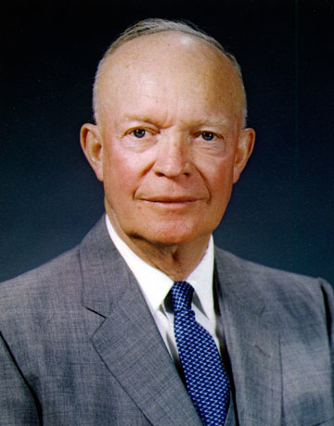
That decision had to be enforced by a white president.

Slide 5
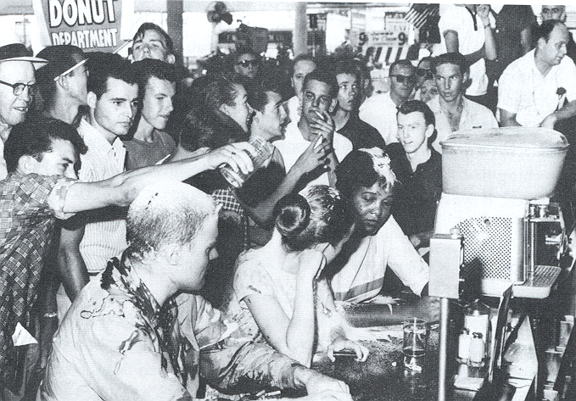
Sit ins, marches, protests etc. were held to draw the attention of white voters to the struggle.

Slide 6
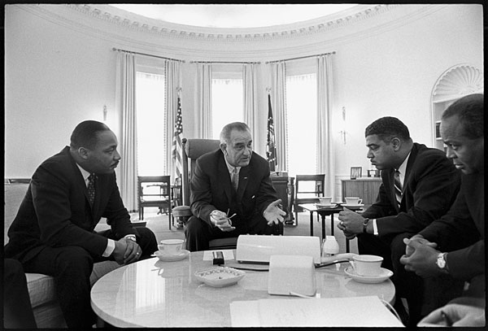
When all was said and done, when those voters began to demand change, white politicians listened and secured change.

Slide 7
As the movement moved North, however, white voters were not necessarily needed for success.

Slide 8
Civil rights groups faced a difficult question in the fight against de facto segregation in the North.
If the goal was to change the way people treated African-Americans, the way they behaved towards them and thought about them, what were the best tactics / methods to achieve that goal?

Slide 9
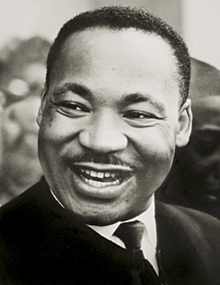
King believed that non-violence could get the job done.
- Continue to hold marches and protests, drawing attention to the inequality.
- As more and more people became aware of the situation, they would join the cause and demand change.

Slide 10
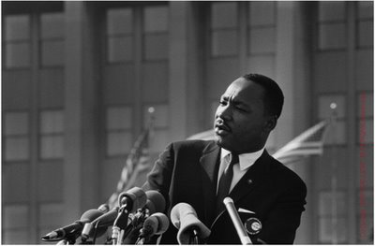
To that end, King and the SCLC led a movement in Chicago in 1966.

Slide 11
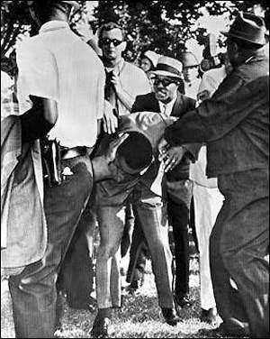
Every march carried out by the SCLC was met with violence by white demonstrators, who threw rocks, bottles, etc…

Slide 12
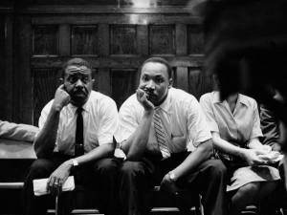
The non-violent push for change in Chicago was not successful.

Slide 13
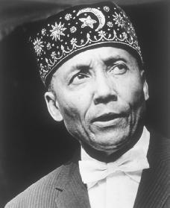
Nation of Islam
- The Nation Of Islam was an activist group that believed that most African slaves were originally Muslim.
- They urged African Americans to reconvert to Islam in an effort to restore the heritage that was stolen from them.
- They wanted to create a second Black nation within the United States.
Elijah Muhammad

Slide 14
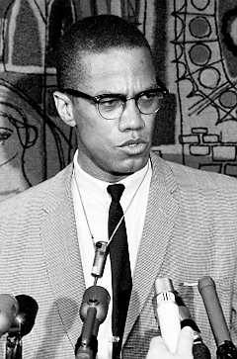
Initially, Malcolm X agreed with the Nation of Islam, arguing that the best way to end inequality in the North was through “Black Nationalism”

Slide 15
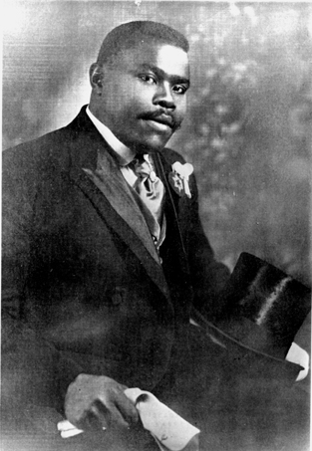
The concept of black nationalism was first proposed by Marcus Garvey in 1923.

Slide 16
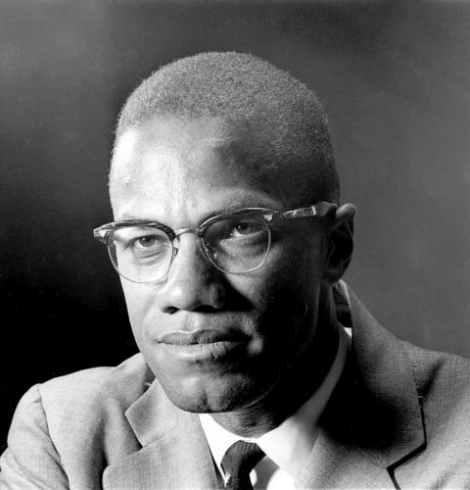
Both Garvey and Malcolm X argued that the best way for African-Americans to live a decent life in America was to limit white influence in black communities.

Slide 17
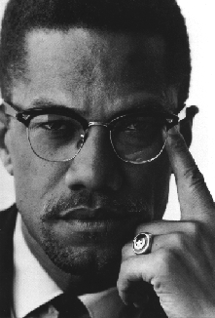
African-Americans needed to control their own political and economic affairs, free from white intervention.
This would allow African-Americans to more easily meet their own needs, to support improvements in their communities.

Slide 18
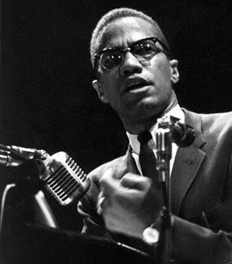
Furthermore, he argued, the movement for civil equality should severely limit participation by white people.
He believed that white leaders would use the movement for their own ends; that they would promise things to the African-American community just to get elected, but then would not follow through.

Slide 19
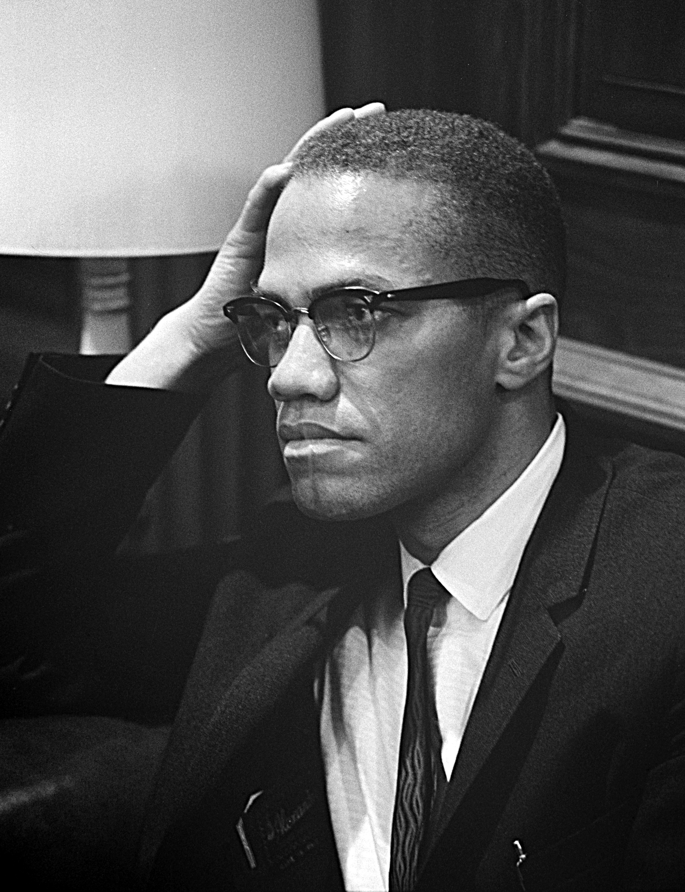
Malcolm X eventually moved away from the philosophy of Black Nationalism, and instead began to suggest that African-Americans should use “any means necessary” to get equality.

Slide 20
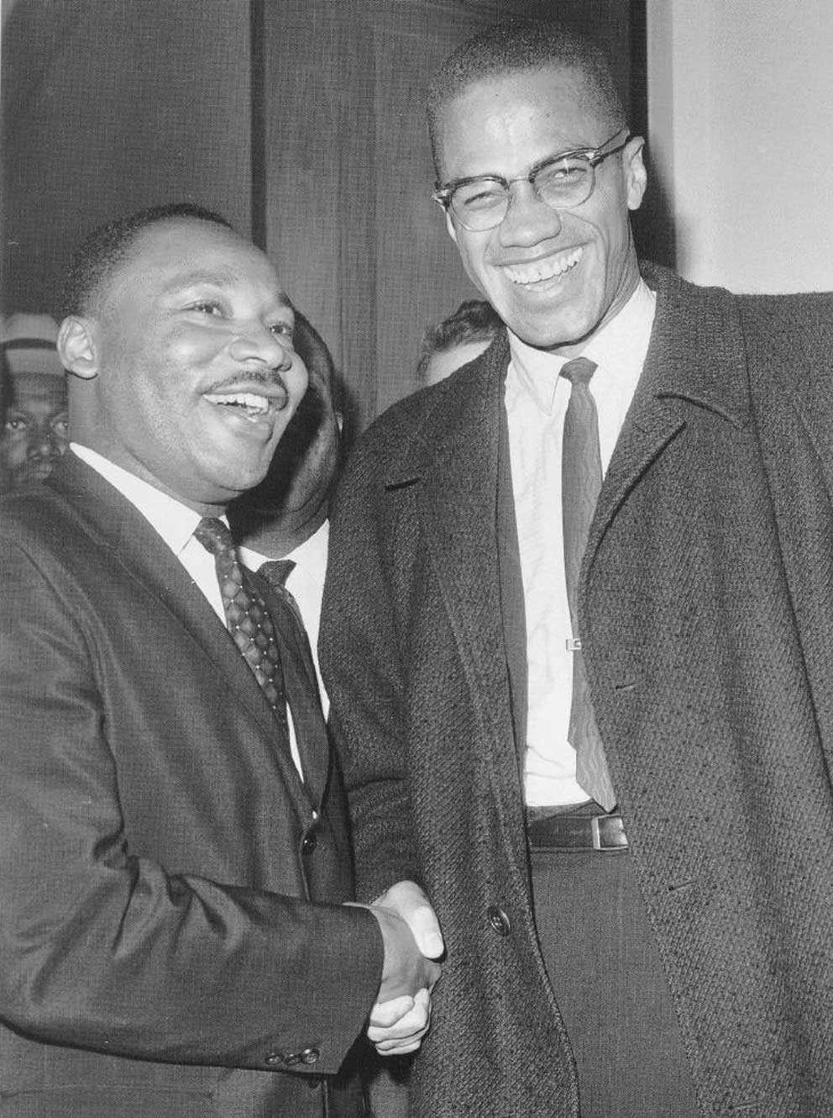
Malcolm X also changed his opinion about the tactics and leadership of Martin King.
He began to see that their two approaches could complement each other. How?

Slide 21
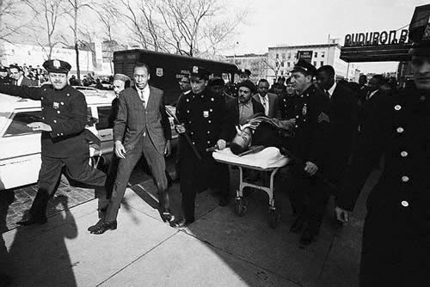
Before he was able to see much change, Malcolm X was shot to death on February 21, 1965.

Slide 22
Confronting de facto segregation grew increasingly difficult, regardless of the means.
This was in part due to the fact that the struggle wasn’t totally about racism. It was also about poverty and issues of class.

Slide 23
Fin.

