Slide 1
Reforming
America
The Progressive Era
1890’s-1920

Slide 2
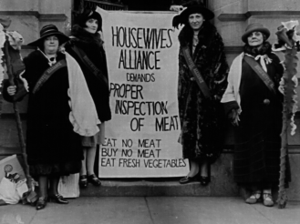
Progressive reform began as a local, grassroots movement.
It began in a serious way at the local, city and town level.
From there it picked up momentum at the state level, and finally found its way onto the national scene.

Slide 3
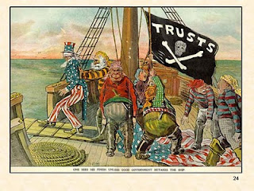
At the federal level, the job of reforming the system was kick started by one man. . .

Slide 4
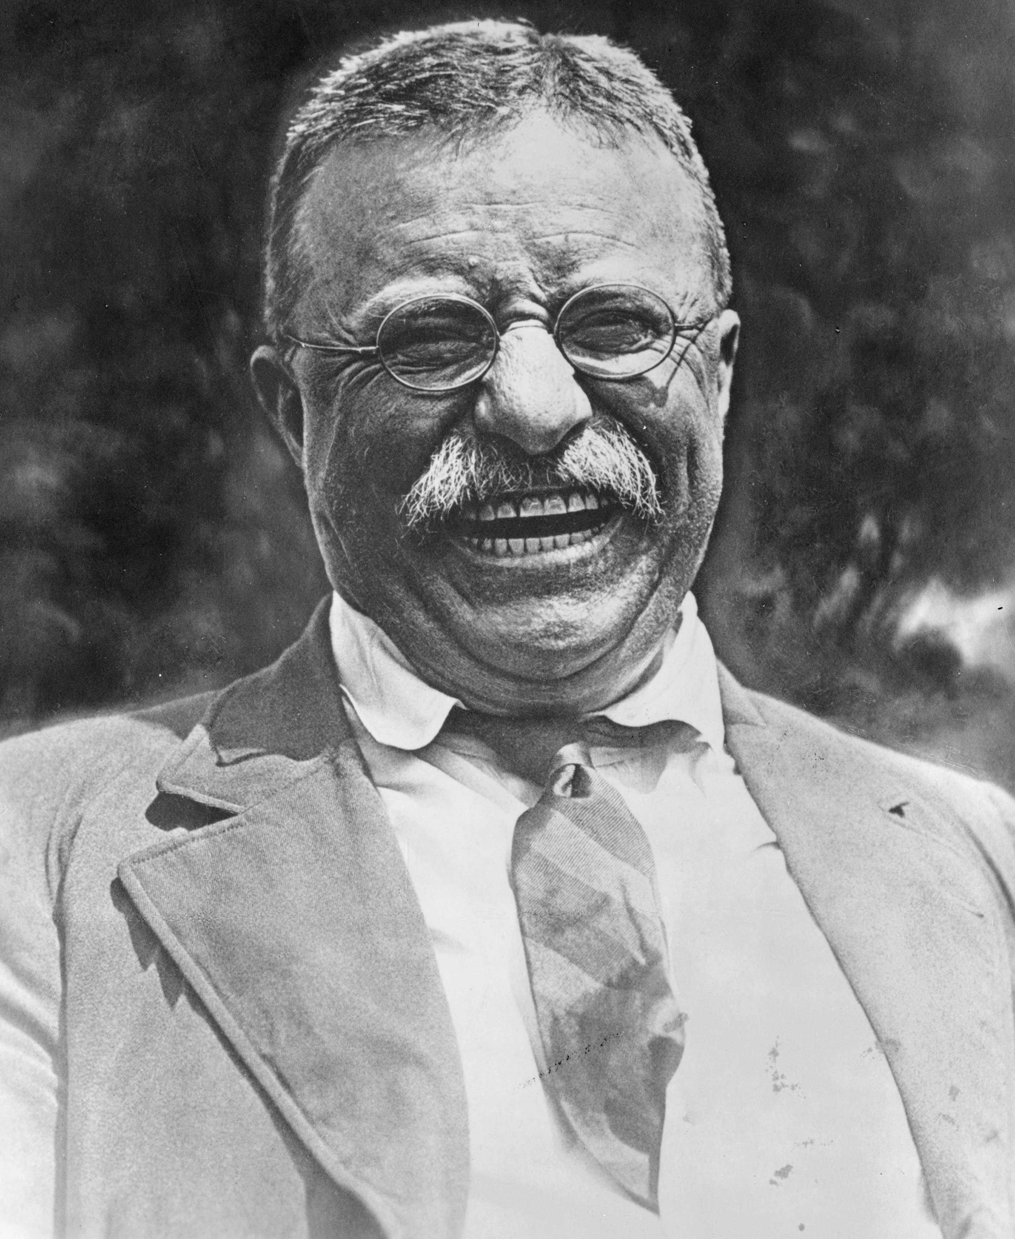
President
Theodore
Roosevelt
President from 1901-1909

Slide 5
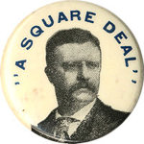
As Roosevelt contemplated the problems the United States faced, he proposed what he called a “Square Deal” for the American public.

Slide 6
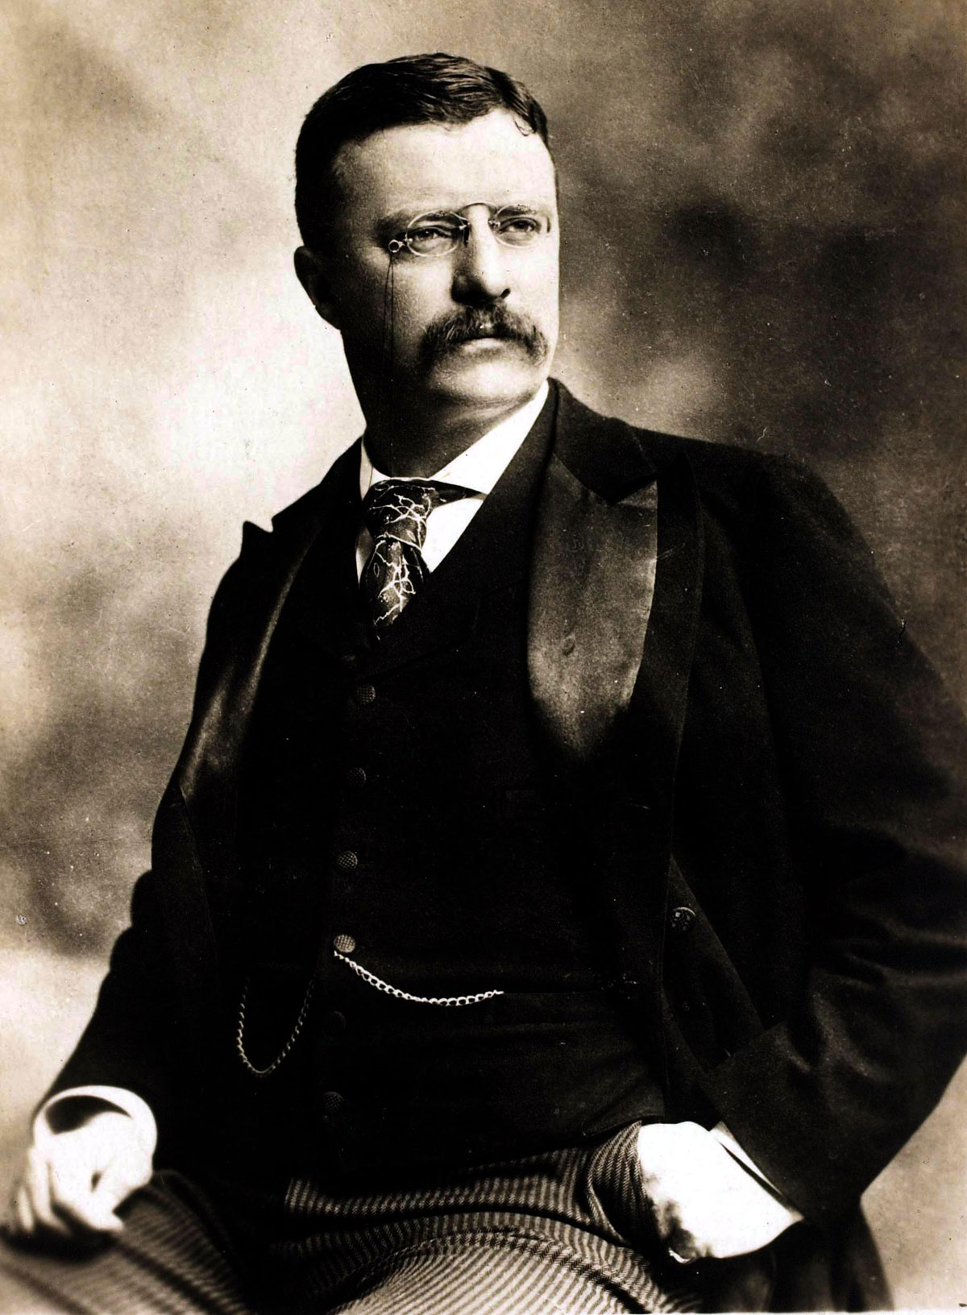
While the Square Deal had a number of goals, we care about two:
Reigning in the Trusts
Providing Consumer Protection

Slide 7
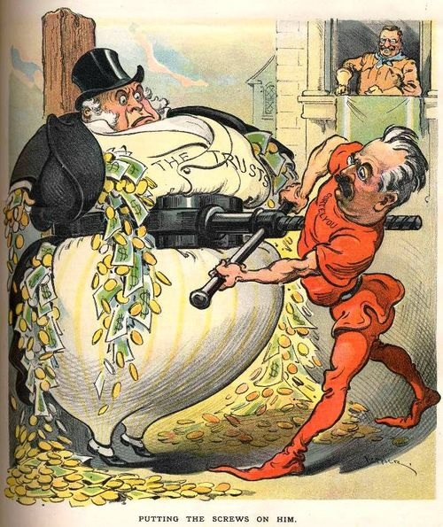
Roosevelt was concerned about the practices of American trusts / monopolies. He was especially concerned about “bad” trusts.
According to Roosevelt, a “bad” trust acted in ways that were damaging to America and the people’s interests.

Slide 8
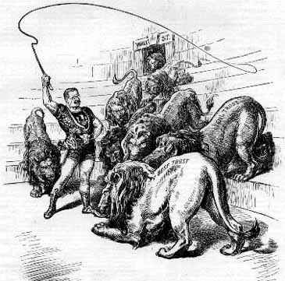
Roosevelt thus set out to tame the “bad” trusts.
He used the Sherman Anti-Trust Act, passed in 1890, to break up those monopolies.

Slide 9
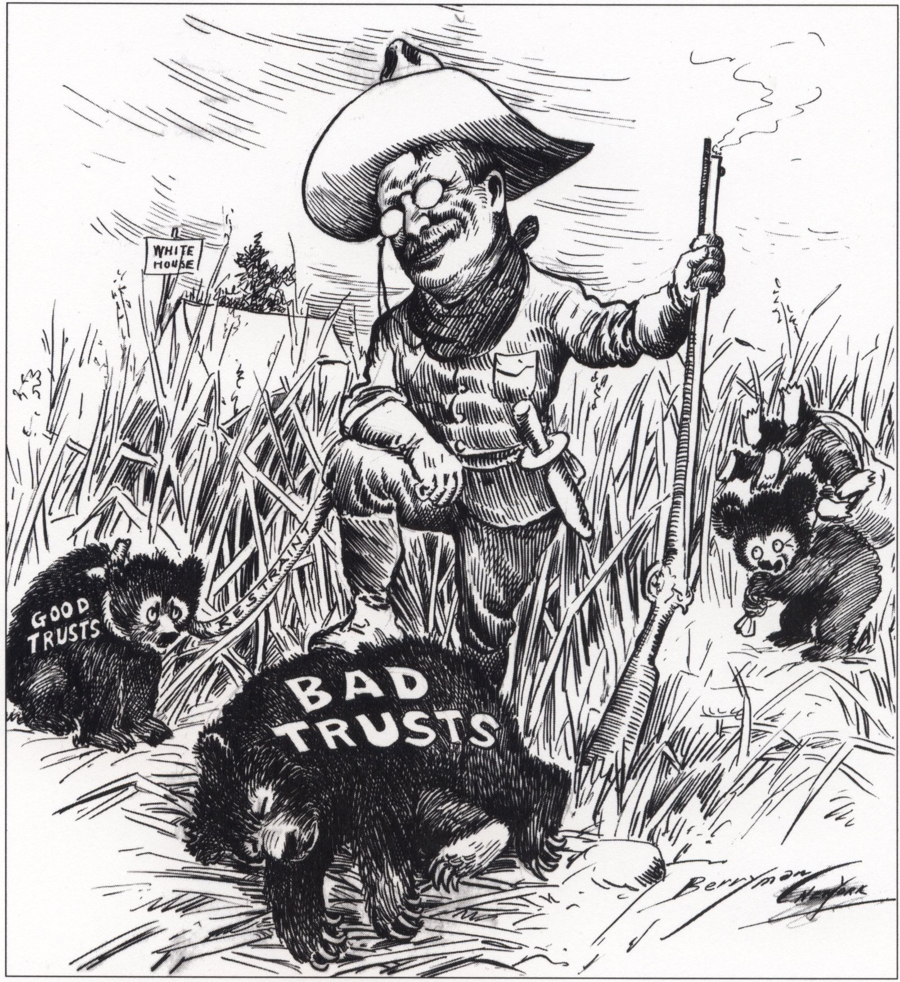
However, according to Roosevelt, not all trusts were “bad.” Some trusts, Roosevelt believed, were okay, as long as they did not go out of there way to hurt the public.

Slide 10
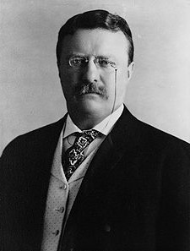
Roosevelt was particularly concerned about the power of Railroad trusts.
To deal with those “bad” trusts, he convinced Congress to pass a series of laws that attempted to limit the power of Railroad monopolies and the ties they had to corrupt government officials.

Slide 11
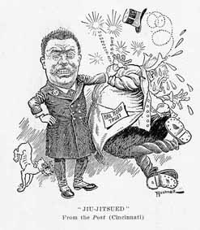
Railroad companies complained that Roosevelt’s actions were unconstitutional.
In what came to be known as the Northern Securities Case, in 1904, the Supreme Court upheld Roosevelt’s efforts.

Slide 12
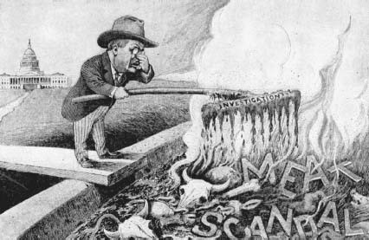
Roosevelt realized consumer protection was necessary after reading Sinclair’s The Jungle.

Slide 13
He demanded a government investigation of Sinclair’s claims.
When this investigation reported the same conditions, Roosevelt demanded Congress take action.

Slide 14
Congress passed the:
- Meat Inspection Act (1906)
Set up minimum health and safety standards and established govt. regulated inspections
- Pure Food and Drug Act (1906)
Set up mandatory labeling laws and prohibited the sale of harmful products.
- Created the Food and Drug Administration (FDA) to enforce the law.

Slide 15
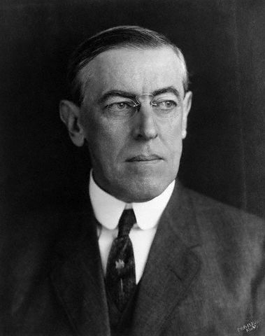
Efforts at reform increased even more under the leadership of President Woodrow Wilson who served as president from 1913-1921.

Slide 16
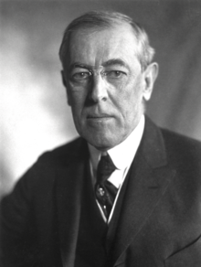
Wilson’s reform programs came to known as the “New Freedom.”
Why might he have picked that name? What might it mean?

Slide 17
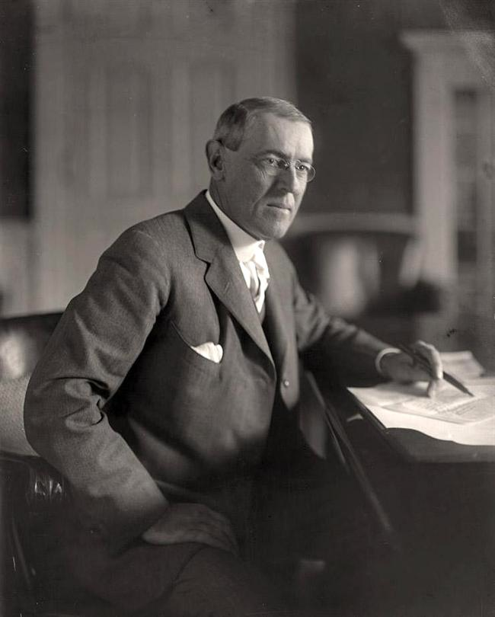
Wilson pledged to do even more to reduce the power of trusts.
For Wilson, all trusts were bad. Their power over the government and the economy had to be regulated.
He attempted to limit their power in several ways.

Slide 18
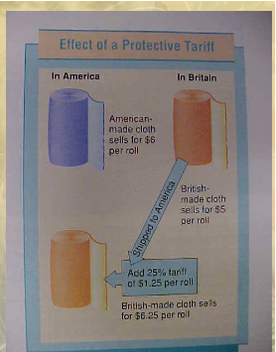
Many saw tariffs as the “mother” of the trusts, and so Wilson worked with Congress to lower tariff rates.

Slide 19
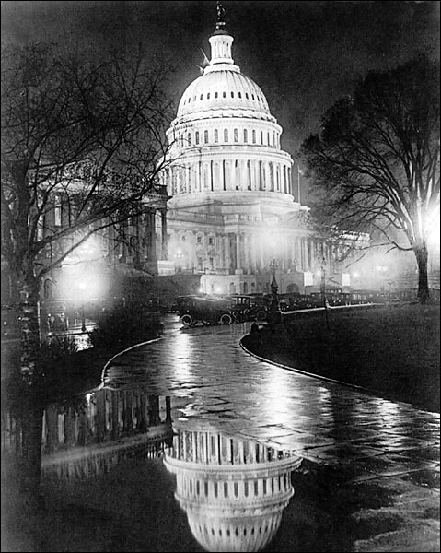
Congress passed the Underwood Tariff in 1913, which was the first reduction in tariff rates in 50 years.

Slide 20
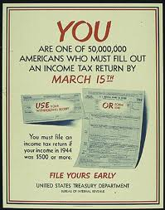
To make up for the money the government would lose, the 16th amendment was added to the Constitution which called for a federal income tax.

Slide 21
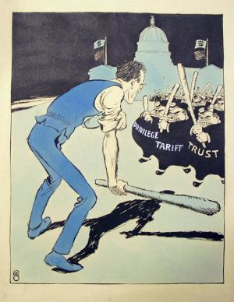
To deal with the Trusts, Wilson convinced Congress to pass the Clayton Anti-Trust Act.
Under this law, monopolies were 100% illegal.

Slide 22
To ensure that companies played by these new rules, Congress created the Federal Trade Commission (FTC)
- Govt. agency in charge of enforcing the Clayton Anti-Trust Act.
- The FTC investigates accusations of monopoly and files court cases against companies it believes violate anti-trust laws.

Slide 23
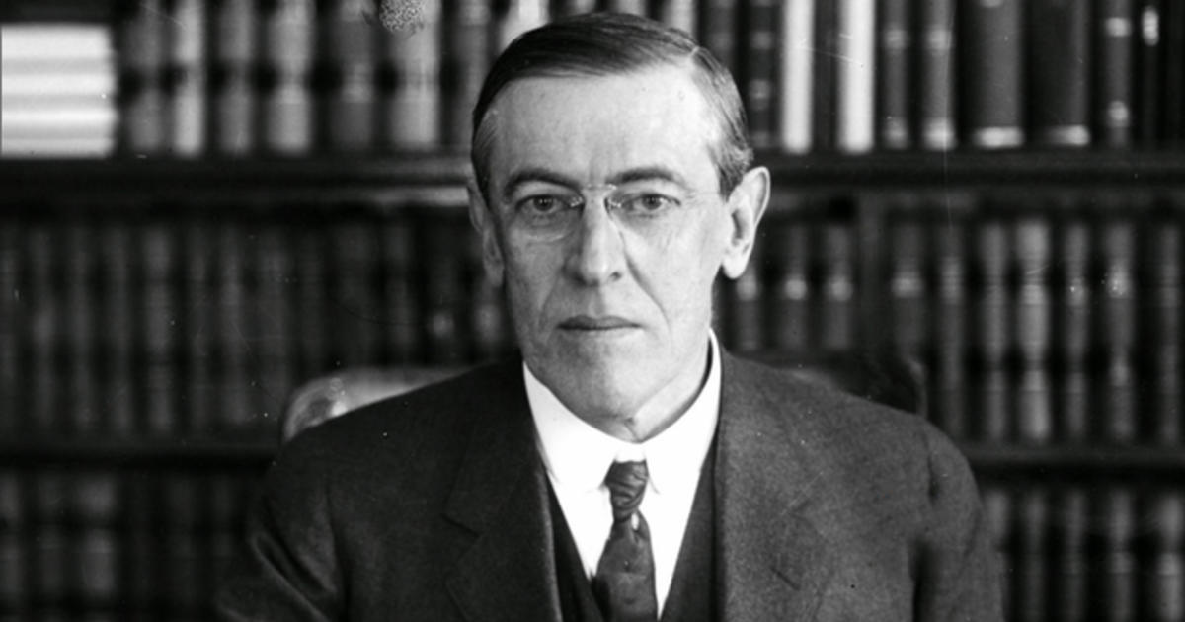
Wilson also promised that the government would no longer use its power to put down strikes or limit the ability of labor unions to push for change.

Slide 24
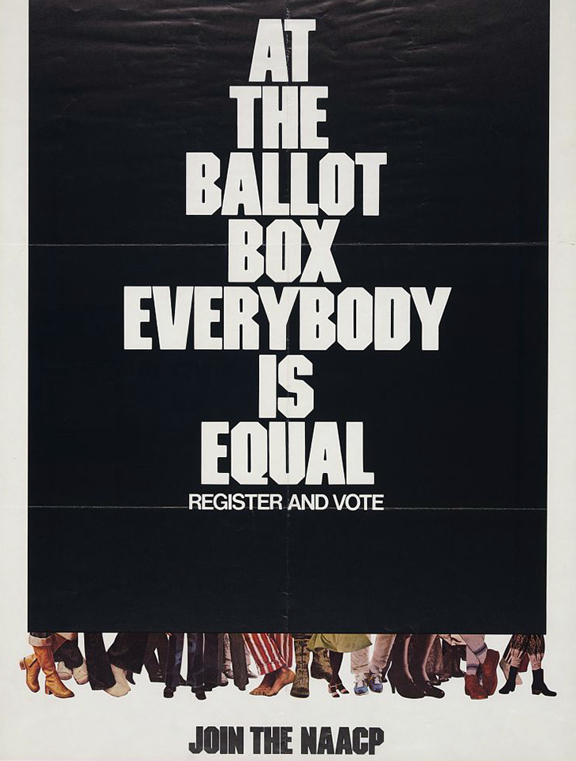
Wilson also worked with Congress and state governments to ensure that voters were given the right to a secret ballot.
Why was this important?

Slide 25
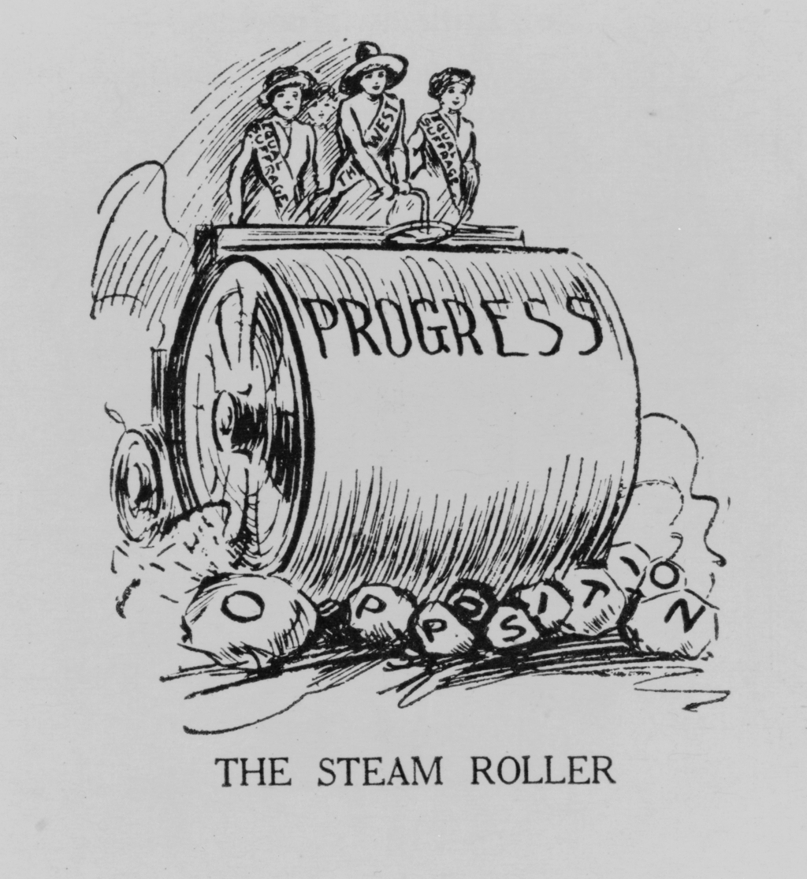
Further reforms were made largely due to the efforts of concerned citizens.

Slide 26
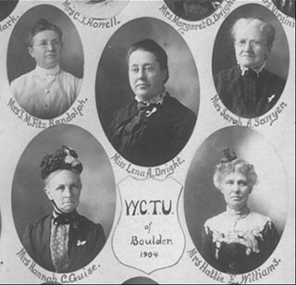
The 18th Amendment to the Constitution, ratified in 1919, prohibited the sale, manufacture, and importation of alcohol.

Slide 27
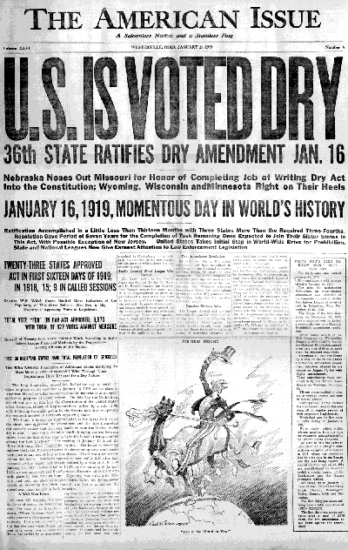
Additionally, Congress passed the Volstead Act to clarify the exact terms of what prohibition looked like (what was legal, what was illegal) and to make some exceptions for religious and scientific purposes.

Slide 28
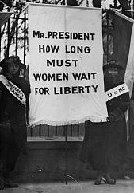
After 80 years of agitation, women won the right to vote through the 19th Amendment, ratified in 1920.

Slide 29
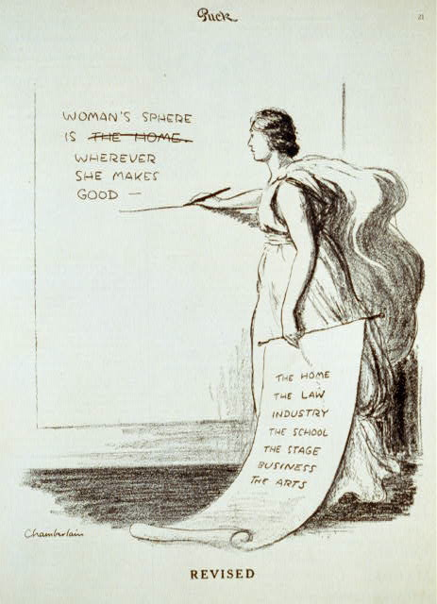
Women also began to fundamentally challenge societal by taking the lead in many of the progressive reform movements.

Slide 30
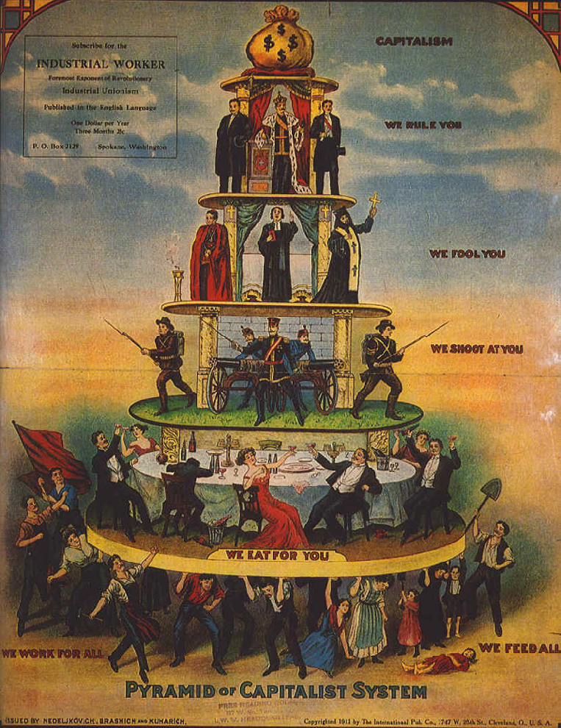
Between 1890’s and 1920, progressive reformers successfully tackled many of America’s problems.

Slide 31
What was the impact of the
Progressive Era?

Slide 32
1. While many of America’ problems had been tackled, reform was NOT 100% successful
- Still a huge gap between rich and poor.
- Women were still not totally equal with men.
- Prohibition did not work.
- Child labor hadn’t gone away.

Slide 33
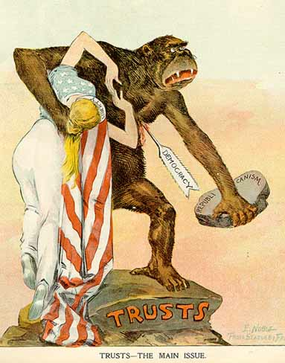
2. The power of the federal / U.S. government was radically increased.
- Laissez faire was gone. Never again would the government totally ignore the practices of business and industry.
- The Clayton Anti-Trust Act, the Pure Food and Drug Act, and the Meat Inspection Act all got the government involved.
- Those laws were / are enforced through new government agencies (FTC & FDA).

Slide 34
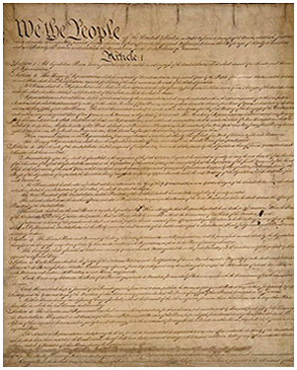
3. The U.S. Constitution was changed, further increasing federal power.
- Traditionally, amendments to the Constitution limited the power of the U.S. government.
- The amendments passed during the Progressive Era, most notably the 18th, saw the U.S. government telling the people and the states what they could and could not do.

Slide 35
4. The U.S. government began to supply help for those in need.
- The government DID NOT provide direct help. It DID NOT provide food, clothing, money etc.. to the people.
- However, it allowed the people to begin to push for what they needed (Unions could exist and push for change. States could pass laws improving conditions).

Slide 36
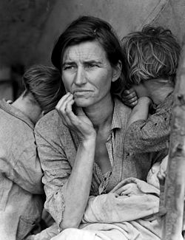
The trends of increasing federal power, the U.S. government helping those in need, and a move away from laissez faire, that started in the Progressive Era, would grow over time.

Slide 37
Fin.

