Slide 2
Quiz
Time!

Slide 3
Voting Rights Act of 1965
- Who was involved in getting in passed?
- What exactly did it do?

Slide 4
President
Lyndon Johnson
and
Equality

Slide 5
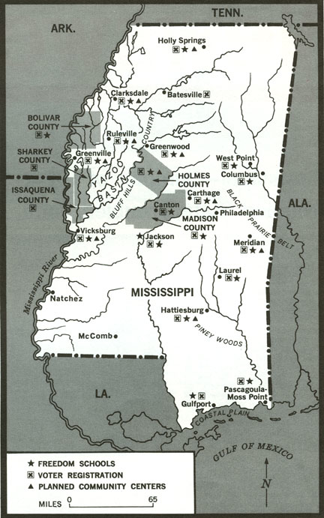
SNCC launched “Freedom Summer” in 1964 targeting Mississippi. Their goal was to help African-Americans register to vote. Why?

Slide 6
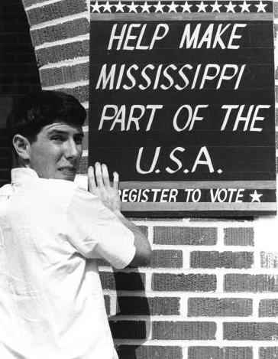
SNCC organizers actively recruited white college students to help in their efforts. Why?

Slide 7
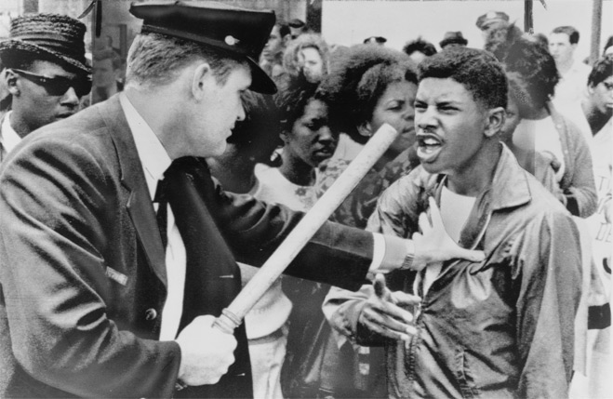
SNCC workers, both white and black were subjected to violence by white politicians desperate to keep power.

Slide 8
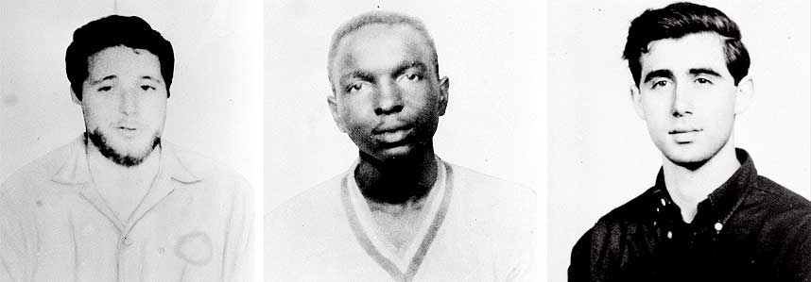
The most famous example occurred on June 21, 1964 with the disappearance of three SNCC volunteers.
Mickey Schwerner
James
Cheney
Andy Goodman

Slide 9
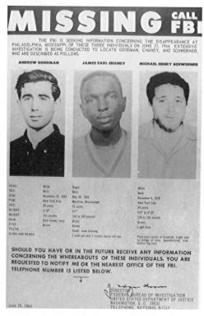
The three were stopped for “speeding” accused of going 75 MPH in a 30 MPH zone.
They were taken to jail and held until their $20 fine could be processed.
They were released at 10:30 PM and told to leave the county.
They were never seen alive again.

Slide 10
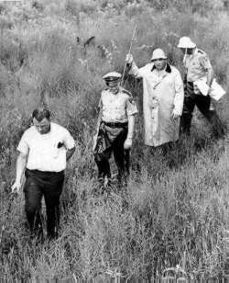
President Johnson ordered the FBI and the U.S. military to help in the search for the missing men.

Slide 11
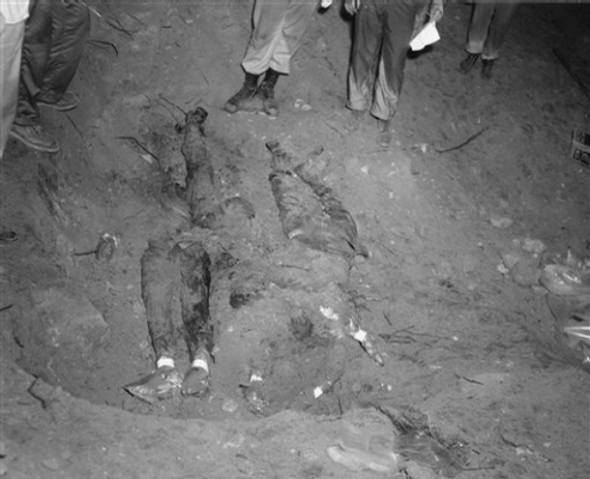
After searching for a month and a half, the FBI was contacted by Mississippi highway patrol man Maynard King who told FBI agents where to find the three men’s bodies, which were recovered on August 4th 1964.

Slide 12
King had been a part of two carloads of KKK members who followed Goodman, Schwerner, and Cheney, pulled their car over, and murdered them.
Goodman and Schwerner were each shot once in the heart. Cheney had been savagely beaten before he too was shot three times.

Slide 13
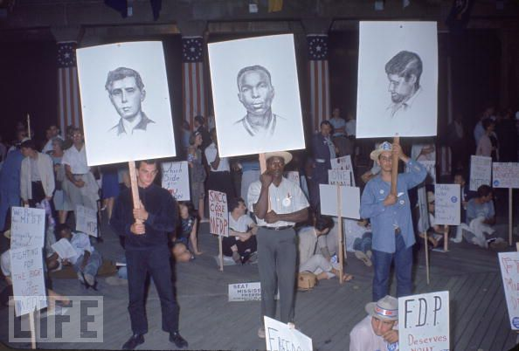
17 men were arrested and put on trial. 7 were found guilty, not of murder, but of denying Goodman, Schwerner and Cheney of their civil rights.

Slide 14
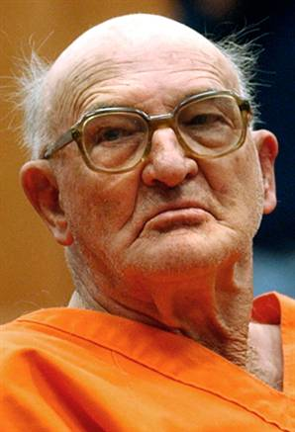
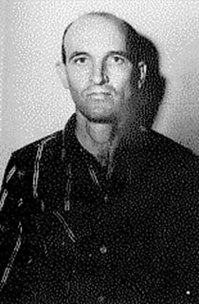
The case was reopened in 2005 and Edgar Ray Killen was found guilty of planning and carrying out the murder of the three men.

Slide 15
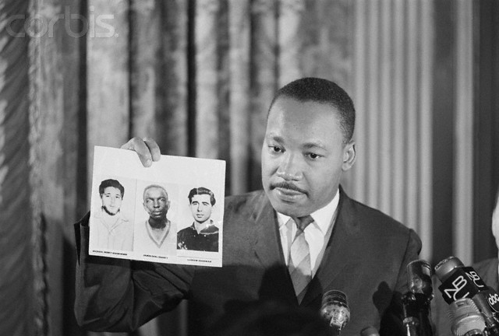
Freedom Summer, and the murder of Goodman, Schwerner, and Cheney, forced the nation to once again confront the reality of inequality in the South.

Slide 16
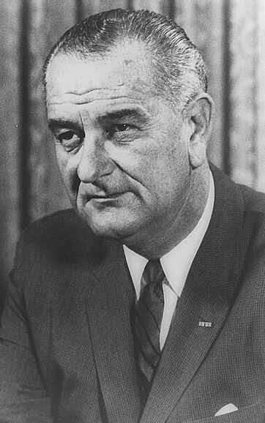
Following President Kennedy’s assassination in 1963, the job of pushing the government into enforcing equality fell to President Lyndon Johnson.

Slide 17
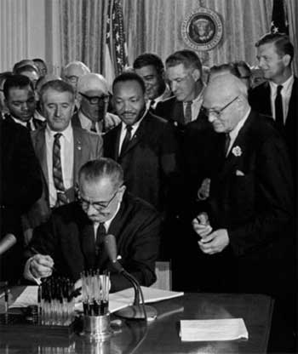
Continuing with President Kennedy’s promise to make Congress take action, Johnson persuaded Congress to pass the Civil Rights Act of 1964.

Slide 18
Civil Rights Act 1964
1. Prohibited discrimination in employment and in public accommodations. (No more Jim Crow)
2. It established the Equal Employment Opportunity Commission (EEOC) to ensure fair hiring practices.
3. It authorized the Department of Justice to ensure that states were following federal law.
4. It committed the U.S. government to protecting African-American voting rights.

Slide 19
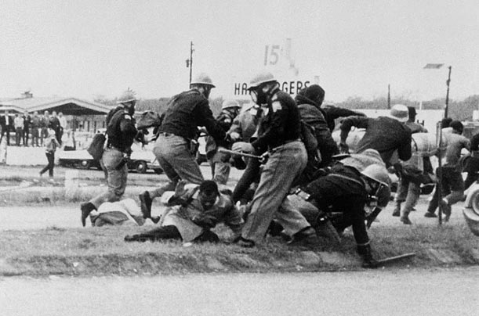
However, extreme violence at a voting rights march in Alabama, showed the nation that more work needed to be done.

Slide 20
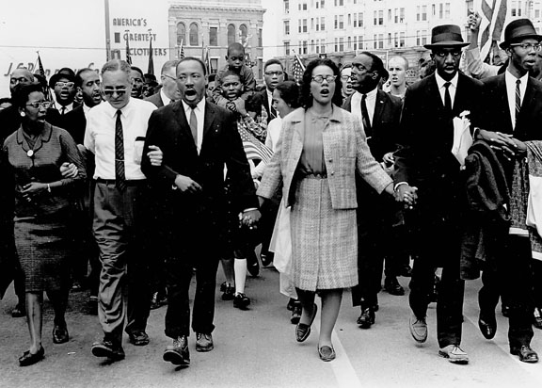
Selma March (1965)
To call attention to the issue of voting rights, King and other leaders decided to organize marchers to walk from Selma, Alabama, to Montgomery, about 50 miles away.

Slide 21
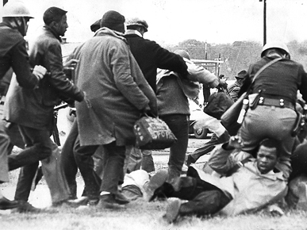
On their first attempt, March 7th, 1965, a day known as “Bloody Sunday”, the 600 marchers were attacked and beaten by the local and state police.

Slide 22
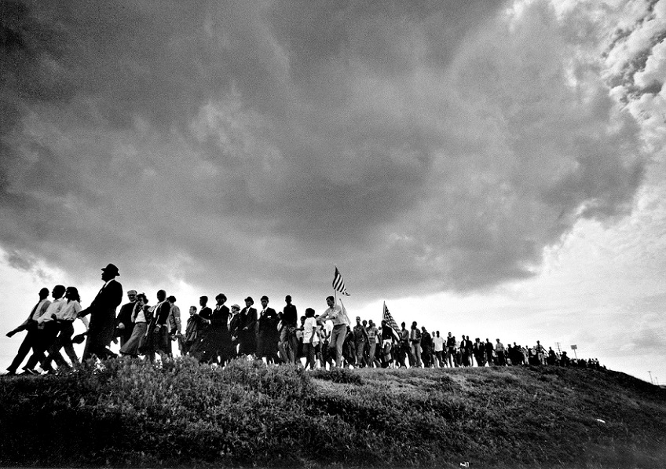
A successful attempt started on March 21st. Marchers were protected by the FBI and by the National Guard.

Slide 23
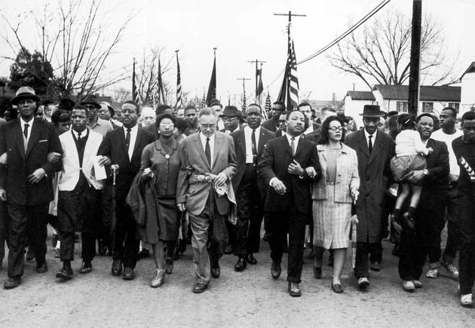
After marching for 5 days, 25,000 protestors marched into Montgomery demanding change.

Slide 24
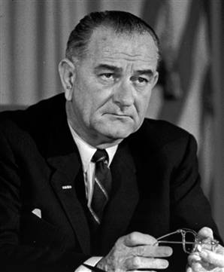
Realizing more needed to be done, Johnson and Congress swiftly moved to pass even more federal civil rights legislation focusing specifically on voting rights.

Slide 25
Voting Rights Act 1965
1. Eliminated literacy tests as a qualification for voting.
2. Allowed U.S. government officials to register citizens to vote, removing this power from state and local officers. Why?

Slide 26
Twenty-Fourth Amendment
Ratified in 1964, it outlawed the poll tax as a qualification for voting.

Slide 27
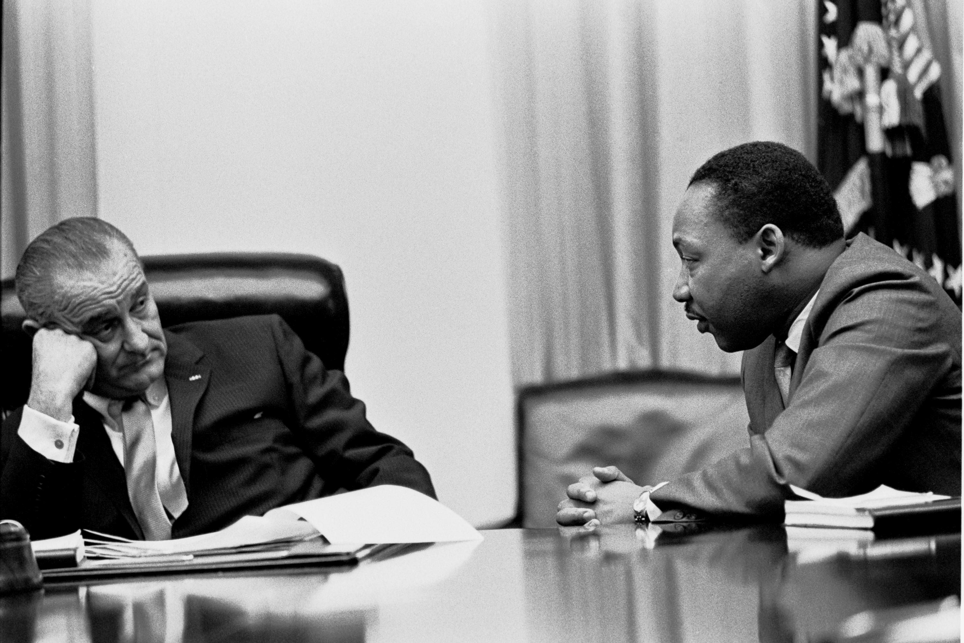
With the legislation signed by President Johnson, de jure segregation was essentially over. However, despite all the good things that had been done, problems remained.

Slide 28
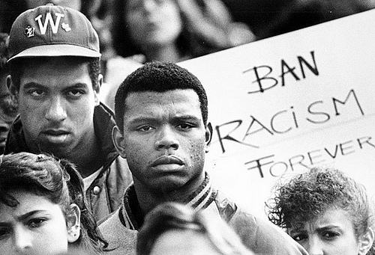
De facto segregation hadn’t gone away. Racism was still everywhere in America.

Slide 29
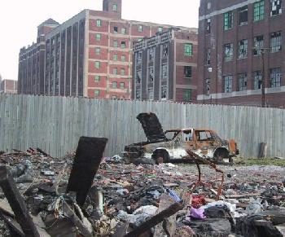
Economically, African-Americans, both North and South, weren’t doing well. Poverty was rampant.

Slide 30
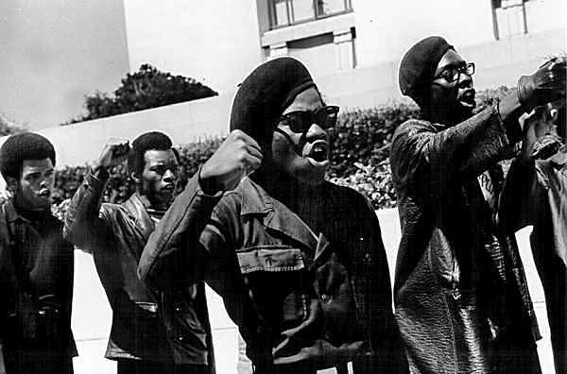
The pace of change was still moving too slow for many, especially younger African-Americans.

Slide 31
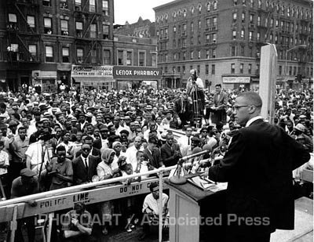
The fight for equality had taken place mostly in the South. What would happen when that struggle went north?

Slide 32
Fin.

