Slide 1
Bush
and
Clinton

Slide 2
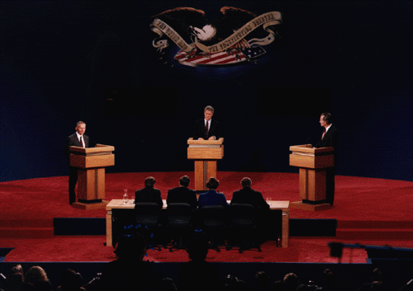
1992 saw America facing its first post Cold War election.

Slide 3
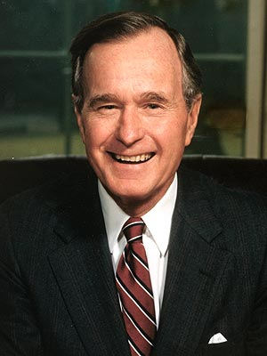
The Republicans nominated President George H.W. Bush.

Slide 4
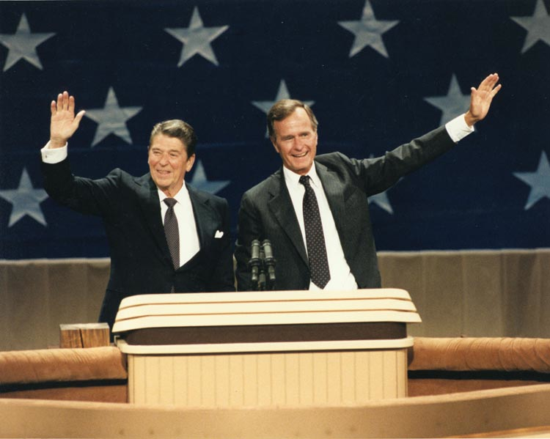
Bush had served as Ronald Reagan’s Vice President and was elected himself in 1988.

Slide 5
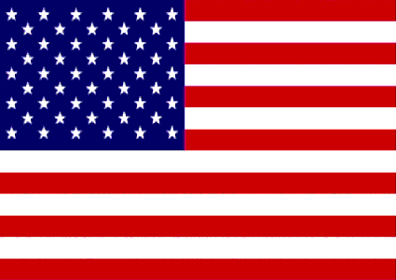
The Cold War came to an end during his presidency.

Slide 6
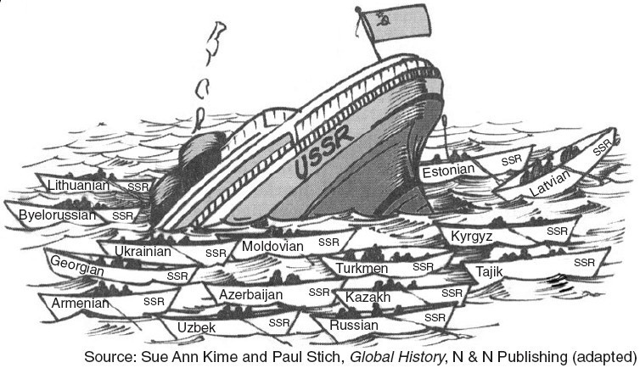
Remember that America was blown away! Overnight, our enemy for over four decades was gone.

Slide 7
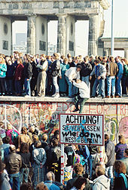
The end of the Cold War left the nation with some nagging questions:
- Who was in control of the Soviet nuclear arsenal? (Russia mostly)
- What would happen to the people of the many new independent nations?
- What would happen to the U.S. economy? (Why was this a question?)

Slide 8
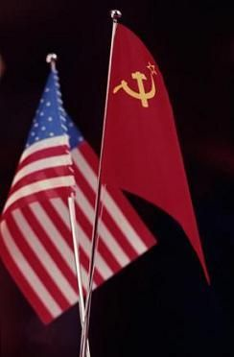
The government had been spending hundreds of billions of dollars to keep up with, and pass the Soviet Union.
That was no longer necessary.
The government began to cut back on military spending.

Slide 9
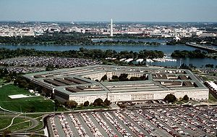
In 1991 alone, the Defense Dept. closed 34 military bases and slashed billions of $ from the budget. More cuts followed.

Slide 10
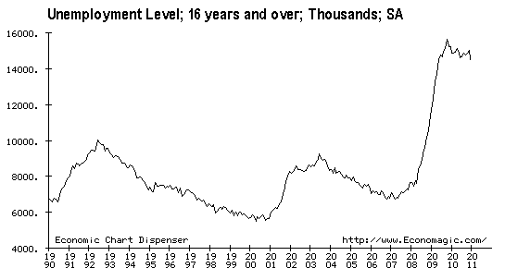
This had a largely negative impact on the economy. Unemployment began to grow.

Slide 11
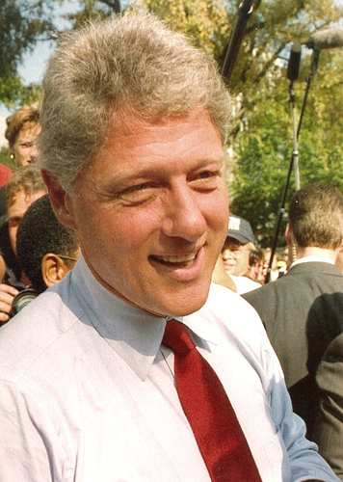
The Democrats nominated William Jefferson Clinton.
- Hoped to move his party towards the political center.
- Tax cuts for the middle class.
- Reform govt. welfare.
- Overhaul America’s health care system.
- “It’s the economy stupid.”

Slide 12
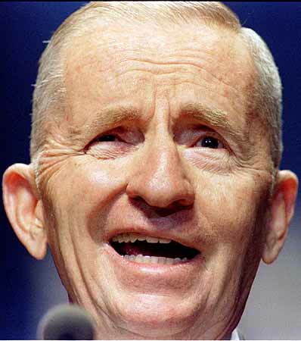
H. Ross Perot, a billionaire businessman, ran as an independent candidate.
- The national deficit and debt had to be fixed.

Slide 13
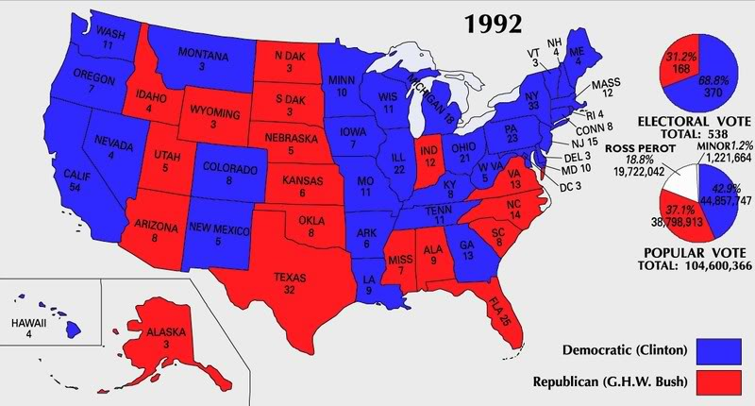

Slide 14
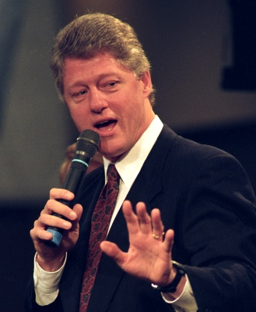
The Clinton Administration began with some rather large missteps.

Slide 15
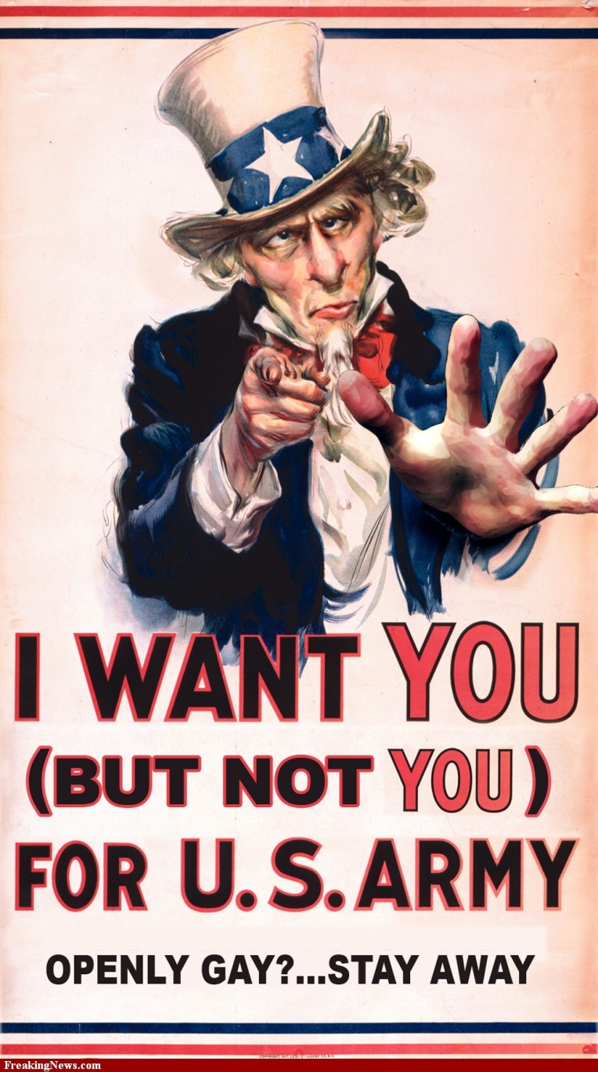
Clinton proposed an end to the prohibition against gays serving in the military.
Critics were outraged and Clinton had to back off.
In the end, Clinton had the military adopt a “Don’t ask, don’t tell” policy.

Slide 16
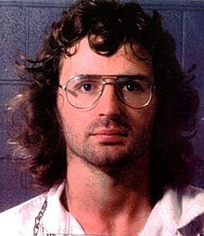
In 1993, the FBI surrounded the compound of a fundamentalist group in Waco, TX, the Branch-Davidians, led by David Koresh.
A gun battle broke out in which 4 FBI agents, and 6 Davidians were killed.

Slide 17
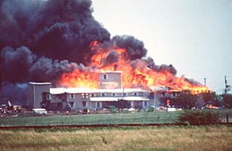
After a 50 day standoff, the ordeal came to an end when the FBI stormed the compound.
A fire broke out in the building eventually killing 74, including 20 children.

Slide 18
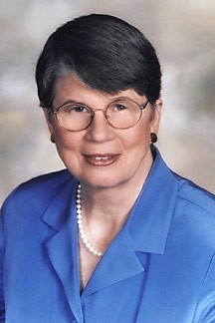
Clinton, and his Attorney General Janet Reno came under fire from anti-government groups claiming that the FBI had started the fire.

Slide 19
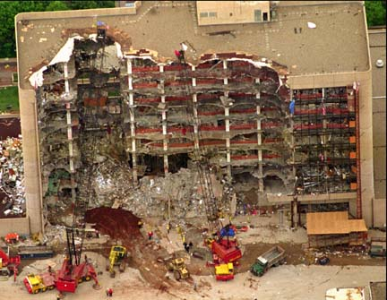
Partly in protest for the deaths in Waco, Timothy McVeigh and Terry Nichols bombed the U.S. federal building in Oklahoma City, OK in 1995 killing 168.

Slide 20
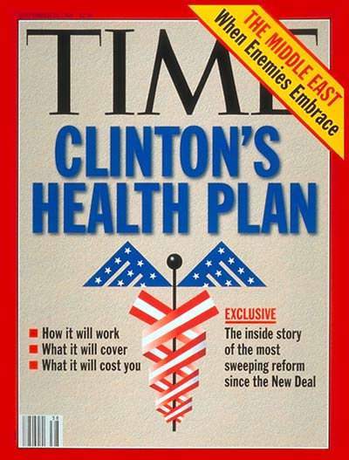
The biggest blunder of Clinton’s early years was his efforts to deal with health care reform.

Slide 21
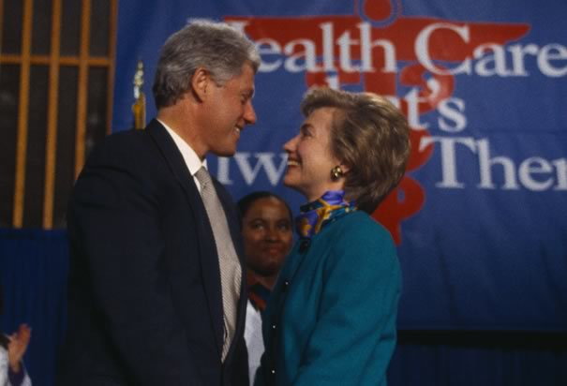
Clinton created a federal task force to design a new national health care program.
He then appointed his wife, Hillary Rodham Clinton, to chair that panel.

Slide 22
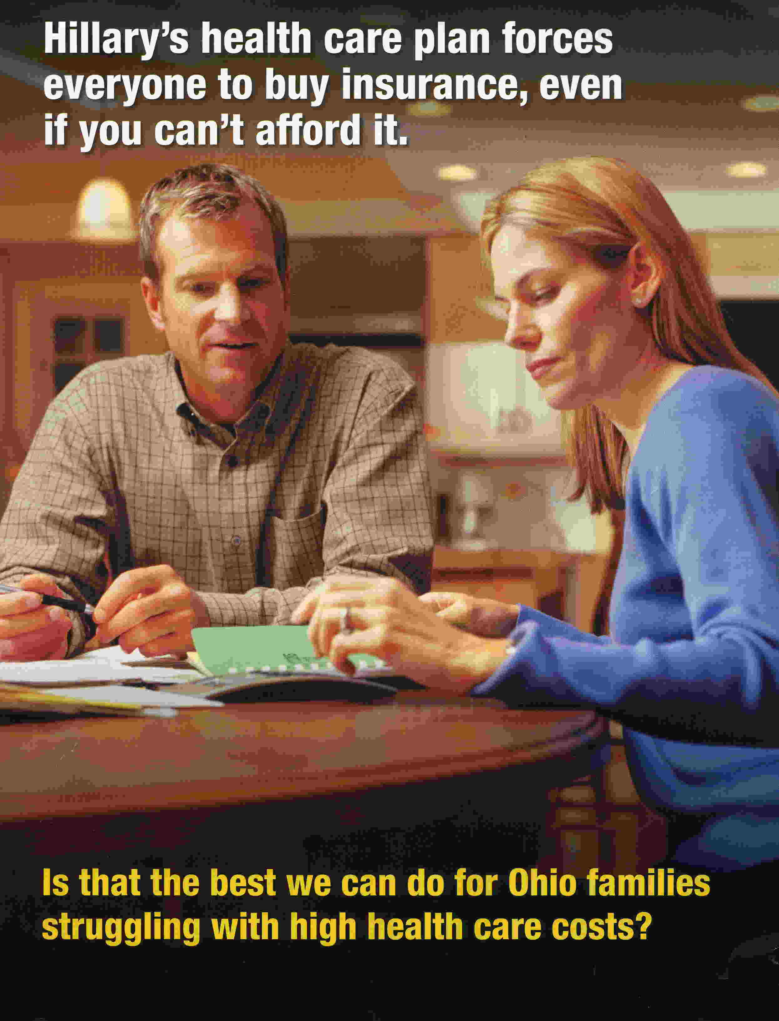
Both Clintons were attacked from numerous sides some arguing the government was going too far, some arguing the government needed to do more, some arguing she had no business being involved, etc…

Slide 23
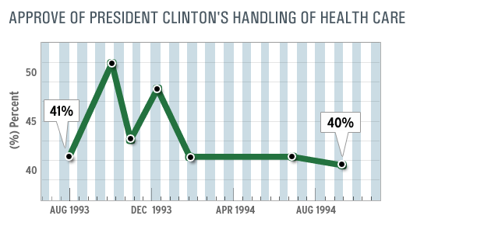
In the end, the reforms proposed by the task force went nowhere, and nothing was accomplished in terms of health care reform.

Slide 24
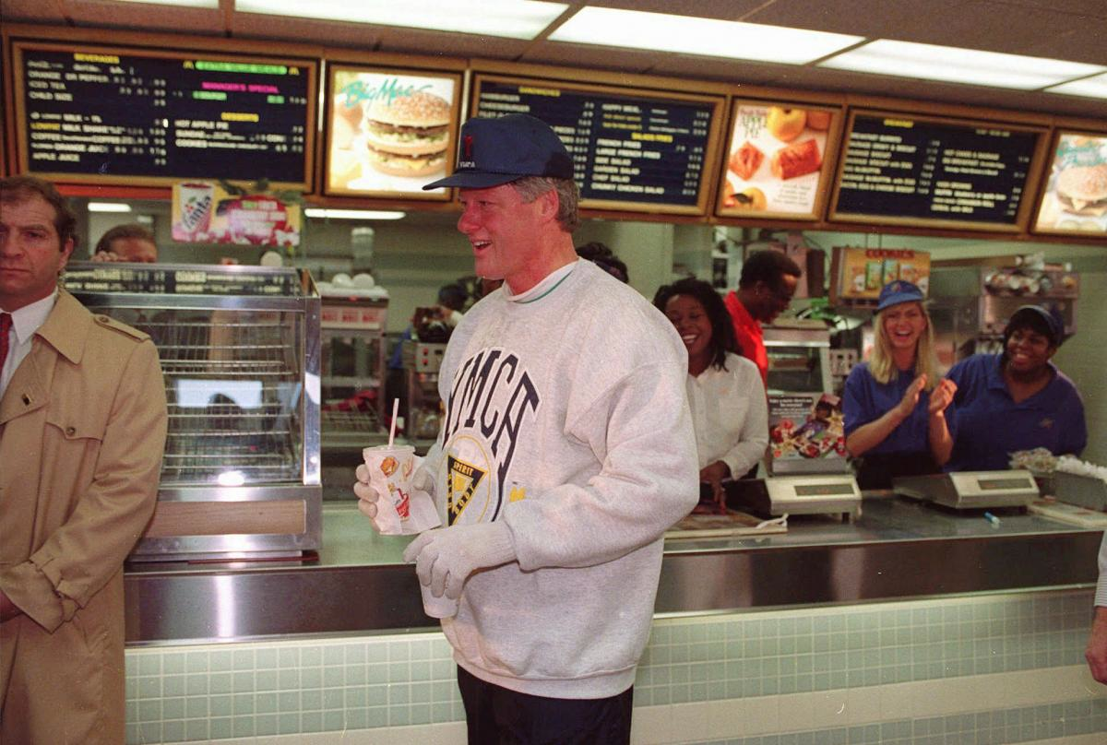
It wasn’t all bad, however.

Slide 25
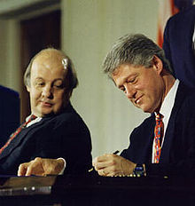
In 1993, Congress passed the Brady Bill
- Named for Pres. Reagan’s press secretary James Brady who had been shot in the head during the assassination attempt on the President.
- Required background checks and waiting periods before purchasing firearms.
- Prohibited some people from buying firearms altogether.

Slide 26
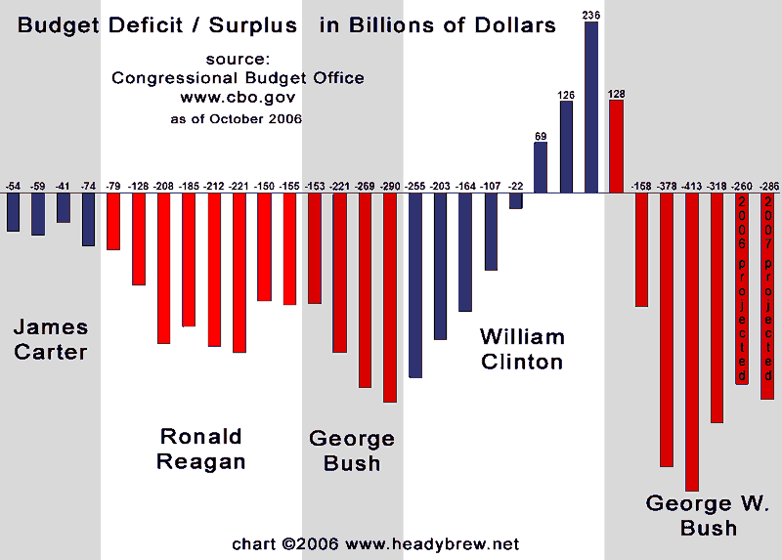
In 1993 Congress also passed Clinton’s plan to reduce the deficit, primarily through raising taxes on the wealthy, on Social Security benefits, and on gas. By the end of his first term, the deficit had been cut in half.

Slide 27
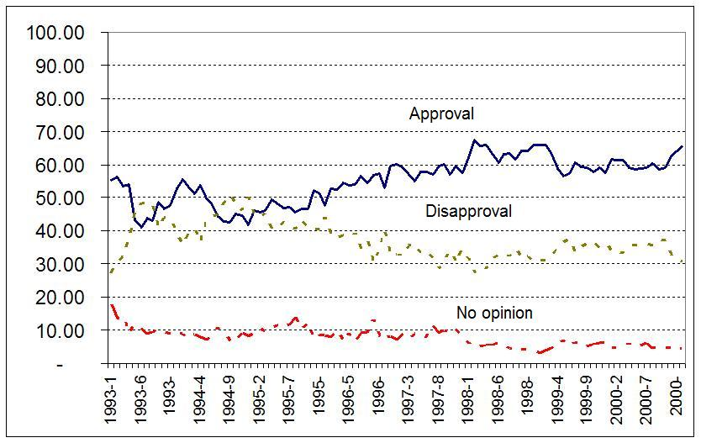
Despite some of these successes, many Americans did not have a positive view of either Clinton or the U.S. government by late 1993.

Slide 28
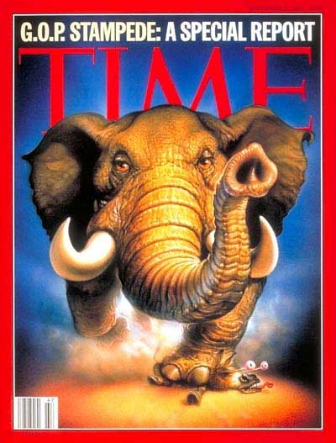
The Republicans hoped to capitalize on this in the mid-term elections of 1994. To that end, they proposed the “Contract With America.”
- Proposed an all out effort to reduce the budget deficit and the national debt.
- Called for lowering taxes and slashing government welfare programs.
- Also demanded reform to government including term limits for elected officials.

Slide 29
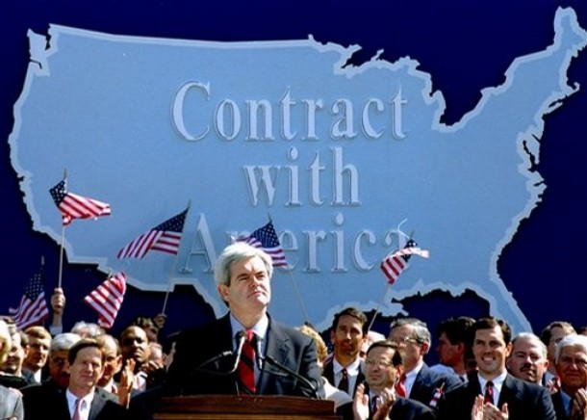
The ‘94 Mid-terms saw unprecedented success for the Republicans in Congress. They gained control of both the House and the Senate for the first time since the 1950’s.

Slide 30
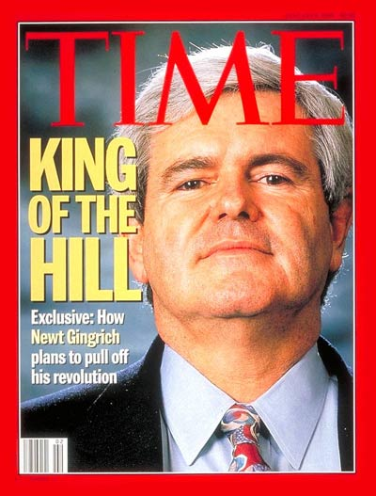
Believing they had a mandate, Congressional Republicans put their plan into action.

Slide 31
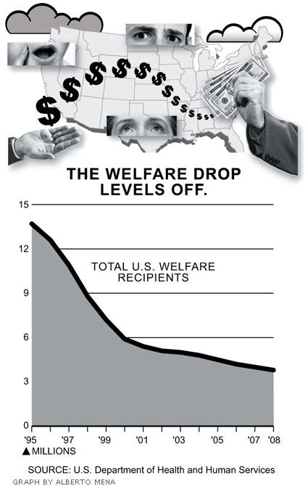
One of their more important successes was the passage of the Welfare Reform Bill of 1996.
- Deep cuts to government welfare programs.
- Placed limits on how much assistance people could receive (5 years max).
- Required people to have a job within two years of receiving benefits.

Slide 32
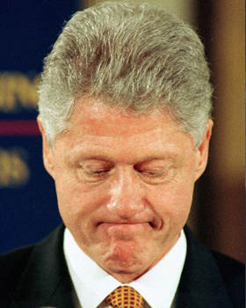
However, the President refused to go along with all of the Republican agenda.
Congress and the White House could not agree on the terms of the federal budget.
Without an approved budget to run on, the U.S. government was literally forced to shut down for 27 days late in 1995.

Slide 33
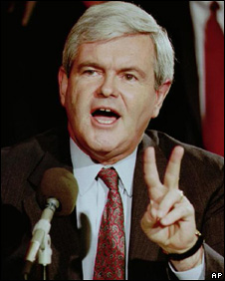
At the same time, Speaker of the House Newt Gingrich, the mastermind behind the Contract with America, began to suggest very conservative ideas such as sending the children of welfare recipients to orphanages.

Slide 34
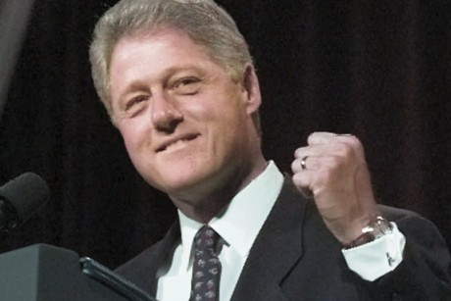
The government shutdown, and the seeming overreach of Republicans in the pursuit of their agenda, helped Clinton in his re-election campaign of 1996.

Slide 35
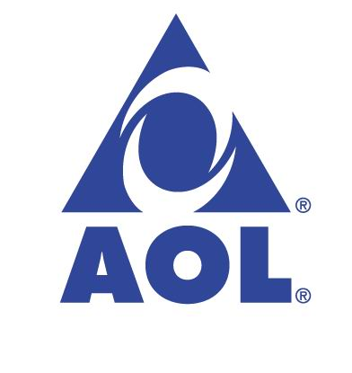
As in 1992, the election in 1996 was primarily about the economy.
This worked to Clinton’s advantage as the American economy was on fire.
Fueled by the growth of internet and media companies, unemployment fell to 4%. At the same time, inflation remained low.

Slide 36
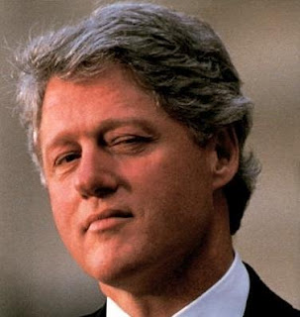
During his second term it became clear that the President might have broken the law while in office.

Slide 37
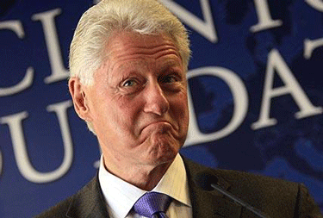
While he was still a candidate in 1992, allegations of sexual harassment and extra-marital affairs had been made against him by a number of different women.

Slide 38
One such claim resulted in a lawsuit that compelled Clinton to testify under oath.
During that testimony, he was asked about a possible affair during his time as president with a White House intern named Monica Lewinsky.
Under oath, Clinton denied having such an affair.

Slide 39
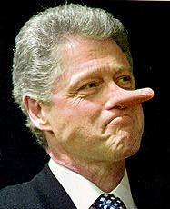
He lied.

Slide 40
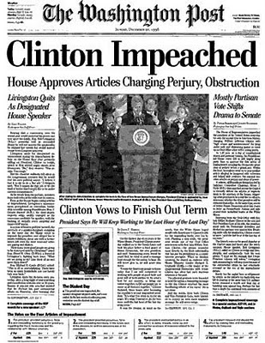
Congress was still controlled by the Republicans and they wanted Clinton’s head. Thus, in December 1998 they voted to impeach him on two charges:
- perjury
- obstruction of justice

Slide 41
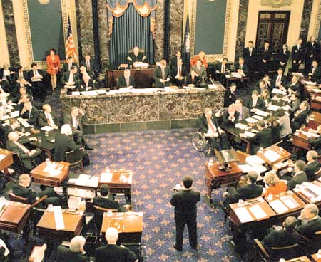
After a televised trial in the Senate, Clinton was found not guilty of both charges.

Slide 42
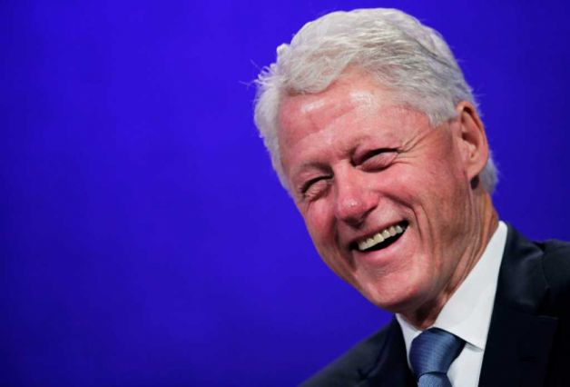
Time and again, Clinton was saved by the economy. As the nation stood on the threshold of the new millennium, things seemed to be going well for most Americans.

Slide 43
Fin.

