Slide 1
The
Great
Recession
2007-2010

Slide 2
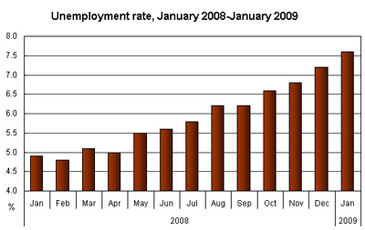
In December of 2007, approximately 7.5 million Americans were unemployed.
In December 2010, that number stood at 14.9 million.

Slide 3
Between 2003 and 2008, a total of 11 banks failed and were taken over by the FDIC.
In 2008 25 banks failed in that year alone.
In 2009: 140
in 2010: 149

Slide 4
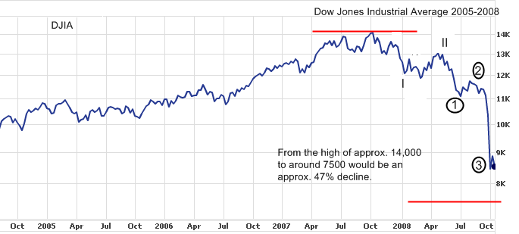
The Dow Jones Industrial Average reached an all time high of 14,078 in October of 2007. By October of 2008 it was at 8,579.

Slide 5
What caused
this economic
downturn?

Slide 6
Problems
in the
Housing
Market

Slide 7
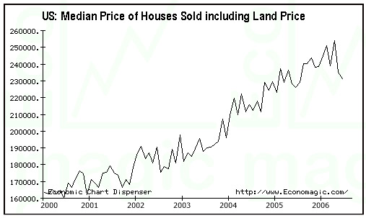
For most of the 2000’s housing prices had been going up.

Slide 8
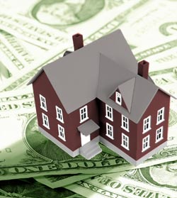
Some saw this as a way to make easy money.
1. They took out a home loan to buy a house to live in.
2. They took out another home loan to buy a house to fix up and sell once the price had risen. (House flipping)
3. Some took out two and three home loans.

Slide 9
Banks and home loan companies were making $, and began to make it easier for people to get a home loan.
1. They loaned to people with less that excellent credit ratings.
2. They structured loans so that interest rates would be low at first, but that would go up, or “balloon” after the first two or three years of the loan.
3. They also lent people more than they could afford to realistically pay back.

Slide 10
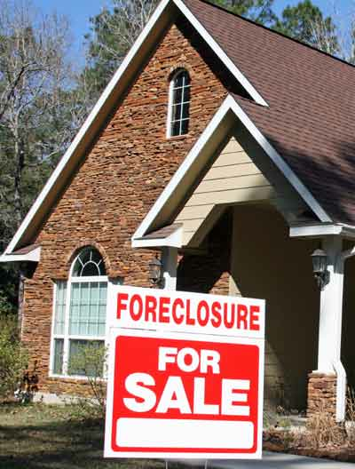
As a result, some people found that they simply could not afford the loan they agreed to or home they had purchased.
As they couldn’t make their loan payments, people began to default on their loans.

Slide 11
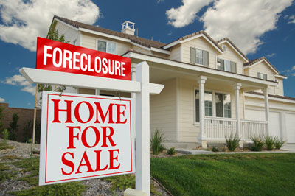
As more and more people lost their homes, the number of available homes on the market went up. What happened to home prices, as a result?

Slide 12
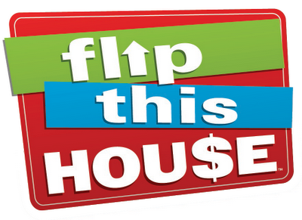
As home prices began to fall, what happened to those people trying to flip two or three homes?

Slide 13
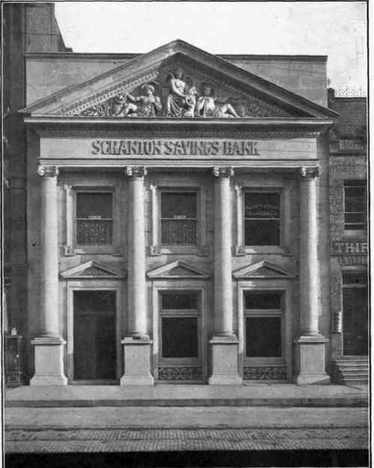
When people began to default on their loans, banks began to lose $.
- Some banks lost so much $ they were forced to close, scaring stable banks even more.
- Worried about further losses, banks cut back on loans of all types, including credit cards.

Slide 14
Drop
in
Consumer
Spending

Slide 15
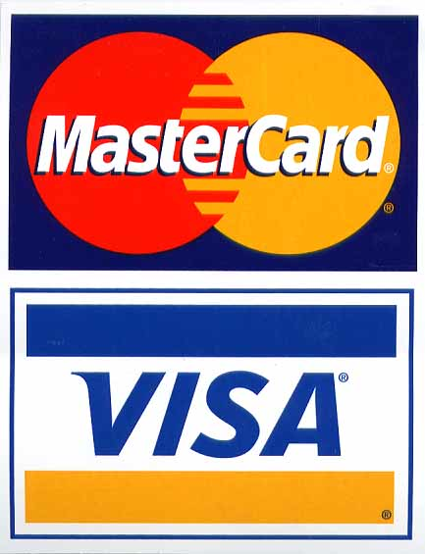
As people began to hear news that some banks were having difficulty, they cut back on spending, and chose to save their $.
Because banks cut back on credit, other people could no longer use credit to continue spending.
As consumers stopped spending, sales for products of all kinds began to fall.

Slide 16
Rise
in
Unemployment

Slide 17
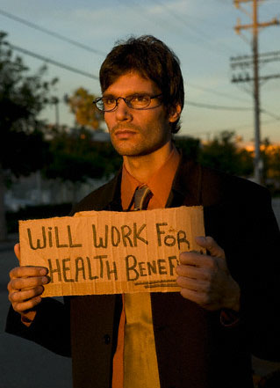
As sales fell, company’s profits also fell.
Companies also found it hard to get loans from banks.
Without $ coming in some companies had no choice but to shut down. (Circuit City)
Others companies fired workers to cut costs.

Slide 18
Government
“solutions”
to the crisis

Slide 19
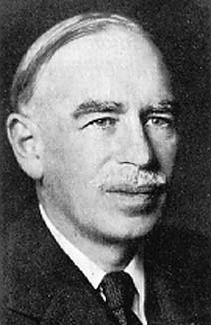
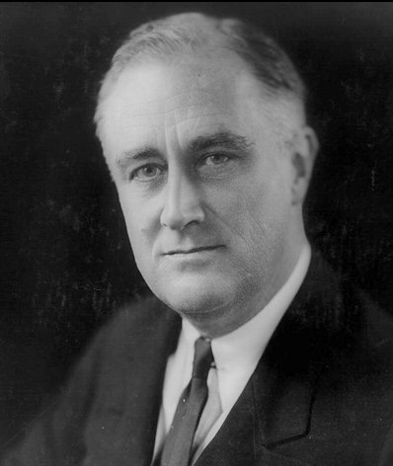
What advice might FDR and John Maynard Keynes give?

Slide 20
As banks cut back on credit, consumer spending fell.
Thus, the government focused its efforts to get credit flowing again and increase consumer spending.

Slide 21
To immediately increase consumer spending, Congress passed, and President Bush signed the Economic Stimulus Act of 2008.
- Under this act, tax payers with an income of less that $75,000 a year, were cut a government check for $300, and an additional $300, check for each child under 17.
- Overall, and individual household received a maximum of $1,200
- What did Congress and President Bush hope people would do with this money?

Slide 22
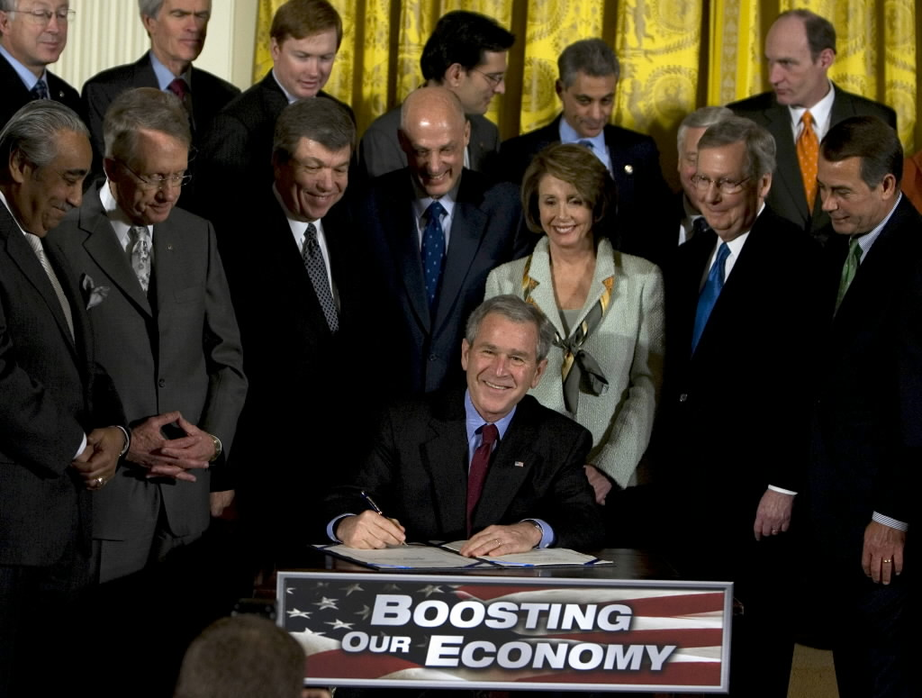
The total cost of the program was $152 Billion

Slide 23
Between 2008 and 2011, over 400 banks closed.
As banks collapsed and closed, the FDIC sprang into action.
In October 2008, the amount insured by the FDIC was raised from $100,000 to $250,000

Slide 24
Total Cost: 45.5 Billion

Slide 25
To help banks feel stable, and to get credit flowing again, Congress passed, and President Bush signed the Troubled Asset Relief Program (TARP).
- The initial plan was for the U.S. government to pay off bad mortgages, giving banks that had made bad home loans money.
- The government then hoped those banks would then use that money to once again extend credit to Americans.
- They didn’t!

Slide 26
As it became clear that huge companies like General Motors were also on the verge of collapse, TARP money was used to keep them afloat. Why?

Slide 27
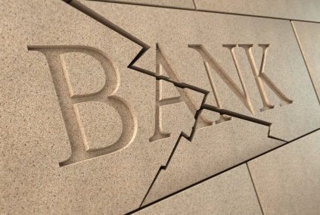
Under the Bush and Obama administrations, the U.S. government pumped over $364 Billion into the TARP program.

Slide 28
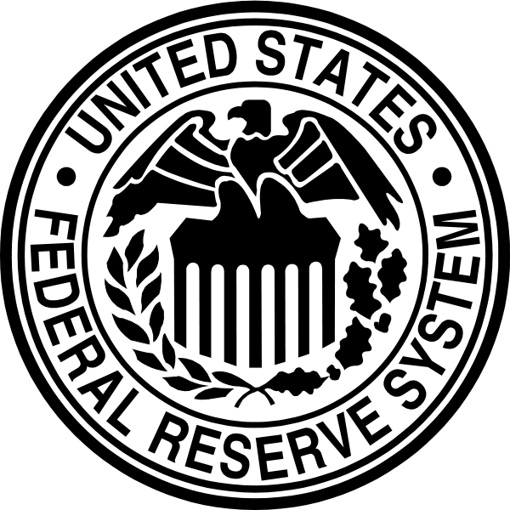
Lastly, to further increase the security of banks and the availability of credit the Federal Reserve, the government agency in charge of regulating US currency, did two things:
1. Paid off even more bad bank loans and investments.
2. Pumped more cash into banks by buying back government bonds from those banks.

Slide 29
The cost of the Federal Reserves’ actions?
$1.8 Trillion
$1,000,000,000,000

Slide 30
The total cost of the government’s overall efforts?
$3 Trillion
$3,000,000,000,000

Slide 31
Just how much is a trillion?
If you counted a million seconds, you’d be counting for 12 days.
If you counted a billion seconds you’d be counting for 31 years.
If you counted a trillion seconds you’d be counting for 31,688 years!

Slide 32
Just how much is a trillion?
Between the year 0 and the year 2014 there have been 734,110 days.
If you had spent $1 Million a day, everyday since the year 0, you would have spent:
a little over $734 billion. You wouldn’t have even spent $1 trillion!!!!!!!

Slide 33
Fin.

