Slide 1
Richard Nixon
and the
War’s End

Slide 2
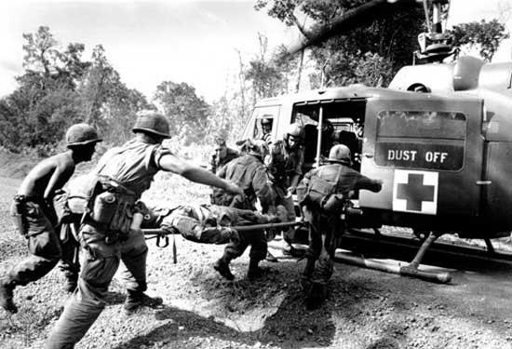
As the war progressed, Lyndon Johnson saw his personal popularity plummet.

Slide 3
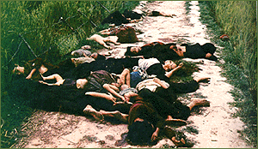
Things didn’t get any better as stories of American atrocities in Vietnam, like the massacre in the village of My Lai in 1968, began to spread. In My Lai, 200-500 peaceful South Vietnamese villagers had been gunned down by U.S. forces.

Slide 4
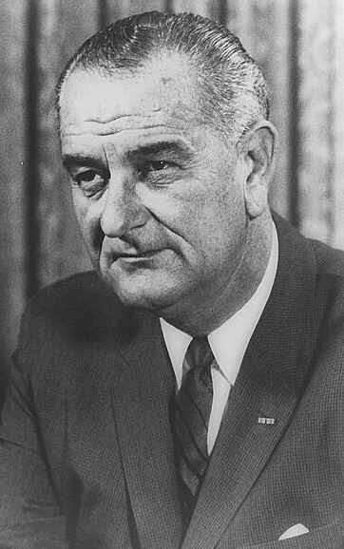
1968 Election
- Due to his growing unpopularity across America, and within his own political party, Johnson decided to not run for re-election.
- The question became “who would represent the Democratic party in 1968?”

Slide 5
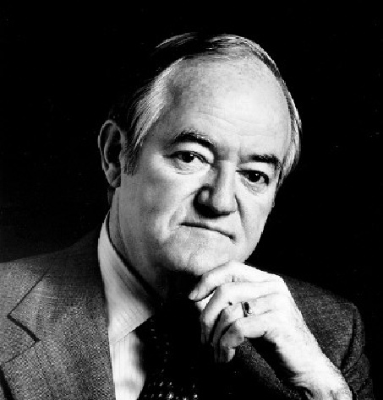
Vice President Hubert Humphrey campaigned as a “hawk” with a pledge to continue the fight in Vietnam.

Slide 6
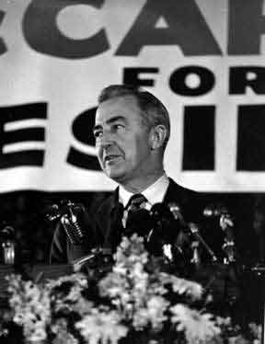
Sen. Eugene McCarthy attempted to capitalize on the growing discontent amongst college aged Americans. He campaigned as a “dove” calling for an end to the war in Vietnam. His chances were hurt, however, when another, more popular Senator entered the campaign.

Slide 7
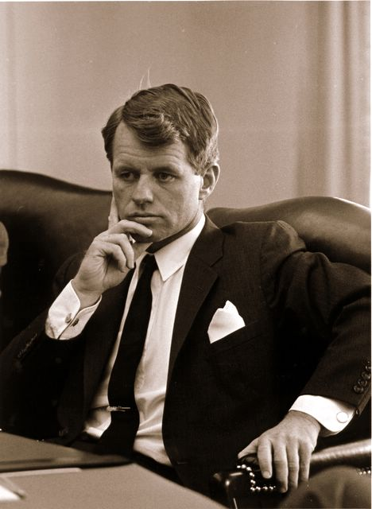
Sen. Robert F. Kennedy, brother of the assassinated President, also campaigned as a “dove” opposed to the war. He emerged as the most serious threat to Humphrey and the war in Vietnam.

Slide 8
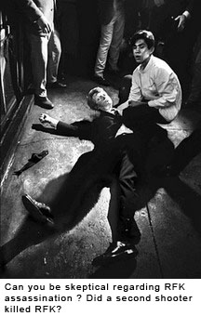
After winning the California primary on June 5, 1968 Kennedy looked like he would win the nomination at least until he was shot dead that evening.

Slide 9
1968 Election
In this election, then the only legitimate voice for peace, Robert Kennedy, had been silenced.

Slide 10
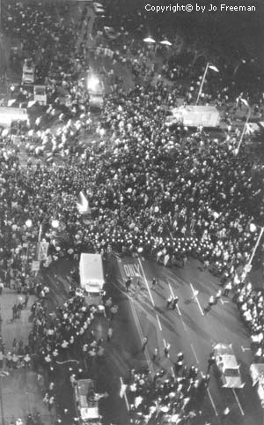
1968 Election
- Democratic National Convention held in Chicago.
- Became a rallying point for anti-war protestors.
- Clashed with Chicago police sent by Chicago mayor Richard J. Daley to “maintain order.”
- The nation was horrified at protestors and police alike.

Slide 11
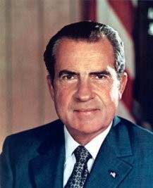
The Republicans nominated Richard Nixon, who also pledged to continue to the war by pressing the North Vietnamese and V.C. to negotiate an “honorable peace.” What does that even mean?

Slide 12
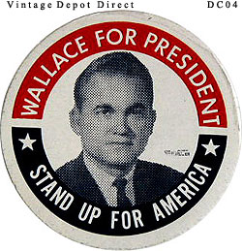
Third party candidate George Wallace, former governor of Alabama ran on a platform of ending civil rights and integration, and supported bombing Vietnam “back to the stone age.”

Slide 13
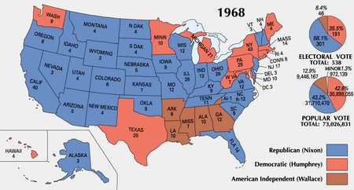

Slide 14
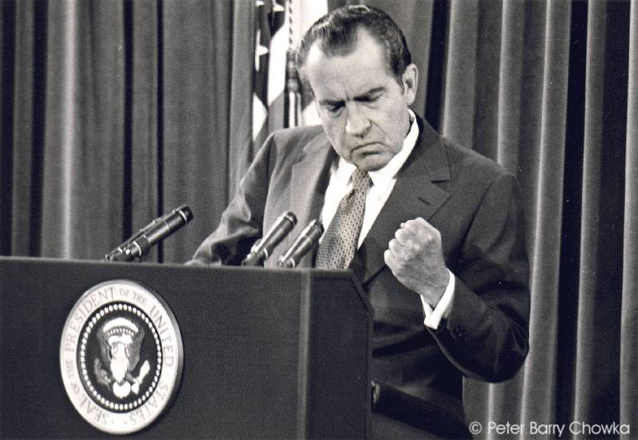
It fell to Nixon, then, to find a way out of Vietnam and to heal the nation that was rapidly falling apart.

Slide 15
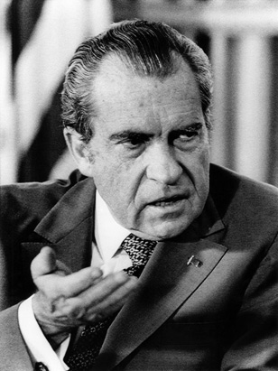
Nixon began the lengthy process of disentangling the U.S. from Vietnam through a policy of “Vietnamization.”

Slide 16
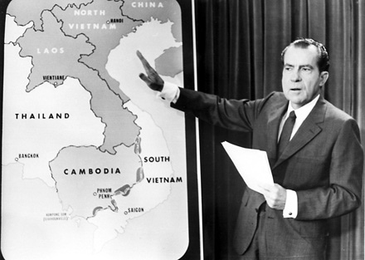
As the U.S. slowly withdrew its forces, the South Vietnamese capitalists would pick up more of the burden of fighting the V.C. and the North Vietnamese.

Slide 17
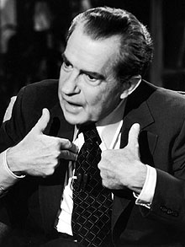
Why not just pull U.S. forces out immediately?
Problems with Vietnamization?

Slide 18
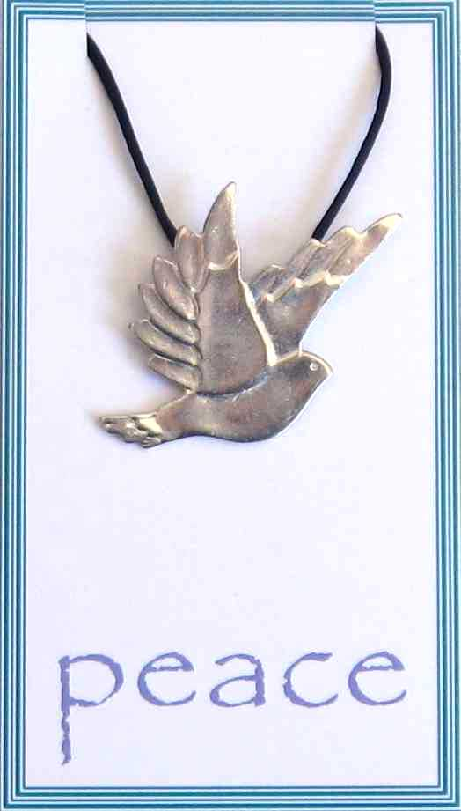
The slow pace of Nixon’s plans was not enough to pacify hard core “doves” who demanded immediate withdrawal from Vietnam.

Slide 19
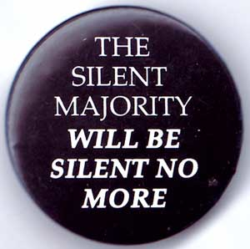
Nixon called upon the “silent majority” of voters, who he assumed had yet to proclaim their support for U.S actions in Vietnam, to speak out and show anti-war protestors that they were a small minority of the population.

Slide 20
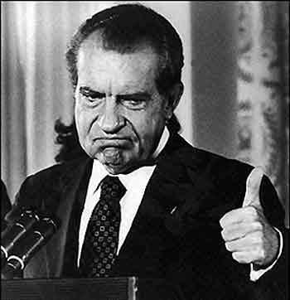
Hoping for a quick end to the fighting, Nixon authorized U.S. forces to invade neutral Cambodia to wipe out VC training facilities and elements of the Ho Chi Minh Trail located in that nation.

Slide 21
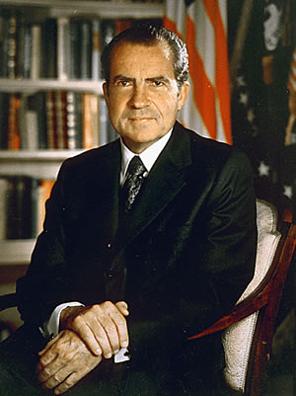
He justified this action by pointing to the blank check powers given to LBJ through the Gulf of Tonkin resolution. Nixon argued that the resolution didn’t apply only to Johnson, but instead applied to the office of the Commander in Chief.

Slide 22
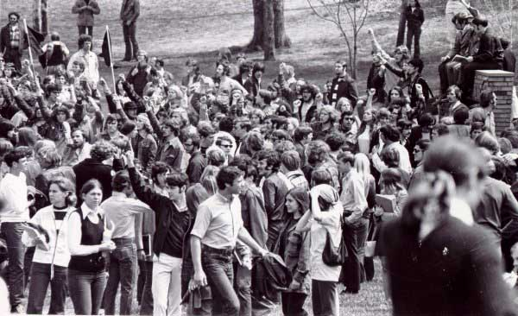
Groups across the country, most notably at Kent State University in Ohio, rose in protest. Students at Kent State, and at Jackson State College in Mississippi, clashed with authorities.

Slide 23
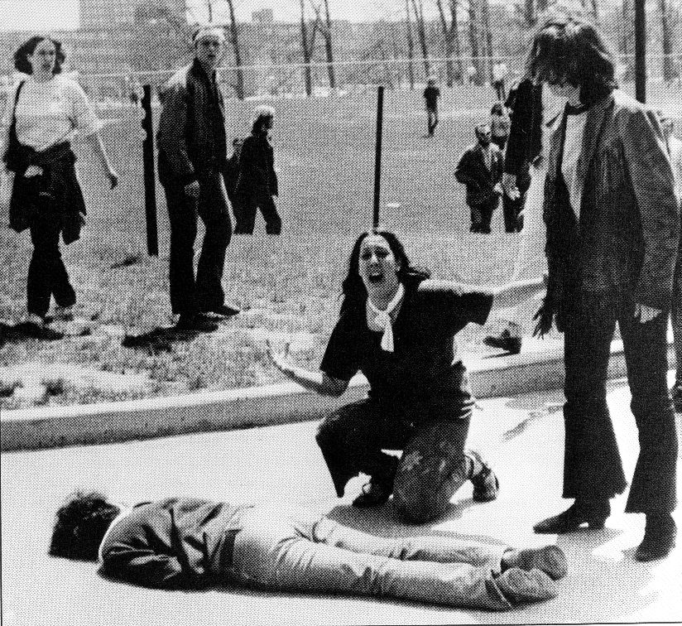
When all was said and done, 6 students were dead, 33 more had been wounded.

Slide 24
What was the impact of the Kent State “massacre”?

Slide 25
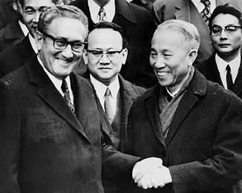
Sec. of State Henry Kissinger attempted to work out a peace settlement acceptable to both sides. However, the North Vietnamese government largely refused to negotiate. Why?

Slide 26
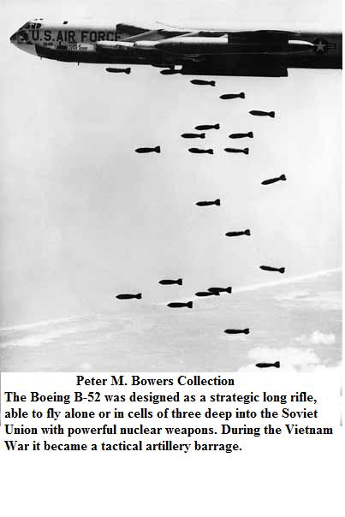
Nixon responded by ordering even more intense bombing of locations in North Vietnam. It worked, and the North Vietnamese government returned to the negotiating table.

Slide 27
Cease Fire, 1973
AKA Paris Peace Accords.
The U.S. would withdraw all remaining soldiers from South Vietnam by the end of 1975.
The VC and North Vietnamese would hand over 560 Prisoners of War, including men like John McCain.
The govt. of South Vietnam could still receive financial and material support from the U.S.
North Vietnam could keep over 145,000 soldiers in South Vietnam.

Slide 28
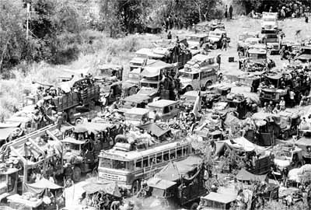
As U.S. forces left, thousands of South Vietnamese also attempted to flee their nation. Eventually the U.S. opened its doors and accepted over 500,000 South Vietnamese immigrants.

Slide 29
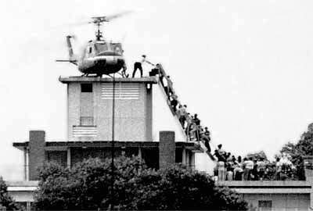
The last U.S. forces were removed from Saigon, the southern capital, on April 29, 1975.

Slide 30
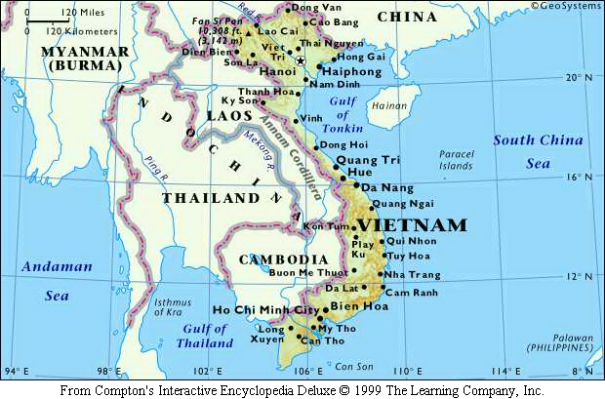
By the end of the year, the North Vietnamese army had completed the task of defeating the South Vietnamese capitalists. Vietnam was reunited as a communist nation.

Slide 31
The Cost
3,000,000 Vietnamese killed
58,000 Americans killed; 300,000 wounded. Many veterans had a very hard time when they returned home.
$150,000,000,000 in U.S. spending
Destroyed U.S. morale, self-confidence, and Americans’ trust of government

Slide 32
Fin.

