Slide 1
The
Movement
Gains
Ground

Slide 2
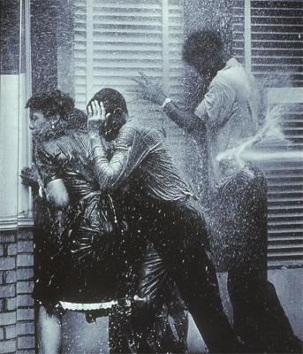
As Martin Luther King and the SCLC waged what they intended to be a relatively peaceful demonstration in Birmingham, AL in April 1963, the push for civil equality took a violent turn.

Slide 3
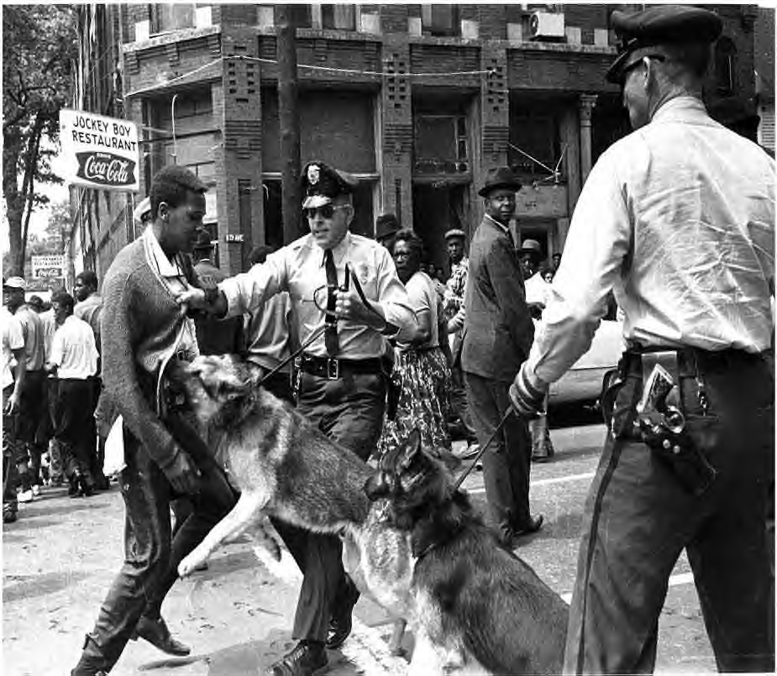
Why were scenes like this fundamentally important to the struggle to end de jure segregation?

Slide 4
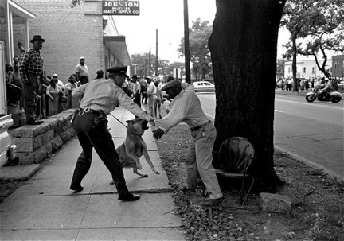
Many people across America, both white and black, were shocked, outraged, and embarrassed about what had gone down.

Slide 5
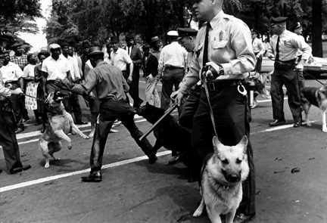
Even though the demonstrations didn’t achieve a whole lot of change in Birmingham itself, the protest had been incredibly successful in bringing nationwide attention to the struggle for equality.

Slide 6
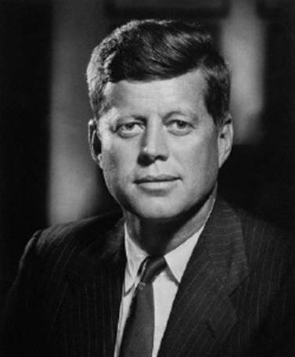
Perhaps most importantly, the events in Birmingham forced President John F. Kennedy to get involved.

Slide 7
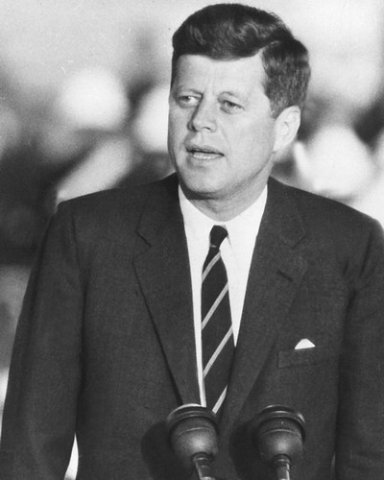
Kennedy labeled the struggle for civil rights a “moral issue” and committed the government to securing sweeping changes in civil rights policy.

Slide 8
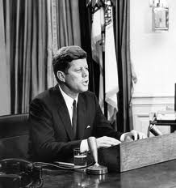
The President called on Congress to pass laws enforcing the 14th and 15th Amendments and to continue to force the states of the South to abide by the Supreme Court’s various rulings on integration.

Slide 9
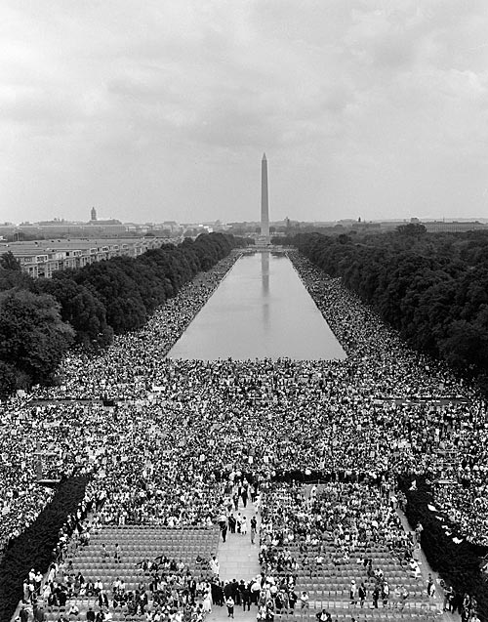
As public opinion began to swing in favor of supporting civil rights, MLK and others organized a massive rally in the nation’s capital.

Slide 10
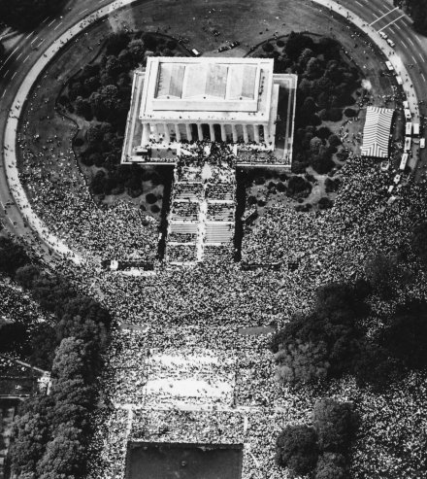
On August 28, 1963, Martin Luther King Jr. was joined by over 250,000 white and black Americans who rallied in Washington D.C. demanding equality.

Slide 11
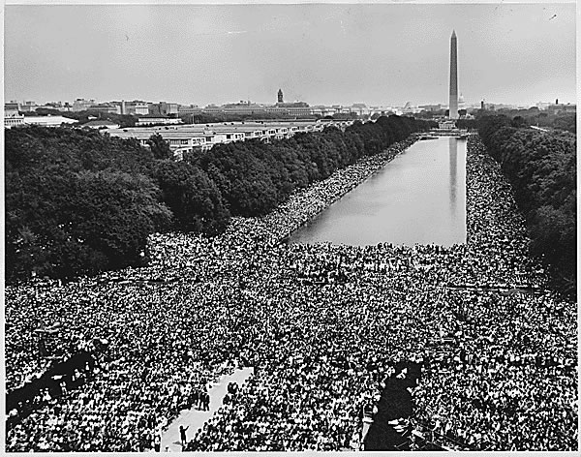
There are two important elements of the March on Washington that you need to be aware of.

Slide 12
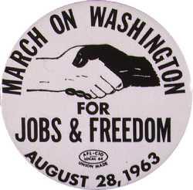
Over 75,000 white Americans attended the rally showing their support for African-American civil rights and equality.

Slide 13
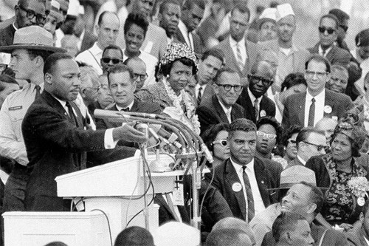
Martin Luther King gave his famous “I have a dream” speech.

Slide 14
The powerful words of Martin Luther King Jr.
“I have a dream that one day this nation will rise up and live out the true meaning of its creed: - 'We hold these truths to be self-evident, that all men are created equal.’”
“I have a dream that one day even the state of Mississippi, a state sweltering with the heat of injustice, sweltering with the heat of oppression, will be transformed into an oasis of freedom and justice.”
“I have a dream that my four little children will one day live in a nation where they will not be judged by the color of their skin but by the content of their character.”
“I have a dream that one day, black men and white men, Jews and Gentiles, Protestants and Catholics - will be able to join hands and sing in the words of the old Negro spiritual: "Free at last! Free at last! Thank God Almighty, we are free at last!"

Slide 15
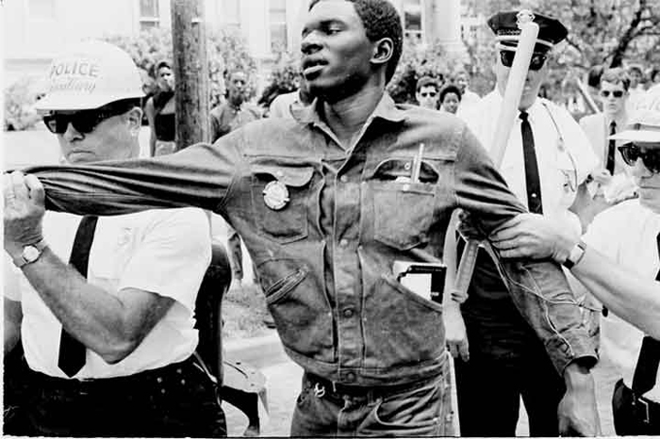
For all that had been achieved, the pace of change was still too slow for some. While President Kennedy was talking about civil rights, elements of the movement wanted to continue using action not just words.

Slide 16
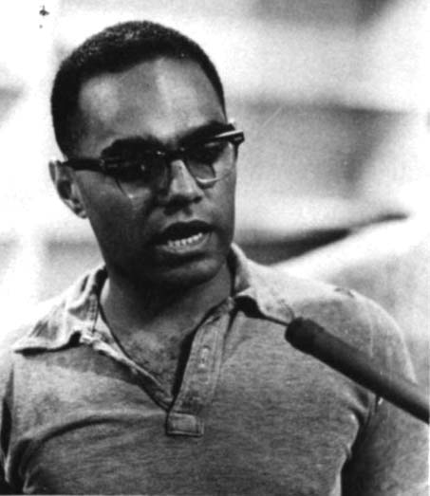
Under the leadership of Bob Moses, SNCC took the campaign to Mississippi in the “Freedom Summer” of 1964.

Slide 17
Fin.

