Slide 1
Mikhail Gorbachev
And the end of
The Cold war

Slide 2
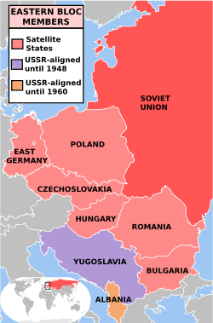
Remember that after WWII the Soviet Union occupied the nations of Eastern Europe forming the Iron Curtain / Communist Bloc.

Slide 3
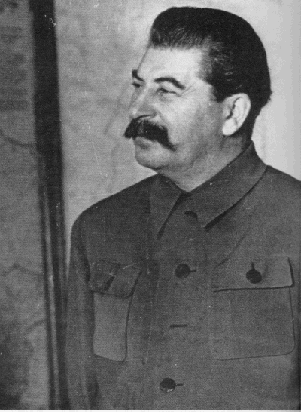
Stalin forced the nations to form their own communist governments which were technically independent of the Soviet Union.

Slide 4
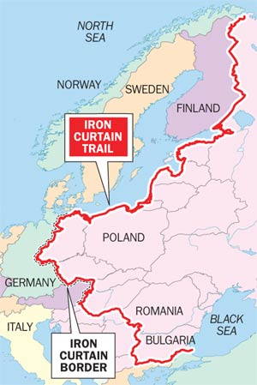
In reality, the communist governments of Eastern Europe were under the thumb of the Soviet government and depended upon the Soviets for their military and their money.

Slide 5
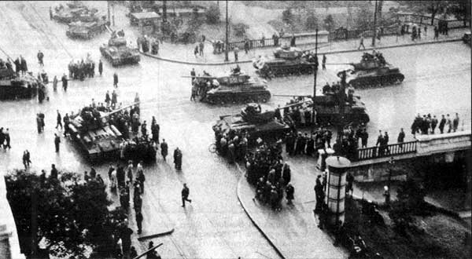
The Soviets were committed to maintaining their dominance. The Soviet Army moved in and crushed popular uprisings against communism and Soviet dominance in Hungary in 1956 and in Czechoslovakia in 1968.

Slide 6
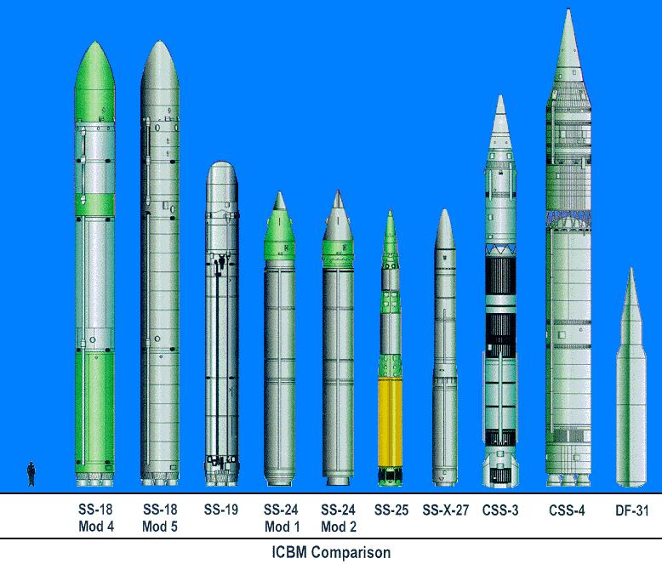
Remember as well, that Ronald Reagan and the U.S. began to rapidly increase America’s military capabilities in an effort to scare, outspend, and eventually bankrupt the Soviet Union.

Slide 7
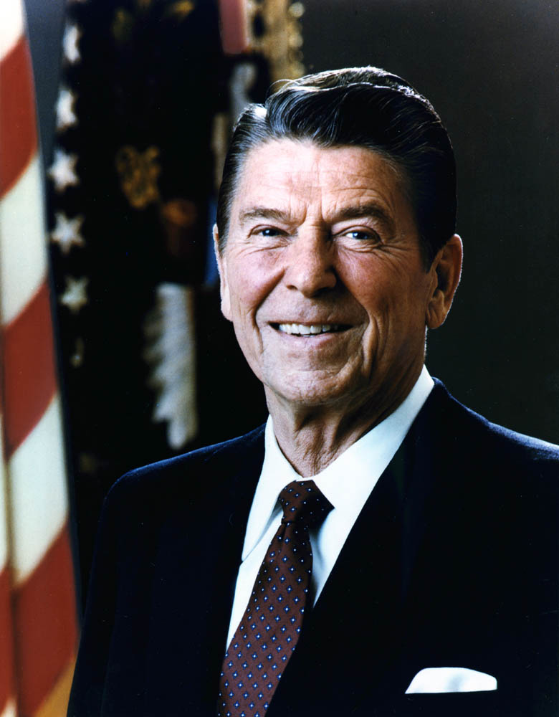
Reagan’s policies could not have come at a worse time for the Soviets.

Slide 8
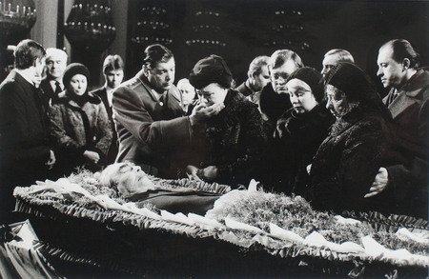
Leonid Brezhnev, the Soviet leader since 1964, died in 1982.

Slide 9
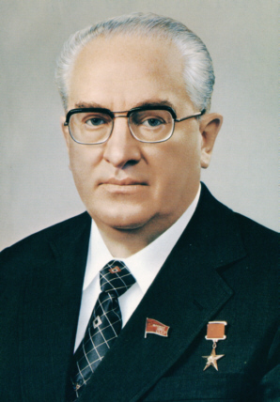
He was replaced by Yuri Andropov.
Andropov died in Feb. 1984 after serving for 15 months.

Slide 10
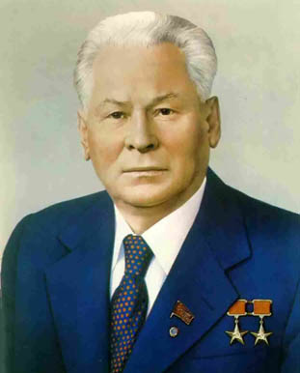
Andropov was replaced by Konstantin Chernenko.
Chernenko was even older and sicker than Andropov had been.
He died in March 1985.

Slide 11
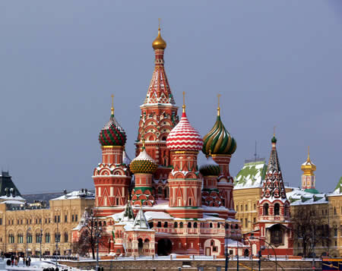
3 different leaders in less than 3 years hurt the Soviet government’s ability to deal with large problems facing the nation.

Slide 12
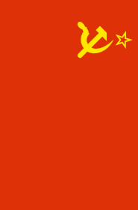
By the late 1970s the Soviet economy was shrinking.
Industrial and farm production, population growth, education, and medical care all fell.
The Soviet Union started importing food.

Slide 13
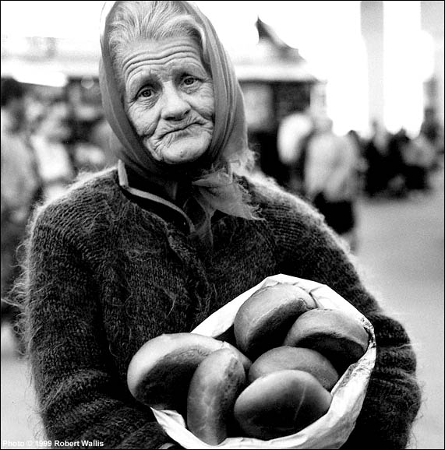
Because the Soviet economy increasingly focused on military production, consumer goods were scarce and thus very expensive.

Slide 14
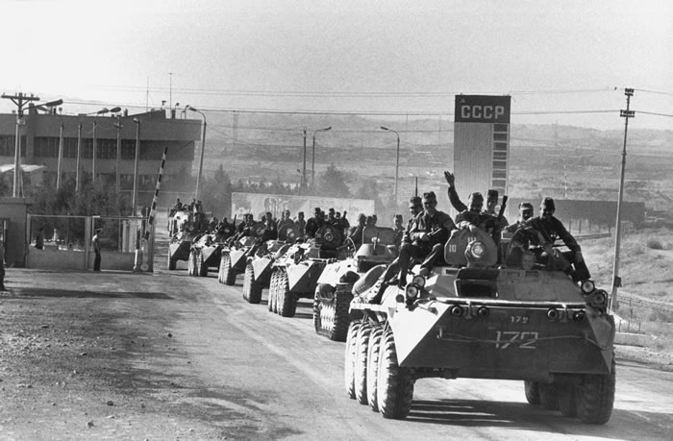
The war in Afghanistan was going terribly costing the Soviets money, lives and morale.

Slide 15
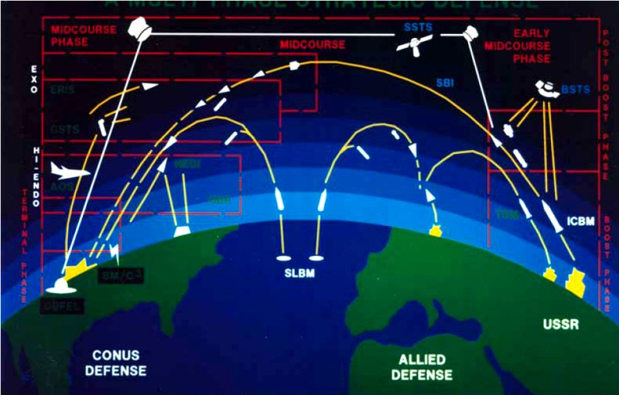
Now, on top of all of that the U.S. was proposing a satellite defense system amongst other things.

Slide 16
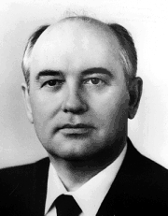
The U.S.S.R needed help. They got it in the form of Mikhail Gorbachev who became the leader of the Soviet Union in March 1985.

Slide 17
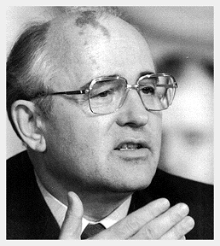
He quickly realized three things had to happen, and happen quickly, if the Soviet Union was going to survive.

Slide 18
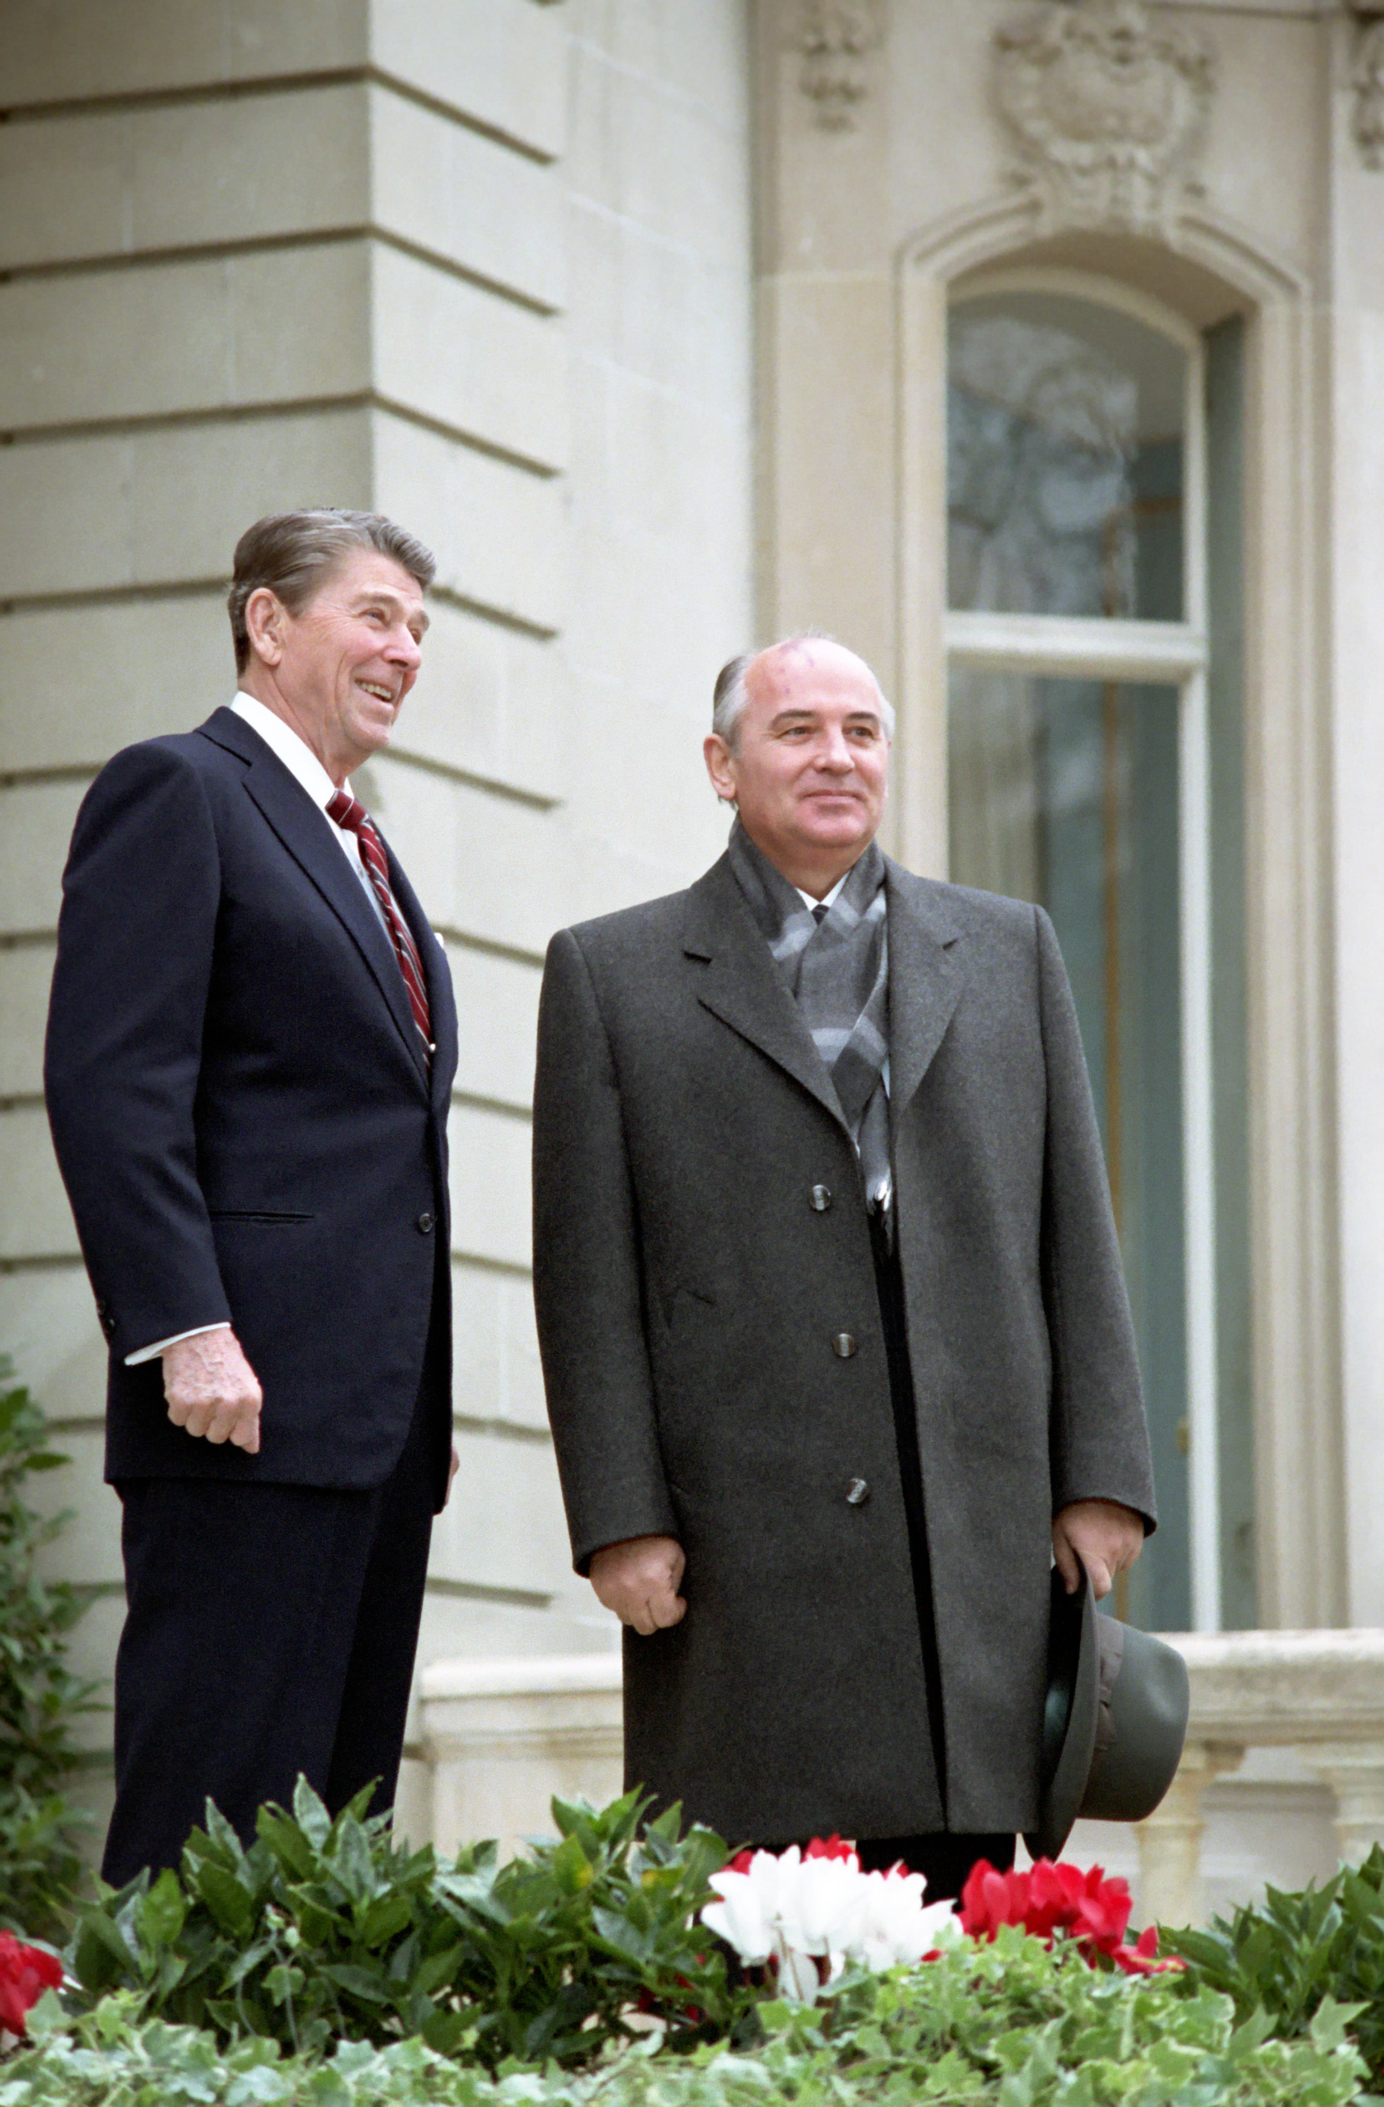
1. The U.S.S.R. had to sign an agreement with the U.S. ending the renewed arms race brought on by President Reagan.

Slide 19
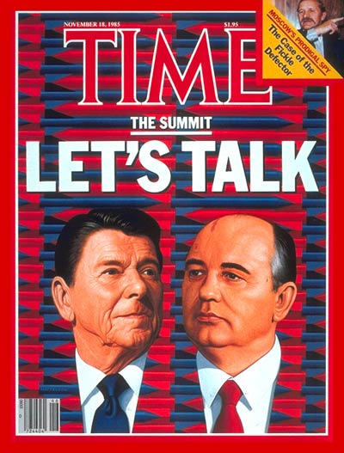
To that end Gorbachev pushed for face to face meetings with Reagan.
The two met four times between 1985 and 1988 and signed a treaty reducing the size of both nation’s nuclear arsenals.

Slide 20
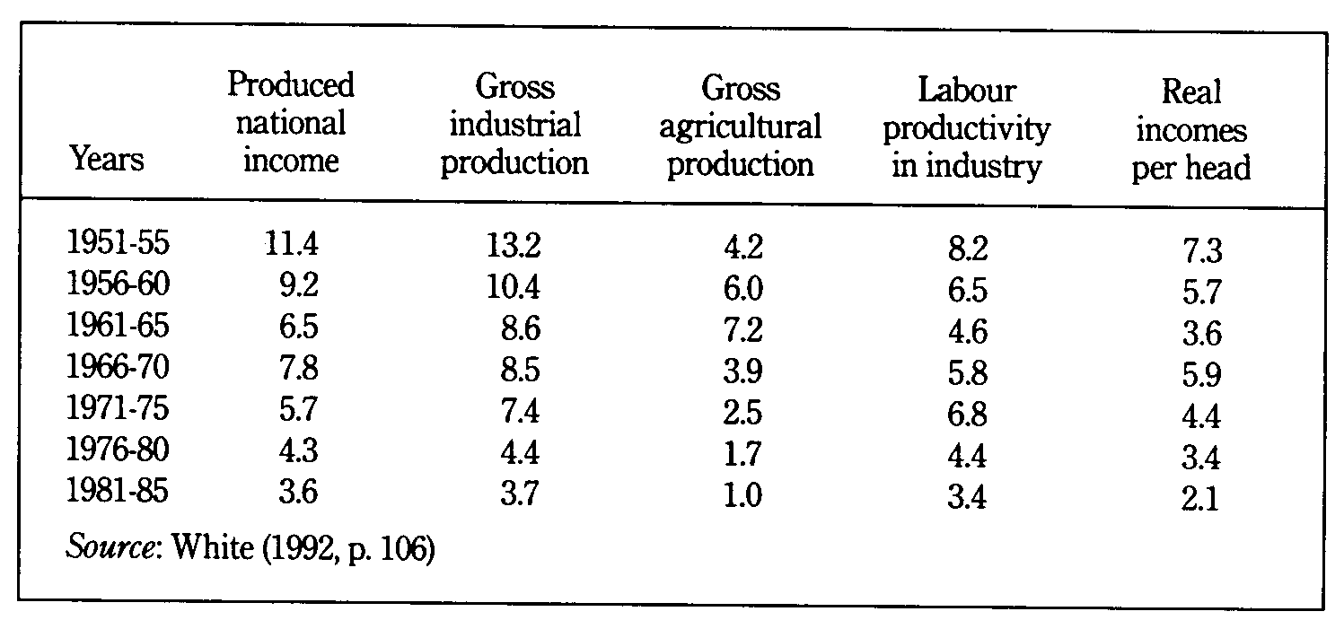
2. Something had to be done about the faltering Soviet economy.

Slide 21
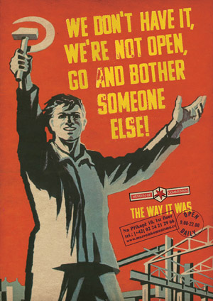
Under communism, the Soviet government controlled all economic activity.
This system was inefficient, full of corruption, and resulted in terrible quality for consumer and military products.

Slide 22
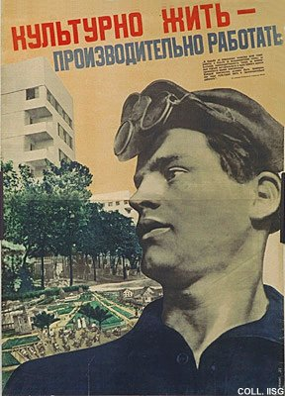
To bring about reform in production and in government control of the economy, Gorbachev adopted a program called “perestroika” or “restructuring.”

Slide 23
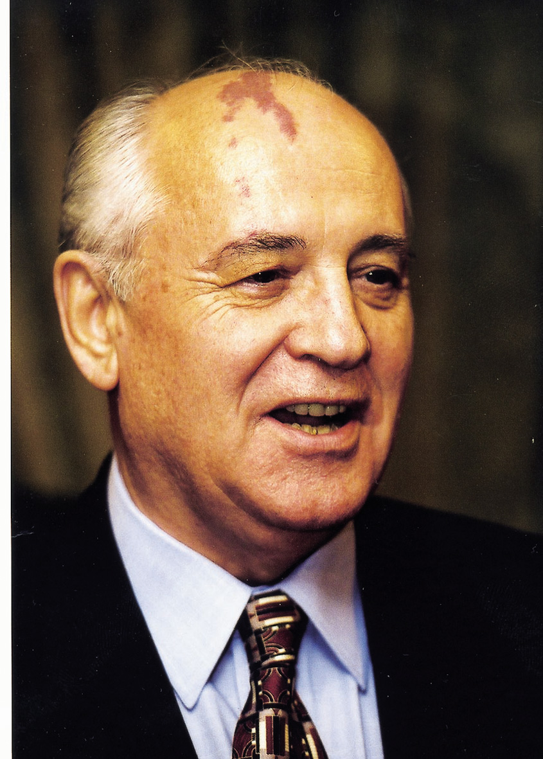
Perestroika
Brought in some capitalist style reform to the economy, allowing factory managers to operate free from government control.
Planned for free, democratic elections in the Soviet Union by 1989.

Slide 24
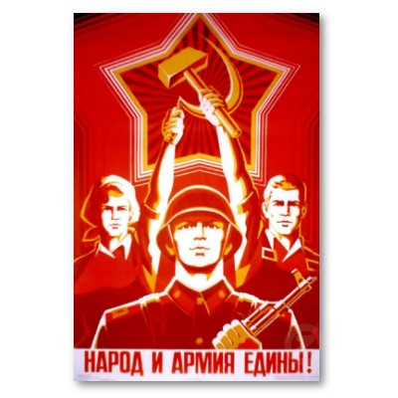
3. The Soviet government had to stop mistreating and silencing its own people.

Slide 25
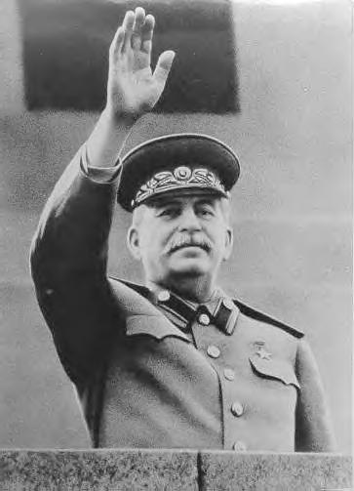
Since the time of Stalin, free speech in the Soviet Union did not, for all intents and purposes, exist.
If you spoke out against the government you would be arrested, thrown in jail, and would most likely end up dead.

Slide 26
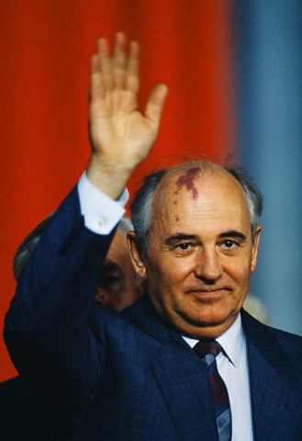
Gorbachev knew this had to stop. As such, he proposed a program of reform known as “glasnost” or “openness.”

Slide 27
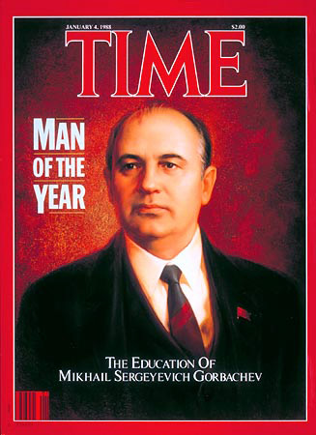
Glasnost
- Lifted media censorship, allowing public criticism of the government. Gorbachev held press interviews.
- Slowly Soviet citizens began to speak out.
- They complained about the price of food, of empty store shelves, and of their sons dying in Afghanistan.

Slide 28
The call for glasnost and perestroika awakened a spirit of nationalism and independence in the nations of the Eastern European Iron Curtain.

Slide 29
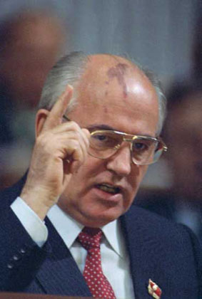
If the economy of the Soviet Union was terrible, the economies of the Communist Bloc nations were even worse.
Gorbachev knew the U.S.S.R. could not support these ailing Eastern European economies.

Slide 30
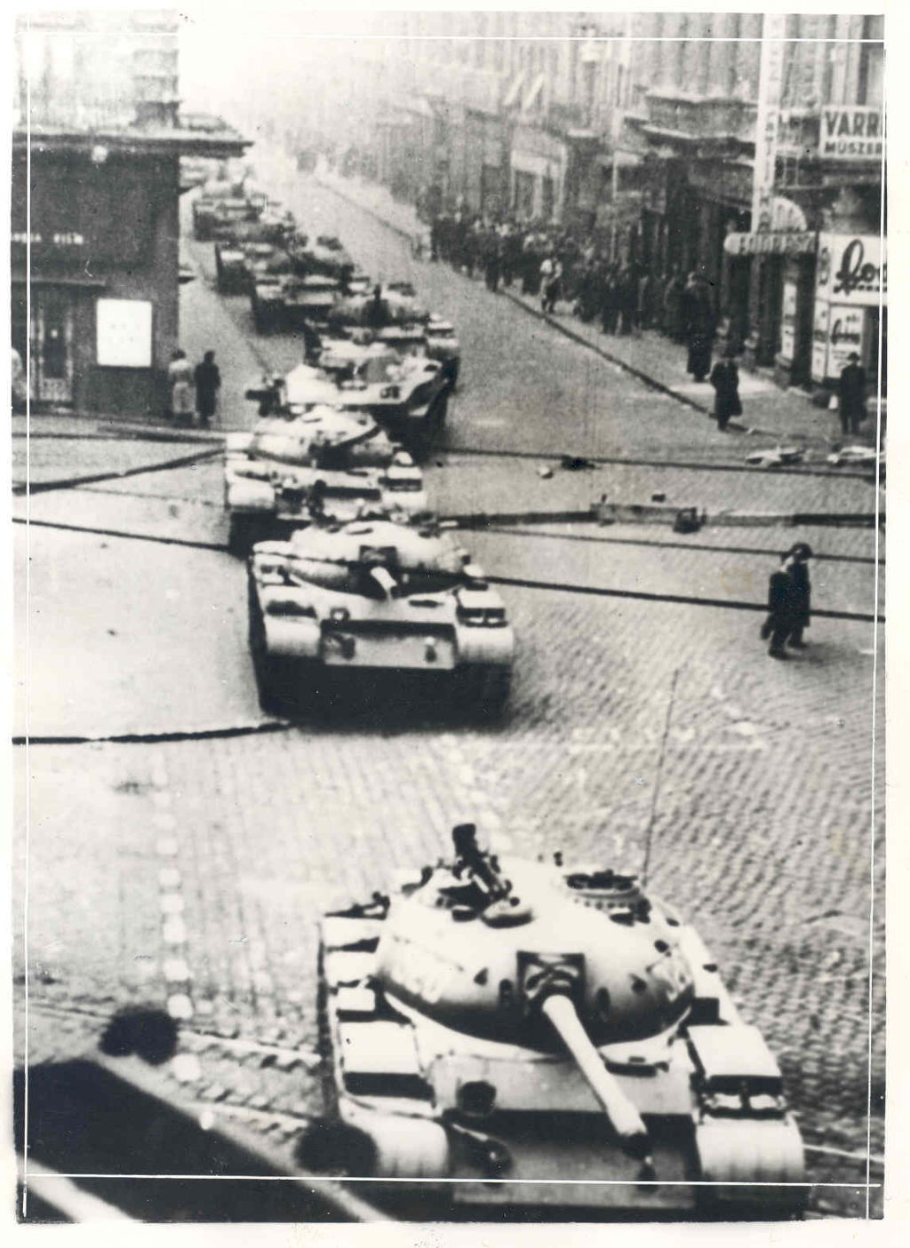
He also knew that if popular unrest turned into popular revolt, the Soviet military would be financially unable to help as they had done in 1956 and 1968.

Slide 31
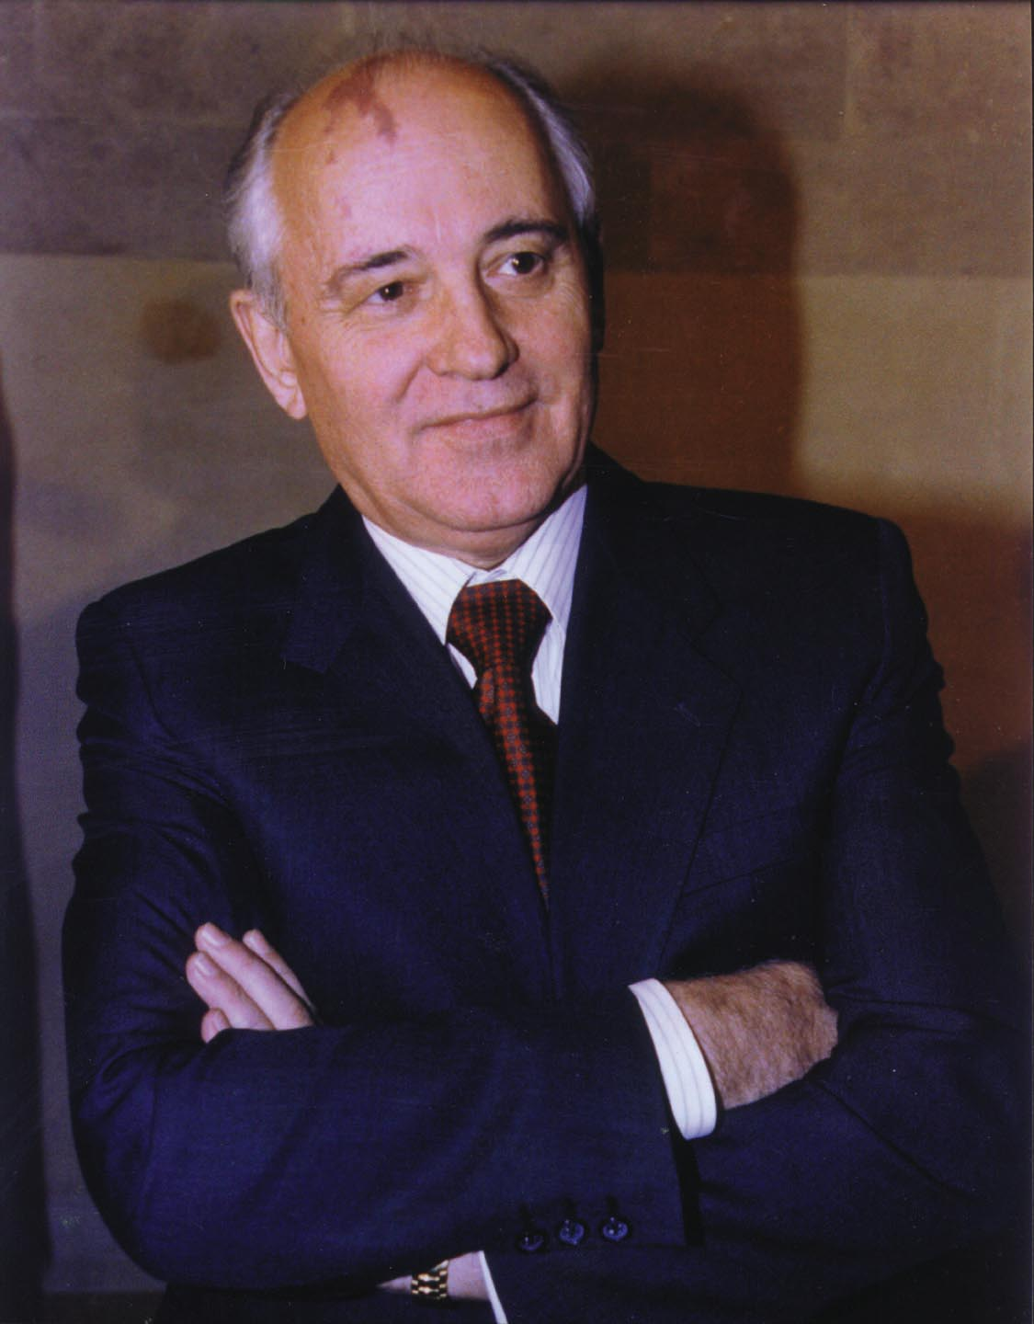
He ordered a large troop pullback from the region and warned leaders to adopt reforms.

Slide 32
Without Soviet support, the communist governments of Eastern Europe collapsed beginning in 1989.

Slide 33
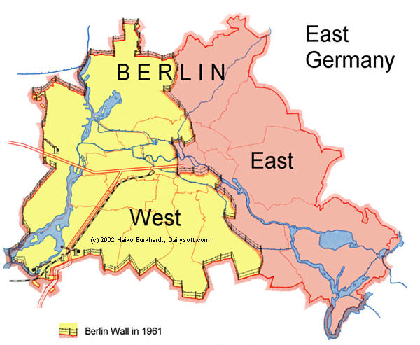
Nowhere was this more important than in Berlin.

Slide 34
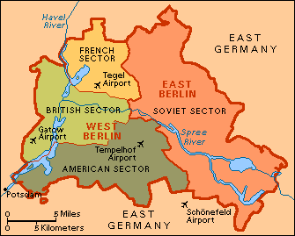
A wall had been built around capitalist West Berlin by the East Germany government in 1961, under Soviet direction, to keep capitalism in and East German communists out.

Slide 35
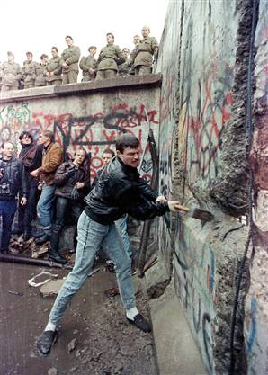
The Berlin Wall remained a repressive symbol of Soviet communism.
To calm rising protests in East Germany, the government opened the gates of the Berlin Wall on November 9, 1989.
Thousands of East Berliners poured into West Berlin.
People pulled down the razor wire and spontaneously began ripping down the wall with axes and sledgehammers and their bare hands.

Slide 36
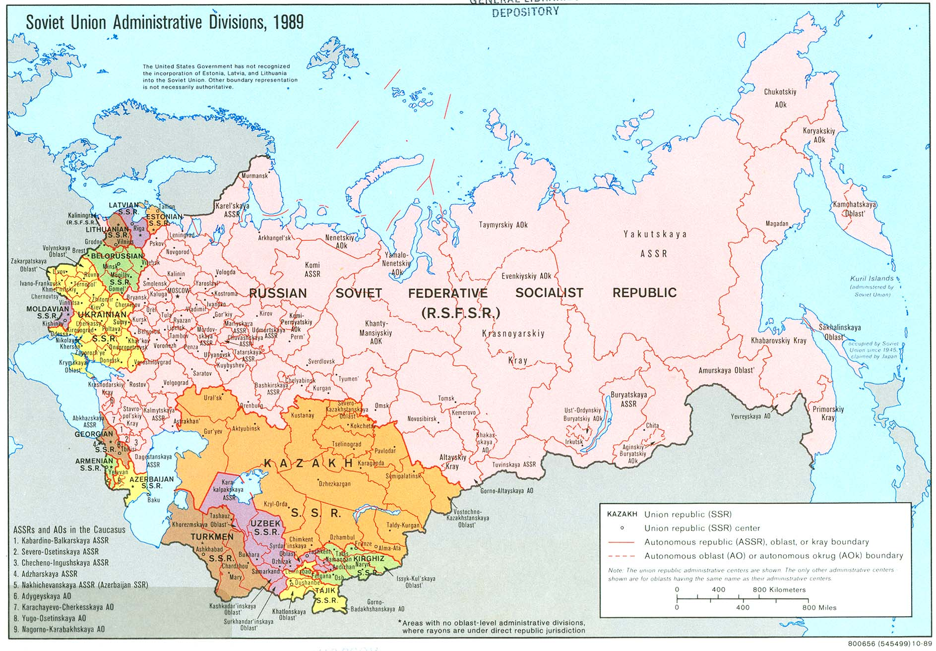
Beginning in 1990, states of the Soviet Union itself began declaring their independence.

Slide 37
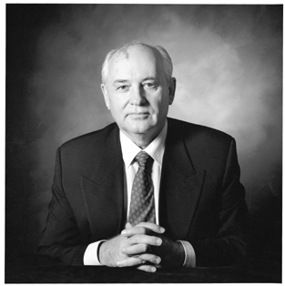
In 1991 Gorbachev resigned as leader of the Soviet Union which essentially ceased to exist as a country.

Slide 38
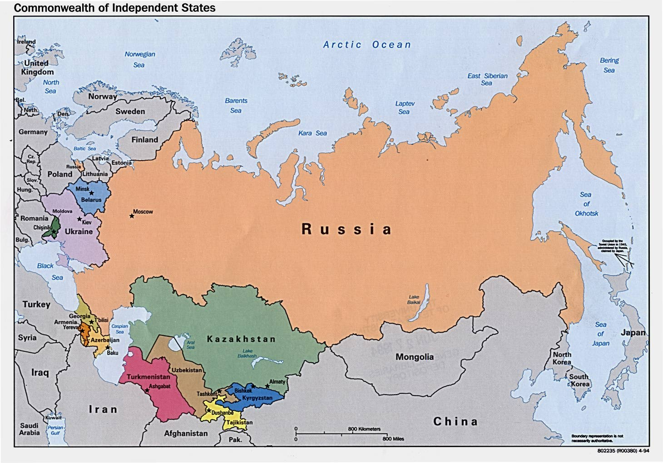
Russia, the largest state of the Soviet Union, inherited power, problems, nuclear weapons, etc. from the U.S.S.R. but would never have as much power or influence.

Slide 39
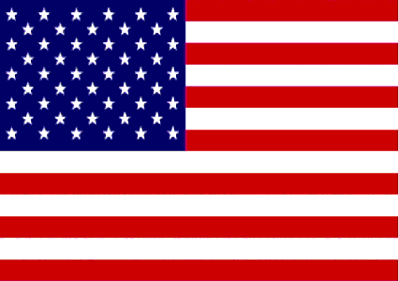
The Cold War was over.

Slide 40
Fin.

