Slide 2
Quiz
Time!

Slide 3
Students for a Democratic Society
- Who was involved?
- What did they say about society?
- What did they want?

Slide 4
The
Draft

Slide 5
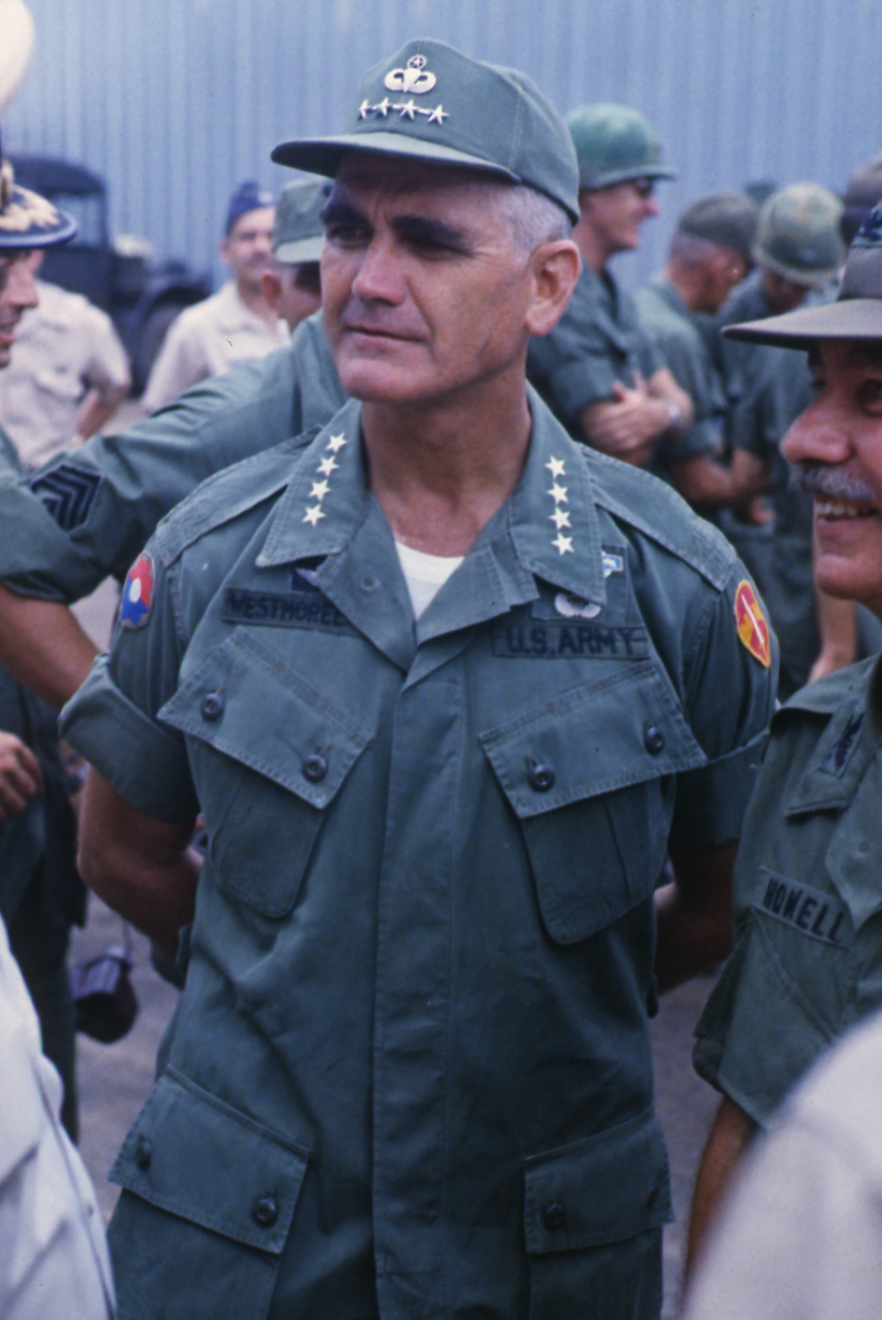
Early in the conflict in Vietnam, Gen. William Westmoreland believed the U.S. needed to radically increase the number of soldiers it had on the ground.

Slide 6
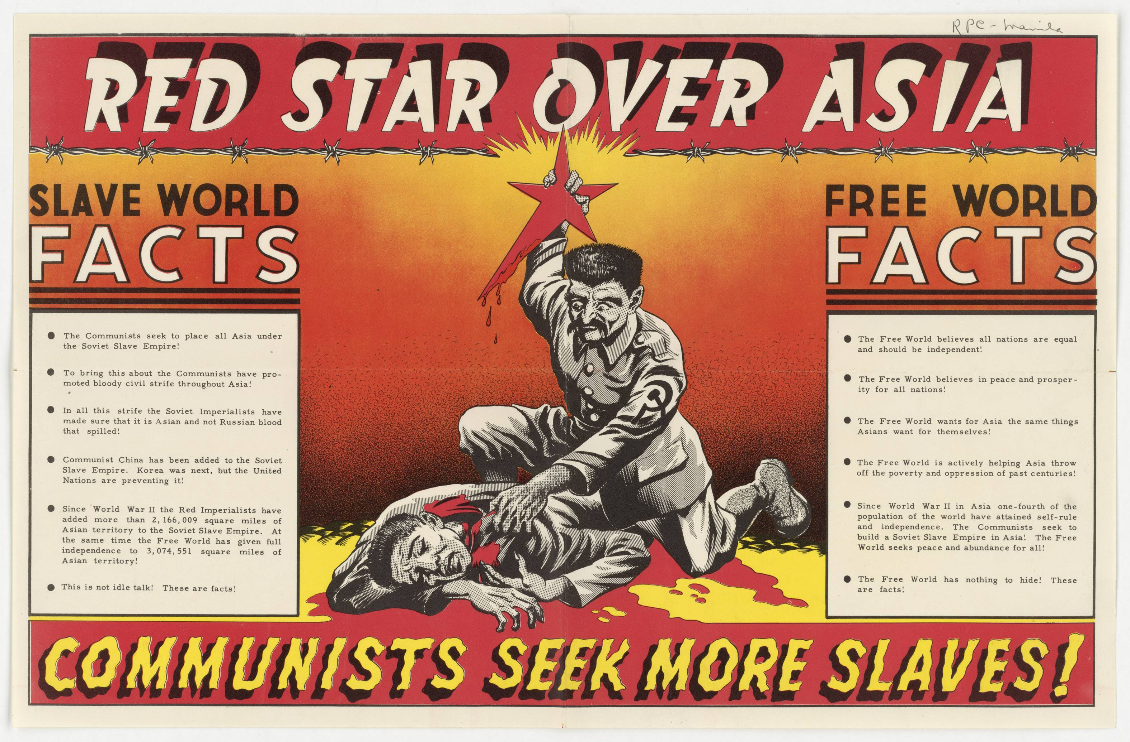
In response, men dedicated to containing communism volunteered for military service.

Slide 7
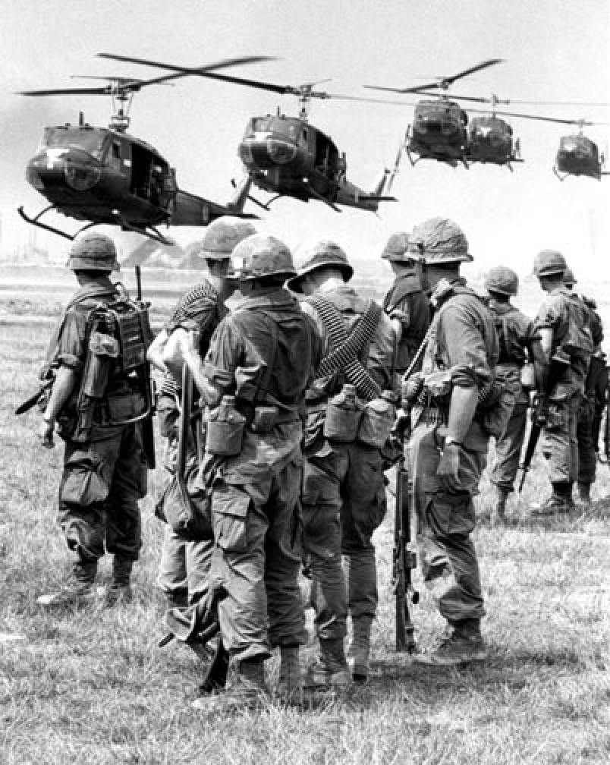
Others joined because they simply saw it as their time to serve.
Their fathers had fought in WWII or Korea. Now it was their turn to go.

Slide 8
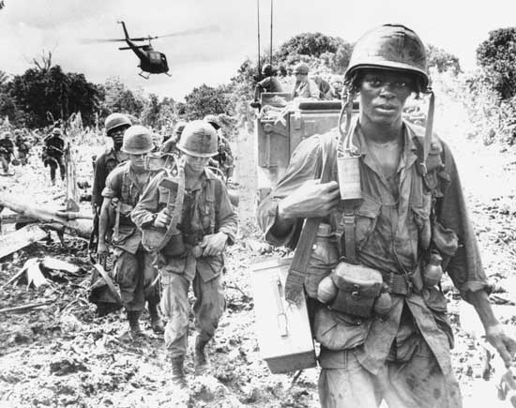
As the war progressed, however, fewer men volunteered. Why?

Slide 9
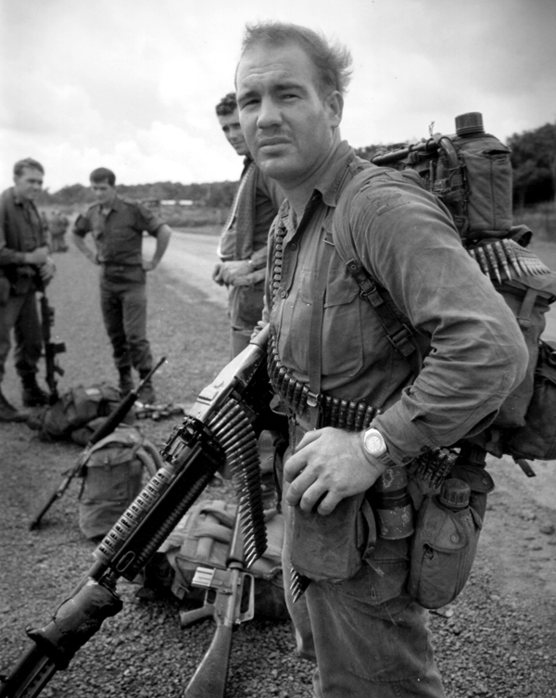
The military still needed men to fight, and perhaps die, in the struggle to stop the spread of communism in South Vietnam.
If not enough men were volunteering to serve, how was Uncle Sam going to get enough troops?

Slide 10
Selective Service Act of 1948
- Required men to register with the government once they turned 18.
- Men 19-26 were eligible to be drafted.
- If selected, a man had to report for either 12 months of active military duty, or 36 months in the reserves.

Slide 11
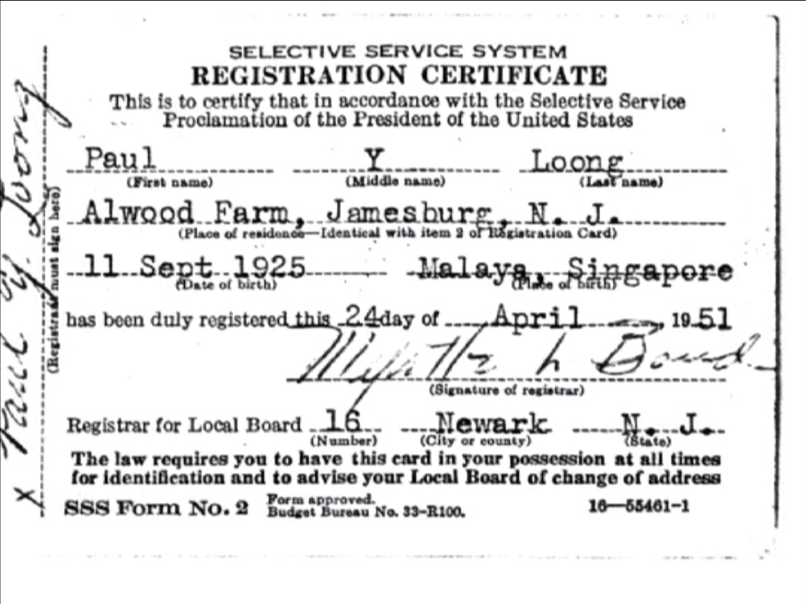
This system was in place for the Korean War and was used initially in Vietnam.

Slide 12
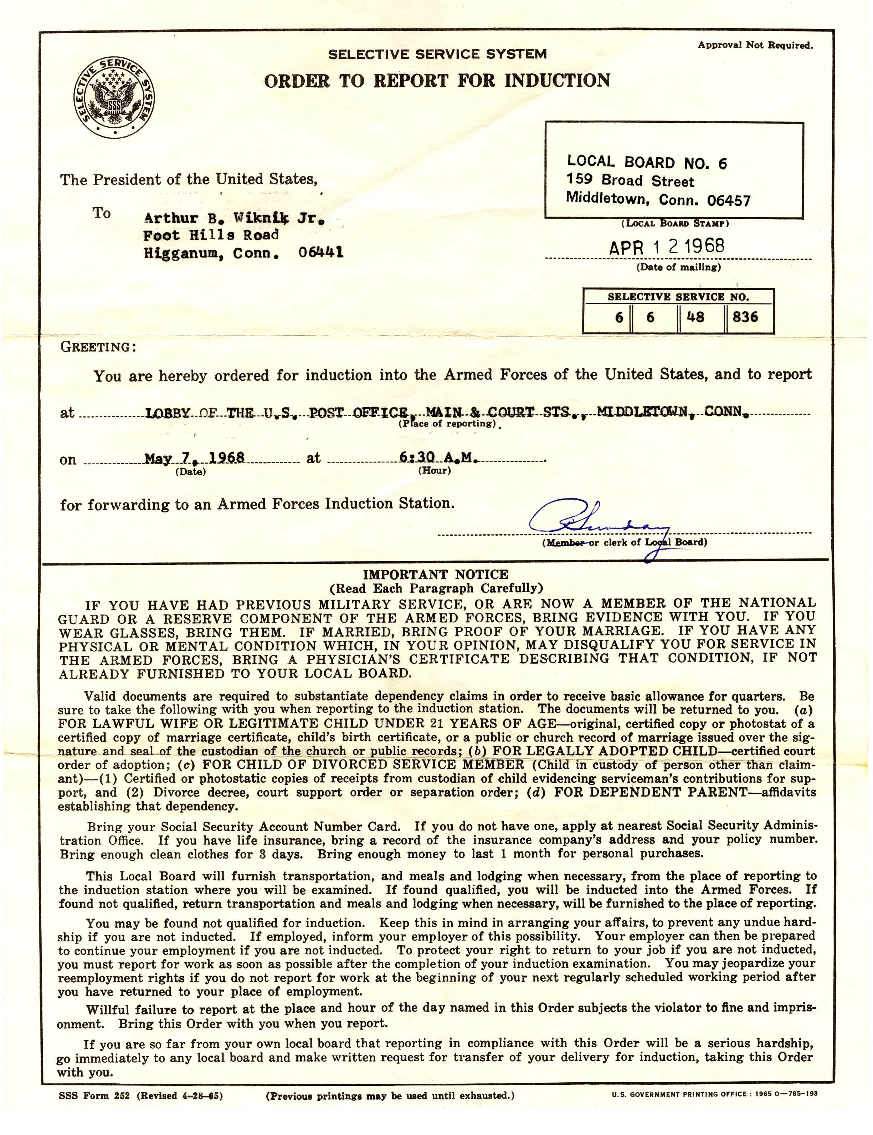
Early on in Vietnam, men aged 18-26 were called to appear before a group know as a “draft board.”

Slide 13
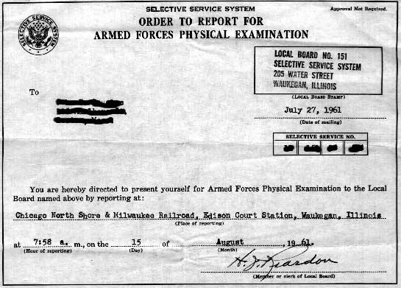
Each town / city in the country had its own local draft board made up of 5 five prominent citizens from the community.

Slide 14
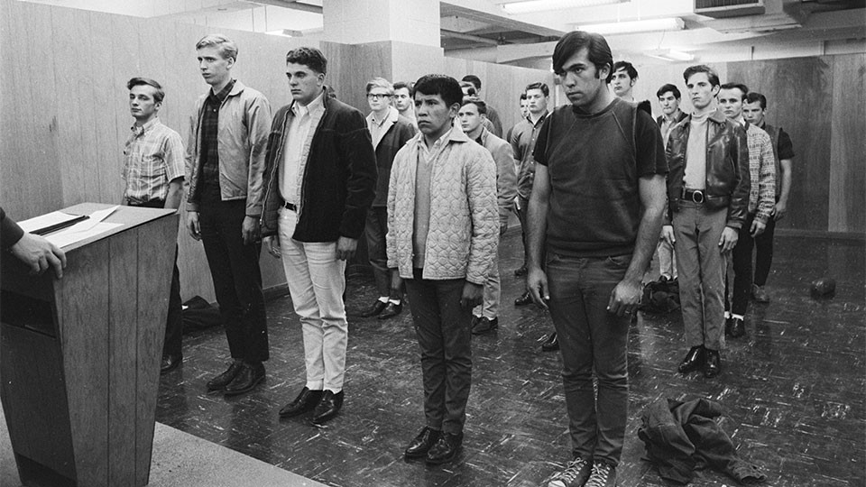
It was up to this board to determine who was to be sent to Vietnam and who got to stay at home.

Slide 15
Draft Boards
A draft board would assign each possible soldier a specific class:
- Class 1-A: Ready for immediate service in Vietnam.
- Class 1-A-O: Conscientious Objector opposed to violence, ready for non-combat service.
- Class 1-S: College student, deferred from service until after graduation.
- Class III-A: Men with dependents (children, elderly parents, etc…) deferred from service due.
- Class IV-F: Men physically, mentally, or morally unfit for military service.

Slide 16
Draft Boards
- Class 1-A: Ready for immediate service in Vietnam.
- Class 1-A-O: Conscientious Objector opposed to violence, ready for non-combat service.
- Class 1-S: College student, deferred from service until after graduation.
- Class III-A: Men with dependents (children, elderly parents, etc…) deferred from service due.
- Class IV-F: Men physically, mentally, or morally unfit for military service.
What potential problems or complaints did Americans have about this system?

Slide 17
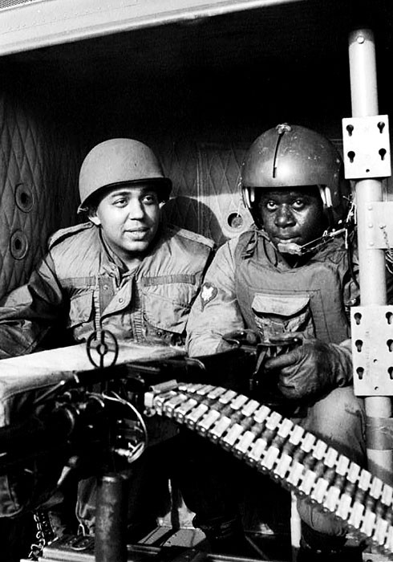
Because of student and other deferments, a disproportionate number of poor and minority Americans were compelled to serve in Vietnam.
- Almost 80% of Americans soldiers came from the poor, working class.
- More than 20% of the combat deaths were African-American, even though African-Americans only comprised 10% of the nation’s population.

Slide 18
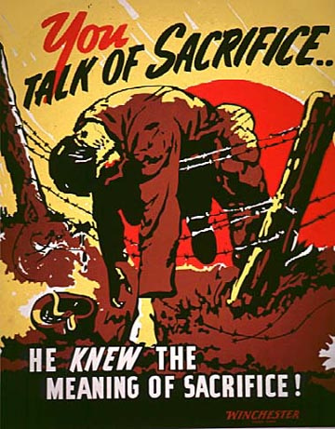
Ultimately, what did the poor, working class in America care about communism, especially thousands of miles away in Southeast Asia?
Who did care about the spread of communism?
“Rich man’s war, poor man’s fight.”

Slide 19
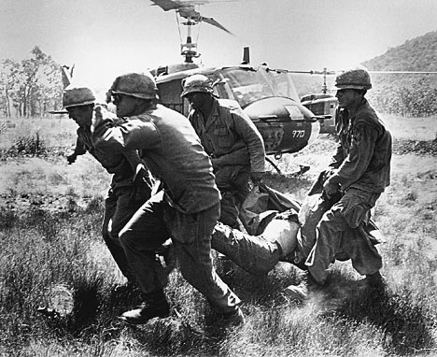
This system was changed over time to try and make it more fair.

Slide 20
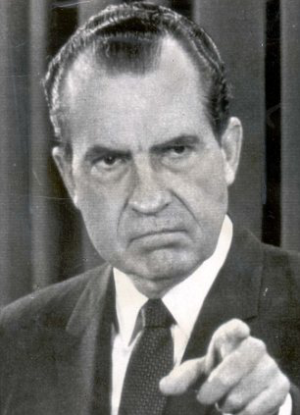
Things changed under President Nixon in 1969.
Working with Congress he modified the law to establish compulsory military service based on a random lottery.

Slide 21
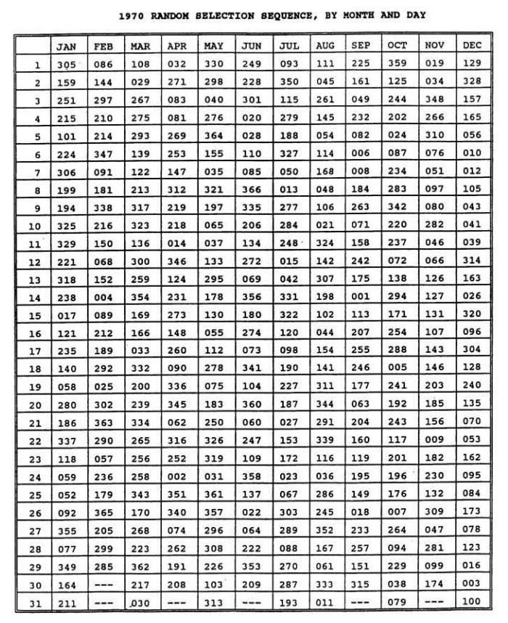
All the days of the year (including Feb 29) were represented by a number 1-366.
All of these numbers were written on pieces of paper that were then put in plastic “balls.”
These balls were then placed in a box and mixed up. After mixing they were dumped into a glass jar.

Slide 22
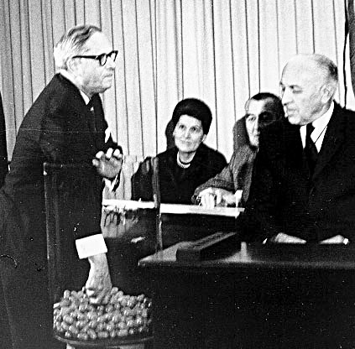
These balls were then drawn from the jar.
The first number drawn was 258 which corresponded to Sept 14.
All men of draft age born on that date were assigned the # 1.
The second number drawn corresponded to April 24, so all of the men of draft age born on that date were assigned the #2.

Slide 23
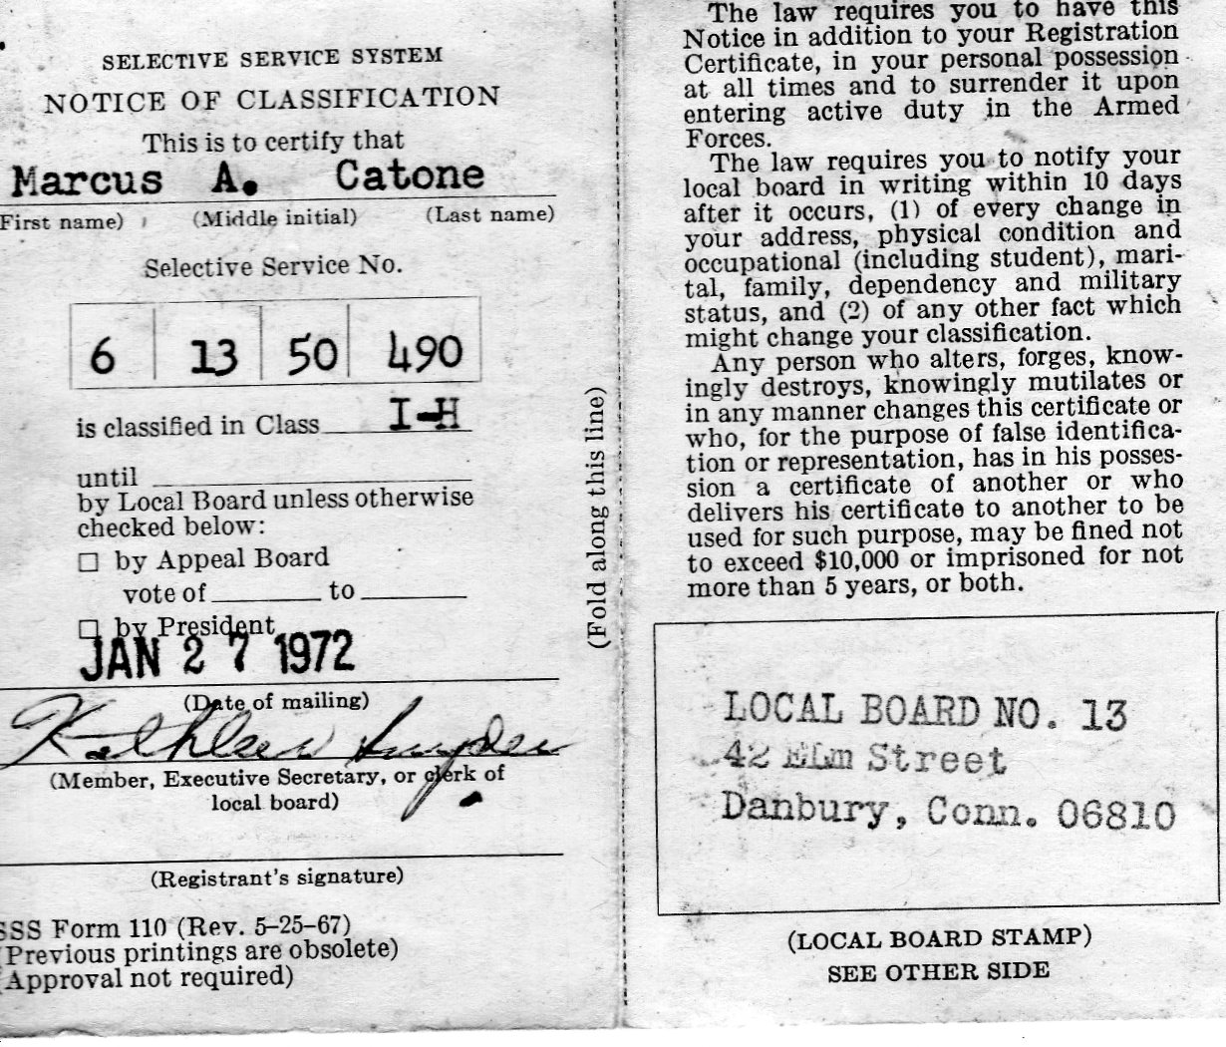
Then, as men were needed, the military went up the list starting with #1, then #2, and so forth. They eventually got to #195.

Slide 24
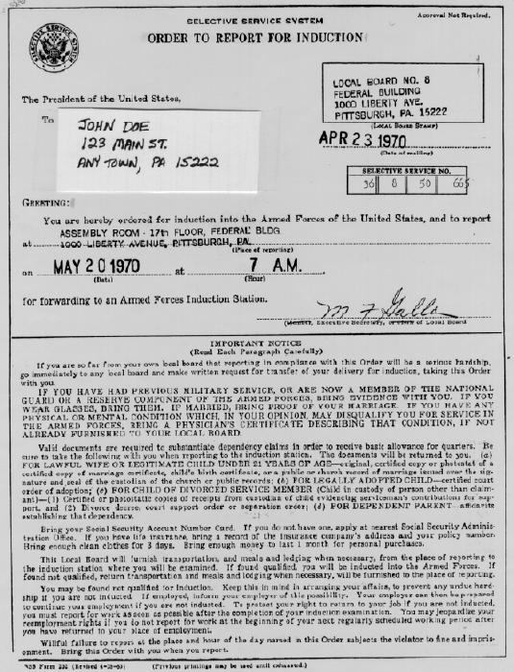
Students could still defer service, but only until they completed a four year degree or turned 24, which ever came first.

Slide 25
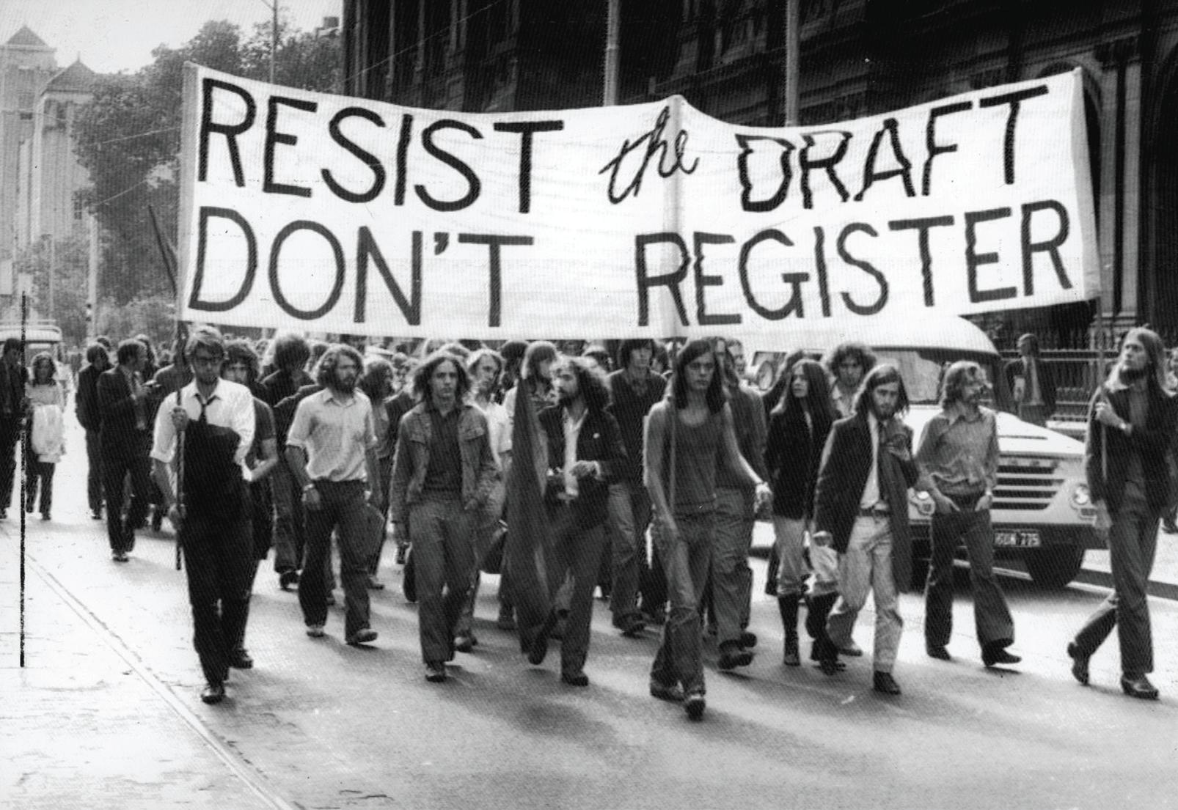
Even though this attempted to make things more fair, people were still forced to fight, and perhaps die in a struggle to contain communism.

Slide 26
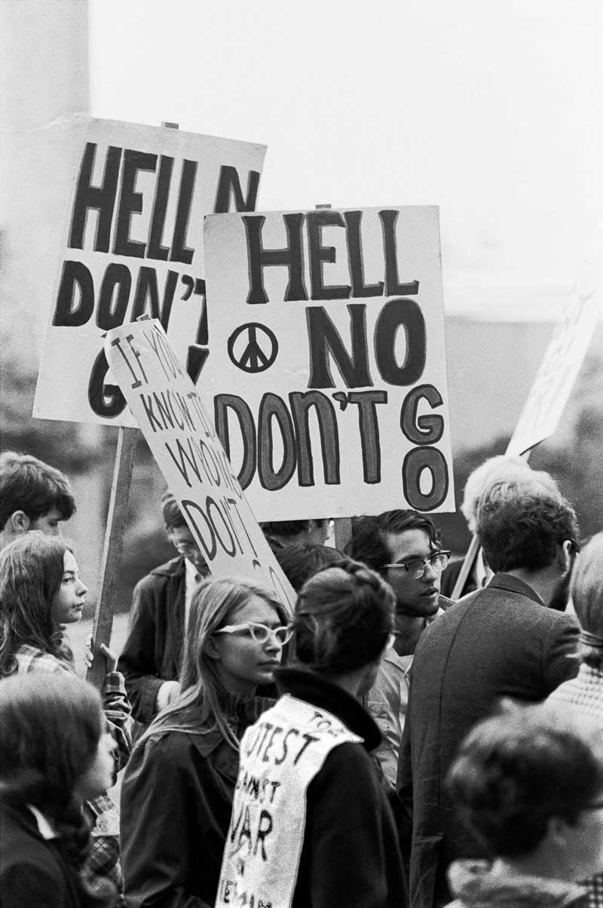
Increasing numbers of drafted men simply refused to serve.
These men usually took one of two different actions.

Slide 27
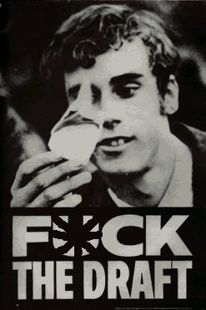
1. They burned their draft card in protest and refused to report for duty.
In doing so, they broke the law and could possibly be arrested and thrown in jail.

Slide 28
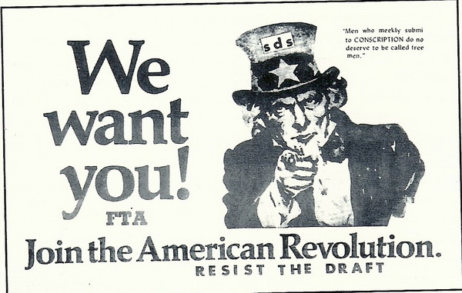
2. They fled the country, usually to Canada. They became known as “draft dodgers.”

Slide 29
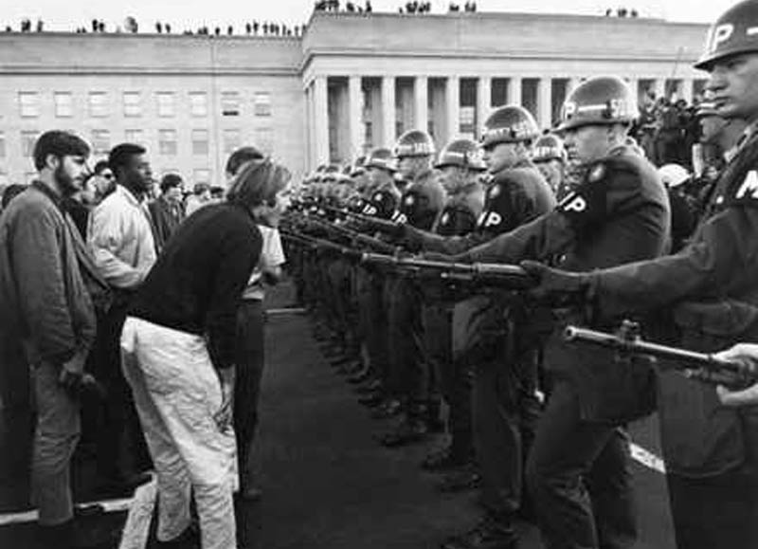
The draft became just one more element of the time period that radically divided the American people.

Slide 30
Fin.

