Slide 1
The
Beat
Movement

Slide 2
The last example of attempts to push against the conformity of 1950’s life emerged from Columbia University in New York City.

Slide 3
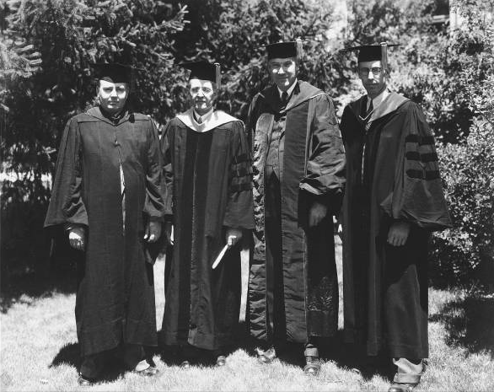
There, students and professors began to contemplate the impact that the pursuit of conformity was having on the lives and minds of Americans.

Slide 4
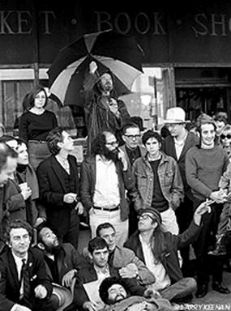
Three influential writers emerged at the forefront of the movement.

Slide 5
Jack Kerouac- On the Road

Slide 6
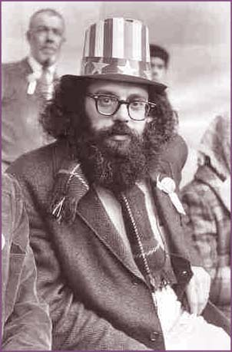
Allen Ginsberg- Howl

Slide 7
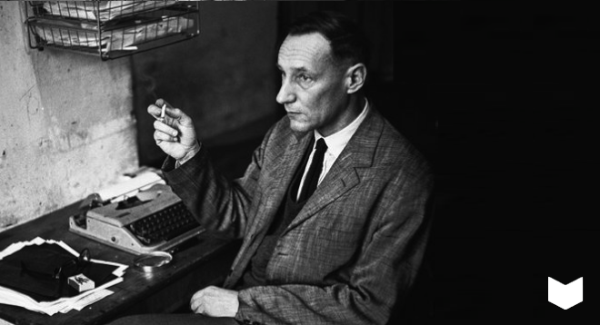
William S. Burroughs- Naked Lunch

Slide 8
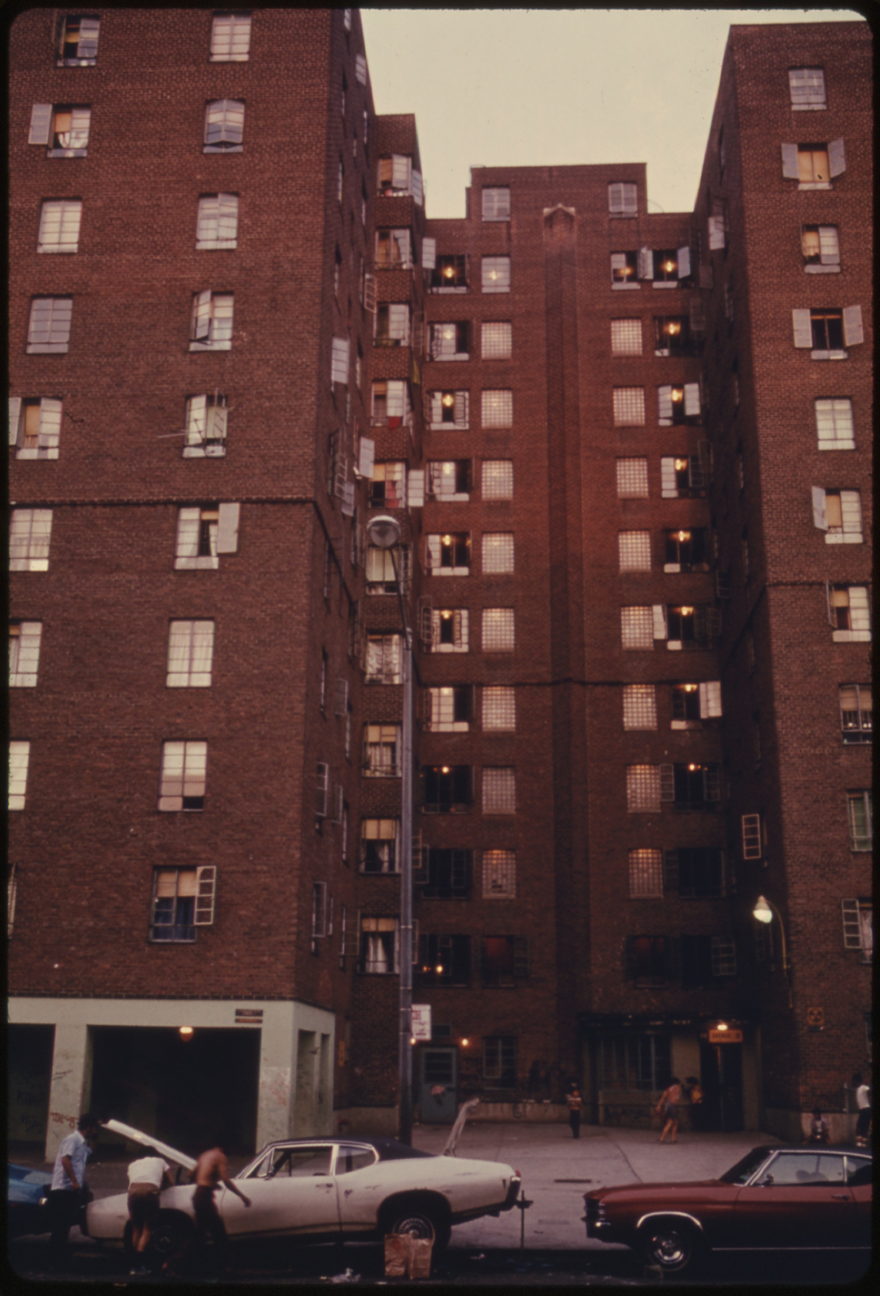
Living in New York City showed the Beats that the conformity of the 1950’s had not spread to all corners of America.

Slide 9
They saw a different world in New York, one that the white middle class living in the suburbs knew little about:
- Drugs
- Prostitution
- Crime
- Poverty

Slide 10
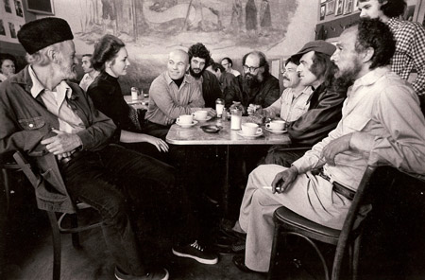
Their personal experiences in this environment, and the experiences of those they met, shaped their work and their philosophy.

Slide 11
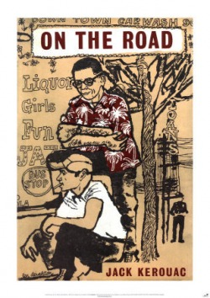
What exactly, then, did the Beats stand for? What ideas did they represent?

Slide 12
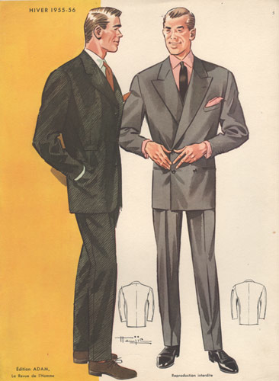
They utterly rejected the conformity of the 1950’s.
- People needed to act and think for themselves.
- Acting differently was okay! Be yourself, not who society expects you to be.
- Sex was okay! Do it!
- Emotions were okay. Have them. Get caught up in them, both good and bad.

Slide 13
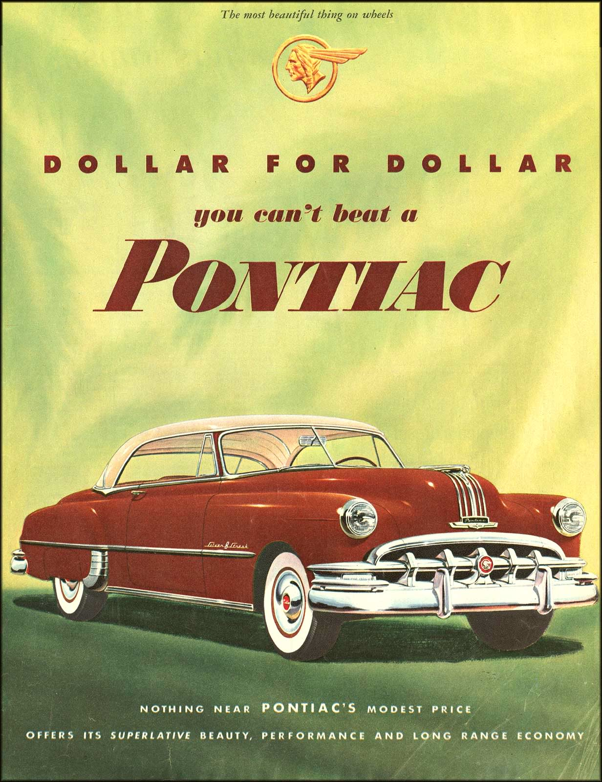
They also rejected the rampant consumer capitalism of the decade:
- Runaway consumerism and capitalism were destructive to the human spirit.
- There’s much more to life than material possessions.
- People should define themselves by who they are and what the believe, not by the things they have.

Slide 14
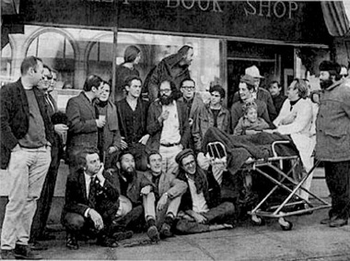
As such, the beats didn’t care about making money. Getting a job to afford possessions was not priority #1.

Slide 15
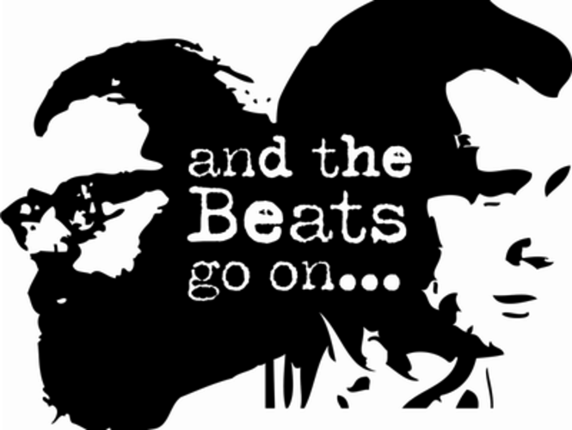
Where did the name “beat movement” come from? What exactly does it mean?
Beat: tired, weary, exhausted

Slide 16
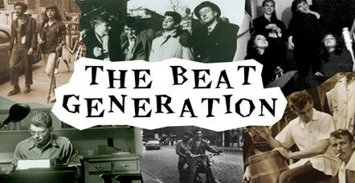
Language, vocabulary, became tools the beats used to continue to reject the dominant culture of the day.

Slide 17
Beat Movement Glossary
Hip: Someone who is cool, in the know. Very good. “She is one hip chick.”
Cat: someone who’s hip “He’s one cool cat.”
Crazy: Implies an especially good thing "Like crazy, man"
Daddy-O: person, a term of address
Dig: to approve, to get with it, to understand “Can you dig it, Daddy-o?”
Square: loser, not hip

Slide 18
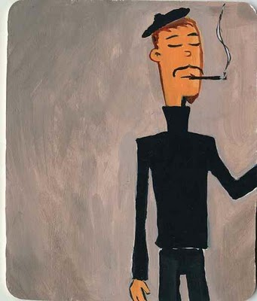
Mainstream America was unimpressed with the beats:
- They began to be seen as troublemakers, anti-American, and lazy.
- This perception began to morph into a stereotype: the beatnik.

Slide 19
According to the stereotype all beatniks:
- Wrote books or poetry, or did something else artistic.
- Wore black turtleneck sweaters and berets.
- grew a goatee.
- played music, primarily the drums / bongos.
- hung around in coffee shops.
- did drugs.
- were lazy.

Slide 20
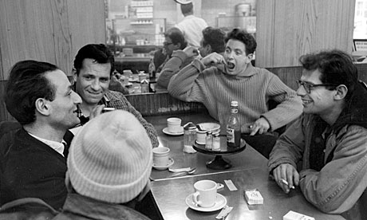
Kerouac, Ginsberg, and others rejected this stereotype, arguing that real beats were more about self discovery and longing for a spiritual fulfillment that the conformist 1950’s could not provide.

Slide 21
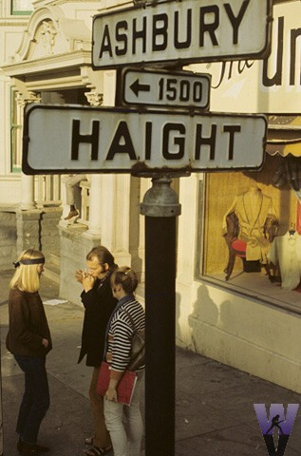
By the late 1950’s the “leaders” of the movement had left New York and headed west.
They settled in San Francisco and continued to challenge the traditional American way of life.

Slide 22
The beats laid the foundation for the emergence of another group that would challenge societal expectations…..

Slide 23
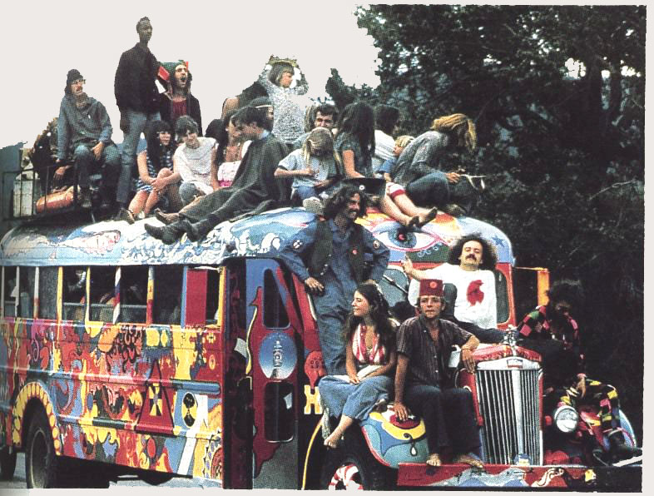
Hippies
Counterculture Movement

Slide 24
Fin.

