Slide 1
Quiz
time!

Slide 2
Conservative Coalition
- What groups of Americans were
involved?

Slide 3
Ronald Reagan
at Home

Slide 4
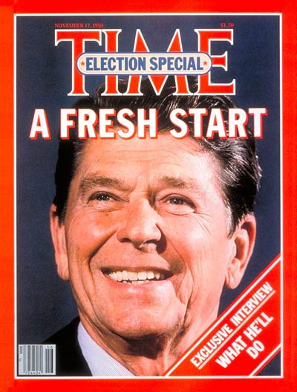
Remember that Ronald Reagan won the presidential election in 1980 after rallying two groups:
- the Neo-conservatives. Remind me what they wanted.
- the “new right” / moral majority / Christian “family values” Republicans. Remind me what they wanted.

Slide 5
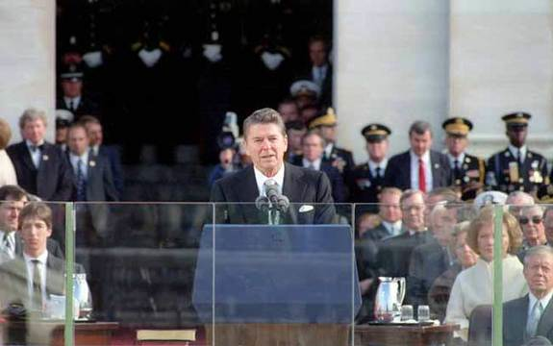
In his inaugural address, Reagan summed up the neo-conservative mindset: “In this present crisis, government is not the solution to the problem, government is the problem.”

Slide 6
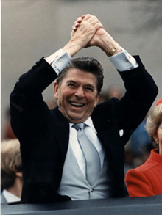
Reagan immediately set out to make good on his campaign promises and bring about neo-conservative change:
- smaller government
- lower taxes
- strong national defense

Slide 7
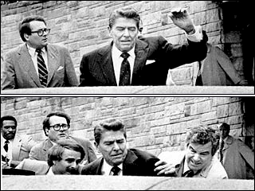
However, on March 30, 1981, just two months after his inauguration, Regan was shot in the chest by John Hinkley Jr.

Slide 8
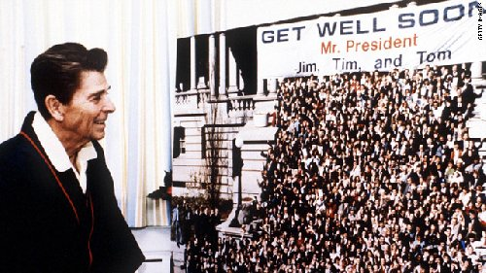
This actually ended up helping Reagan as a sympathetic public sent well wishes. His approval rating climbed to 73%.

Slide 9
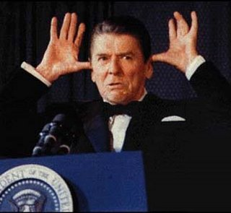
Capitalizing on this popularity, Reagan took action.

Slide 10
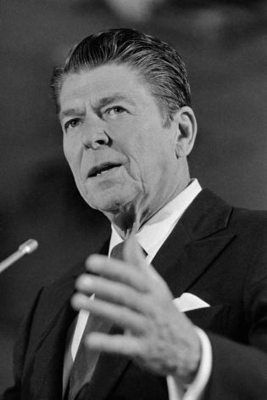
Congress passed the Economic Recovery Tax Act of 1981 which cut tax rates by 25% over 3 years.
This was the largest tax cut in American history. How was it supposed to help the economy recover?

Slide 11
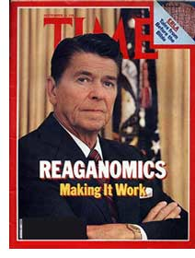
Supply Side / Reaganomics
Reagan believed that the wealthy would take their money and invest it in creating or expanding their businesses. As such, the hoped they would create jobs. That money would thus “trickle down” to those Americans who needed it in the form of paychecks.

Slide 12
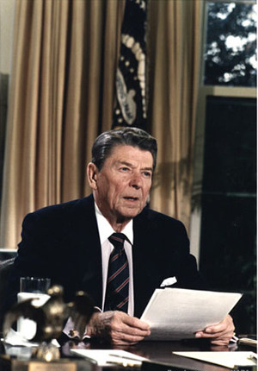
Congress also passed the Omnibus Reconciliation Act of 1981 which cut $136 Billion from 200 government programs over 2 years.

Slide 13
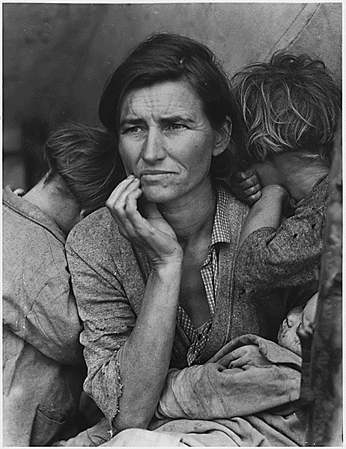
Many of the programs that were cut had come out of the New Deal and the Great Society. They were primarily designed to help out those Americans most in need.

Slide 14
The neo-conservatives argued that money spent on programs to help the poor was money wasted, and that it was not the job of the government to help out those in need.

Slide 15
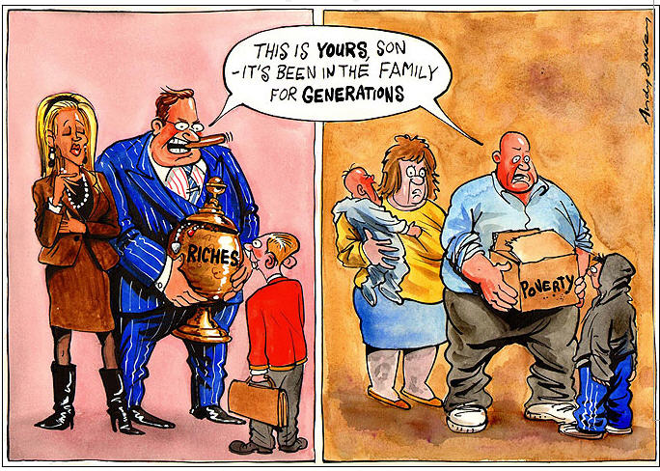
Taken together, the tax cuts and the cuts for social welfare programs resulted in a growing gap between the rich and the poor. The rich got richer, and the poor got poorer.

Slide 16
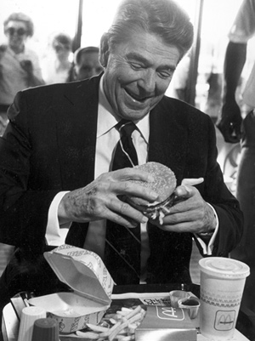
Reagan had successfully implemented much of the neo-conservative agenda, and was on his way to balancing the federal budget.
- He had cut the amount of money the government took in every year (cut in taxes)
But, he had also cut how much the government was spending (social welfare programs)

Slide 17
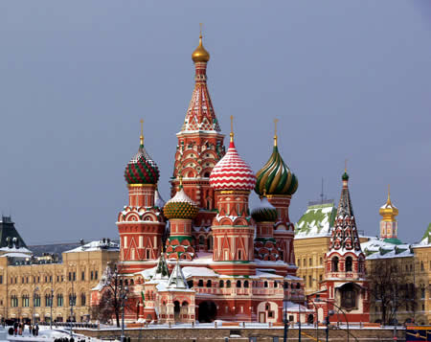
However, in dealing with the Soviet Union, Reagan contradicted his own commitment to a balanced budget. He believed that U.S. national security demanded lots and lots of government spending.

Slide 18
Ronald Reagan:
Commie
Hater

Slide 19
Remember that the last part of the neo-conservative agenda was increasing American defense and taking a hard line with the Soviet Union.

Slide 20
Reagan was not merely content to continue America’s long standing policy of containing the spread of communism.
He described the Soviet Union as the “focus of evil in the modern world.”
His ultimate goal was to win the Cold War

Slide 21
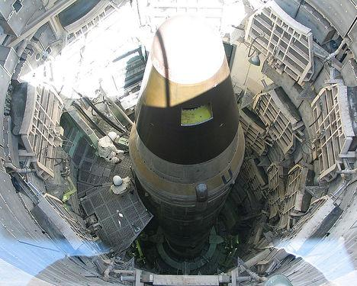
Reagan believed that the U.S. might possibly succeed in that goal by engaging the Soviet Union in another arms race.

Slide 22
Thinking back to the 1940’s and 1950’s, he saw how the Soviet Union had desperately tried to keep up with, and then pass, the U.S. in atomic, nuclear, and rocket technologies.

Slide 23
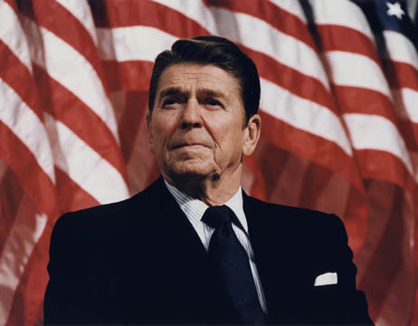
Reagan’s foreign policy advisors argued that if the U.S. began to once again build a ton of new weapons and nuclear missiles, the Soviets would have no choice but to keep up.

Slide 24
To do so would require the U.S. to spend billions of dollars on defense.
But it would also require the Soviet Union to do the same.
Regan gambled that the U.S. economy could handle such spending, while the Soviet economy could not.

Slide 25
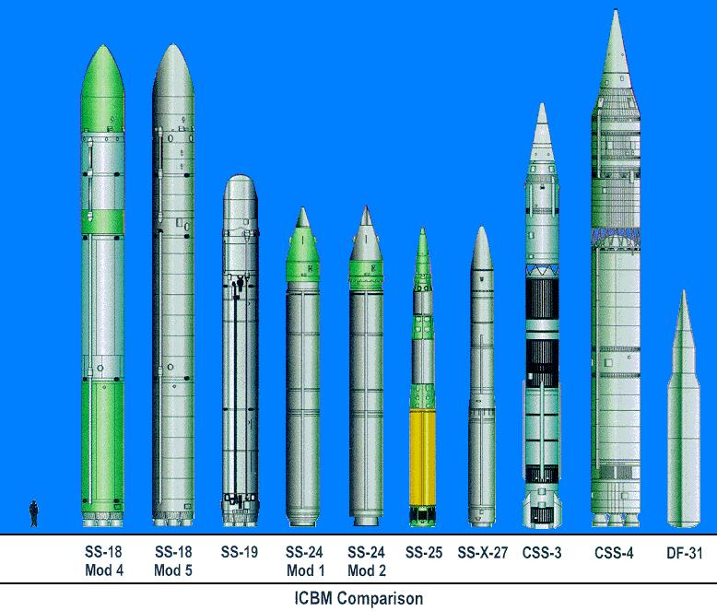
To accomplish the goal of bankrupting the Soviet Union, Reagan authorized a massive buildup of U.S. nuclear weapons and a commitment to use them if necessary.

Slide 26
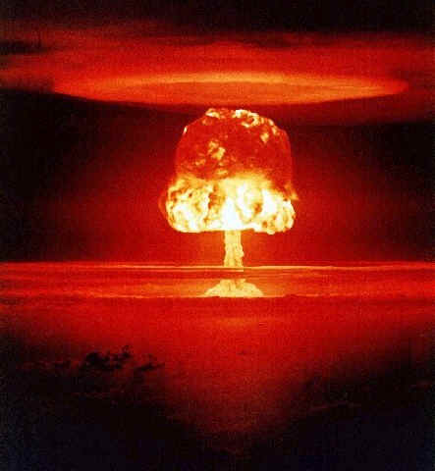
Nuclear War
Glossary
Mutually Assured Destruction
- Both sides must possess, and be willing to use enough nuclear weapons to ensure the absolute destruction of the other. We all might die, but at least we’ll know our enemy is also dead.

Slide 27
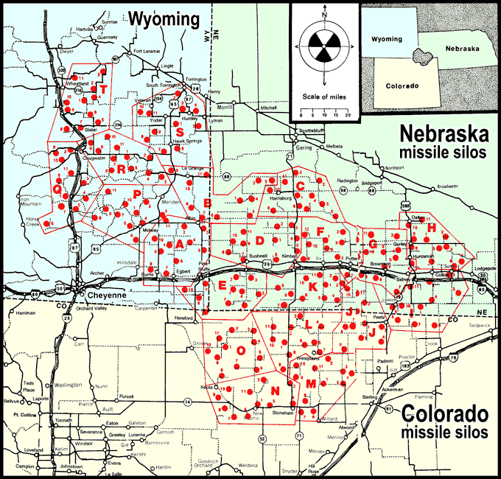

Slide 28
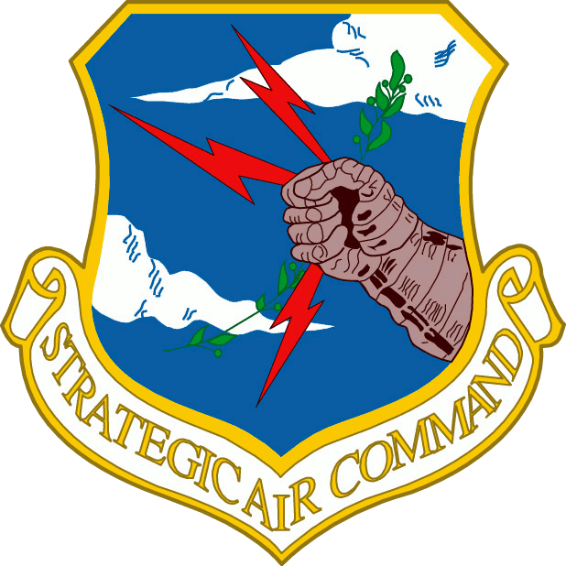
Nuclear War
Glossary
Strategic Air Command (SAC)
- Military unit charged with planning and carrying out America’s nuclear strategy.
- First effort was long range air bombing.
- Shifted overtime to command America’s nuclear missile arsenal.

Slide 29
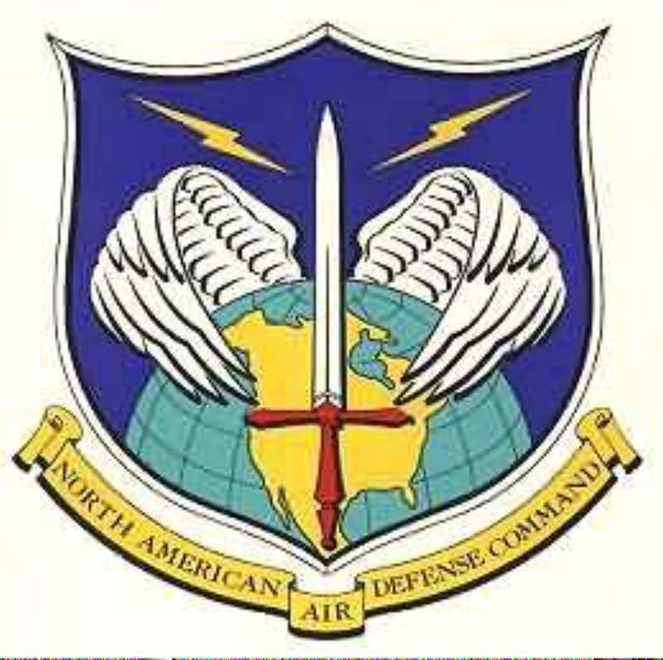
Nuclear War
Glossary
NORAD
-North America Aerospace Defense Command
-Its mission was to detect and track any Soviet nuclear launch against the United States relaying information to SAC and the President.
-Headquarters inside Cheyenne Mountain in Colorado Springs

Slide 30
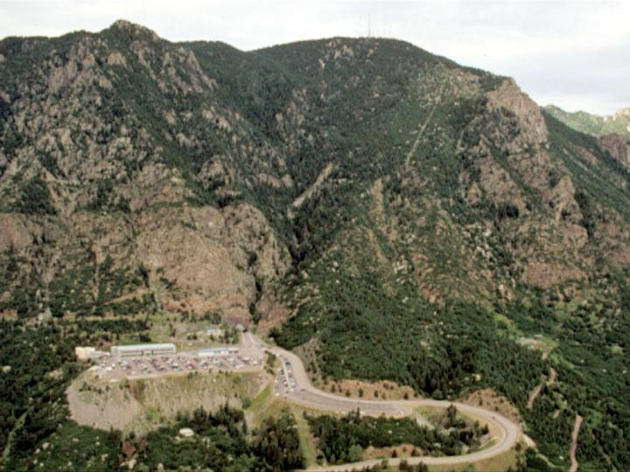

Slide 31
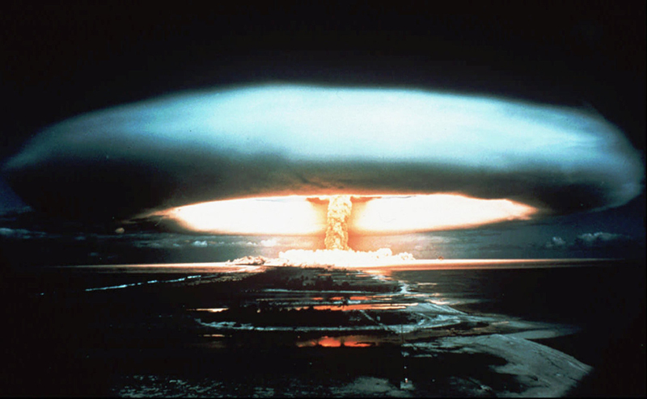
Reagan’s efforts to out-build and out-arm the Soviets dramatically increased tension between the two nations and made the possibility of nuclear war the greatest it had been in 20 years.

Slide 32
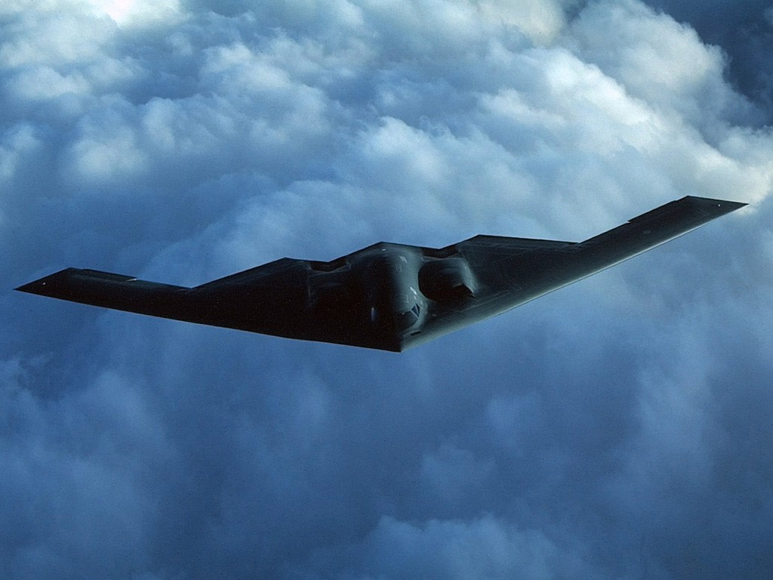
Reagan continued to push the Soviets by proposing new, expensive military technologies. The B-2 “stealth” bomber is one example.

Slide 33
The best example, however, was a proposed program known as the Strategic Defense Initiative (SDI).
-Reagan proposed a series of space based satellites capable of shooting down Soviet nuclear missiles headed for the U.S.
-Nicknamed “Star Wars” by the media.
- Critics argued such a system was not scientifically possible. If so, why did Reagan propose it?

Slide 34
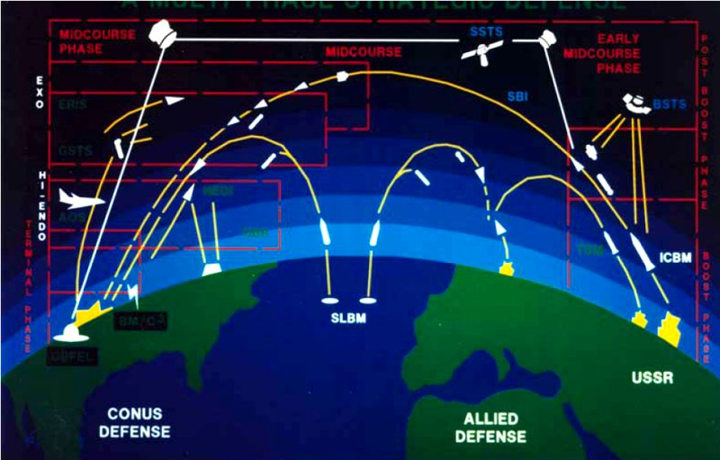

Slide 35
Reagan’s plan was incredibly successful in that the Soviet Union felt pressure to keep up with America. In doing so they focused their economy on military production.

Slide 36
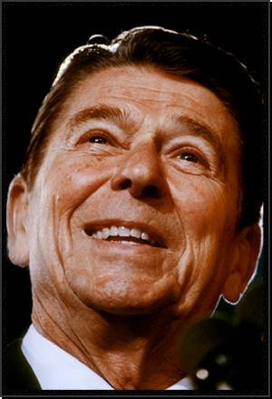
Reagan also spent billions of dollars helping stop the spread of communism in various places around the world.

Slide 37
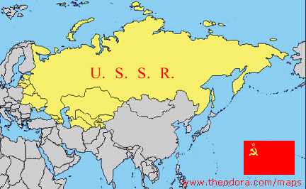
The most important example was his support for groups in Afghanistan fighting against a Soviet Invasion.

Slide 38
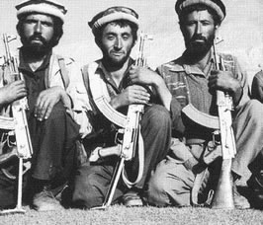
Through the CIA, the U.S. provided billions of dollars of weapons and military training to a group known as the Mujahedeen, Afghanis fighting against the Soviets.

Slide 39
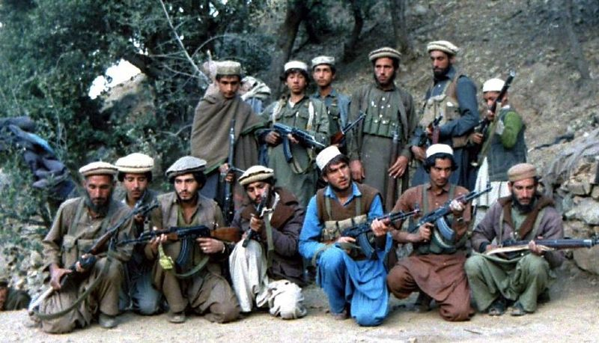
Some Muslims were concerned about the impact the Soviet invasion would have on Afghanistan's Islamic population and went to join the fight against the Soviets.

Slide 40
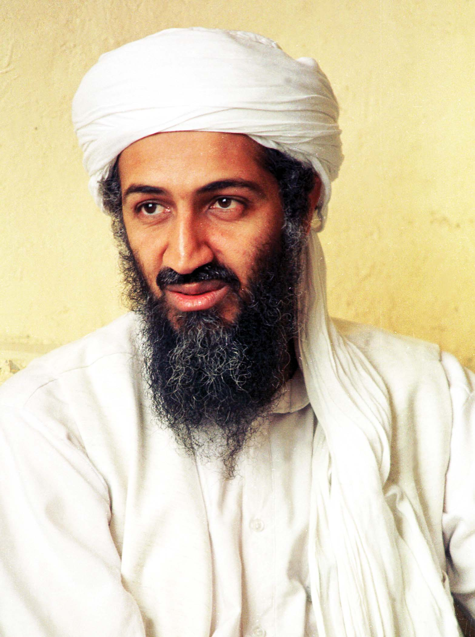
One such Muslim left his wealthy life in Saudi Arabia, joined the Mujahedeen and received weapons from the U.S.
His name?
Osama Bin Laden

Slide 41
Between 1981 and 1988 Reagan’s military spending increased 50%. He had no hope of balancing the budget. U.S. debt exploded and America became the largest debtor nation in the world.

Slide 42
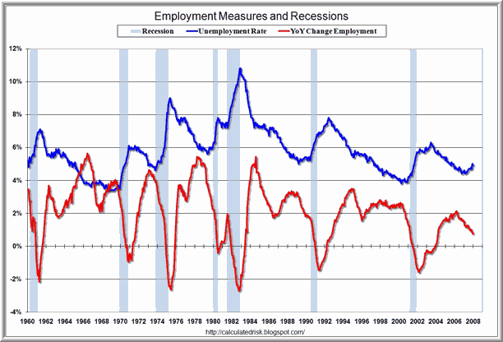
As Reagan’s economic policies began to take effect the U.S. economy didn’t do so well.

Slide 43
Reagan and his advisors weren’t worried about the economy. Given what we know about his economic plan, why was this?

Slide 44
As Reagan ran for re-election in 1984 the economy had begun to pick up and didn’t really impact the campaign.

Slide 45
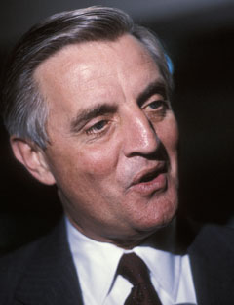
Regan faced Jimmy Carter’s Vice President Walter Mondale.

Slide 46
- Argued that Reagan’s policies of cutting taxes and social programs had helped the rich and hurt the poor.
- Called for a freeze on any new nuclear arms construction.
- Made history with his choice of Vice Presidential running mate.

Slide 47
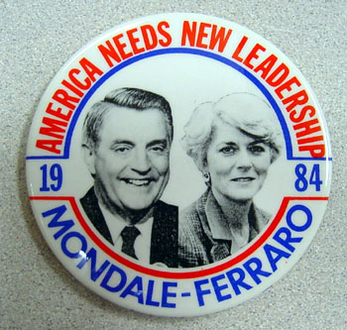

Slide 48
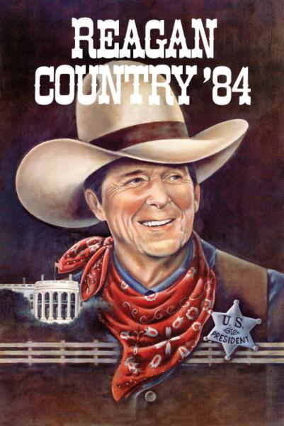
What record did Reagan have to run on?

Slide 49
Supply side economics seemed to be working.

Slide 50
Regan had made history of his own in 1981 when he nominated Sandra Day O’Connor to be the first woman on the U.S. Supreme Court.

Slide 51
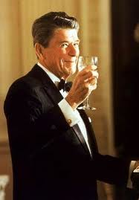
He had rallied the conservative movement, and made good on securing the fundamental parts of their agenda.

Slide 52
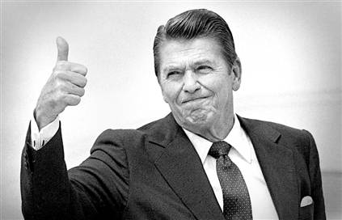
Most importantly, Reagan had restored America’s confidence in America. We were strong once again showing the communists who was in charge.

Slide 53
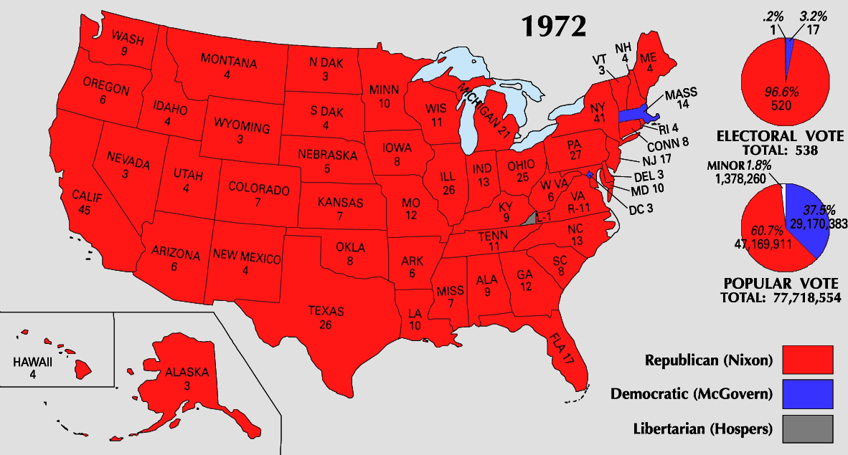
Nixon’s Victory in 1972

Slide 54
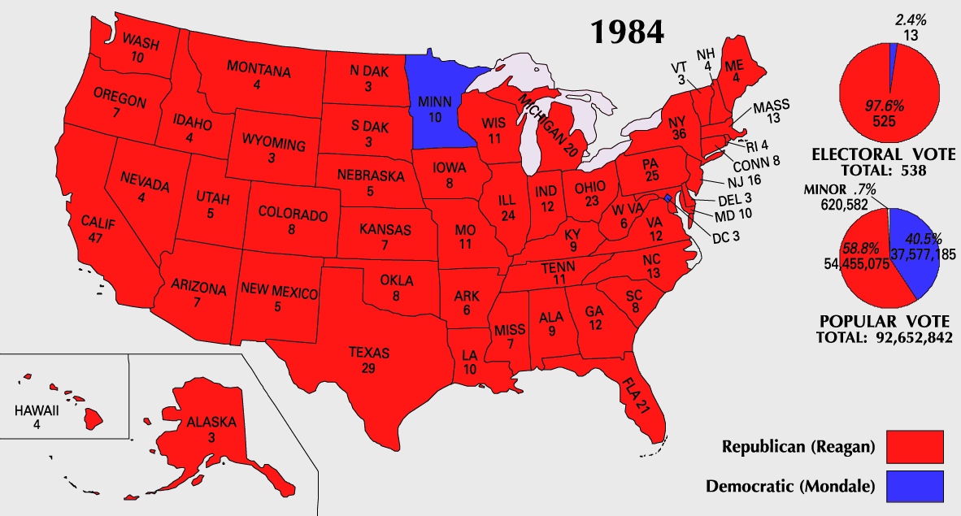
Reagan’s Victory in 1984

Slide 55
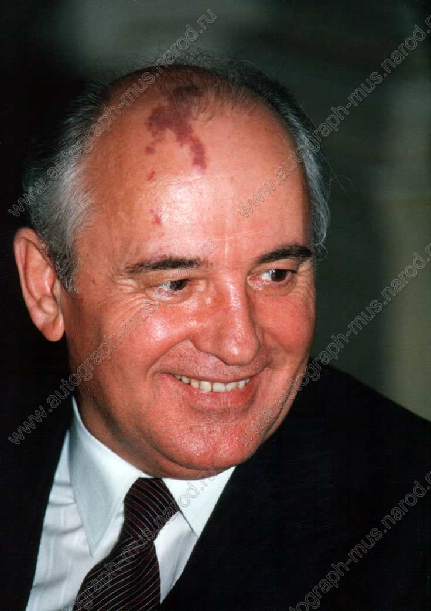
As Reagan’s plan went into action, the Soviet Union got a new leader, Mikhail Gorbachev. His promotion to power, combined with Reagan’s goal to outspend the Soviet Union planted the seeds for an end to the Cold War.

Slide 56
Fin.

