Slide 1
Imperial
Expansion
and the
Presidents

Slide 2
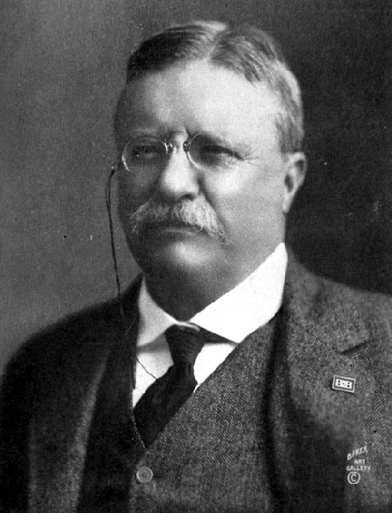
Theodore
Roosevelt
1901-1909

Slide 3
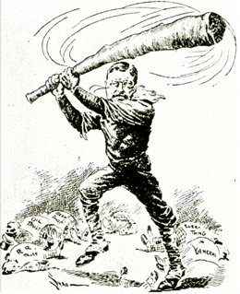
His approach to foreign affairs is known as “Big Stick Diplomacy.”

Slide 4
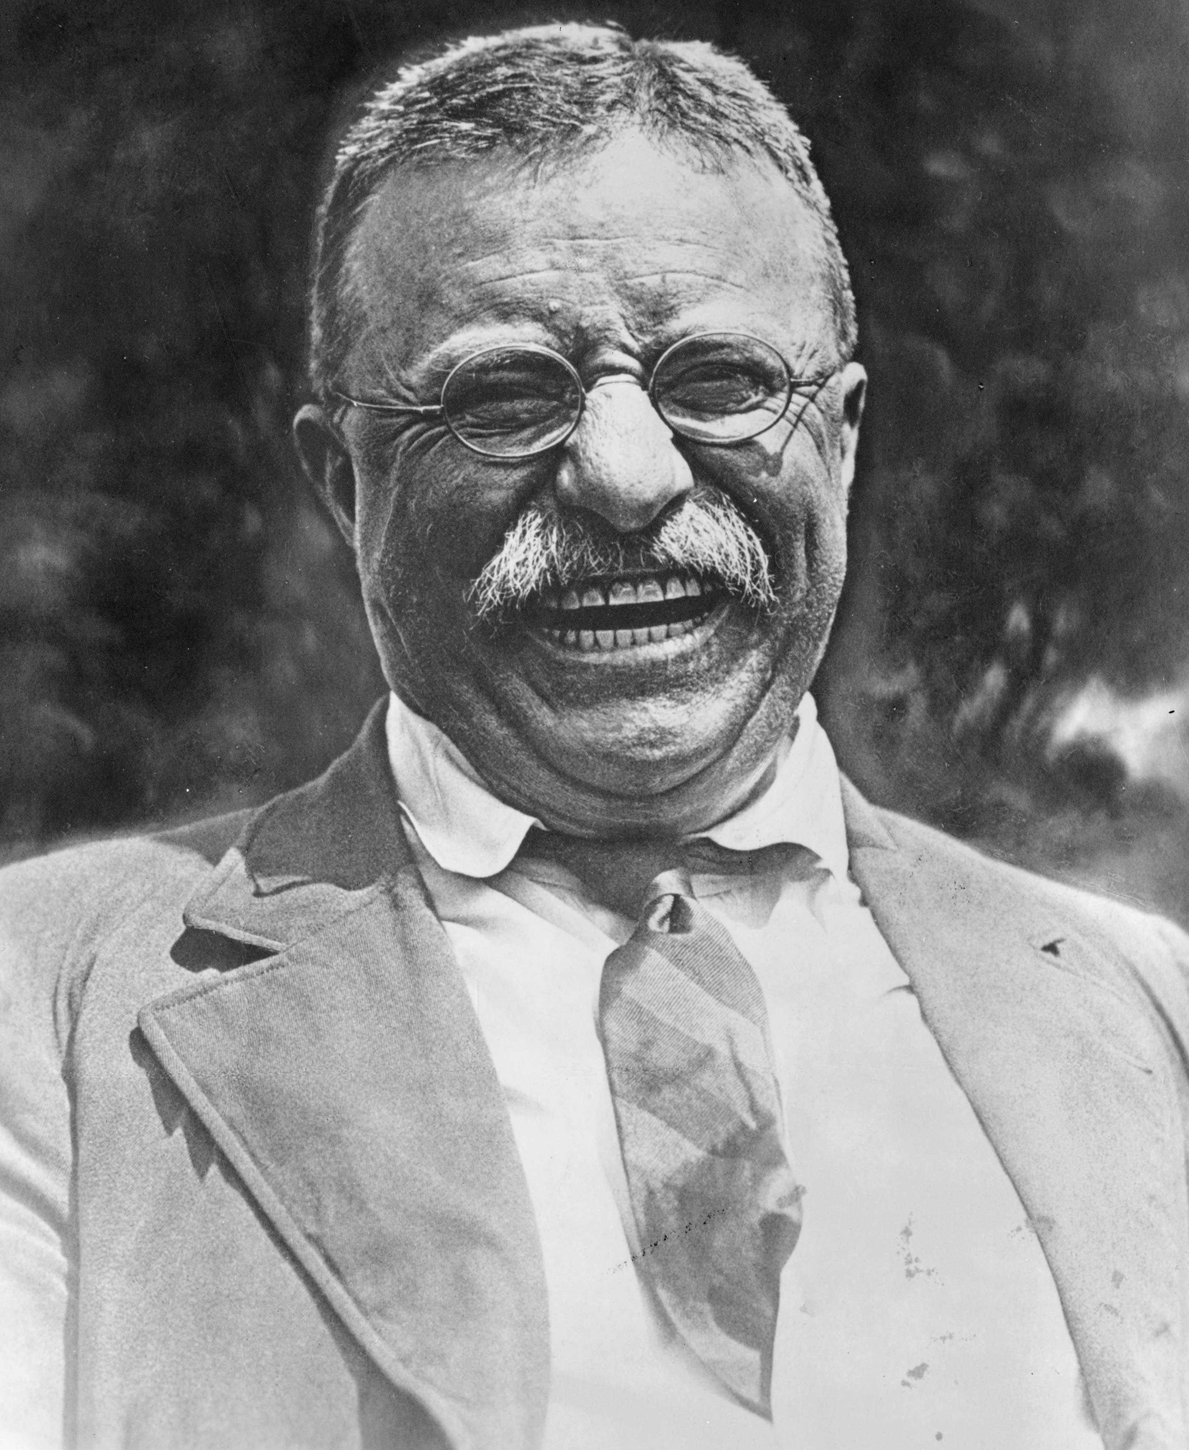
Roosevelt hoped to continue transforming the U.S. into a major international power by first making America the dominant power in the Caribbean and Central America.

Slide 5
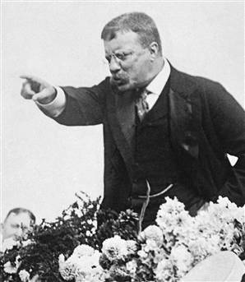
To do so he first reminded the powers of Europe of the Monroe Doctrine. What did it say?

Slide 6
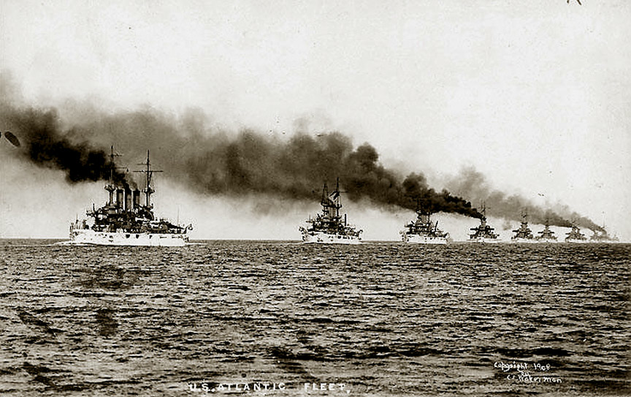
Then, he reminded Europe that the U.S. now had the military power to enforce the Doctrine.

Slide 7
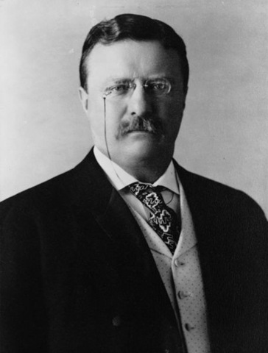
Finally, he added what is known as the Roosevelt Corollary to the Monroe Doctrine.
1. Any disorder or chaos in Latin American nations might force the U.S. to intervene and restore order.
2. The U.S. would also intervene to protect American economic interests in Latin American nations.

Slide 8
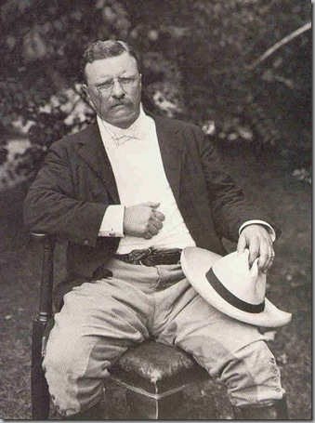
Where James Monroe had warned European nations to stay out of Western Hemisphere nations, Roosevelt essentially said that it was the duty and the right of the U.S. to get involved in those nations, if such action was necessary to further or protect American interests.

Slide 9
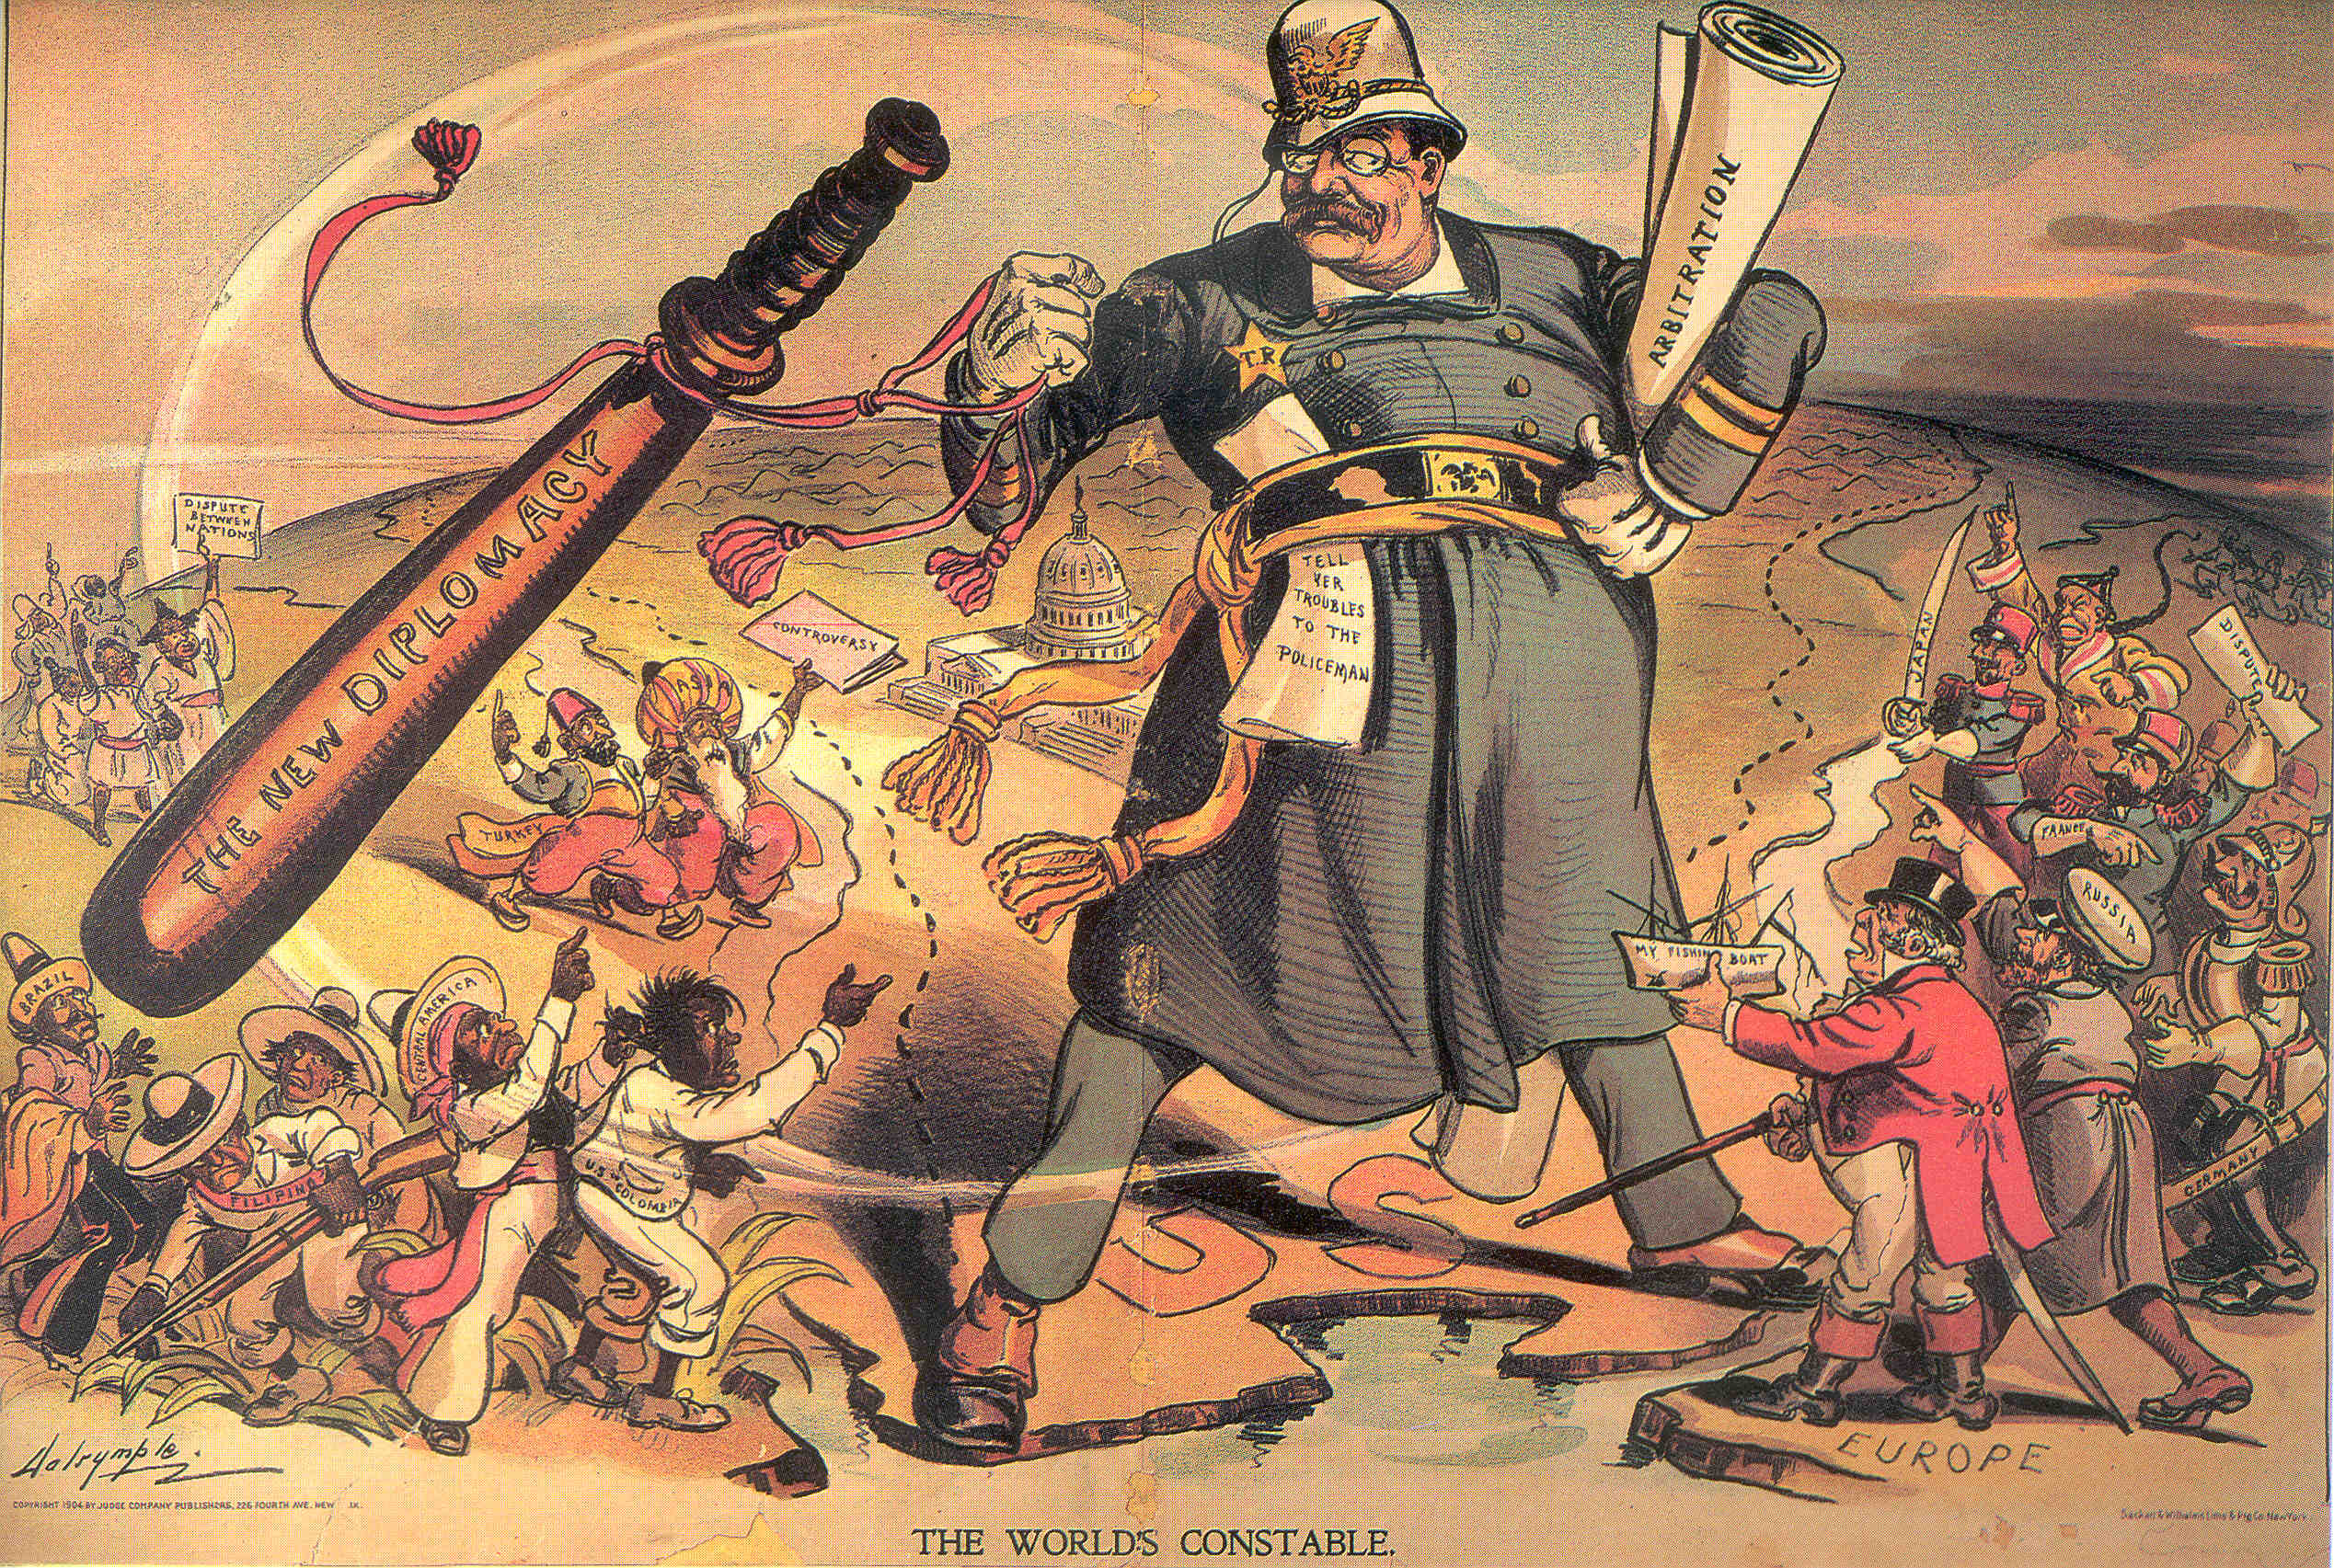

Slide 10
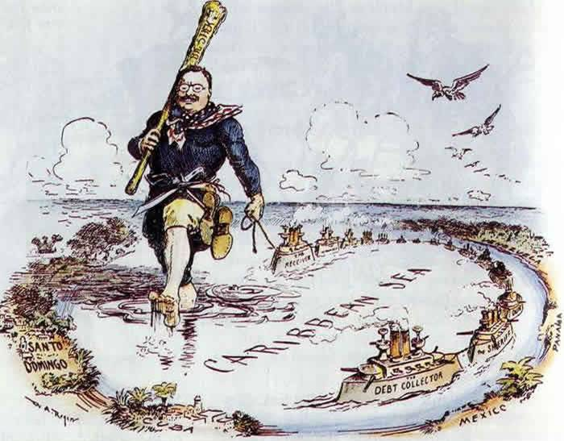

Slide 11
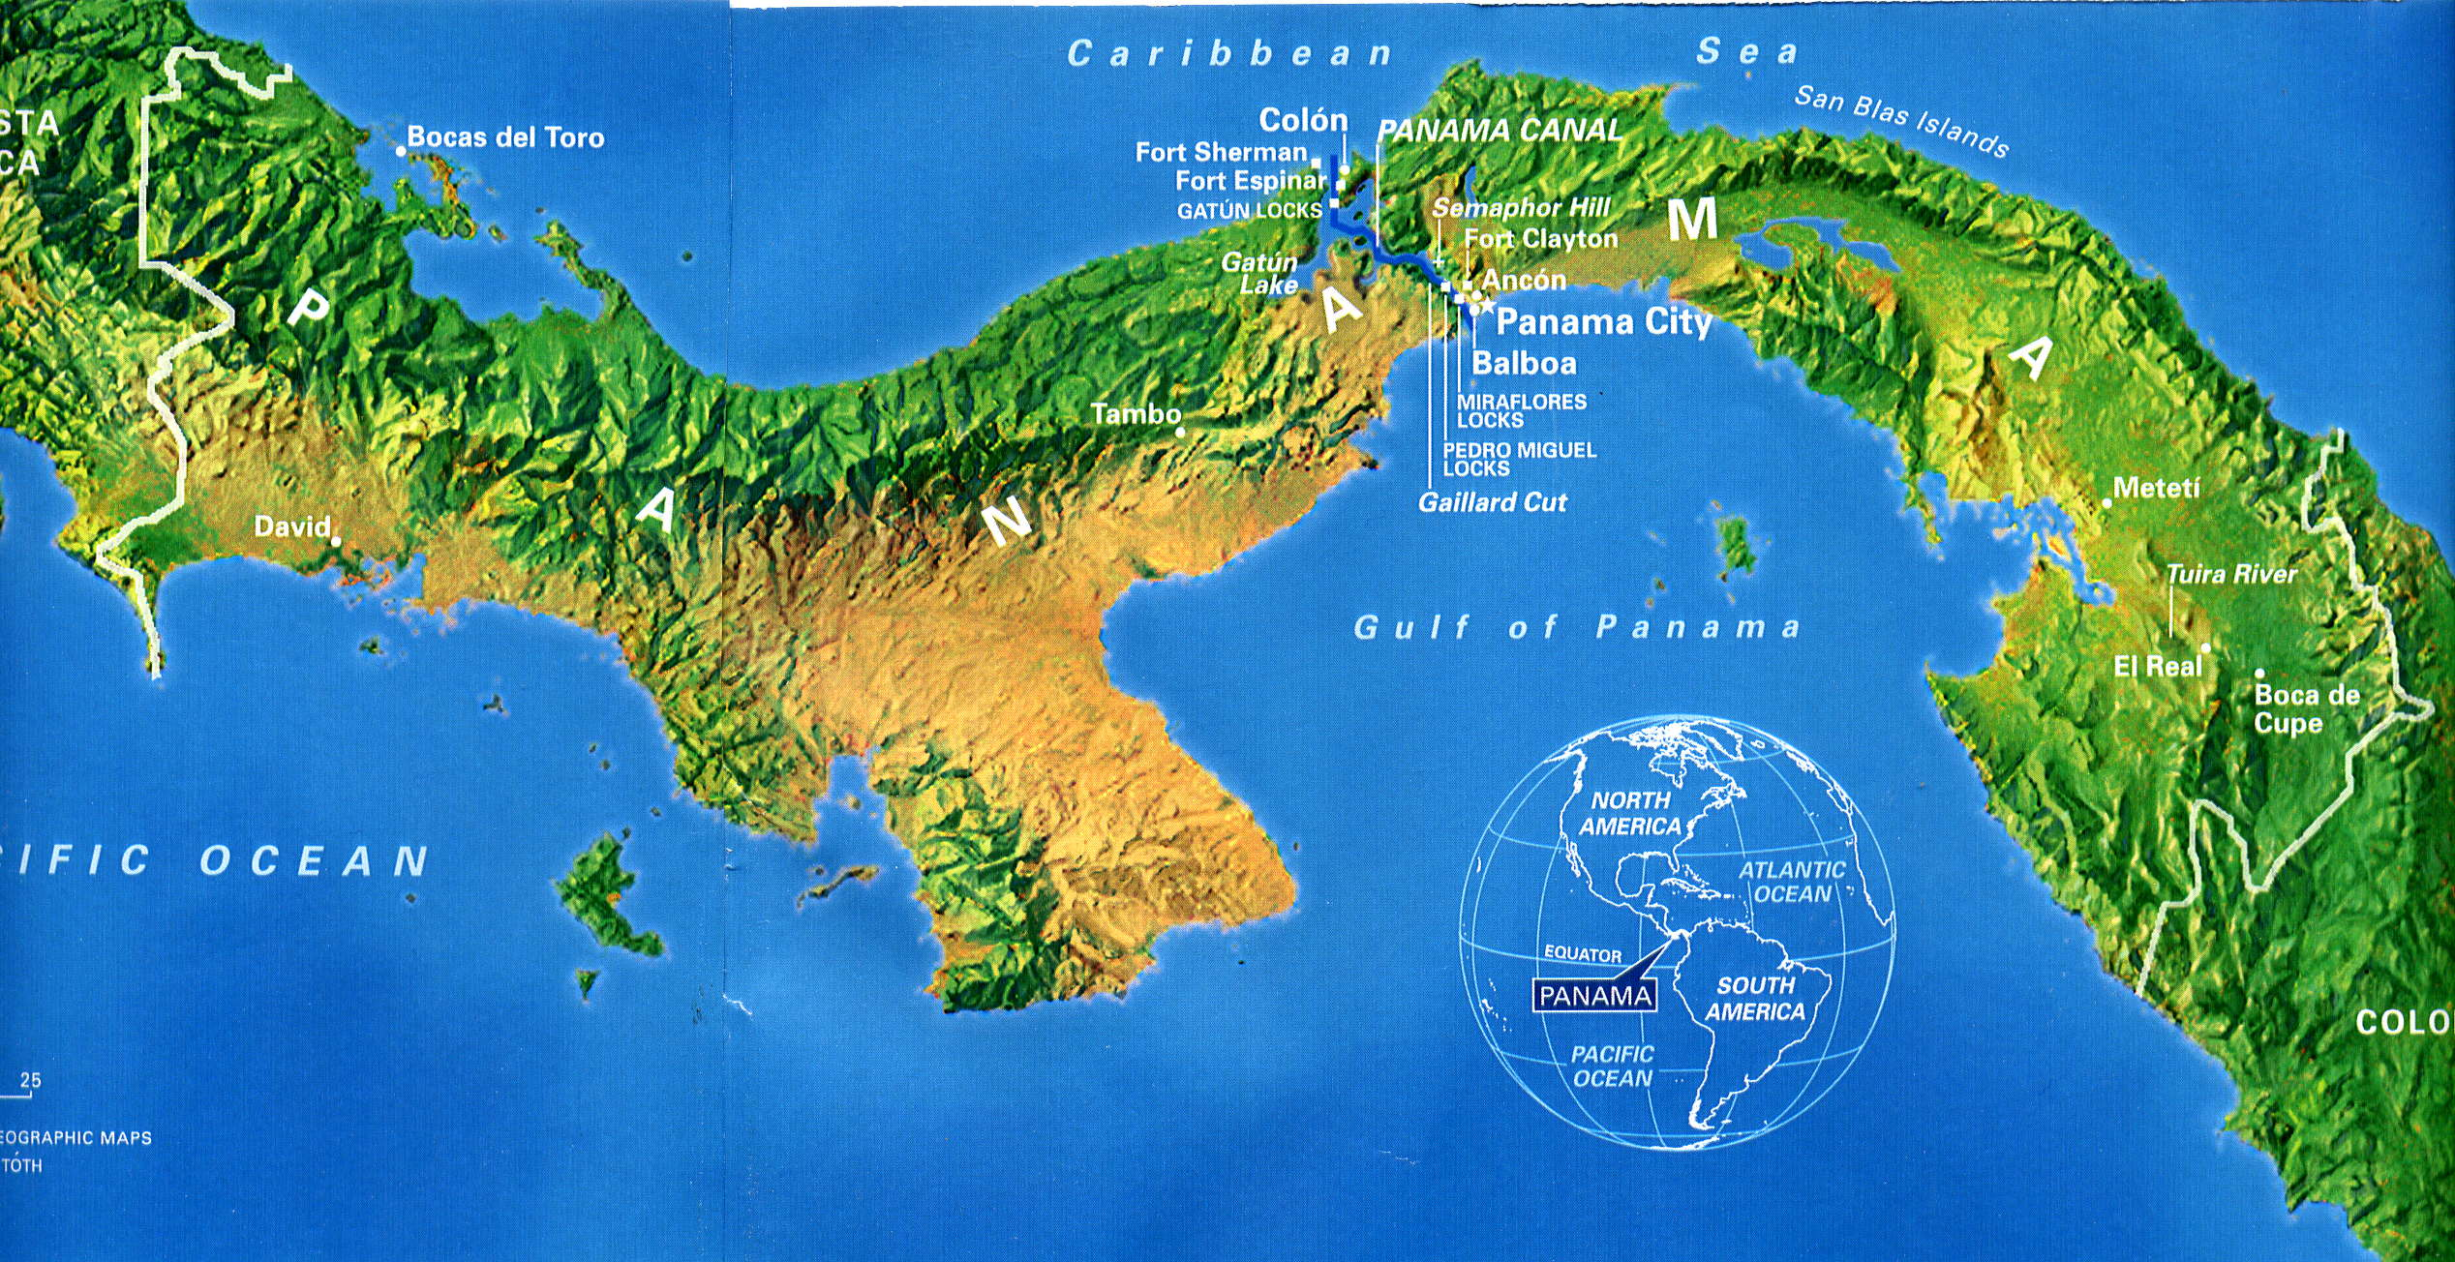
The best example of Big Stick diplomacy in action was in Panama. Why did Roosevelt believe a canal in Panama was necessary?

Slide 12
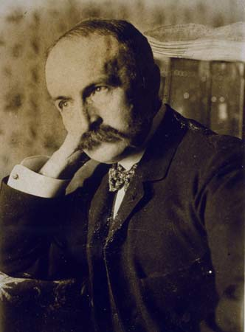
Having gotten approval for the canal project from the Senate, TR worked with Philippe Bunau-Varilla, the head of the failed French Canal Co., and purchased French equipment and the failed French attempt at a canal.

Slide 13
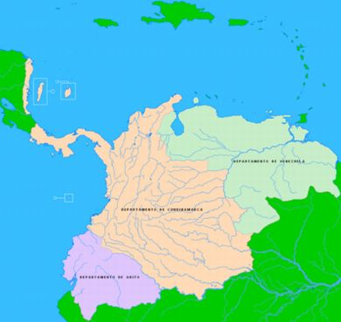
He then had to negotiate a deal with Colombia to purchase the remaining land for completion of the canal.

Slide 14
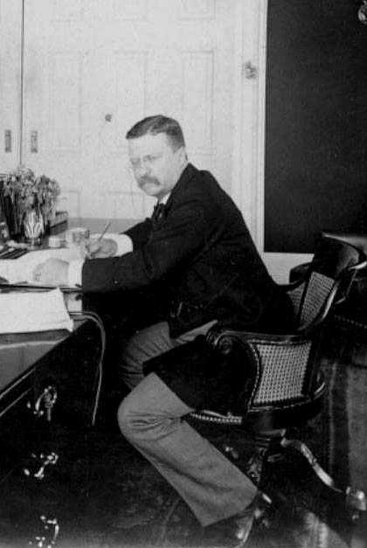
- Colombia rejected Roosevelt’s proposals They wanted more $.
- Bunau-Varilla, fearing the deal would collapse, raised a small rebel army and declared Panamanian independence from Colombia 11/3/1903.
- Roosevelt authorized the U.S. navy to block any and all Colombian troops from entering Panama.
- The revolution was a success and Roosevelt recognized the independent nation of Panama.

Slide 15
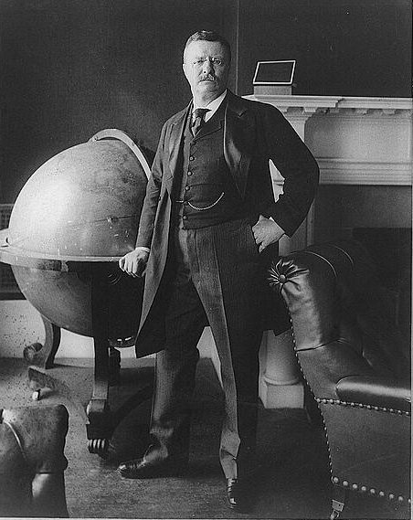
Hay-Bunau-Varilla Treaty
- Recognized Panama as an independent nation after revolution from Colombia.
- Paid $10 million for the canal zone.
- $250,000 yearly rental.
- Eventually Panama would regain the Canal zone.
- Jan. 1, 2000, the canal zone returned to Panama.

Slide 16
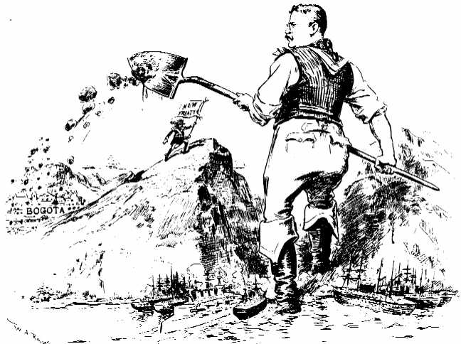

Slide 17
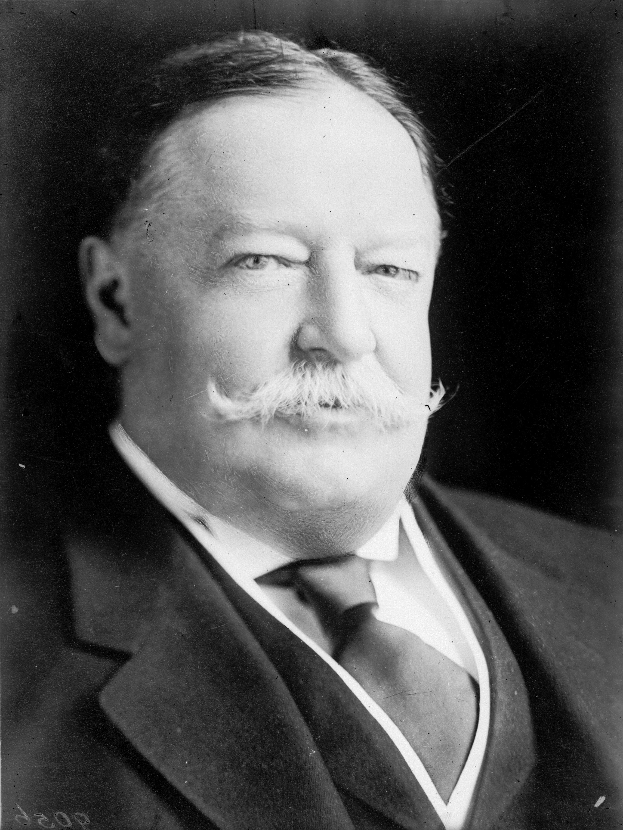
William
Howard
Taft
1909-1913

Slide 18
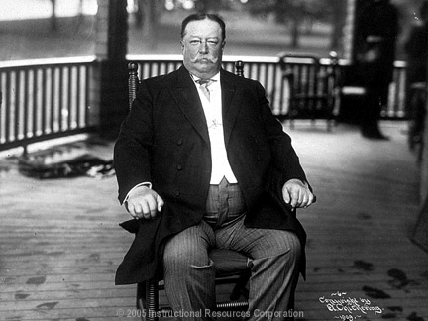

Slide 19
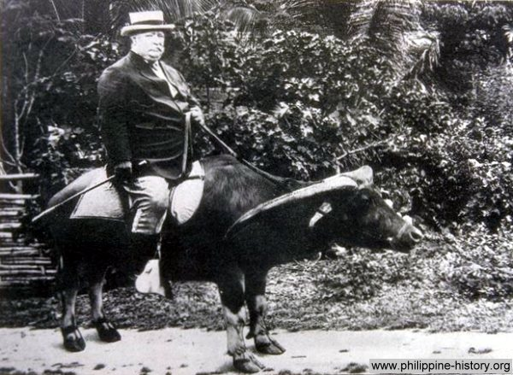

Slide 20
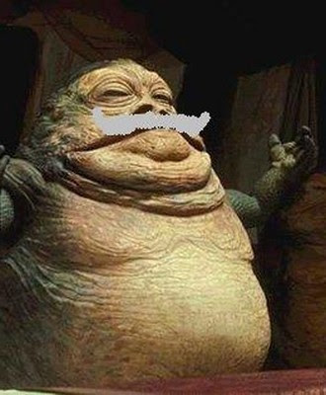

Slide 21
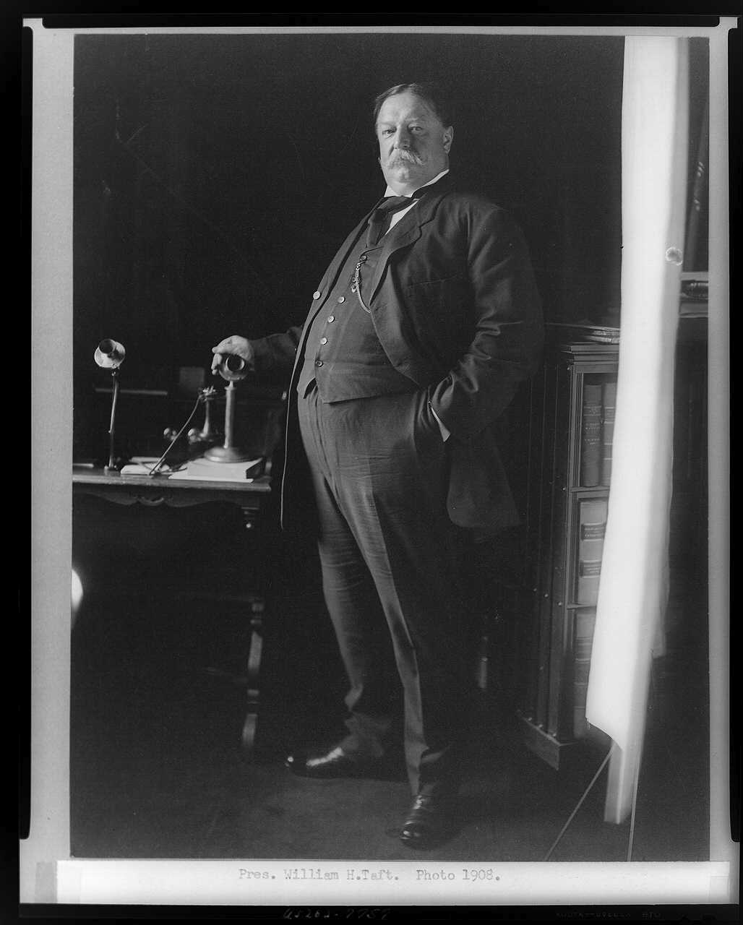
His approach to foreign affairs is known as “Dollar Diplomacy.”

Slide 22
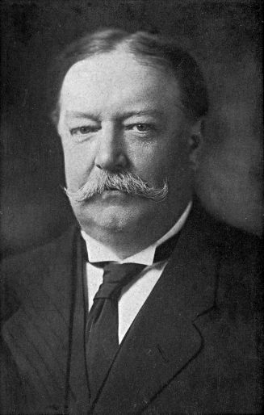
He continued to worry that Latin American nations would be unable to pay back loans to European countries. If that happened, Europe might attempt to intervene, violating the Monroe Doctrine and Roosevelt Corollary, pushing the U.S. to possible war.

Slide 23
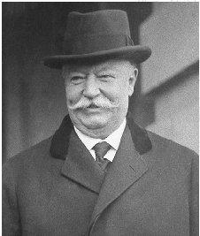
To prevent Latin nations from defaulting on their debts to Europe, Taft encouraged U.S. banks and businesses to loan $ to Latin American nations.

Slide 24
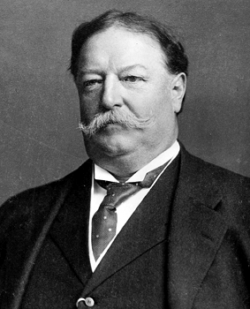
He promised that if those nations could not repay their loans, he would send in U.S. forces to guarantee repayment.

Slide 25
Taft’s “Dollar Diplomacy” was put into action in most famously in Nicaragua.

Slide 26
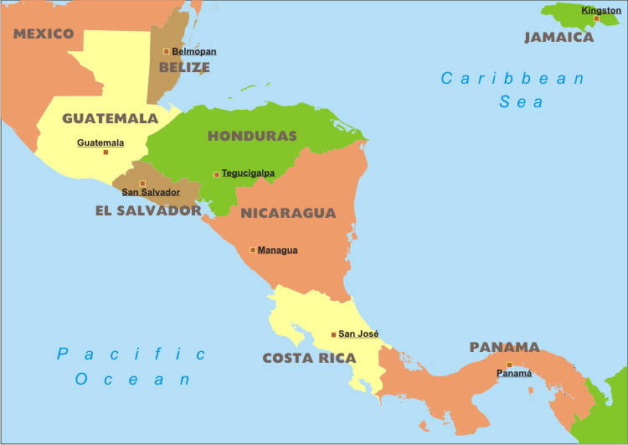
Nicaragua was deep into to European countries and their government was very unstable. What was Taft worried about?

Slide 27
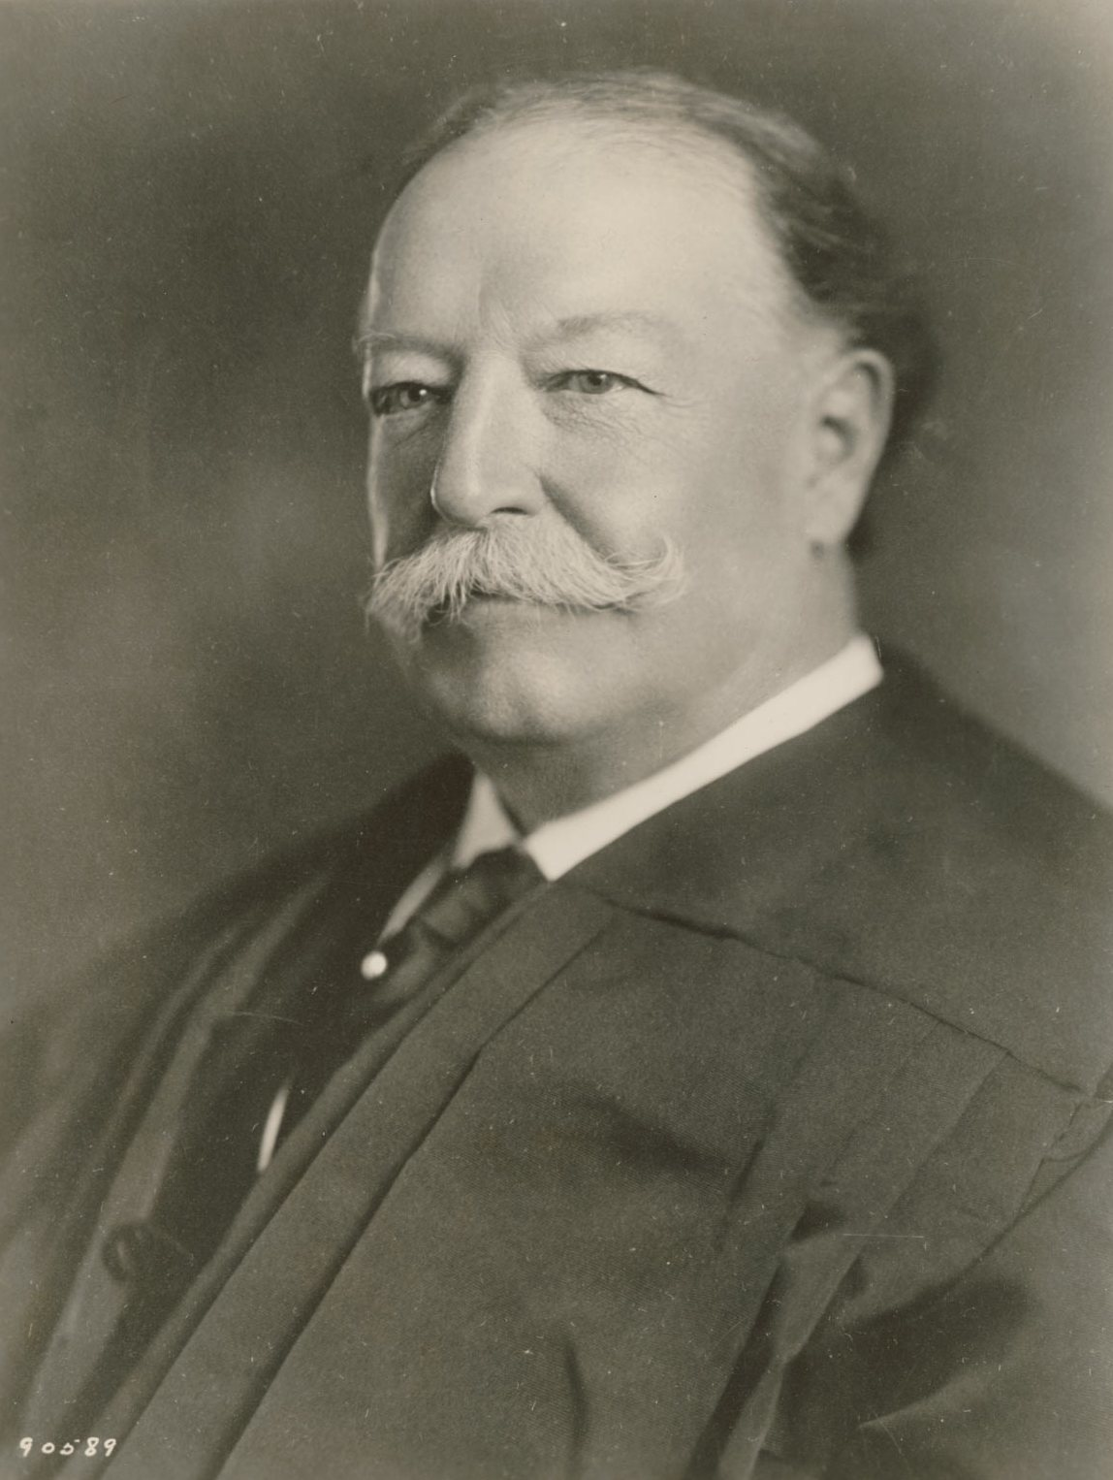
Taft persuaded American banks to make loans to the Nicaraguan government.
Not surprisingly, Nicaragua couldn’t pay back those debts.
What did Taft do then?

Slide 28
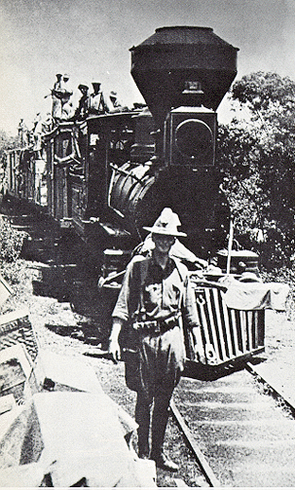
The US Army invaded Nicaragua in August 1912.
The American government took control of Nicaragua’s banks and railroads and used the money from them to pay back American banks.
America didn’t leave for 13 years.

Slide 29
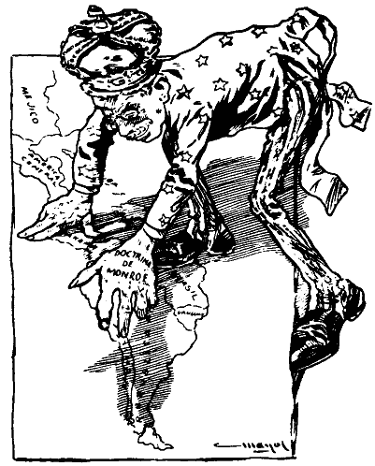
Through the use of Big-Stick and Dollar Diplomacy, and through enforcement of the Roosevelt Corollary, the United States began to upset and outrage countries in its own back yard.

Slide 30
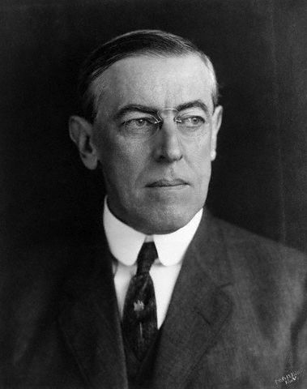
Woodrow
Wilson
1913-1921

Slide 31
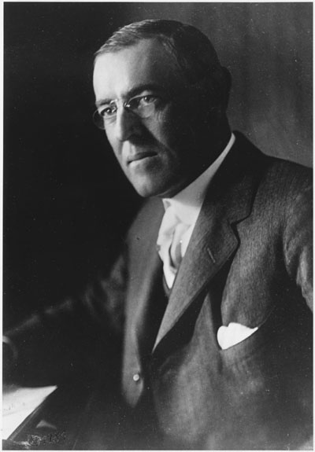
His approach to foreign affairs is known as “Moral Diplomacy.”

Slide 32
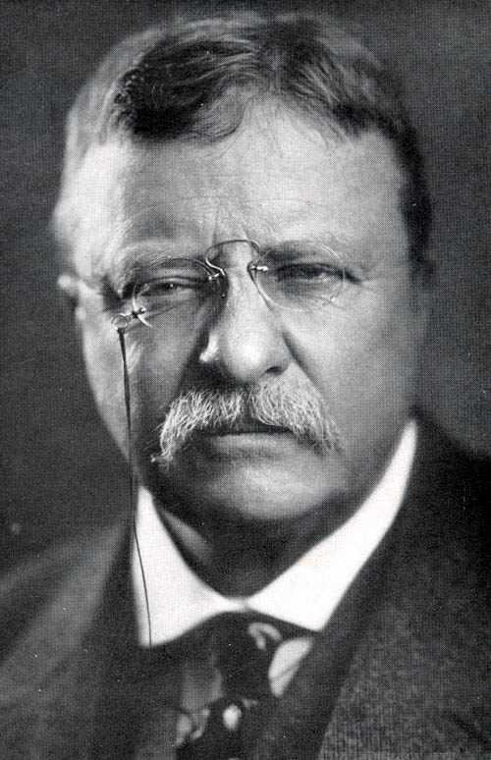
Wilson modified the Roosevelt Corollary. Roosevelt had suggested the U.S. could intervene in Latin American affairs for, essentially, any reason.

Slide 33
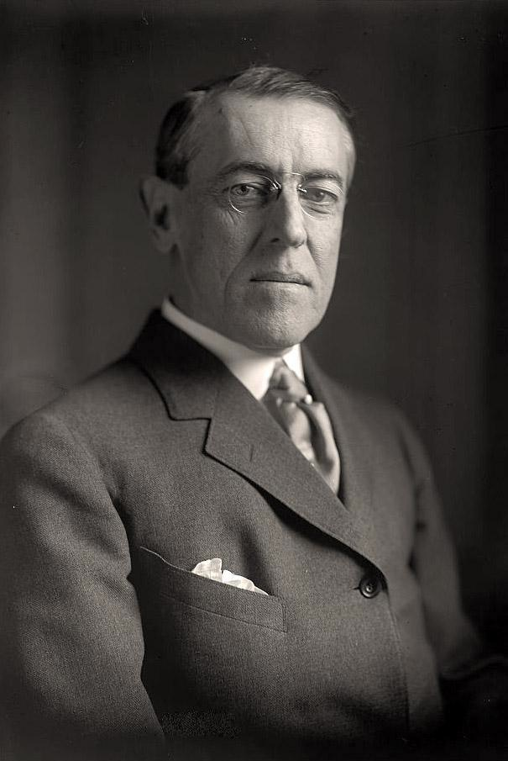
Wilson disagreed, arguing that the U.S. should only get involved to protect democracy and freedom in the Western Hemisphere.

Slide 34
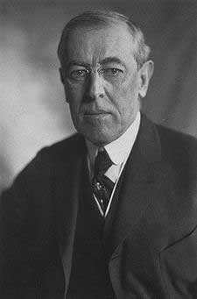
Wilson refused to recognize any Latin American government that he saw as “oppressive, undemocratic, or hostile to U.S. interests.”

Slide 35
In doing so, he hoped to pressure Latin American governments to secure freedom and equality in their own nations.

Slide 36
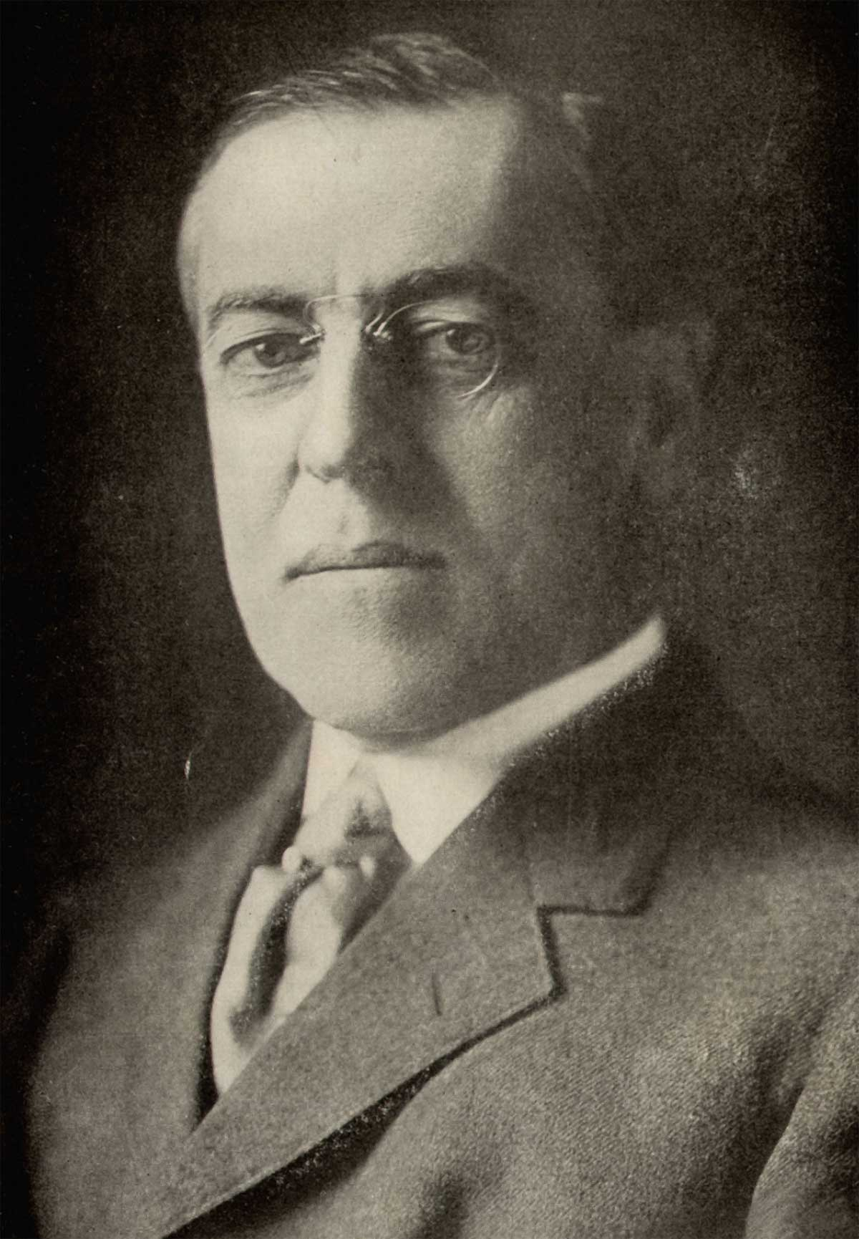
Mexico
- Popular uprising began in 1913 against the elite.
- Gen Victoriano Huerta took control.
- U.S. businesses, with heavy investment in Mexico, called on Wilson to intervene.
- Wilson refused. Why?

Slide 37
Mexico
- Wilson refused to get involved until the Mexican government arrested U.S. sailors anchored off the port of Tampico in April, 1914.
- Wilson ordered the navy to seize the key port of Vera Cruz and prepare for armed conflict.
- A treaty was negotiated before war officially broke out.

Slide 38
Fin.

