Slide 1
Immigration
in the
Gilded Age

Slide 2
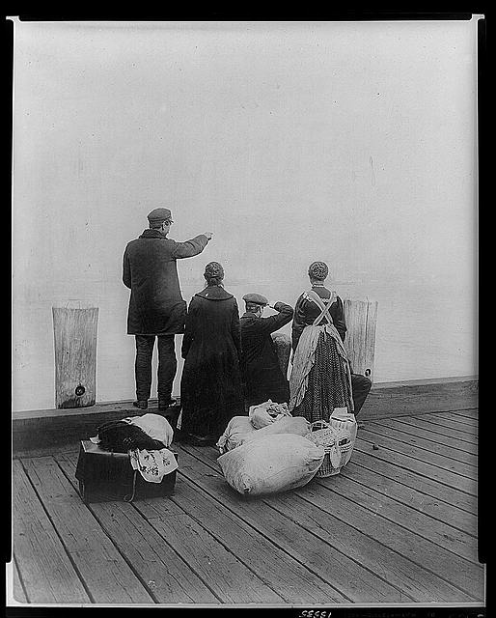
During the Gilded Age, immigrants from around the world flooded into America.
Why?

Slide 3
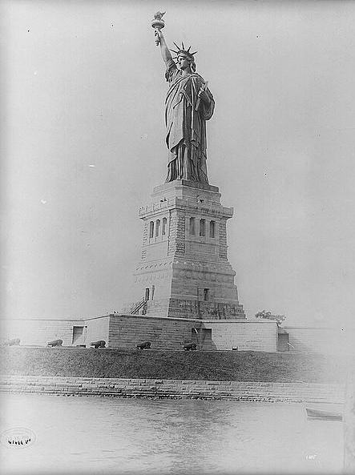
- Growing number of jobs due to industrial growth.
- America was seen as the “Land of Opportunity.”
- American commitment to Democracy.

Slide 4
While immigration stations like Ellis Island, in New York, and Angel Island, in San Francisco, prevented some immigrants from entering the U.S., the vast majority were let in with little or no restriction.

Slide 5
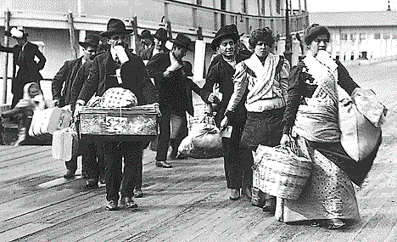
How can we explain the fact that the gates to American were flung wide open for all immigrants, at least initially?

Slide 6
Business owners wanted people who would work for next to nothing.
Shipping companies wanted to make profits transporting people across the oceans.

Slide 7
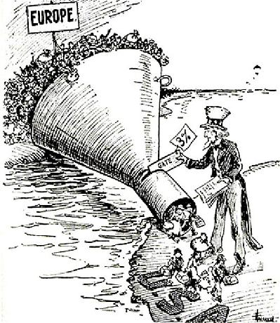
Over time, however, many Americans began to call for limitations on the number of people allowed into the U.S.

Slide 8
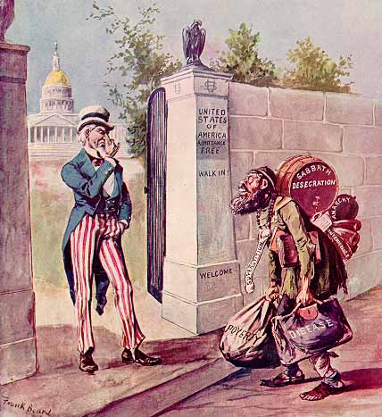
Three main elements of anti-immigration began to come together in the 1890’s.

Slide 9
1. Nativists argued that immigrants threatened the “American way of life.”
- Immigrants took jobs from “good Americans.”
- Most immigrants were not Protestant and threatened America’s religious heritage.
- They brought crime, disease and anarchy with them.
- Those that were coming were uneducated, and if they couldn’t find work, they became a burden to society.

Slide 10
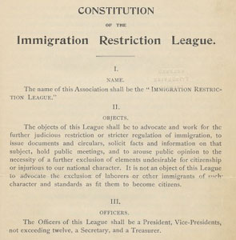
Immigration Restriction League
- Founded by Harvard graduates Charles Warren and Prescott Hall.
- Hoped to use their influence in Congress to push for anti-immigration laws.
- Did not dislike all immigrants

Slide 11
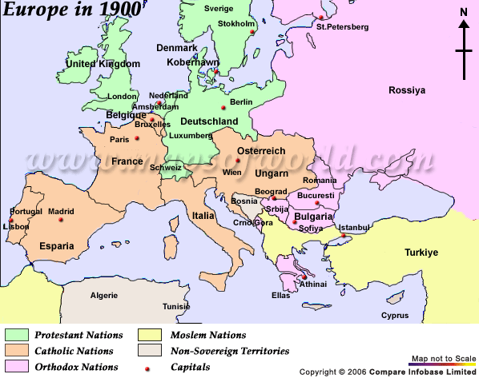
Immigrants from N. and W. Europe were okay. Why?

Slide 12
Immigrants from southern and eastern Europe, and Asia were not desirable. Why?

Slide 13
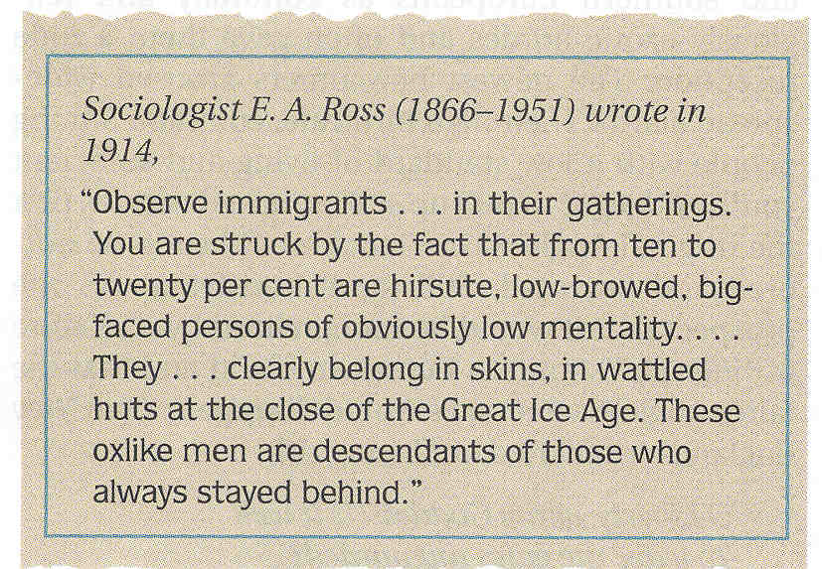

Slide 14
2. Immigrant men were given the right to vote scaring many Americans. What were they afraid of?

Slide 15
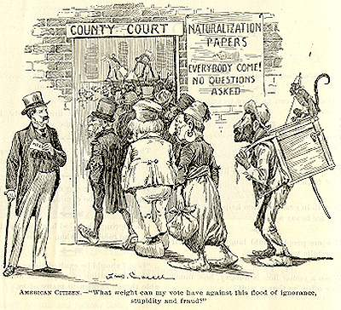
American Citizens: What weight can my vote have against this flood of ignorance, stupidity and fraud?

Slide 16
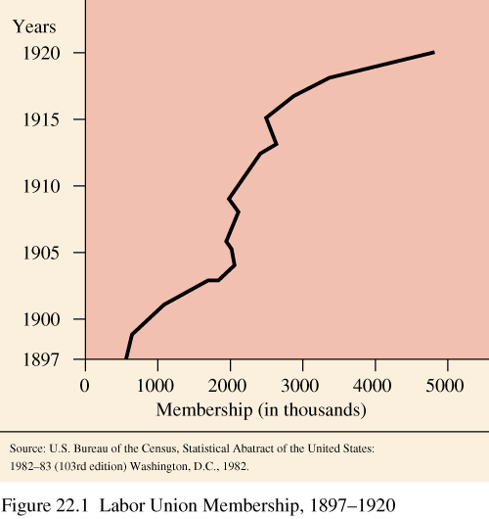
3. Immigrants posed a problem for the labor unions. Explain.

Slide 17
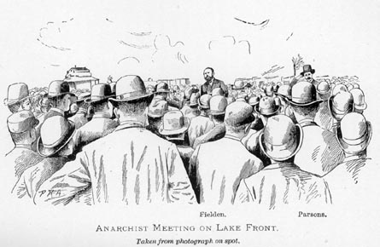
Immigrants were also increasingly tied to the more radical and violent elements of the labor movement such as the anarchists. (Haymarket Square)

Slide 18
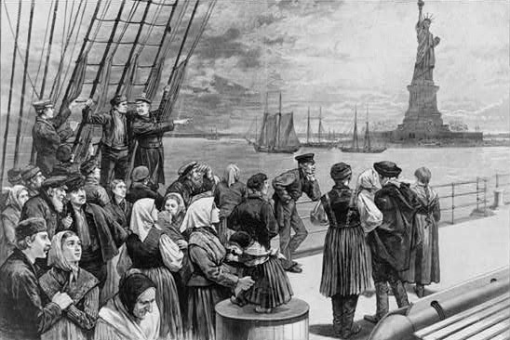
As a result of all three issues, the federal government eventually began to take action to stem the tide of immigration.

Slide 19
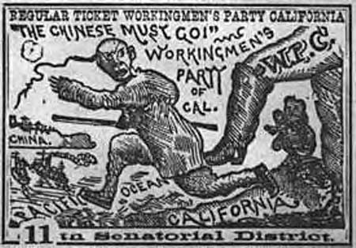
Hostility had been growing about the number of Chinese immigrants allowed into America, especially in the state of California.

Slide 20
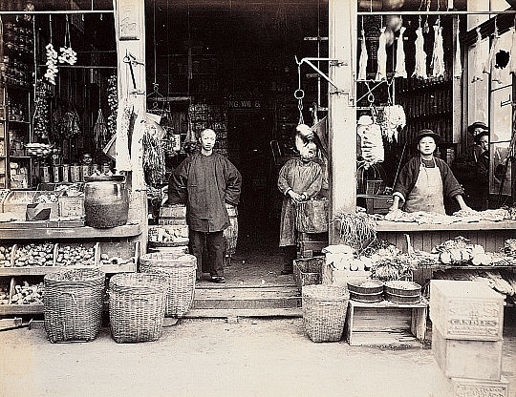
Having initially found success working on the railroad, thousands of Chinese immigrants became successful farmers and business owners across the west coast.

Slide 21
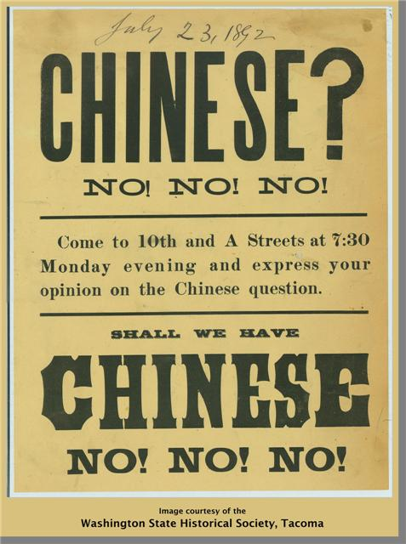
American farmers and businessmen did not like this competition and asked the government to prohibit allowing any more Chinese immigrants into America.

Slide 22
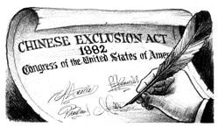
To that end, Congress passed the Chinese Exclusion Act. This law banned all immigration from China except for students, teachers, businessmen, tourists, and government officials.

Slide 23
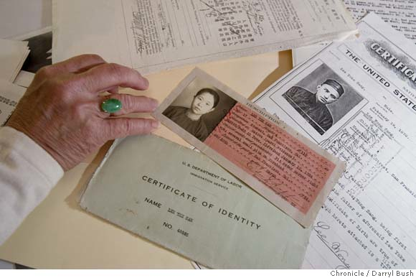
Those Chinese who were allowed in had to carry proof of their identity with them at all times.

Slide 24
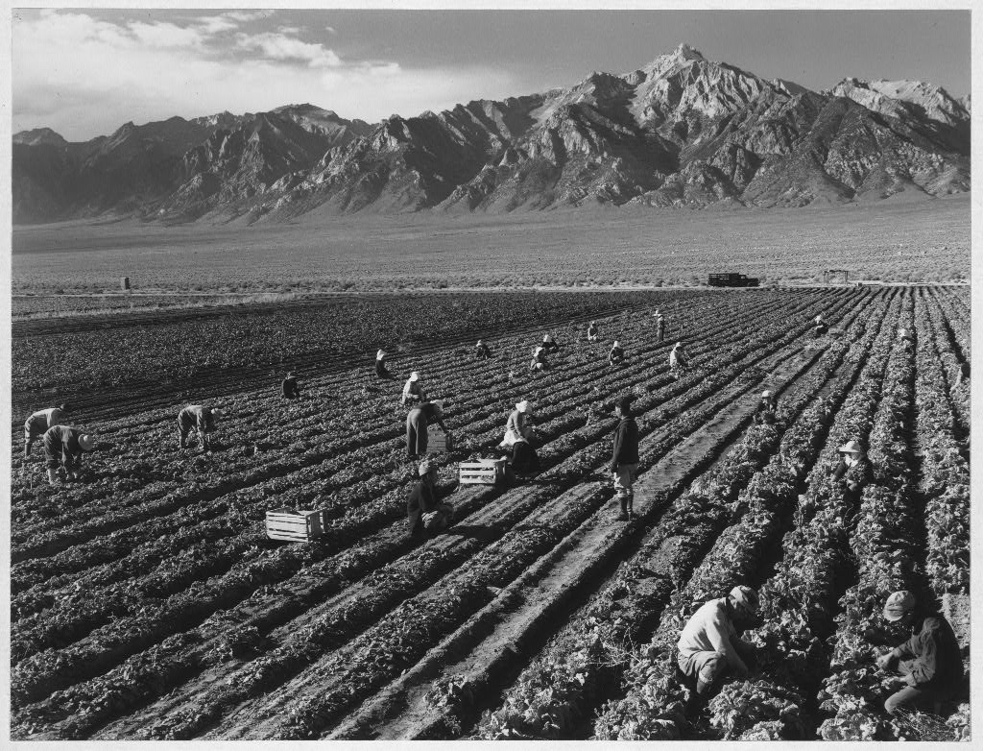
Japanese immigrants were disliked for many of the same reasons. They competed with American farmers and businessmen.

Slide 25
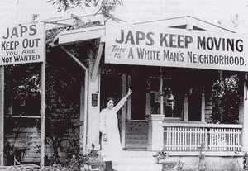

Slide 26
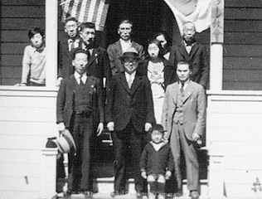
The city of San Francisco passed a series of laws segregating and persecuting Japanese immigrants. The government of Japan grew increasingly concerned about what was going on.

Slide 27
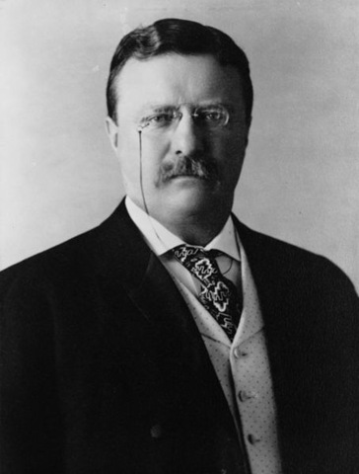
Pres. Theodore Roosevelt worked out the Gentlemen’s Agreement in 1907 under which discrimination would end if Japan agreed to prohibit unskilled Japanese workers to leave for the United States.

Slide 28
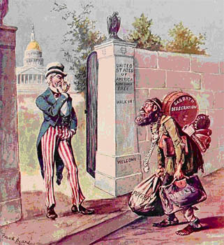
Immigrants from Asia weren’t the only ones targeted.

Slide 29
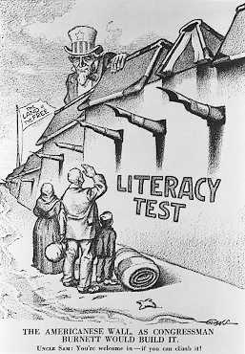
In 1917, Congress passed a law requiring all immigrants to take and pass a literacy test.
- Applied to any immigrant over the age of 16.
- Had to prove they could read at least 30 words in any language.

Slide 30
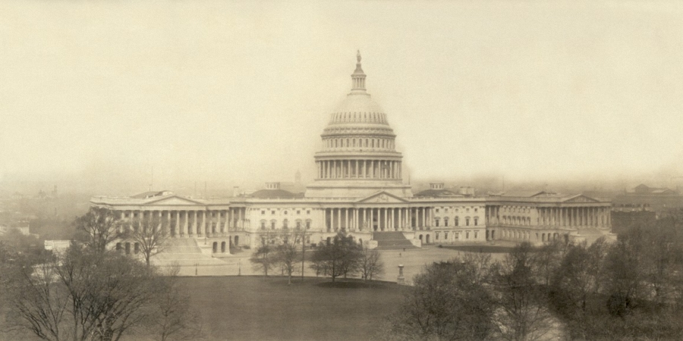
To further restrict immigration from all over the world, Congress passed the Emergency Quota Act in 1921.

Slide 31
Under the law the government set a yearly limit on the number of people allowed into the U.S. from each foreign nation. Once that limit was reached, no more immigrants could enter the U.S. from that nation until the next year.

Slide 32
Quotas were higher for nations in Northern and Western Europe than for nations in Southern and Eastern Europe. Why?

Slide 33
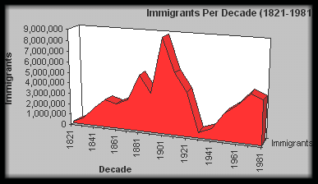

Slide 34
While the doors had been opened from the 1830’s to the 1890’s, by the 1920’s those doors were effectively shut.

Slide 35
Fin.

