Slide 1
The Rise of
Martin Luther
King Jr.

Slide 2
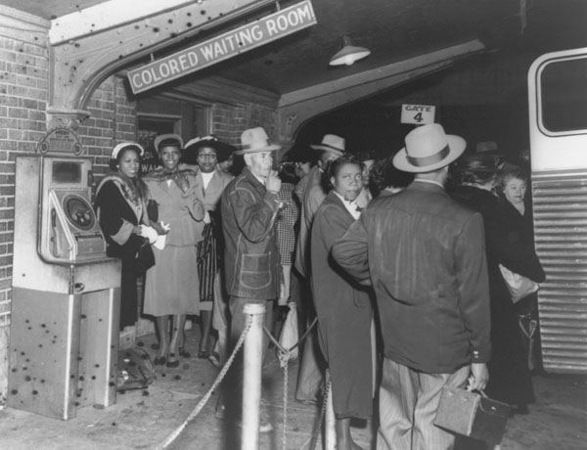
Two events were key in getting a push to end de jure segregation off the ground.

Slide 3
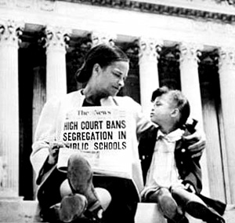
1954- The Supreme Court’s decision in the case of Brown v. Board in which the Court said….

Slide 4
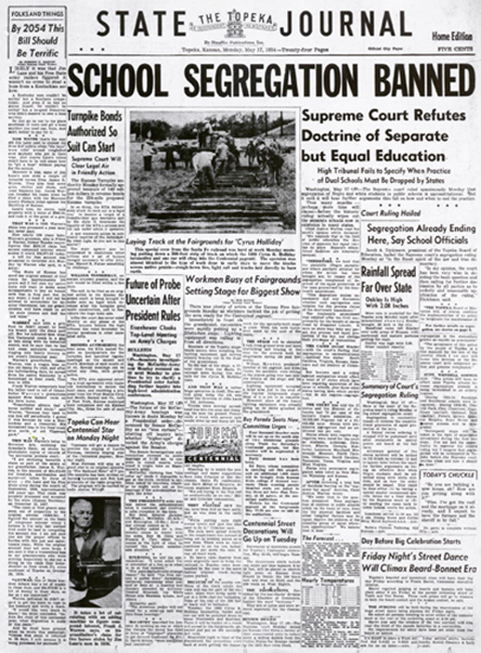
Why was this Supreme Court decision so important?

Slide 5
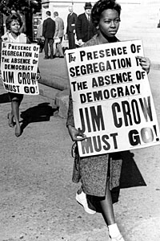
It made change possible.
It showed African-Americans that they had a powerful friend in the U.S. government that would help them in their quest to end Jim Crow.

Slide 6
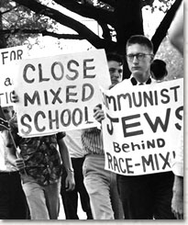
However, the Supreme Court’s decision didn’t accomplish a whole lot by itself. Why not?

Slide 7
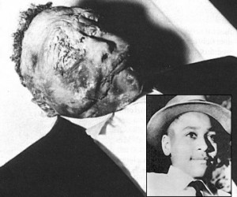
Event #2
1955- The murder of Emmett Till and the subsequent “not guilty” verdict at his trial.

Slide 8
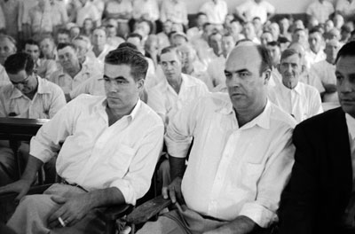
Why was this case so important?

Slide 9
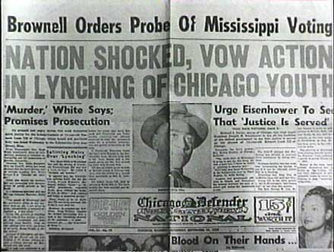
It pissed people off!

Slide 10
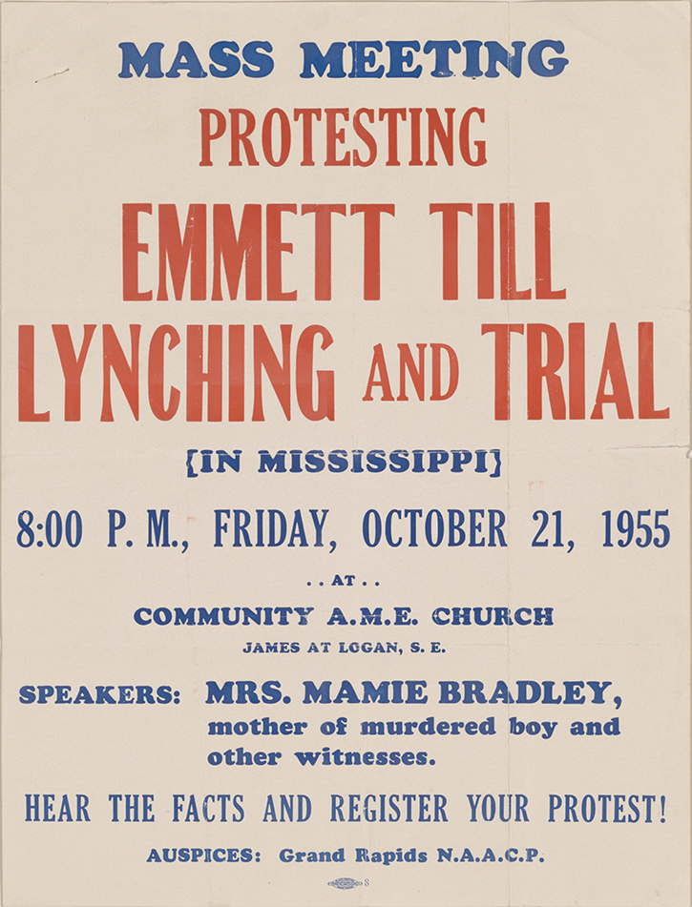
It outraged African-Americans, North and South, and inspired them to force change to happen.

Slide 11
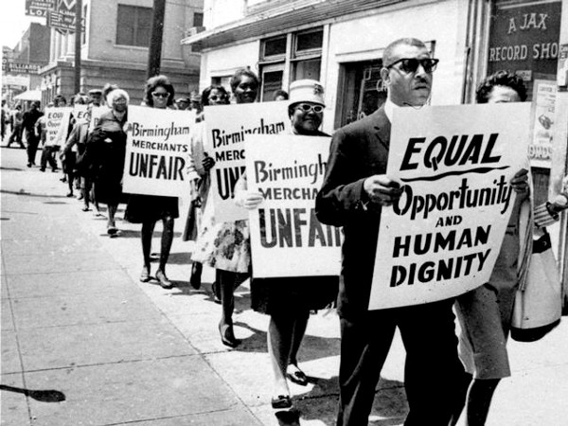
If the response of southern whites to the Supreme Court’s order to integrate was “make us”……
…. the Till case inspired African-Americans to say “Okay, we will!”

Slide 12
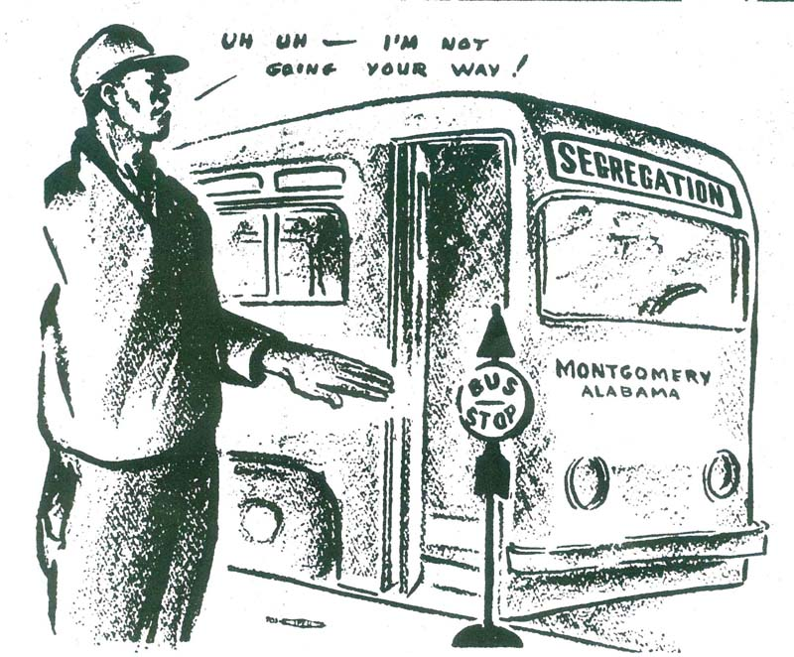
Montgomery Bus Boycott
Began in December 1955, after the arrest of several African-Americans who refused to give up their seats on segregated buses.

Slide 13
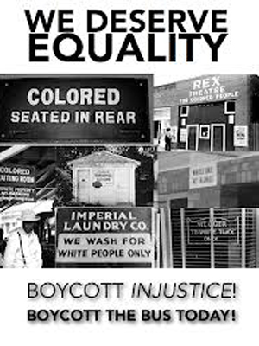
The bus boycott in Montgomery is important for three reasons.
1. It brought national attention to the issue of southern segregation.
2. The Supreme Court ordered public transportation to be integrated, further dismantling elements of de jure segregation / Jim Crow.

Slide 14
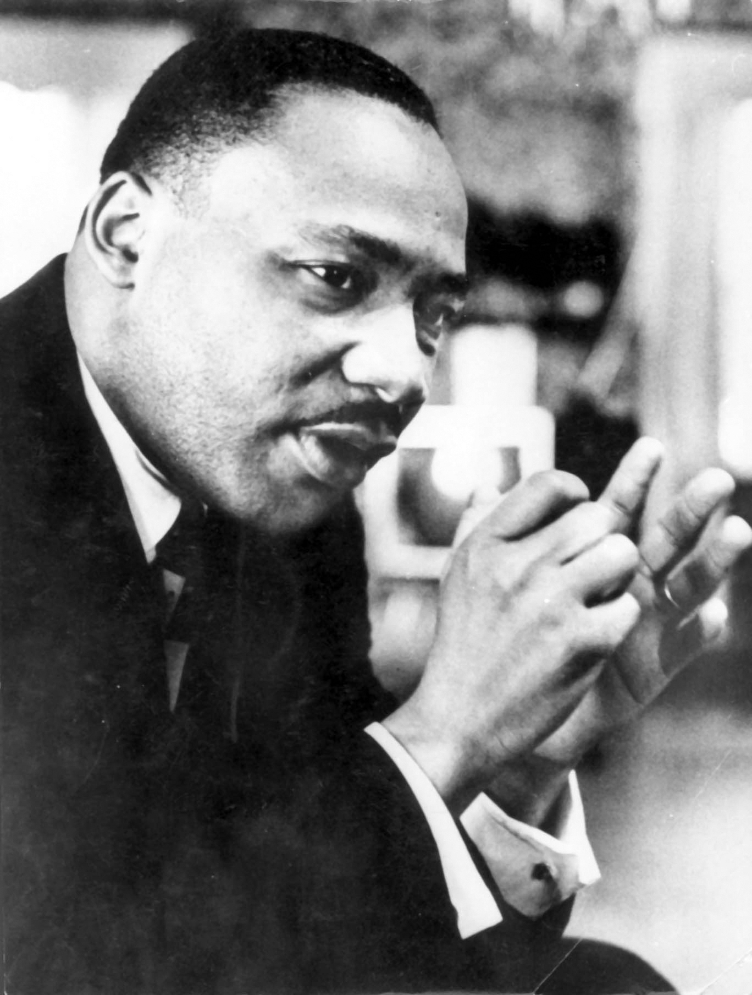
3. It pushed Martin Luther King Jr. to the front of the struggle to end inequality.

Slide 15
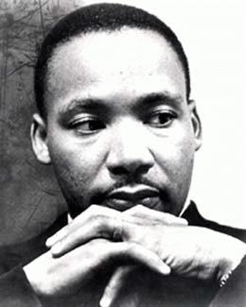
To help in that struggle, King and others formed the Southern Christian Leadership Conference (SCLC) in 1957.

Slide 16
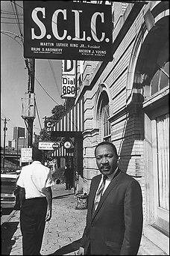
King and the SCLC had two real methods for forcing change:
1. Use sit-ins, marches, demonstrations, etc… to bring publicity to the cause. The idea was to use the power of television to show the inequality and unfair treatment of African-Americans in the South to the rest of the nation.

Slide 17
2. Boycott white owned and operated businesses that supported segregation and inequality. Cripple them economically and force them to accept integration.

Slide 18
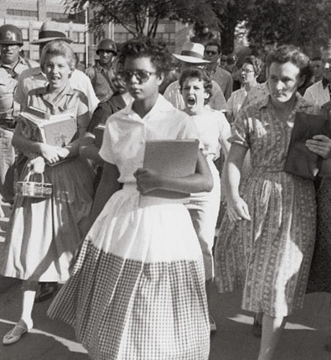
1957 also saw the federal government enforcing the Brown decision in Little Rock, AR.
President Eisenhower used the US army to escort the Little Rock Nine to the previously segregated Central High School.

Slide 19
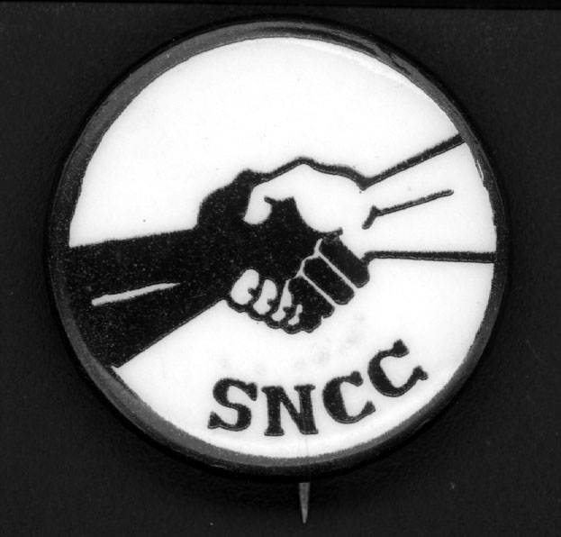
A new civil rights group run by young activists, the Student Nonviolent Coordinating Committee (SNCC), began in 1960 at a meeting in Raleigh, North Carolina.

Slide 20
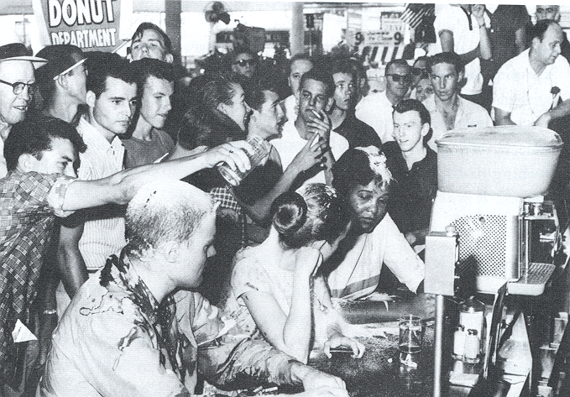
SNCC advocated a more confrontational approach than was advocated by other organizations like the SCLC.

Slide 21
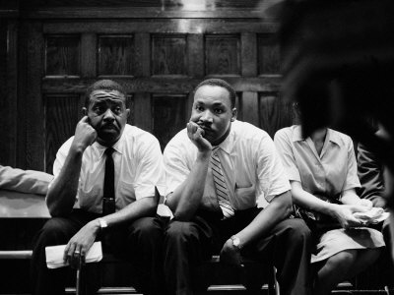
King and the SCLC had been reluctant to engage in SNCC’s confrontational style. Some younger elements of the civil rights movement began to question just how committed he was to the cause.

Slide 22
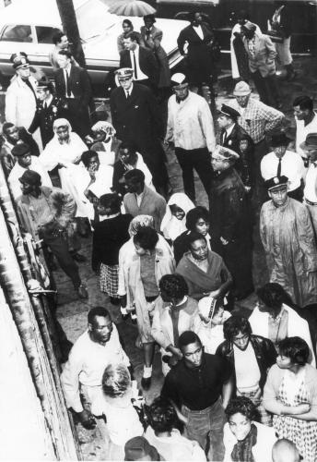
As a result, King and the SCLC joined SNCC in a series of demonstrations in Albany, Georgia in 1961.
There they collectively engaged in demonstrations and boycotts designed to end segregation in that city.

Slide 23
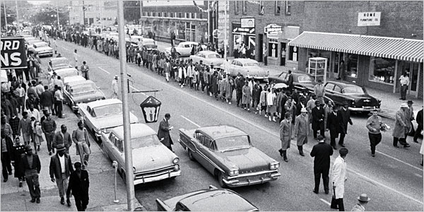
Despite over a year of almost constant protest, the city government refused to budge and King, the SCLC and SNCC had to deal with a fairly high profile failure.

Slide 24
Fin.

