Slide 1
The New Deal
Part II:
Recovery

Slide 2
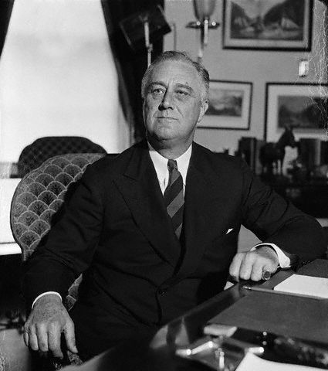
The second goal of FDR’s New Deal was Recovery. Remind me what this meant.

Slide 3
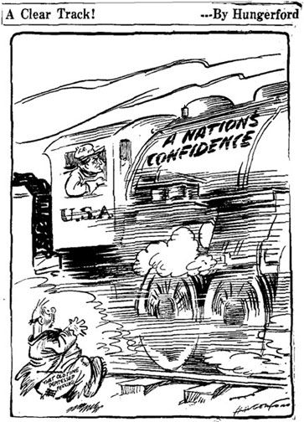
Roosevelt and Congress rolled out four important programs in the first 100 days of the New Deal to help get the economy back on track.

Slide 4
Civilian Conservation
Corps (1933)
Created 3 million jobs for men 18-25
Put to work “outdoors” planting trees, preventing soil erosion, cutting trails, building roads.
Provided with food, clothing, shelter on the job site.
Required to send $25 of every $30 made home to their families. Why?

Slide 5
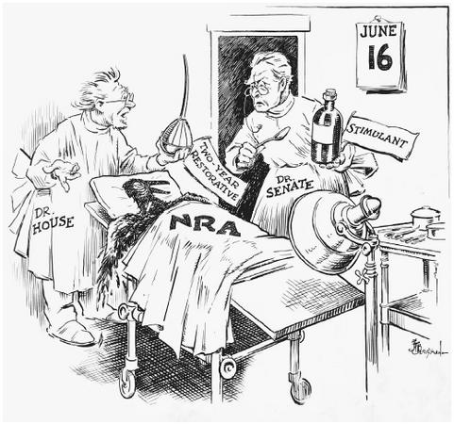
National Industrial Recovery Act (1933)
The NIRA created two additional government agencies, each with a different purpose:
The Public Works Administration
The National Recovery Administration

Slide 6
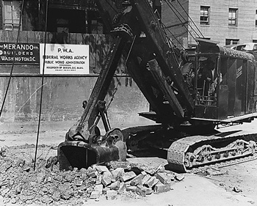
The PWA was designed to create even more jobs available to all Americans.
Public Works
Administration (1933)
These jobs were facilitated by the states and were mostly found in massive public works projects like roads, dams, and construction of govt. and public buildings.

Slide 7
Required a code of “fair competition” and initially set a minimum price for many products. Why set a minimum price?
Enforced a maximum 9 hr. work day, 45 hr. week. How would this help?
Established a minimum wage.
Formally recognized and protected organized labor unions.

Slide 8
All of this was voluntary. A business could choose to live by the codes or not. Problem?
To deal with this, the government created the Blue Eagle, a symbol of the NRA.

Slide 9
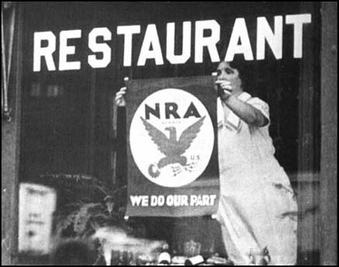
Companies and businesses who agreed to live by the rules hung the Blue Eagle in their windows. How was this supposed to help?

Slide 10
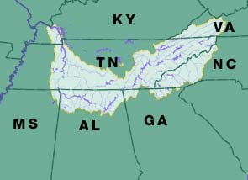
Things were bad across America during the Depression, but the suffering was especially bad in the Tennessee River Valley.

Slide 11
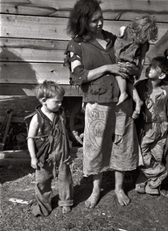
- Unemployment and poverty were rampant.
- Health care sucked.
- The farmland had been overused.
- Many towns and homes didn’t yet have reliable electricity.
- Flooding along the river was common.

Slide 12
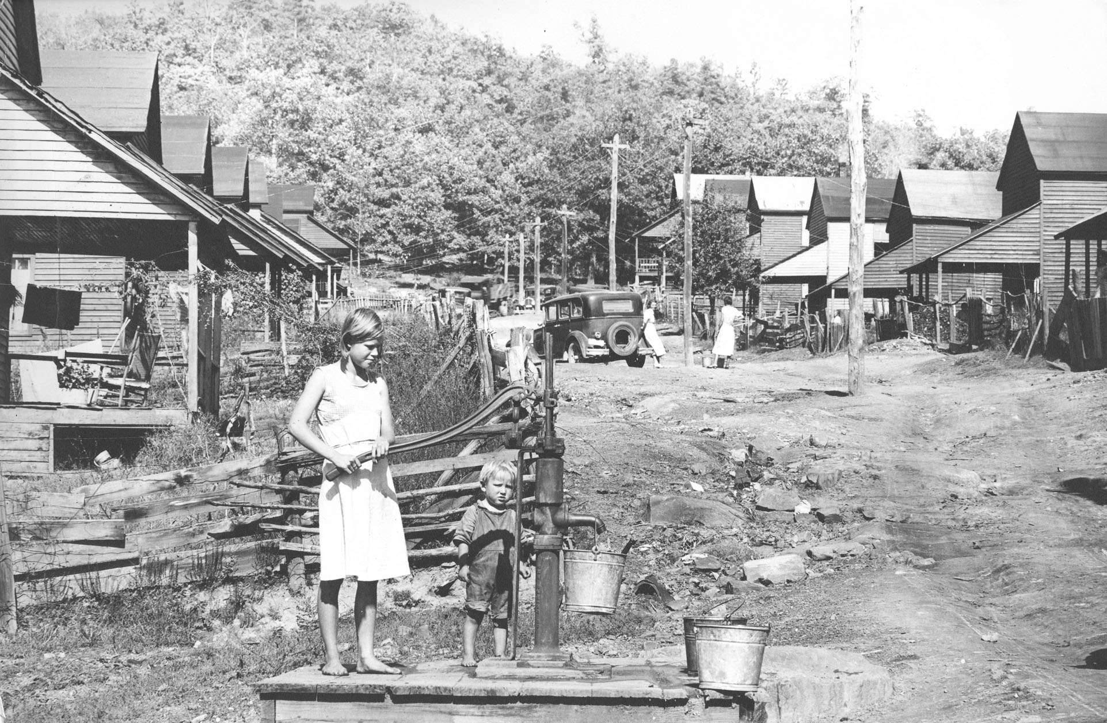
To solve all of these problems, Roosevelt proposed the Tennessee Valley Authority.

Slide 13
Tennessee Valley
Authority (1933)
- Established a company (TVA) owned and operated by the U.S. government.
- Hired workers to construct a series of dams on the Tennessee River. These dams controlled flooding and generated electricity. More importantly, they created jobs.
- The electricity was distributed throughout the area and sold by the U.S. government.

Slide 14
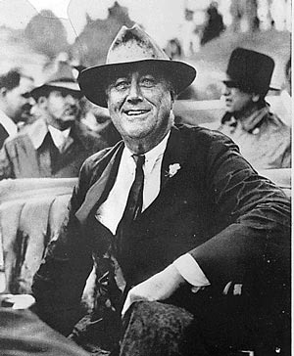
By 1935, Roosevelt realized that, while the programs and helped a great many Americans, there was still much to be done. Unemployment was still sky high.
So, in 1935 he unleashed his most massive job creation program.

Slide 15
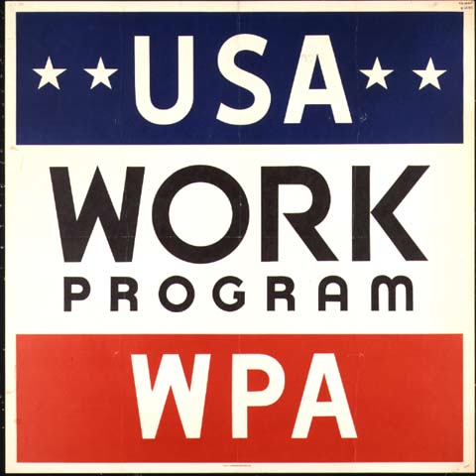
Works Progress Admin.
- $11 Billion for public works programs and projects
- Construction of government buildings, schools, airports, roads, etc.
- Also put more “educated scholars” to work in their fields of expertise.

Slide 16
Lousville Middle School

Slide 18
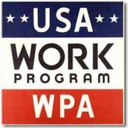
Roosevelt had two goals with the PWA, TVA, WPA, CCC, and other such programs:
1. Get people a paycheck so they could buy things.
2. Don’t just give them a handout.
Why the difference?

Slide 19
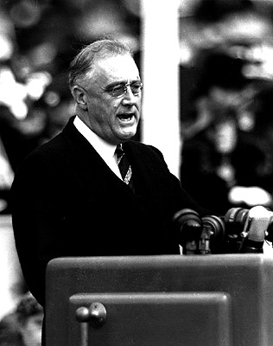
As the size, scope, and expense of the New Deal became apparent to the nation, critics began to attack FDR from all sides.

Slide 20
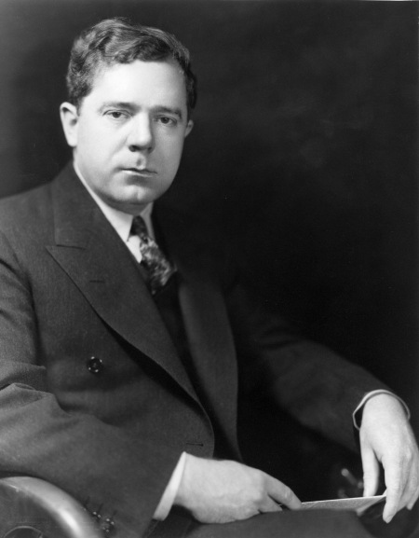
The most famous critic was Sen. Huey Long, who argued that for all that the New Deal had done, it had not done enough.

Slide 21
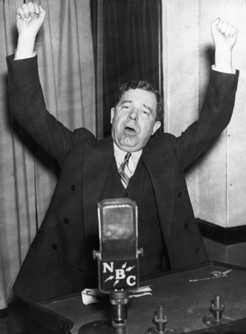
He put forth his own “Share Our Wealth” proposal.
- Wanted to make “every man a king.”
- Promised a minimum yearly income of $5,000.
- Would be paid for by raising huge taxes on the wealthy.
- Assassinated in 1935.

Slide 22
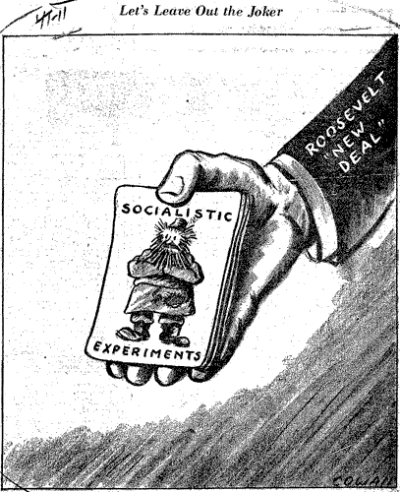
More conservative, big business oriented laissez faire Republicans began to repeat one word:
Socialism.
Evidence?

Slide 23
By 1935, New Deal programs had created millions of jobs, providing millions of American families with a paycheck. Things seemed to be turning around.

Slide 24
Fin.

Slide 25
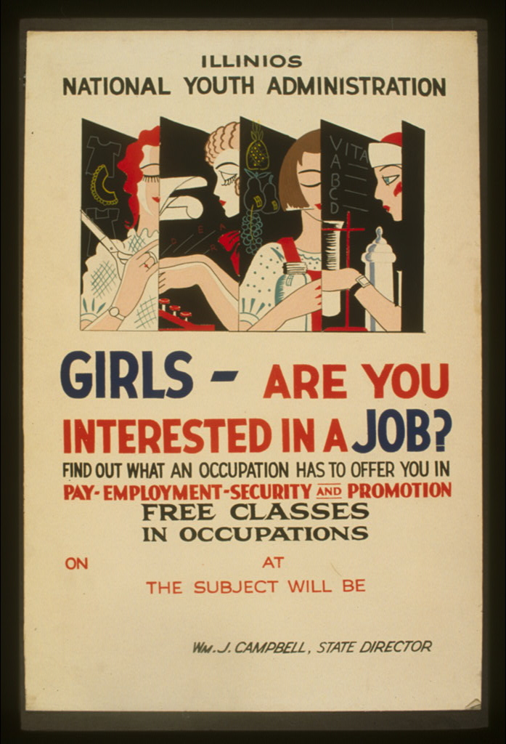

Slide 27
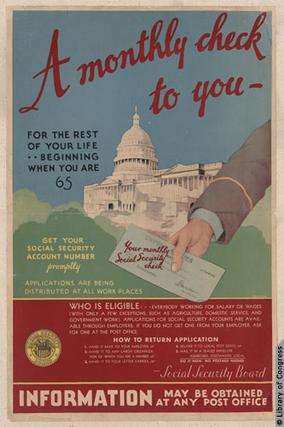

Slide 29
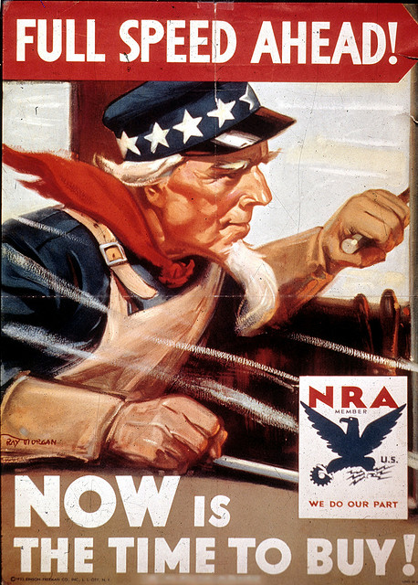

Slide 30
Now, it’s your turn. In order to let Americans know what type of help they can receive from the government through the New Deal, you need to show them by creating four high quality posters of your own. Those posters should:
- Advertise four different programs that we’ve talked about:
FERA HOLC AAA Social Security
CCC PWA NRA TVA WPA
- Let people know what type of help they can receive and what opportunities are open to them.
- Include both words and drawings.
- Be in full color!
- Be the best work you can do.
Plan out what you’re going to do. Don’t just start drawing. Give them some thought. They will be due at the end of the period and will be graded for their clarity and appearance.

