Slide 1
William McKinley
and the
“American Empire”

Slide 2
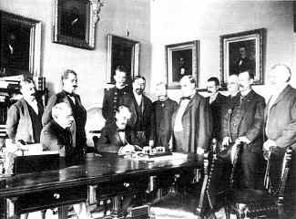
Remember that after a fairly brief war, Spain surrendered to the United States August 12, 1898. They then quickly signed the Treaty of Paris, 1898.

Slide 3
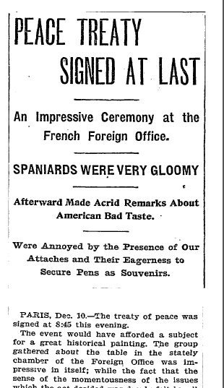
What were the terms of the peace settlement?
Spain gave the colonies of Puerto Rico and Guam to the United States.
Cuba was granted its independence.
America paid Spain $20 Million to acquire the Philippines. Why?

Slide 4
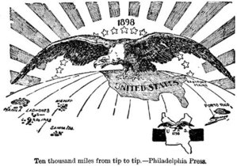
After expanding the “empire” America’s next job was to govern it.

Slide 5
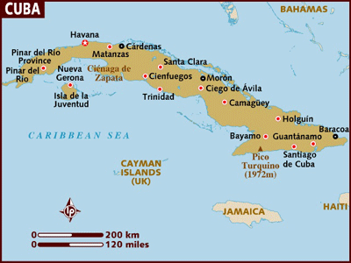
Through the Teller Amendment, Congress pledged to give Cuba its independence. However…

Slide 6
Congress also passed the Platt Amendment, designed to allow the U.S. government to keep a close eye on Cuban affairs.

Slide 7
Platt Amendment
Cuba could not sign any foreign treaty that threatened its independence.
Cuba had to allow the US to intervene to preserve Cuban independence and to protect life liberty and property.
Cuba was forced to give land to the US government for a naval base.
Cuba was technically free, but was kept under the thumb of American power.

Slide 8
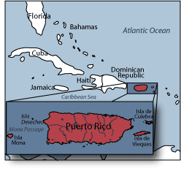
Congress also passed the Foraker Act in 1900 assigning Puerto Rico the status of an unincorporated territory.

Slide 9
Under this act, the President of the United States appointed the governor and upper house of the legislature.
The people themselves elected the lower house.

Slide 10
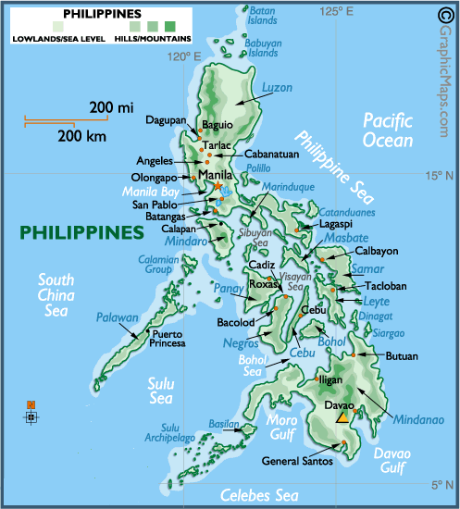
The goal of bringing order to the “empire” proved especially difficult in the Philippines

Slide 11
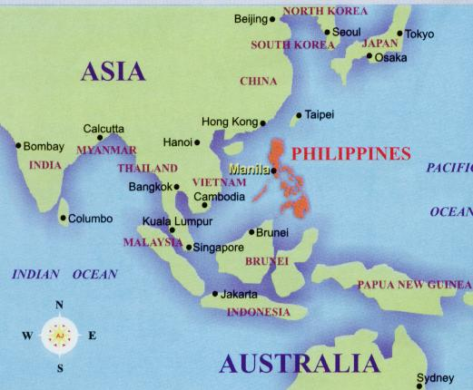
Why did many Americans want the U.S. to take the Philippines?

Slide 12
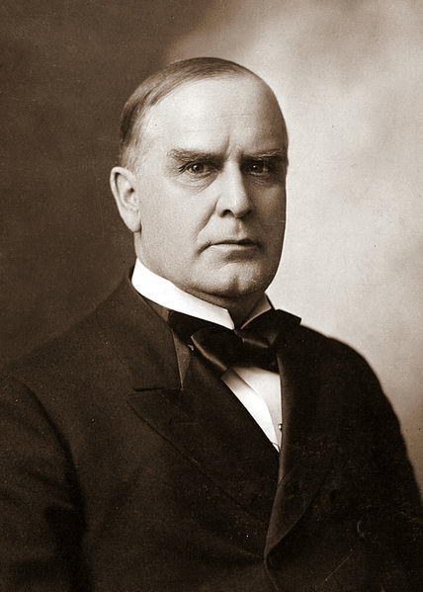
President McKinley was unsure what to do.
The war had really been about Cuba and he wasn’t sure the U.S. was justified in taking the Philippines too.

Slide 13
However, he also didn’t simply want to set them free either. Any possible reasons as to why?

Slide 14
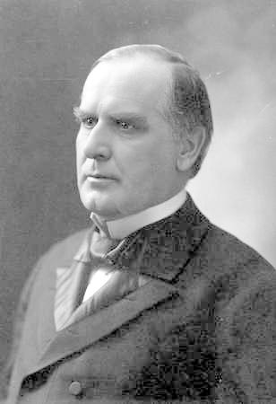
In seeking out advice as to what to do with the Philippines, McKinley turned to an unlikely source.

Slide 15
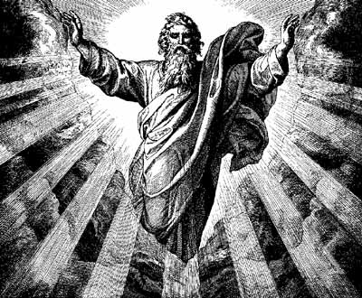

Slide 16
According to McKinley, God told him the U.S. should annex the Philippines. Why?

Slide 17
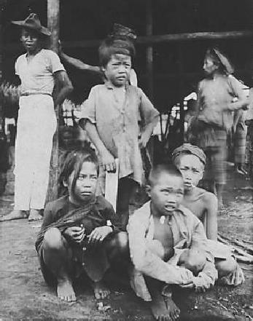
The problem was that Filipinos didn’t want to be annexed. What did they want instead?

Slide 18
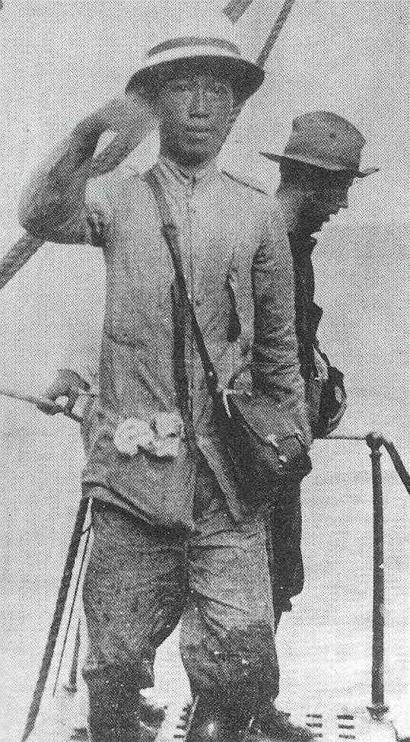
As such Filipinos, led by Emilio Aguinaldo, pushed for independence from U.S. control.
An official rebellion was begun on Feb. 4, 1899.

Slide 19
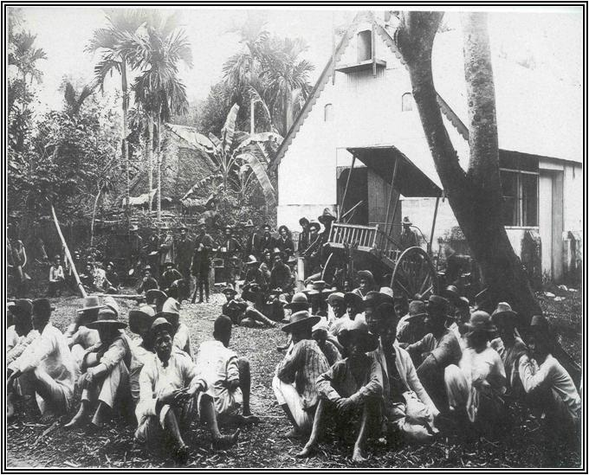
Aguinaldo, and his rebel forces, used guerilla tactics against the United States army that had remained in the Philippines following the war with Spain.

Slide 20
Having made the decision to annex the Philippines, President McKinley ordered the military to crush the rebels.

Slide 21
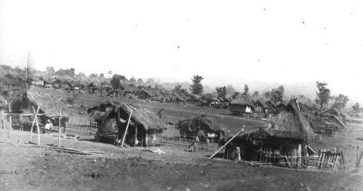
The U.S. army responded by rounding peasants into "reconcentration camps.“ No distinctions were made between combatants and civilians. Sound familiar?

Slide 22
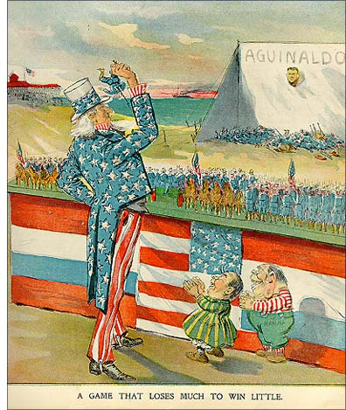
Some in America began to argue that McKinley was wrong. The U.S. should NOT be taking the Philippines at all, especially by force.

Slide 23
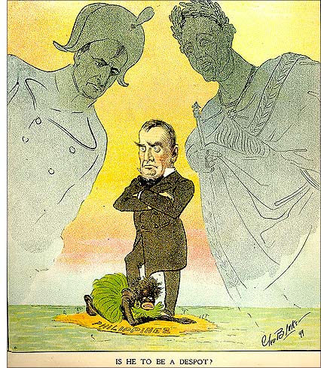
Critics argued that McKinley and the U.S. were violating the founding principles of this country in their actions toward the Filipinos.

Slide 24
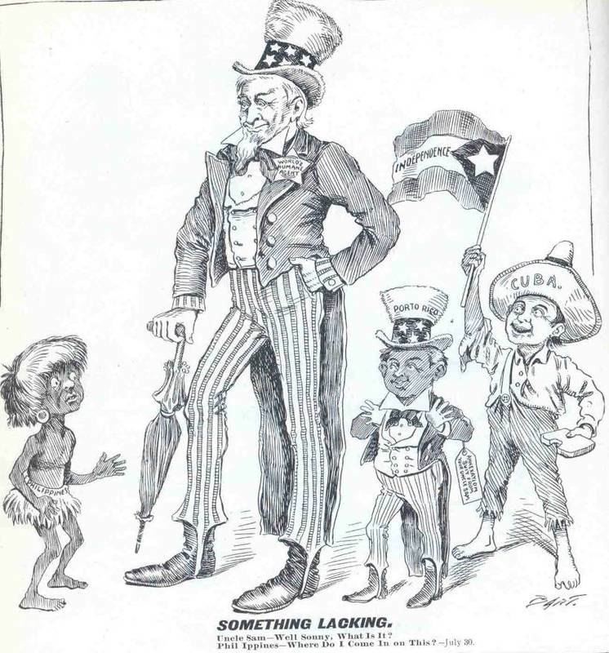

Slide 25
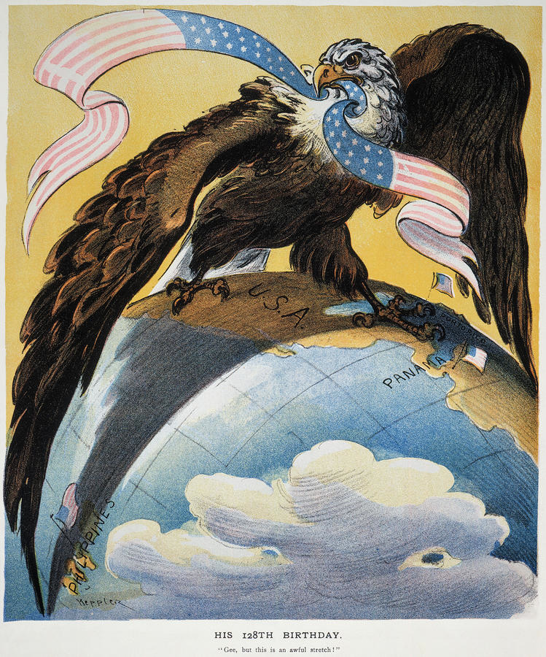
Supporters of American expansion argued that we were providing the Philippines with democracy, that we were civilizing them.

Slide 26
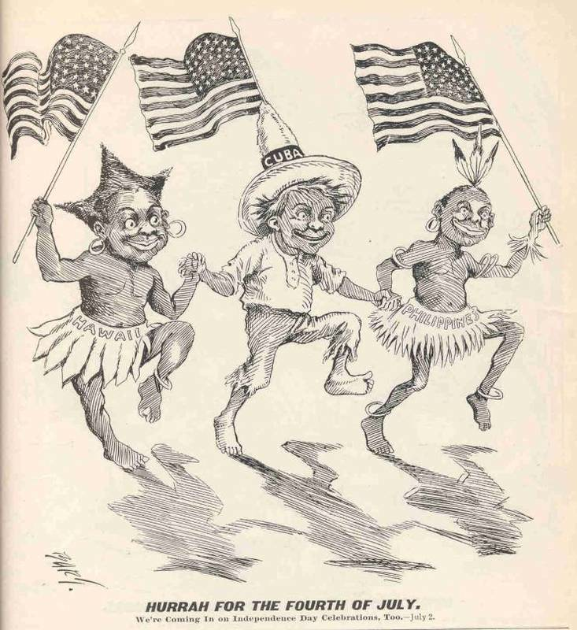

Slide 27
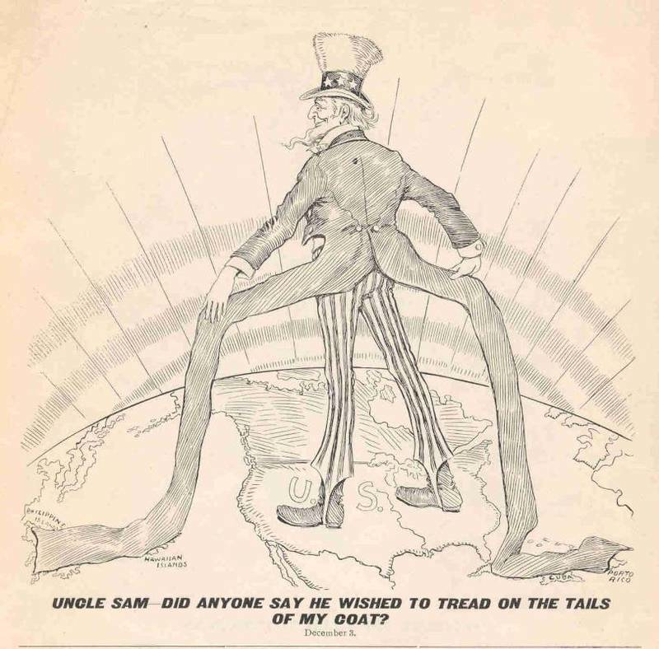

Slide 28
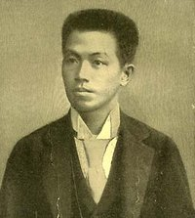
The uprising came to a swift end in 1901 when U.S. forces captured Aguinaldo and forced him to take a public loyalty oath to the United States.

Slide 29
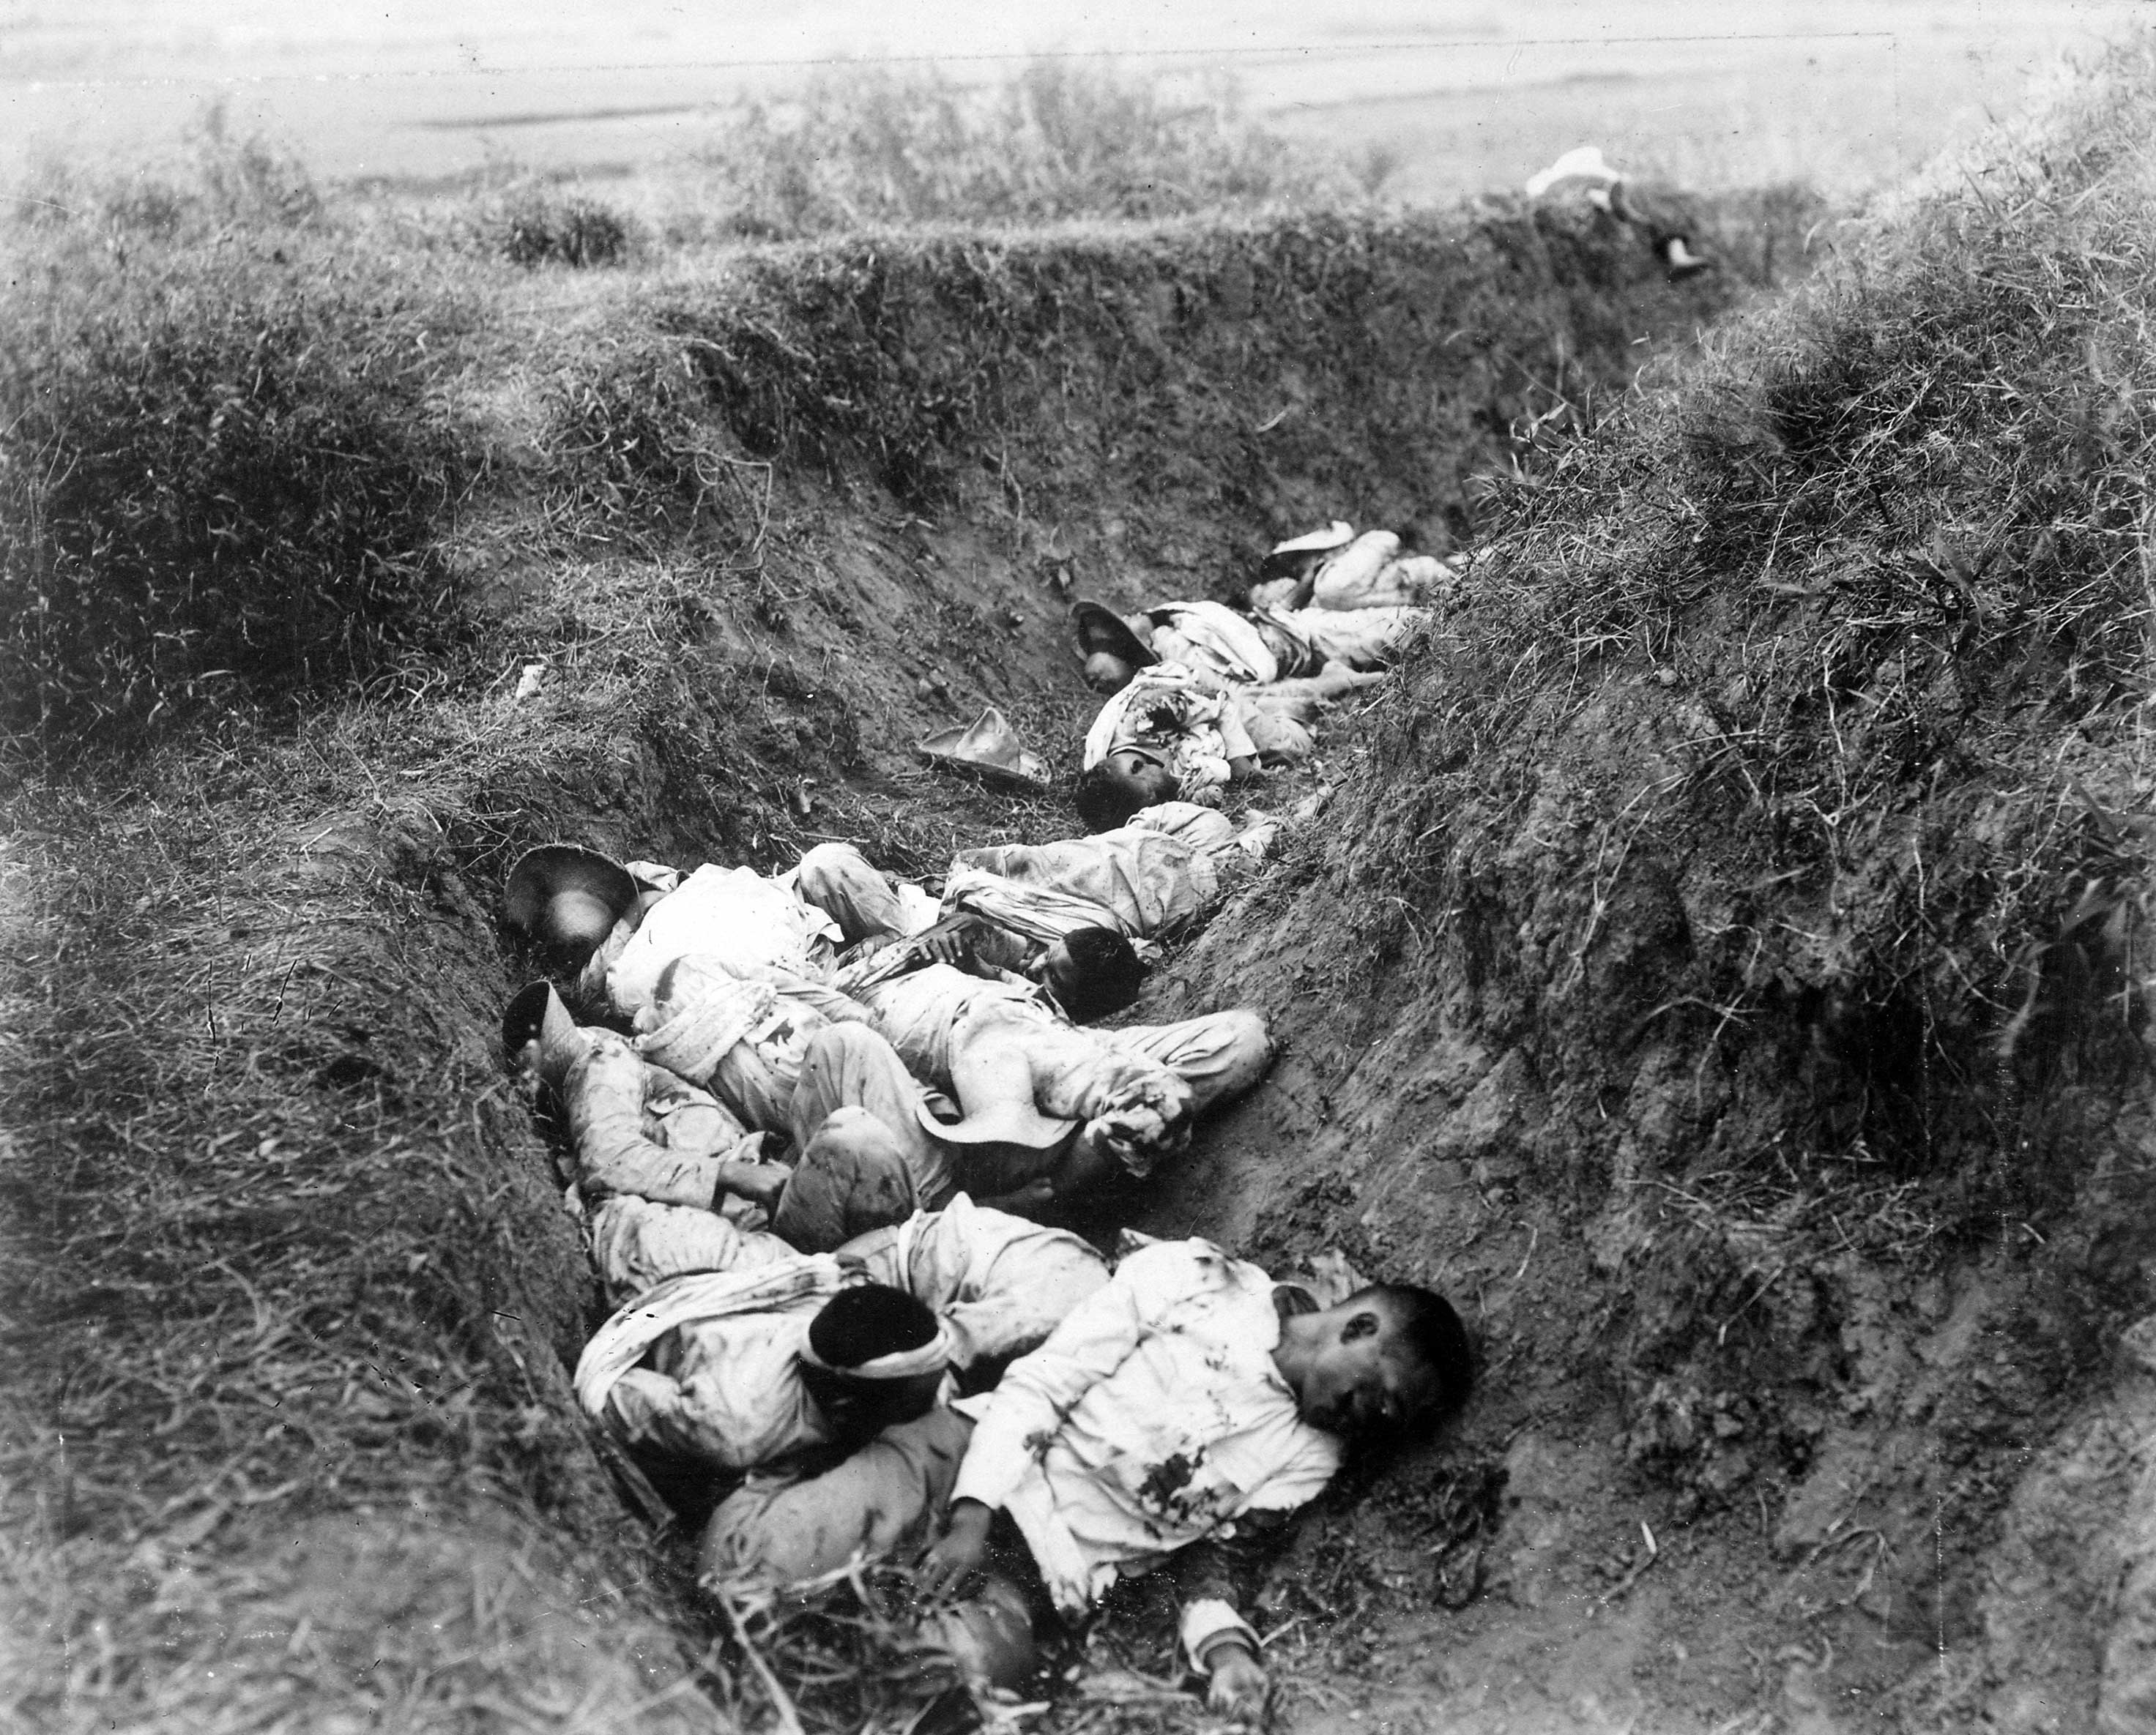
4,200 American and 16,000 Filipino soldiers are thought to have been killed in the fighting.

Slide 30
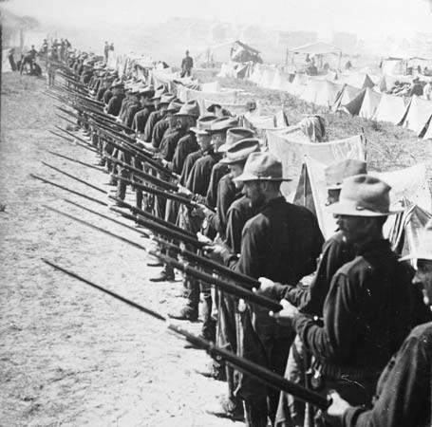
By comparison, the total number of U.S. causalities in the war with Spain, including those killed on the U.S.S. Maine totaled 3, 549.

Slide 31
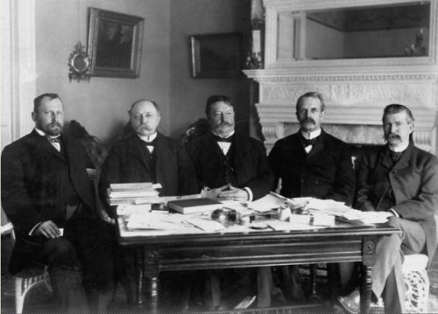
McKinley dispatched William Howard Taft to the Philippines as head of the Philippine Commission. This commission was charged with “Americanizing” the Filipinos, whether they wanted it or not.

Slide 32
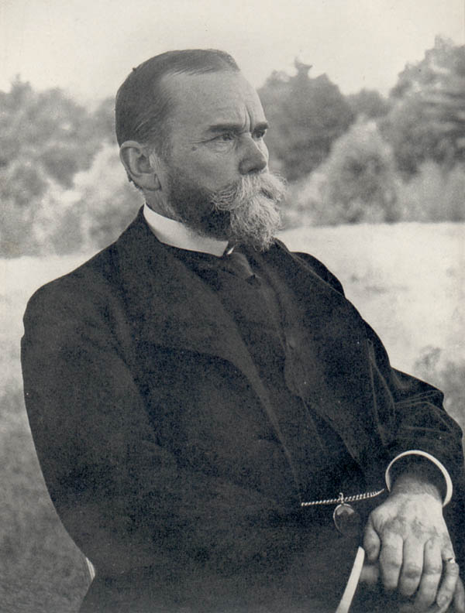
To further U.S. influence in Asia, Sec. of State John Hay attempted to force America’s way into the lucrative marketplace of China.

Slide 33
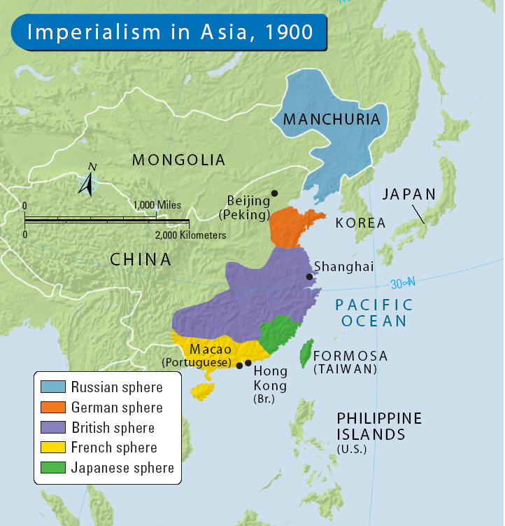
The European powers had carved China up into monopolistic spheres of influence, and Hay saw that American was left out of the picture.

Slide 34
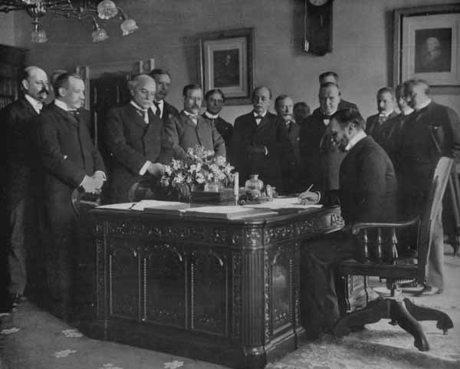
In his “Open Door Notes,” Hay argued that the established powers should open the door to their spheres recognizing the rights of China, and the rights of economic competition.

Slide 35
None of the established powers formally accepted these “Open Door Notes.”
But, none of them had outright rejected them either.

Slide 36
As none of the powers specifically said “No!”, Hay announced that they had been accepted and that the U.S. expected the powers of Europe to live by them.

Slide 37
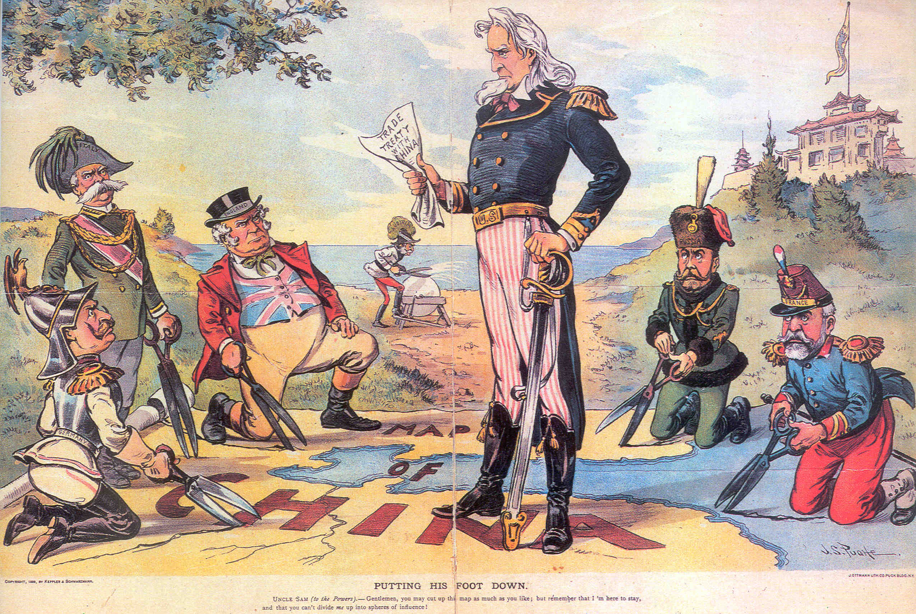
Uncle Sam to the European powers….”Gentlemen, you may cut up the map as much as like; but remember that I’m here to stay and that you can’t divide me up into spheres of influence”.

Slide 38
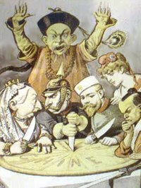
In this whole process, no one asked the people of China what they wanted.
Had we asked, the Chinese would have told us they wanted to be left alone!

Slide 39
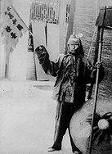
In this atmosphere, a secret society, known as the Fists of Righteous Harmony, attracted thousands of followers.
Foreigners called members of this society "Boxers" because they practiced martial arts.

Slide 40
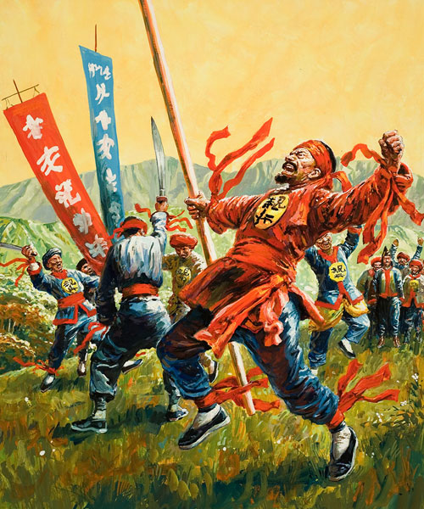
The Chinese government rallied the Boxers and together, they pushed to drive all foreign influence out of China. Thus began the “Boxer Rebellion” in 1900.

Slide 41
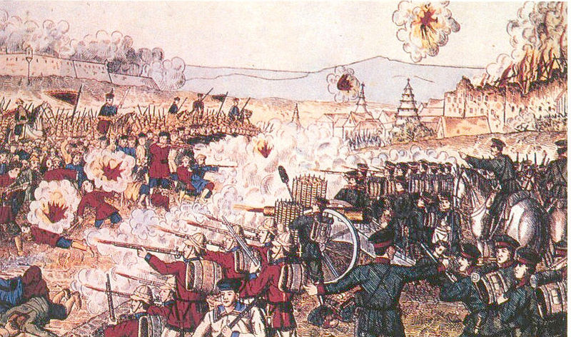
Concerned for the safety of their citizens, and their lucrative trading deals, the U.S. and the European powers invaded China in 1900 and put down the Boxers.

Slide 42
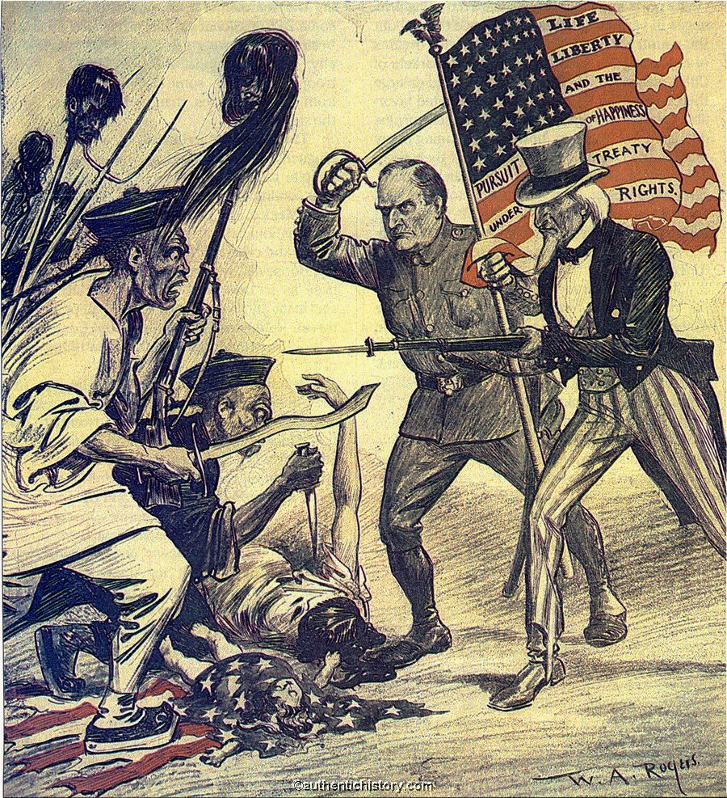
U.S. soldiers did their part by capturing Peking, the capital of China now known as Beijing.

Slide 43
China would continue to be dominated by foreign powers for 45 more years.

Slide 44
Fin.

Slide 45
We have seen and talked about several political cartoons and pieces of propaganda commenting on American imperialism.
Now it’s your turn!
Your task is to draw two awesome cartoons / propaganda that do the following:
- 1 should SUPPORT America’s actions. It should convince people that America is doing the right thing.
- 1 should REJECT America’s actions. It should convince people that what America is doing is wrong.
- Both must contain words and picture and be in full color.
- They are due at the end of class today!

