Slide 1
1950’s
American
Conformity

Slide 2
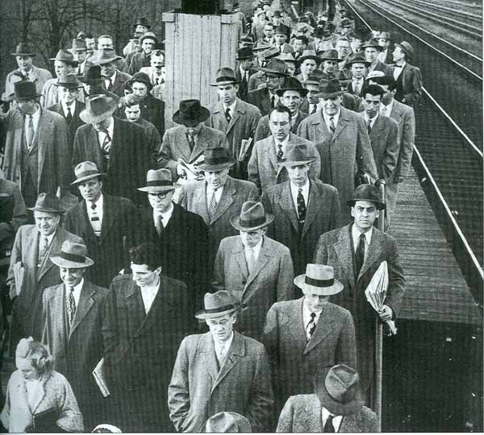
Throughout the decade of the 1950’s “Middle Class” Americans thought, acted, looked, and lived the same.
Given this time of mass conformity, there are three things we need to examine:
Evidence of conformity
Why people desired conformity
Challenges against that conformity

Slide 3
Examples
of 1950’s
Conformity

Slide 4
The Baby
Boom

Slide 5
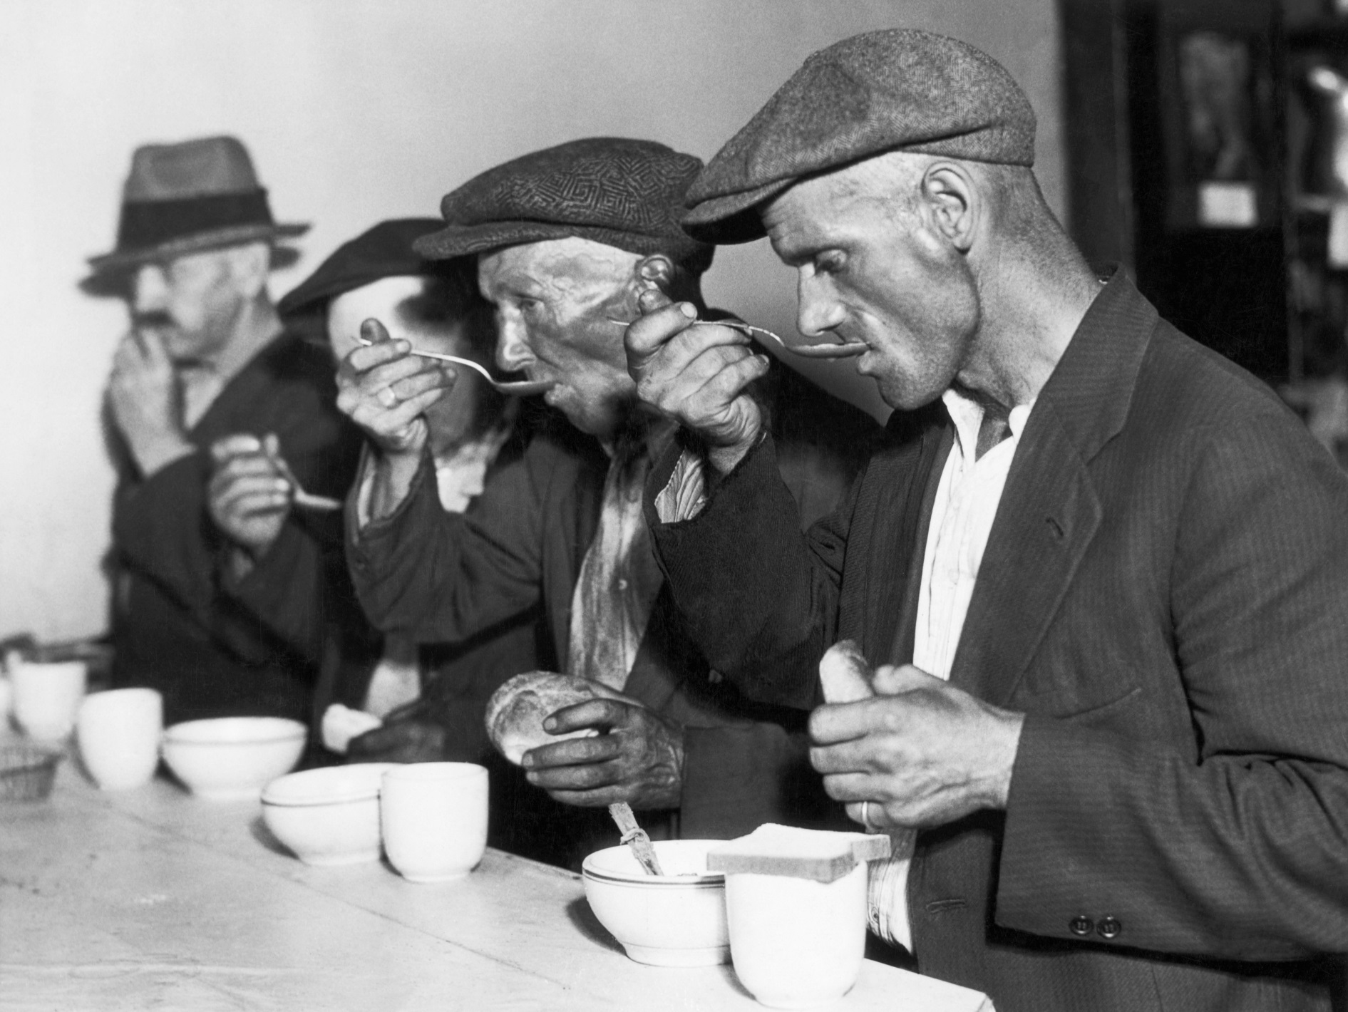
During the 1930’s many couples thought twice about having children. Why?

Slide 6
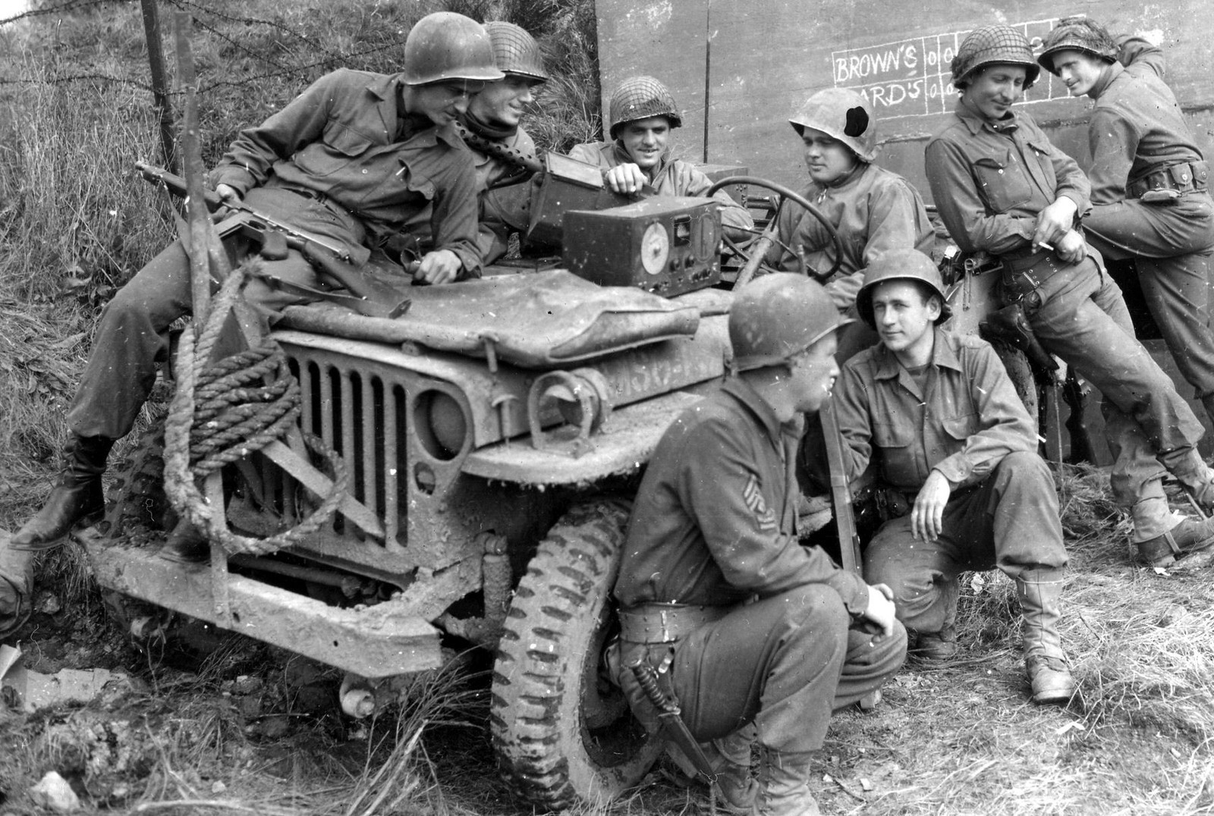
During the 1940’s many couples thought twice about having children, or were otherwise prevented from having them. Why?

Slide 7
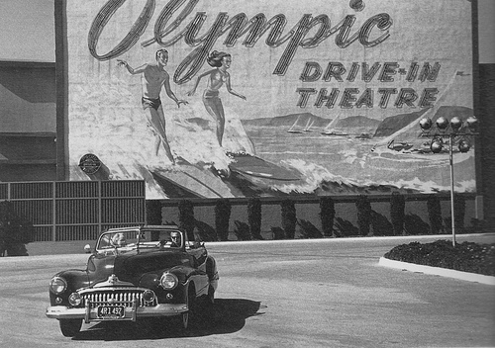
By 1950, those problems were mostly gone.

Slide 8
America’s soldiers came home and readjusted to civilian life.
The G.I. Bill enabled record numbers those soldiers to attend college and trade schools and qualify for a low interest home loan.

Slide 9
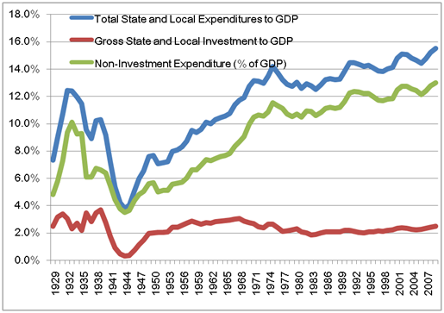
Consumer spending, and government investment in cold war military production allowed the US economy to grow by leaps and bounds.

Slide 10
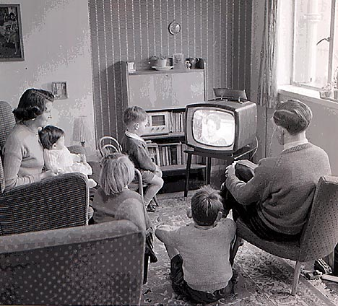
These factors provided the perfect conditions for couples to have children.

Slide 11
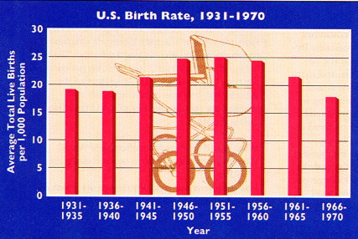
1957 → 1 baby born every 7 seconds

Slide 12
2. The Growth of
Suburbs

Slide 13
With the growth of families, new housing needs arose. Increasingly, families found that housing in the suburbs.

Slide 14
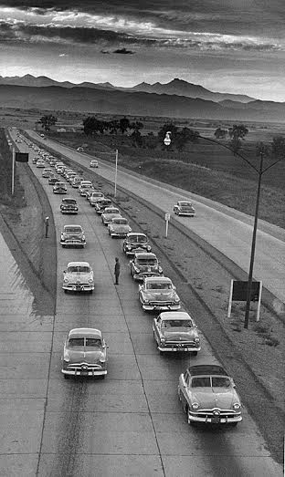
Middle class families were increasingly able to move from downtown areas of cities, to the outskirts of those cities.
Two things really made this possible:
Government home loans
The new interstate highway system

Slide 15
Why would a family choose to live in the suburbs instead of downtown?

Slide 16
Levittown, NY “The American Dream”
1949 → William Levitt produced 150 houses per week.
$7,990 or $60/month with no down payment. (About $100,000 today)

Slide 17
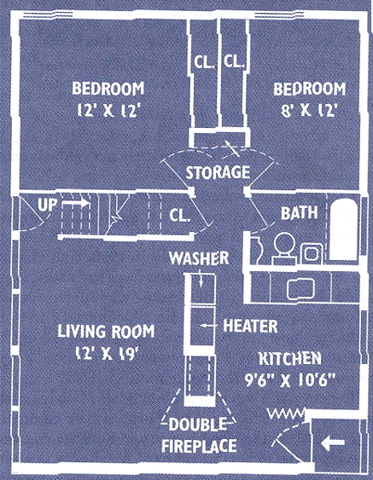
1 story high
12’x19’ living room
2 bedrooms
1 bathroom
garage
small backyard
front lawn
By 1960 → 1/3 of the U. S. population in the suburbs.

Slide 18
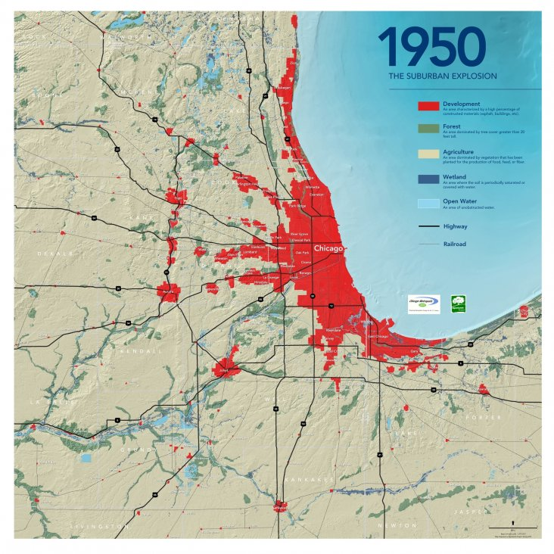
This move to the suburbs had important consequences:
White, middle class families increasingly left the cities.
Who remained behind?

Slide 19
Gender
Roles

Slide 20
Middle class society had very clear expectations for men, women and teenagers.

Slide 21
Men:
Breadwinner: Go to work, earn a paycheck, support the family
Boss of the house, king of the castle: Wife and kids do what he says

Slide 22
Women:
Left the wartime workforce and went home to raise children
Homemaker: Take care of the family, take care of the house
Cook, clean, and look good doing so! (Dress, heels, makeup, hair done)

Slide 23
Women:
Some middle class women continued to work.
Those that did were usually single and often quite those jobs when they got married.
Did stereotypical women’s job: teacher, librarian, nurse, secretary

Slide 24
Single middle class men and women were expected to get married and to stay that way. Divorce wasn’t really an option.

Slide 25
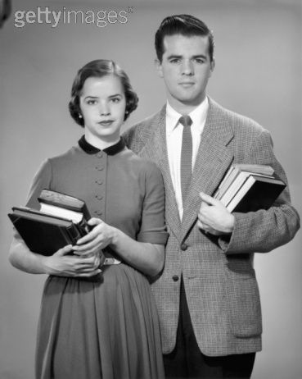
Teenagers:
Obey authority (parents, teachers, cops, anyone older and therefore wiser than you)
Don’t make waves, fit in with the group
Control your emotions
Don’t even think about S.E.X. !!!

Slide 26
4. Television

Slide 27
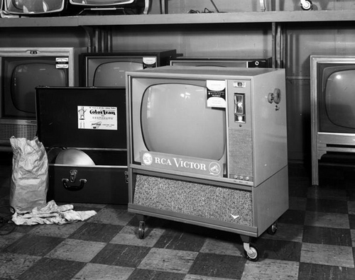
1946 → 7,000 TV sets in the U.S.
1950 → 50,000,000 TV sets in the U.S.

Slide 28
Many popular shows celebrated traditional American values. (Truth, Justice, and the American way!) Why?

Slide 29
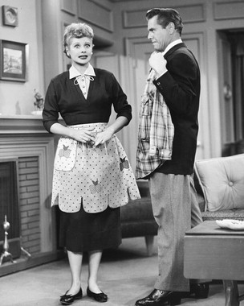
Many of the most popular shows reflected society’s gender expectations.
I Love Lucy
1951-1957

Slide 30
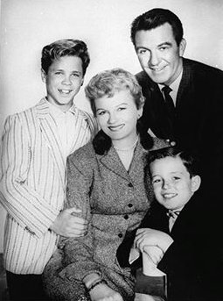
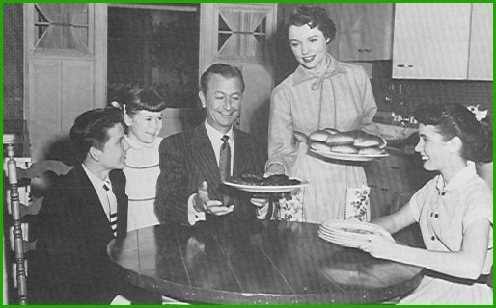
Leave It to Beaver 1957-1963
Father Knows Best 1954-1958

Slide 31
5. Consumer Culture

Slide 32
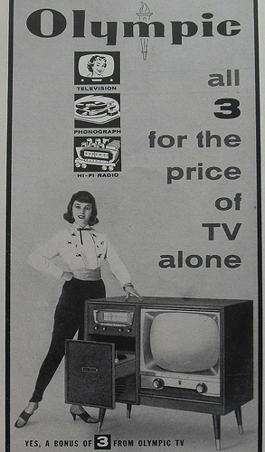
With a booming economy, people had money to spend. As such, they bought the latest and greatest stuff, stuff they had seen advertised on television.

Slide 33
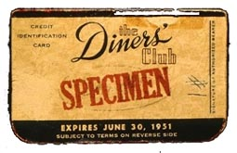
Some Americans couldn’t afford to buy what their neighbors were buying. How could they get in on the action?

Slide 34
6. Church

Slide 35
More and more American families went to church.
Church membership:
1940 → 64,000,000 1960 → 114,000,000
Today in the U. S., the Christian faith is back in the center of things.
-- Time magazine, 1954
Why?

Slide 36
Why did
middle class
Americans
desire conformity?

Slide 37
- Watch out for those who don’t conform, for those who stick out! Why?

Slide 38
The early Cold War was full of constant tension and anxiety
Conformity was comfortable.
People knew what to expect from their daily routine.

Slide 39
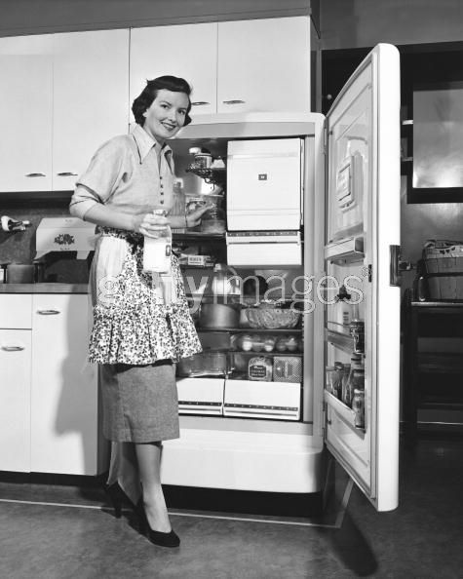
Although the vast majority of middle class Americans embraced this culture of conformity, there were those who rejected it and denounced a society full of short comings.

Slide 40
Challenges
to
Conformity

Slide 41
Rock n’ Roll
How did music represent a challenge to the conformity of the 1950’s?

Slide 42
Sexual Practices
Sociologist Alfred Kinsey began to study what Americans were up to behind closed doors. 1948 → Sexual Behavior in the Human Male 1953 → Sexual Behavior in the Human Female
Kinsey reached two conclusions about Americans:
1. Premarital sex was common.
2. Extramarital affairs were frequent among married couples.

Slide 43
Sexual Practices
Hugh Hefner launched Playboy magazine in 1953.
“The Girl Next Door”
Sex is okay!

Slide 44
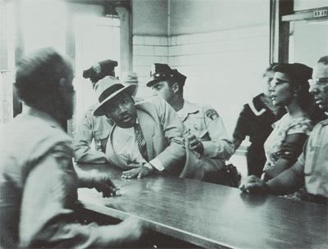
Civil Rights Movement

Slide 45
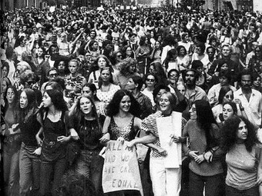
Feminist Movement

Slide 46
Fin.

