Slide 1
Organized
Labor
in the
Gilded Age

Slide 2
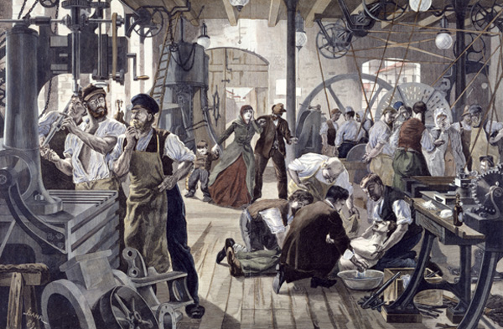
As it became clear that the government and business leaders were largely going to ignore working conditions and wages, workers began to take matters into their own hands.

Slide 3
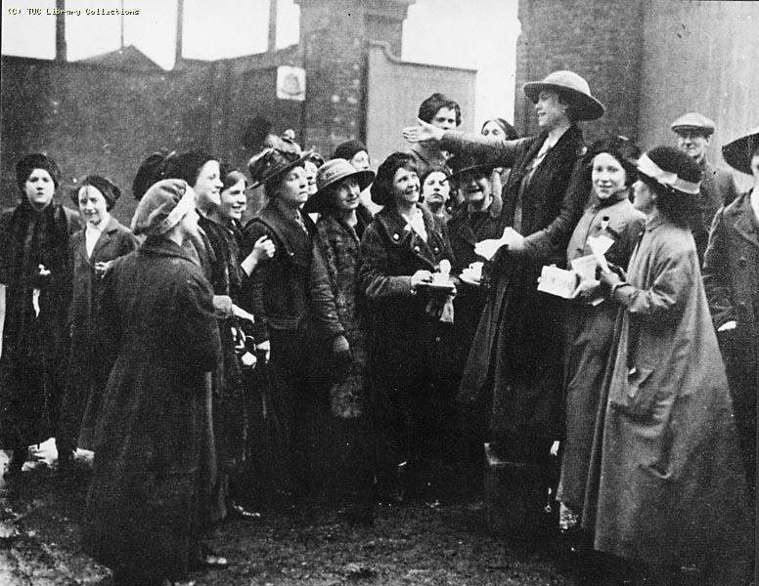
Thus, to begin to push for improvements, workers in American cities began to unionize.

Slide 4
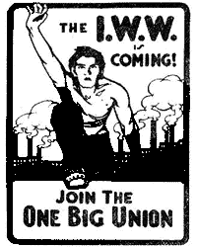
How do unions work?
Essentially the workers in any given industry / factory / business etc.. unite together to push for change.
Why do they believe they will be successful in getting what they want if they all push together?

Slide 5
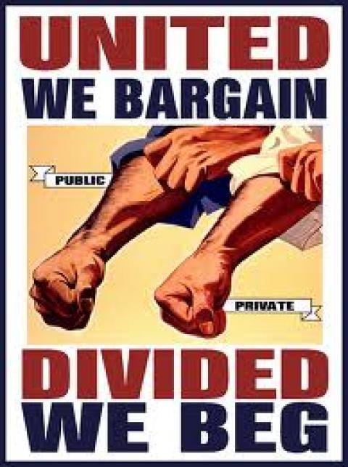
The members of the union then elect leaders to speak for them and organize union action.

Slide 6
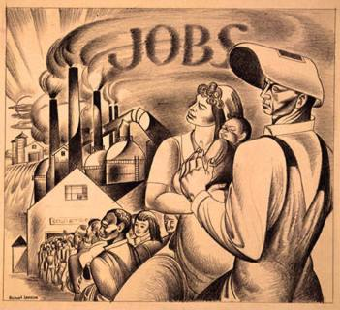
Those union leader then use three basic methods to get what the workers want.

Slide 7
1. Collective Bargaining
The union leaders meet with the owners and negotiate for change. Hopefully both sides come to an agreement.

Slide 8
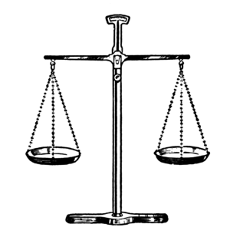
2. Arbitration
Both the workers and the owners present their demands / wants to an outside, neutral third party, an arbitrator. (Judge)
The judge then comes up with a settlement that he/she believes in fair to both sides.

Slide 9
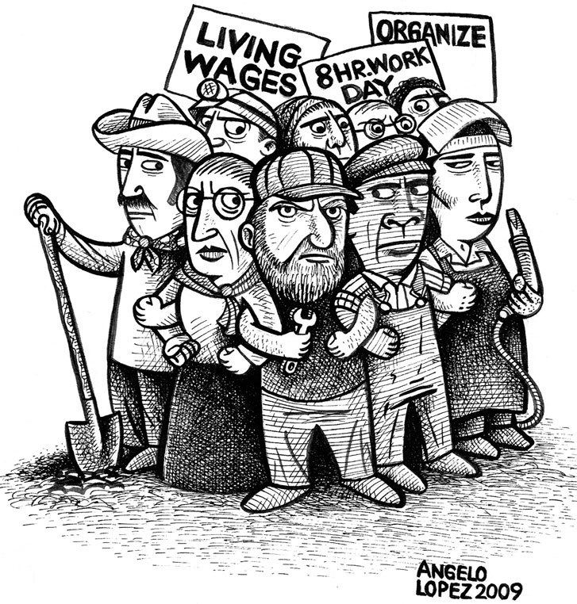
3. Strike!
Workers walk off the job and refuse to go back to work until their demands are met.
Why do they think this will work?

Slide 10
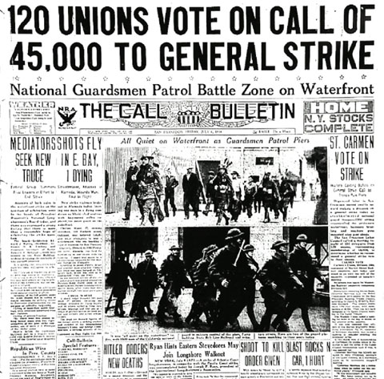
However, going on strike was usually a union’s last resort. They didn’t like going on strike. Why? What might be some possible problems?

Slide 11
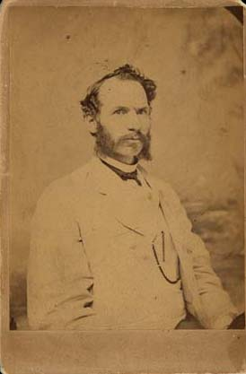
The first notable, national organization was the National Labor Union (NLU):
- Founded by William Sylvis in 1866
- Attempted to link together numerous smaller unions of both skilled and unskilled workers.
- Pushed for a standard 8 hr. work day.
- Hoped to settle disputes with company owners through arbitration.

Slide 12
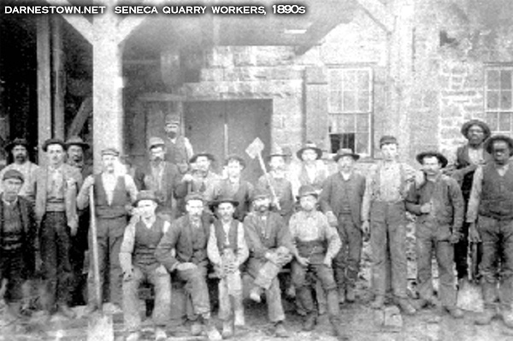
While the NLU was eventually successful in securing an 8 hour day for some government employees, it’s impact was limited by an economic downturn in the 1870’s.

Slide 13
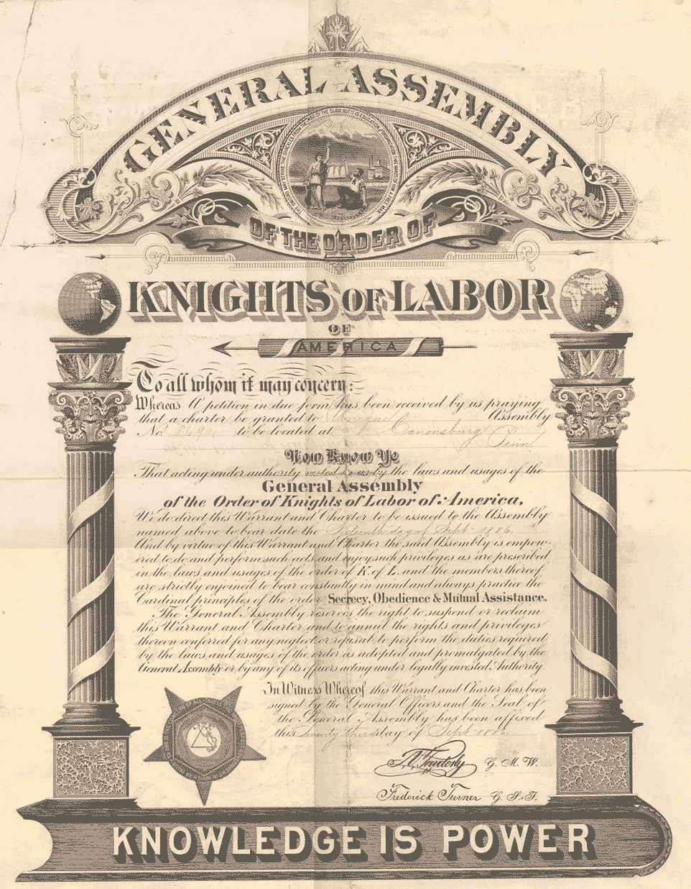
A new organization quickly rose to pick up the cause. The Noble and Holy Order of the Knights of Labor.

Slide 14
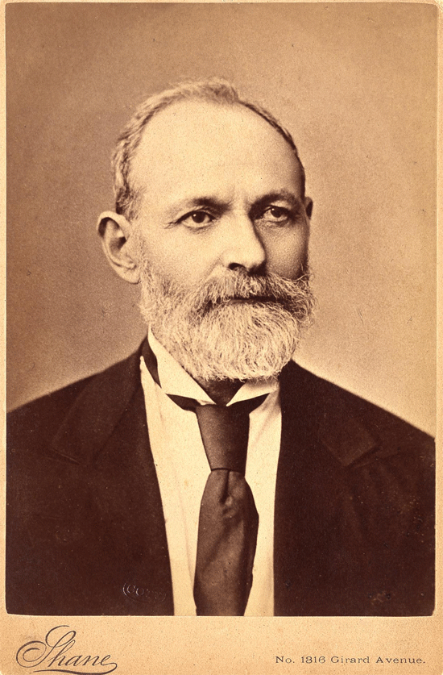
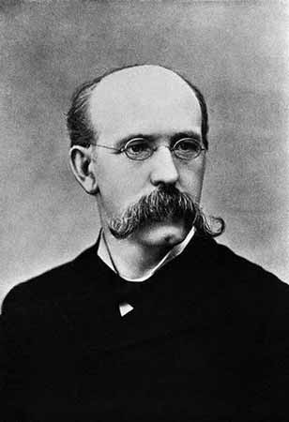
Uriah Stephens
Terence Powderly

Slide 15
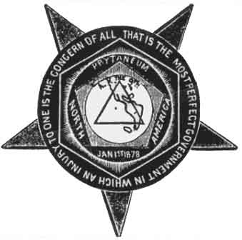
An injury to one is the concern of all!
Eight-hour workday.
Worker-owned factories.
Abolition of child labor.
Equal pay for men and women.
Safety codes in the workplace.
Prohibition on hiring foreign labor.
Open to ALL, skilled and unskilled workers alike!

Slide 16
Organizations like the Knights found achieving change difficult, especially as they attempted to organized unskilled labor. Why?

Slide 17
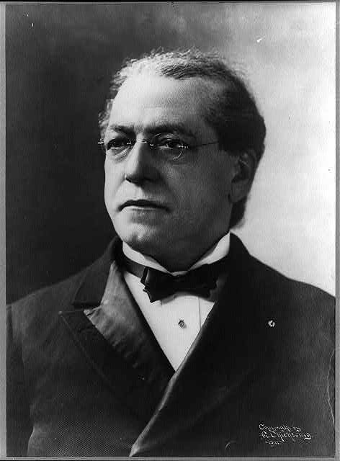
To deal with that, some began to focus their efforts on skilled labor only.
Samuel Gompers helped form the American Federation of Labor (AFL) in 1886.

Slide 18
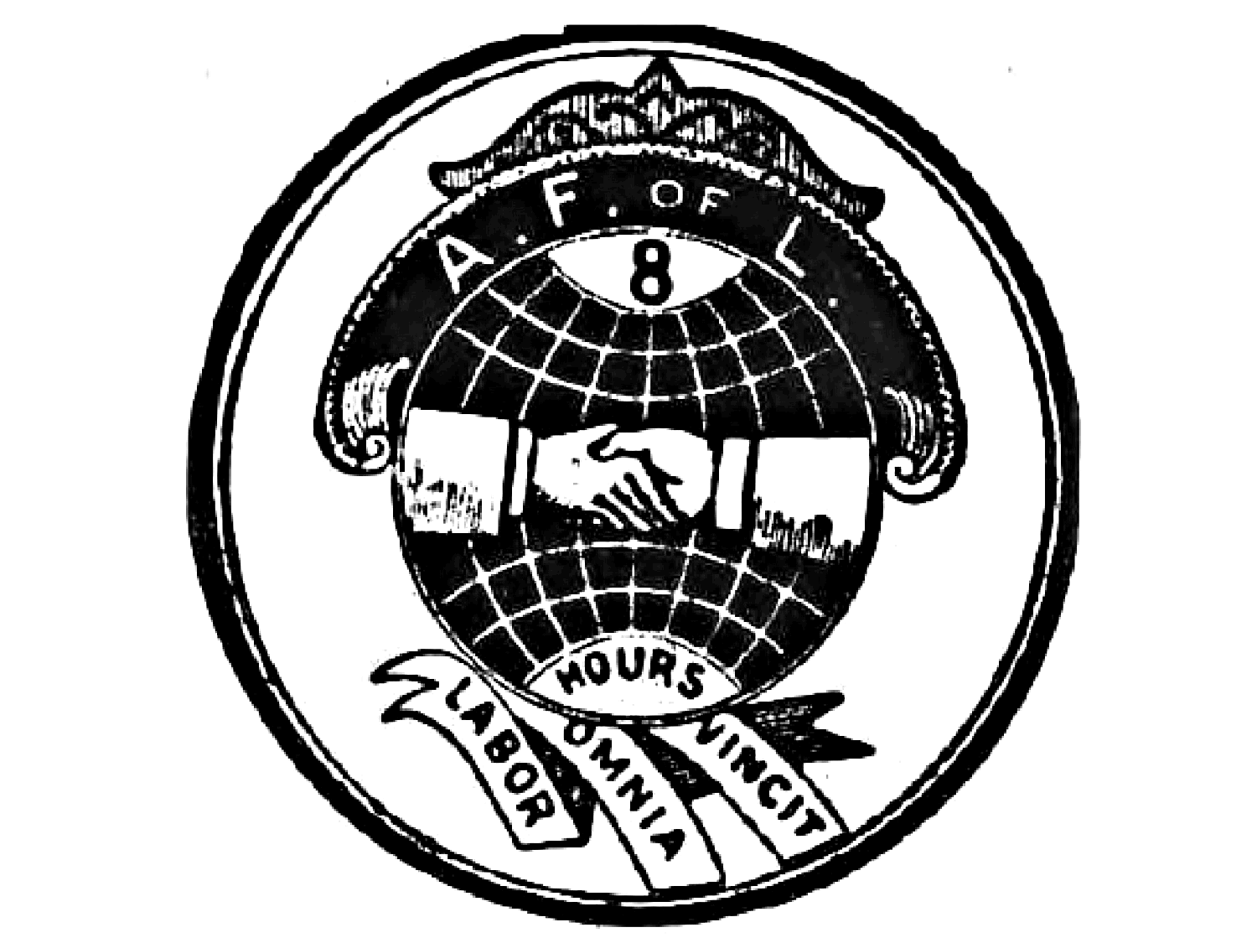
Catered to the skilled worker.
Hoped to negotiate with business owners.
Maintained a national strike fund.
Prevented disputes among the different unions.
Represented workers in matters of national legislation. Wanted to get the government to act.

Slide 19
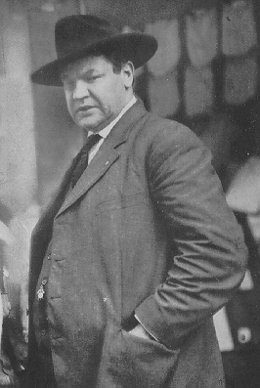
Other unions began to call for even greater change to both American industry and America itself. The best example was the Industrial Workers of the World (I.W.W) led by William “Big Bill” Haywood in 1905.

Slide 20
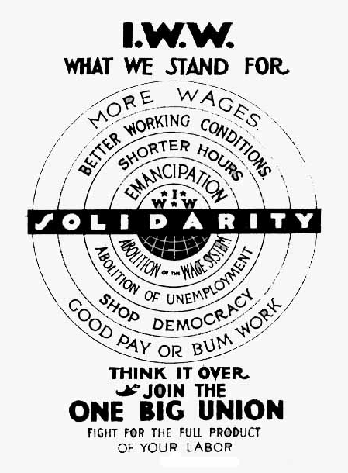
The IWW began to call for socialist style reform to the capitalist American system.

Slide 21
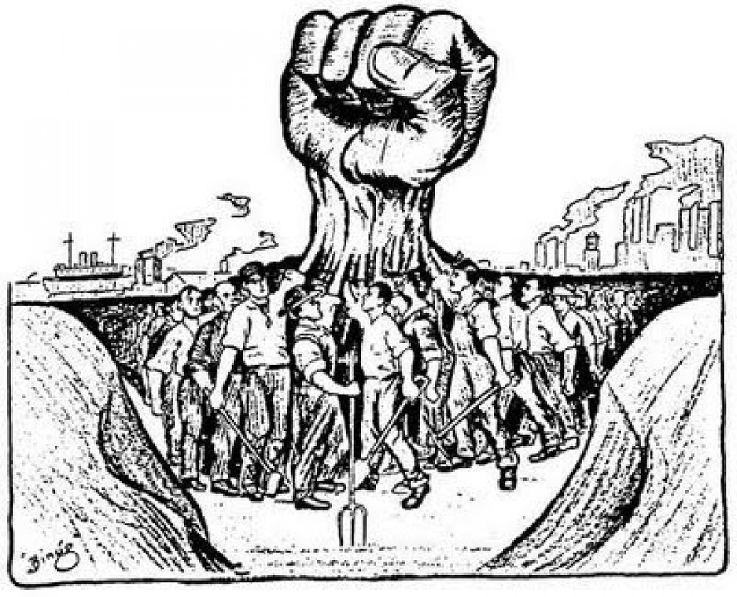
To summarize: Every union in the Gilded Age pushed for, at minimum, three things:
- better wages.
- shorter hours (8 hour day).
- improved safety conditions for factories.

Slide 22
Fin.

