Slide 1
The
Seeds
of
Change
1880-1954

Slide 2
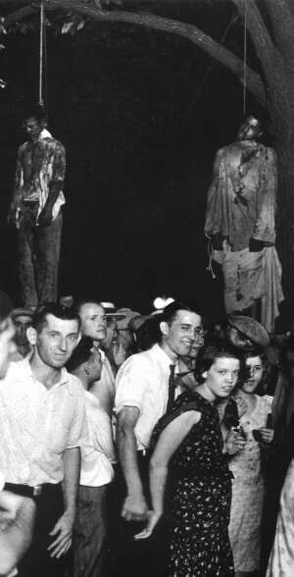
By the 1890’s-1900, African-Americans in the South faced three big problems.
- Southern state laws that violated their political and social equality.
- The KKK and their campaign of lynching and terror.
- The fact that the U.S. government was doing little to protect African-Americans lives, let alone their rights.

Slide 3
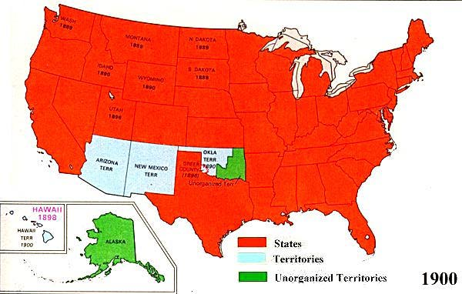
What were things like for African-Americans up North during this same time period?

Slide 4
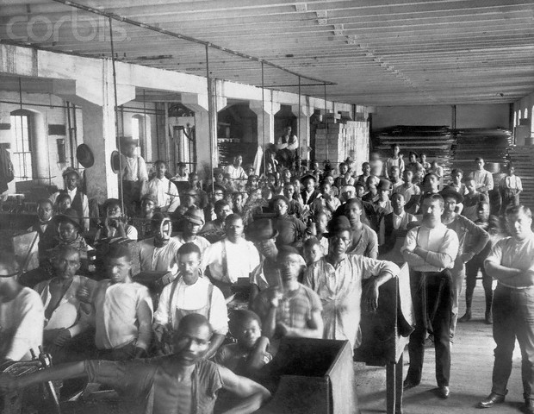
While they were not subjected to either Jim Crow laws, or the Klan, Northern African-Americans also dealt with their fair share of discrimination and violence.

Slide 5
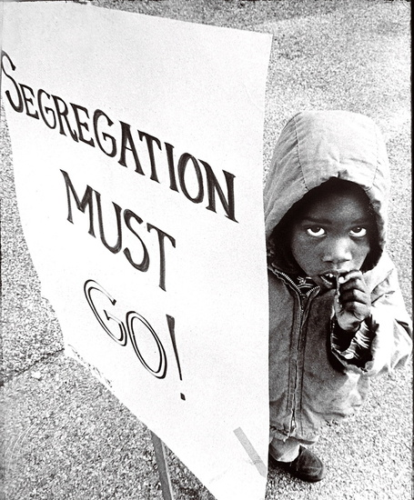
It’s important to note, then, that African-Americans had to confront two different types of segregation.

Slide 6
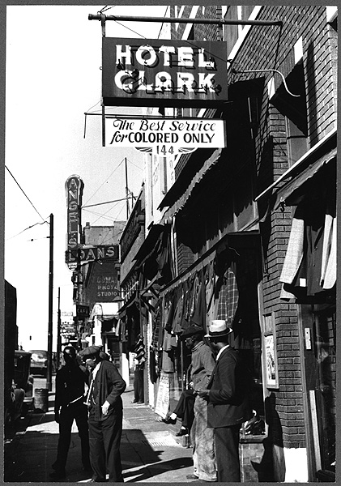
De Jure Segregation
This is segregation by law. The Jim Crow laws passed by every single southern state are a prime example.

Slide 7
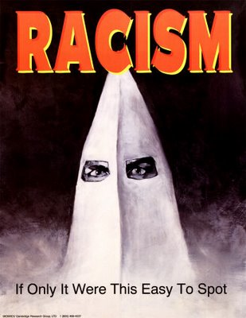
De Facto Segregation
This means segregation by “custom or practice.” Essentially it’s segregation by the way people think about, and act toward African-Americans.

Slide 8
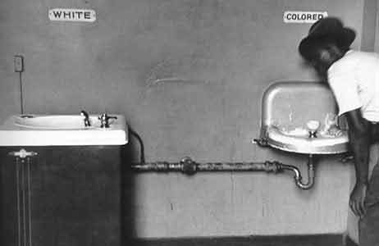
De jure segregation is much easier to end than de facto segregation. Why?

Slide 9
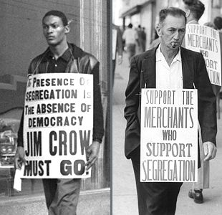
De Jure Segregation
To end de jure segregation, African-Americans only needed to change the law; that is they either needed to make the government enforce existing equal rights laws like the 14th and 15th Amendments, or get the government to pass new laws further guaranteeing equality.

Slide 10
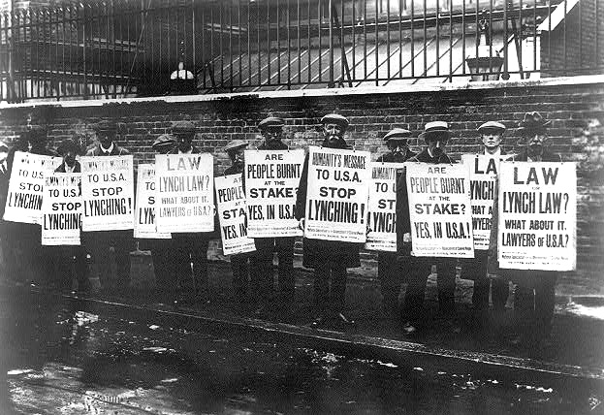
By the last decade of the 19th century, African-Americans began to talk about ways to end both types of segregation.

Slide 11
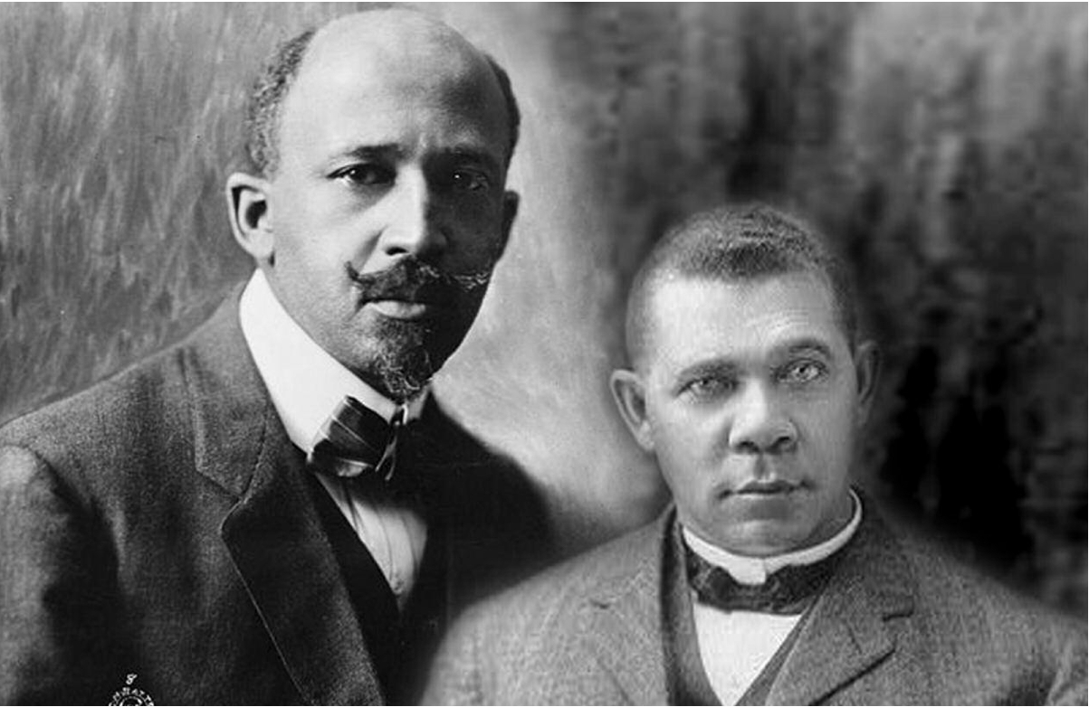
In that push, two men came to dominate the conversation, each with a very different idea of the best way for African-Americans to achieve equality.

Slide 12
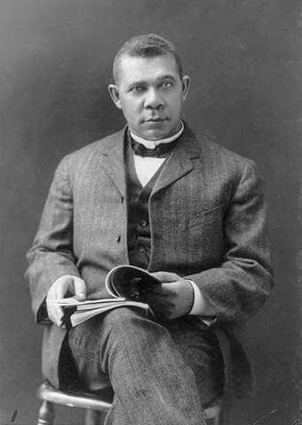
Booker T.
Washington
- Former slave
- Explained his position on equality and rights in a speech at the Atlanta World Exposition on Sept. 18, 1895

Slide 13
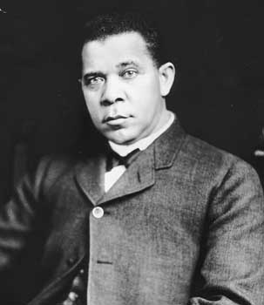
Washington argued that African-Americans would only enjoy equality when they were given it by white voters through the power of the government.

Slide 14
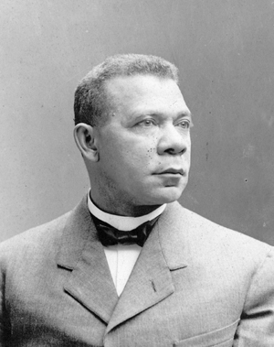
In order for that to happen, those white voters had to believe that African-Americans deserved equality.

Slide 15
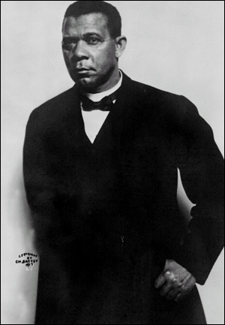
African-Americans, according to Washington, thus had a problem.
When white voters looked at African-Americans they saw:
- little education
- few job skills
- a group of people not yet ready for political participation.

Slide 16
To secure equality then, Washington argued that African-Americans had to change this perception; they had to prove themselves worthy of equality.
To that end, Washington helped establish the Tuskegee Institute in Alabama, a school where African-Americans could learn job skills and improve themselves.

Slide 17
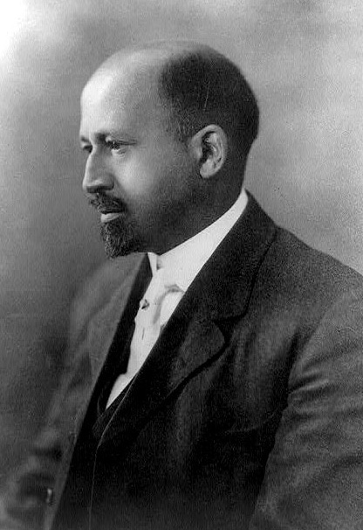
W.E.B. DuBois
- Born in Massachusetts in 1868 after the end of slavery.
- Was the first African-American to earn a PhD from Harvard.

Slide 18
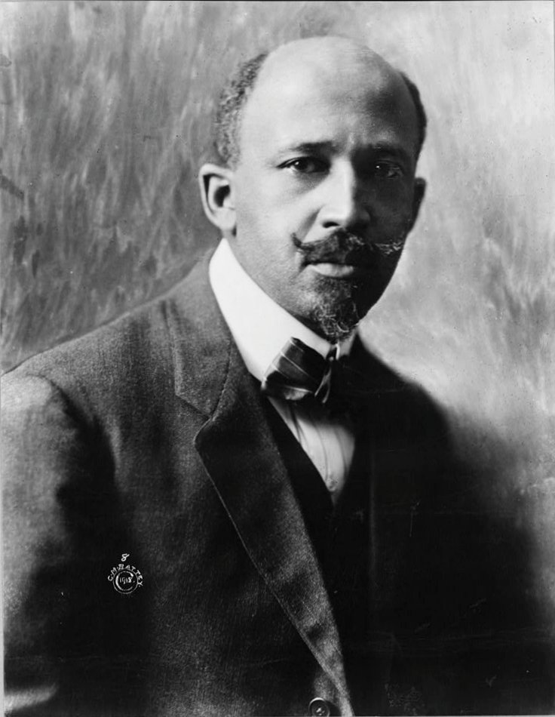
He argued that African Americans deserved equality NOW!
There were already laws that had been passed guaranteeing rights and equality. (14th and 15th Amendments)

Slide 19
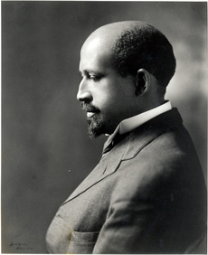
How long would Washington’s approach take? Will white people ever believe that African-Americans are ready for equality?

Slide 20
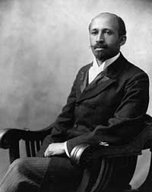
Furthermore, many African-Americans already had education and job skills, had already “proven” themselves worthy of equality.

Slide 21
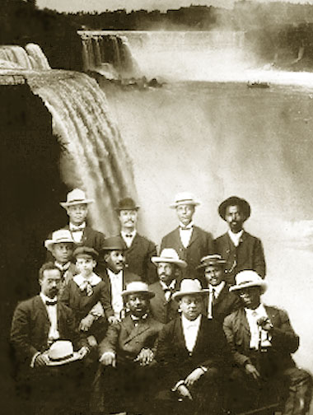
Niagara Movement
Du Bois helped organize a meeting of likeminded African-Americans in Niagara Falls, Canada to discuss what strategies the African-American community could employ to secure equality immediately.

Slide 22
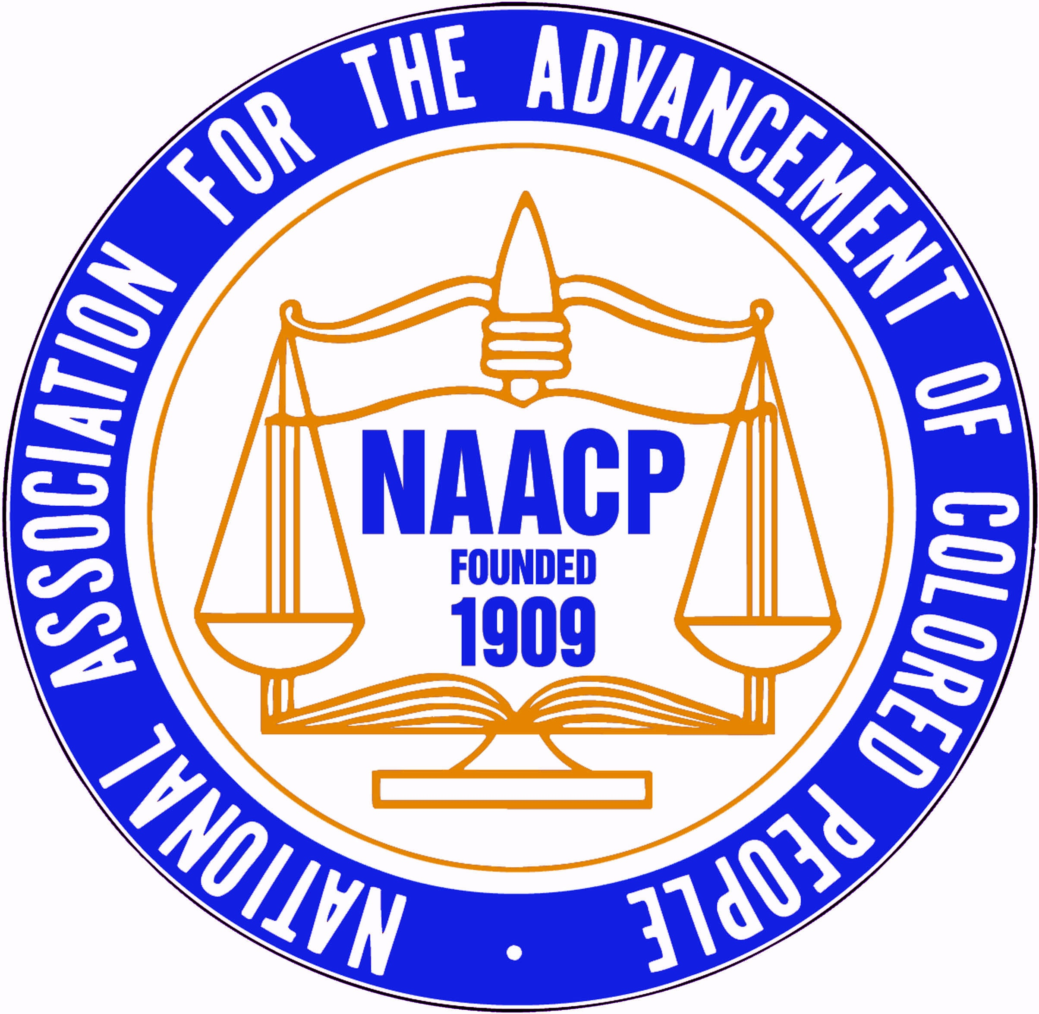
Du Bois and the Niagara Movement gave birth to the National Association for the Advancement of Colored People, a social and political organization designed to push for inclusion, equality, and government action.

Slide 23
In the 1940’s the NAACP began to plan a strategy for fighting against de jure segregation in the South. In that fight, however, they had a giant obstacle to overcome.

Slide 24
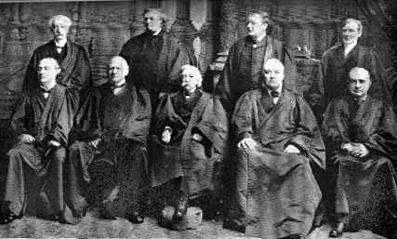
If the NAACP had any hope of making Jim Crow laws go away, they first had to overcome the Supreme Court decision in Plessy v. Ferguson, which had argued that Jim Crow laws did not violate African-American rights.

Slide 25
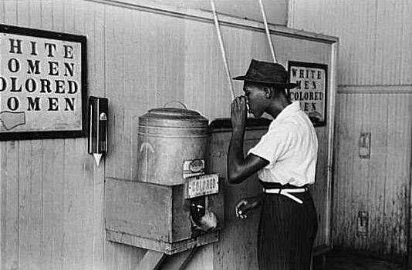
Remember, in that case the Court had argued that separate facilities did not violate African-American equality provided that….

Slide 26
So, if the NAACP could show that the facilities provided to African-Americans were not equal, the court would be forced to reconsider its previous decision.

Slide 27
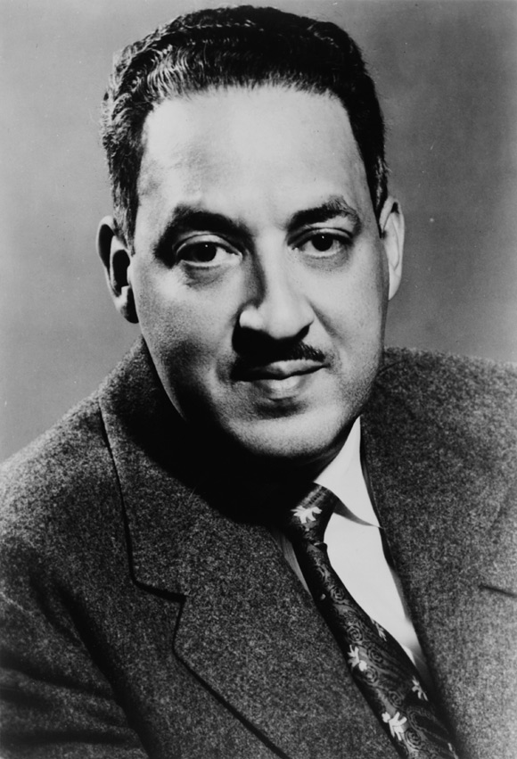
NAACP leaders placed Thurgood Marshall in charge of challenging Plessy and fighting segregation in the courts.

Slide 28
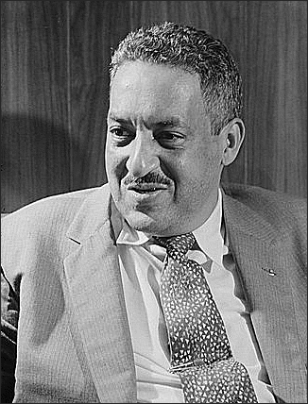
Marshall, and the NAACP lawyers who worked with him, decided to use the inequality of segregated schools as the key to overturning the Plessy decision.

Slide 29
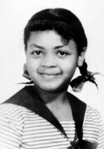
Brown v. Board of Education
- In 1951, Oliver Brown wanted his 8-year-old daughter to attend a white only Topeka, Kansas school 4 blocks from her home, instead of the African-American school 21 blocks away.
- Brown sued the Topeka Board of Education, and his case reached the Supreme Court. Thurgood Marshall argued Brown’s case.

Slide 30
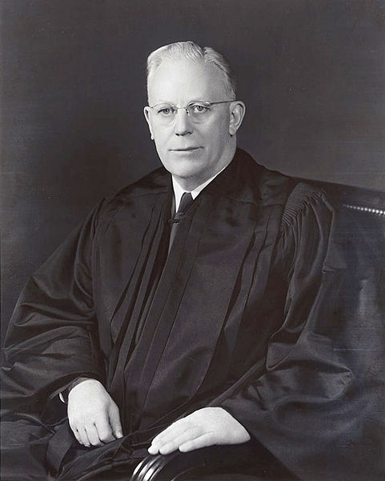
Brown v. Board of Education
- May 17, 1954
- Court ruled that “Separate educational facilities are inherently unequal.”
- Overturned the Plessy decision.
- Demanded that segregated schools throughout America be integrated.

Slide 31
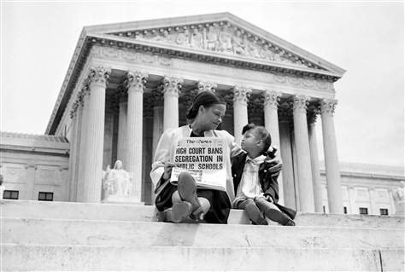
Many Americans, both white and African American, rejoiced at the Brown ruling. The Supreme Court had begun to attack and attempt to stop de jure segregation.

Slide 32
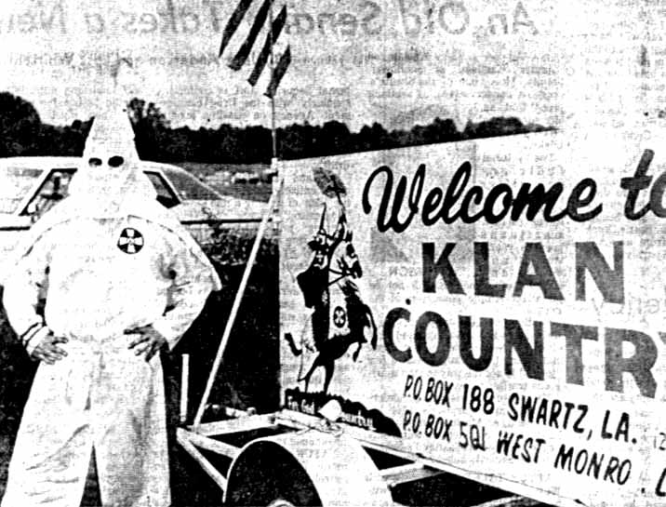
However, many southern whites vehemently opposed the ruling. Congressional representatives of states in the Deep South joined together to protest the decision, claiming that it violated states’ rights.

Slide 33
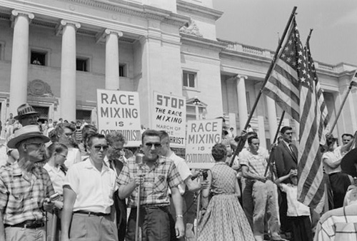
It was one thing for the Supreme Court to call for an end to segregation. It was something else entirely to make that happen.

Slide 34
Fin.

