Slide 2
The 1970’s
Suck.

Slide 3
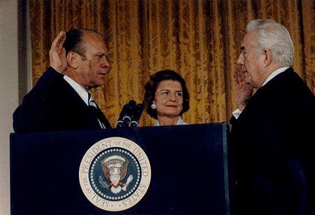
Gerald Ford took the oath of office on August 9, 1974, the same day President Nixon resigned.

Slide 4
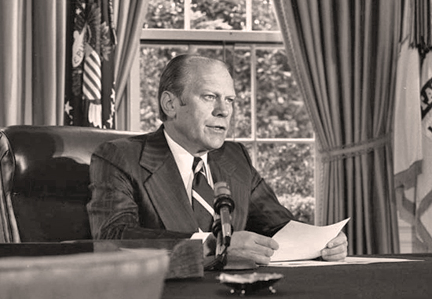
One of his first actions was to grant Richard Nixon a full pardon for any crimes he might have committed.

Slide 5
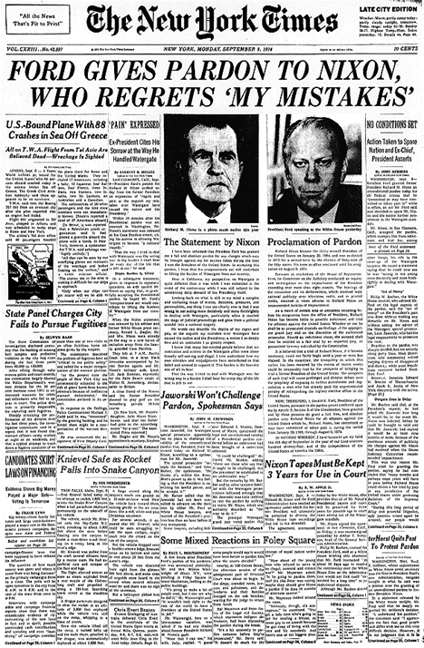
Why did he do it?
- Any trial would expose numerous crimes that would damage the image of the government.
- Any verdict would divide the nation.
- He wanted to put the past behind and look to the future.

Slide 6
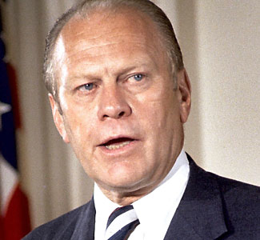
This had the opposite effect as many Americans were outrage that Nixon would never be held accountable for his actions.

Slide 7
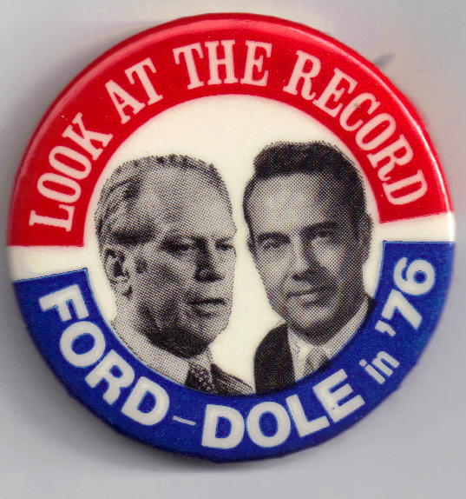
Partly due to Nixon’s pardon, Ford was unable to win re-election in 1976.

Slide 8
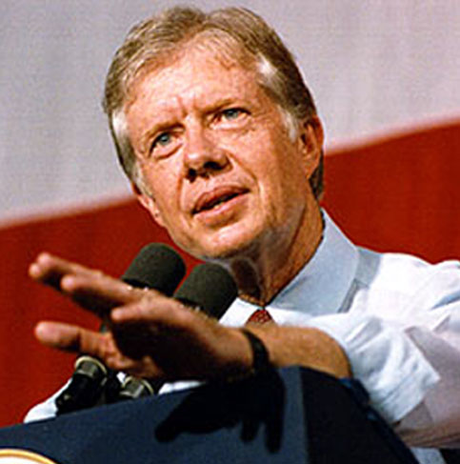
Ford was replaced by Jimmy Carter.
- Former peanut farmer
- One term governor of Georgia
- Chosen because he was a “Washington outsider”

Slide 9
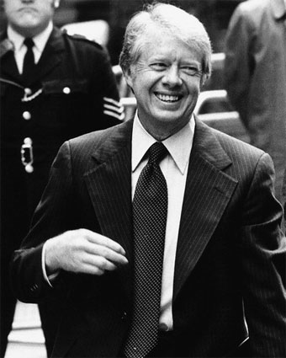
As we shall see, things didn’t go very well for Carter.
Part of his problem was the neither he, nor his advisors had much experience running a government.

Slide 10
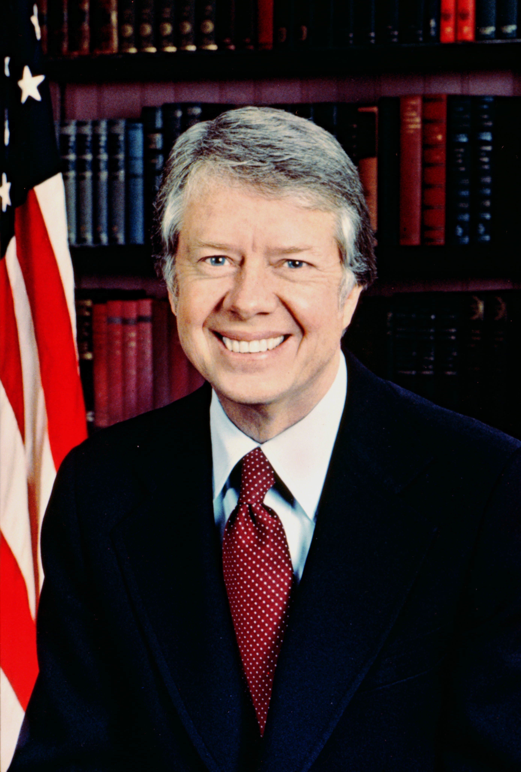
The relative inexperience of the President and his group of advisors became increasingly apparent as the problems America had to deal with began to pile up.

Slide 11
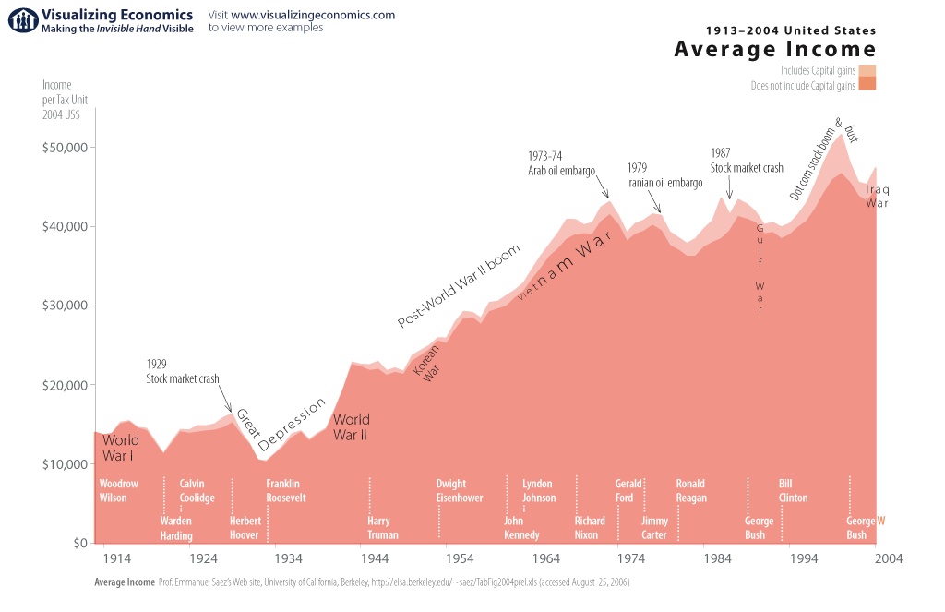
One of Carter’s largest problems was the sad state of the American economy.

Slide 12
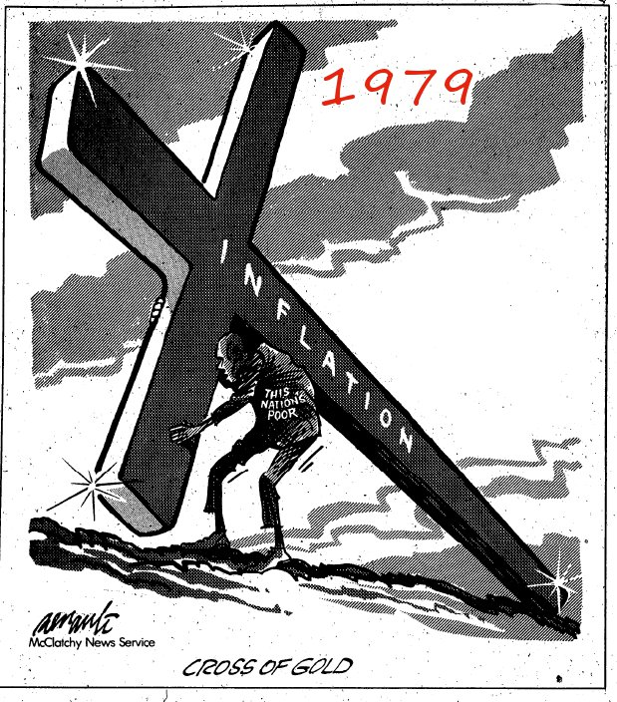
Prices for products of all sorts continued to rise, but worker’s wages and family incomes did not.

Slide 13
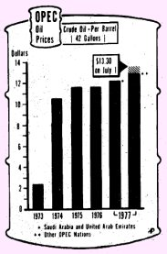
Much of America’s economic difficulty during Carter’s administration was based upon the skyrocketing price of oil.

Slide 14
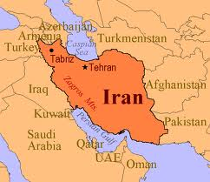
That problem was caused, in part, by America’s relationship with Iran.

Slide 15
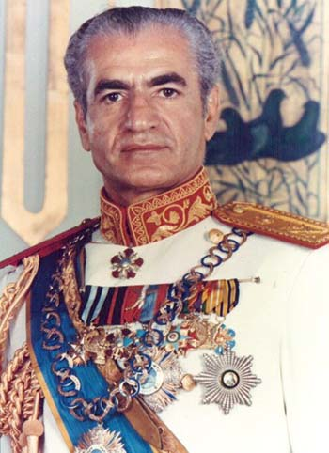
During the Eisenhower Administration, the CIA had helped bring the Shah of Iran to power.
- He was friendly to the U.S. and would sell us oil
- He hated communism.
- However, the people of Iran did not necessarily support him.

Slide 16
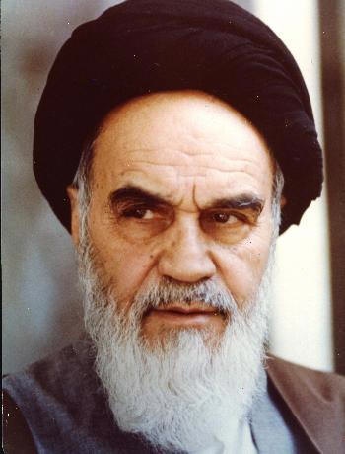
In October 1979, the people of Iran had had enough.
The Shah was thrown from power and replaced by the radical Muslim cleric Ayatollah Khomeini.

Slide 17
Iran’s oil production radically decreased during this time of upheaval.
This reduction in the global oil supply resulted in less oil for the United States and skyrocketing prices.

Slide 18
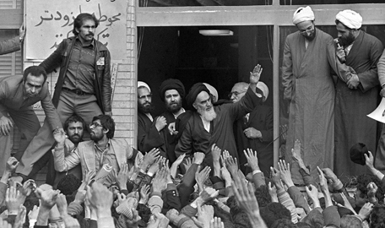
Khomeini, and the people of Iran, wanted to charge the Shah with crimes against the Iranian nation. The Shah would have most likely been found guilty and executed.

Slide 19
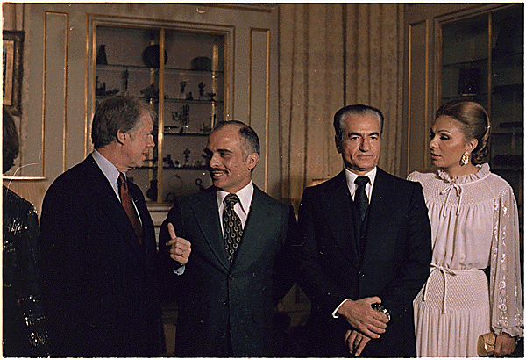
Carter allowed the Shah to come to the United States and avoid such a fate. Why was this a problem?

Slide 20
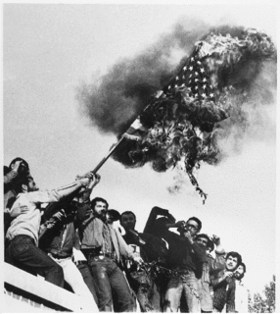
In response, Khomeini’s supporters seized the U.S. embassy in Iran in November 1979, capturing 52 Americans which the Iranian government then held as hostages.

Slide 21
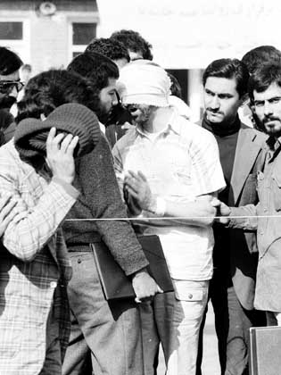
After months of abortive efforts to forge a diplomatic solution, the President ordered a secret military rescue operation in April 1980.

Slide 22
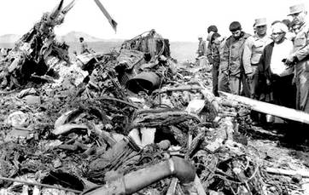
The operation ended in disaster before getting close to the embassy when two helicopters malfunctioned and another collided with a cargo plane, killing eight service members. Iranians displayed the burned corpses before television cameras.

Slide 23
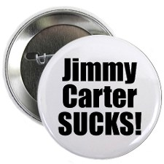
The Iran Hostage Crisis became symbolic of two perceived trends:
- the decline of US prestige in the world.
- the growing incompetence of the President and his advisors.

Slide 24
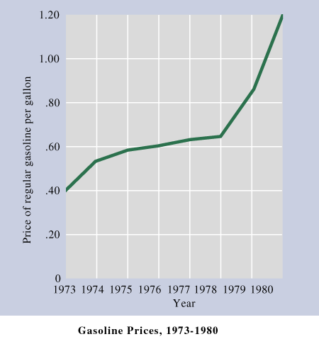
To deal with the high price of oil, and its impact on America, President Carter called upon Congress and the American people to take action.

Slide 25
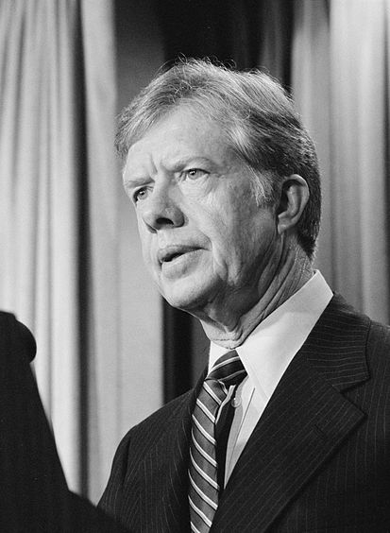
- Carter asked Americans to conserve fuel in their homes, cars, and businesses.
- He also created a new Cabinet department, the Department of Energy.
- Congress also passed legislation forcing auto manufacturers to improve fuel consumption in the cars they produced.

Slide 26
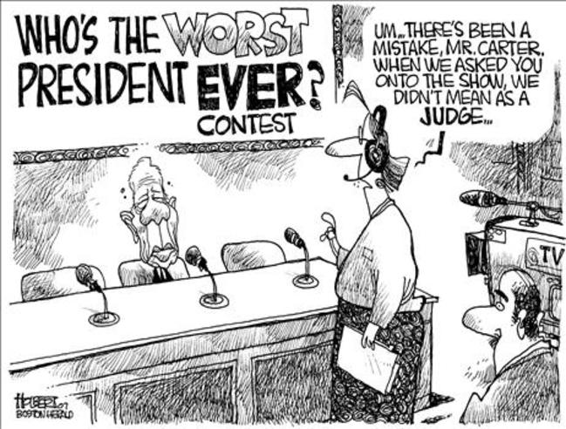
Americans remained skeptical that Carter was the man for the job.

Slide 27
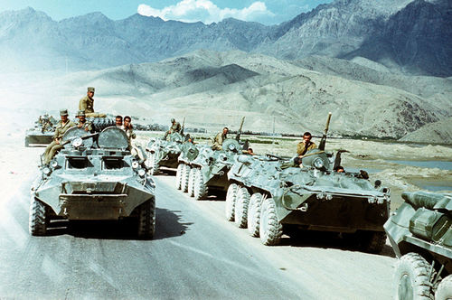
If all of this wasn’t bad enough for Carter, and America, in December of 1979, the Soviet Union invaded the country of Afghanistan.

Slide 28
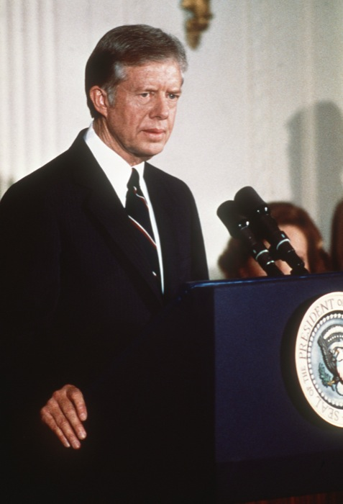
Carter responded by Announcing that the U.S. would boycott the 1980 summer Olympics that were scheduled to be held in Moscow. Why was this a problem for Carter?

Slide 29
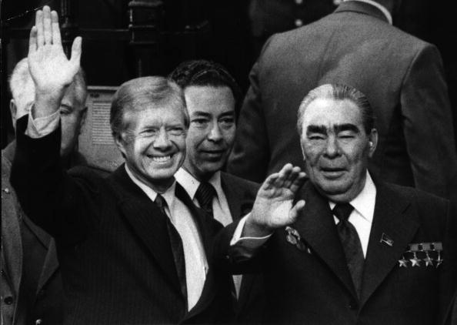
This abruptly ended any positive improvement in U.S./Soviet relations that had been growing since Nixon’s détente.

Slide 30
As Carter was dealing with all of this, changes were taking place within the Republican Party.
To understand those changes, we need to go back to the 1960’s.

Slide 31
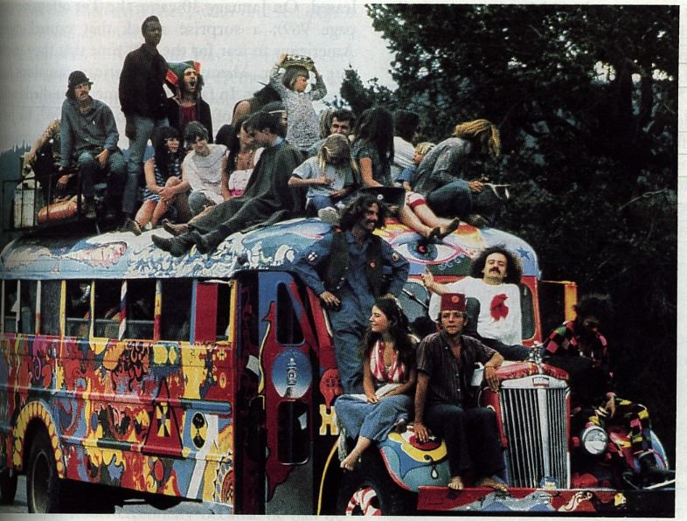
With the rise of the counterculture, traditional American values, and ideas about authority and respect were challenged.

Slide 32
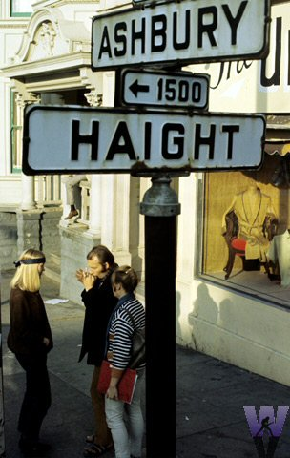
More conservative Americans were shocked and outraged by the behavior of “hippies.” Some argued that they represented all that was wrong with America.

Slide 33
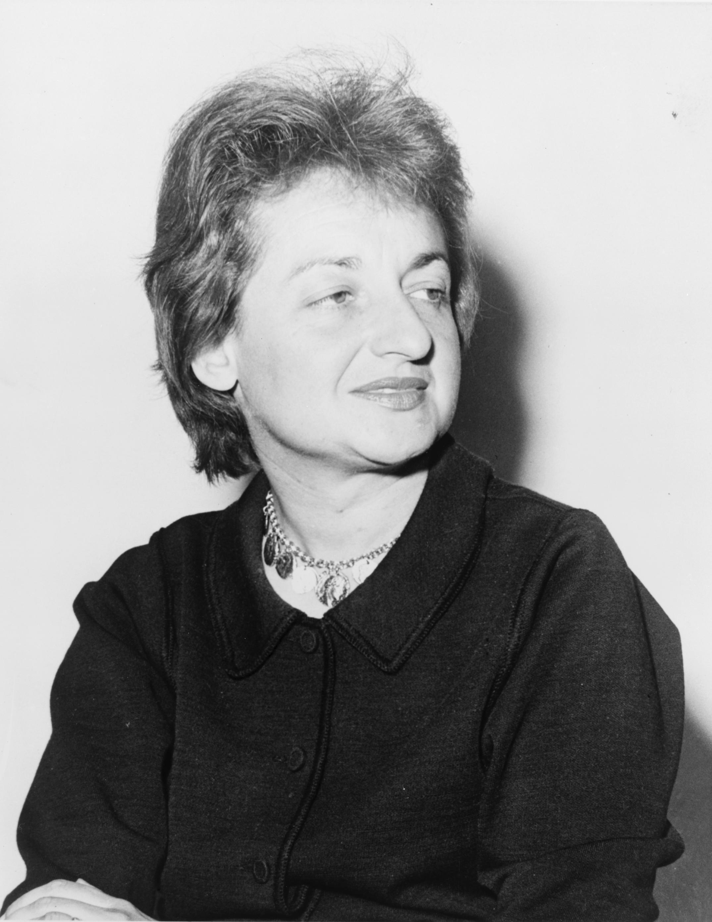
At the same time there was a growing push for civil equality.
- Women
- Latinos
- Native Americans
- Homosexuals

Slide 34
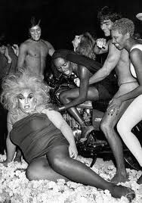
It also appeared to some, that American morality was slipping in the 1970’s.
- Disco era partying and drug use
- Increasing number of divorces
- Increasing national crime rate

Slide 35
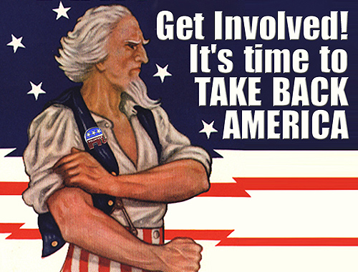
All of this taken together, convinced some Americans that the nation had lost its way and that massive changes were needed to get it back on track.

Slide 36
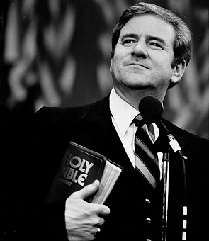
Groups like Moral Majority, founded by Christian pastor Jerry Falwell, sought to use the political process to return America to a time of “traditional family values.”

Slide 37
Moral Majority, and other “conservative Christians” often supported:
- Return to traditional gender expectations
- Banning of all forms of abortion
- No support for gay / lesbian rights
- No accommodation for the “godless” Soviet communists.

Slide 38
At the same time as the Moral Majority was growing, other Republicans argued that the party get back to its’ roots.
Since the Gilded Age, the Republicans had been the party of big business and Laissez Faire.

Slide 39
Thus emerged a group know as the “neo-conservatives.
They wanted:
- Lower taxes
- A balanced budget
- Smaller / less government
- Less govt. spending and assistance for those in need
- A hard line stance against communism and the Soviet Union

Slide 40
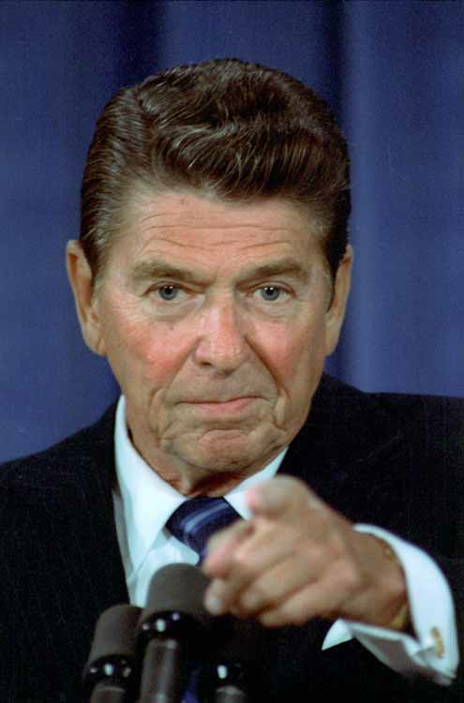
In 1980, Ronald Reagan hoped to ride both of these growing movements, the “New Right” Christian conservatives, and the economic neo-conservatives, into the White House.

Slide 41
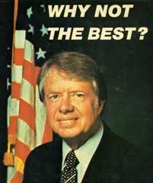
The Democrats reluctantly nominated Jimmy Carter to be their candidate in 1980.

Slide 42
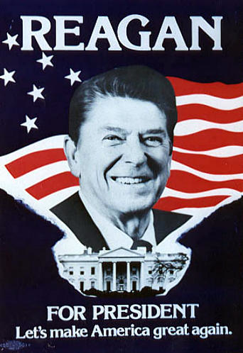
- Carter is incompetent.
- Are you better off now, than you were four years ago?
- It’s morning again in America.

Slide 43
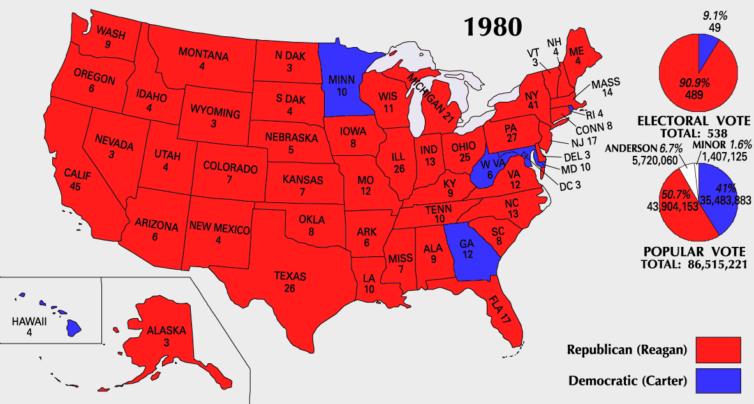

Slide 44
Fin.

