Slide 1
The New Deal
Part I:
Relief

Slide 2
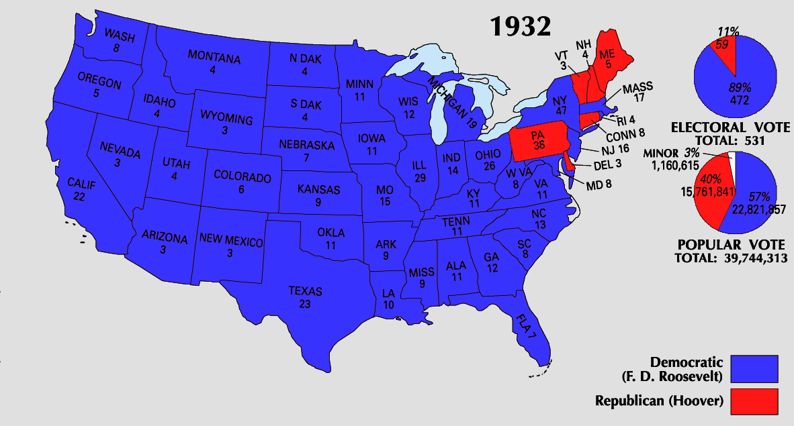
As we have suggested, FDR won big in 1932.

Slide 3
Not only did FDR win the presidency, but Democrats swept both houses of Congress as well. Why does this matter?

Slide 4
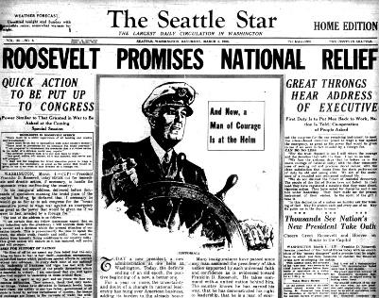
FDR and the Democrats won the election in November, 1932. However, they would not officially take power until Inauguration Day in March of 1933.

Slide 5
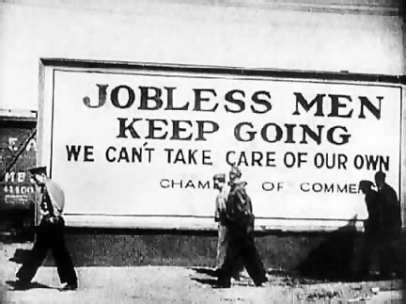
Following the election, the Depression continued. More banks closed, more people lost jobs, more farmers and homeowners faced foreclosure.

Slide 6
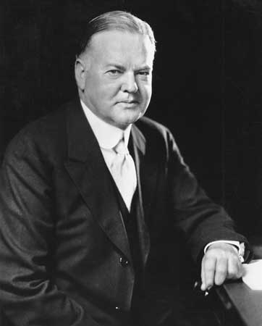
Hoover was still the president and he still believed he needed to continue to try and alleviate the problems.

Slide 7
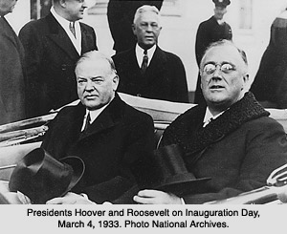
To that end, Hoover reached out the Roosevelt and proposed that the two join together and work on ending the Depression.

Slide 8
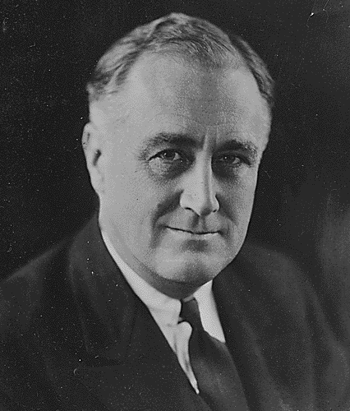
Roosevelt responded with a firm No.
Why?

Slide 9
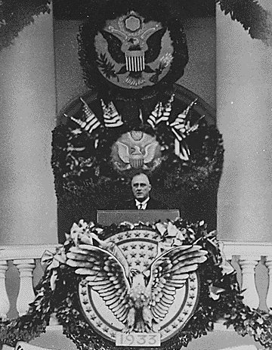
Finally, March 4, 1933 FDR took the oath of office. On that day he spoke one of the most famous quotations in all of American history:
“The only thing we have to fear is, fear itself.”

Slide 10
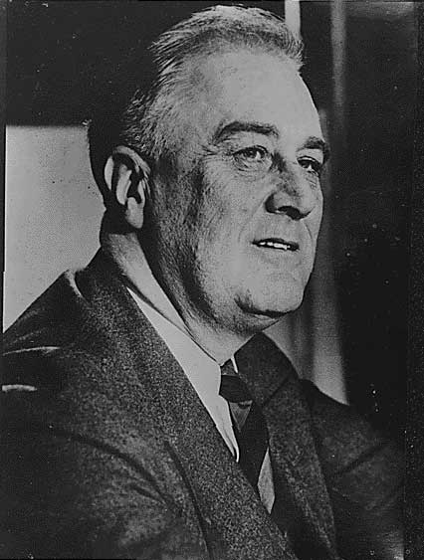
Roosevelt had basic
problems to solve:
- Banks were failing.
- Millions were out of work.
- Farmers and homeowners were unable to make regular payments on their mortgages.
- Cities and states had run out of funds to feed the unemployed.
- Factories stood idle.

Slide 11
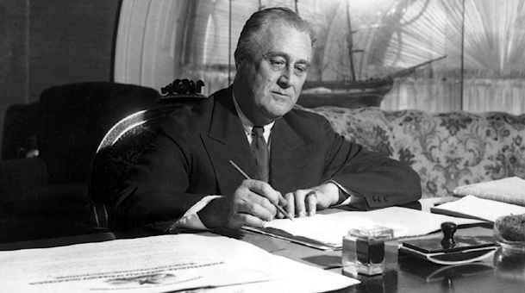
Working with his advisors and cabinet, a group known as the “Brain Trust,” Roosevelt cobbled together a host of programs to put people back to work and get the nation back on its feet.

Slide 12
Some of what the Brain Trust proposed was merely an expansion on some of what Hoover had already attempted.

Slide 13
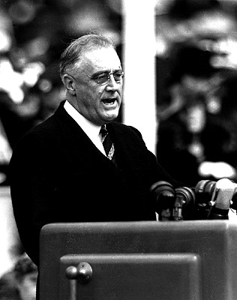
Other things that Roosevelt and the Brain Trust proposed were sweeping, fundamental, and revolutionary changes.

Slide 14
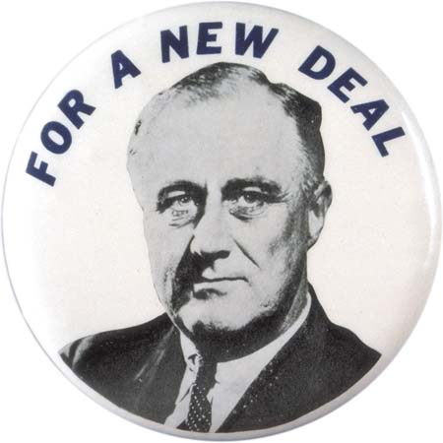
The programs FDR and the Brain Trust put together came to be known as the New Deal.
Through these programs Roosevelt hoped to accomplish one or more of three overall goals.

Slide 15
Relief
FDR wanted to provide immediate, direct government assistance to those who needed most.
Get food, clothing, shelter, $, etc. for those who needed it, and do it today!

Slide 16
Relief
He also hoped to alleviate the fear many Americans had about the health of the economy and America’s financial institutions.

Slide 17
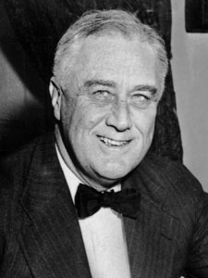
Recovery
He then hoped to put people back to work, providing them a paycheck. They would then use this paycheck to purchase consumer goods, stimulating the economy.

Slide 18
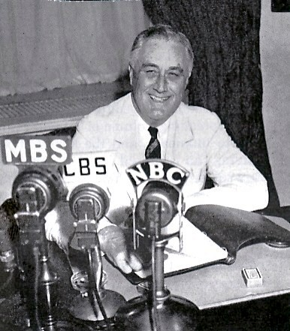
Reform
He also needed to make changes to the American system, placing regulations on American businesses and financial institutions to prevent any future economic collapse.

Slide 19
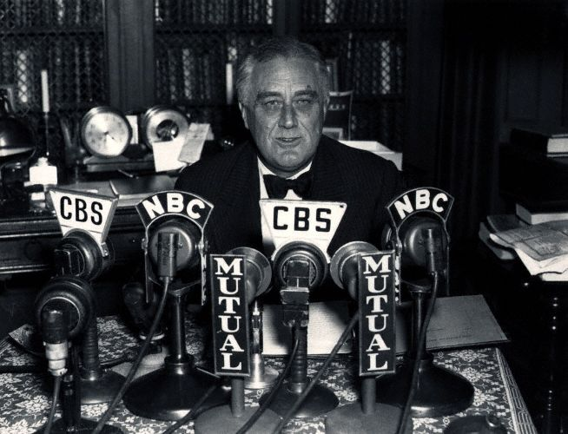
To begin to deal with the sense of fear that still gripped America, Roosevelt took to the radio.

Slide 20
He made a series of speeches to the American public over the radio that came to be known as the fireside chats.
In these speeches he explained to the American public exactly what he and the government were doing to solve America’s problems.

Slide 21
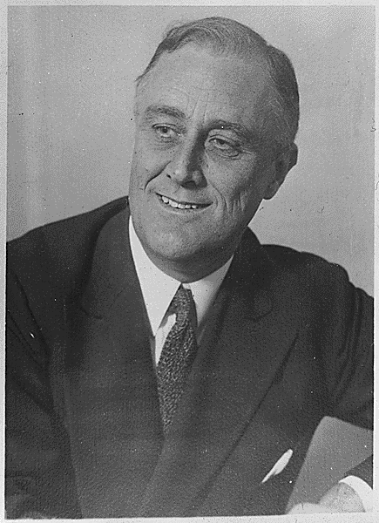
His first such “chat” focused on the status of American banks.
He ordered all remaining banks to take a “holiday” lasting from March 6 to March 10 1933.
This would allow time for the government to ensure the stability of those banks.

Slide 22
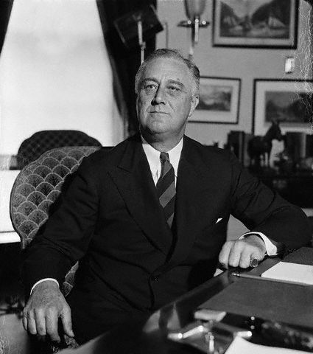
Emergency Banking
Relief Act (1933)
- Authorized the President to proceed with the Bank Holiday.
- All banks would then be inspected by the Treasury Dept.
- Banks deemed safe and secure would be permitted to reopen.
- Banks deemed unfit would either be closed permanently or offered loans from the U.S. government and allowed to reopen.

Slide 23
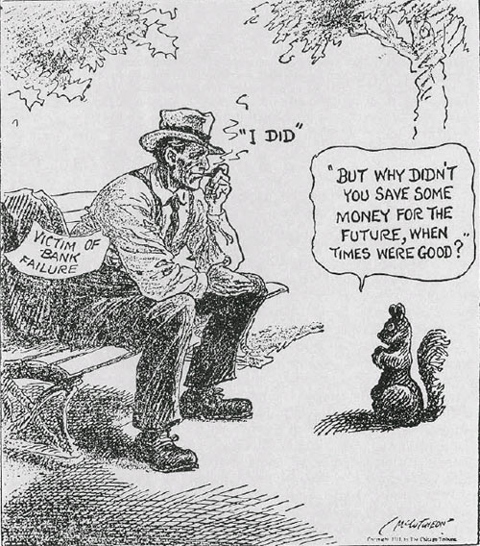
How was this supposed to help?

Slide 24
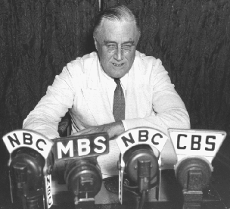
Roosevelt also wanted to explain how he was going to help those most in need. He took to the airwaves to unveil still more government programs.

Slide 25
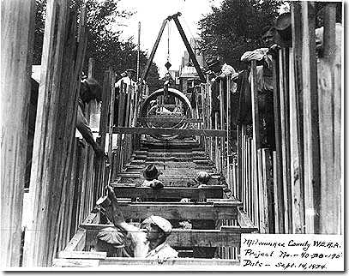
Federal Emergency
Relief Act (1933)
U.S. Govt. loaned over $3 Billion to state governments.
½ of the money was to be given directly to the needy through welfare organizations within each state.
½ of the money was to be used to create public works jobs within each state.

Slide 26
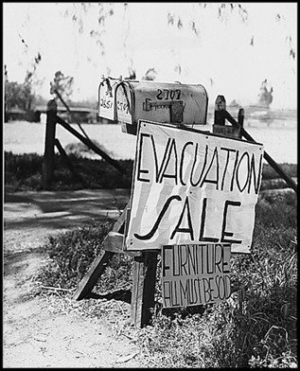
- The U.S. govt. sold bonds to banks in exchange for troubled home loans and then renegotiated the terms of the loan with the homeowner.
- Interest rates were reduced and the length of time for repayment was extended. This reduced monthly payments.
- This allowed over 1 million people to avoid foreclosure and keep their homes, but did not apply to farms.
Home Owners
Loan Corporation
(1933)

Slide 27
Agricultural
Adjustment
Act (1933)
- Paid farmers to not grow crops, or destroy a % of crops already planted. How would this help?
- Bought up surpluses of crops already grown
- Set a fixed “parity” price for items independent of true market prices

Slide 28
Parity Prices
1918 Price
Parity Price
Price farmers need to make a profit
1933 Price

Slide 29
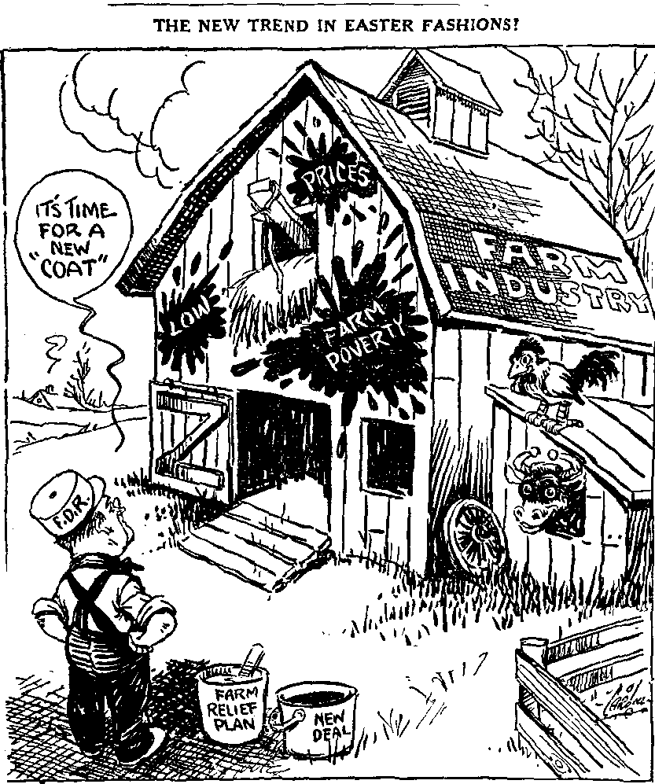
Thus, the AAA attempted to do two things:
- Give farmers money now!
- Deal with the low price of food so that farmers could once again take care of themselves.

Slide 30
By 1935, Roosevelt realized that more needed to be done to help those in need, especially for the nation’s elderly.

Slide 31
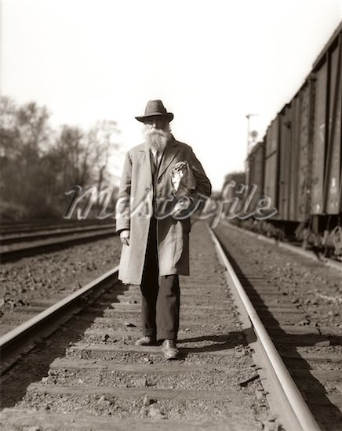
Why would old people especially need help?

Slide 32
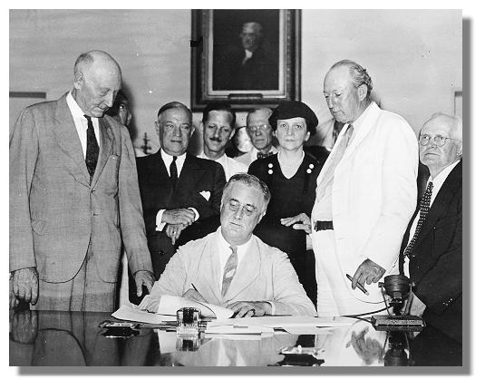
In 1935, FDR signed the Social Security Act into law, changing the role of government in peoples’ lives dramatically.

Slide 33
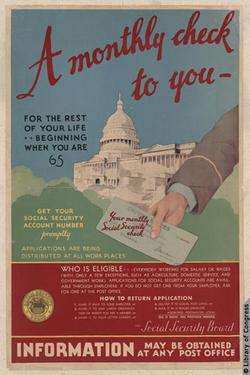
Social Security
- helped support workers in their retirement.
- set up a trust fund from which retirees would receive a monthly payment.
- trust fund supported by taxes paid by both workers and employers.
- still around with minor change today.

Slide 34
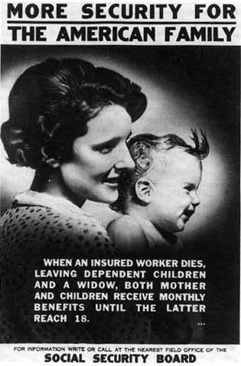
The program also provided benefits for the unemployed, the disabled, and to families with dependant children. These benefits are also around today.

Slide 35
Fin.

