Slide 1
Progressive
Era
Reform

Slide 2
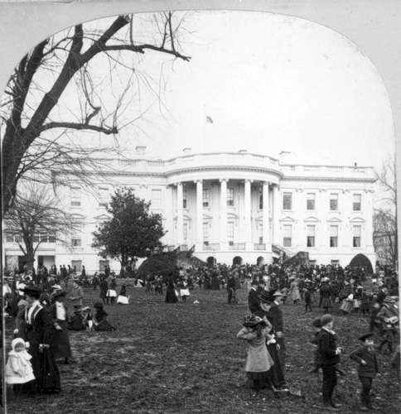
As America began to tackle its problems, three successive U.S. presidents took up the cause.

Slide 3
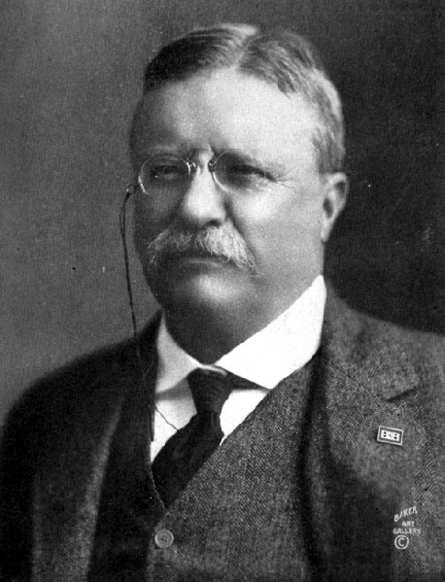
Theodore
Roosevelt
1901-1909

Slide 4
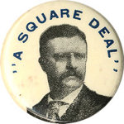
As Roosevelt contemplated the problems the United States faced, he proposed what he called a “Square Deal” for the American public.

Slide 5
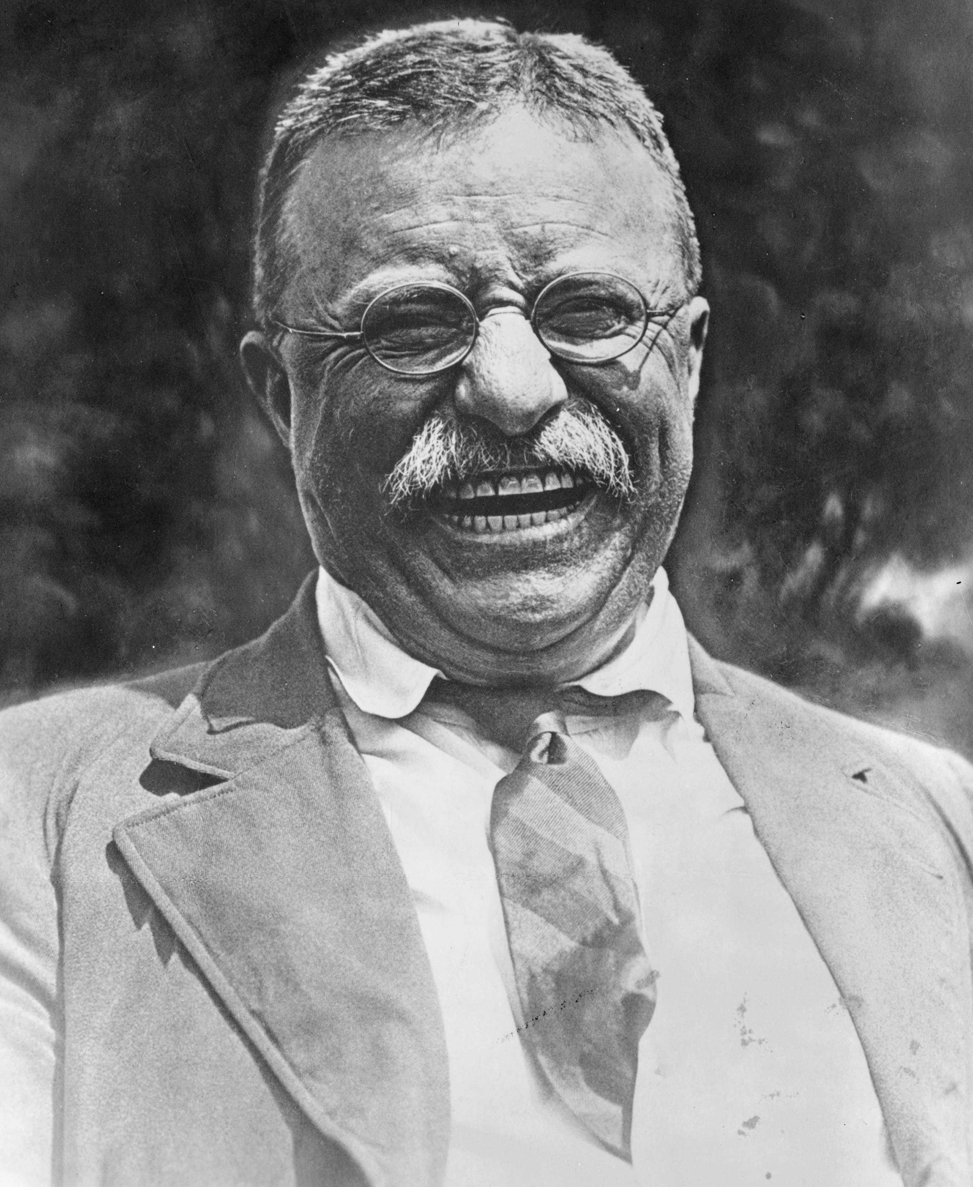
The Square Deal was really all about the “three C’s”:
Corporations
Consumer Protection
Conservation of Resources

Slide 6
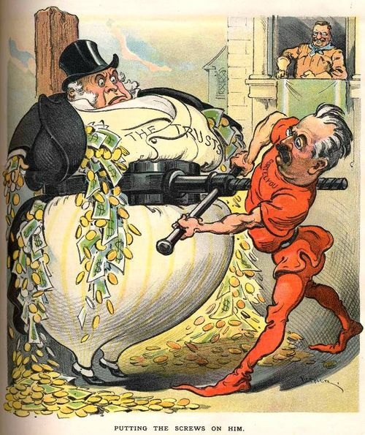
Corporations:
Roosevelt was concerned about the practices of American trusts / monopolies. He was especially concerned about “bad” trusts.
According to Roosevelt, a “bad” trust acted in ways that were damaging to America and the people’s interests.

Slide 7
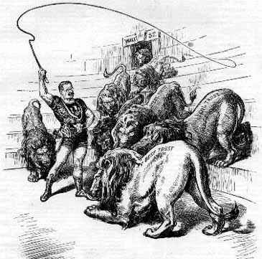
Roosevelt thus set out to tame the “bad” trusts.
He used the Sherman Anti-Trust Act, passed in 1890, and the power of the government to break up those monopolies.

Slide 8
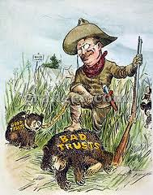
However, according to Roosevelt, not all trusts were “bad.” Some trusts, Roosevelt believed, were okay, as long as they did not go out of there way to hurt the public.

Slide 9
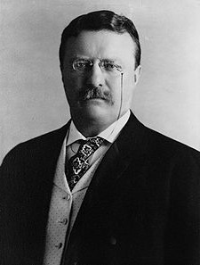
Roosevelt was particularly concerned about the power of Railroad trusts.
To deal with those “bad” trusts, he convinced Congress to pass a series of laws that attempted to reign in the power of Railroad monopolies and the ties they had to corrupt government officials.

Slide 10
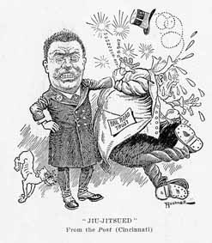
Railroad companies complained that Roosevelt’s actions were unconstitutional.
In what came to be known as the Northern Securities Case, in 1904, the Supreme Court upheld Roosevelt’s efforts.

Slide 11
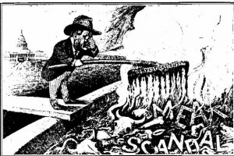
Consumer Protection:
Roosevelt was personally horrified after reading Upton Sinclair’s The Jungle.

Slide 12
He demanded a government investigation of Sinclair’s claims.
When this investigation reported the same conditions, Roosevelt demanded Congress take action.

Slide 13
Congress passed the:
- Meat Inspection Act (1906)
Set up minimum health and safety standards and established govt. regulated inspections
- Pure Food and Drug Act (1906)
Set up mandatory labeling laws and prohibited the sale of harmful products.
- Created the Food and Drug Administration (FDA) to enforce the law.

Slide 14
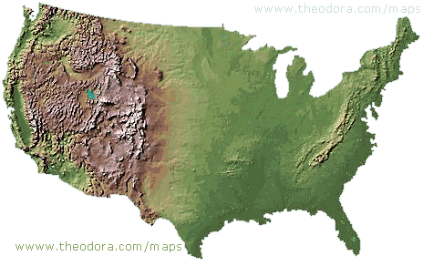
Conservation of Resources:
Up to 1900, no one was very concerned about the environment. America was huge, and its natural resources seemed limitless.

Slide 15
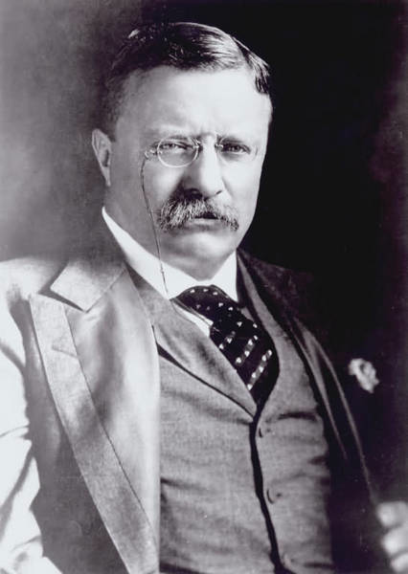
By Roosevelt’s time as president it had become clear that America’s resources were not unlimited, and that if things didn’t change, we might run out of resources, especially trees.

Slide 16
Roosevelt thus demanded the government take action to conserve America’s environmental resources. To that end, he set aside millions of acres to join the national park system.

Slide 17
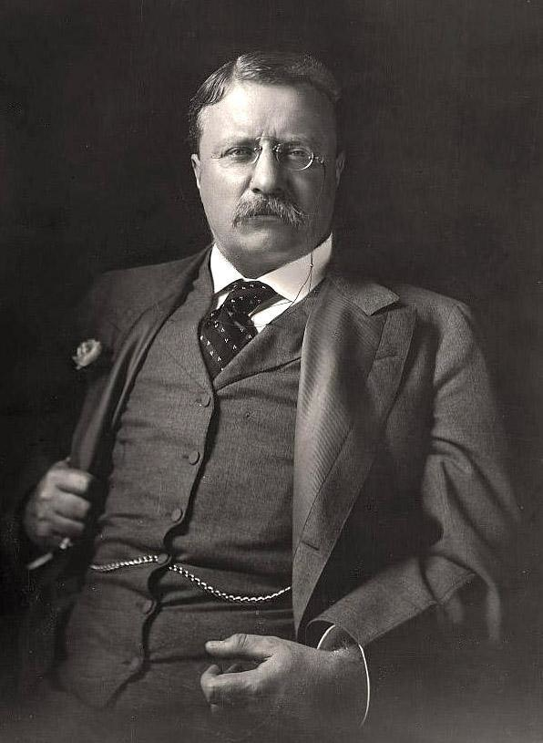
However, Roosevelt did not necessarily believe in total preservation.
Roosevelt believed that some land should be totally preserved, but that most of it needed to be carefully managed, and used over time.

Slide 18
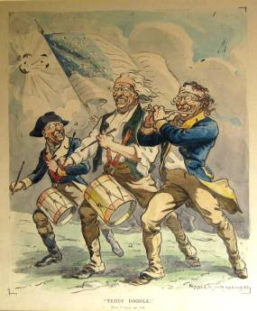
As the election of 1908 approached, Roosevelt believed he had accomplished enough and decided to not run again.

Slide 19
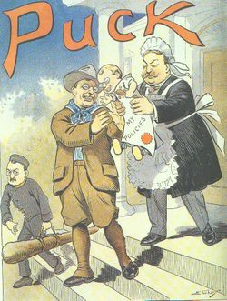
Roosevelt handpicked William Howard Taft to take the reigns of power. Roosevelt was confident that Taft would carry on with reform.

Slide 20
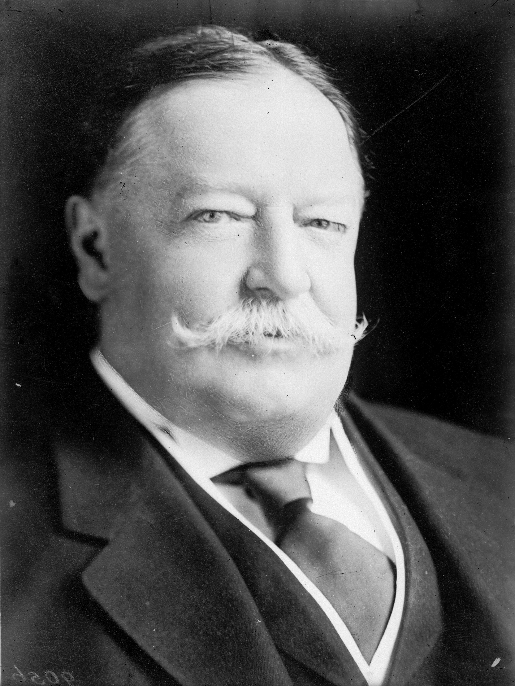
William
Howard
Taft
1909-1913

Slide 21
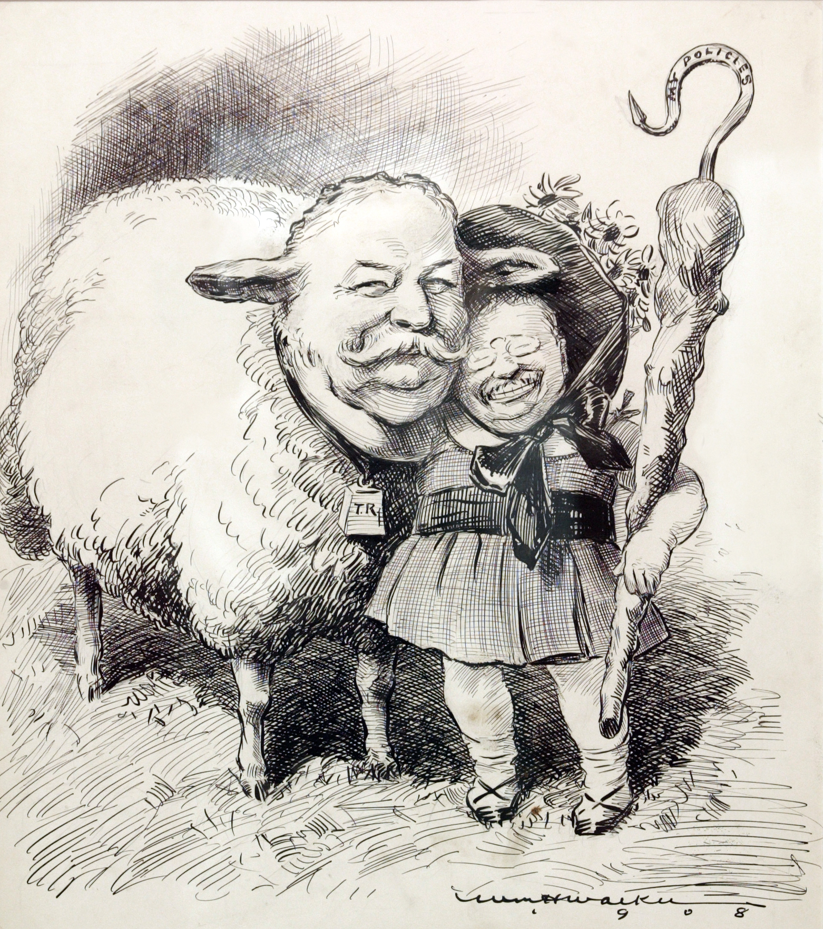
Initially, Taft did a very good job continuing the progressive reform begun by Roosevelt.

Slide 22
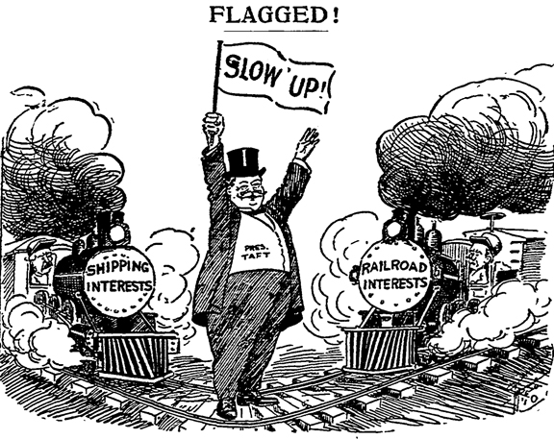
He continued to work with Congress to reign in the power of Railroad trusts.

Slide 23
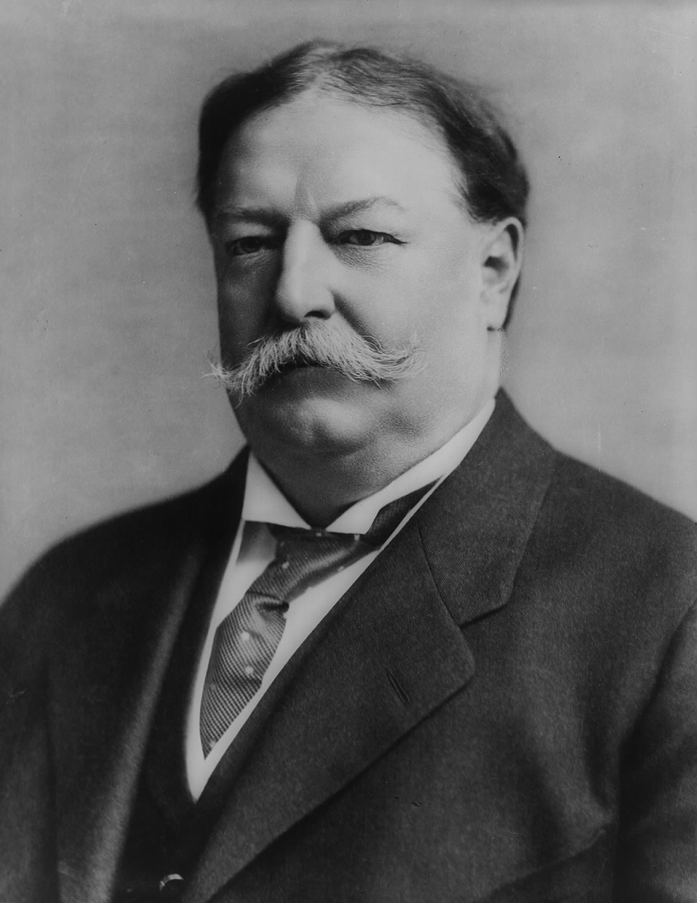
And, unlike Roosevelt, Taft initially believed that there was no such thing as a good trust. They were all bad and needed to be destroyed.

Slide 24
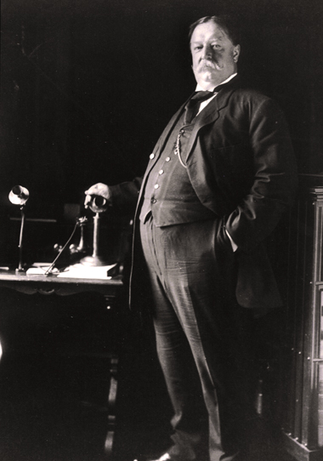
However, Taft did not support the conservation of resources as clearly as Roosevelt, and many in America assumed he didn’t care about the issue at all.

Slide 25
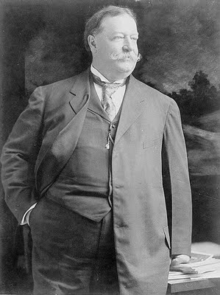
Even worse from a progressive perspective, Taft signed a bill raising tariff rates.
So what? Why was this a problem? Why didn’t reformers like tariffs?

Slide 26
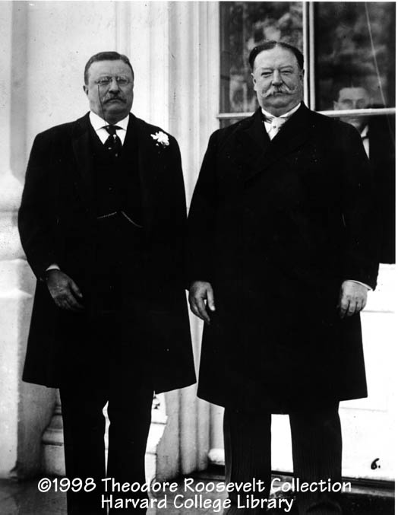
Some in the Republican party wanted Roosevelt to come back and carry on with reform.
Other’s, especially Republicans that supported big business, were more happy with Taft.

Slide 27
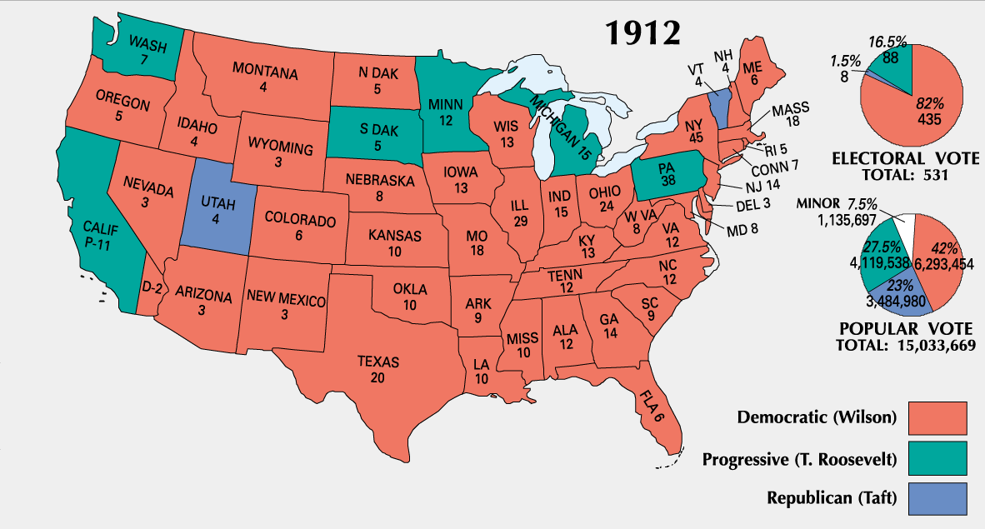
This split in the Republican party allowed the Democratic party, and their candidate Woodrow Wilson, to win the election of 1912.

Slide 28
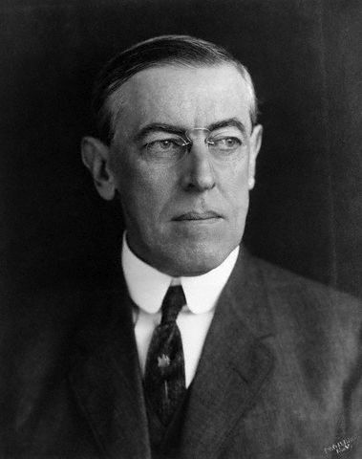
Woodrow
Wilson
1913-1921

Slide 29
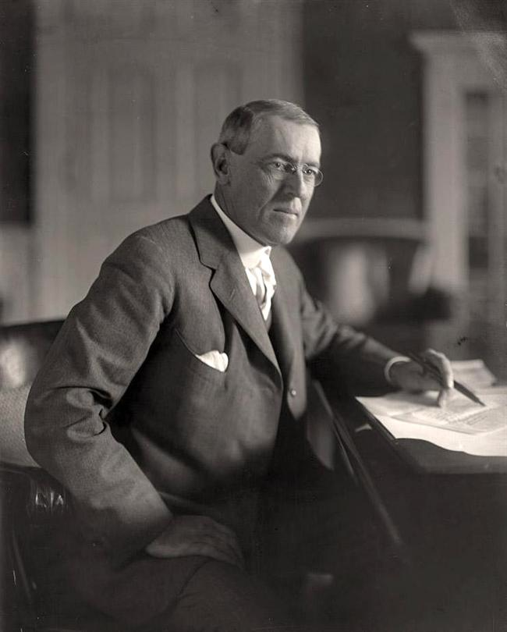
Wilson pledged to take on the “triple wall of privilege.”
Tariffs
Banks
Trusts

Slide 30
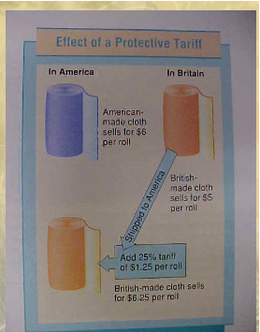
Many saw tariffs as the “mother” of the trusts, and so Wilson worked with Congress to lower tariff rates.

Slide 31
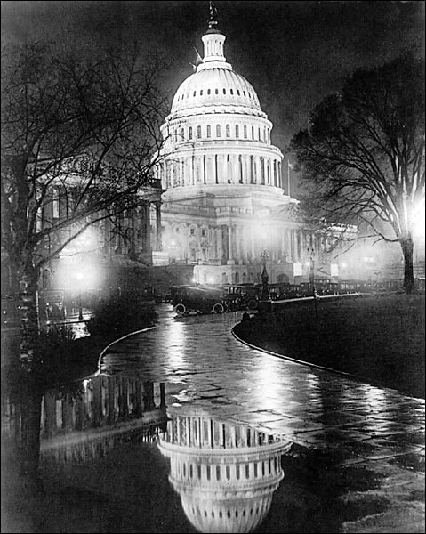
Congress passed the Underwood Tariff in 1913, which was the first reduction in tariff rates in 50 years.

Slide 32
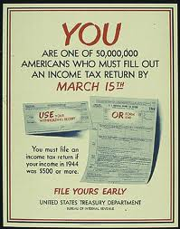
To make up for the money the government would lose, the 16th amendment was added to the Constitution which called for a federal income tax.

Slide 33
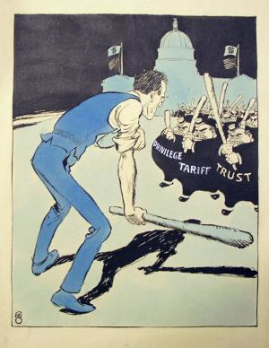
To deal with the Trusts, Wilson convinced Congress to pass the Clayton Anti-Trust Act.
Under this law, monopolies were 100% illegal.

Slide 34
To ensure that companies played by these new rules, Congress created the Federal Trade Commission (FTC)
- Govt. agency in charge of enforcing the Clayton Anti-Trust Act.
- The FTC investigates accusations of monopoly and files court cases against companies it believes violate anti-trust laws.

Slide 35
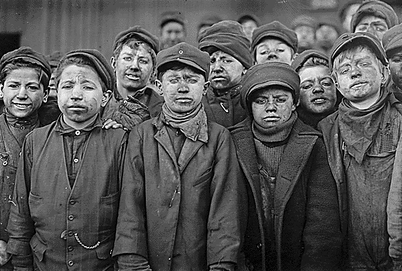
To tackle the problem of child labor, Congress passed the Keating-Owen Act in 1916 which attempted to ban child labor across the country.

Slide 36
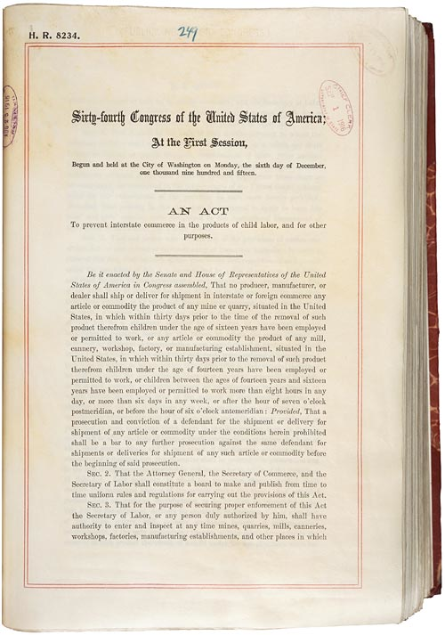
However, the act was eventually declared unconstitutional by the Supreme Court.
The Court argued that regulating labor was the job of state government, not the government of the United States.

Slide 37
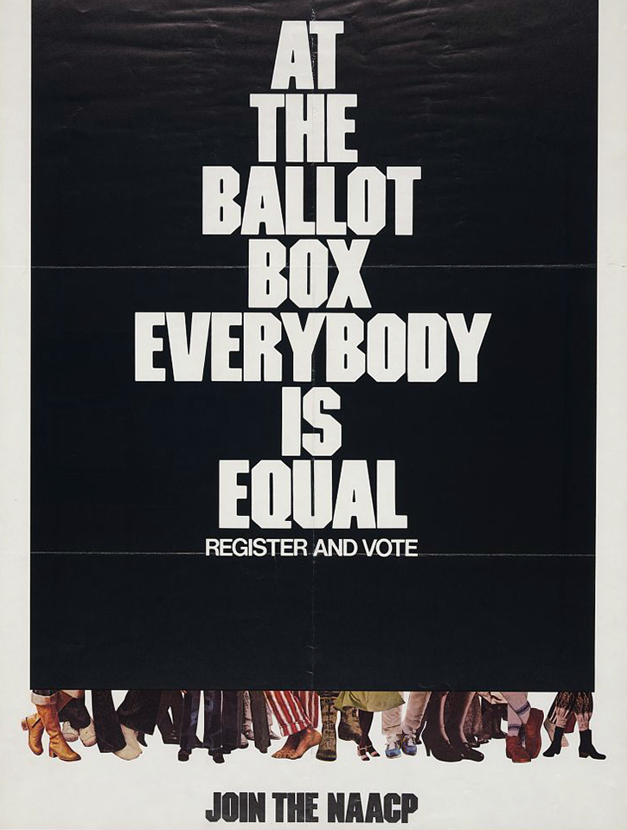
Congress and the states attempted to clean up the US government in two ways:
1. Secret ballot.
2. The 17th Amendment:
Removed the power to choose Senator from the state legislatures and gave that power to the people (direct election)

Slide 38
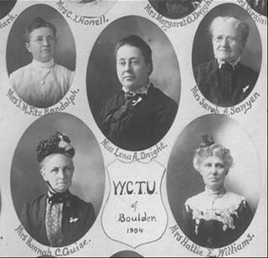
Groups like the WCTU and the Anti-Saloon league were successful at confronting the problem of alcohol abuse with the ratification of the 18th Amendment to the constitution in 1919.

Slide 39
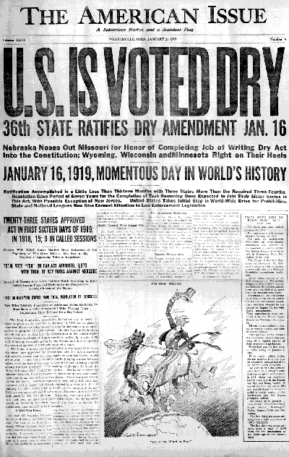
Additionally, Congress passed the Volstead Act to clarify the exact terms of what prohibition looked like (what was legal, what was illegal) and to make some exceptions for religious and scientific purposes.

Slide 40
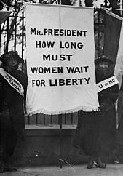
After 80 years of agitation, women won the right to vote through the 19th Amendment, ratified in 1920.

Slide 41
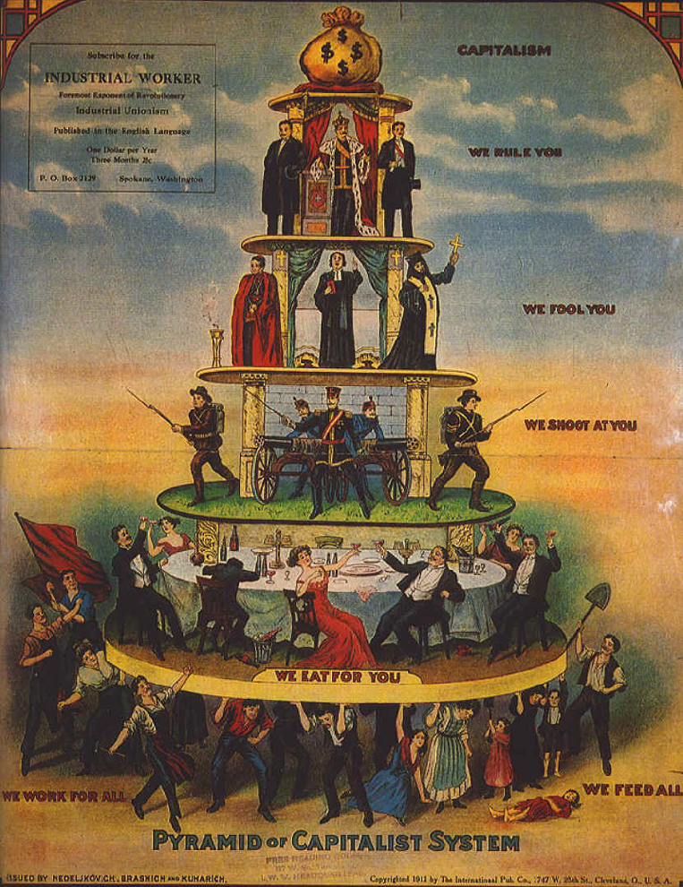
Between 1900 and 1920, progressive reformers, led in part by these three Presidents, effectively tackled many of America’s problems.

Slide 42
What was the impact of the
Progressive Era?

Slide 43
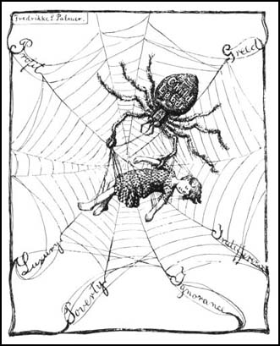
1. While many of America’ problems had been tackled, reform was NOT 100% successful
- Still a huge gap between rich and poor.
- Women were still not totally equal with men.
- Prohibition did not work.
- Child labor hadn’t gone away.

Slide 44
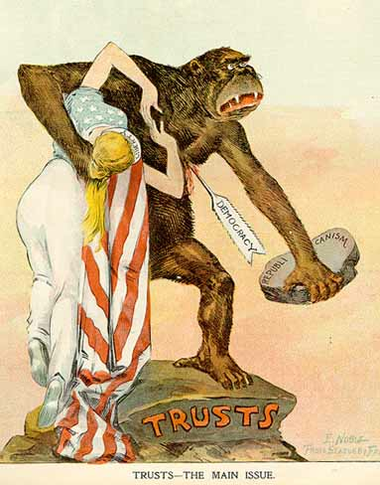
2. The power of the federal / U.S. government was radically increased.
- Laissez faire was gone. Never again would the government totally ignore the practices of business and industry.
- The Clayton Anti-Trust Act, the Pure Food and Drug Act, and the Meat Inspection Act all got the government involved.
- Those laws were / are enforced through new government agencies (FTC & FDA).

Slide 45
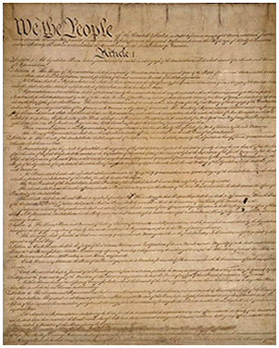
3. The U.S. Constitution was changed, further increasing federal power.
- Traditionally, amendments to the Constitution limited the power of the U.S. government.
- The amendments passed during the Progressive Era, most notably the 18th, saw the U.S. government telling the people and the states what they could and could not do.

Slide 46
4. The U.S. government began to supply help for those in need.
- The government DID NOT provide direct help. It DID NOT provide food, clothing, money etc.. to the people.
- However, it allowed the people to begin to push for what they needed (Unions could exist and push for change. States could pass laws improving conditions).

Slide 47
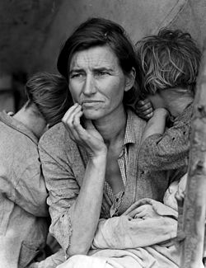
The trends of increasing federal power, the U.S. government helping those in need, and a move away from laissez faire, that started in the Progressive Era, would grow over time.

Slide 48
Fin.

