Slide 1
Dealing With
Inequality
Part I:
Farmers and
Reform

Slide 2
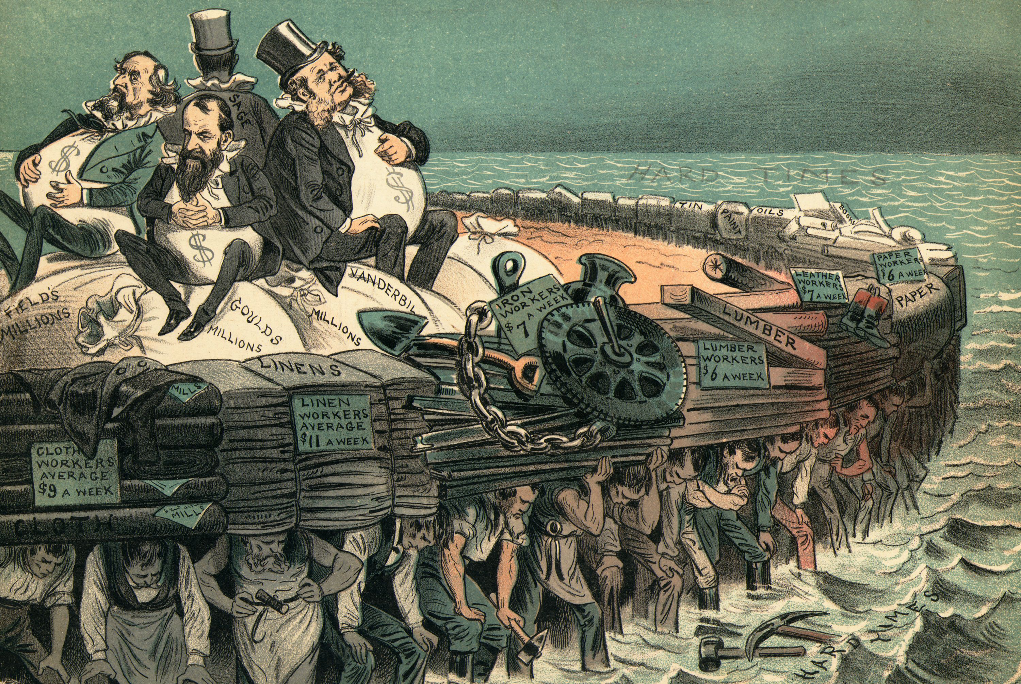
As the clear disparity of wealth in the Gilded Age grew more and more apparent, frustrated citizens began to push back.

Slide 3
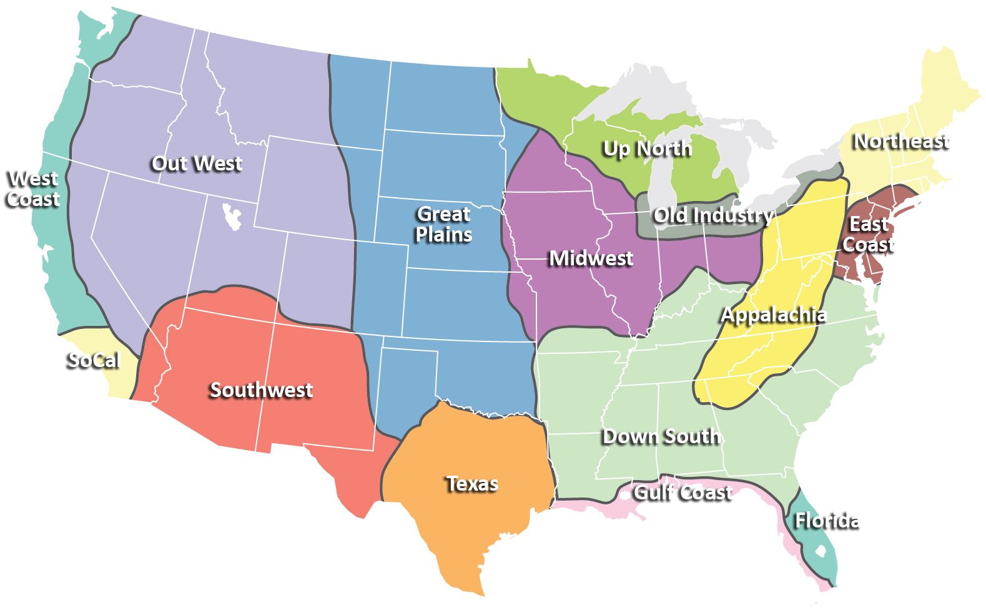
Some of the first efforts at challenging the system began to grow on farms across the Midwest and Great Plains.

Slide 4
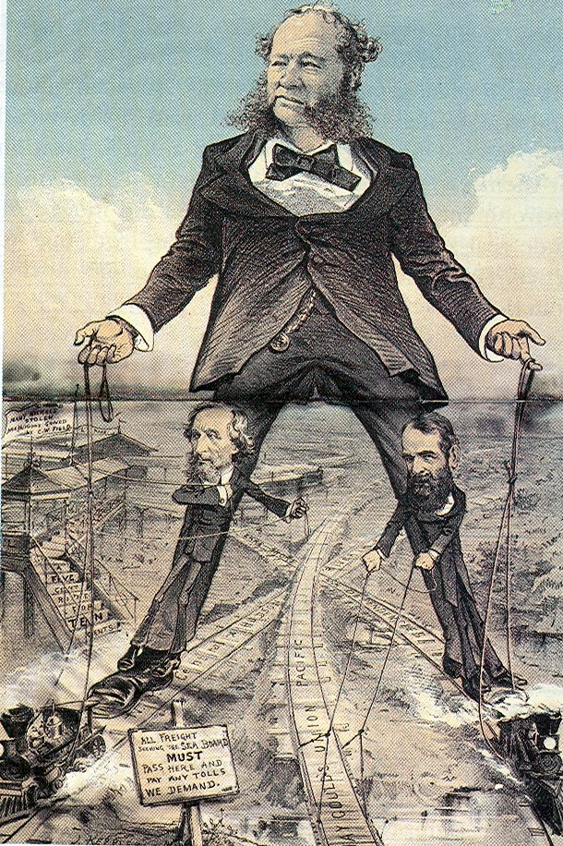
Why were
farmers upset?
1. Railroad monopolies made it incredibly expensive for farmers to ship their crops to market.

Slide 5
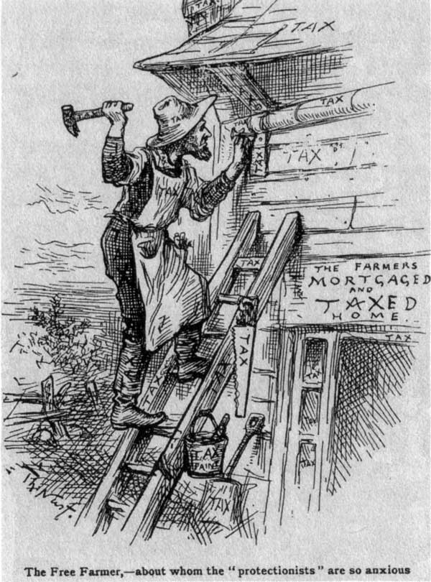
Why were
farmers upset?
2. As the US government increased tariff rates, American businesses increased their prices. Thus, consumer goods grew more and more expensive costing farmers more and more money.

Slide 6
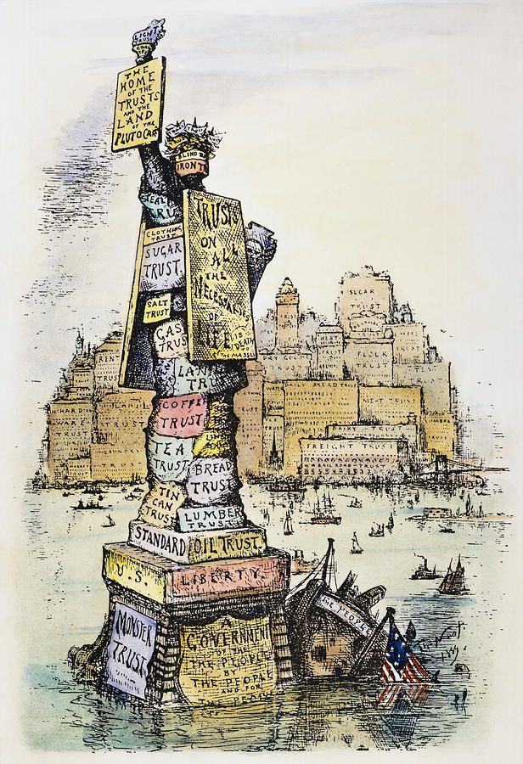
Why were farmers upset?
3. Monopolies gained more and more influence over the government.
- How?
- Funding re-election campaigns.
- Bribing government officials.
- Forcing workers to vote for specific candidates.

Slide 7
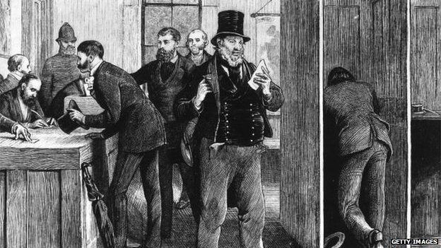
Who a person voted for was NOT secret during the Gilded Age.

Slide 8
When a person showed up to vote, they were asked which party they were planning on voting for, and were given a different color ballot depending on their answer.
So what?
Problems with this?

Slide 9
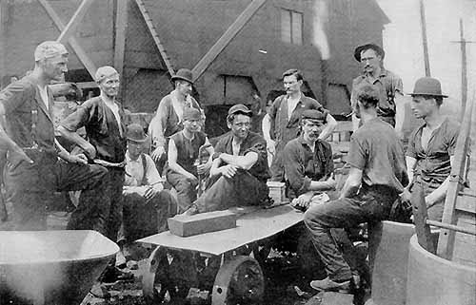
Employers would instruct their workers to vote for a candidate who supported the needs / desires of big business. If a worker didn’t vote the right way, their boss would know, and they would be fired.

Slide 10
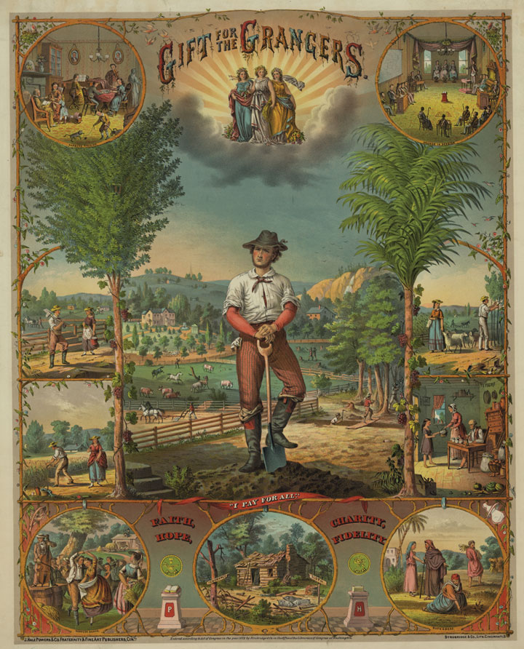
As their frustration grew, farmers organized politically.
Through groups like the Grange and the Farmer’s Alliance, farmers across the Great Plains began to support candidates for state and local offices who pledged to push for reform.

Slide 11
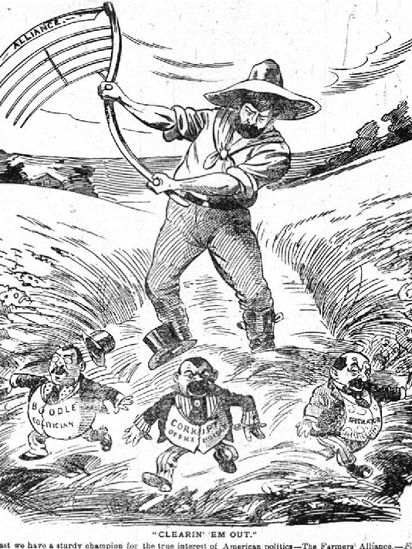
Their political efforts met with some success as states like Wisconsin, Illinois, and Iowa passed what came to be known as “Granger Laws.”
- State governments placed regulations on the practices of the railroads.
- States attempted to regulate fair prices for shipping farm goods.
- Opened the door for possible regulation of other industries.

Slide 12
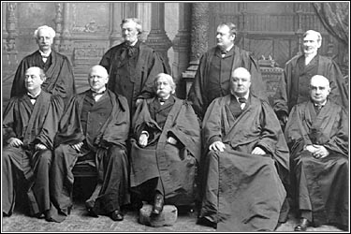
Despite some initial success, elements of these Granger Laws were eventually declared unconstitutional by the US Supreme Court.

Slide 13
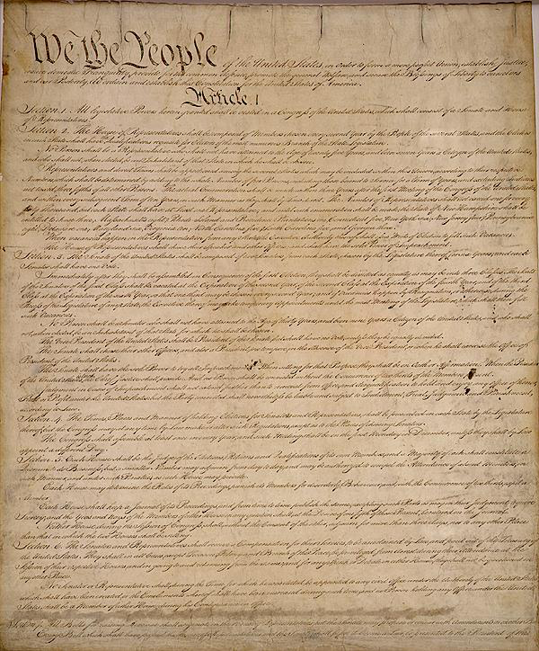
Wabash v. Illinois
- The Constitution gives Congress the exclusive right to regulate interstate commerce.
- Because railroads operate in more than one state, their business practices can only be regulated by Congress.
- Thus, state laws that attempt to regulate railroads are unconstitutional.

Slide 14
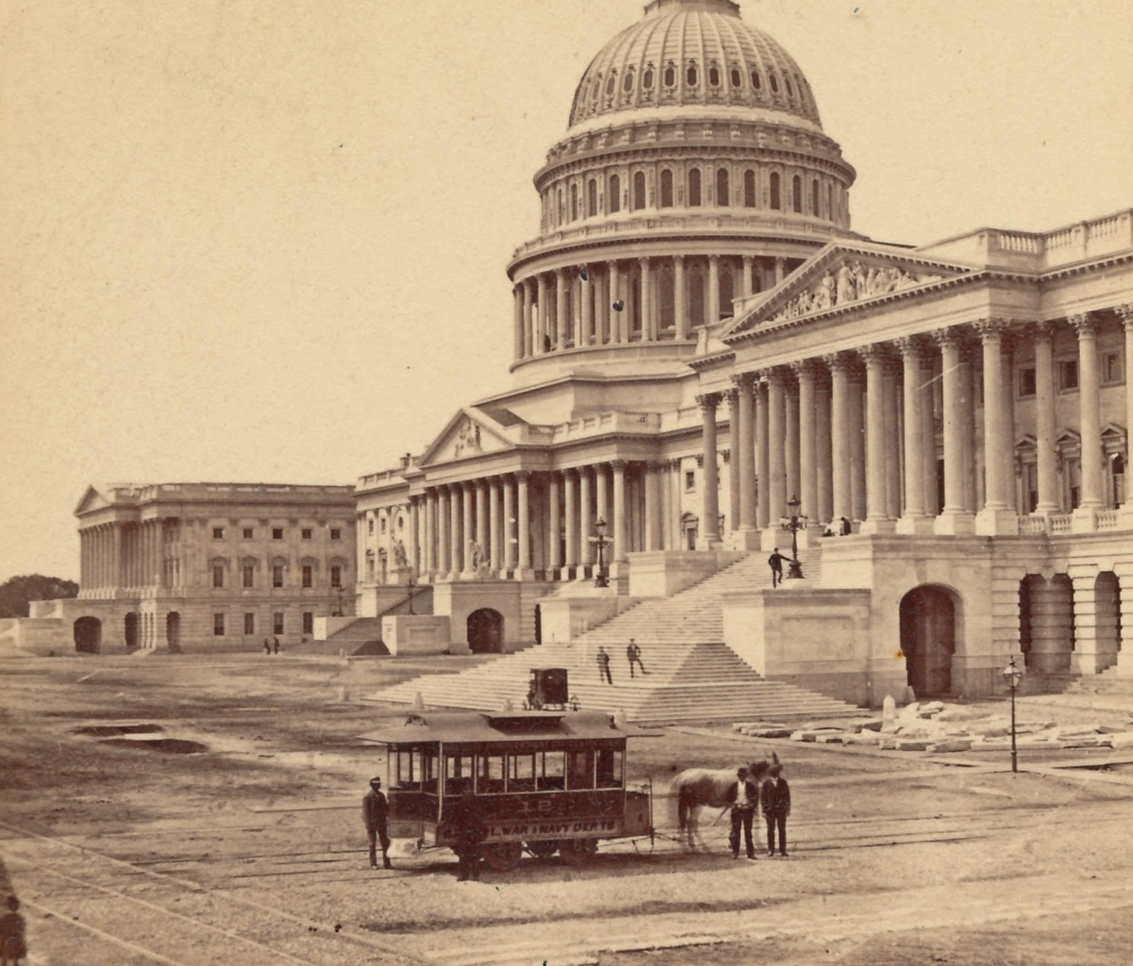
Farmers, and other concerned voters thus pressured the Congress and the federal government to take action.

Slide 15
Congress eventually responded in two ways:
1. Interstate Commerce Act (1887):
- Demanded that railroad rates be “reasonable and just.”
- Didn’t define what “reasonable and just” were.
- Didn’t provide a way for the government to enforce the law.

Slide 16
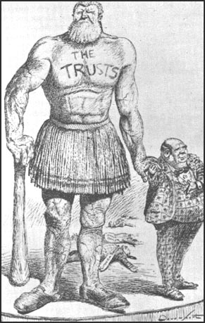
Congress eventually responded in two ways:
2. Sherman Anti-Trust Act (1890):
- Outlawed any business combination or practice that restrained or limited “trade or commerce.”
- Didn’t define exactly what a “trust” was.
- Contained loopholes that allowed businesses to avoid the law.

Slide 17
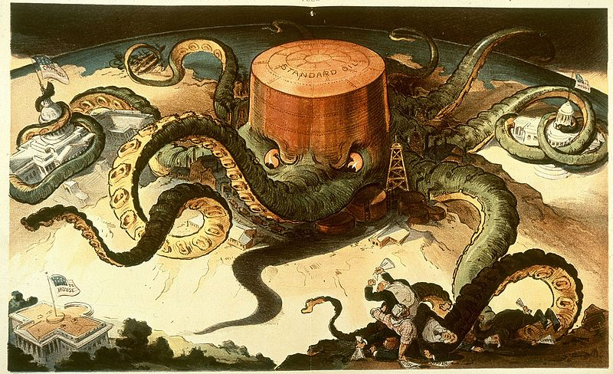
Ultimately then, while farmers had some initial impact at the state level, monopolies largely went unregulated by the government.

Slide 18
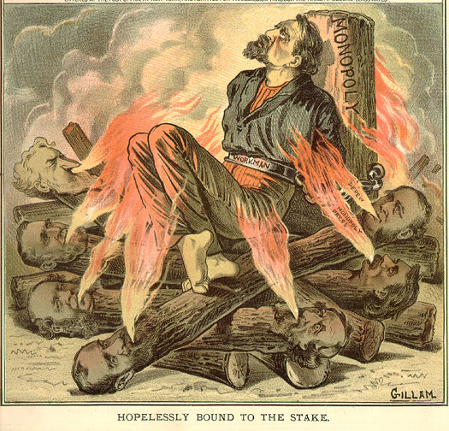
As the inequality in America became more and more obvious, some members of the wealthy class began to make arguments to justify their unbelievable wealth.

Slide 19
The dominant philosophy used to justify the gap between rich and poor was….
Social
Darwinism

Slide 20
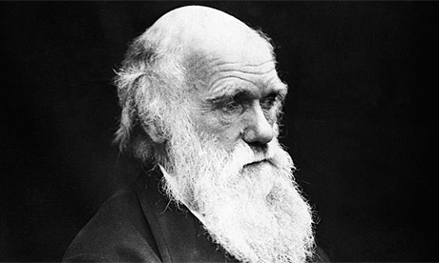
What, if anything can you tell me about the theory of evolution / natural selection?

Slide 21
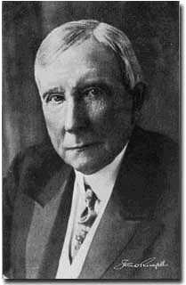
According to the theory of Social Darwinism, some people are simply born to be successful. Using their talents and intelligence they will make something of themselves. They will become rich.

Slide 22
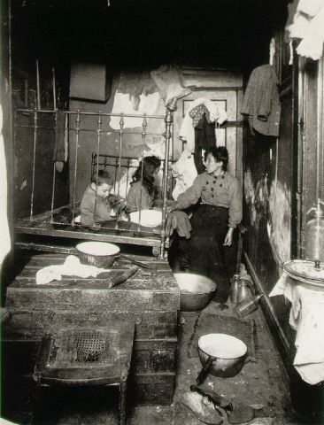
Some people are simply born to fail. They lack talent and intelligence. They will remain poor.

Slide 23
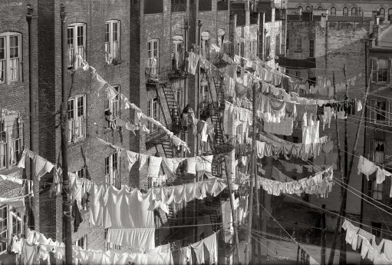
According to Social Darwinism then, the laws of nature dictate that a gap between rich and poor should exist.

Slide 24
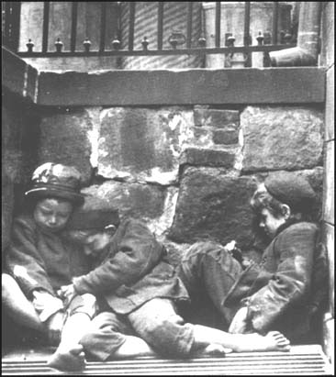
Hard core Social Darwinists also made the argument that given this gap, not only should the rich not feel bad about it…
they should also NOT help the poor deal with it.

Slide 25
They argued that in nature, the strong of a species survive and pass on their genes. The weak of a species die off and their genes are removed from the gene pool.

Slide 26
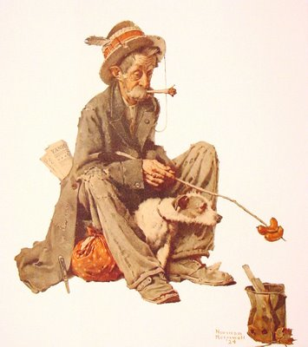
If the rich go out of their way to help the poor survive, the natural order will be violated. The poor will become a burden to society and will drag the human race down.

Slide 27
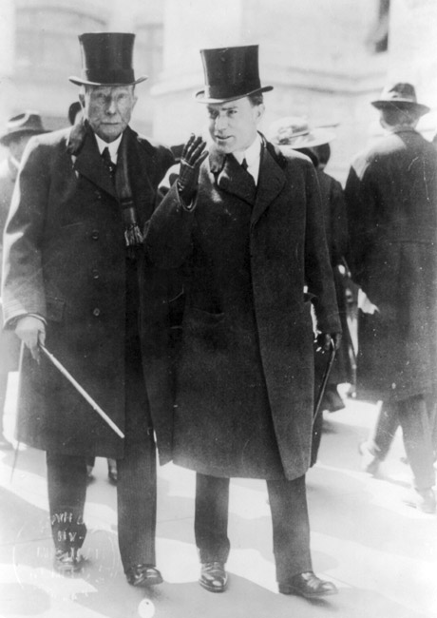
As a result, to maintain the natural order, the rich should not help the poor nor should the government step in and regulate the economy.

Slide 28
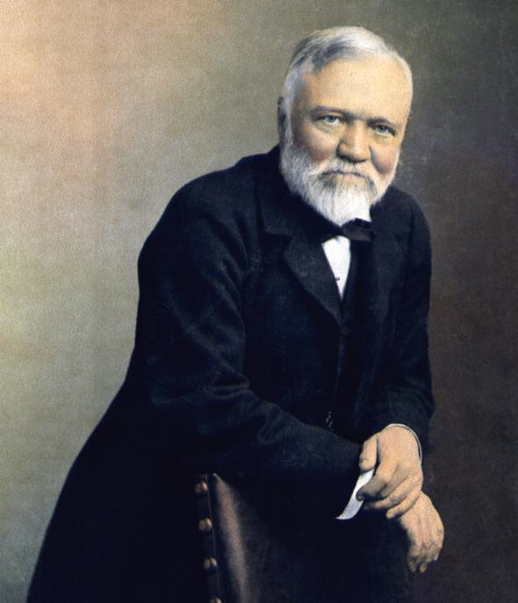
Some of the very wealthy, who had most to gain from the theory of Social Darwinism, didn’t totally agree with it. Chief among them was Andrew Carnegie.

Slide 29
Carnegie proposed the theory of…
The Gospel of Wealth

Slide 30
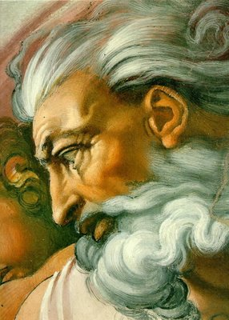
According to Carnegie, and those who agreed with him, God had blessed the wealthy with money and power.

Slide 31
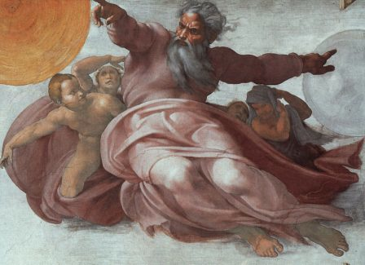
However, He also gave the wealthy a mission, a duty.

Slide 32
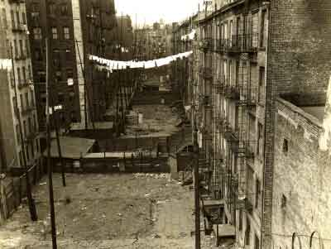
Carnegie argued that God wanted the rich to make society a better place.

Slide 33
However, the rich couldn’t simply give money to the poor in the form of handouts or better wages. Why not?

Slide 34
Instead, the wealthy should provide opportunities to allow the poor to help themselves.

Slide 35
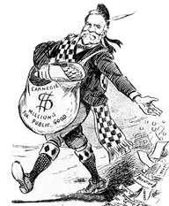
To do so, the wealthy should build schools, build libraries, fund colleges, etc.. to provide the poor the necessary skills so that they could improve their own lives.

Slide 36
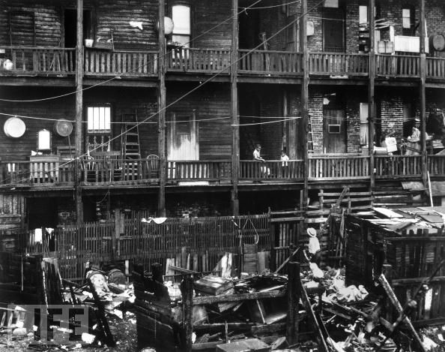
Others began to argue that Social Darwinism was wrong and cruel, and that Carnegie didn’t come close to really helping those in need.

Slide 37
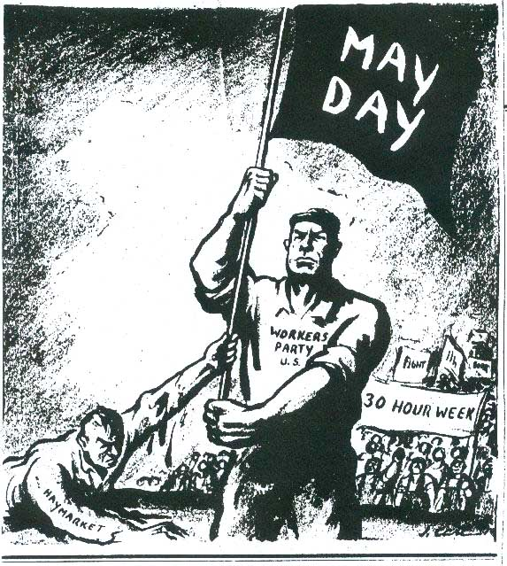
As people and government debated these theories, workers increasingly called for help. Over time they began to realize that if things were going to change they might have to force that change themselves.

Slide 38
Fin.

