Slide 1
Who will
solve
America’s
Problems?

Slide 2
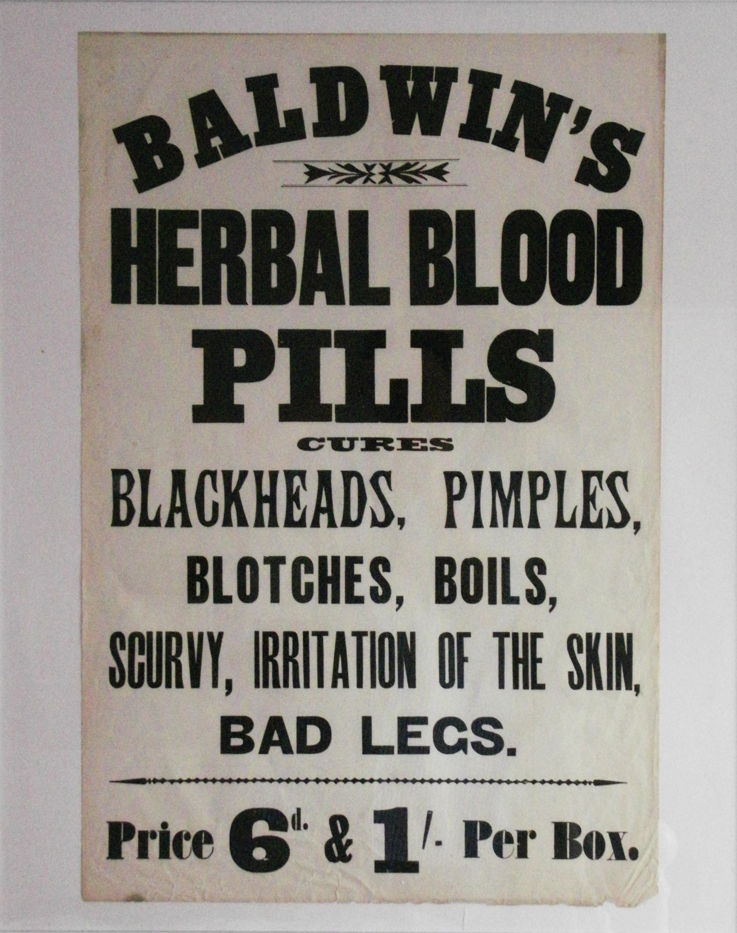
As we have suggested, by 1900 America faced a number of problems.

Slide 3
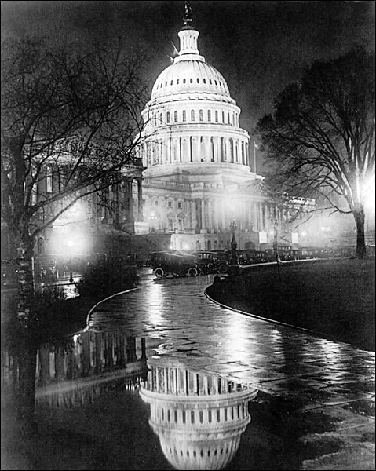
In terms of solving those problems:
1. The government still believed in laissez faire.
2. The wealthy had no interest in solving them.
3. When workers had tried to solve them, what had happened?

Slide 4
By 1890, a group of Americans began to argue that we could ignore the problems no longer. Over time, this group grew more and more popular. Then name of this group?
The American
Socialist Party

Slide 5
What did the socialists want?
1. A total rejection of laissez faire
2. U.S. government ownership of railroads
3. Government inspections of factories and housing
4. Maximum 8 hour work day
5. A guaranteed minimum wage
6. Women’s right to vote.
7. A limit on how much companies and individuals could earn.

Slide 6
More and more Americans began to embrace the socialist cause.
Year | Socialist Party | Socialist Labor Party | Total
1888 |  | 2,068 | 2,068
1890 |  | 13,704 | 13,704
1892 |  | 21,512 | 21,512
1894 |  | 30,020 | 30,020
1896 |  | 36,275 | 36,274
1898 |  | 82,204 | 82,204
1900 | 96,931 | 33,405 | 130,336
1902 | 223,494 | 53,763 | 277,257
1904 | 408,230 | 33,546 | 441,776
1906 | 331,043 | 20,265 | 351,308
1908 | 424,488 | 14,021 | 438,509
1910 | 607,674 | 34,115 | 641,789
1912 |  |  | 901,873
This scared the pants off of upper and middle class Americans. Why?

Slide 7
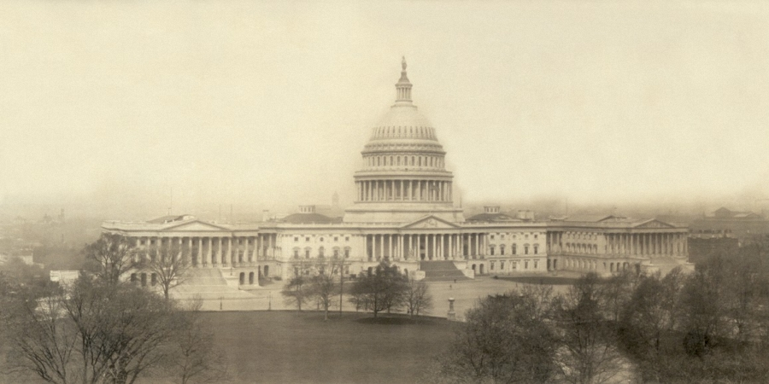
Many American reformers began to argue that the U.S. government itself needed to do something to solve the problems before the socialist party got enough votes to take over and limit the American capitalist system.

Slide 8
Reformers very quickly realized that if change was going to happen one group of Americans was more important than all the rest:
The
Middle
Class

Slide 9
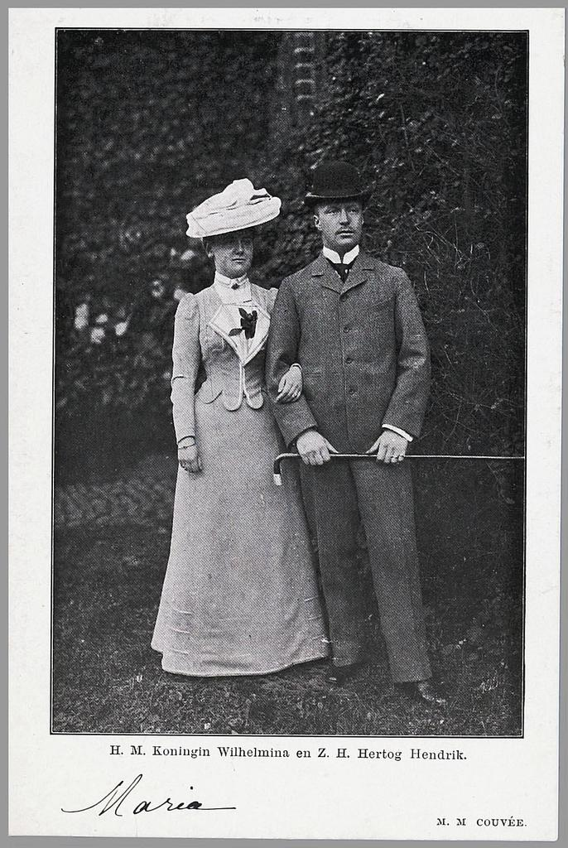
The middle class had enough money, power, and most importantly political influence in the form of votes to force politicians to make changes.
The trick was getting the middle class to care about the issues facing poor working Americans.

Slide 10
Thus, early reformers adopted two central beliefs:
1. America’s problems would only really be solved though the power of the U.S. government.
2. That would only be happen if the middle class was forced to acknowledge and then confront the problems.

Slide 11
Progressive Math
Middle Class voters care about the problems
=
Middle Class voters want to do something to bring about change
=
Middle class voters elect politicians who also care and want to bring about change
=
The government takes action to bring about that change

Slide 12
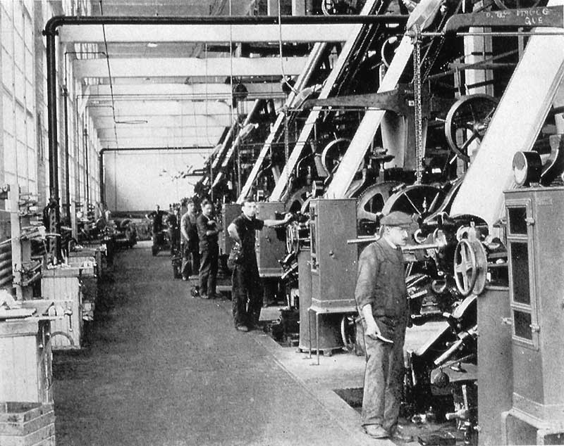
The first task then was getting the middle class to care.

Slide 13
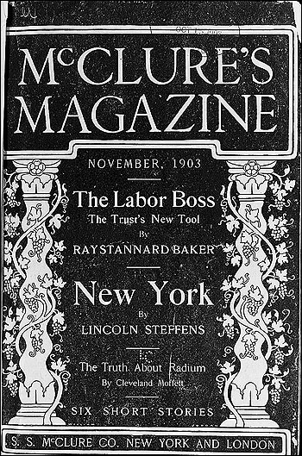
To that end, a group of photographers and journalists, collectively known as “muckrakers”, took it upon themselves to educate the middle class on the exact nature of the problems facing the nation.

Slide 14
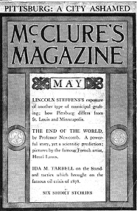
These muckrakers investigated the problems, then reported on what they found.
Most importantly, the muckrakers used carefully researched facts to educate the middle class.
They didn’t exaggerate, they didn’t lie, they didn’t simply make stuff up.
This is important. Why?

Slide 15
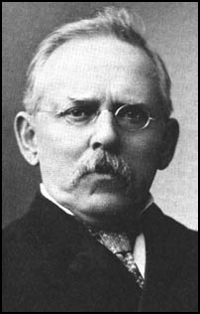
Jacob Riis exposed the terrible conditions of tenements and factories.

Slide 16
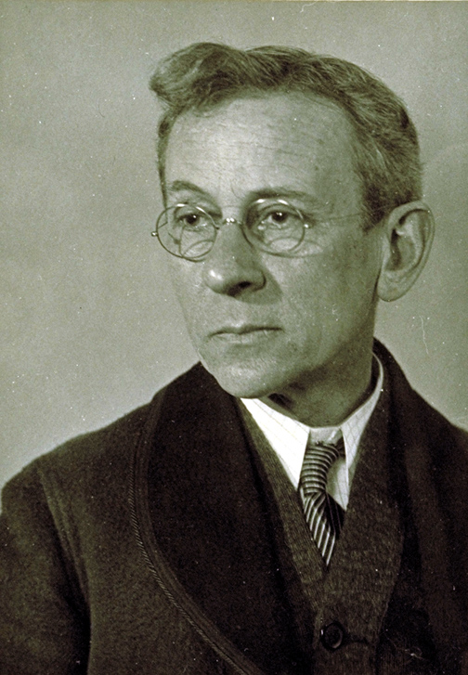
Lewis Hine focused on factories and zeroed in on child labor.

Slide 17
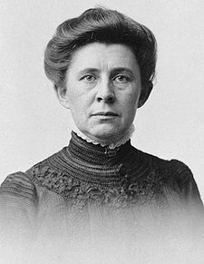
Ida Tarbell exposed the power of trusts.

Slide 18
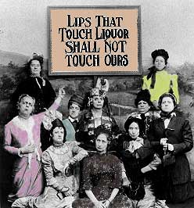
The Women’s Christian Temperance Union (WTCU) and the Anti-Saloon League focused on preaching the dangers of alcohol.

Slide 19
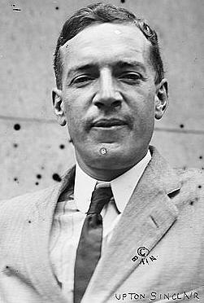
Upton Sinclair tackled the trusts and consumer safety, most importantly in his book The Jungle.

Slide 20
Fin.

