Slide 1
Workers
in the
Gilded age

Slide 2
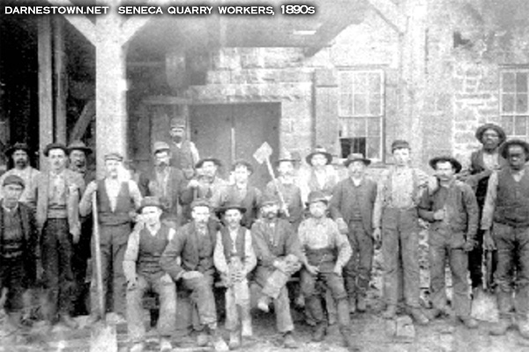
What was the reality of daily life for factory workers in Gilded Age America?

Slide 3
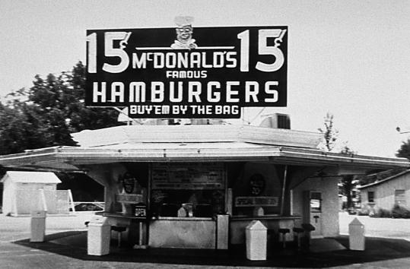
What is the goal of any business or company?
Make as much money / profit as possible.

Slide 4
How?
Monopoly / Trusts: Drive out all competition.
Limit expenses / costs.

Slide 5
The biggest cost / expense for any business is:
Labor
- Paychecks
- Health Care
- Work conditions and safety.
To maximize profits and minimize costs, spend as little on these as possible!

Slide 6
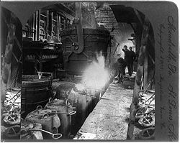
Most factories demanded workers be on the job 10-16 hours a day, 6 or 7 days a week, 365 days a year.

Slide 7
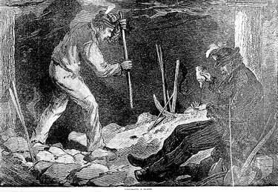
There was no paid vacation, no sick pay, no disability pay. If you didn’t show up to work, you were fired. Why could factory owners get away with this?

Slide 8
Wages were not good.
1899: average male made $498 each year ($11,000 today)
A family could not live on these wages alone, so many poor and lower class women had to go to work as well.
1899: average female made $267 each year ($6,000 today)

Slide 9
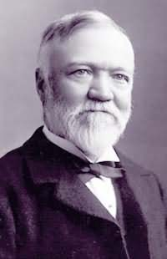
By comparison, in 1900 Andrew Carnegie made $23 Million ($516 million today).

Slide 10
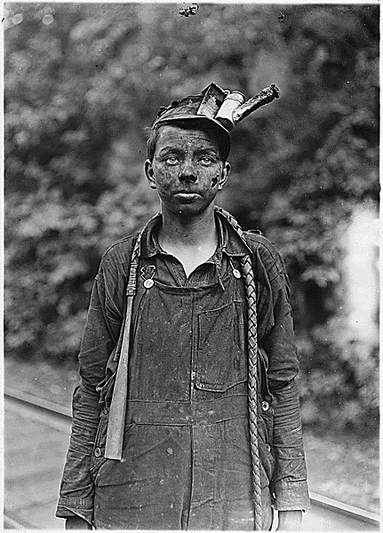
Due to such low pay, many parents were forced into sending their children to work as well.

Slide 11
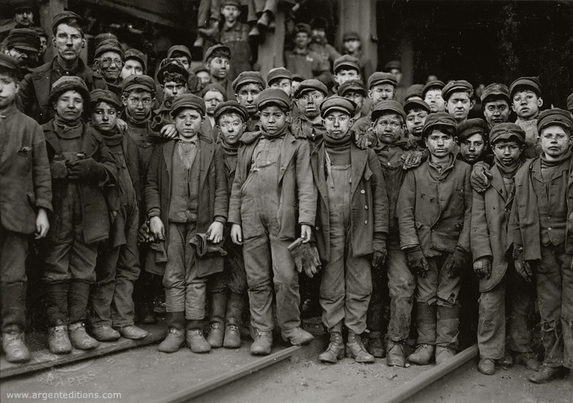
In the 1890’s 20% of boys and 15% of girls under the age of 15 in America had a job.

Slide 12
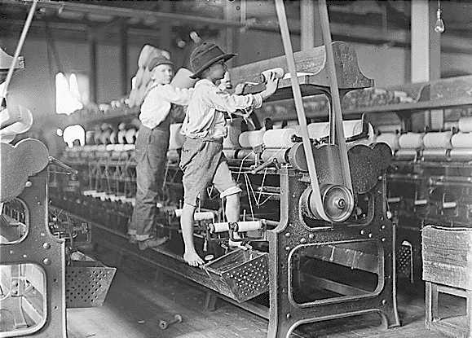
Many children worked 10-12 hours a day and for that shift they earned an average of 27 cents.

Slide 13
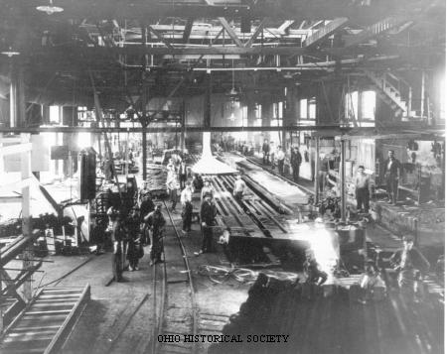
They worked along side their parents in factories that were incredibly dangerous.

Slide 14
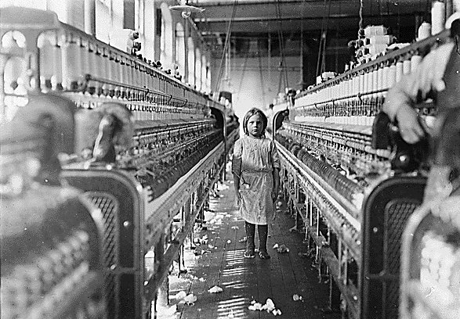
Factories were dirty, dark, poorly ventilated, too hot, too cold, filled with dangerous machinery, etc…

Slide 15
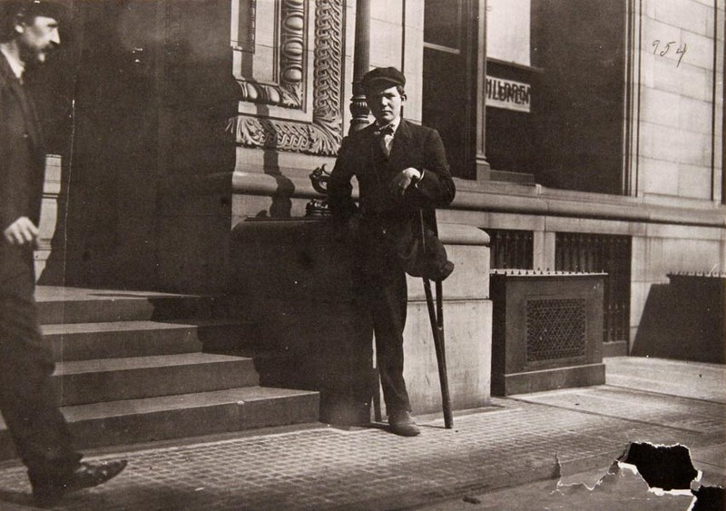
Death and injury on the job were common:
-1880’s an average of 25,000-35,000 workers killed in RR industry each year
-1882 an average of 675 workers were killed in America each week.

Slide 16
People were horribly injured and were dying on the job. Children were in factories not in school. Monopolists were growing terribly rich, but with a high human cost.
Where was
the
Government?!

Slide 17
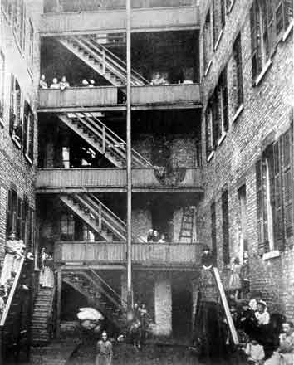
Things didn’t get much better when they got to leave the factory and go home.

Slide 18
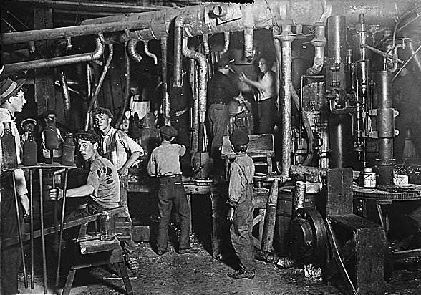
Most factory workers earned so little that they could barely afford the necessities of life. (Food, clothing, shelter, etc…)

Slide 19
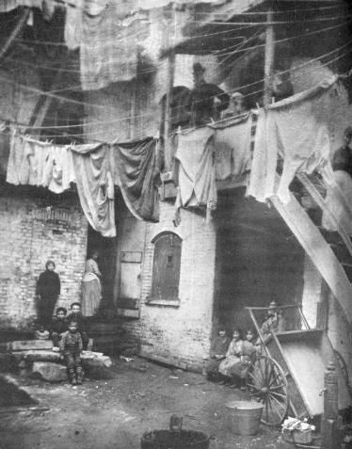
As a result, immigrant, and lower class Americans found shelter wherever they could. This often meant living in poorly constructed, cheap, crowded, and dirty apartments jammed together in slum neighborhoods.

Slide 20
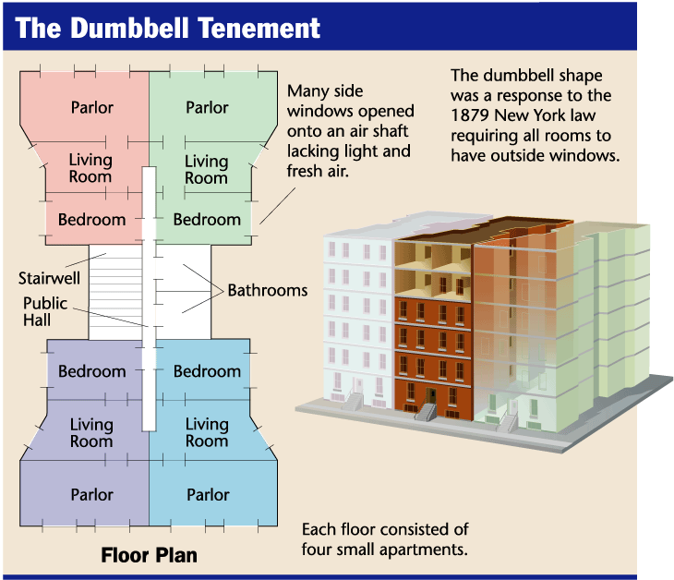

Slide 21
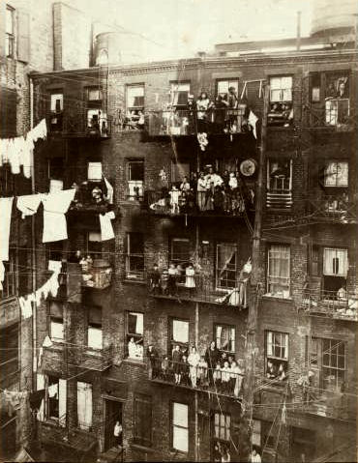

Slide 22
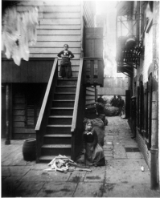

Slide 23
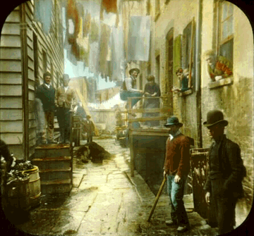

Slide 24
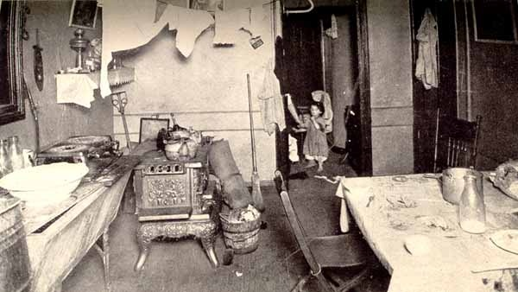

Slide 25
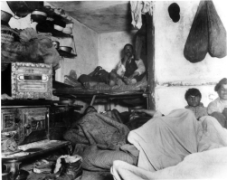

Slide 26
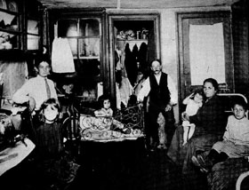

Slide 27
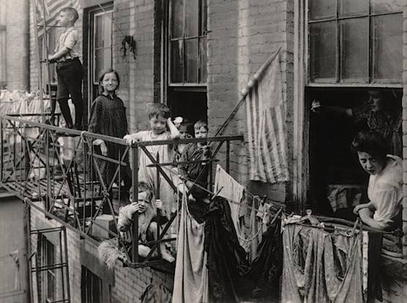

Slide 28
The divide between rich and poor in America during the Gilded Age was huge.

Slide 29
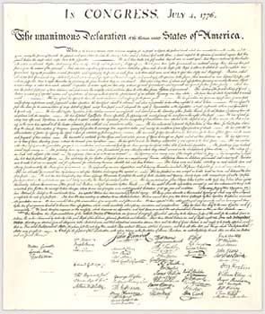
Was this okay? Why?
If it wasn’t okay, what could be done to change it?
Equality and Liberty?

Slide 30
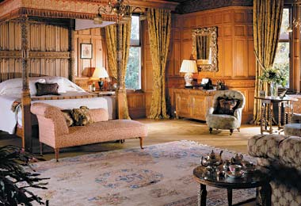
In an effort to deal with these issues, some members of the wealthy class began to make arguments to justify their unbelievable wealth.

Slide 31
The dominant philosophy used to justify the gap between rich and poor was….
Social
Darwinism

Slide 32
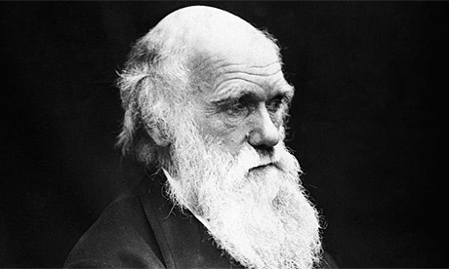
What, if anything can you tell me about the theory of evolution / natural selection?

Slide 33
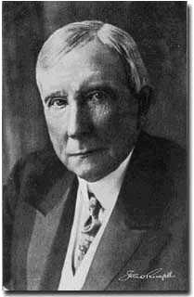
According to the theory of Social Darwinism, some people are simply born to be successful. Using their talents and intelligence they will make something of themselves. They will become rich.

Slide 34
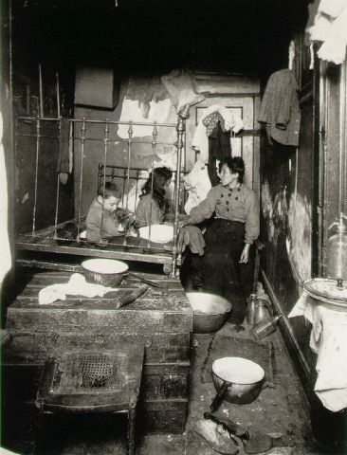
Some people are simply born to fail. They lack talent and intelligence. They will remain poor.

Slide 35
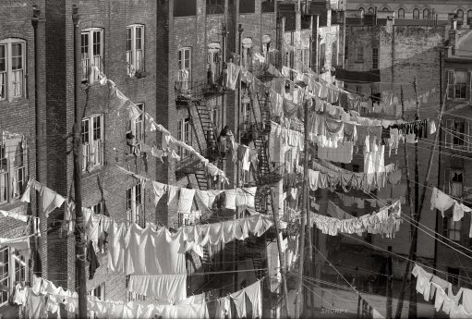
According to Social Darwinism then, the laws of nature dictate that a gap between rich and poor should exist.

Slide 36
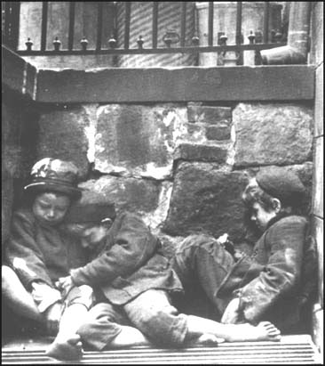
Social Darwinists also made the argument that given this gap, not only should the rich not feel bad about it…
they should also NOT help the poor deal with it.

Slide 37
They argued that in nature, the strong of a species survive and pass on their genes. The weak of a species die off and their genes are removed from the gene pool.

Slide 38
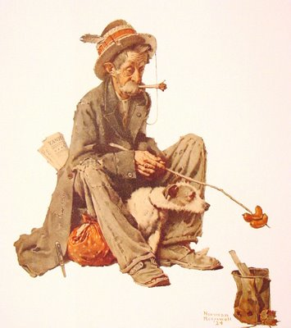
If the rich go out of their way to help the poor survive, the natural order will be violated. The poor will become a burden to society and will drag the human race down.

Slide 39
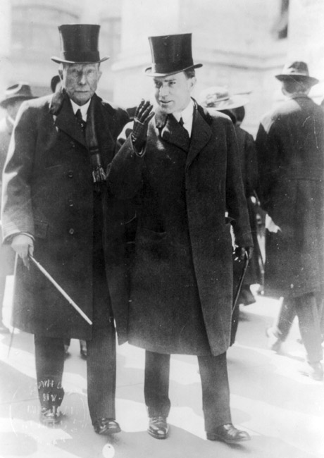
As a result, to maintain the natural order, the rich should not help the poor nor should the government step in and regulate the economy.

Slide 40
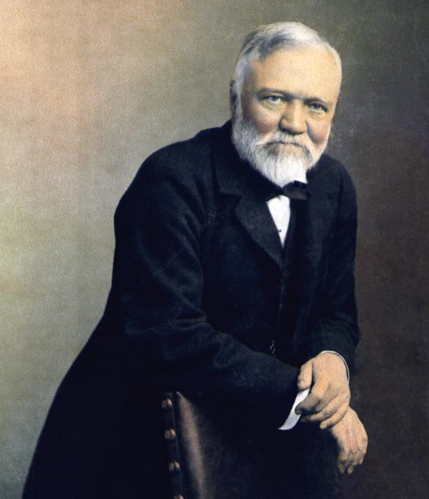
Some of the very wealthy, who had most to gain from the theory of Social Darwinism, didn’t totally agree with it. Chief among them was Andrew Carnegie.

Slide 41
Carnegie proposed the theory of…
The Gospel of Wealth

Slide 42
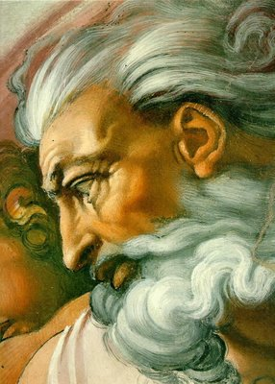
According to Carnegie, and those who agreed with him, God had blessed the wealthy with money and power.

Slide 43
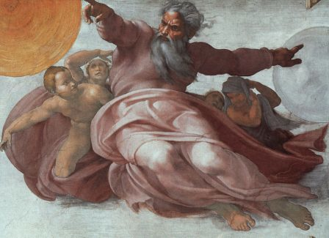
However, He also gave the wealthy a mission, a duty.

Slide 44
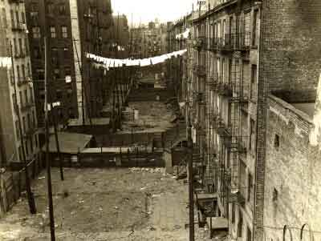
Carnegie argued that God wanted the rich to make society a better place.

Slide 45
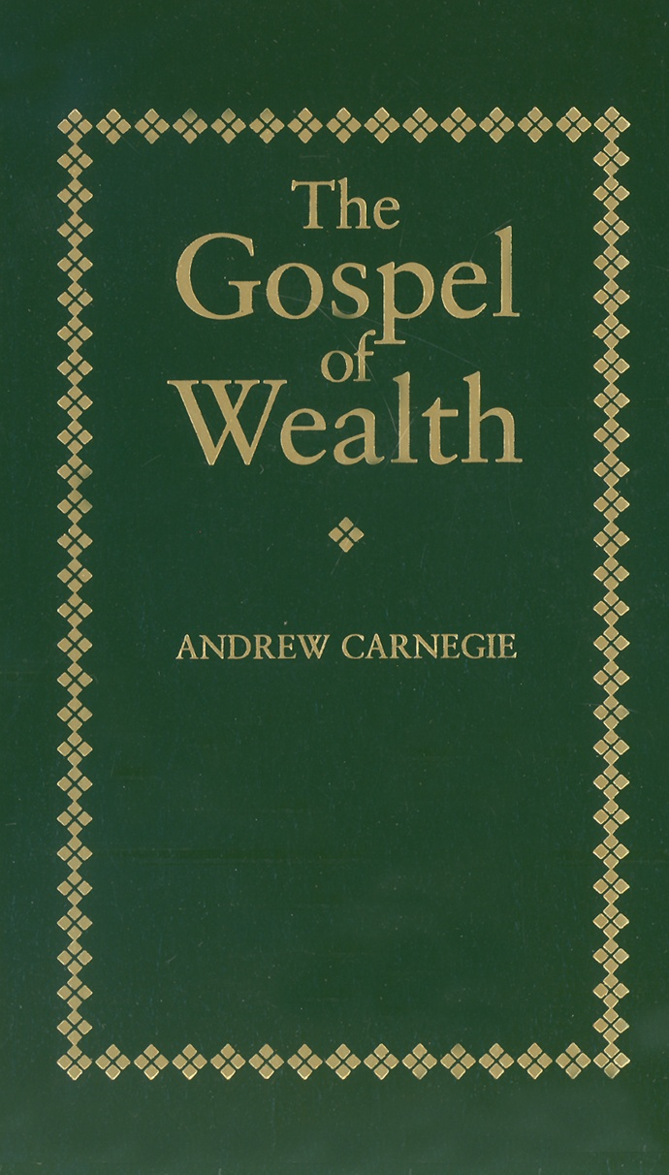
However, the rich couldn’t simply give money to the poor in the form of handouts or better wages. Why not?

Slide 46
Instead, the wealthy should provide opportunities to allow the poor to help themselves.

Slide 47
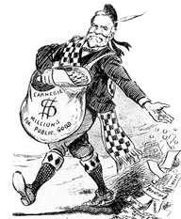
To do so, the wealthy should build schools, build libraries, fund colleges, etc.. to provide the poor the necessary skills so that they could improve their own lives.

Slide 48
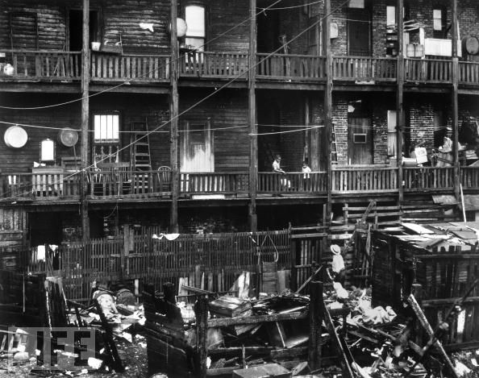
Others began to argue that Social Darwinism was wrong and cruel, and that Carnegie didn’t come close to really helping those in need.

Slide 49
More and more voices began to call for direct government action. The most radical began to argue that the United States needed to embrace…
Socialism

Slide 50
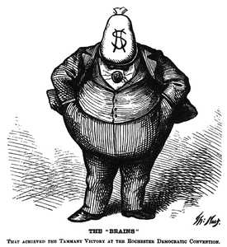
Socialists argued that it was ridiculous for men like Carnegie and Rockefeller to earn so much more than their workers.

Slide 51
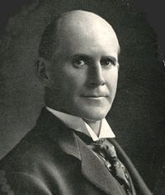
As such, Socialists like Eugene V. Debs began to call for a cap, a maximum, on how much any person could make in a year.

Slide 52
What did Debs and others propose the government do with that money?

Slide 53
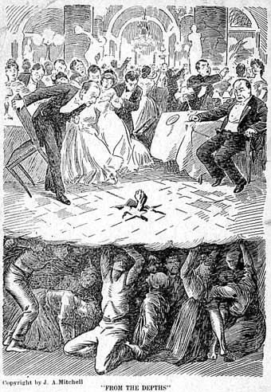
Socialists also called for:
- Government inspection of factories and minimum safety conditions.
- Improvements in workers housing.
- Government ownership of public utilities.

Slide 54
Fin.

