Slide 1
American Expansion
And
War With Spain

Slide 2
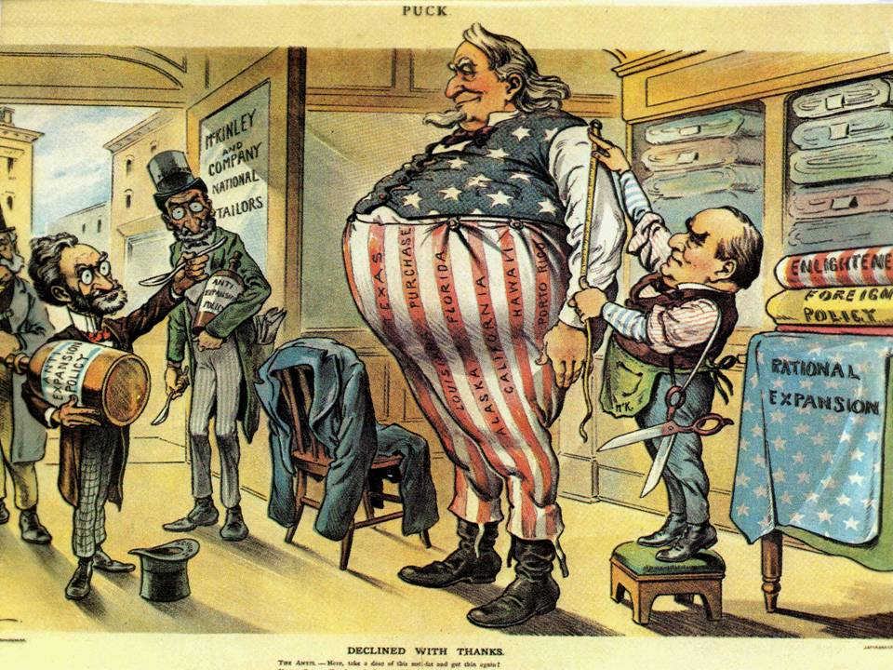
Following the successful acquisition of Hawaii, American imperialists looked to the Caribbean.

Slide 3
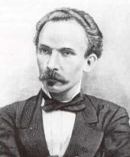
As America was expanding, Cuban revolutionaries, under the leadership of poet Jose Marti, pushed for Cuban independence from Spain.

Slide 4
Cuba Libre!
In 1885, Marti and others helped launch a rebellion against Spanish control. What tactics did Marti and the rebels use in their attempt to get Spain out of Cuba?

Slide 5
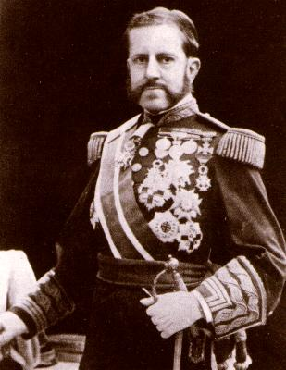
Spain responded by dispatching Gen, Valeriano Weyler to Cuba to put and end to the rebellion.
He did this by forcing almost the entire population of central and western Cuba into camps.

Slide 6
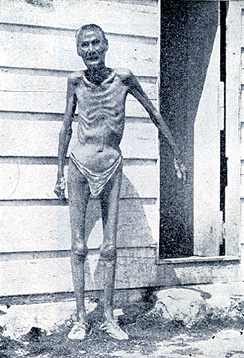
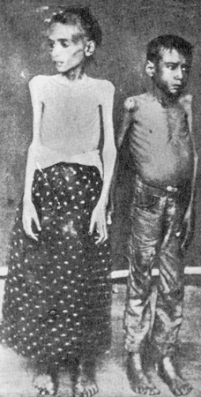

Slide 7
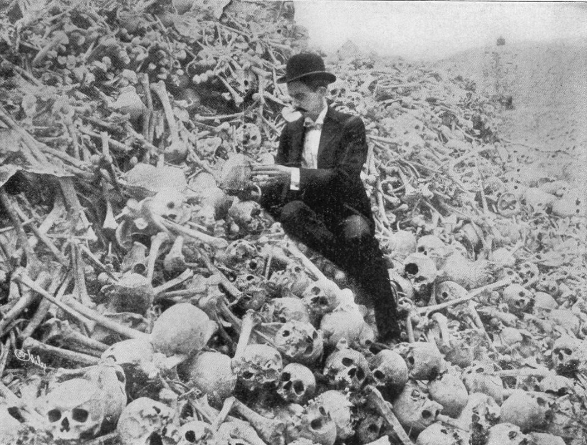
An estimated 300,000 Cubans were forced into these camps were over 100,000 died from hunger and disease.

Slide 8
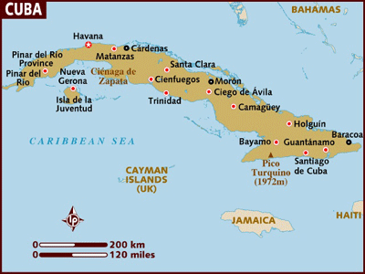
Why did Americans care about any of this? Well. . .

Slide 9
Why did Americans care about any of this?
1. A natural affection for revolutionaries fighting against an oppressor.
2. Business investments in Cuban sugar of over $50 Million.
3. Lucrative trade deals with Cuban companies.
4. Instability in Cuba threatened trade throughout the Caribbean just off the American coast.
5. Yellow Journalism.

Slide 10
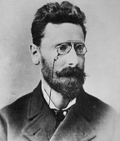
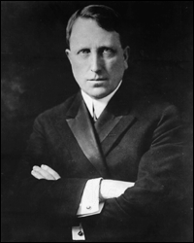
Titans of New York Journalism
Josef Pulitzer
William Randolph Hearst
(New York World )
(New York Journal )

Slide 11
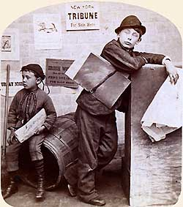
Hearst, Pulitzer, and other newspaper men in New York competed fiercely to get the most readers and sell the most newspapers.

Slide 12
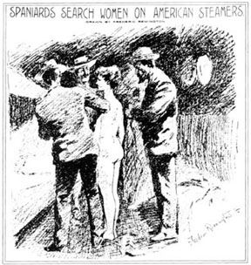
They used sensational stories of events occurring in Cuba in an effort to boost sales of their newspapers.

Slide 13
Newspapers began to call Weyler “The Butcher” and stories of the horrors of Cuban camps were splashed across the front pages of American newspapers.

Slide 14
As Hearst and Pulitzer continued to compete with one another, the first real comic strip character got into the mix.

Slide 15
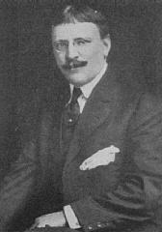
Cartoonist R. F. Outcault drew a very popular cartoon, “The Yellow Kid” for Pulitzer’s paper. Hearst agreed to pay Outcault more money to switch papers in a effort to both screw Pulitzer, and attract readers to his own paper,

Slide 16
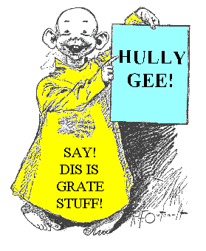
I will now show you a picture of the yellow kid, perhaps the ugliest cartoon character in American history.

Slide 17
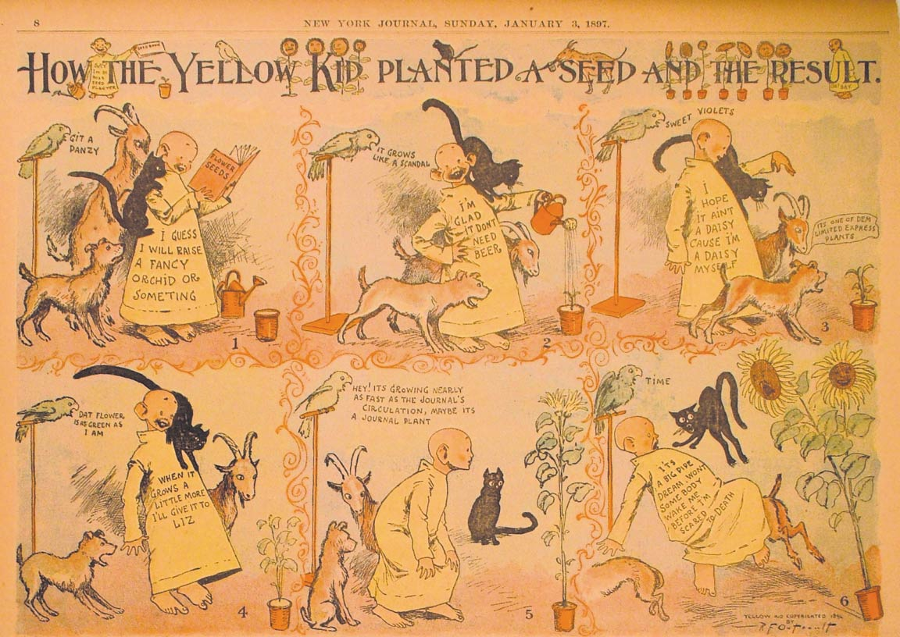

Slide 18
Hearst’s actions with the Yellow Kid continued into the newsroom where the two newspapers attempted to outdo each other. Because the first effort involved the Yellow Kid, the entire process of attracting readers through sensational reporting came to be known as. . .
Yellow
Journalism

Slide 19
Both newspapers continued to exaggerate, and even completely fabricate stories about events in Cuba, to enflame the passions of U.S. readers and, in doing so, sell more newspapers.

Slide 20
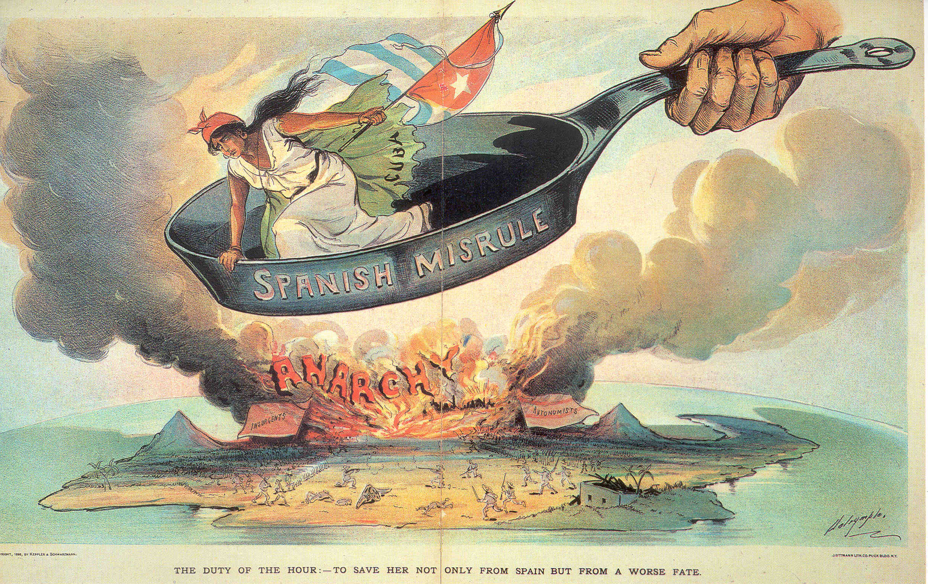

Slide 21
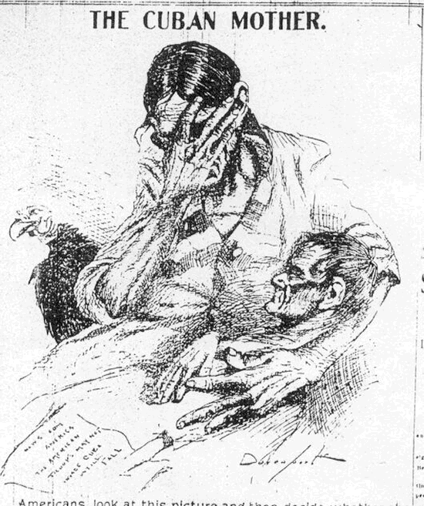
Hearst, Pulitzer, and others across the country began to call for war with Spain in defense of Cuba. Why?
War meant more people buying newspapers!

Slide 22
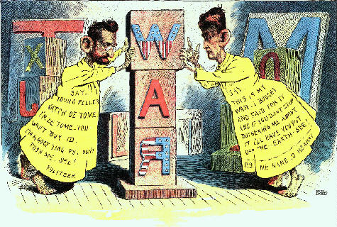

Slide 23
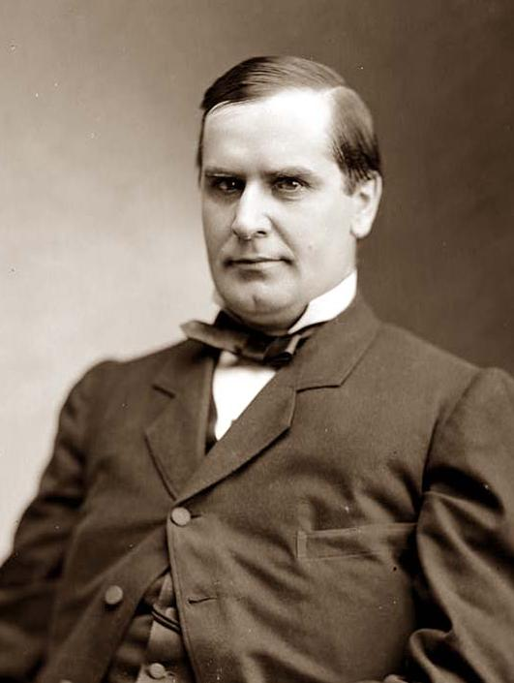
Americans began to call on President McKinley to intervene on behalf of the Cuban revolutionaries.
Relations between the U.S. and Spain began to grow tense as a result.

Slide 24
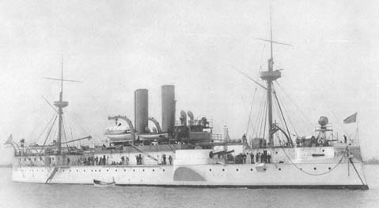
As conditions continued to deteriorate, President McKinley dispatched the U.S.S. Maine to Havana to protect Americans, and American business interests in the event that things got out of hand.

Slide 25
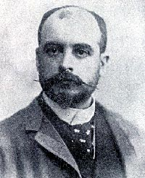
In another effort to make headlines, Hearst published an intercepted letter from Spain’s ambassador in Washington, Dupuy de Lome, to the Spanish government.

Slide 26
In his letter de Lome characterized President McKinley as a weak politician intent on pleasing his supporters, by whom he was controlled.
Americans were outraged and tensions with Spain only increased.

Slide 27
On February 15, 1898, in this atmosphere of tension, the U.S.S. Maine went. . .
BOOM!

Slide 28
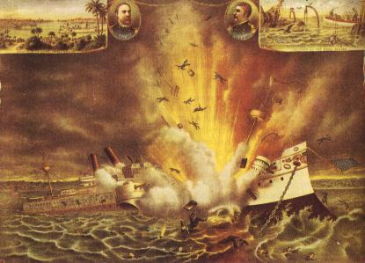

Slide 29
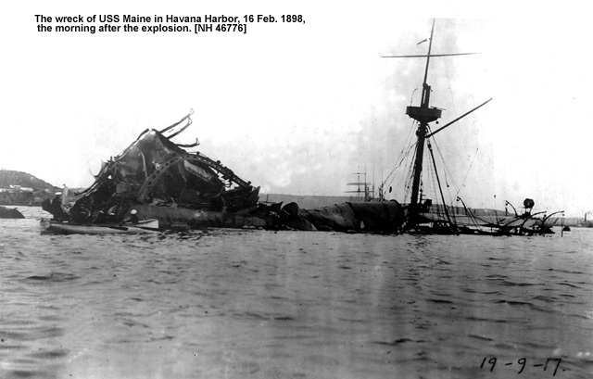

Slide 30
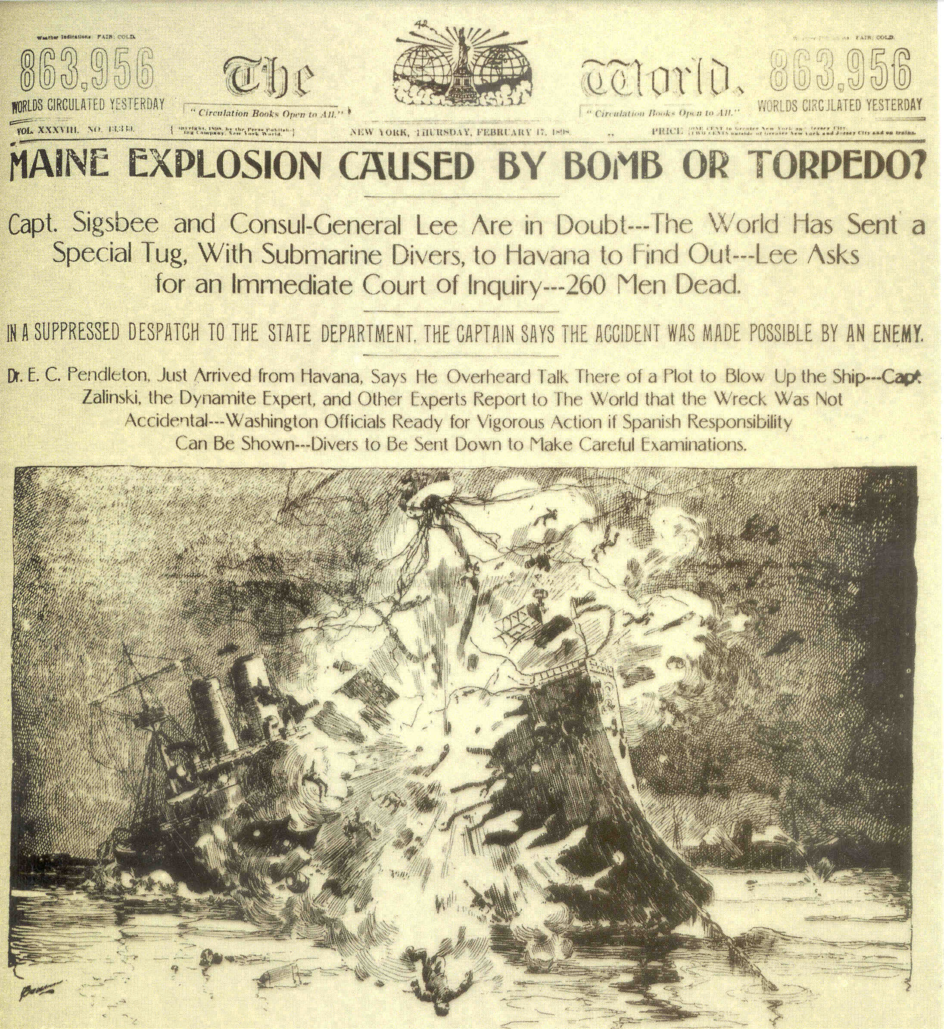

Slide 31
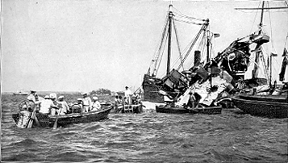
260 American sailors were killed. The “yellow press” immediately blamed the Spanish and Americans began to demand war with Spain.

Slide 32
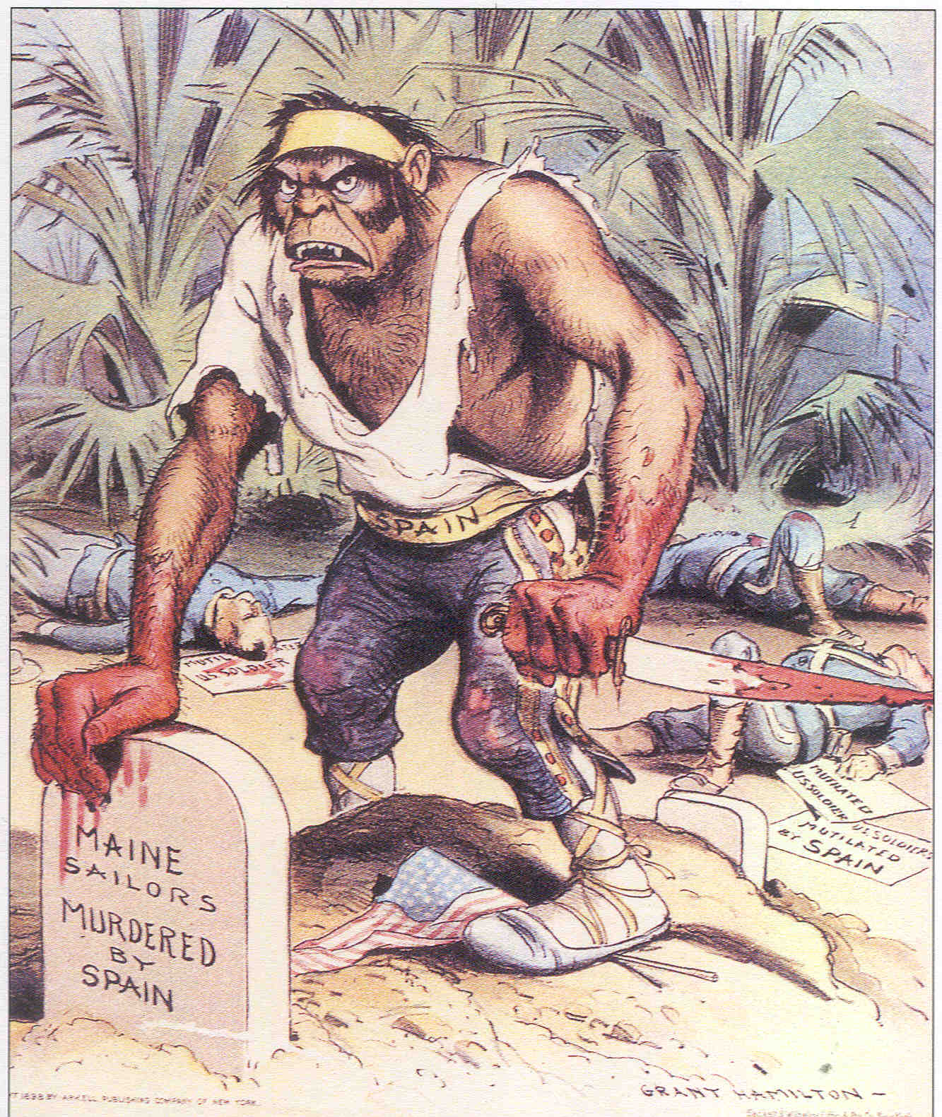

Slide 33
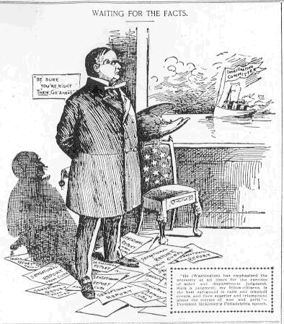
Hearst and Pulitzer had whipped the nation into a frenzy. In response President McKinley asked Congress to declare war on 4 / 11/ 1898.

Slide 34
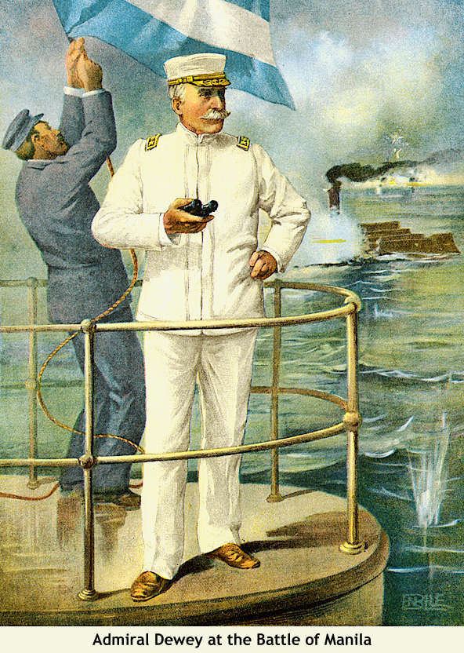
Adm. George Dewey, and the U.S. Pacific fleet just happened to be anchored in the British colony of Hong Kong. Dewy looked south and saw the Spanish colony of the Philippines.

Slide 35
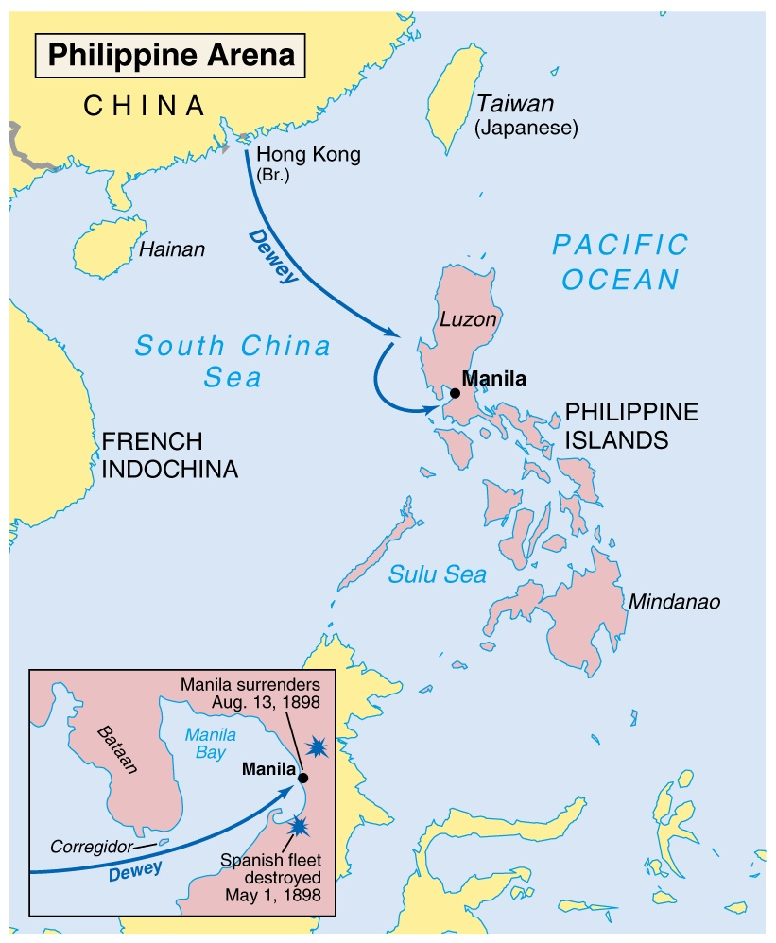

Slide 36
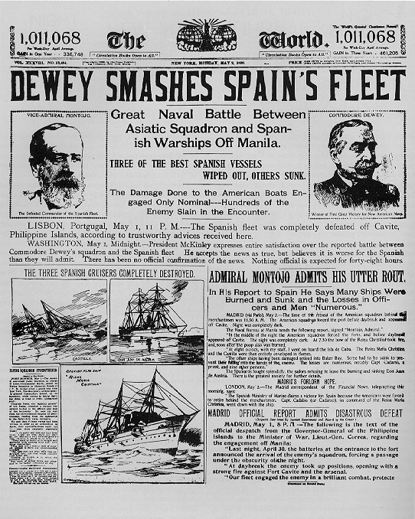
Dewey wasted no time. He led the Pacific fleet to meet the Spanish navy. The Americans destroyed the Spanish ships on May 1, 1898.

Slide 37
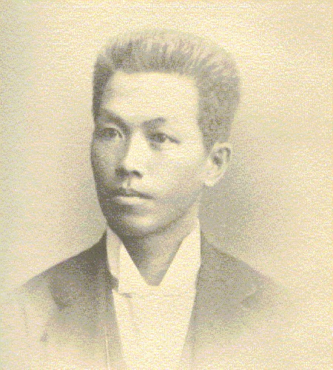
The U.S. army invaded during the summer of 1898 in an effort to capture the Philippines. U.S. troops were assisted by Filipino rebels led by Emilio Aguinaldo. The combined force captured the capital of Manila on August 13, 1898.

Slide 38
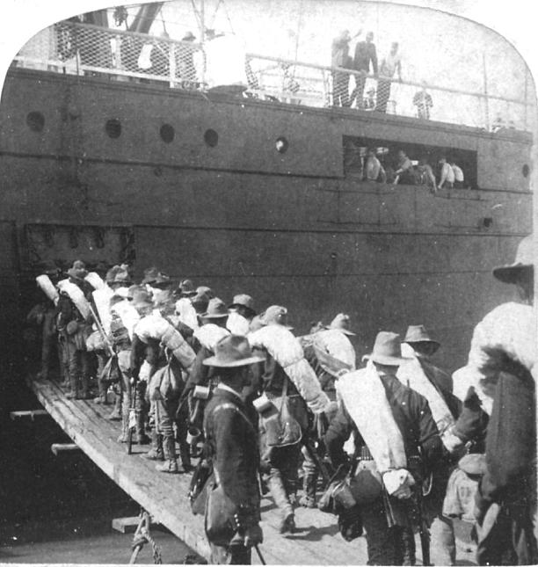
When war was declared in April, the U.S. army consisted of 28,000 men. The government believed it needed at least 50,000 to take Cuba. The army began to gather volunteers and supplies in Tampa Bay, Florida.

Slide 39
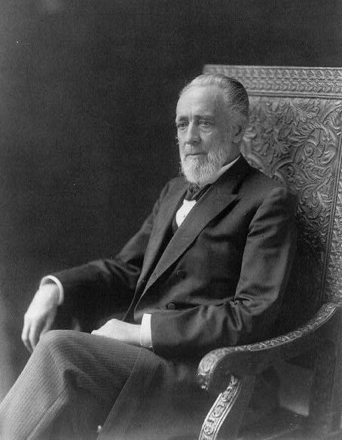
As the army was getting ready, Senator Henry Teller, of Colorado, wanted to ensure that we were fighting in Cuba to help them secure freedom from Spain. He was concerned that when the war was over, the United States would keep Cuba as an American colony.

Slide 40
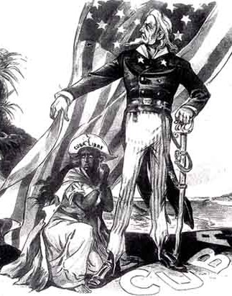
As such, Congress passed the Teller Amendment which proclaimed that America would invade Cuba to help it gain independence, but once that goal was accomplished, the army would leave, and Cuba would be free.

Slide 41
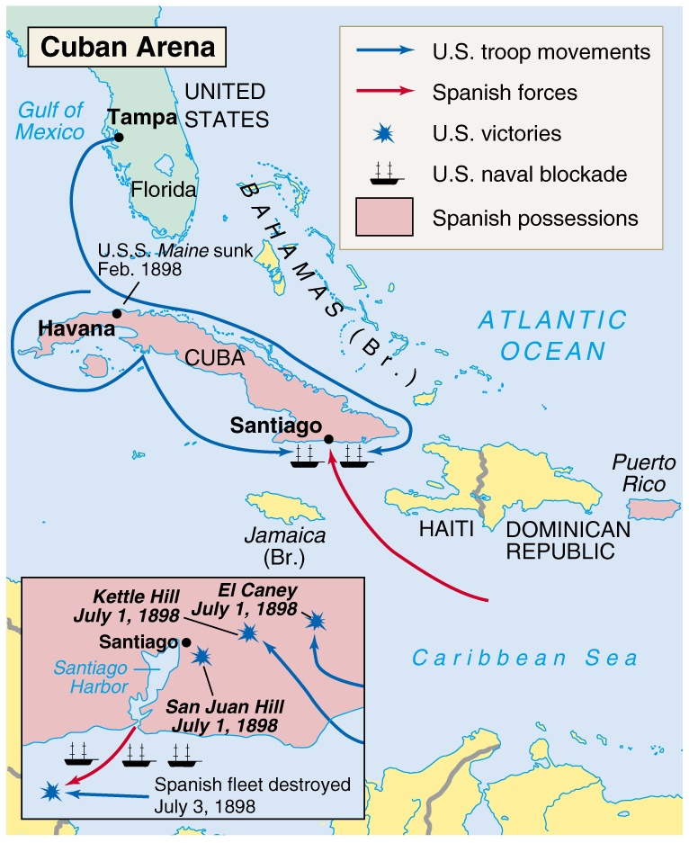

Slide 42
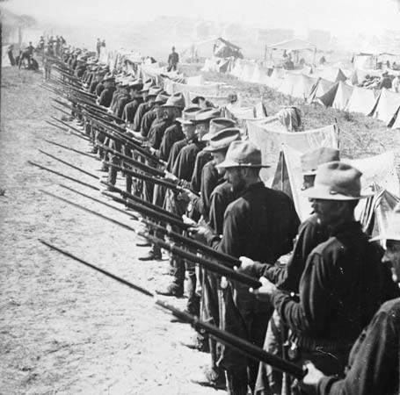
American soldiers finally invaded Cuba on July 1, 1898.
By July 3, Cuba had been taken by U.S. forces.

Slide 43
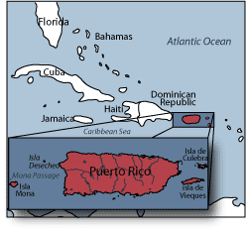
Plans were quickly laid to invade the Spanish possession of Puerto Rico which fell to the U.S. by early August.

Slide 44
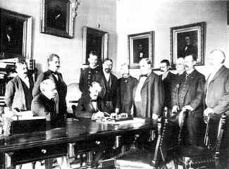
On August 12, 1898, the Spanish government signed an armistice ending the fighting. An official treaty was then hammered out in which America expanded its “empire.”

Slide 45
Fin.

