Slide 1
The Push for
Civil Rights
Round II

Slide 2
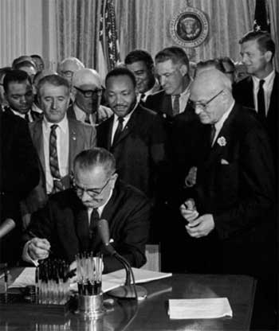
If you recall, the African-American push to secure elements of equality that took place in the 1950 & 1960’s had been pretty successful, at least in terms of fighting against de jure segregation.

Slide 3
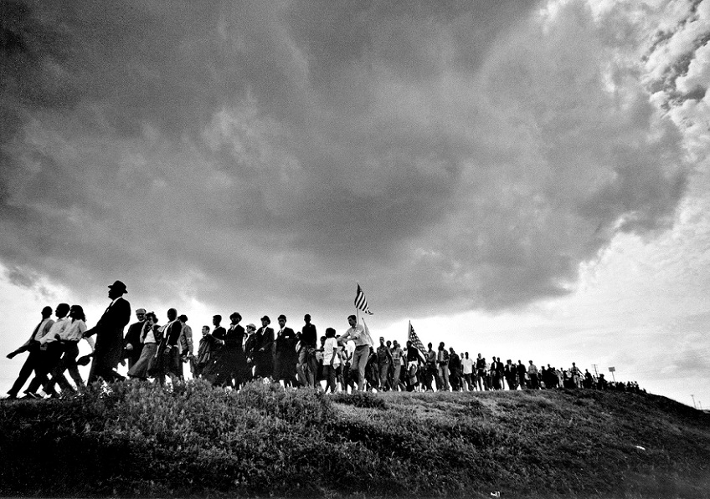
Partially inspired by the success of that movement, other groups in America began their own push for rights and equality.

Slide 4
Mexican
Americans

Slide 5
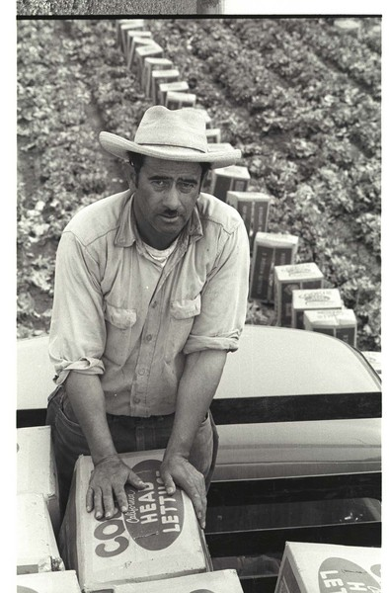
Remember that during WWII Franklin Roosevelt helped create the “Bracero” program.
Under this program the U.S. government, working with the government of Mexico actively recruited immigrants to fill agricultural jobs across America.

Slide 6
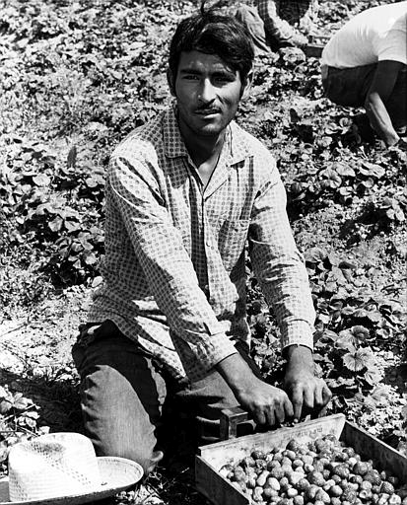
American farms began to depend upon this source of labor.
This did not mean, however, that Mexican-American farm workers were treated fairly.

Slide 7
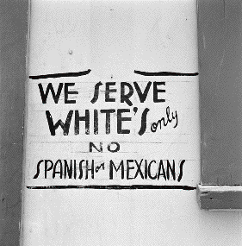
Not only did they encounter racism and discrimination, they worked incredibly long hours, with little pay. On some farms, they didn’t even get breaks to rest or use the bathroom.

Slide 8
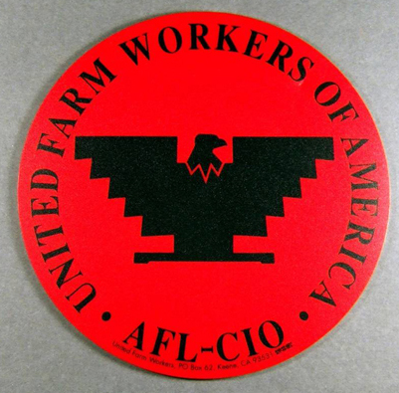
To combat working conditions, Mexican-American workers in California formed the United Farm Workers Union in 1962.

Slide 9
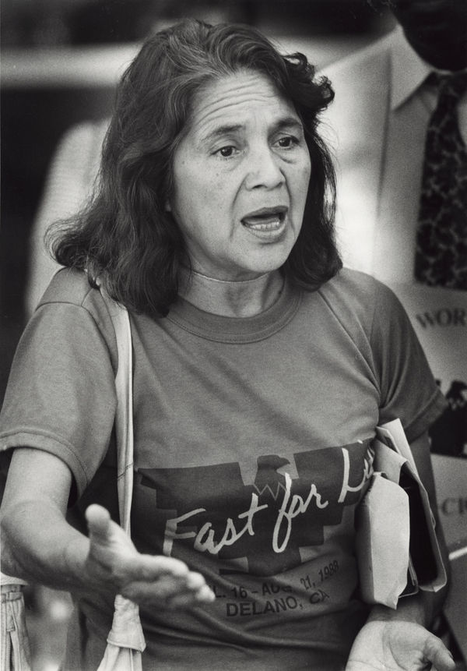
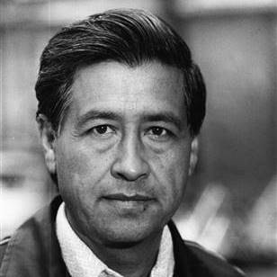
This labor organization was led by Cesar Chavez and Dolores Huerta.

Slide 10
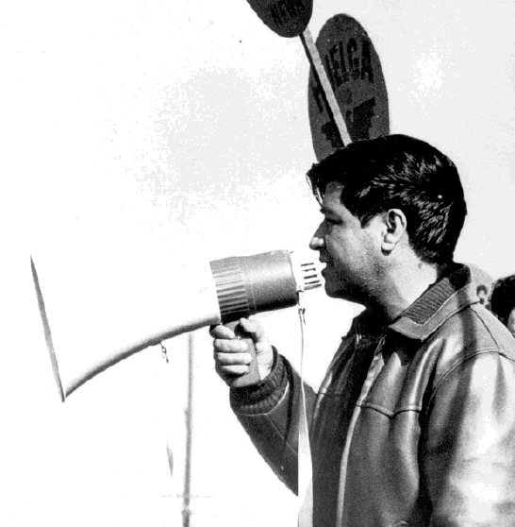
Chavez and the Farm Workers took a page from Martin King and adopted non-violent protest to bring about change for field workers in California, and eventually throughout the West.

Slide 11
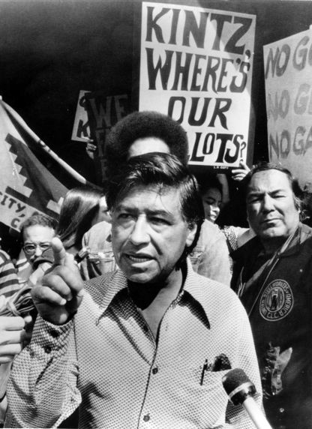
The United Farm Workers demanded that growers negotiate with Chavez and improve wages, cut hours, and provide breaks.
The growers refused.

Slide 12
Beginning in 1965, Chavez attempted to get American consumers to boycott California grapes in protest. How was this going to help?

Slide 13
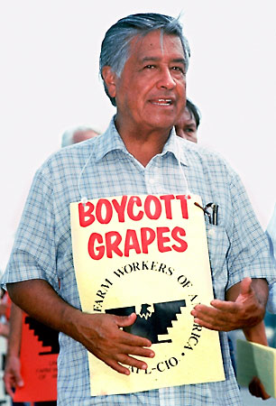
It worked, and by 1970 growers in California agreed to improved wages and health benefits for field workers.

Slide 14
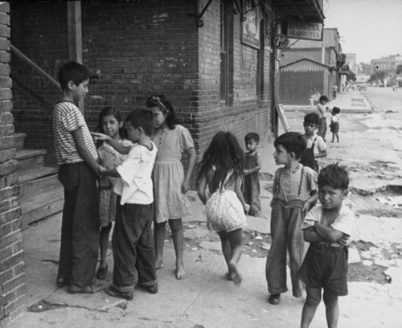
Mexican-Americans living in inner cities of America faced many of the same problems as African-Americans:
- Poverty
- High Unemployment
- Poor Housing
- Poor Schools
- Poor Health Care
- Police Brutality

Slide 15
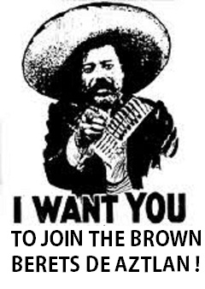
In 1968, in response to police brutality in their East L.A. communities Mexican-Americans formed the “Brown Berets.”

Slide 16
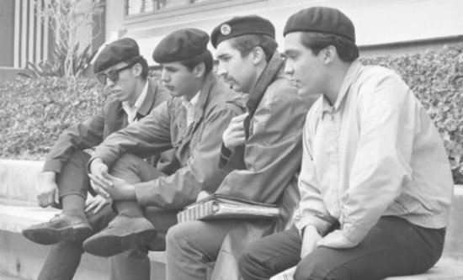
They were clearly inspired by the Black Panthers in Oakland, and adopted many of the same goals and techniques.

Slide 17
One of their primary goals was to improve the quality of education in their communities. As such, they wanted:
- smaller class sizes
- dropout prevention programs
- bilingual education
- more teaching of Chicano history and culture
- more Chicano teachers

Slide 18
A group known as La Raza Unida was formed in 1970 to push for greater political participation.

Slide 19
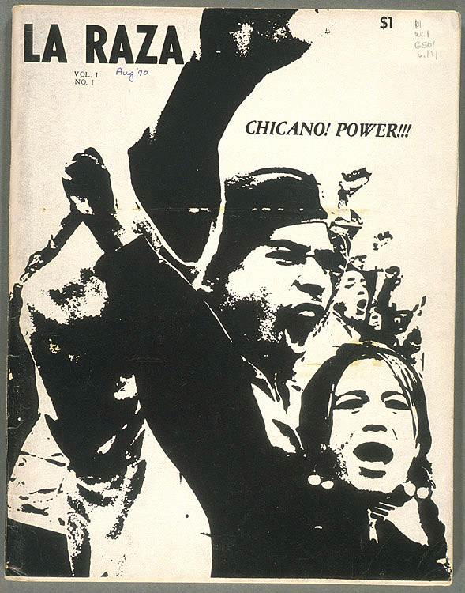
La Raza had / has two main goals:
- Register Mexican-Americans to vote, and then get them to actually go and vote.
- Run Mexican-American candidates for elected office.
- Their votes have become, and will continue to be very important in national elections.

Slide 20
Native
Americans

Slide 21
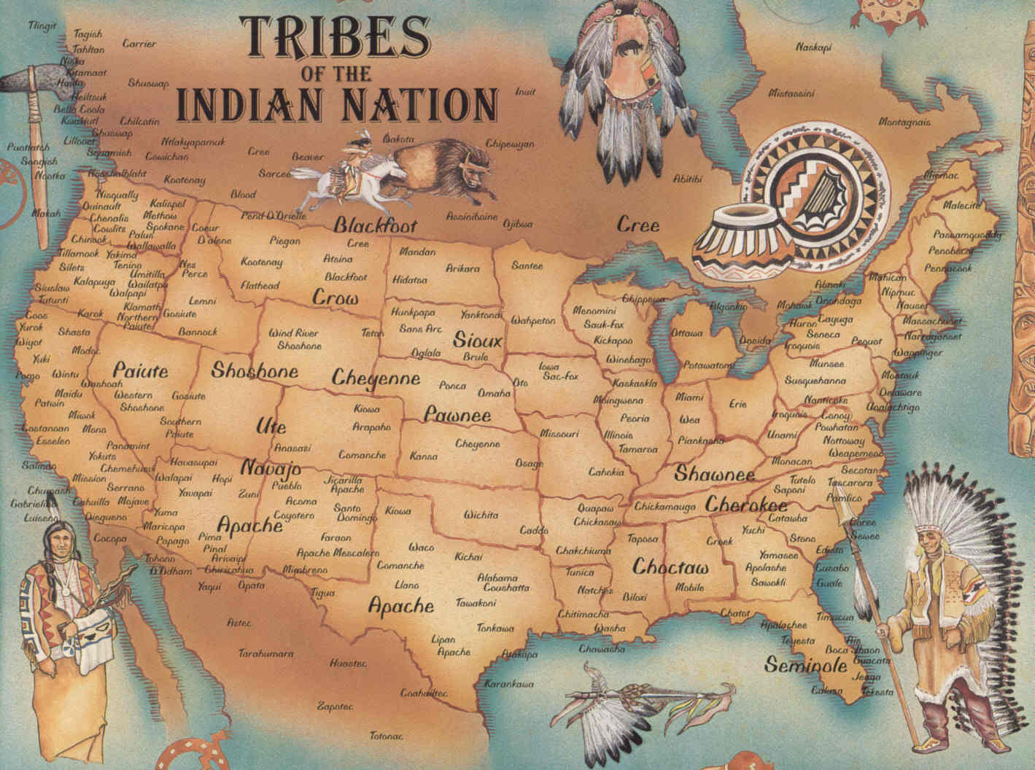
By 1890 every Native American tribe was either dead or living on a government reservation.

Slide 22
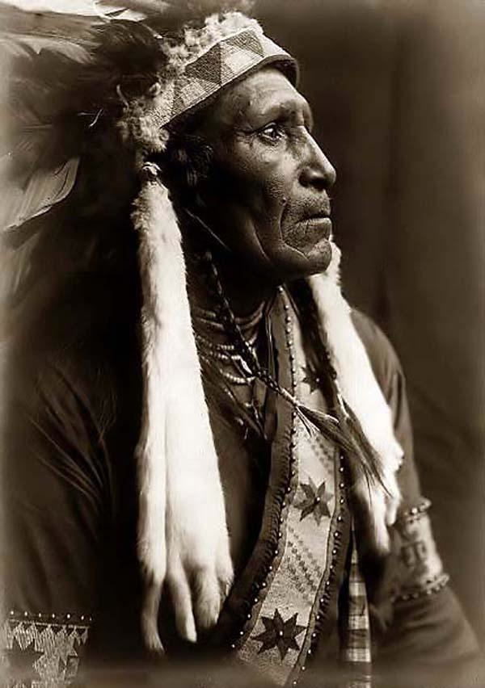
For most of the decades between 1890 and 1960 Natives had been left of the reservations to rot. As a result, by the 1960’s they faced a number of problems:
- Poverty
- Unemployment
- High infant death rates
- High levels of drug and alcohol abuse
- Low life expectancy
- The destruction of their culture

Slide 23
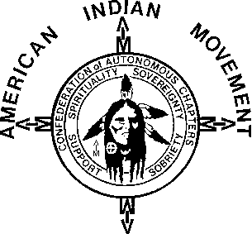
In response to some of these conditions, the American Indian Movement (AIM) was born in 1968.

Slide 24
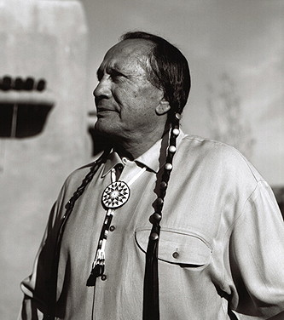
AIM’s long term goal was to improve conditions for Native Americans and to protect Native culture.
Their short term goal was to protest and counteract police violence against Natives in Minneapolis, MN.

Slide 25
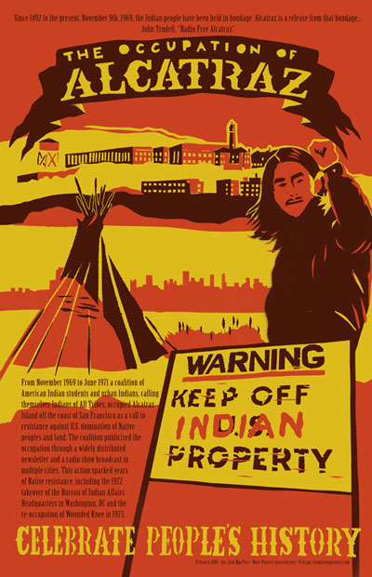
To bring attention to the conditions many Natives faced, in 1969 AIM staged a rally on Alcatraz Island in San Francisco bay.

Slide 26
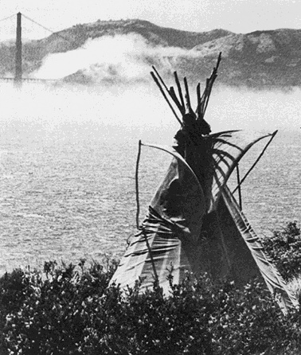
Natives argued that under the terms of the Treaty of Ft. Laramie, signed by the Sioux and the U.S. govt. in 1868, Alcatraz was Native land. As such, they wanted it.

Slide 27
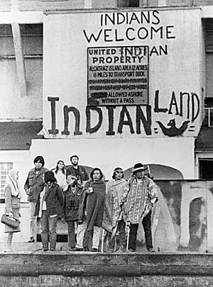
Native leaders wanted a peaceful demonstration that would draw publicity to their cause.
More than 5,000 Natives set up camp and refused to leave for 19 months.

Slide 28
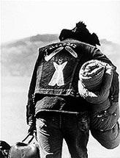
During that 19 months, the U.S. govt. cut off all water and power to the island in an effort to drive the protestors off.
Eventually the protestors all left for a variety of different reasons, and the occupation came to an end in June, 1971.
If the goal had been to gain publicity, it had worked. People around the world had heard of the takeover and began to talk about Native issues.

Slide 29
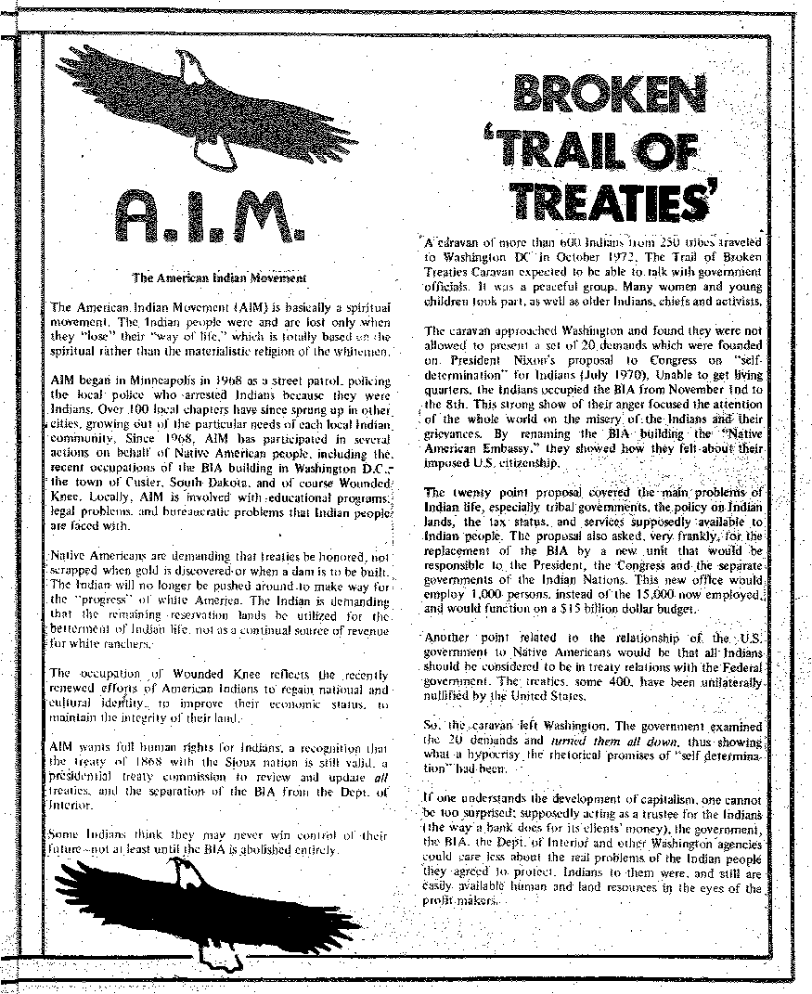
Building on that publicity, AIM launched the “Trail of Broken Treaties” in 1972.

Slide 30
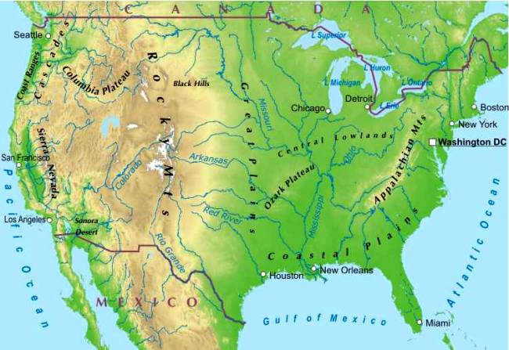
The plan was to caravan from the Pine Ridge Sioux reservation in South Dakota to Washington D.C.

Slide 31
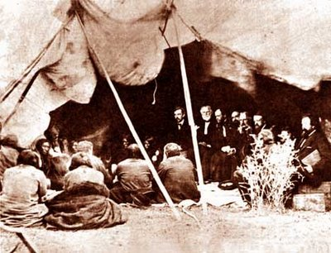
Their goal was to draw attention to the promises that the U.S. government had made to Natives in the past, and how those commitments had been repeatedly violated.

Slide 32
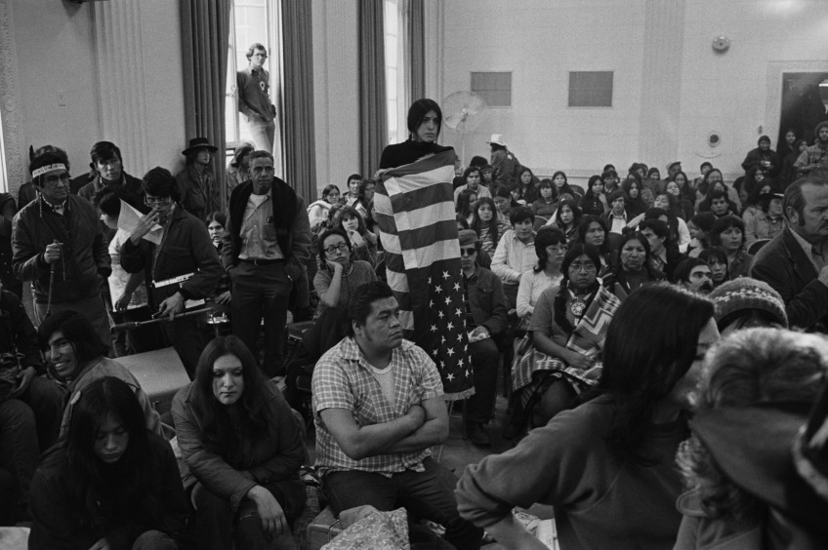
When they arrived in Washington, protestors took over the Bureau of Indian Affairs building and vandalized it.

Slide 33
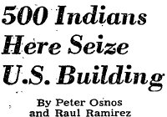
The destruction at the B.I.A. building brought negative publicity to the cause.

Slide 34
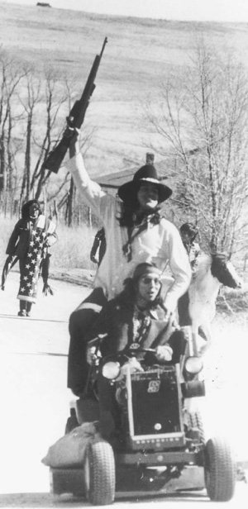
AIM continued to generate publicity in February, 1973 when they led an occupation in the small town of Wounded Knee, SD.
- Cite of a massacre of Natives by the U.S. army in 1890.
- Designed to draw publicity to the repeated abuses of Natives by the govt.
- Armed “battle” between AIM and the FBI lasted for 71 days.

Slide 35
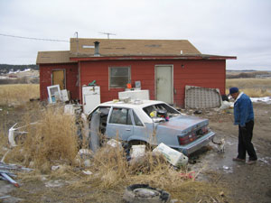
Each of these incidents brought attention to the struggles of Natives, and over time, voters and the government made attempts to help.

Slide 36
Women

Slide 37
Remind me, what did America expect of most women in the 1950’s?

Slide 38
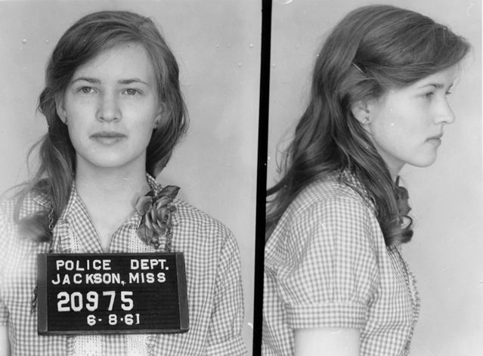
Many white women had taken part in supporting the African-American civil rights movement joining SNCC on the Freedom Rides and Freedom Summer.

Slide 39
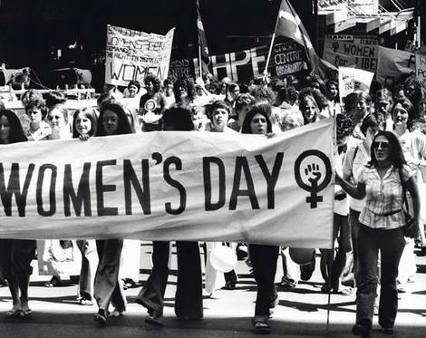
In the 1960’s they also began to push for their own equality.

Slide 40
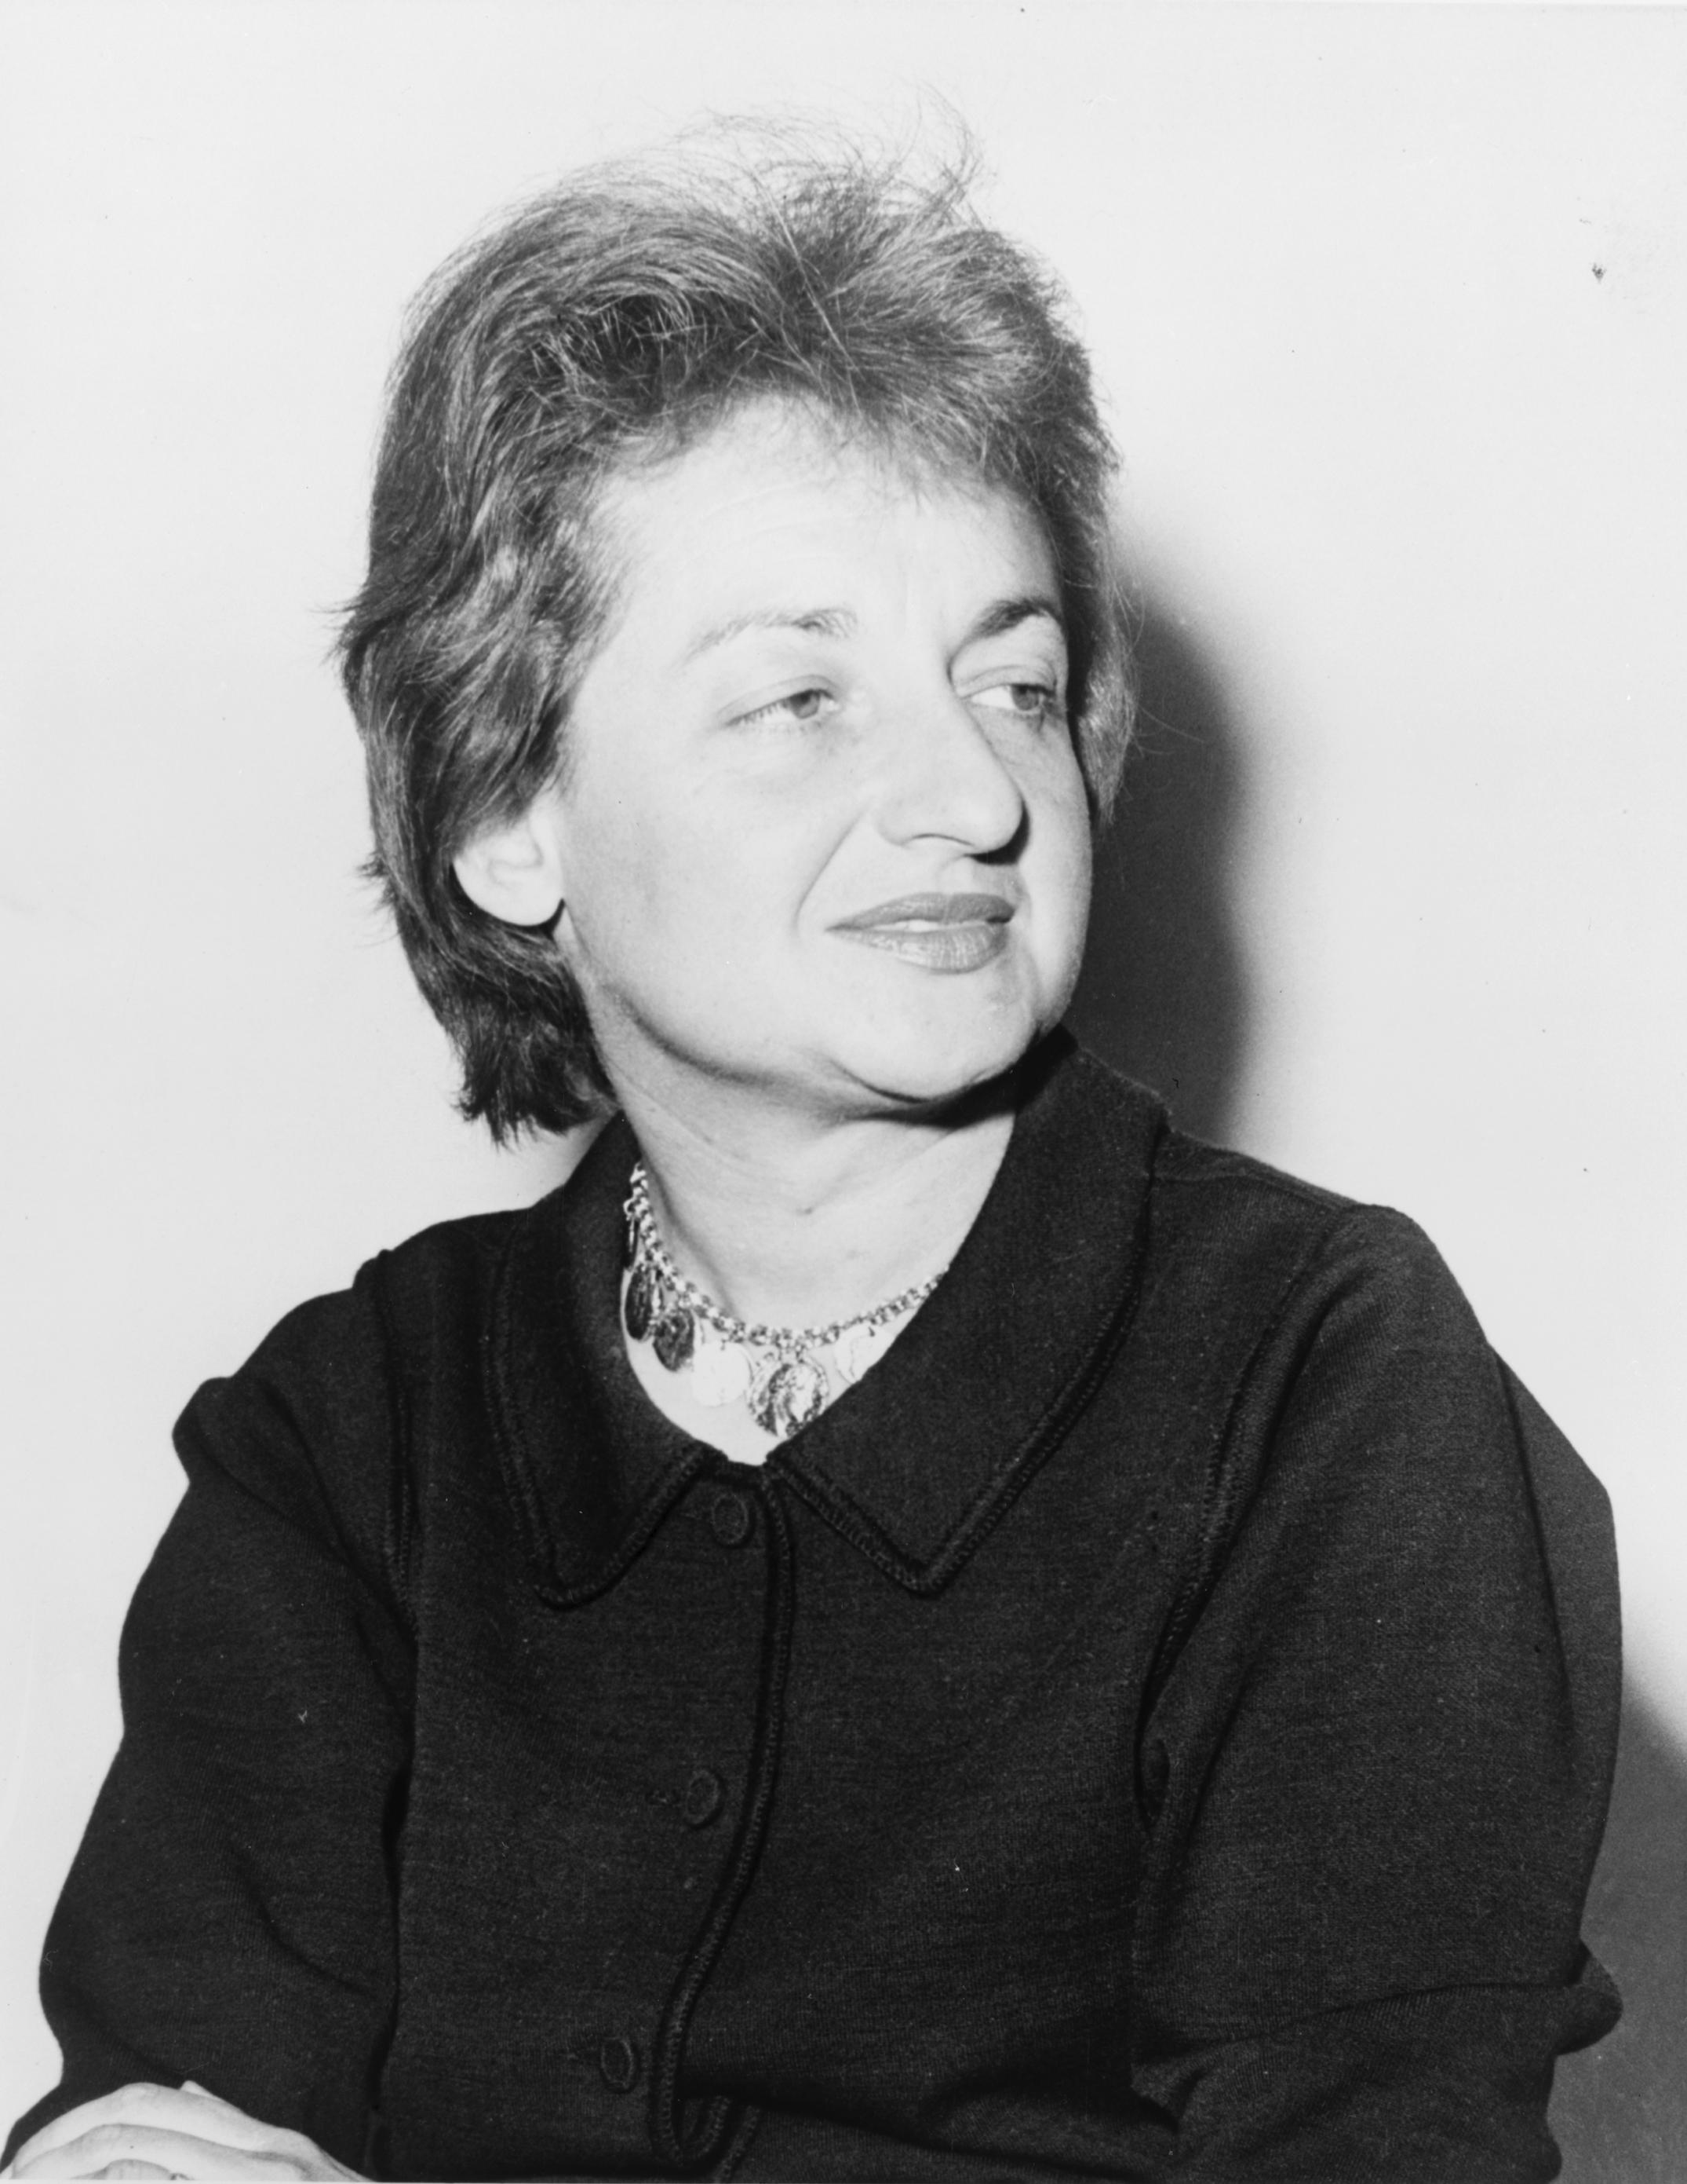
In 1963, Betty Friedan wrote a book called The Feminine Mystique in which she openly challenged society’s expectations of women as mothers and homemakers.

Slide 41
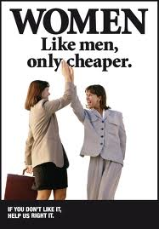
In that same year, 1963, Congress passed the Equal Pay Act.
- First federal law prohibiting discrimination based on gender.
- In 1963 the avg. female worker earned 58.9% what the avg. male worker earned.
- Made it illegal to pay women less for doing the same job.
- Didn’t totally end the problem.

Slide 42
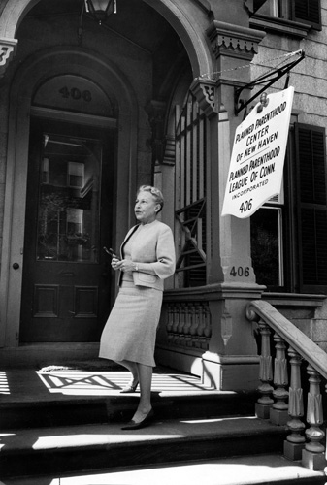
Griswold v. Connecticut (1965)
- Law in Connecticut made the use of contraceptives illegal.
- Estelle Griswold sued arguing that this law denied her of her rights.
- U.S. Supreme Court agreed suggesting that a persons right to privacy allowed them to use contraceptives in their homes.

Slide 43
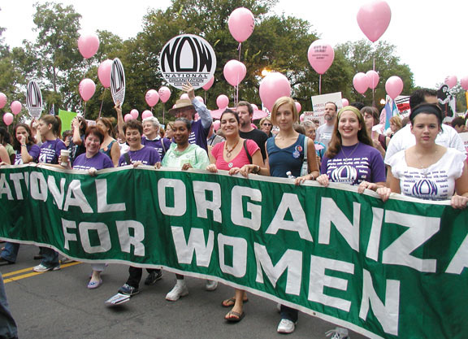
In 1966 Betty Friedan helped create the National Organization for Women (NOW).

Slide 44
Goals:
- Bring about equality for all women.
- End discrimination and harassment in the work place, in schools, and in the American justice system.
- End all forms of violence against women.
- Secure abortion, birth control, and reproductive rights for women.

Slide 45
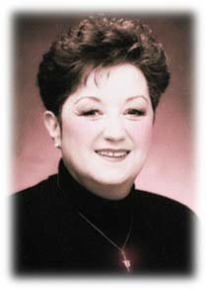
Roe v. Wade (1973)
- In 1969 Norma McCorvey (Roe) discovered she was pregnant and wanted an abortion.
- Texas law outlawed abortion, so she sued, and the case went to the Supreme Court.
-In 1973 the Supreme Court ruled that a woman’s constitutional right to privacy gave her a right to an abortion in the first trimester.

Slide 46
Fin.

