Slide 1
Immigration
and
Nativism

Slide 2
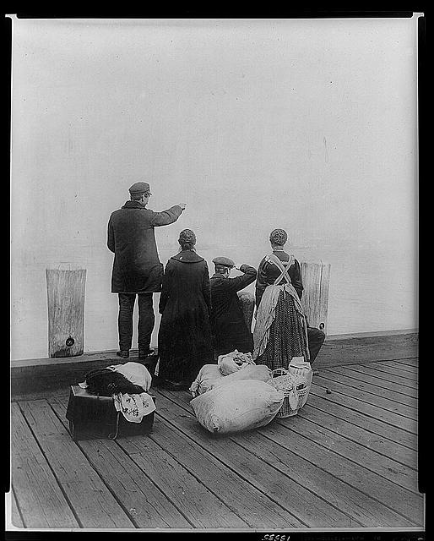
Another change taking place in the 1920’s was the nation’s attitude toward immigrants.

Slide 3
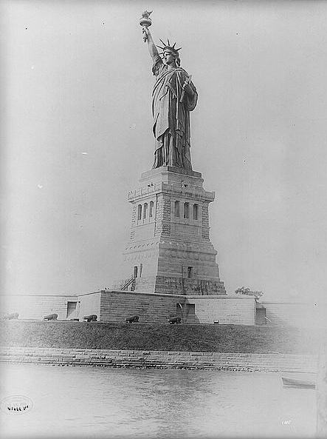
America was a nation born and raised by immigrants.
- 1600-1700’s: Primarily from Great Britain
- 1820’s-1850’s: Primarily from Germany and Ireland
- 1870’s-1890’s: Primarily from Southern and Eastern Europe
- Immigrants also came from China and Japan throughout the 19th century.

Slide 4
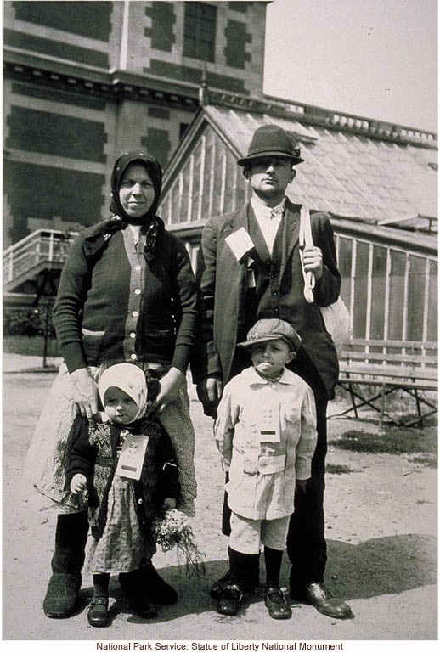
Throughout the second half of 1800’s, the experience for many immigrants was the same:
- Move to an American city.
- Get a job in a Gilded Age factory and struggle to scrape by.
- Struggle to be accepted by those already here.
- Eventually assimilate into American society and culture.

Slide 5
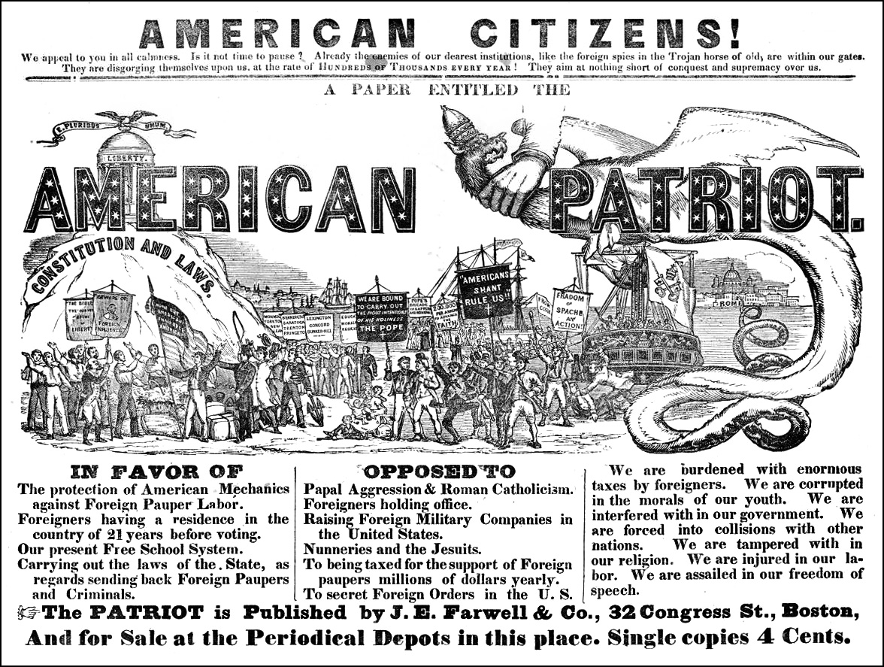
Over time, arguments against letting immigrants continue to pour into the nation began to grow. These arguments reached their climax in the 1920’s.

Slide 6
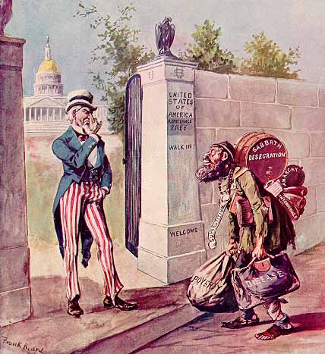
What arguments did Americans make in support of limiting or ending immigration?

Slide 7
1. Nativism

Slide 8
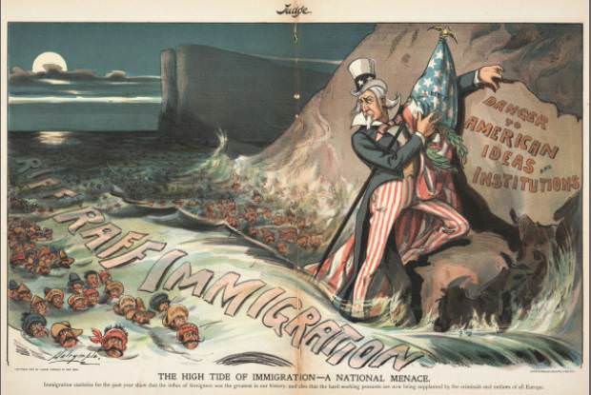
Nativists argued that immigrants threatened the “American way of life.”

Slide 9
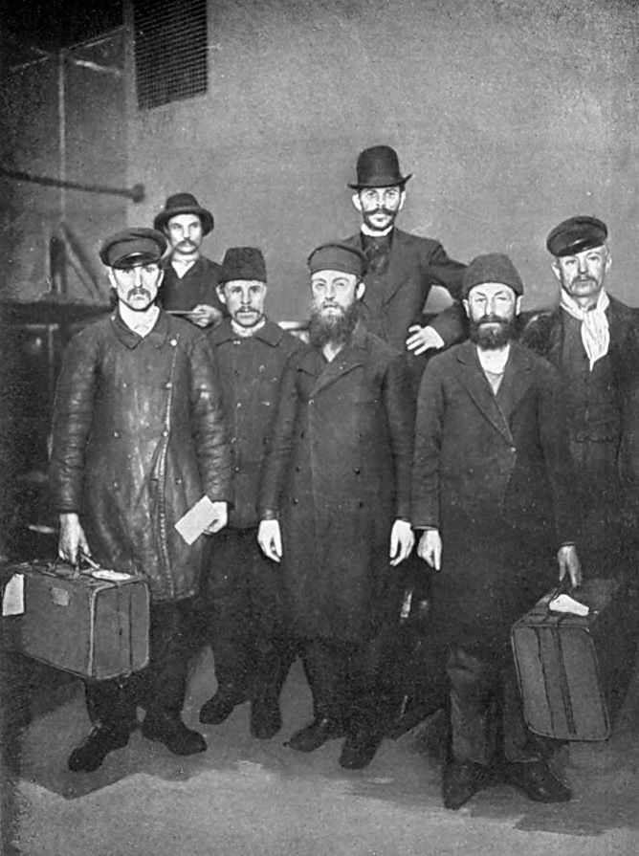
Many nativists believed in the concept of Social Darwinism, and so they made the following arguments:
- Those immigrants who came from eastern and southern Europe were genetically inferior to Americans.
- They were lazy, and ignorant and would become a burden to society.
- If they married Americans, their genes inferior genes would corrupt “our” solid American DNA.

Slide 10
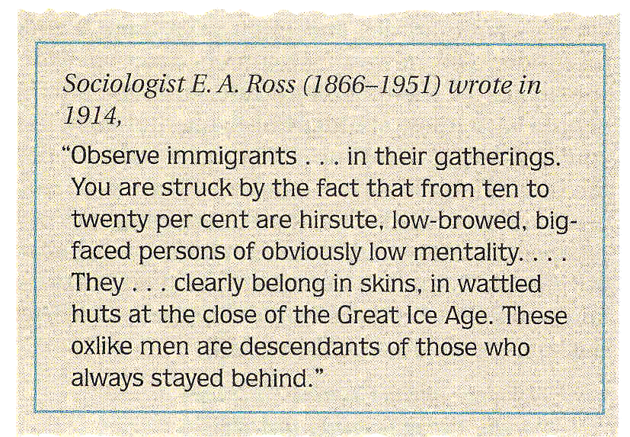

Slide 11
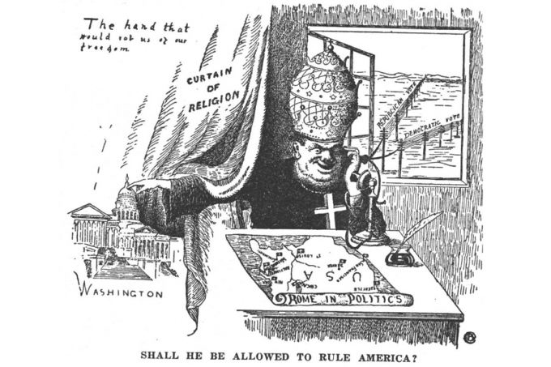
Furthermore, traditional Americans suggested that immigrants posed an increasing threat to faith and spirituality.

Slide 12
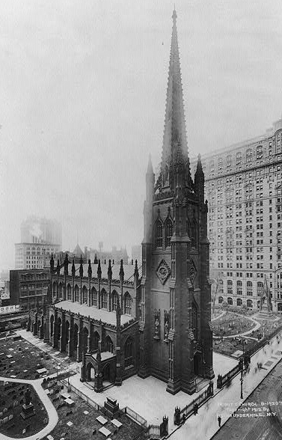
The immigrants arriving in the late 19th and early 20th centuries came from a variety of religious backgrounds:
- Roman Catholics from Italy.
- Orthodox Christians from Eastern Europe.
- Jews from Eastern Europe.
- Buddhists, Muslims, etc. from Asia.

Slide 13
The fear amongst Americans was that more and more people were living in America who were NOT Protestant Christian.
In their minds, the nation was founded on Protestant Christianity. It was “America’s religion.”
Non-Protestants threatened that status.

Slide 14
2. Democracy

Slide 15
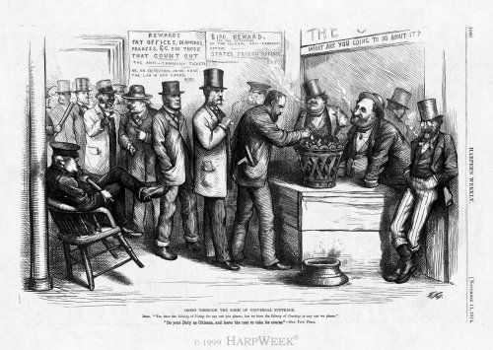
After going through a short naturalization process, immigrants were given the right to vote.

Slide 16
Nativists began to point out that many of these immigrants came from places that did not have democracy. What might these nativists have been worried about?

Slide 17
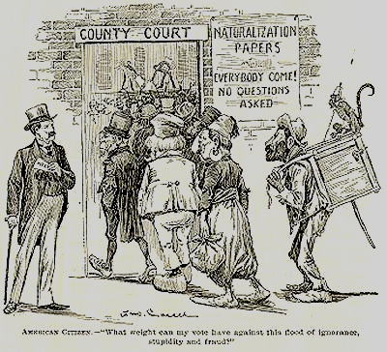
American Citizens: What weight can my vote have against this flood of ignorance, stupidity and fraud?

Slide 18
3. Economics

Slide 19
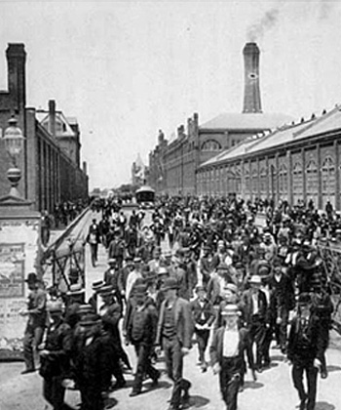
By the 1920’s the argument had grown ever louder:
Immigrants are taking our jobs!

Slide 20
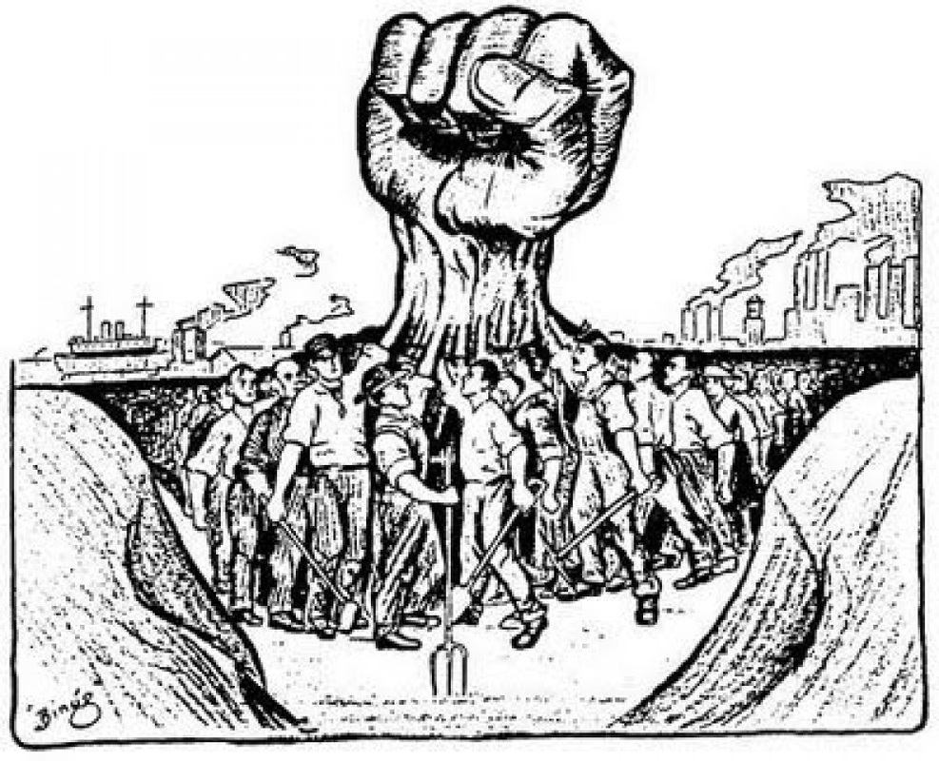
In addition, as we have suggested, labor unions were less than happy about the flood of immigrants. Why?

Slide 21
4. Socialism
and
Communism

Slide 22
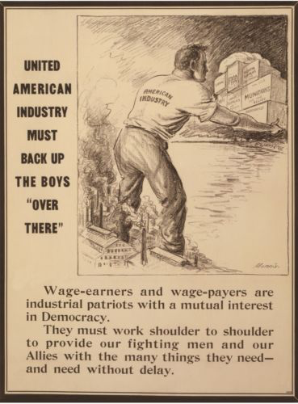
During World War I, labor unions had pledged to not go on strike in support of America’s war effort.

Slide 23
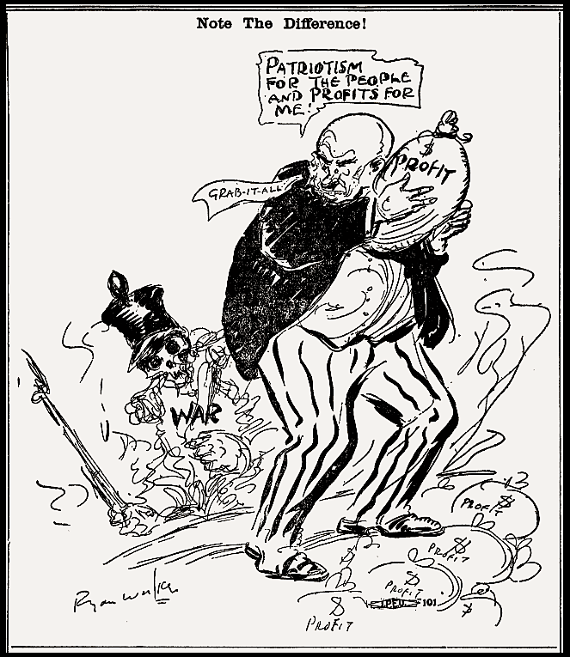
When the fighting ended, Unions began to demand that workers should be able to share in the massive profits companies had made during the War.

Slide 24
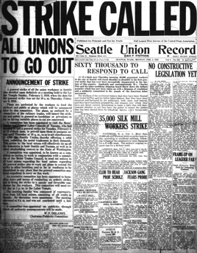
Unions engaged in several large strikes in 1919 demanding improvements to workers wages.

Slide 25
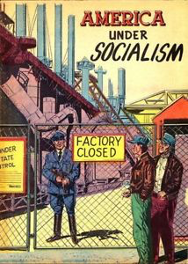
Business owners began to suggest that these strikes were inspired by a socialist agenda.
They argued that workers not only wanted more money, that wanted to overthrow American democracy in favor of socialism.

Slide 26
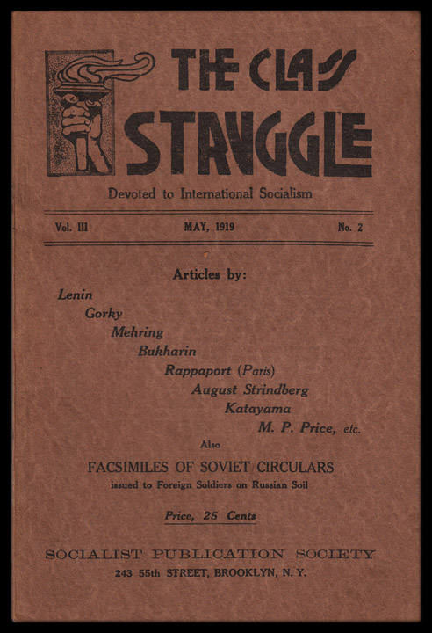
Lending credibility to such arguments was the advent of communism in the Soviet Union.

Slide 27
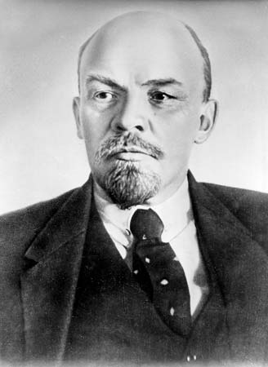
in 1919, the communist Bolsheviks overthrew a democratic government in Russia.
- Led by Vladimir Lenin
- Formed a communist government for the new nation of the Soviet Union.
- Began to call for worldwide communist revolution.

Slide 28
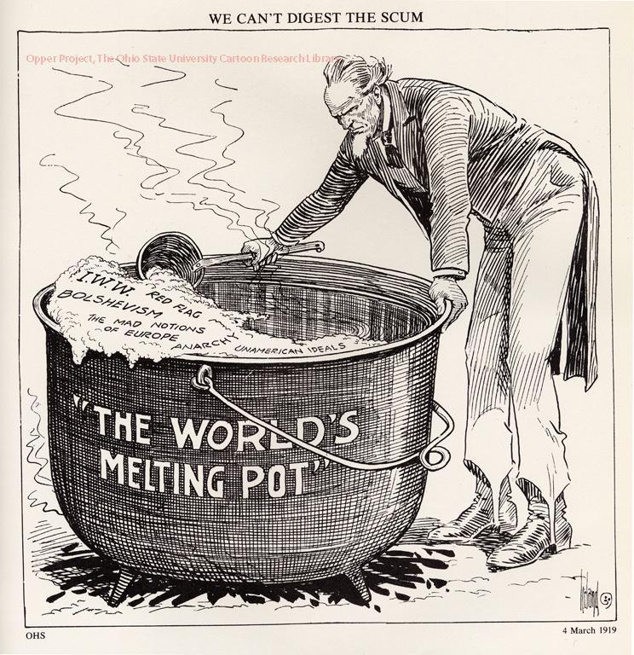
Labor agitation at home and the communist revolution in Russia led to a “red scare” in America.

Slide 29
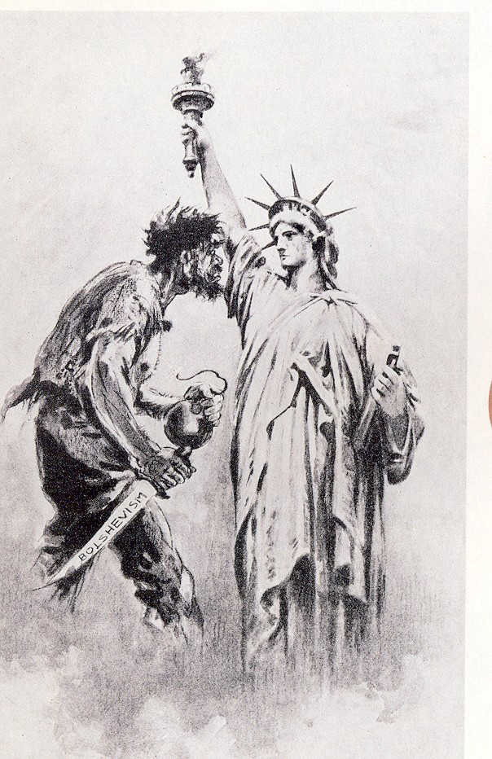
The fear was that socialists, communists, and anarchists from Europe would flood into America and make things worse.

Slide 30
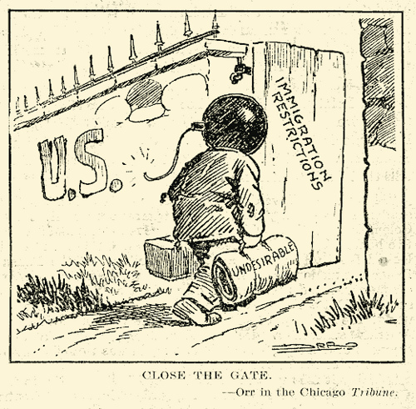
Given all of that, the US government began to take action to restrict immigration.

Slide 31
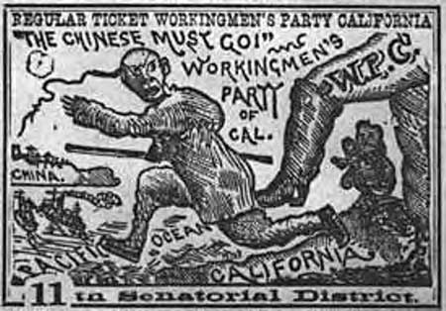
Hostility had been growing about the number of Chinese immigrants allowed into America, especially in the state of California.

Slide 32
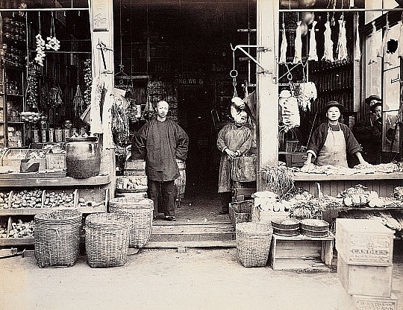
Having initially found success working on the railroad, thousands of Chinese immigrants became successful farmers and business owners across the west coast.

Slide 33
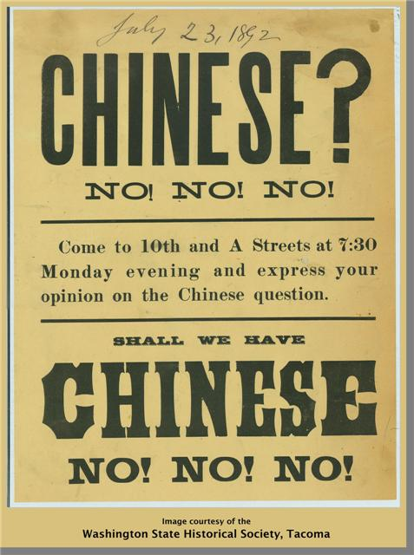
American farmers and businessmen did not like this competition and asked the government to prohibit allowing any more Chinese immigrants into America.

Slide 34
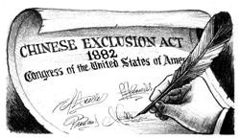
To that end, Congress passed the Chinese Exclusion Act in 1882. This law banned all immigration from China except for students, teachers, businessmen, tourists, and government officials.

Slide 35
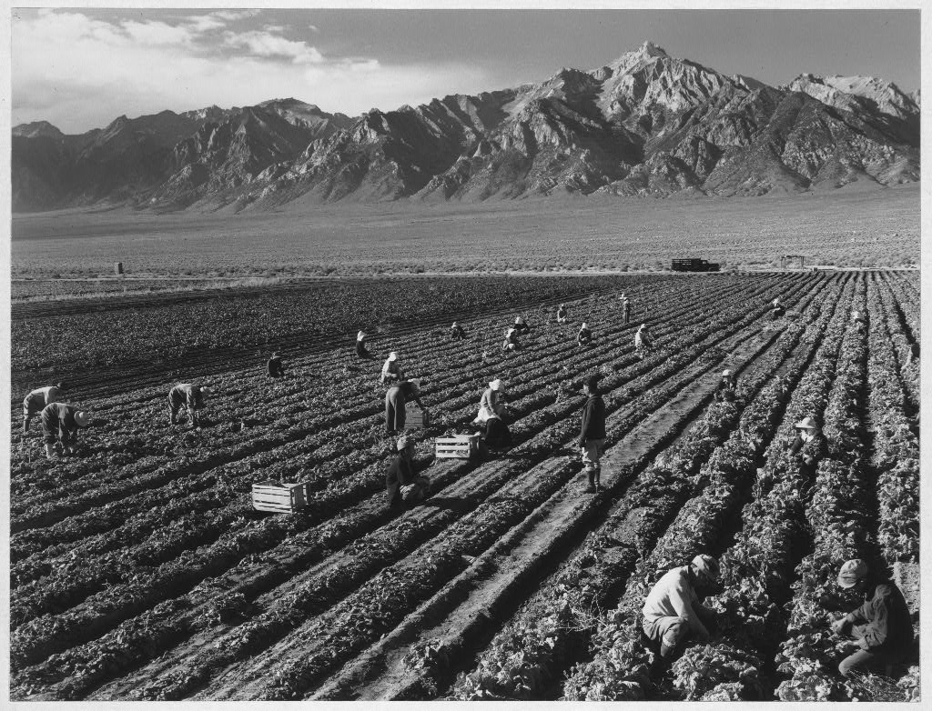
Japanese immigrants were disliked for many of the same reasons. They competed with American farmers and businessmen.

Slide 36
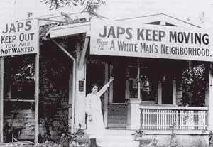

Slide 37
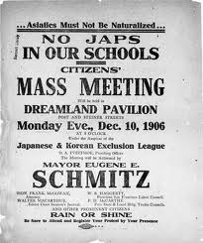
The city of San Francisco passed a series of laws segregating and persecuting Japanese immigrants.
The government of Japan grew increasingly concerned about what was going on.

Slide 38
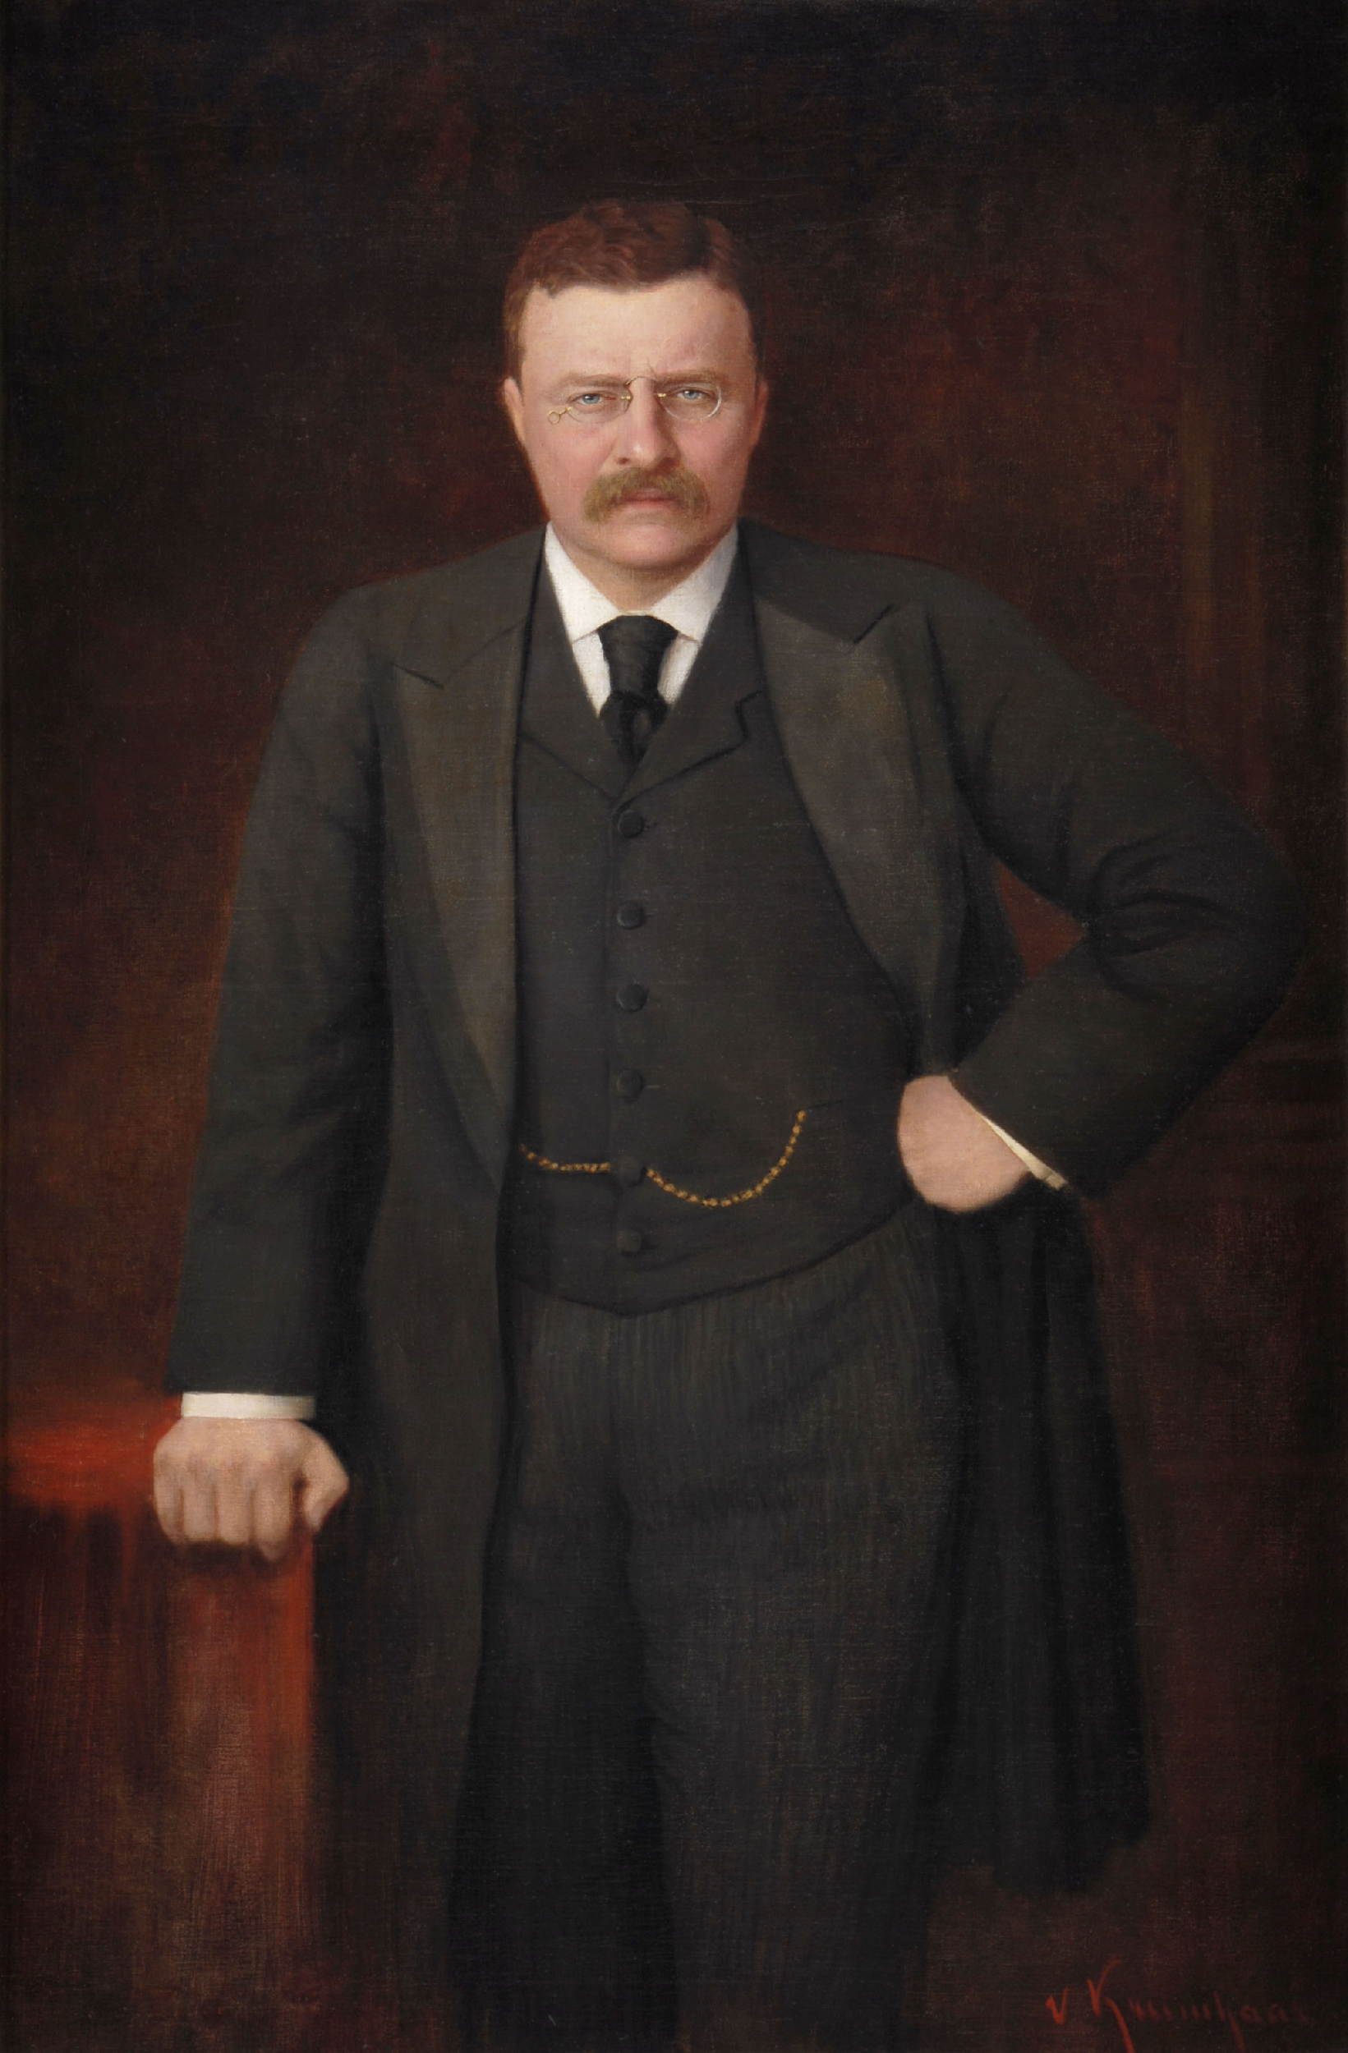
Pres. Theodore Roosevelt worked out the Gentlemen’s Agreement in 1907 under which discrimination would end if Japan agreed to prohibit unskilled Japanese workers to leave for the United States.

Slide 39
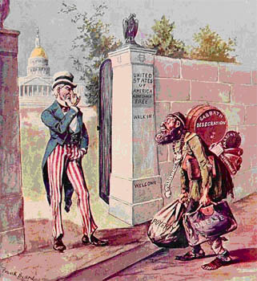
Immigrants from Asia weren’t the only ones targeted.

Slide 40
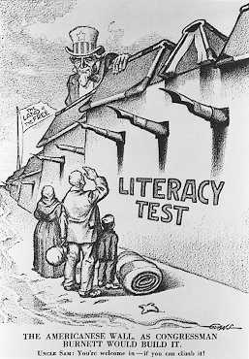
In 1917, Congress passed a law requiring all immigrants to take and pass a literacy test.
- Applied to any immigrant over the age of 16.
- Had to prove they could read at least 30 words in any language.

Slide 41
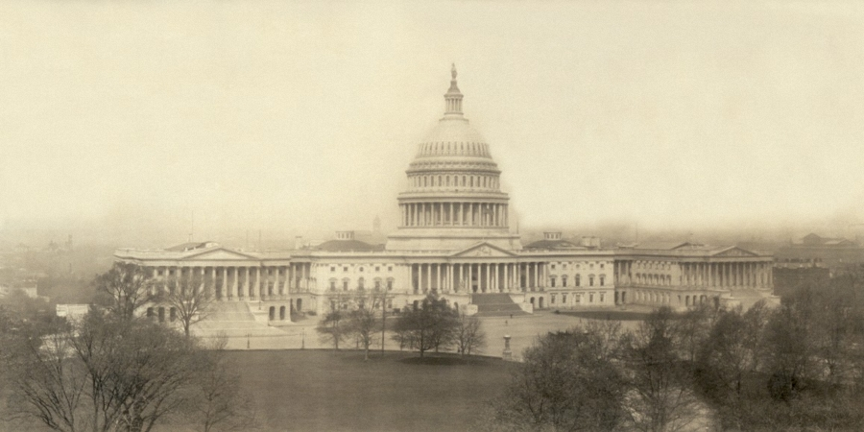
To further restrict immigration from all over the world, Congress passed the Emergency Quota Act in 1921.

Slide 42
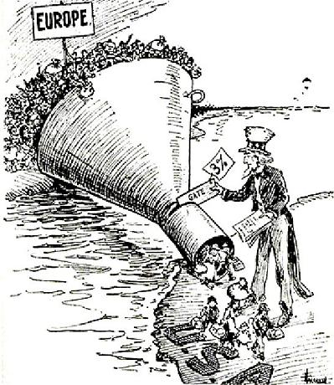
Placed a yearly limit, or quota, on the number of immigrants allowed into America from individual nations.
Once that number was reached, the door was shut.

Slide 43
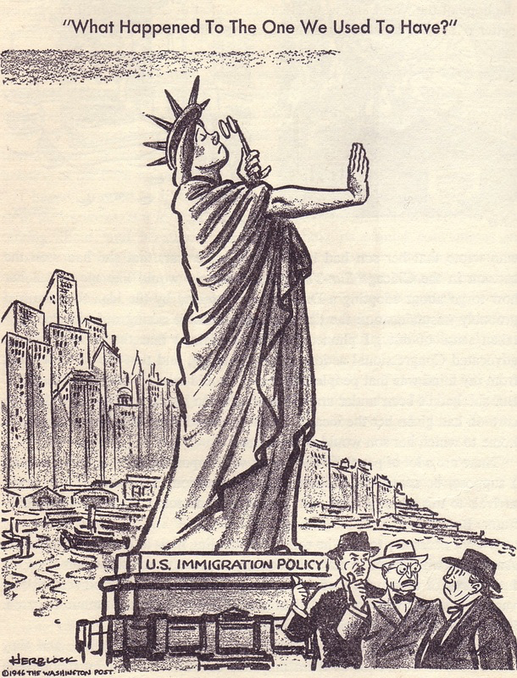
The law was amended in 1924.
- The goal was to further reduce the number of immigrants allowed in.
- The # was lowered to 2% of the population of immigrants already in America from each nation according to the 1890 census.

Slide 44
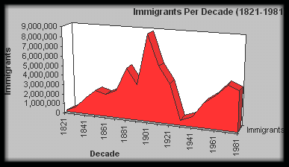

Slide 45
Fin.

