Slide 1
W.

Slide 2
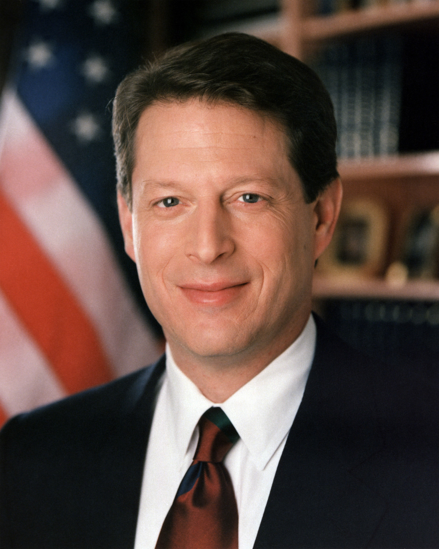
Hoping to continue their success, the Democrats nominated Clinton’s VP Al Gore to run in 2000.
- Stay the course
- Middle class tax cuts
- Use the federal budget surplus to shore up Social Security and Medicare

Slide 3
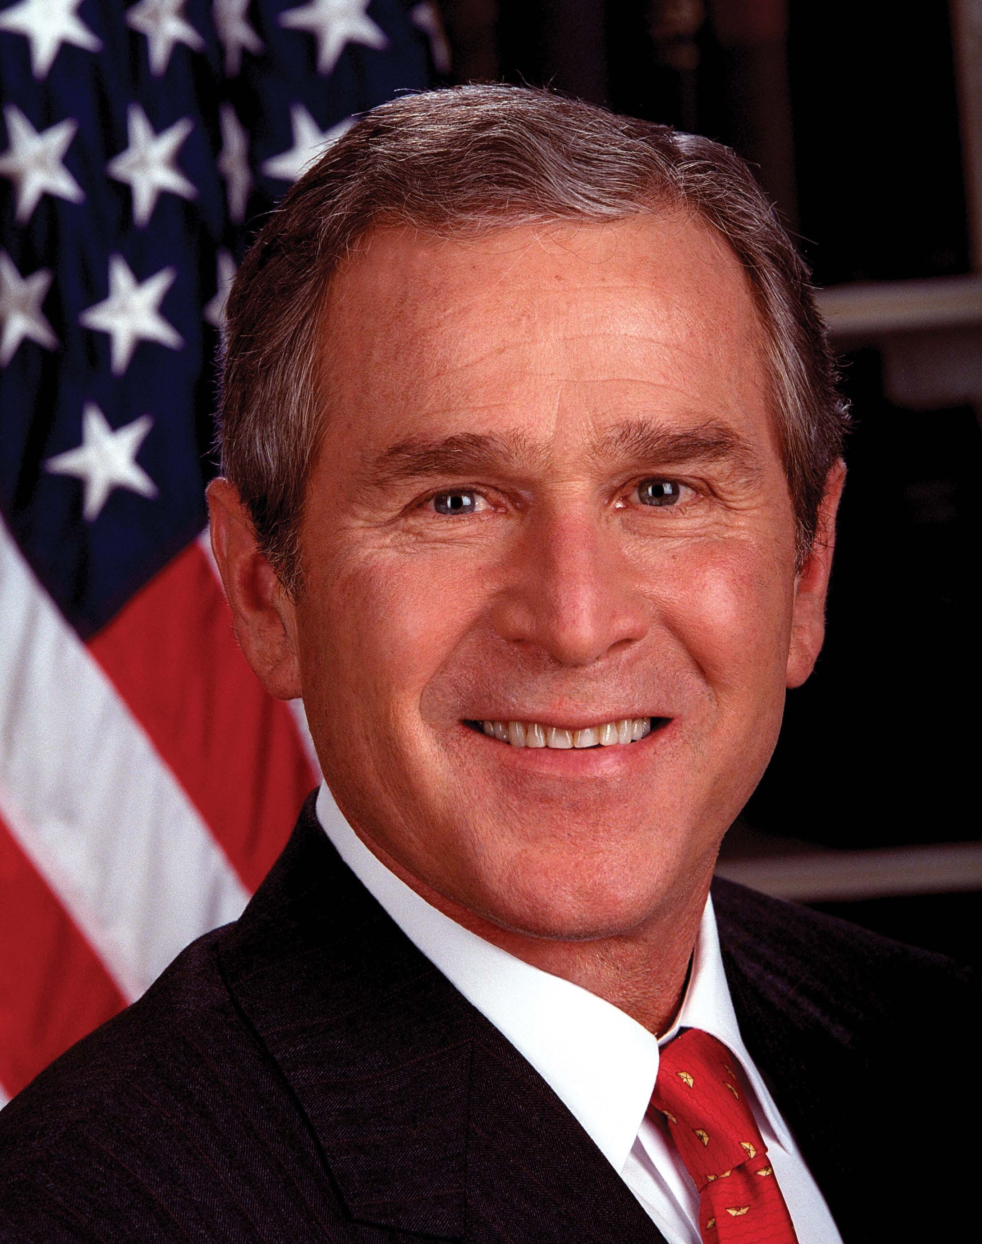
The Republicans nominated the governor of Texas George W. Bush.
- Massive tax cuts, especially for the wealthy
- Smaller government
- Social welfare through “faith based” programs

Slide 4
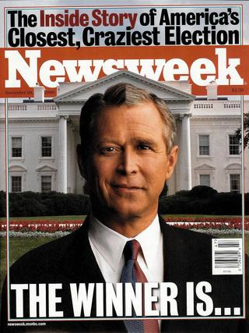
On election day Nov. 2000 it first appeared that Gore would win, then Bush would win, then no one had any idea.

Slide 5
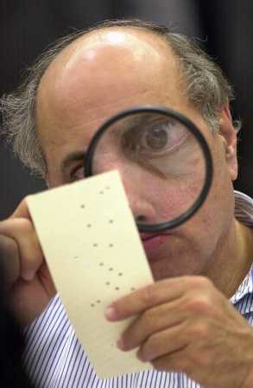
It came down to Florida. The candidate that won Florida’s electoral votes would win the election.
- Ballot and voter irregularity in the state caused Democrats to demand a statewide recount.
- Republicans protested demanding that only already certified ballots be counted.

Slide 6
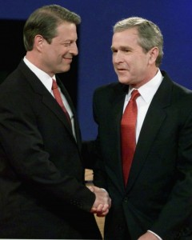
The matter of a Florida recount found its way to the U.S. Supreme Court in the case of Bush v. Gore.
- In a 5-4 vote the Court ordered the recount in Florida to stop.
- Bush won Florida by 537 votes and thus won the election.

Slide 7
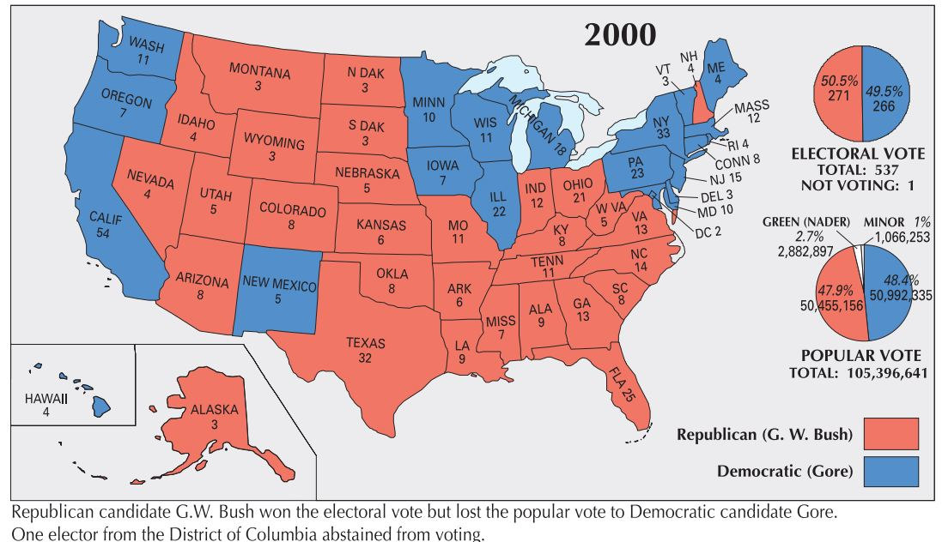

Slide 8
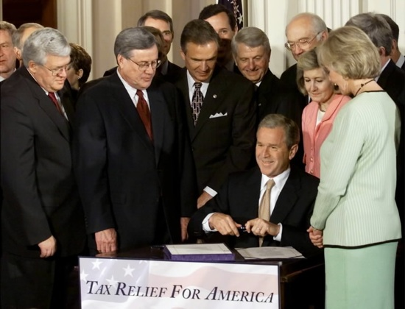
Bush got to work and made good on his campaign proposal to slash taxes by signing the Economic Growth and Tax Relief Act in 2001.

Slide 9
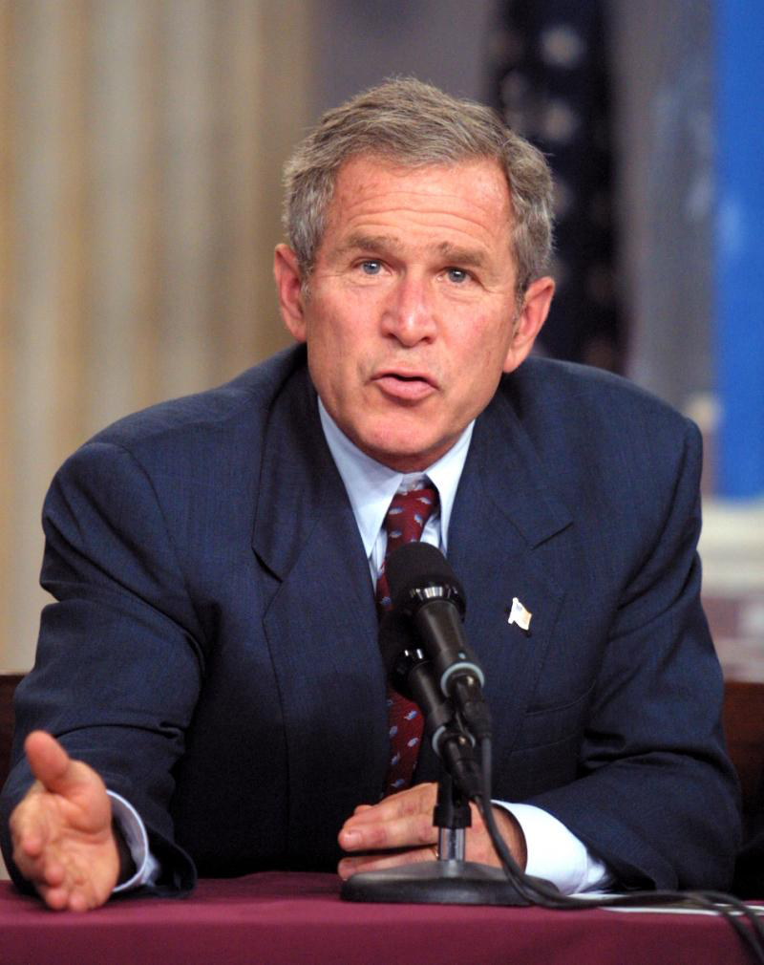
- Passed in May, 2001.
- Tax cuts for almost every tax paying American were to be phased in over 9 years.
- That process was sped up in 2003.
- Ultimately reduced government income by $1.3 trillion.

Slide 10
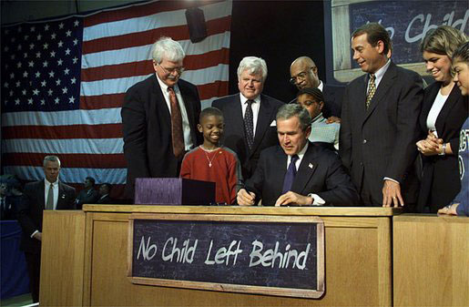
He also pushed education reform through the so called “No Child Left Behind” act in 2001.

Slide 11
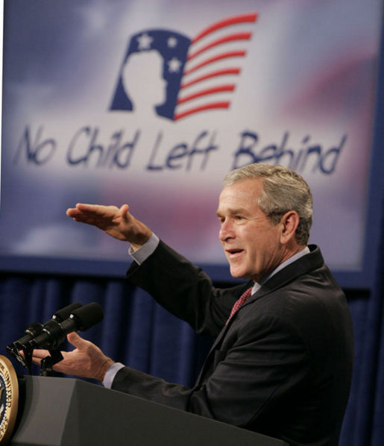
NCLB
- States were required to develop academic standards and test students annually to ensure that the standards were being met.
- The ultimate goal was to ensure that all students were proficient by 2014 and that schools made annual yearly progress toward that objective.
- States had to comply to receive money from the federal government.

Slide 12
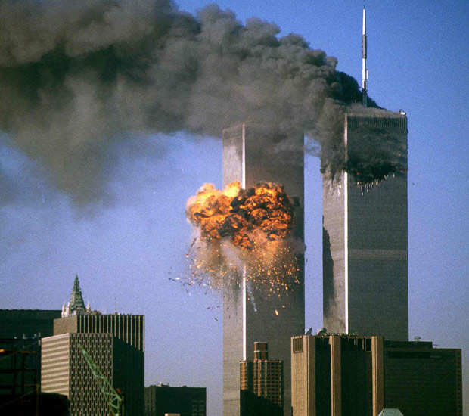
A lot of Bush’s presidency was dominated by foreign affairs caused mostly by the 9/11 attack on America.

Slide 13
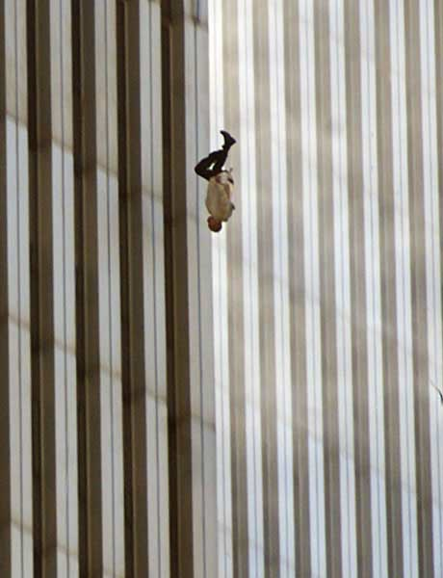
September 11, 2001
- Attack on America carried out by the terrorist group Al Qaeda, under the leadership of Osama bin Laden
- 4 planes were hijacked
2 crashed into the World Trade Center in NYC
1 crashed into the Pentagon
1 crashed in PA
- Carried out to enact revenge against America for its “desecration of Islam.”
- 2,977 people were killed.

Slide 14
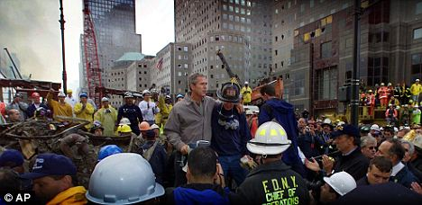
The Bush administration responded to these attacks both at home and abroad.

Slide 15
To “protect” Americans at home Congress passed, and President Bush signed, the PATRIOT Act in October, 2001.

Slide 16
- Expanded the authority of agencies like the FBI and NSA to gather information on potential terrorists through wiretapping, examining personal records, accessing cell phone and internet information, and executing search warrants.
- Allowed for easier and quicker sharing of information between intelligence agencies like the CIA, NSA, FBI, etc..
- Raised accusations that the government was targeting the civil liberties of all Americans.

Slide 17
Bush and Congress also created the Department of Homeland Security and the Transportation Security Administration (TSA) in an effort to prevent another terrorist act inside the United States.

Slide 18
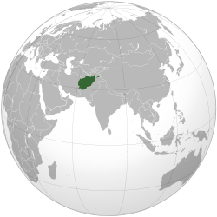
America’s foreign response to 9/11 immediately focused on Afghanistan.

Slide 19
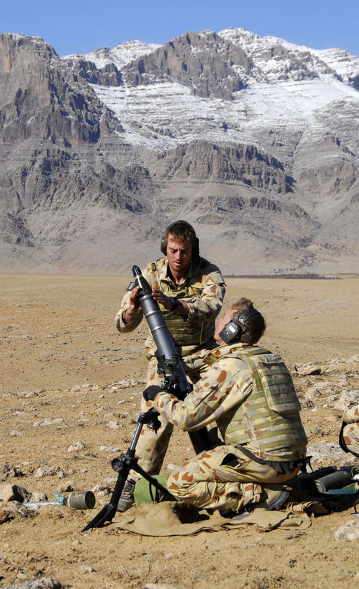
Operation Enduring Freedom
- Launched 10/7/01.
- Goal was to destroy Al Qaeda and the government of Afghanistan the Taliban.
- Successfully drove the Taliban from power in December, 2001 and replaced them with a democratic government.

Slide 20
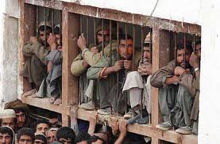
During the war against the Taliban and Al Qaeda, the government captured more and more Afghani prisoners.

Slide 21
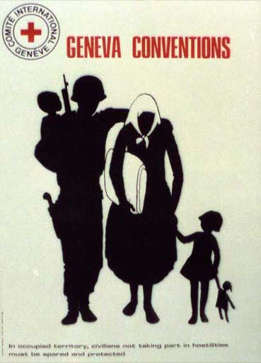
Under various international agreements, nations like the U.S. agreed to very strict rules of war that established what could and what could not be done to P.O.Ws.

Slide 22
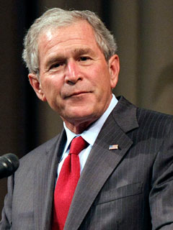
It became the policy of President Bush and the U.S. government that captured members of Al-Qaeda were not official prisoners of war.
They were terrorists and criminals, and thus the rules of war did not apply.

Slide 23
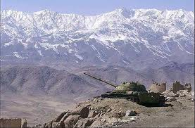
As a result, two things began to happen.

Slide 24
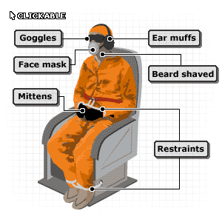
1. The American government wanted to know what other attacks Al-Qaeda might be planning and where Bin Laden was.
The best way to get information from prisoners was to find ways to convince them to tell what they knew.

Slide 25
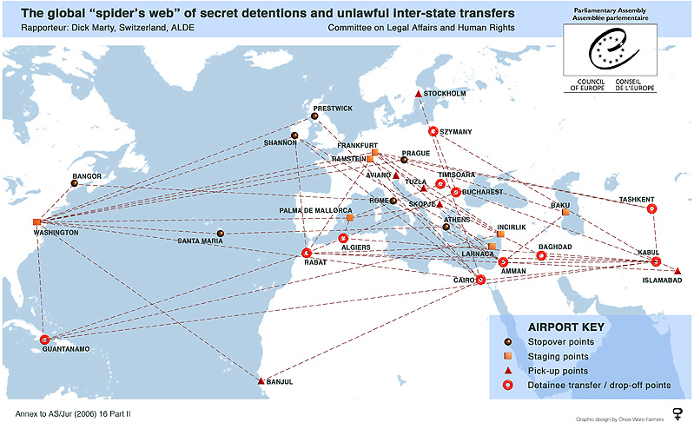
To that end, the U.S. government worked with Middle Eastern, African, and Eastern European nations and began to engage in “extraordinary rendition.”

Slide 26
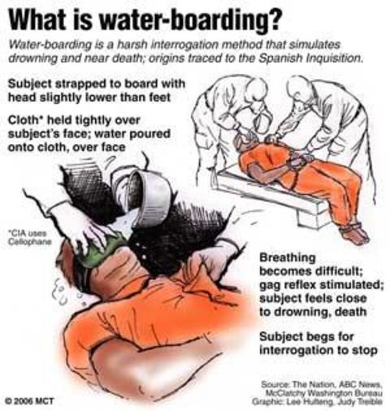
Under this policy, prisoners were taken by the CIA to prisons and other undisclosed locations around the world.
There, they were tortured by a variety of methods, until they told the government what they knew.

Slide 27
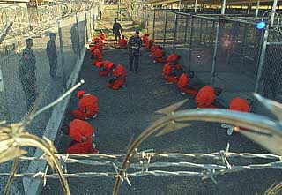
2. After they had been interrogated, prisoners were sent to a military prison located at Guantanamo Bay in Cuba.

Slide 28
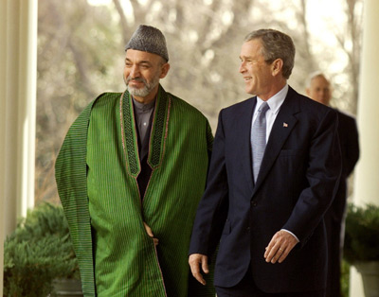
Protecting the democratic government of Afghanistan proved to be very difficult for a variety of reasons.

Slide 29
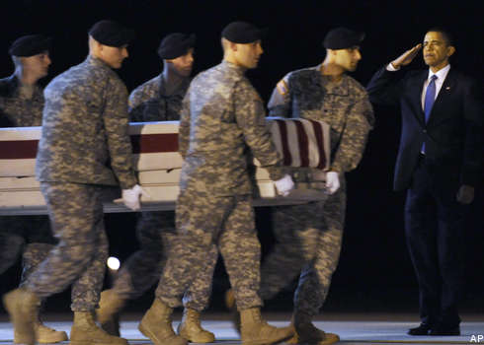
America still has soldiers in Afghanistan as a result.

Slide 30
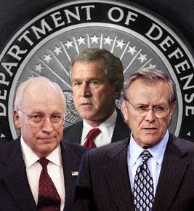
President Bush, and members of his administration, most notably Vice President Dick Cheney, and Sec. of Defense Donald Rumsfeld, also argued that Iraq posed a major threat to the United States.

Slide 31
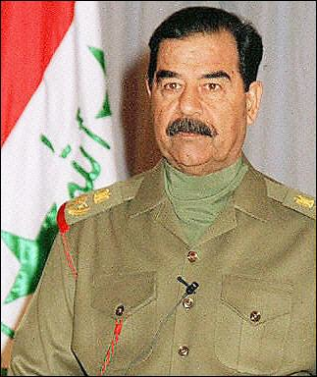
Their primary concern was that any weapons of mass destruction (WMDs) owned by Saddam Hussein and the Iraqi government might be sold or given to terrorist organizations who would then use them against the United States.

Slide 32
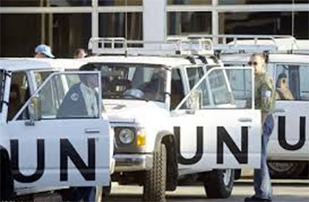
Both Saddam Hussein and the United Nations argued that military action was not necessary, as Iraq had destroyed any WMDs it had ever produced.

Slide 33
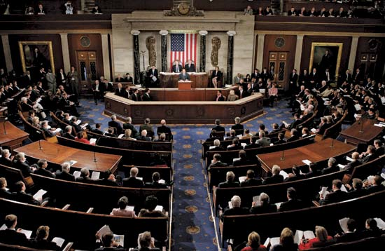
Despite such protest, on October 11, 2002 the U.S. Congress voted to approve military action against Iraq in order to protect America.

Slide 34
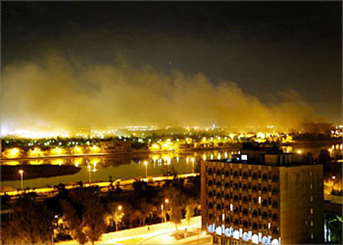
Working with several allies, most importantly the UK, operations began March 19, 2003.

Slide 35
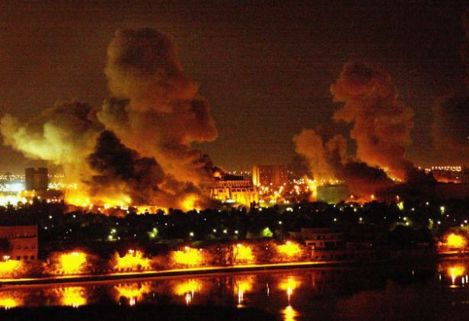
The Navy and the Air Force unleashed a massive bombing campaign targeting the Iraqi military and Hussein’s government. The following day, ground troops poured into Iraq.

Slide 36
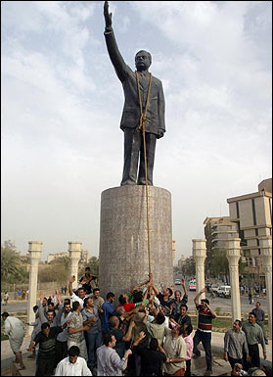
Within three weeks the U.S. army occupied the capital of Baghdad.
Saddam Hussein and his supporters had fled.

Slide 37
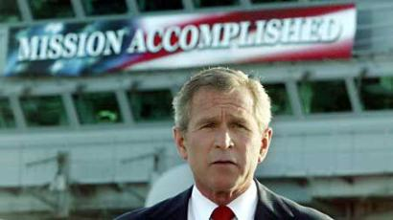
On May 1, 2003 President Bush travelled to the aircraft carrier U.S.S. Abraham Lincoln and declared that major military operations in Iraq were over.

Slide 38
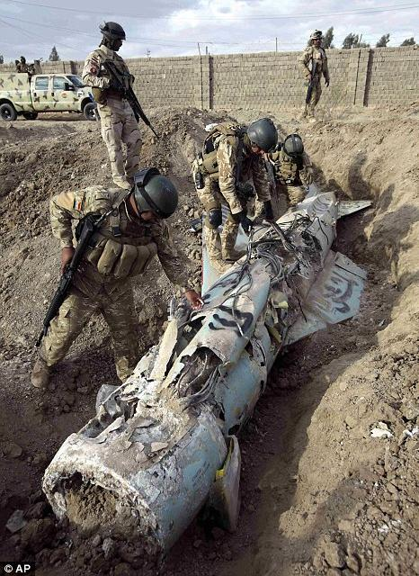
As the invasion got underway in March, the CIA began scouring Iraq to find the alleged Weapons of Mass Destruction.
They couldn’t find any.
They never found any.

Slide 39
Failing to find any WMDs, the American mission became building up a democracy for the people of Iraq.

Slide 40
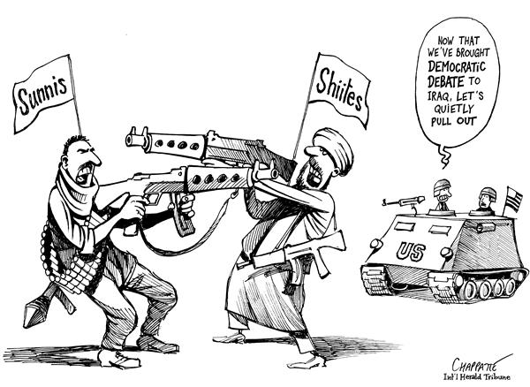
Largely due to religious and ethnic issues, the people or Iraq fell into civil war, with American soldiers caught in the middle.

Slide 41
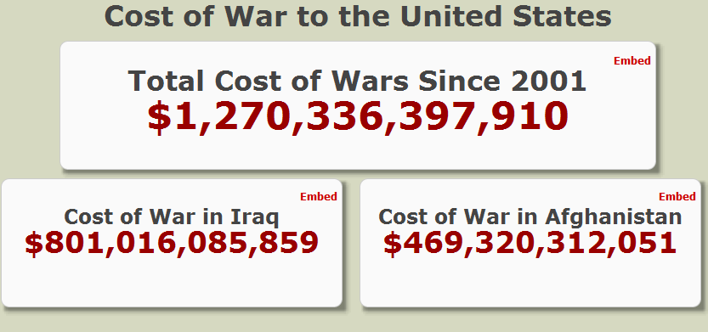

Slide 42
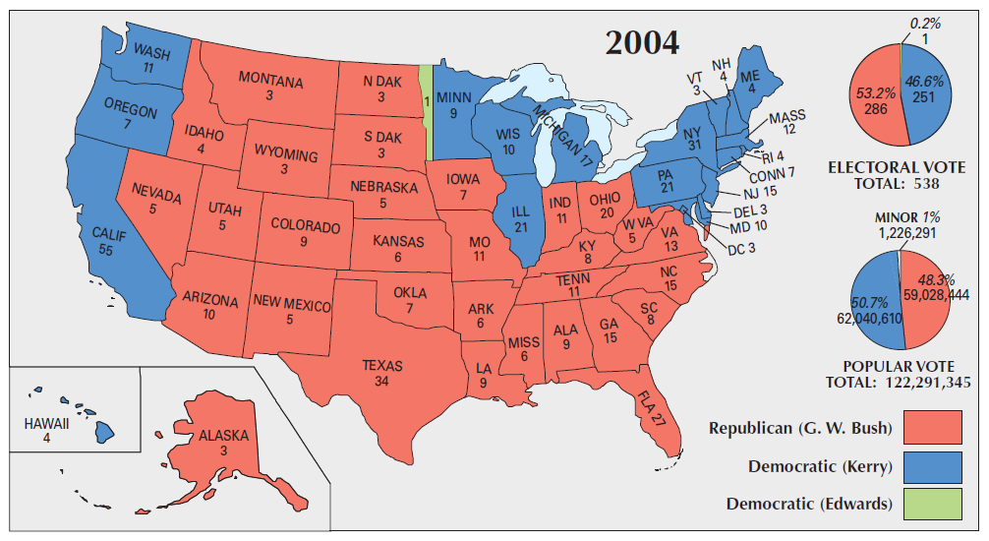
As the situation in Iraq began to deteriorate, Bush fairly easily defeat John Kerry and the Democrats in 2004, largely due to America’s fear of more terrorist attacks.

Slide 43
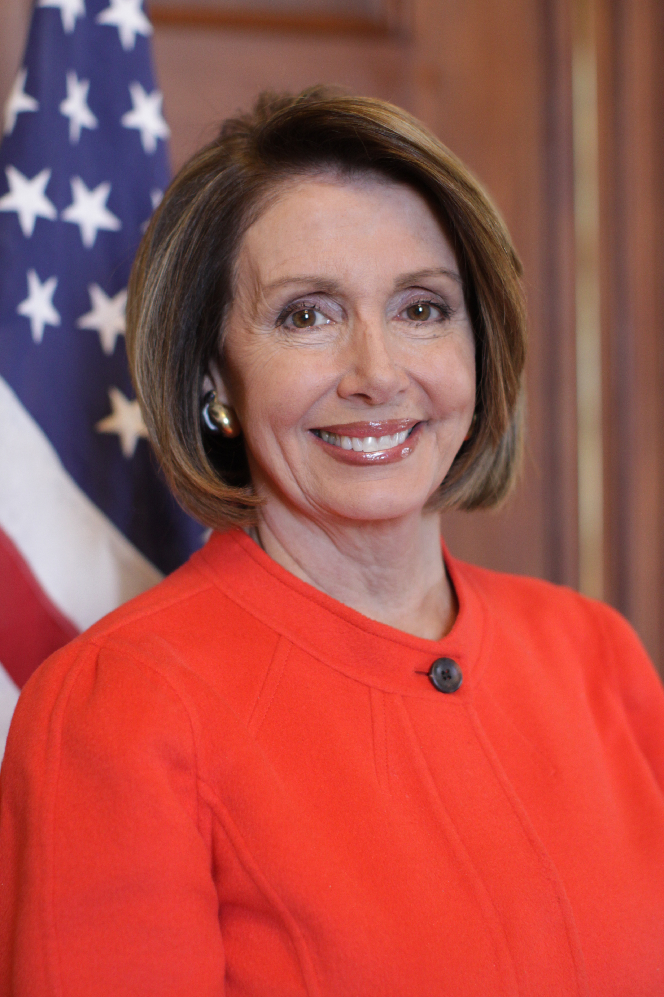
However, two years later, the Democrats were able to take back control of the House of Representatives for the first time in 12 years.
- Nancy Pelosi was elected Speaker of the House.
- Caused in part by:
a. Growing unpopularity of war in Iraq
b. Attempts by Bush to privatize social security
c. Bush’s handling of Hurricane Katrina
d. Several Congressional scandals
e. A slipping economy

Slide 44
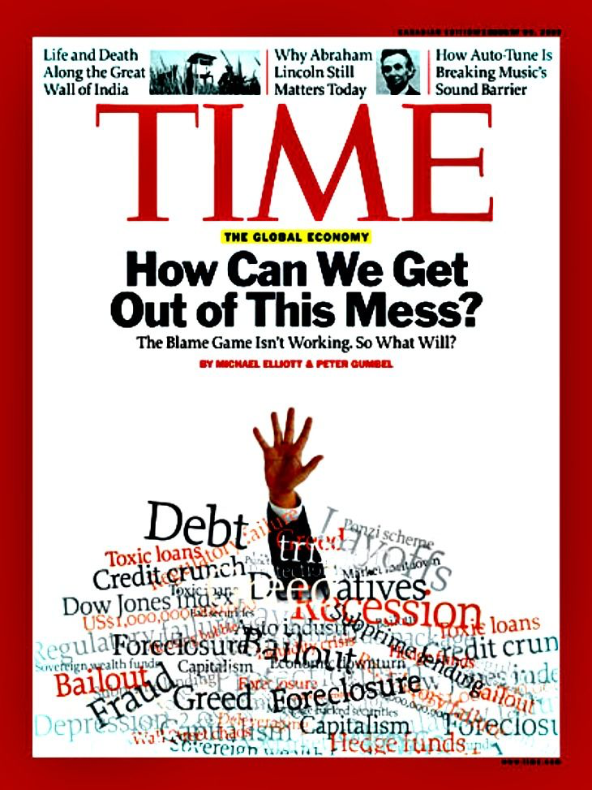
The Great Recession
Numerous potential causes including:
1. Banks making increasingly risky home loans
2. Investment firms purchasing investments backed by these home loans
3. Increasing debt amongst American consumers
4. Lack of available credit and a decrease in consumer spending

Slide 45
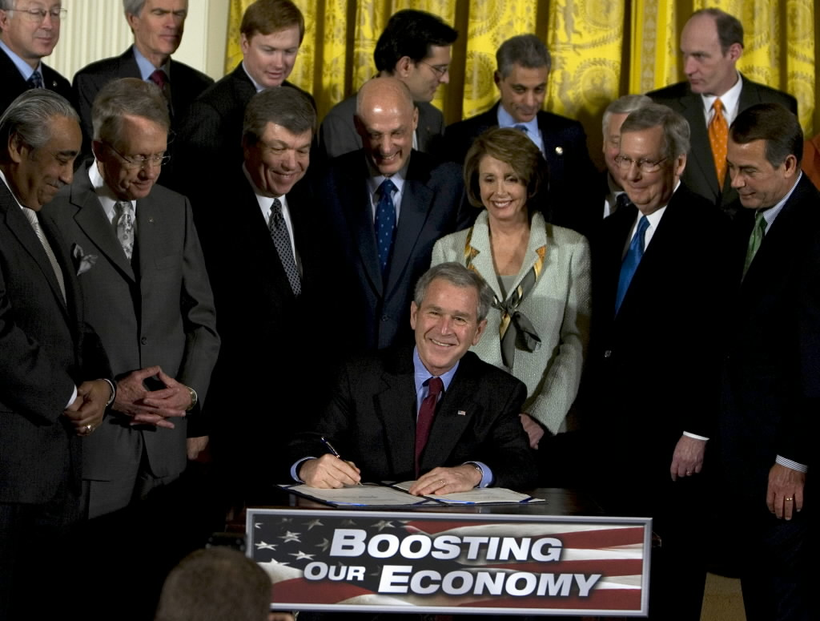
To immediately increase consumer spending, Congress passed, and President Bush signed the Economic Stimulus Act of 2008.

Slide 46
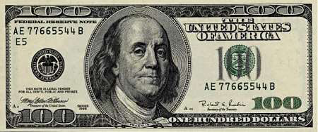
- Tax payers with an income of less that $75,000 a year, were cut a government check for $300, and an additional $300, check for each child under 17.
- Overall, and individual household received a maximum of $1,200
- What did Congress and President Bush hope people would do with this money?
- Cost $152 Billion

Slide 47
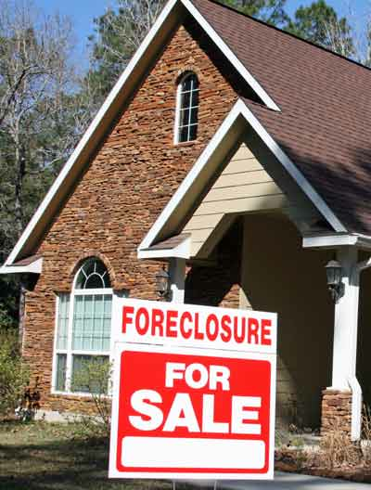
Part of the underlying problem was that a number of banks found themselves with a ton of homes they had foreclosed on.

Slide 48
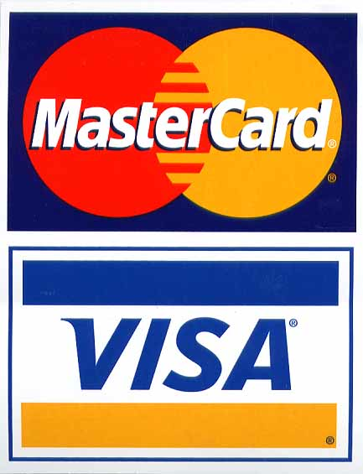
Many of those banks found it difficult to sell those homes at a price that allowed them to recoup their money.
This in turn resulted in the vast majority of banks cutting way back on extending credit of any kind.

Slide 49
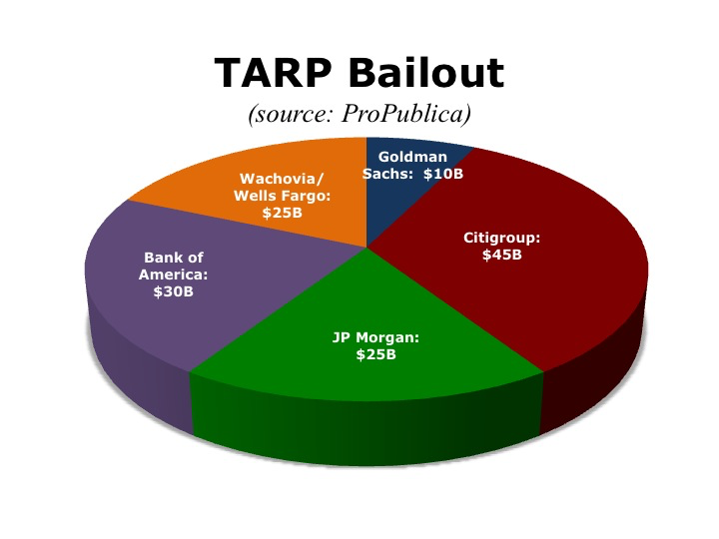
To help banks feel stable, and to get credit flowing again, Congress President Bush created the
Troubled Asset Relief Program (TARP).

Slide 50
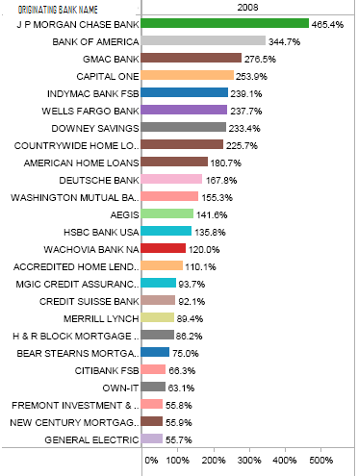
TARP
- The initial plan was for the U.S. government to pay off bad mortgages, giving banks that had made bad home loans money.
- The government then hoped those banks would then use that money to once again extend credit to Americans.
- They didn’t!

Slide 51
As it became clear that huge companies like General Motors were also on the verge of collapse, TARP money was used to keep them afloat. Why?

Slide 52
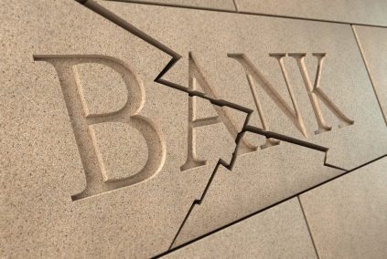
Under the Bush and Obama administrations, the U.S. government pumped over $386 Billion into the TARP program. Much of that has been repaid.

Slide 53
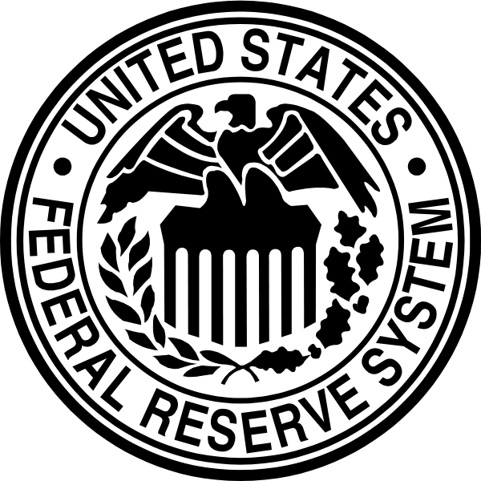
Lastly, to further increase the security of banks and the availability of credit, the Federal Reserve did two things:
1. Paid off even more bad bank loans and investments.
2. Pumped more cash into banks by buying back government bonds from those banks.

Slide 54
The cost of the Federal Reserves’ actions?
$1.8 Trillion
$1,000,000,000,000

Slide 55
The total cost of the government’s overall efforts?
$3 Trillion
$3,000,000,000,000

Slide 56
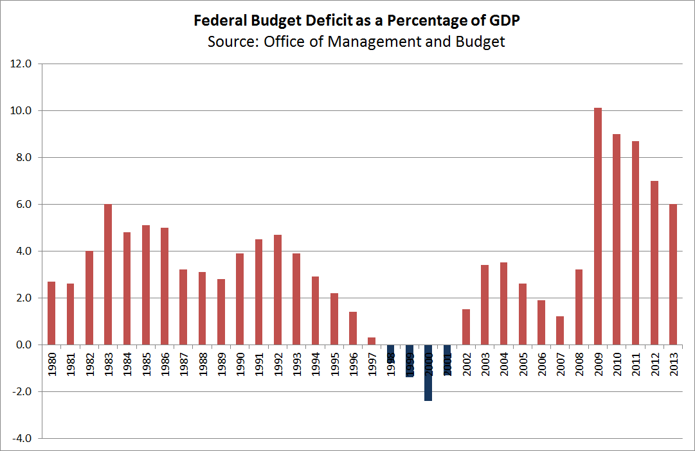
All of that, the tax cuts, war in Iraq and Afghanistan, and the Great Recession all help explain this chart.

Slide 57
Just how much is a trillion?
If you counted a million seconds, you’d be counting for 12 days.
If you counted a billion seconds you’d be counting for 31 years.
If you counted a trillion seconds you’d be counting for 31,688 years!

Slide 58
Just how much is a trillion?
Between the year 0 and the year 2015 there have been 734,476 days.
If you had spent $1 Million a day, everyday since the year 0, you would have spent:
almost to $734.5 billion.
You wouldn’t have even spent $1 trillion!!!!!!!

Slide 59
Fin.

