Slide 1
The Roots
of
Poverty

Slide 2
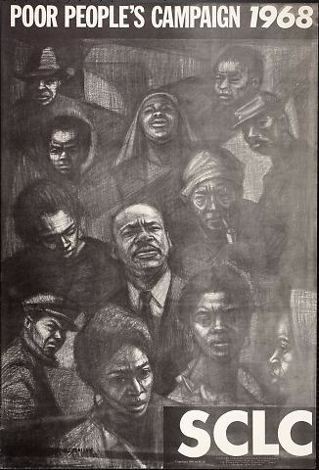
Remember that in 1968 King and the SCLC wanted to draw attention to the issue of poverty through the Poor People’s Campaign.

Slide 3
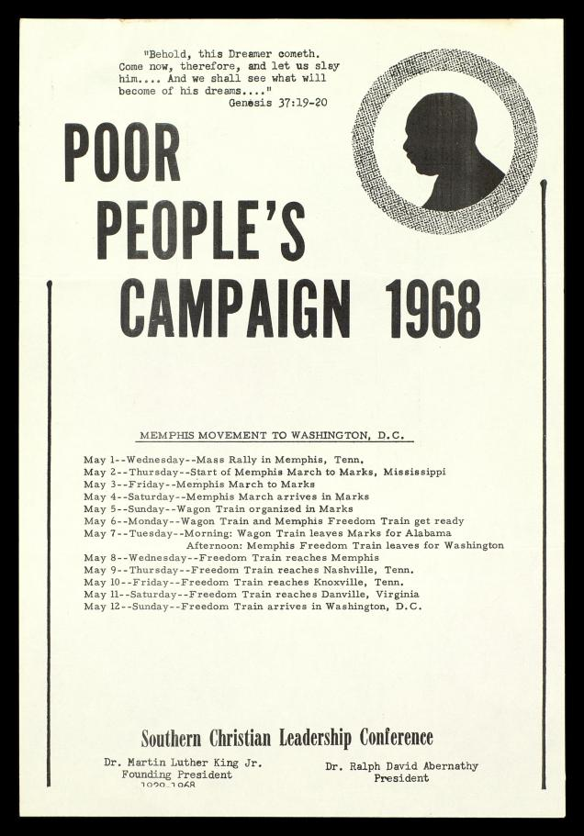
The ultimate goal was a march on Washington D.C. set for May, 1968.
The idea was to gather thousands of protestors to demand the government increase the war on poverty.

Slide 4
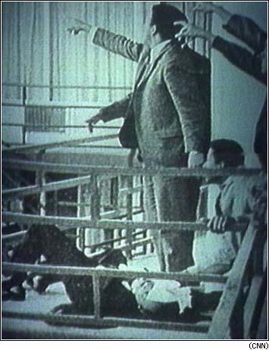
As the final plans for the March were being finalized, Martin King was shot to death April 4, 1968.

Slide 5
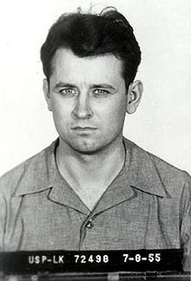
King’s assassin was James Earl Ray.
- Ray was a racist who supported continued segregation and Jim Crow.
- He confessed to the murder and was sentenced to 99 years in prison.
- He died in prison in 1998.

Slide 6
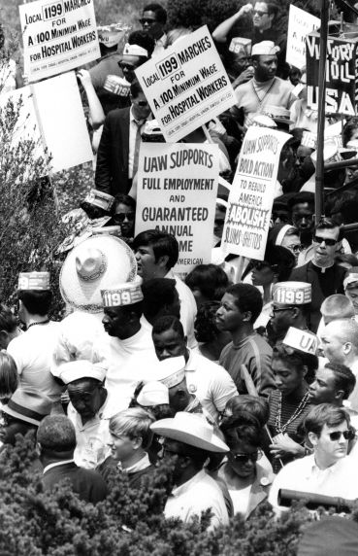
The SCLC vowed to carry on with King’s Poor People’s Campaign.
Groups began to gather throughout early May in preparation for their journey to Washington.

Slide 7
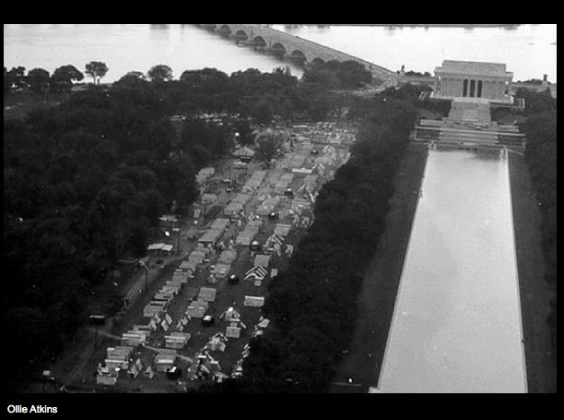
On May 21, 1968 thousands of demonstrators set up a camp in the nation’s capital which came to be known as “Resurrection City.”

Slide 8
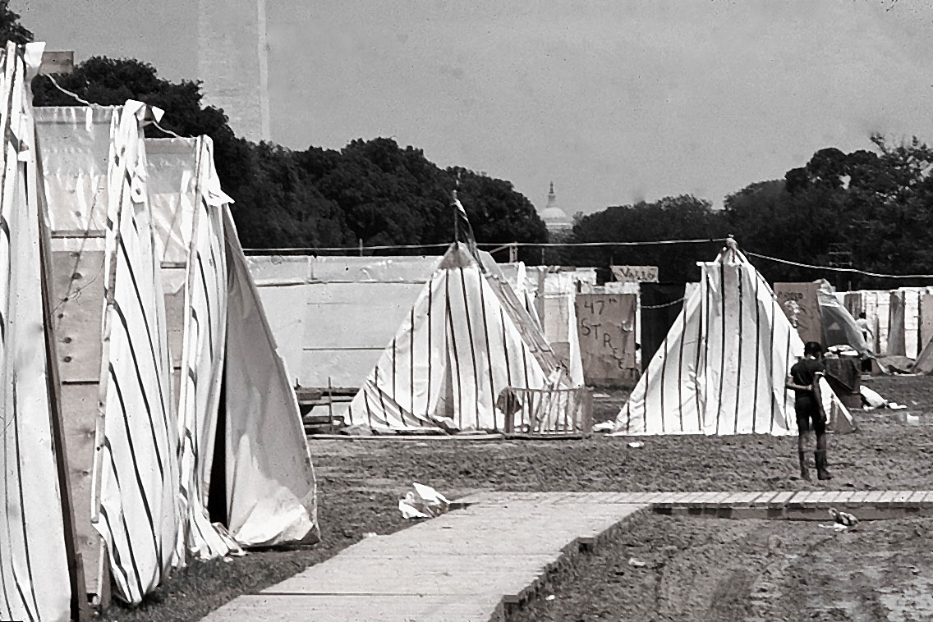
For six weeks protestors lived in this camp attempting to meet with Congressmen and other government officials.

Slide 9
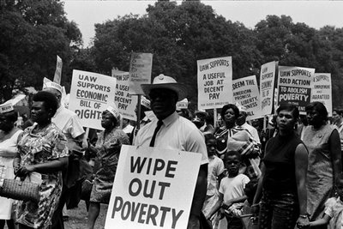
But, without effective leadership and financial support, the protest had little impact.

Slide 10
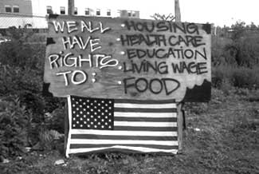
By late June, 1968 many protestors had gone home. Those that remained were finally forced out by the police on June 24th.

Slide 11
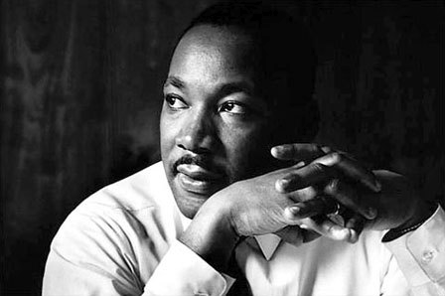
King’s Poor People’s Campaign accomplished relatively little and secured no real change in government policy.

Slide 12
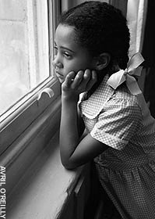
Poverty was still a problem and many began to push for confronting one of the the root causes of continued poverty in African-American communities:
The poor quality of public education.

Slide 13
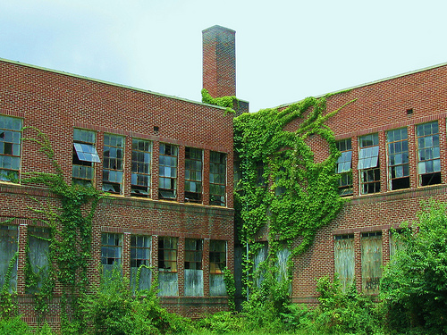
White flight had also caused de facto segregation of urban schools.

Slide 14
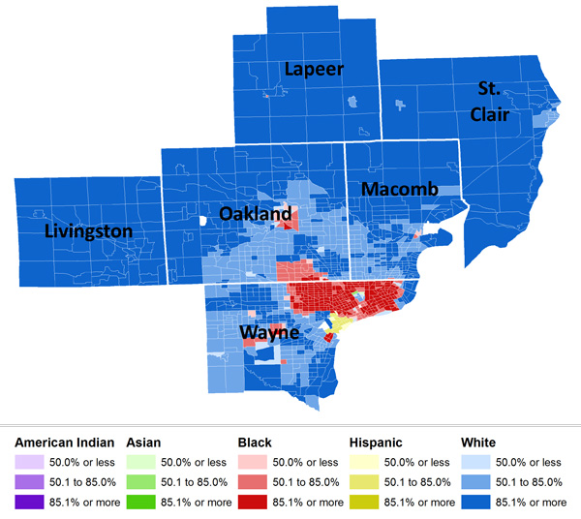
As upper and middle class whites left for the suburbs they took their money and their children with them.

Slide 15
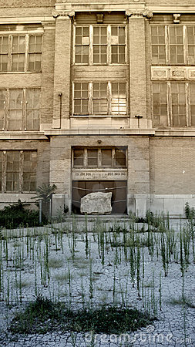
This had two major impacts on schools in inner city neighborhoods.
1. There were fewer students attending inner city schools.
This resulted in less funding for those schools.

Slide 16
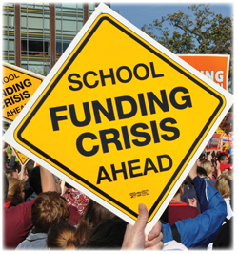
2. There was less tax money to support schools to begin with.
- Schools are traditionally supported by local property taxes. Those taxes are based on the value of that property.
- Problem?

Slide 17
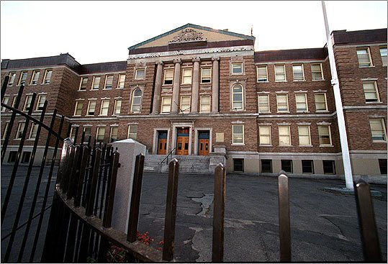
African-Americans began to push for school integration as a way to improve the quality of their children’s education.

Slide 18
Fin.

