Slide 1
The
War In
Iraq

Slide 2
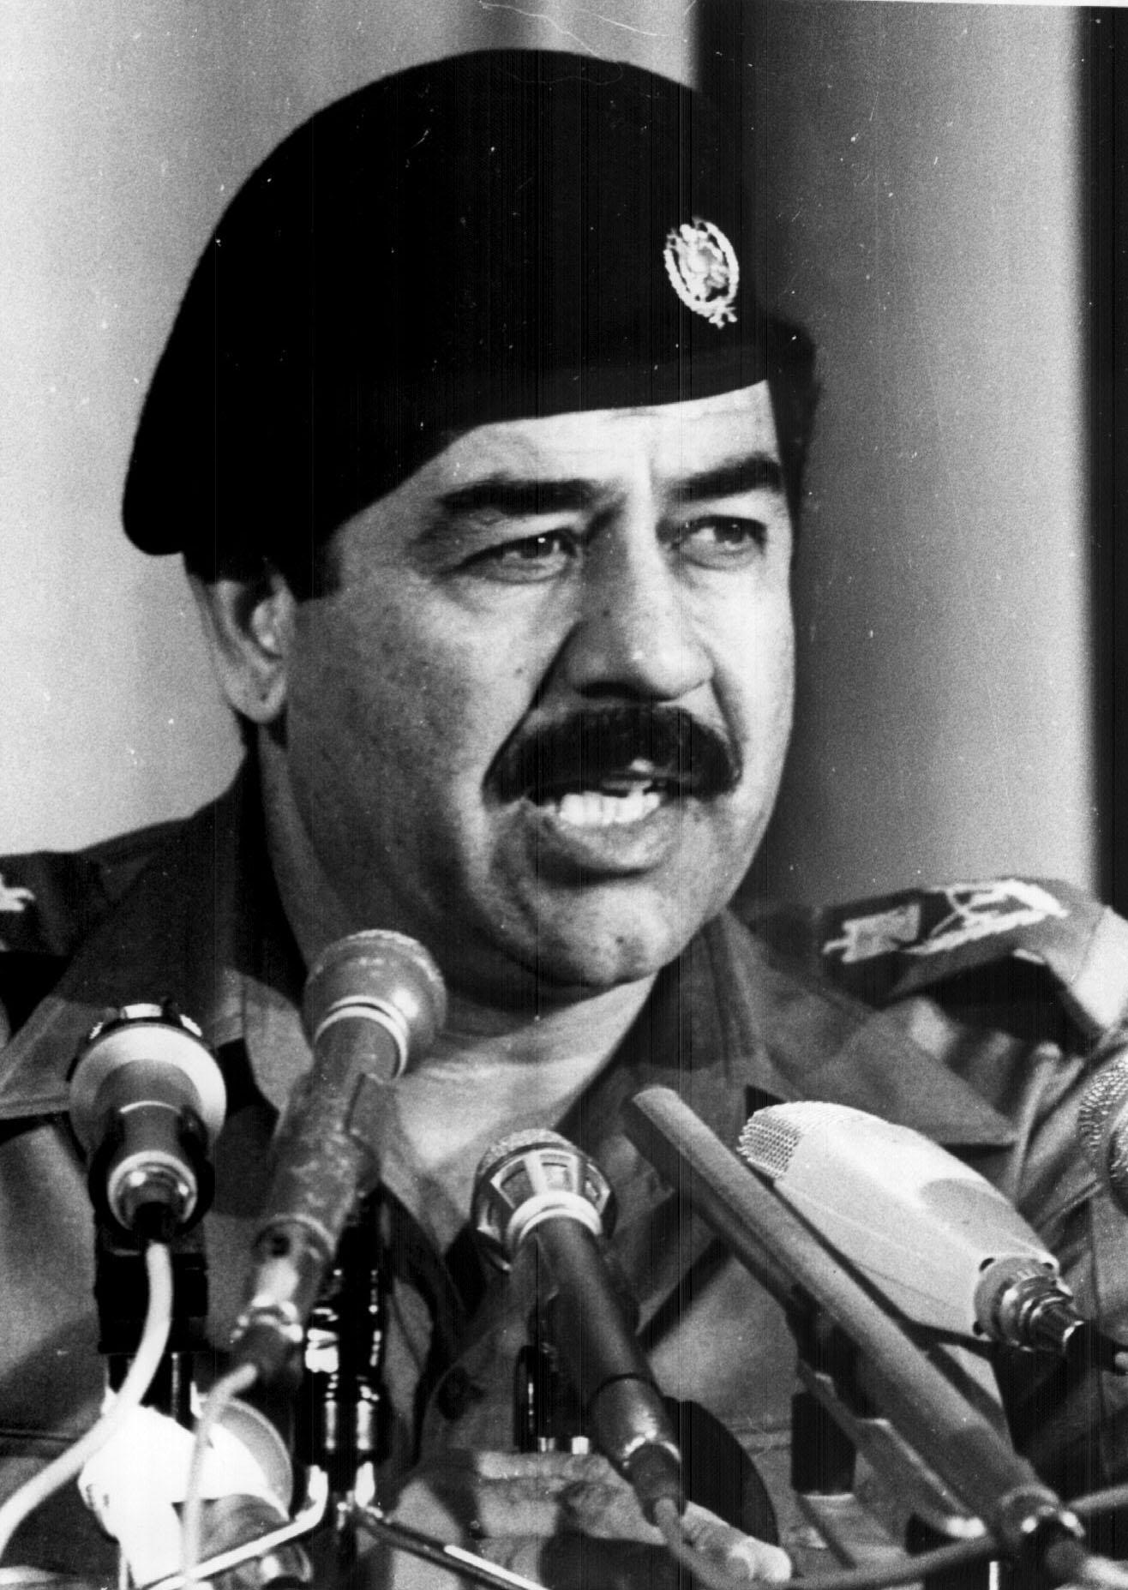
If you recall, Saddam Hussein and the Ba’ath Party controlled the nation of Iraq.

Slide 3
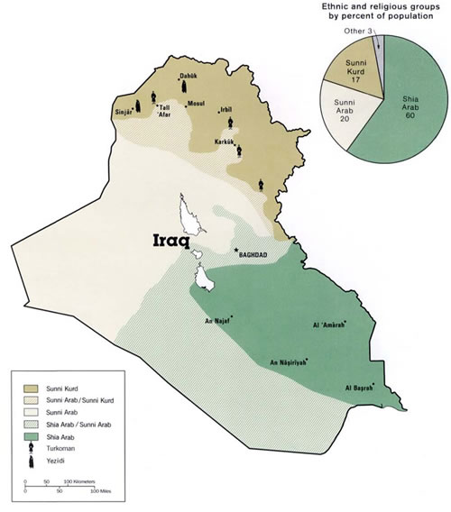
Remember as well that he and the govt. were dominated by Sunnis, while the majority of the people were Shiite.

Slide 4
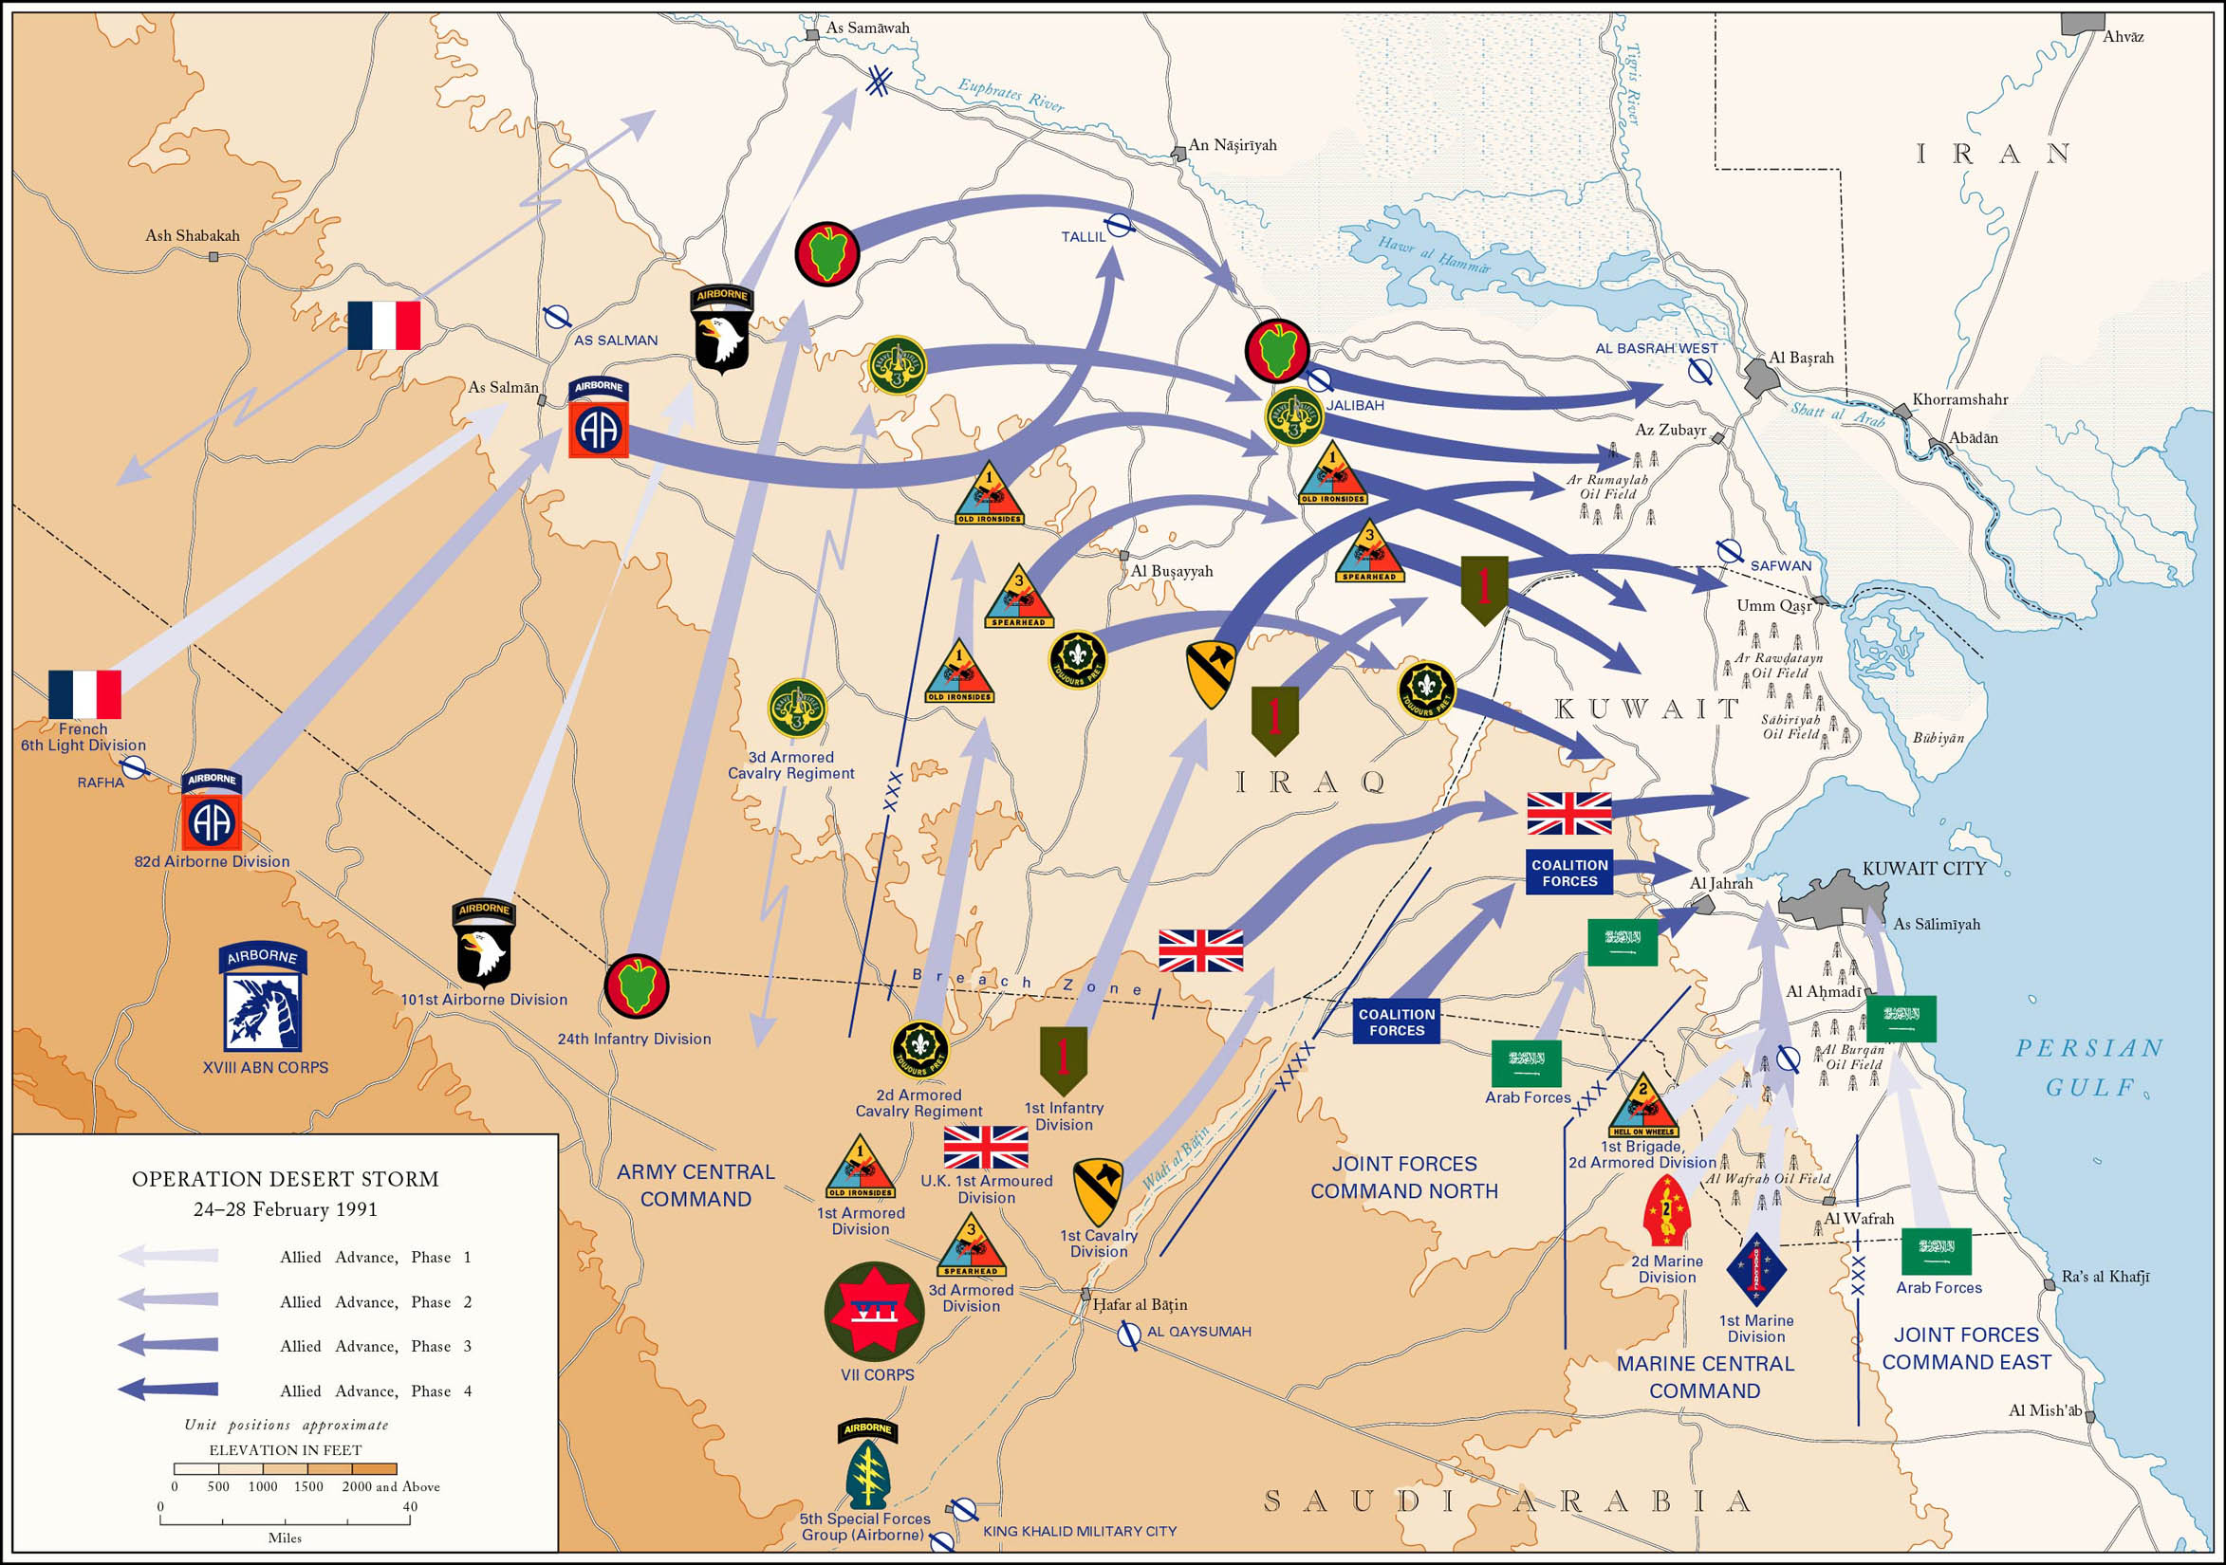
In 1991, the Iraqi army was decimated during the Persian Gulf War (Operation Desert Storm).

Slide 5
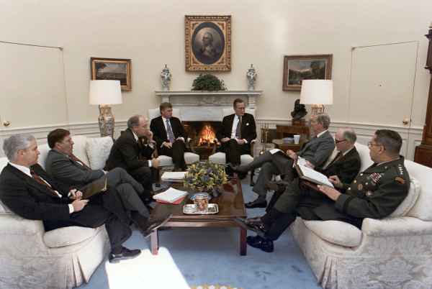
But remember, President Bush refused to invade deep into Iraq and take Hussein out of power.

Slide 6
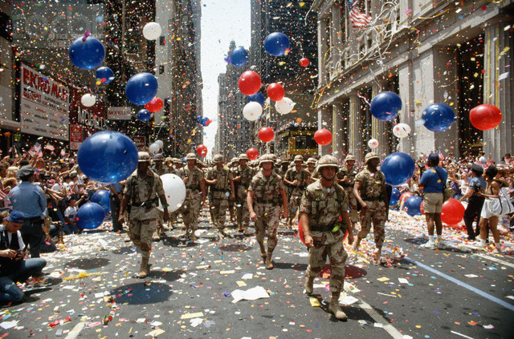
When the war was over, two important things happened.

Slide 7
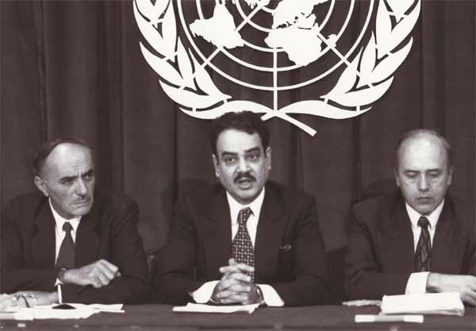
Worried about a possible future Iraqi attack on its neighbors, most likely the nation of Israel, the United Nations demanded that Iraq do two things:

Slide 8
Destroy any and all biological and chemical weapons it possessed.

Slide 9
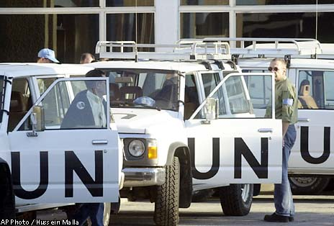
Allow United Nations weapons inspectors into Iraq to ensure compliance with that demand.

Slide 10
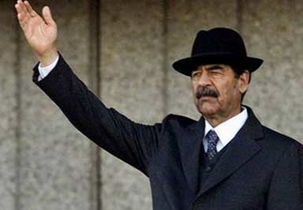
Saddam Hussein agreed, and destroyed what he claimed were all of Iraq’s weapons of mass destruction by 1998.

Slide 11
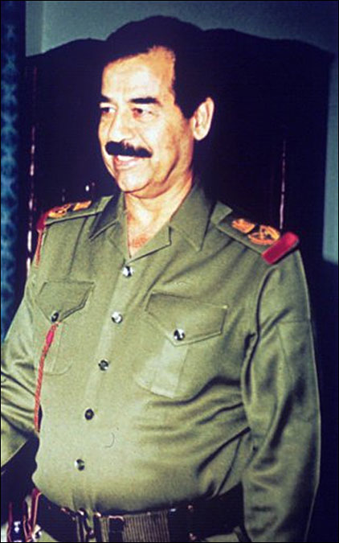
However, thing #2:
He was afraid of losing power, both in his own nation and in the Middle East.

Slide 12
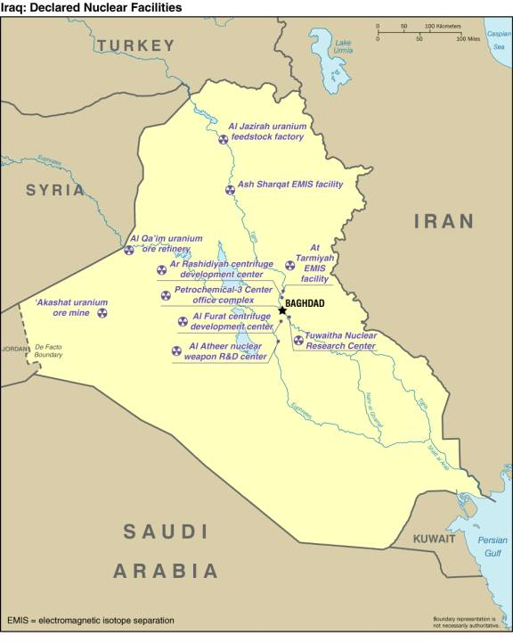
Desperate to hold onto power, he ordered the military to begin developing nuclear weapons.

Slide 13
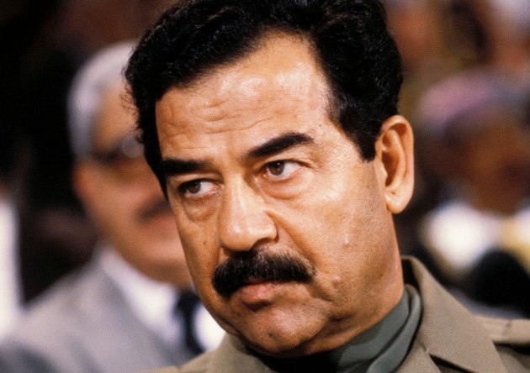
Unfortunately for Iraq, Hussein and his military could never get the money, the radioactive materials, or the knowledge to successfully construct a nuclear device.

Slide 14
By the mid 90’s, the Iraqi nuclear program was all but abandoned.

Slide 15
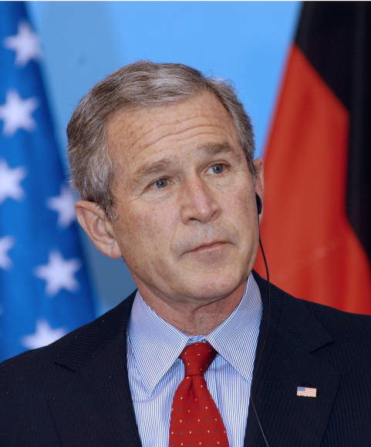
A number of important people in the U.S. government doubted Hussein’s claims that he had destroyed all of his weapons of mass destruction (WMDs) and that he had given up pursuit of nuclear weapons.

Slide 16
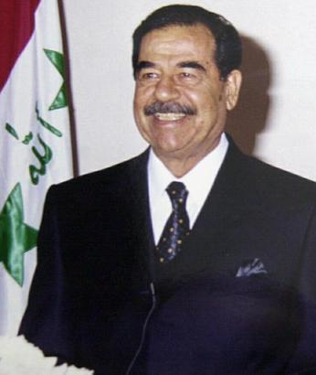
Hussein’s actions at times helped reinforce this idea.
He did not want to appear weak to his enemies, both in and out of Iraq.
Thus, he would, at times, prevent UN weapons inspectors from entering certain areas of Iraq. Why?

Slide 17
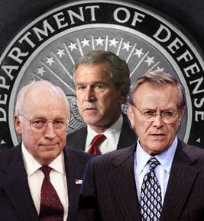
After 9/11, President Bush, and members of his administration, most notably Vice President Dick Cheney, and Sec. of Defense Donald Rumsfeld, argued that Iraq posed a major threat to the United States.

Slide 18
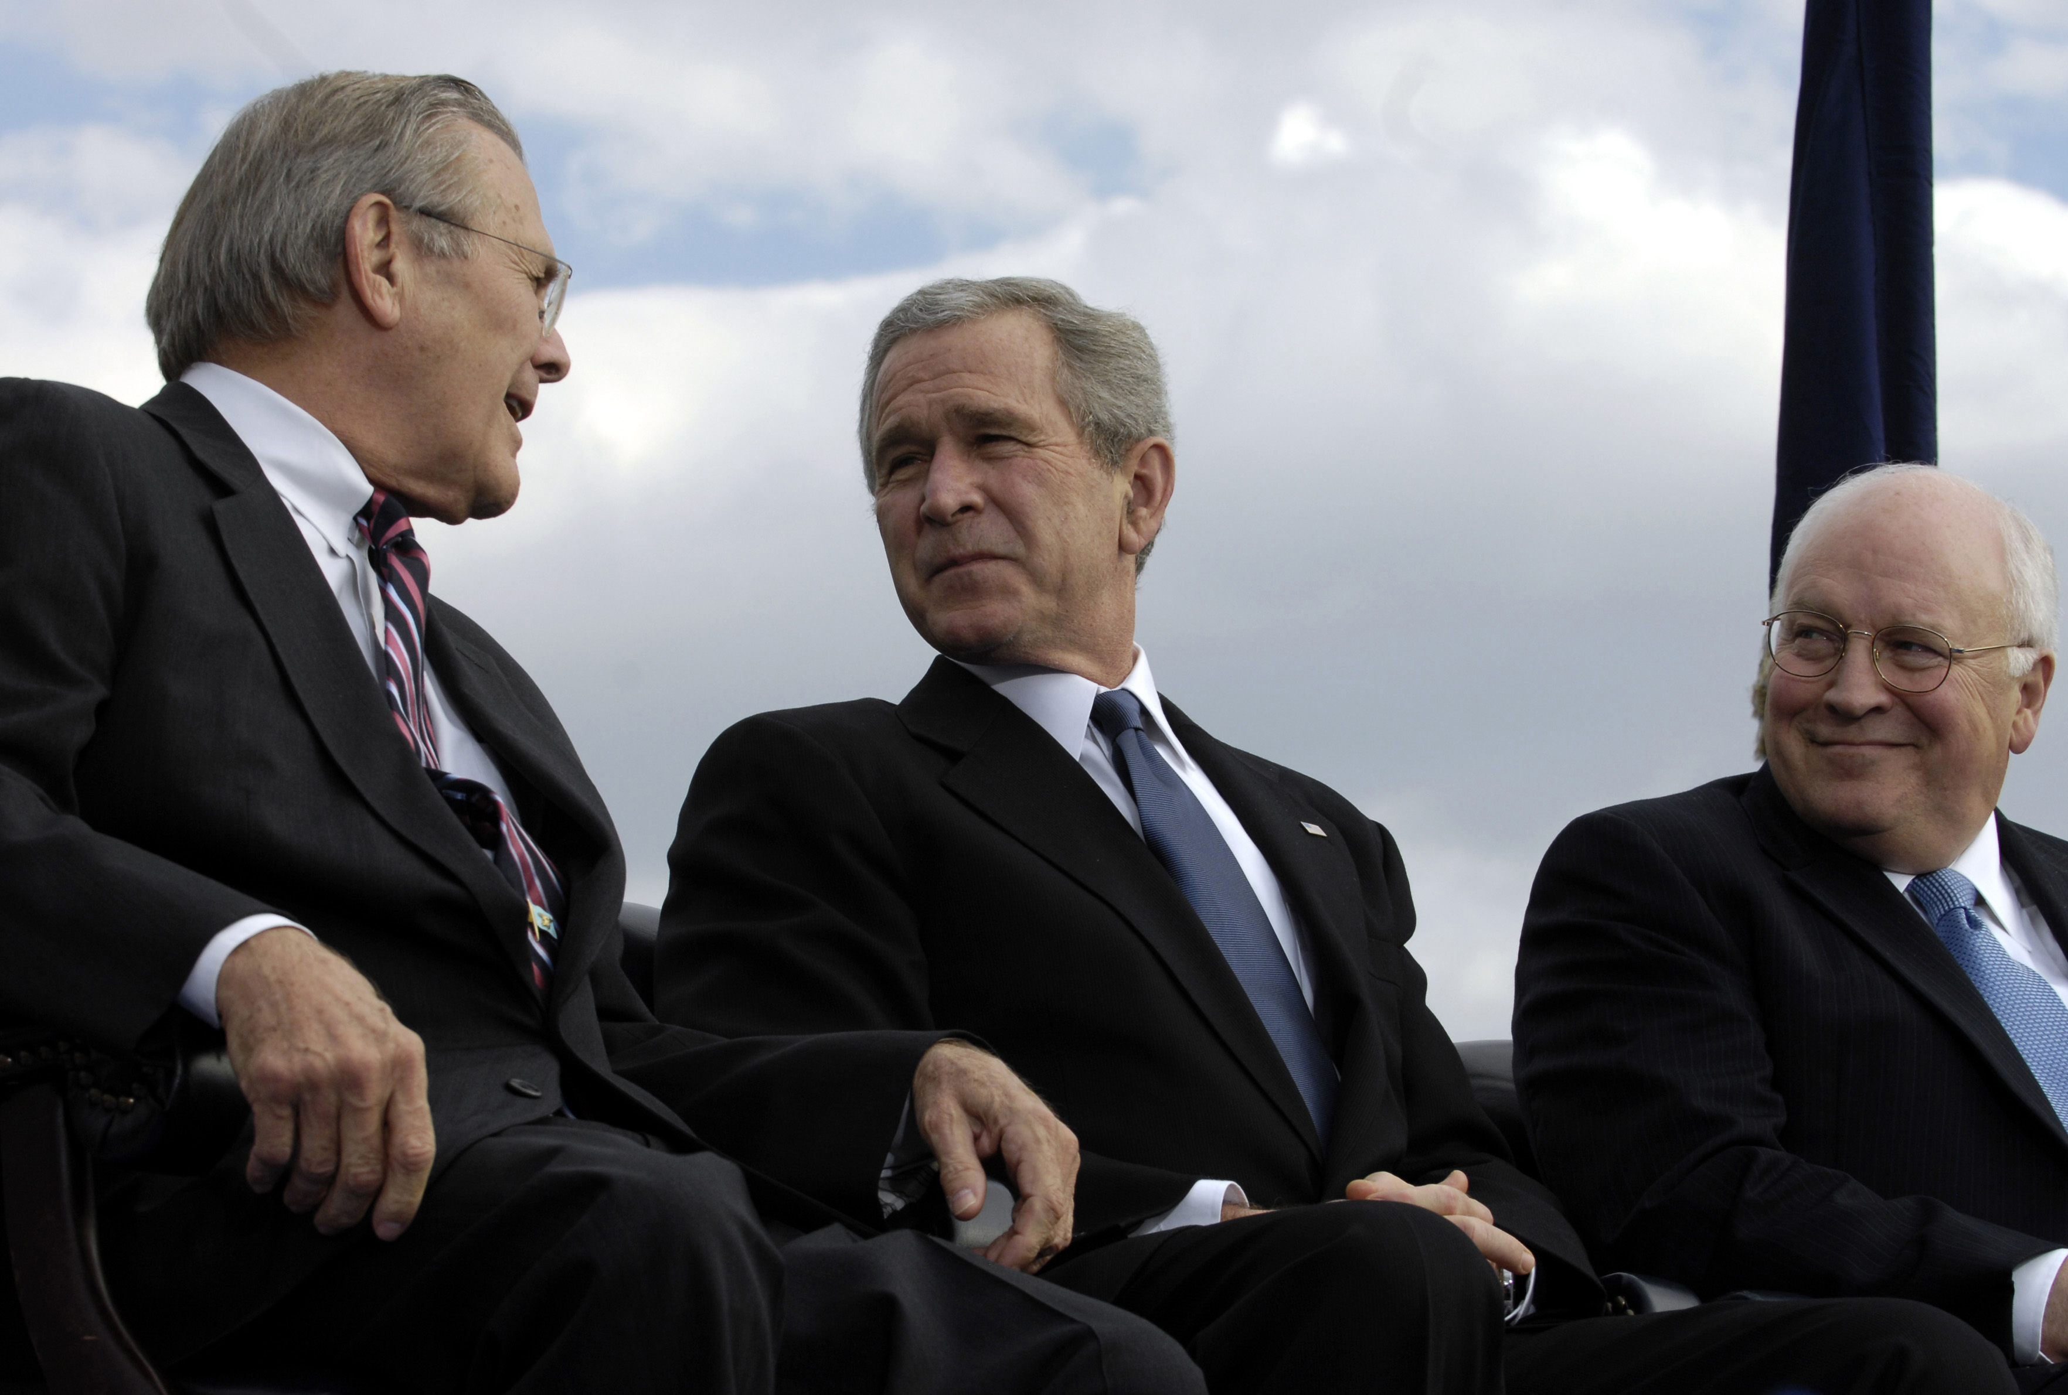
Bush, Cheney, and Rumsfeld argued that if Hussein did have any remaining WMDs, he could easily give them to Al-Qaeda or other terrorist groups to be used against America.

Slide 19
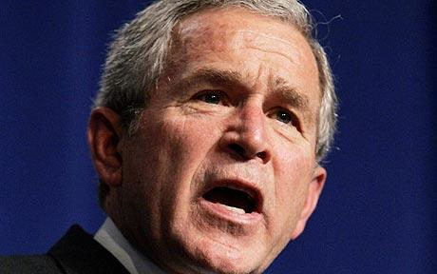
The President, and others, began to make speeches in which they claimed Iraq DID have WMDs and that Hussein was an imminent threat to the U.S.

Slide 20
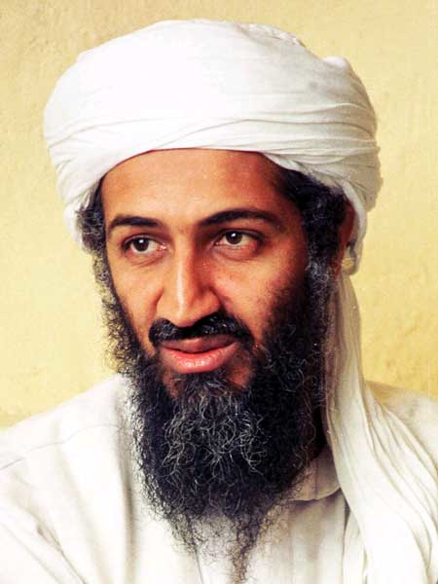
In some of these speeches, government officials began to imply that there was a connection between Iraq and Al-Qaeda.

Slide 21
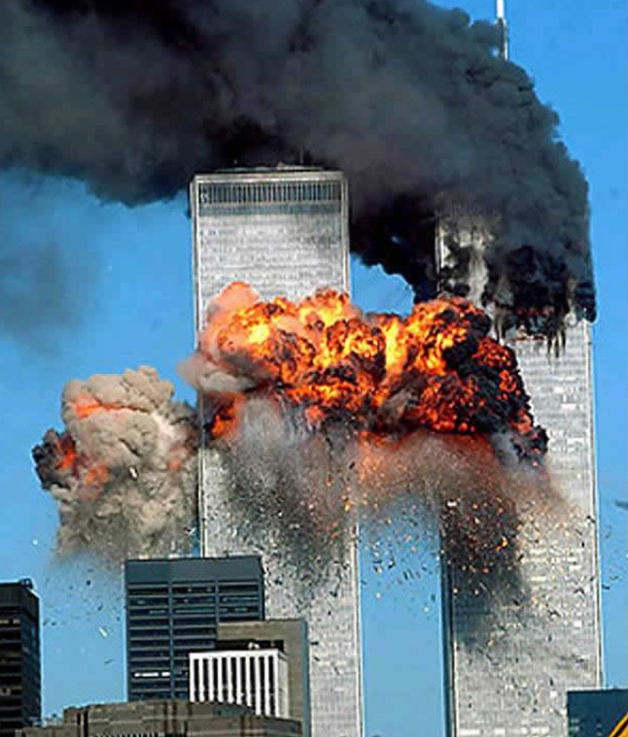
Many Americans began to believe that Iraq was, in part, responsible for the attacks on 9/11.
In one national poll, conducted in October 2002, 66% of Americans believed that Saddam Hussein was directly involved in the attack.
He wasn’t.

Slide 22
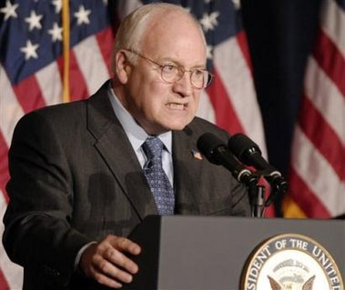
Throughout 2002 and early 2003, the Bush administration repeatedly suggested that Iraq possessed WMDs and that Hussein was still working to obtain nuclear weapons.

Slide 23
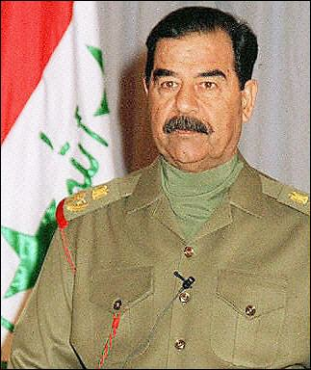
Much of the information they were using to support their claims came from people who had fled Iraq and who hated Saddam Hussein. Why might this have been a problem?

Slide 24
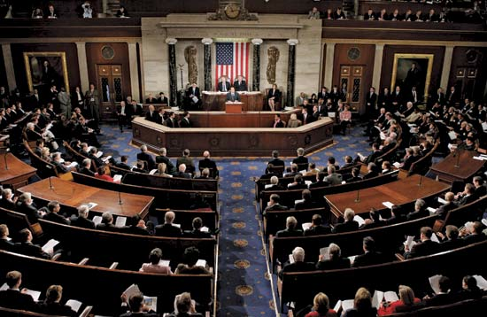
Based upon the reports from these people, on October 11, 2002 the U.S. Congress voted to approve military action against Iraq in order to protect America.

Slide 25
In November, 2002 the United Nations sent weapons inspectors into Iraq to verify America’s claims.

Slide 26
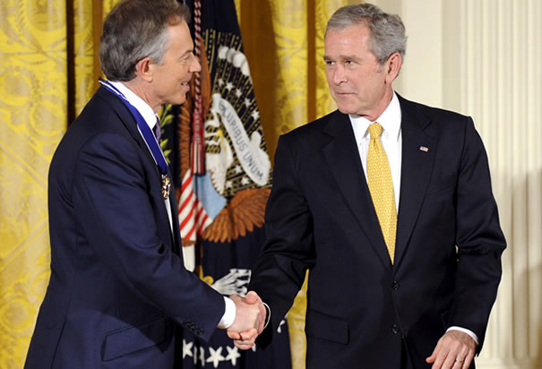
While those inspections were taking place, the U.S. government began working on building a coalition of nations to invade Iraq if necessary.

Slide 27
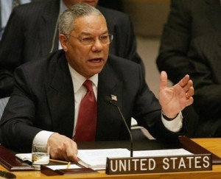
To that end, in February 2003 Sec. Of State Colin Powell appeared before the United Nations Security Council and laid out America’s case.

Slide 28
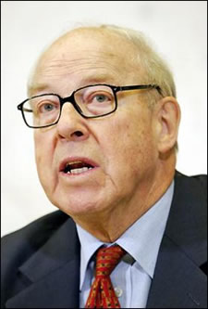
The following month, March, 2003, Chief U.N. weapons inspector Hans Blix returned from Iraq with the news that after careful investigation, the U.N. had been unable to find any evidence of WMDs or a nuclear program in Iraq.

Slide 29
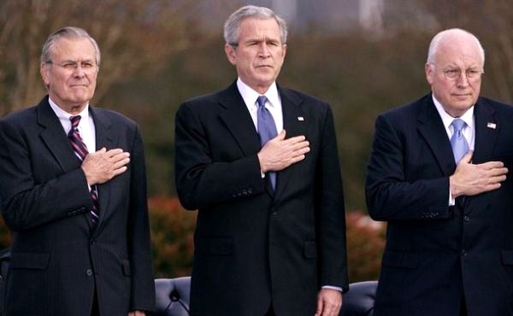
This did not stop the call for war from the Bush administration. They argued that Hussein was simply hiding them.

Slide 30
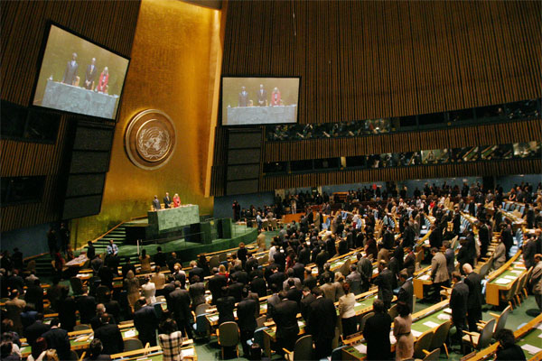
The U.N. refused to issue formal sanctions against Iraq and protested America’s push for war.

Slide 31
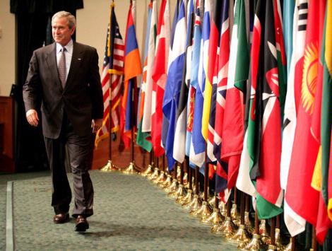
Undeterred, the U.S. formed a coalition with Great Britain, Australia, Denmark, and Poland.

Slide 32
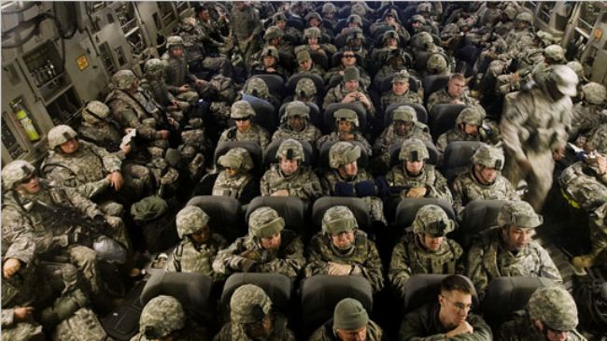
By March 1, 2003 125,000 American and 45,000 British troops were stationed in Kuwait awaiting the invasion of Iraq.

Slide 33
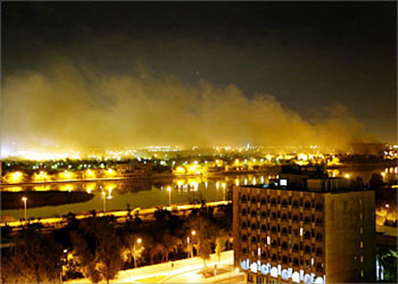
On March 19th, 2003 it began.

Slide 34
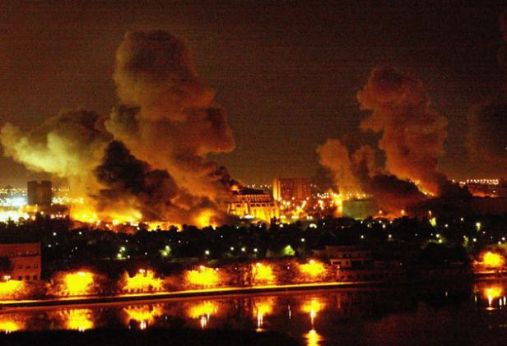
The Navy and the Air Force unleashed a massive bombing campaign targeting the Iraqi military and Hussein’s government. The following day, ground troops poured into Iraq.

Slide 35
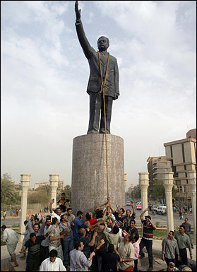
Within three weeks the U.S. army occupied the capital of Baghdad.
Saddam Hussein and his supporters had fled.

Slide 36
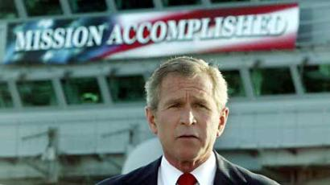
On May 1, 2003 President Bush travelled to the aircraft carrier U.S.S. Abraham Lincoln and declared that major military operations in Iraq were over.

Slide 37
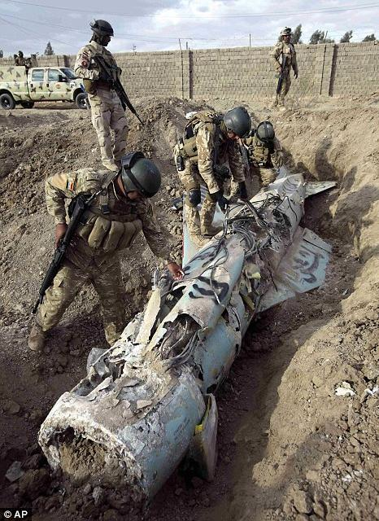
As the invasion got underway in March, the CIA began scouring Iraq to find the alleged Weapons of Mass Destruction.
They couldn’t find any.
They never found any.

Slide 38
Failing to find any WMDs, the American mission became building up a democracy for the people of Iraq.

Slide 39
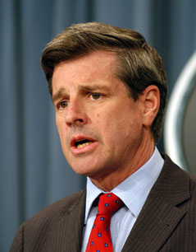
To that end, the United States set up a temporary government led by American L. Paul Bremer.
Bremer’s job was to put together a democratic government and oversee the transition of power from the U.S. military to an Iraqi government.

Slide 40
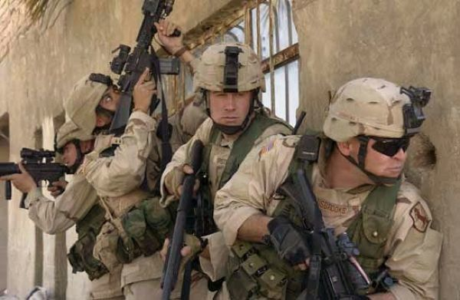
Very quickly, and number of things started to go bad.

Slide 41
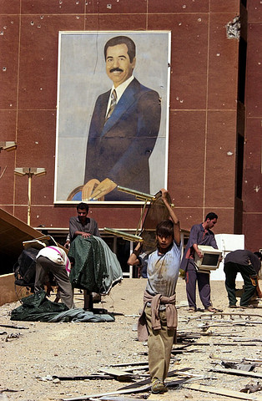
After Hussein fled, and before Bremer could set up control, no one maintained order.
Billions of dollars worth of money, weapons, supplies, art, electronics, etc. were stolen first from the government, then from everywhere.
Problem?

Slide 42
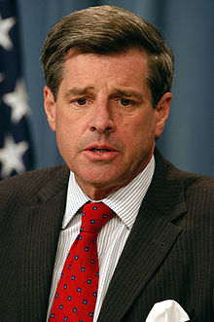
The Ba’ath party had held the power in Iraq since 1968.
In order to convince the Shiite majority that things were different, Bremer prohibited all members of the Ba’ath Party from participating in the new government.
Problem?

Slide 43
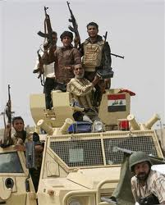
To continue that policy, Bremer next disbanded the Iraqi military, essentially firing all remaining soldiers.
While a new group of, mostly Shiite soldiers were trained, the formers soldiers went home, often with their guns.
Problem?

Slide 44
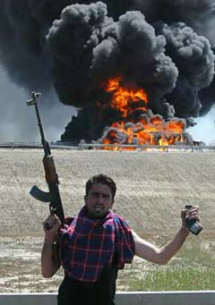
In this atmosphere an insurgency began to grow. It was built from a variety of groups:
- Sunnis who were upset at their new lack of power.
- Shiites who wanted revenge on Hussein and the Sunnis.
- Al-Qaeda, who hope to use the death in Iraq to inspire more hatred of America.

Slide 45
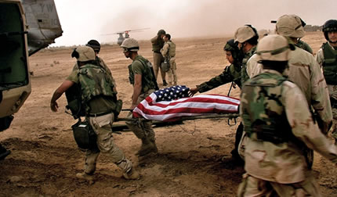
By November, 2003 American soldiers faced daily attacks from suicide bombers, roadside bombs, and any number of looters, criminals, etc…

Slide 46
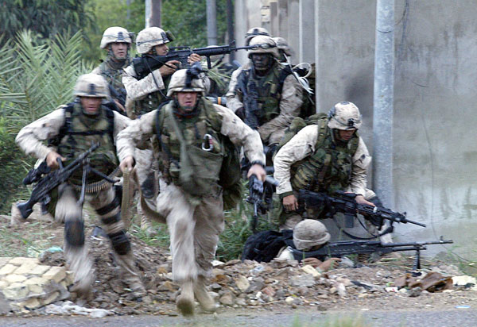
Things continued that way for the next 7 years, while various attempts were made to set up a stable Iraqi government.

Slide 47
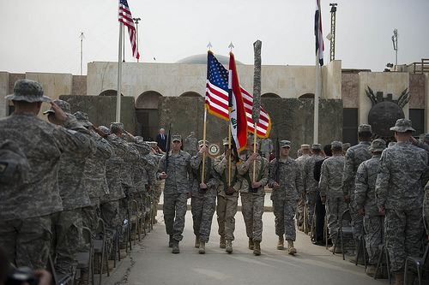
U.S. forces left Iraq in August, 2011.

Slide 48
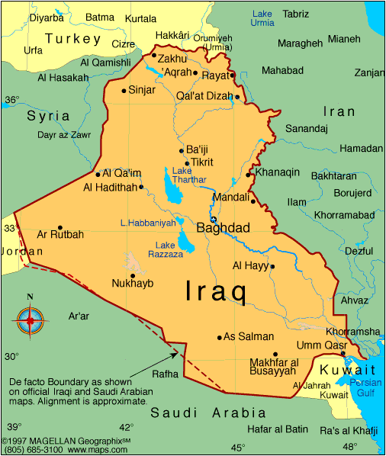
What has been accomplished?
- Saddam Hussein was removed from power. He was captured by U.S. forces in December 2003, and executed by the Iraqi government in in 2006.
- Iraq has a democratic government.
- Al-Qaeda in Iraq has been decimated, although some argue Al-Qaeda never would have been in Iraq if the U.S. hadn’t invaded.

Slide 49
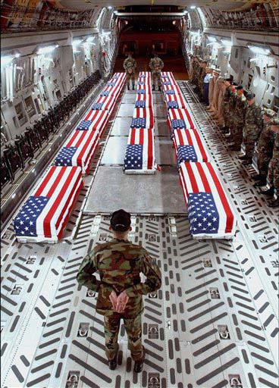
The Cost
- $ 800,000,000,000
- 4,486 U.S. soldiers killed
- 33,184 U.S. soldiers wounded
- Over 110,000 Iraqi civilians killed
- Loss of focus in Afghanistan

Slide 50
Fin.

