Slide 1
Why did
the
Cold War
start?

Slide 2
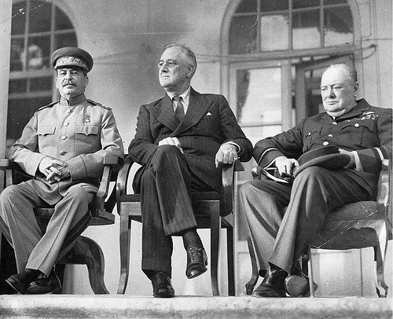
The U.S. and Soviet Union (AKA USSR / Russia) had been allies during WWII. But, as we have suggested, even before the war was over, distrust was growing.

Slide 3
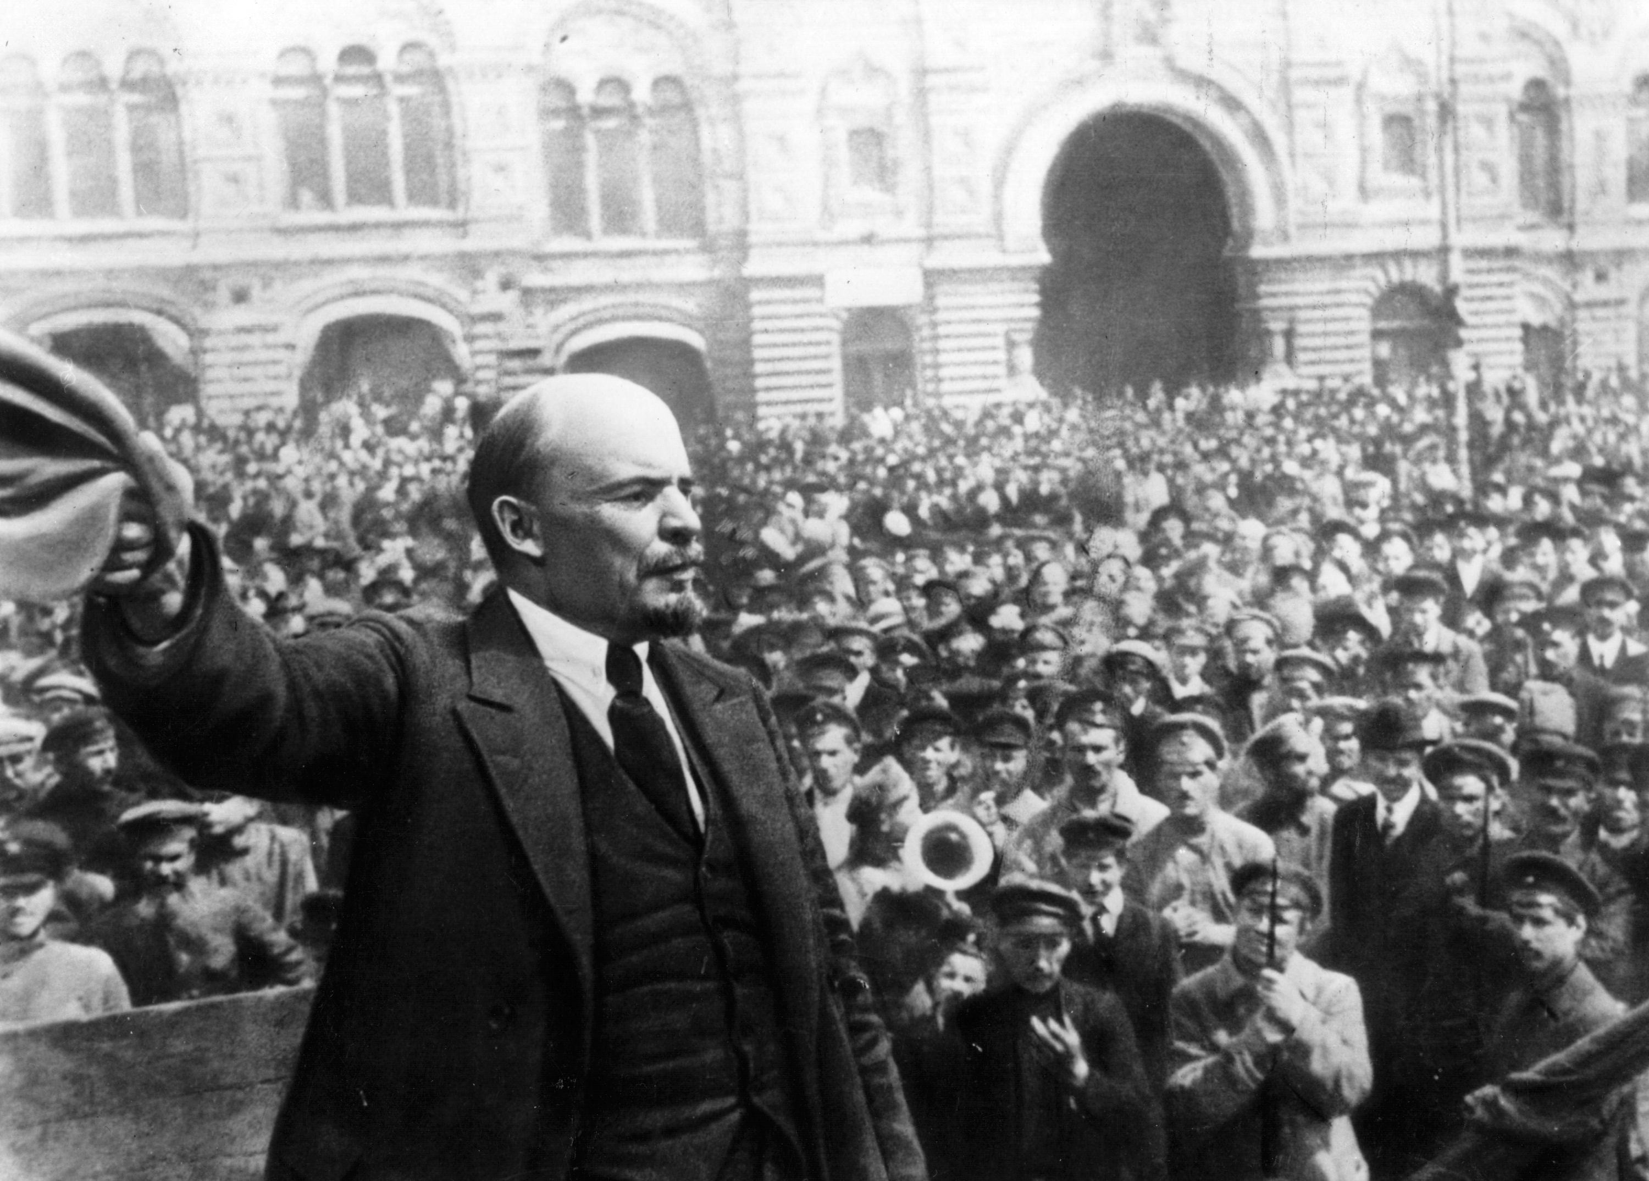
Tension had begun as early as 1917 when Vladimir Lenin brought his version of communism to Russia, eventually creating the Soviet Union.

Slide 4
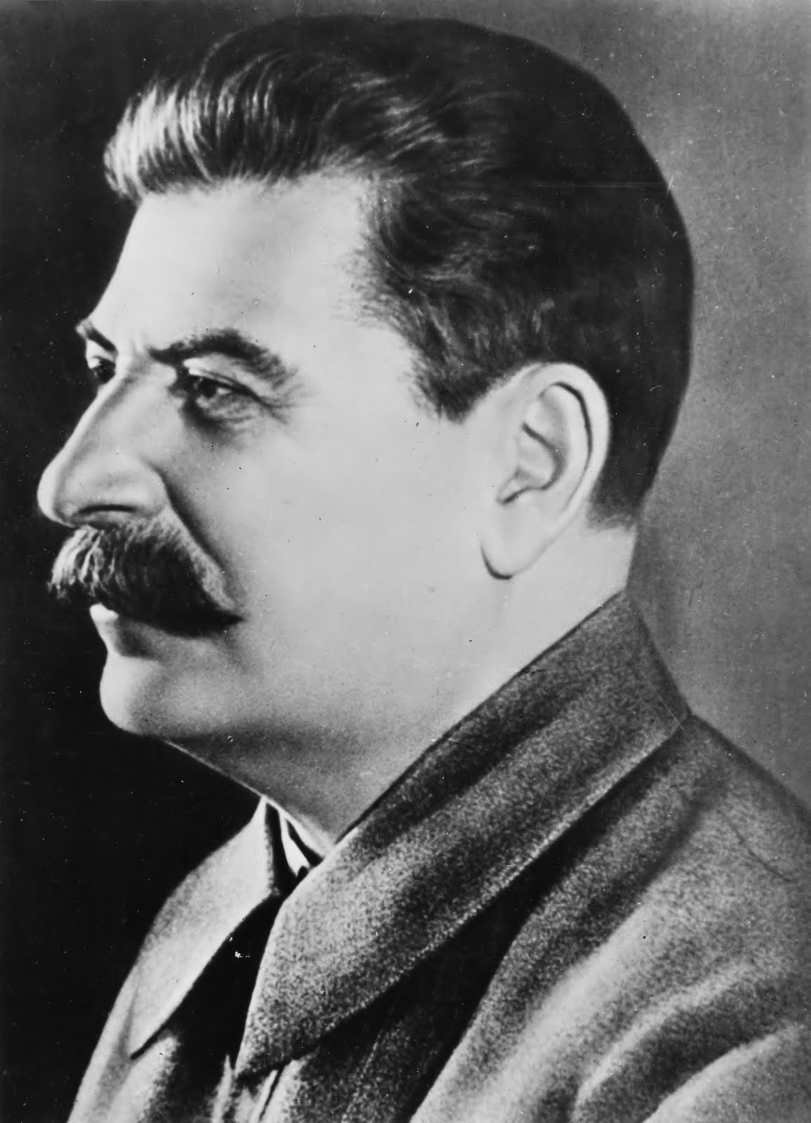
That tension further increased when Joseph Stalin came to power in 1924.

Slide 5
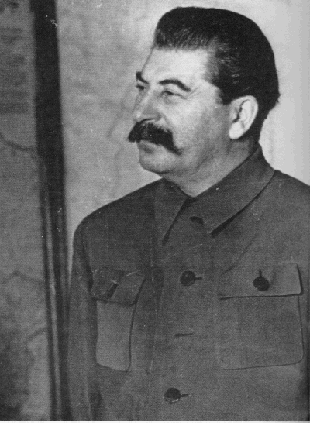
The nation Stalin took over was relatively weak.
It was a nation still based primarily on agriculture and many people lived in very poor conditions.

Slide 6
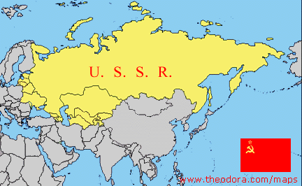
Stalin immediately set out to change that, hoping to turn the Soviet Union into an international power based on industry.

Slide 7
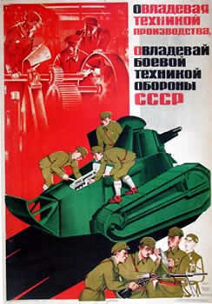
In 1928 he put in place a series of “5 year plans” designed to industrialize the Soviet Union as quickly as possible.
At the conclusion of the second “5 Year plan” in 1938, the Soviet Union was the 2nd most powerful economy in the world.

Slide 8
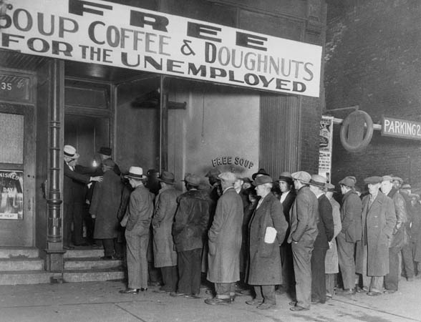
This unprecedented economic success terrified the American government, especially in the 1930’s. Why?

Slide 9
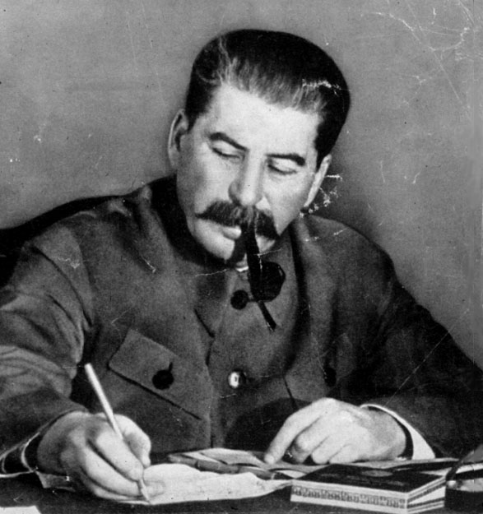
Stalin was incredibly proud that his “communist” country had seen an economic boom, while the rest of the capitalist countries of the world were experiencing a crippling economic depression.

Slide 10
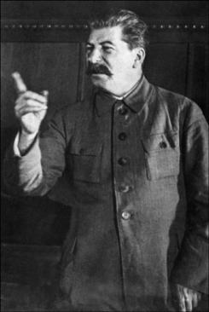
America also hated the Soviet Union because they lacked democracy.
- Joseph Stalin was a brutal dictator who ruled the USSR with an iron fist.
- Those who opposed his rule or spoke out against him “disappeared.”
- There was very little freedom or liberty for the Soviet People.

Slide 11
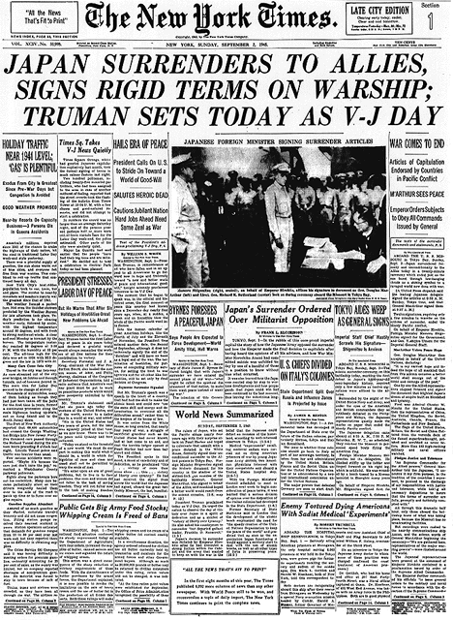
This underlying animosity between the US and the Soviet Union broke out into the open when WWII was over.

Slide 12
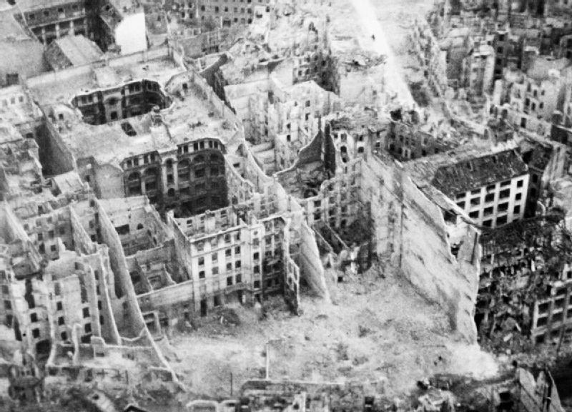
The US became increasingly concerned that the people of Europe might embrace communism in light of the devastation and suffering brought on by the war.

Slide 13
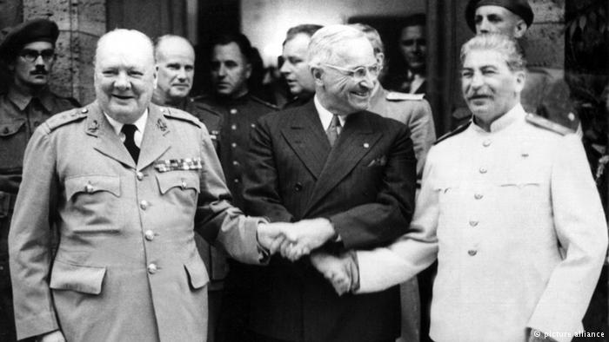
Additionally by July, 1945 at Potsdam, it became clear to President Truman that Stalin was not going to keep all of the promises he had made at the Yalta Conference in February.

Slide 14
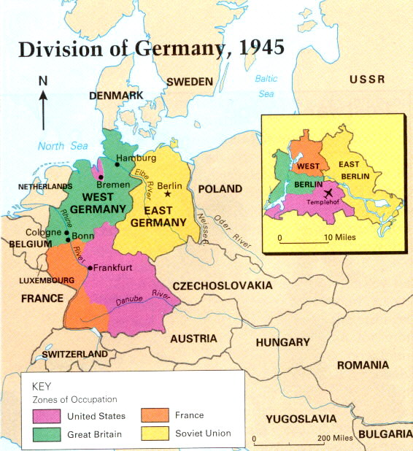
At Yalta, the big three had agreed to temporarily divide Germany into four zones of occupation.
This happened when the war in Europe was over.

Slide 15
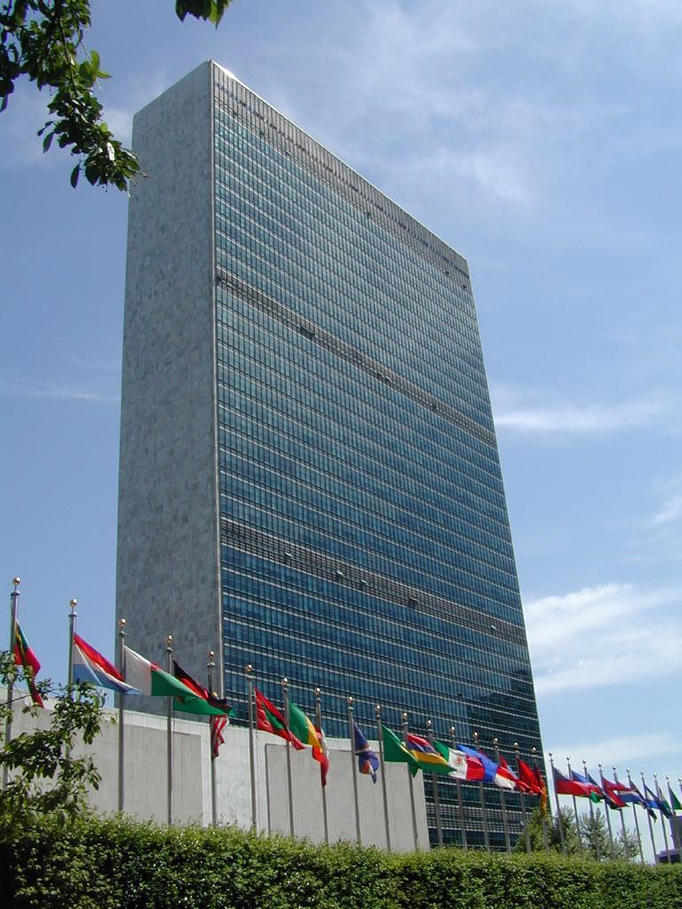
The big three had also agreed to form the United Nations which was intended to serve as a world forum where all the nations of the world could settle their disputes, and maintain world peace and stability through diplomacy.

Slide 16
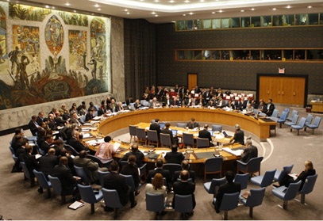
This happened too. The U.N. was created in 1945.

Slide 17
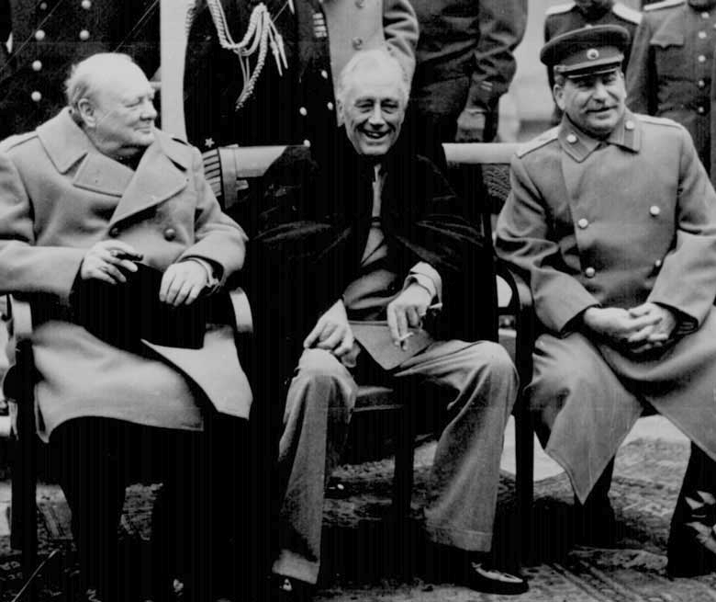
Most importantly, they also agreed to allow the nations of Europe to hold free, democratic elections when the war was done.

Slide 18
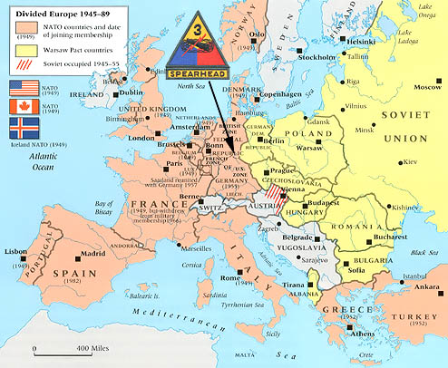
When the Nazis were defeated in May, 1945, Stalin changed his mind and did not allow such elections to happen.

Slide 19
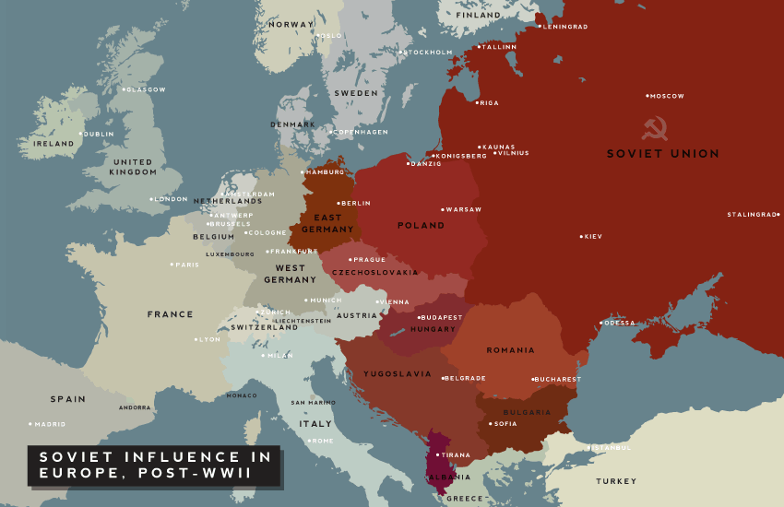
Instead, Stalin decided to keep the nations of Eastern Europe under Soviet control.

Slide 20
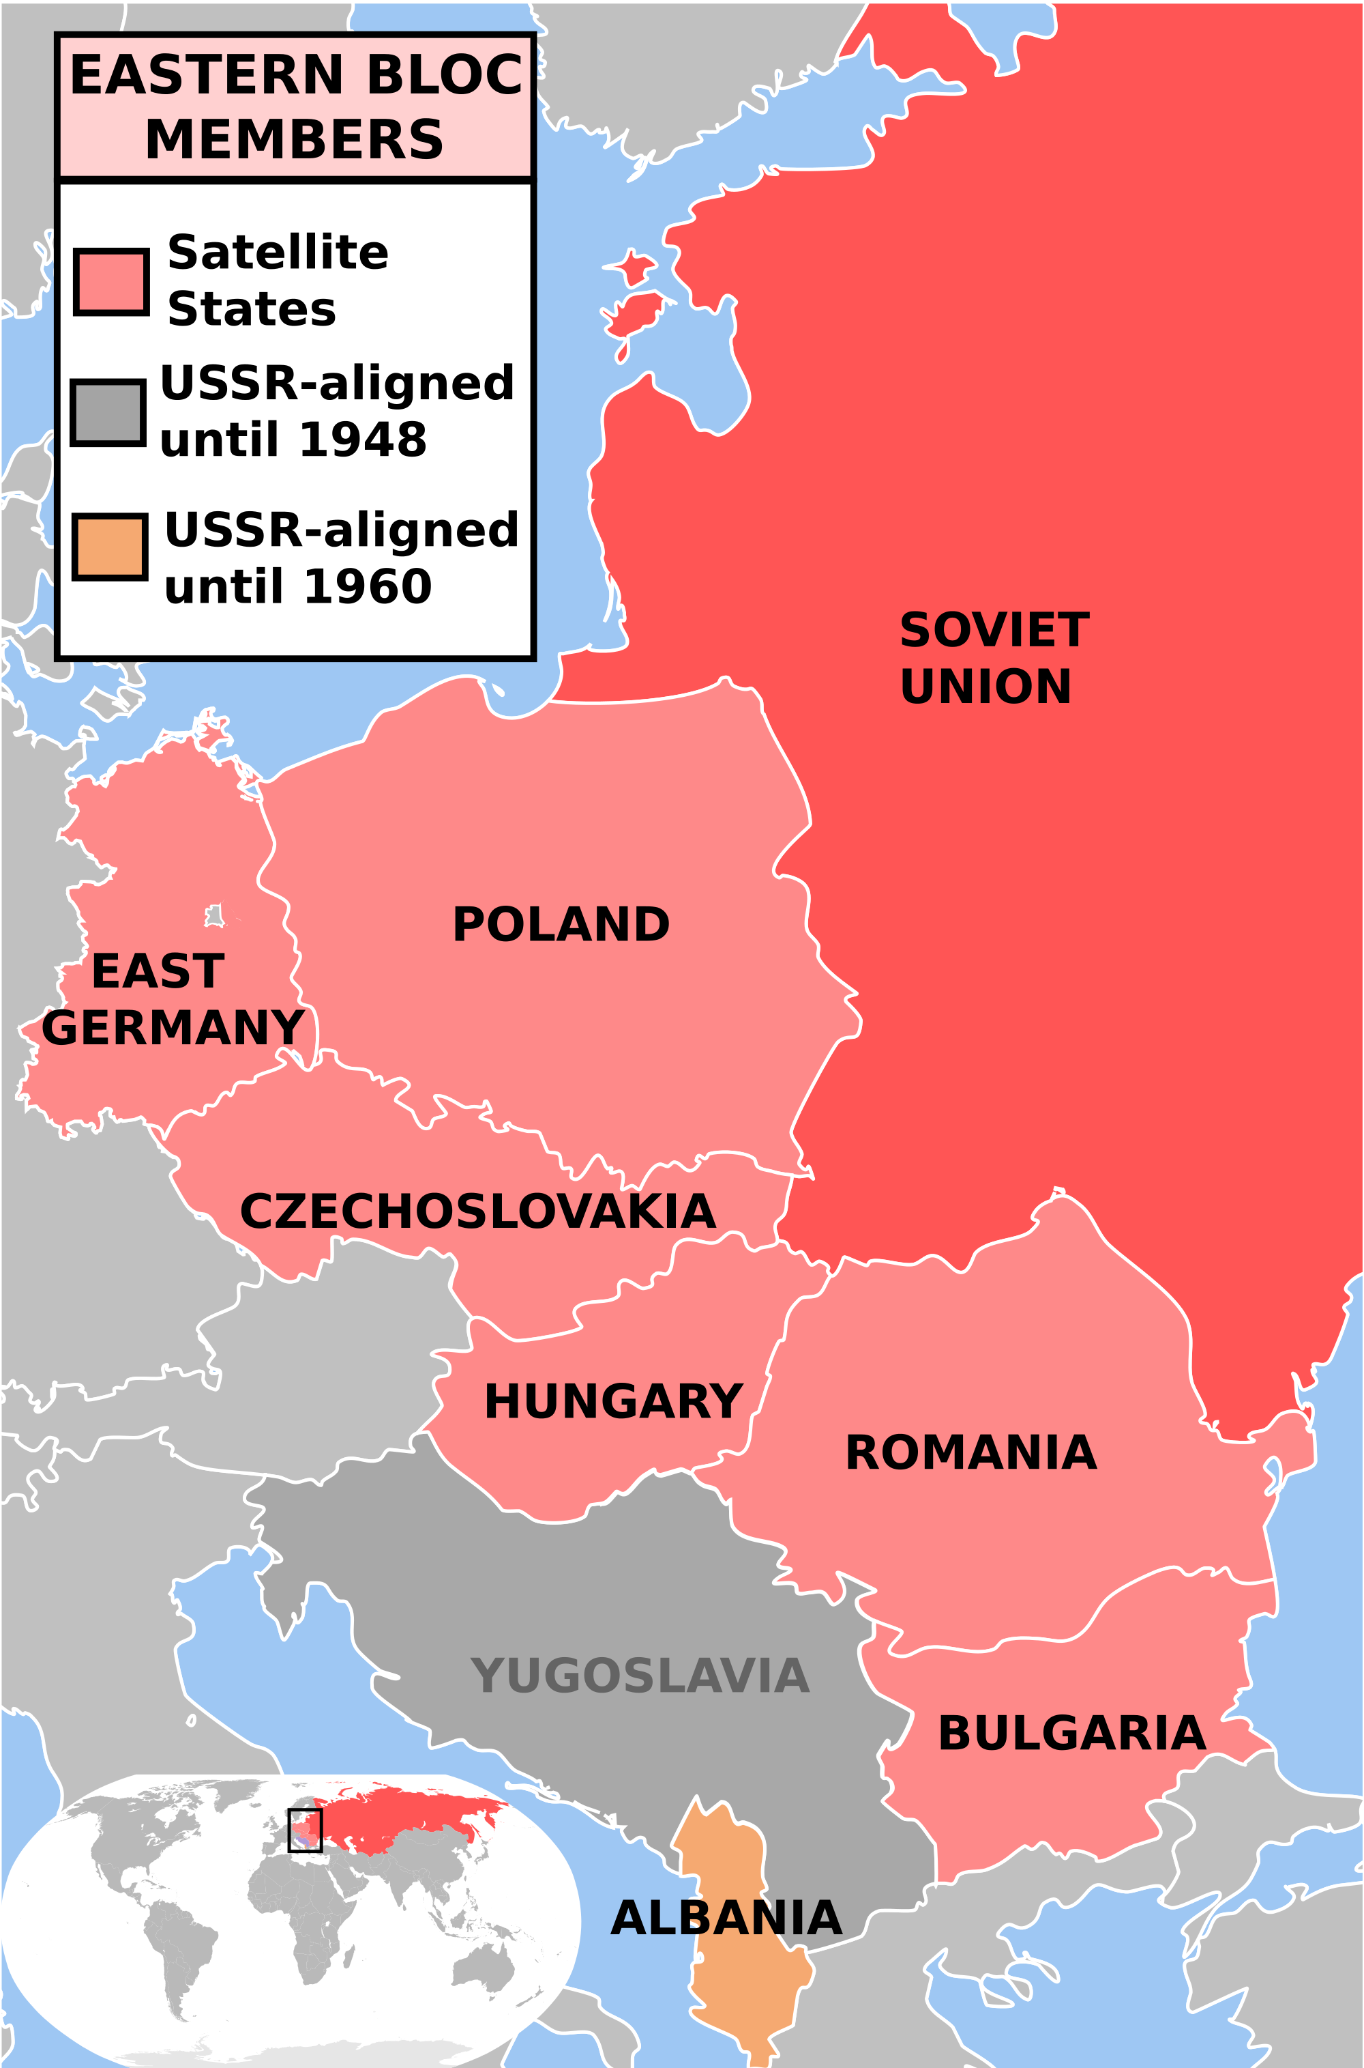
In keeping Eastern Europe under Soviet domination, Stalin created what came to be known as the Iron Curtain, or the Communist Bloc.

Slide 21
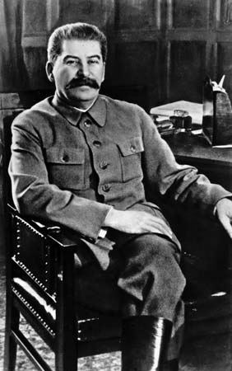
Stalin’s reasons for taking such action were pretty straight forward:
- Hoped to encourage the spread of communism, either by the will of the people or by force if necessary.
- Planned to rebuild his own war-ravaged economy using materials and money from E. European nations.
- Wanted a physical and psychological buffer between the Soviet Union and the West.

Slide 22
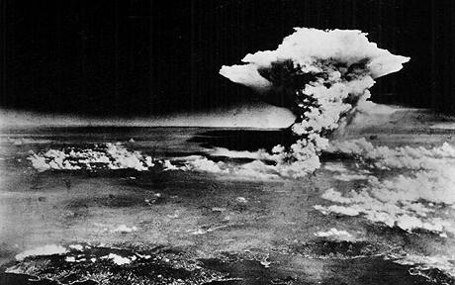
Remember that Stalin’s actions in Eastern Europe were in part responsible for Truman’s decision to use the atomic bomb on Japan.

Slide 23
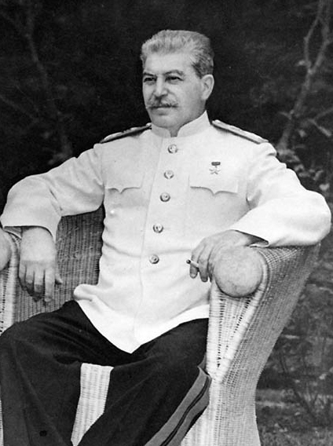
That decision had a huge impact on Stalin and his relationship with America.
- He was initially scared by this new weapon and backed off of plans to expand Soviet influence over large sections of Asia.
- However, he also quickly ordered his military to get the bomb for the Soviet Union.

Slide 24
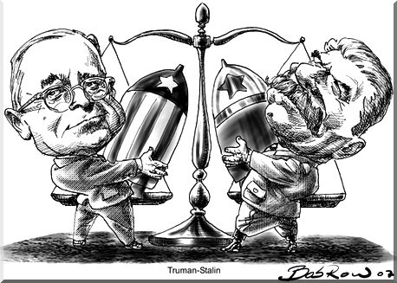
By 1949, the Soviet Union got the bomb too. America had lost its advantage and was forced to compete with the USSR for nuclear domination.

Slide 25
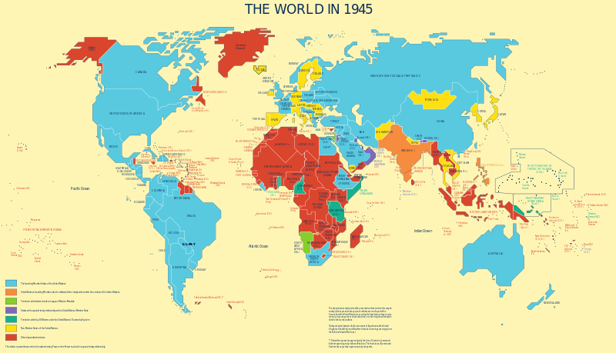
Competition between the two had a lot to do with how both nations envisioned the post-war world.

Slide 26
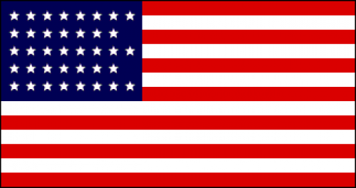
America had three basic ideas about what needed to happen:
- Hoped for a new world order in which all nations enjoyed democracy and self determination
- Hoped to rebuild European nations to ensure stability and to promote trade with American businesses.
- Wanted a unified Germany, believing that only a productive, prosperous Germany would lead to lasting peace.

Slide 27
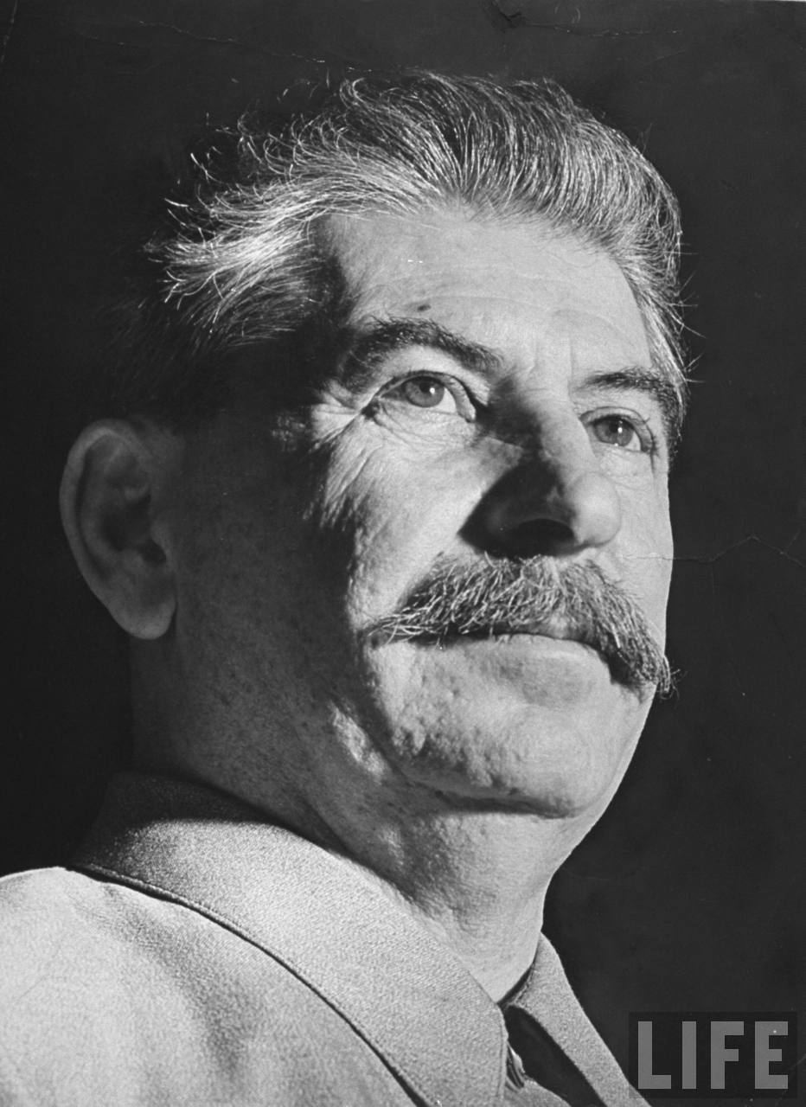
Given his actions, Stalin had a much different idea.
- Exploit Eastern European nations which would technically be free. They would have their own governments, but those governments would take orders from the Soviet Union.
- Keep Germany divided and weak so that they wouldn’t cause any more trouble.

Slide 28
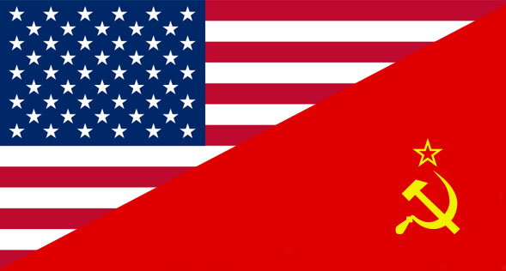
Ultimately, the Cold War began over a clash of ideology.
- The Soviet Union was, at least for our purposes here, a Communist nation.
- America was, at least for our purposes here, a capitalist nation.
- Those two systems are at opposite ends of the spectrum

Slide 29
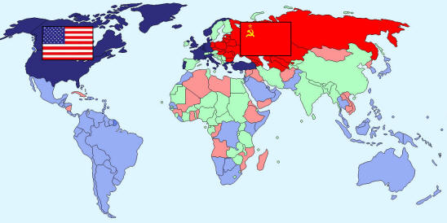
Most importantly the U.S. and Soviet Union believed that their system was best and that it should dominate the world.

Slide 30
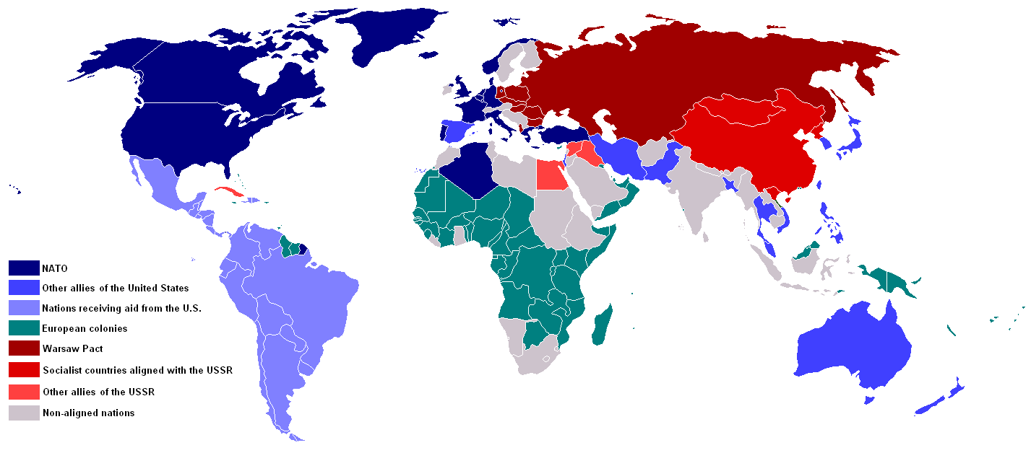
During the Cold War (1946-1991), pretty much every other country of the world had to pick a side: America and capitalism vs. the Soviet Union and communism.

Slide 31
Fin.

