Slide 1
John
Kennedy
and the
Cold War

Slide 2
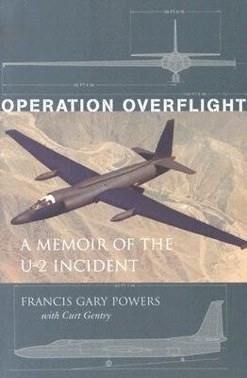
When we last left off talking about the Cold War, we had suggested that tension between the U.S. and the Soviet Union was at an all time high in 1960 as a result of the U-2 incident.

Slide 3
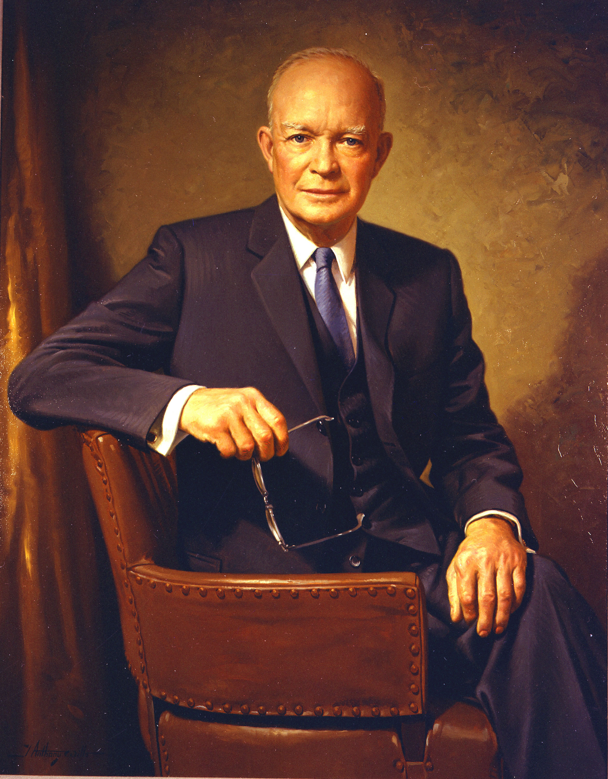
We had also suggested that President Eisenhower had adopted a policy of “brinksmanship.”
What exactly was this?

Slide 4
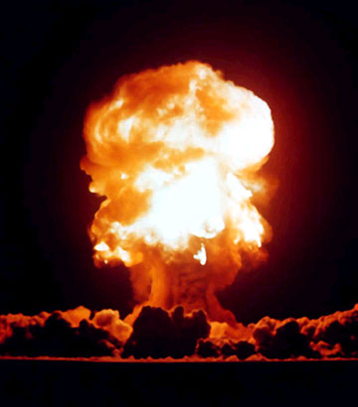
What were the possible problems with adopting such a strategy?

Slide 5
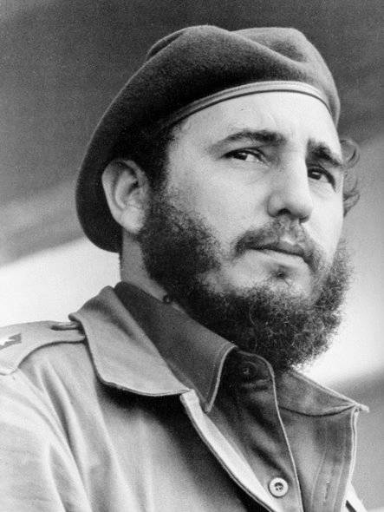
In 1959, Fidel Castro rose to power in Cuba, leading a popular uprising against a corrupt, U.S. supported, capitalist government.
Castro won the support of the Cuban people by promising to end inequality and poverty.

Slide 6
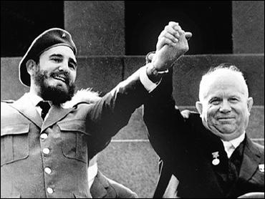
Shortly after taking power, Castro placed businesses and farmland under direct government control, creating a communist nation. He then moved to ally Cuba with the Soviet Union and their leader Nikita Khrushchev.

Slide 7
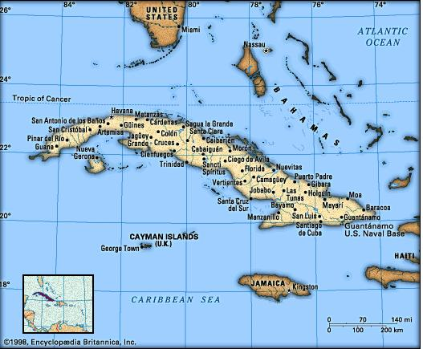
Americans were shocked and outraged. Now there was a communist nation just 90 miles from the United States!

Slide 8
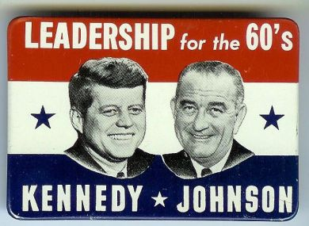
The problem of what to do about Cuba largely fell to John F. Kennedy who was elected to the presidency in November, 1960.

Slide 9
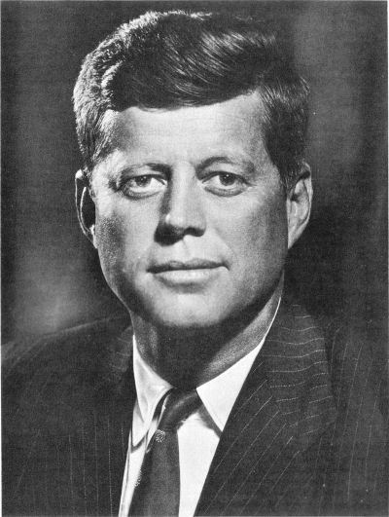
Kennedy was immediately worried that with a communist, Soviet ally so close to the U.S. things might get out of hand.
If that happened, what would likely result from Pres. Eisenhower’s approach?

Slide 10
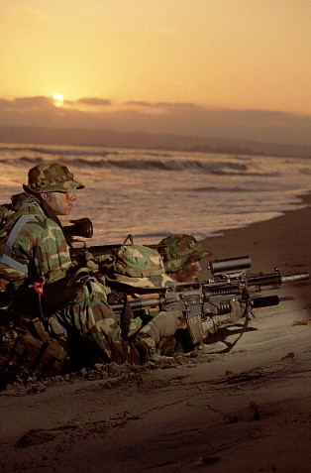
To replace brinksmanship, Kennedy advocated a plan known as “flexible response” that depended upon a variety of possible weapons which would be used according to the severity and importance of the event.

Slide 11
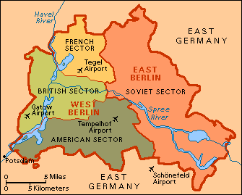
The importance of such a flexible response became clear as the world once again turned its attention to the city of Berlin.

Slide 12
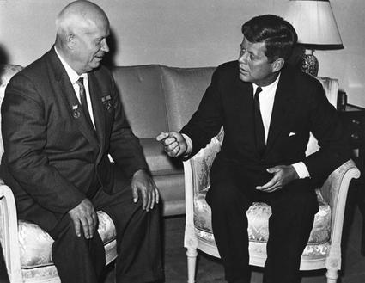
At a conference in Vienna in 1961, Khrushchev demanded that the U.S. and NATO withdraw their support from the capitalists in West Berlin. Why?

Slide 13
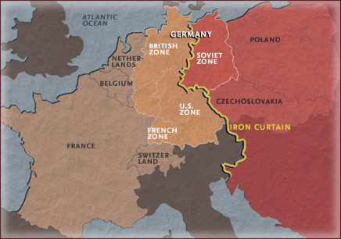
People from across Soviet controlled Eastern Europe were flocking to West Berlin. Why?

Slide 14
By July, 1961, over 1000 people a day would escape from communism by flying out of East Germany through airports in West Berlin.

Slide 15
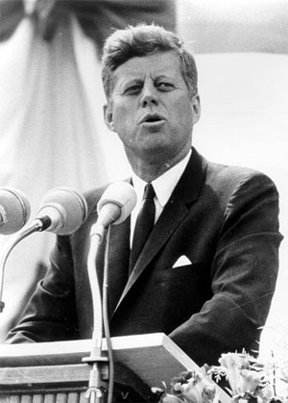
Kennedy and NATO flat out refused Khrushchev’s demand that they abandon West Berlin. In fact the President pledged even more support than before.

Slide 16
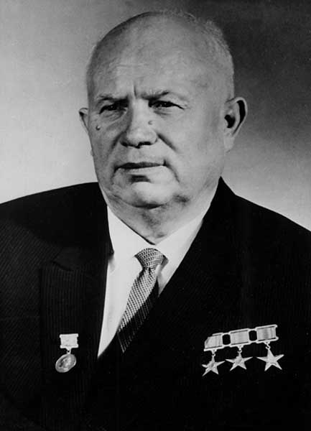
Khrushchev had failed to remove western influence from Berlin.
He still needed to stop the flow of people out of Eastern Europe.
So he ordered the East German government to begin construction of a barbed wire fence cutting off access from East to West Berlin.

Slide 17
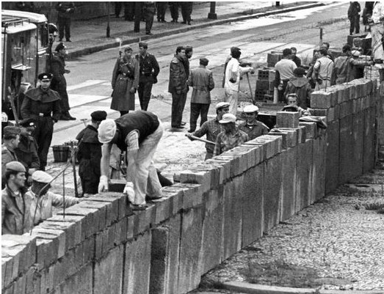
Work on a stronger, more permanent wall, was begun shortly thereafter.

Slide 18
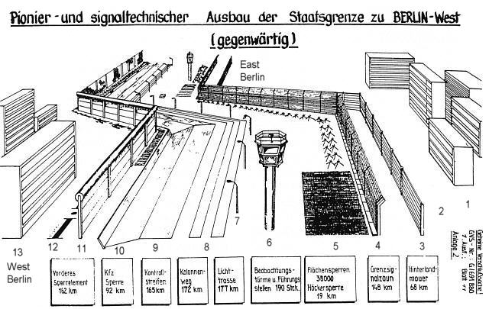

Slide 19
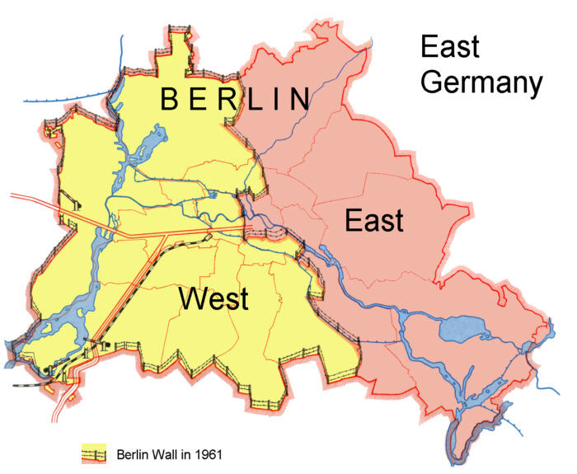

Slide 20
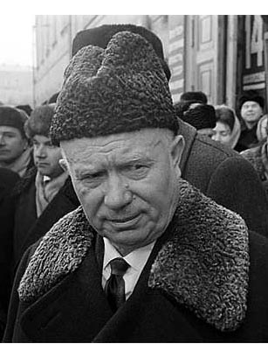
Once again, the U.S. was shocked, this time by the obvious oppression of Soviet communism on the people of West Berlin, and also on the people of their own allied nations.

Slide 21
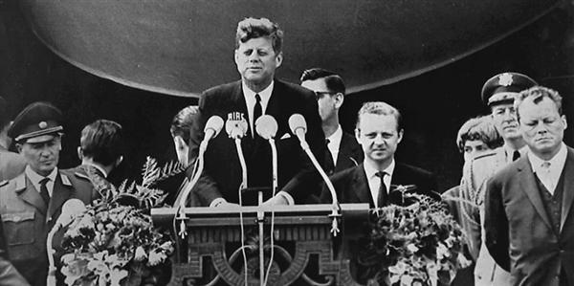
In 1963, President Kennedy travelled to West Berlin to pledge continued American support and to protest Soviet action. There he told the world “Ich bin ein Berliner.”

Slide 22
Kennedy’s biggest problem, however, remained Cuba.

Slide 23
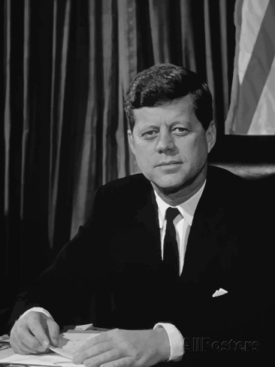
Cuba became a huge issue for Kennedy for two main reasons.

Slide 24
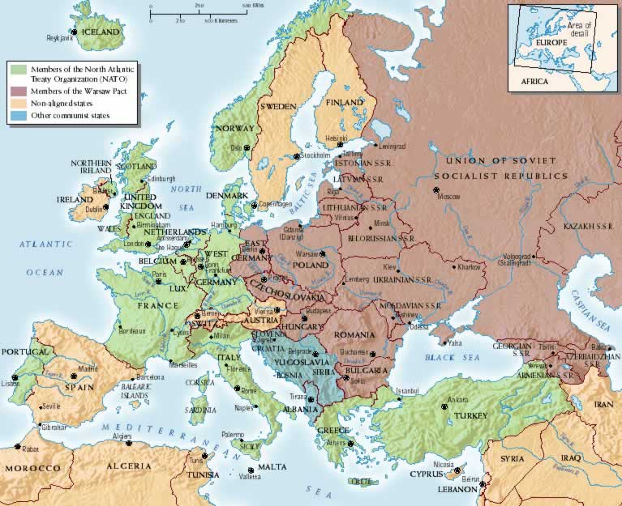
#1
In 1959, the U.S. placed nuclear missiles in Turkey.

Slide 25
#2
In 1961, the U.S. had supported an unsuccessful rebellion led by pro-U.S. Cubans against Fidel Castro.

Slide 26
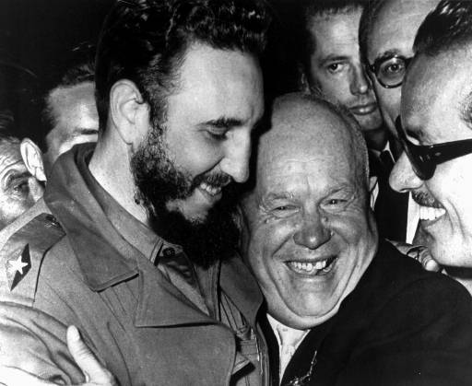
The Soviets grew increasingly worried about both the U.S. missiles in Turkey, and of another possible attempt to overthrow Castro and communism in Cuba.

Slide 27
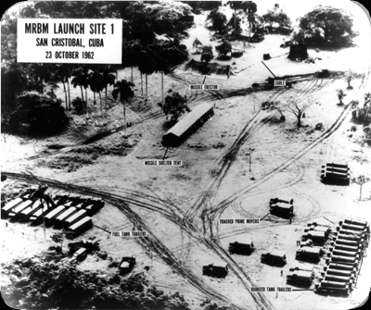
To deal with both of these problems, the Soviet Union placed nuclear missiles of its own in Cuba in September 1962.

Slide 28
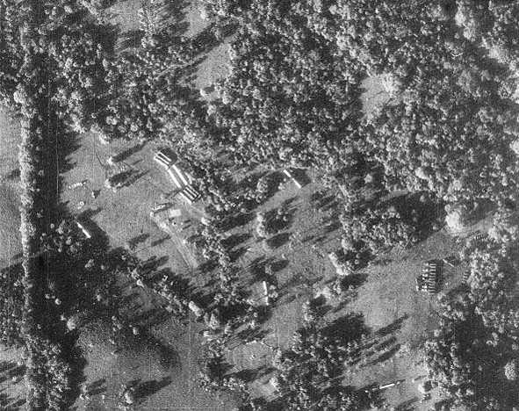
U.S. spy planes first noticed the construction of missile launch sites on October 14th and 15th.

Slide 29
The presence of Soviet nuclear weapons in Cuba was totally unacceptable to the American government.

Slide 30
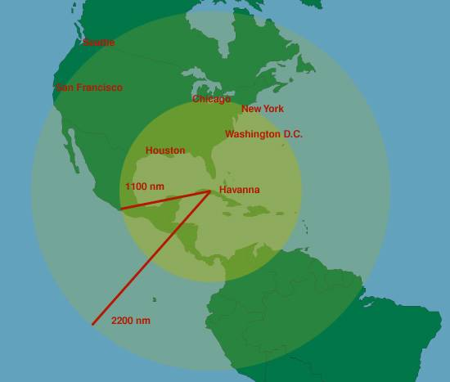
It also made an attack on the US far more dangerous.

Slide 31
Kennedy informed the public of the missiles in Cuba and told Americans that any attack by those missiles would result in an all out U.S. nuclear attack against the Soviet Union.

Slide 32
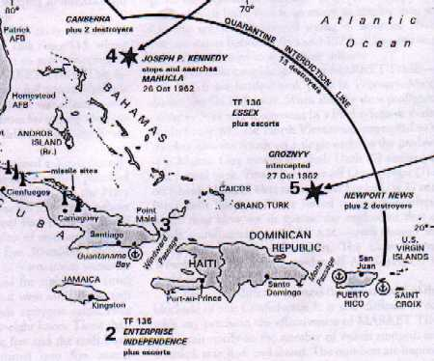
To prevent any more Soviet missiles from reaching Cuba, Kennedy ordered the U.S. navy to quarantine Cuba, not allowing any ships in or out.

Slide 33
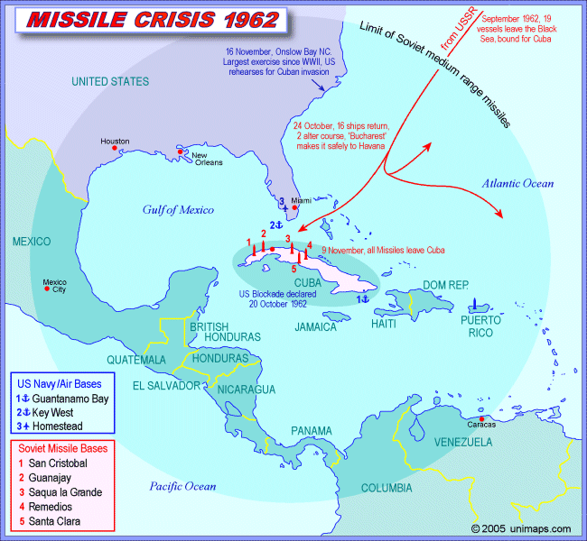
The problem was that there were already Soviet ships headed to Cuba. If those ships attempted to breach the U.S. quarantine . . .

Slide 34
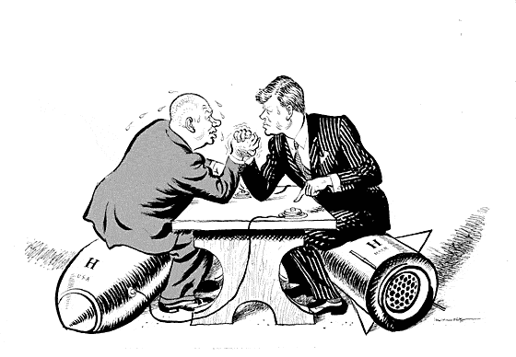

Slide 35
On October 26th, Khrushchev ordered the ships to stop and began to negotiate for and end to the crisis.

Slide 36
The Soviet Union agreed to remove all nuclear weapons from Cuba.

Slide 37
The U.S. agreed to not invade Cuba and remove Castro from power.

Slide 38
Kennedy also agreed to remove U.S. nuclear weapons in Turkey slowly over time.

Slide 39
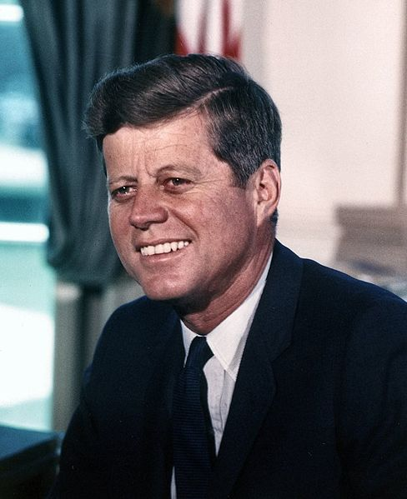
Kennedy, like Eisenhower before him, was also increasingly concerned about the spread of communism in a far away nation called Vietnam.

Slide 40
Fin.

