Slide 1
Early
American
Expansion

Slide 2
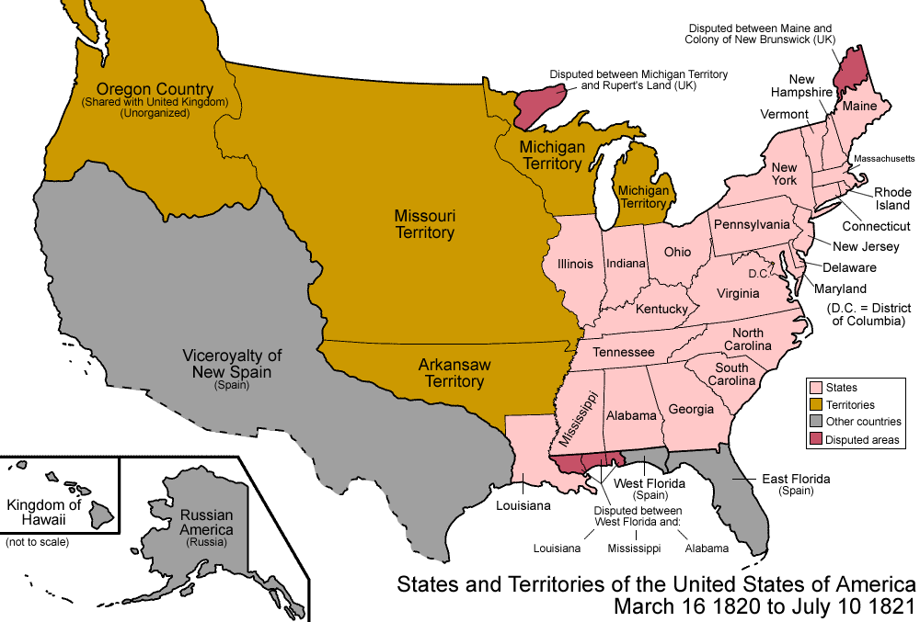
In the 1820’s, the United States attempted to stay out of foreign affairs as much as possible. This was due to two main factors.

Slide 3
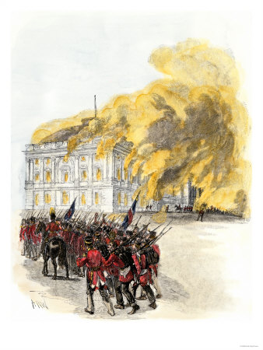
1. In 1820, the U.S. was fairly weak compared to Britain and France, the major powers of the time.
- We didn’t have a very powerful army or navy.
- We had won the War of 1812 against Britain, but only after they had invaded and burned Washington D.C. We didn’t want this to happen again.

Slide 4
2. The U.S. government and its people were more concerned with expanding across the continent of North America.

Slide 5
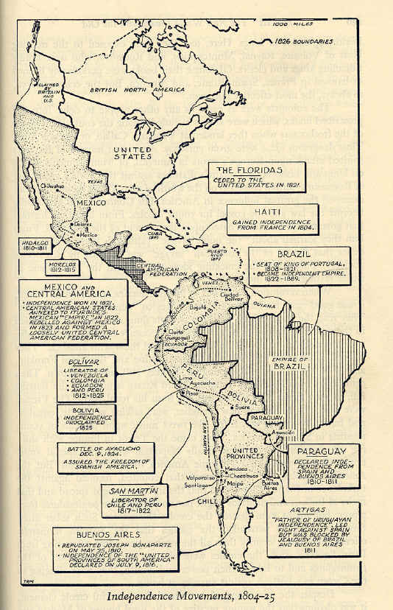
However, America was concerned about European nations like Britain, France and Spain.
Due to a series of wars occurring in Europe caused by Napoleon, a number of nations in Latin and South America gained their independence in the 1810’s.

Slide 6
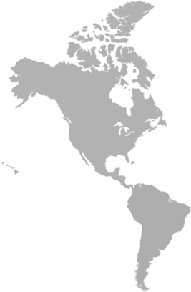
With those wars over in the 1820’s, the U.S. was concerned that the powers of Europe might try to take those colonies back, and cause trouble in America’s backyard.

Slide 7
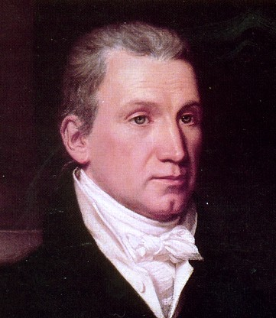
To deal with that concern, President James Monroe issued what came to be known as the Monroe Doctrine in 1823.

Slide 8
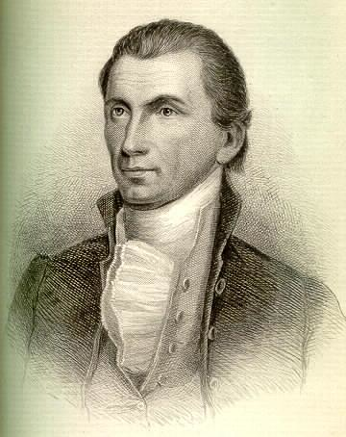
What exactly did he say?
1. Monroe warned all European powers to not interfere with the affairs of nations in the western hemisphere. As such, European nations should not try to reclaim, or create new, colonies.

Slide 9
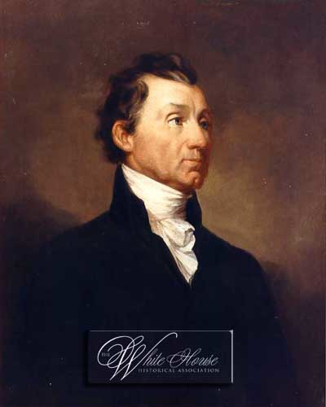
2. If a European nation did interfere in the western hemisphere, the U.S. would consider such action “dangerous to our peace and safety.”
3. At the same time, the U.S. would not involve itself in the affairs of European nations, or with existing European colonies in the western hemisphere.

Slide 10
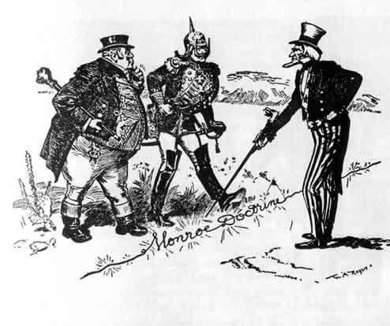
For the most part, both the U.S. government and European nations agreed to live by these rules, primarily because Britain, with its dominant navy, endorsed the Monroe Doctrine.

Slide 11
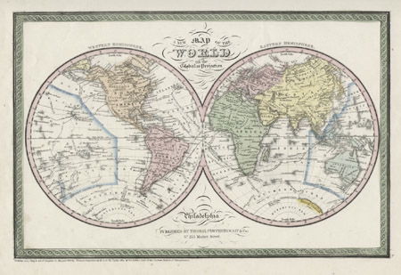
However, by the 1890’s American attitudes toward foreign policy began to change dramatically.

Slide 12
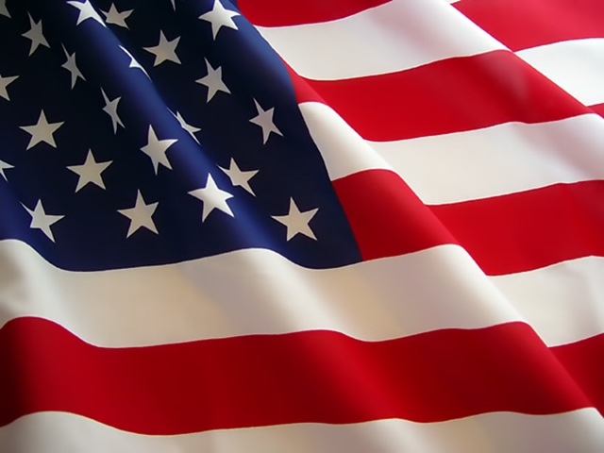
Four main factors caused Americans to support expanding beyond the nation’s borders.

Slide 13
1. The needs of American business and industry

Slide 14
1. The needs of American business and industry
Foreign markets
=
More customers
=
More profits!

Slide 15
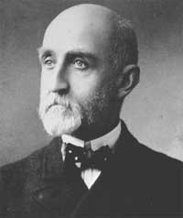
2. Military and Strategic Interests
Alfred T. Mahan → The Influence of Sea Power on History: 1660-1783
Mahan argued that American needed to expand its military and its global presence to protect the homeland and growing American commercial interests.

Slide 16
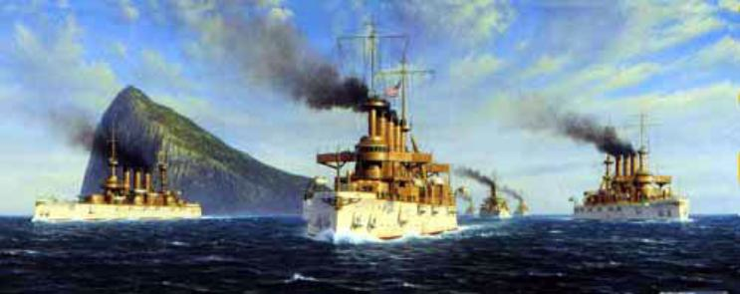
Congress agreed and ordered the expansion of the U.S. navy. What emerged was the one of the most modern navies in the world. American’s ships would come to be known as the “Great White Fleet.”

Slide 17
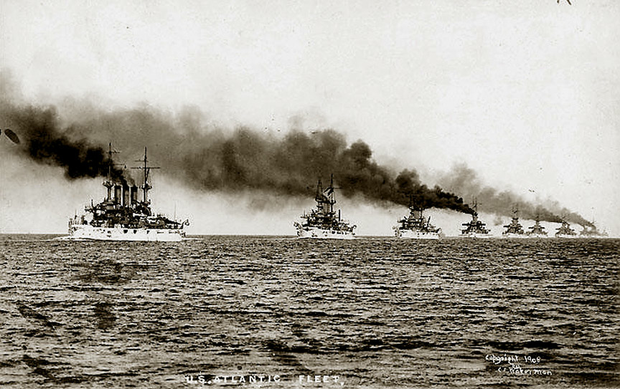

Slide 18
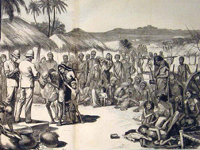
3. Social Darwinism

Slide 19
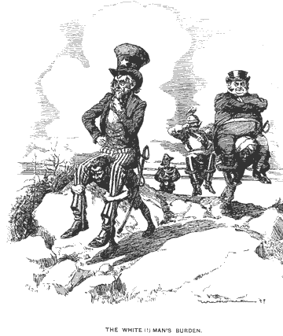
According to the theory, white people in general, and Americans specifically, were destined to dominate the world.

Slide 20
Source: Josiah Strong, Our Country: Its Possible Future and Its Present Crisis
…It seems to me that God, with infinite wisdom and skill, is training the Anglo-Saxon race for an hour sure to come in the world’s future….The unoccupied arable lands of the earth are limited, and will soon be taken. Then will the world enter upon a new stage of its history----the final competition of races, for which the Angle-Saxon is being schooled…. Then this race of unequalled energy, with all the majesty of numbers and the might of wealth behind. . .will spread itself over the earth…. If I read not amiss, this powerful race will move down upon Mexico, down Central and South America, out upon the islands of the sea, over upon Africa and beyond. And can any one doubt that the result of this competition of races will be the “survival of the fittest”?

Slide 21
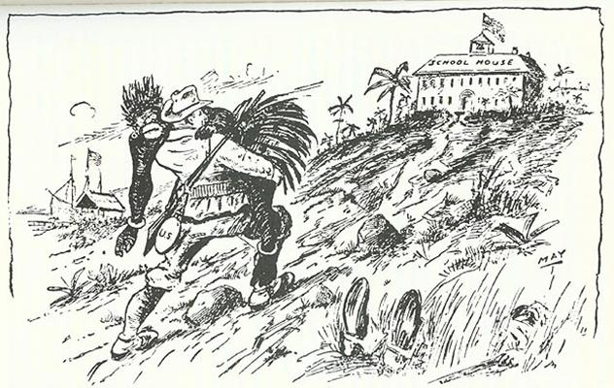
4. “The White Man’s Burden”

Slide 22
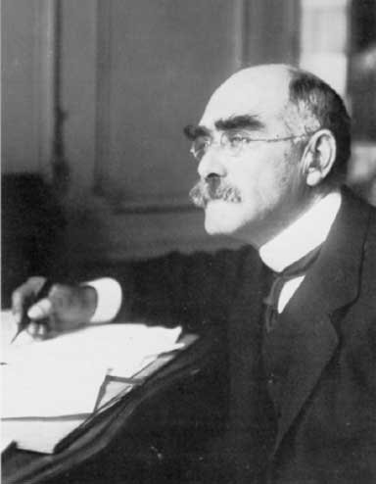
In 1899, poet Rudyard Kipling wrote a poem “The White Man’s Burden” as a social commentary on what he saw happening around the world.

Slide 23
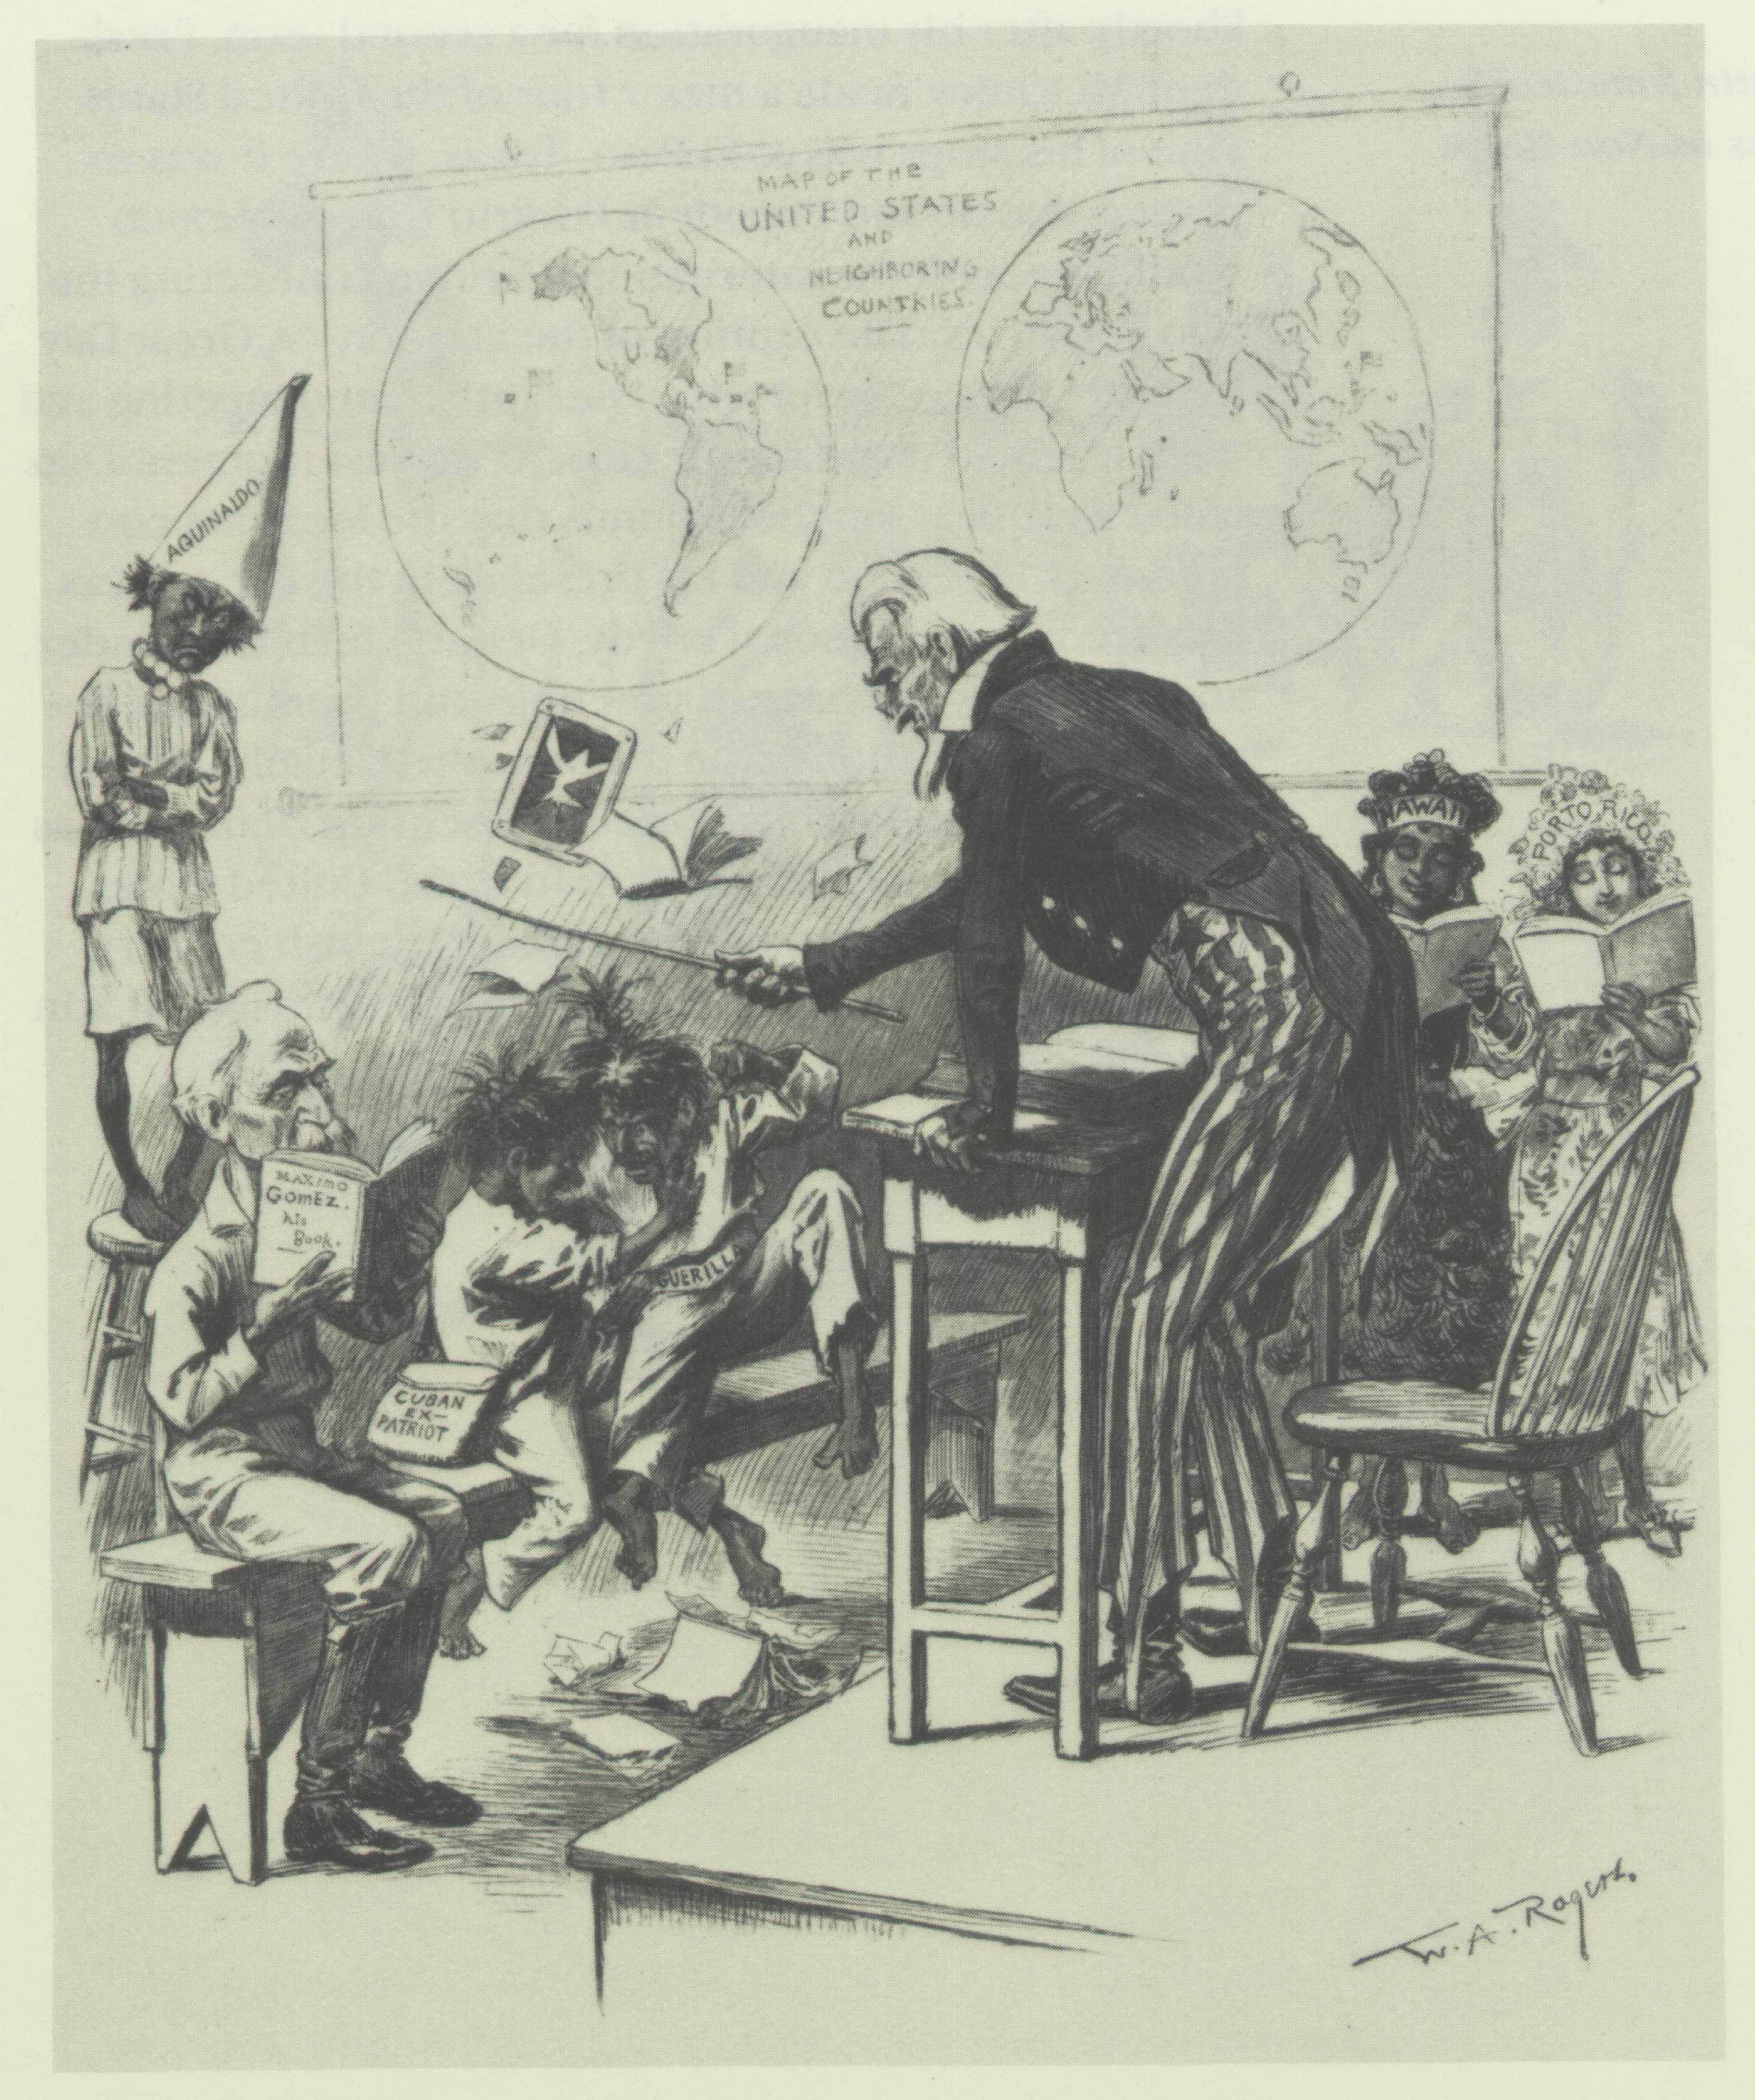
American expansionists used ideas in the poem to argue that it was okay for America to dominate other people because we would them help them make something of themselves.

Slide 24
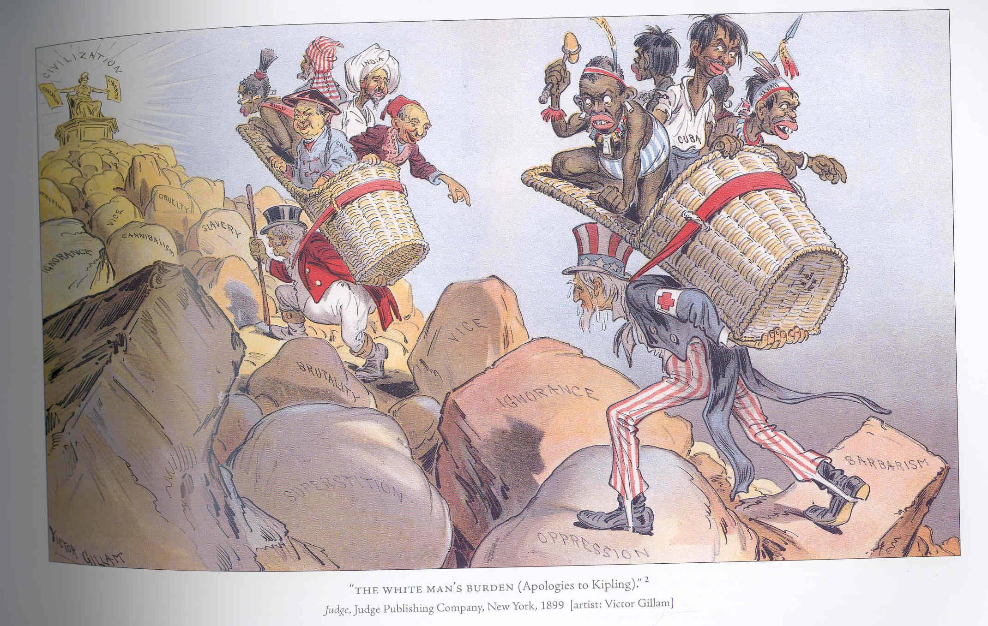

Slide 25
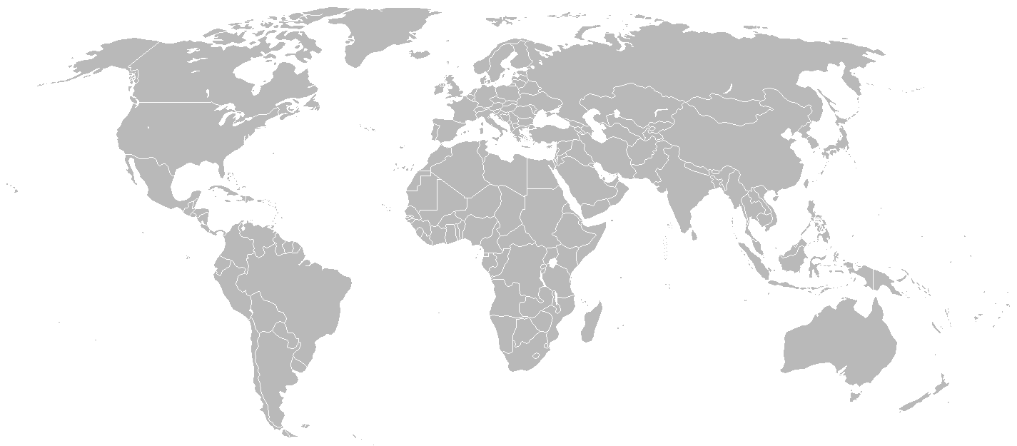
Where did American Imperialists first look to for expansion?

Slide 26
Hawaii

Slide 27
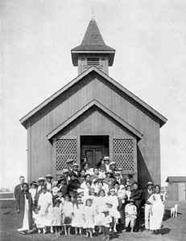
Missionaries had been in Hawaii since the late 1820’s, trying to spread Christianity to the native population.

Slide 28
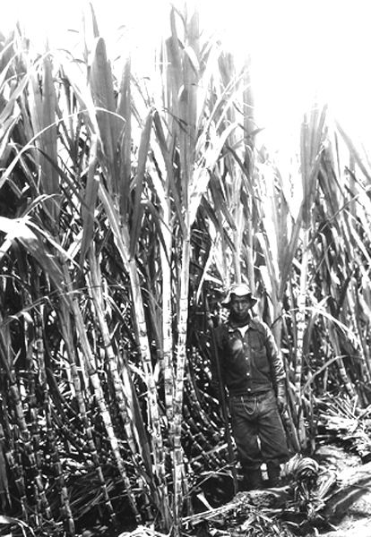
American business men poured into Hawaii making fortunes in agriculture, primarily in growing sugar.
These missionaries and business men tied Hawaii to America economically and socially.

Slide 29
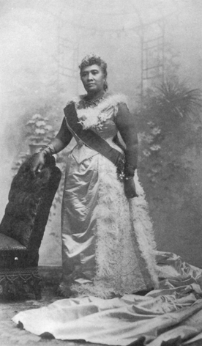
Over time, native Hawaiians grew increasingly concerned about the economic and political power white Americans had over their islands.
Natives, led by Queen Liliuokalani, moved to limit the power and access of American businessmen.

Slide 30
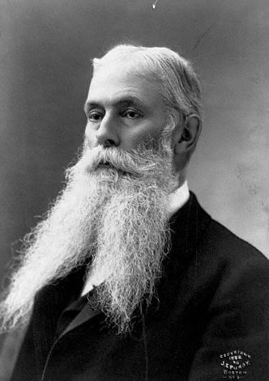
Businessmen, like Sanford B. Dole, were worried that the Queen might strip them of their money and rights.
They began to look for ways to remove her from power, and make Hawaii an official part of the United States.

Slide 31
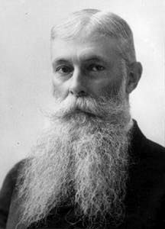
Dole, and others, also hoped to make Hawaii part of the U.S. for economic reasons as well.

Slide 32
The McKinley Tariff of 1890 placed taxes on goods imported into the U.S. from Hawaii.
This meant that Hawaiian goods, sold in America, would be more expensive.
Dole, and others knew that if Hawaii became part of the U.S., Hawaiian products would no longer be subjected to the tariff.

Slide 33
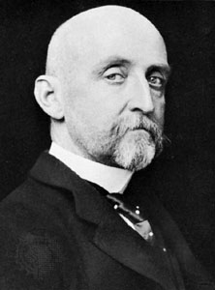
Alfred T. Mahan, and the U.S. navy also had its eye on Hawaii. Why?

Slide 34
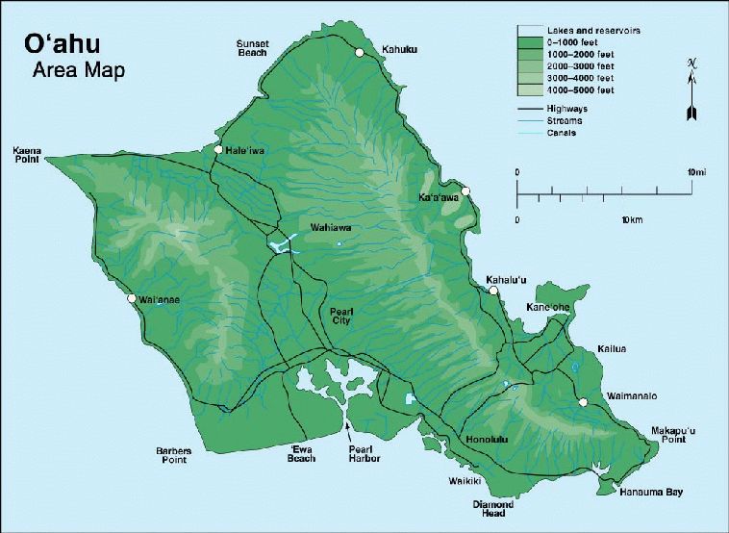

Slide 35
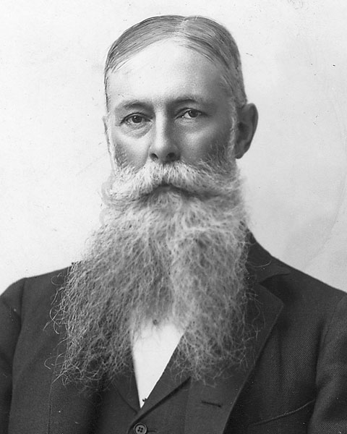
With secret help from the U.S. military, Dole, and the wealthy American business men of Hawaii, staged a coup against Liliuokalani and established the Republic of Hawaii in 1894.

Slide 36
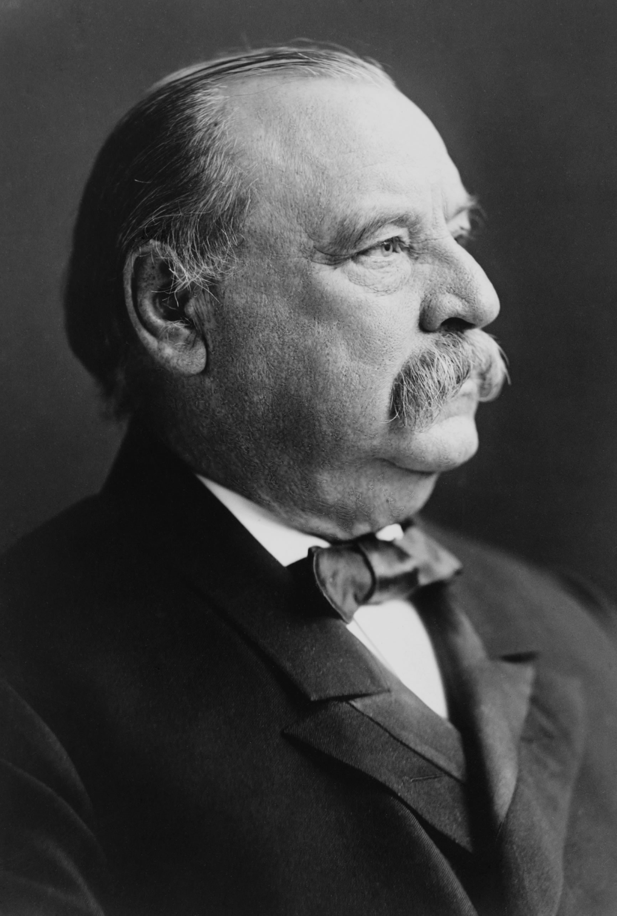
Dole immediately asked Pres. Grover Cleveland to annex Hawaii into the U.S. The President refused citing the “unethical” manner in which the Hawaiian government was overthrown.

Slide 37
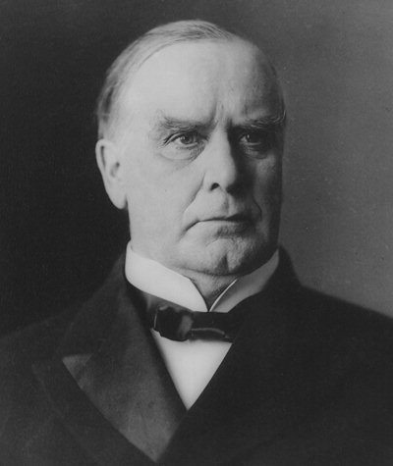
Cleveland was replaced when William McKinley was elected in 1896.

Slide 38
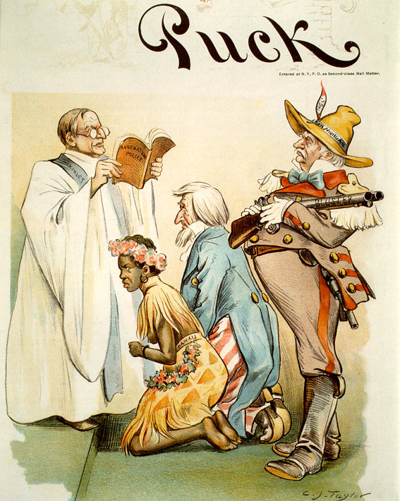
McKinley was a friend to business and industry and authorized the annexation of Hawaii as an official U.S. territory in 1898.

Slide 39
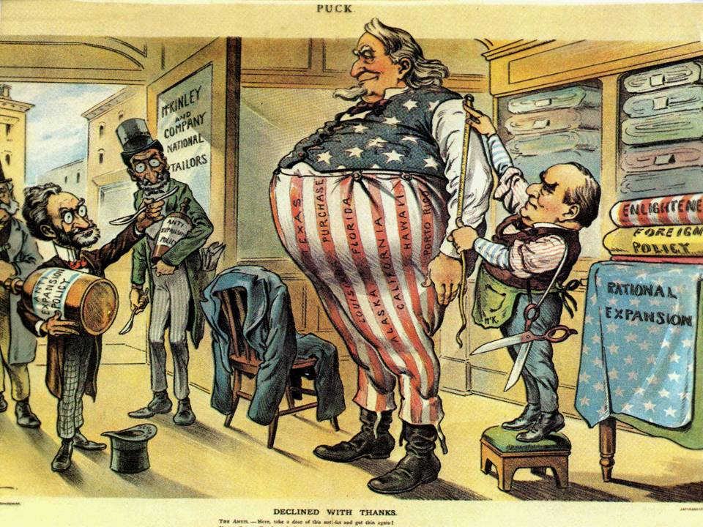
Imperialists in the U.S. were just getting warmed up. They quickly turned their attention south to Cuba and, in doing so, set the U.S. on a path to war.

Slide 40
Fin.

