Slide 1
Causes
of the
Great
Depression

Slide 2
1. Problems
for
American
Farmers

Slide 3
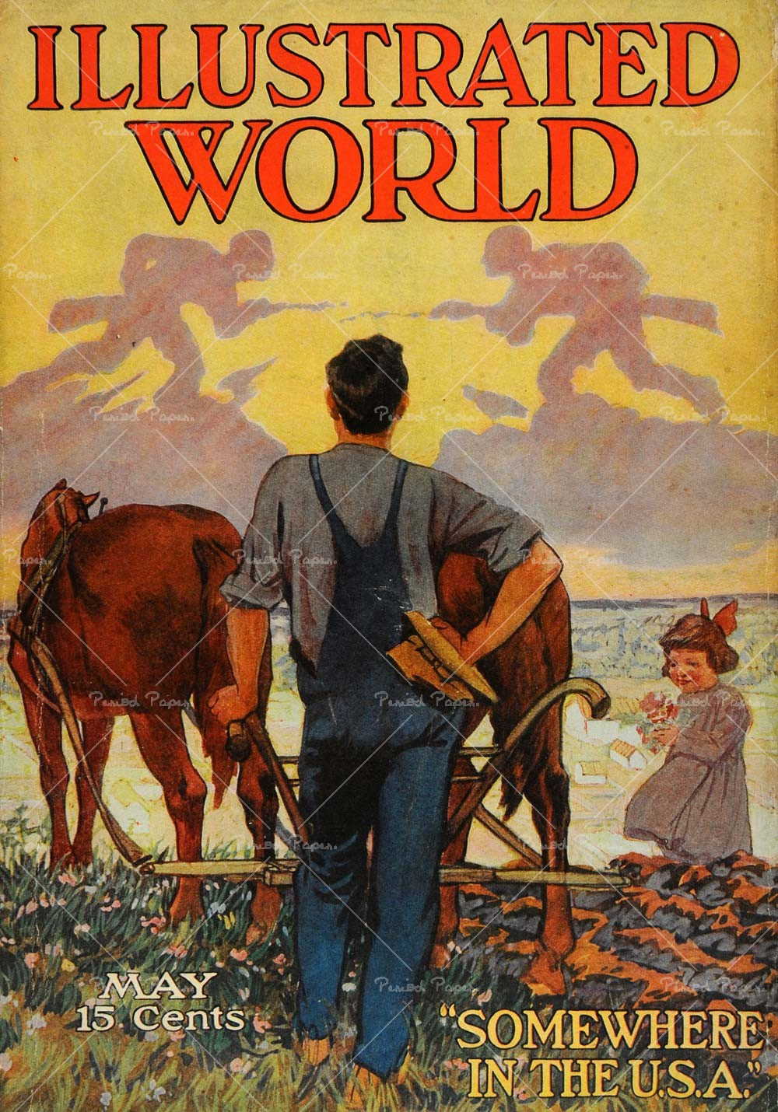
- During WWI the US government and European nations purchased tons of food from American farmers.
- To meet this demand, farmers took out loans to buy more land and farm equipment to grow more food.

Slide 4
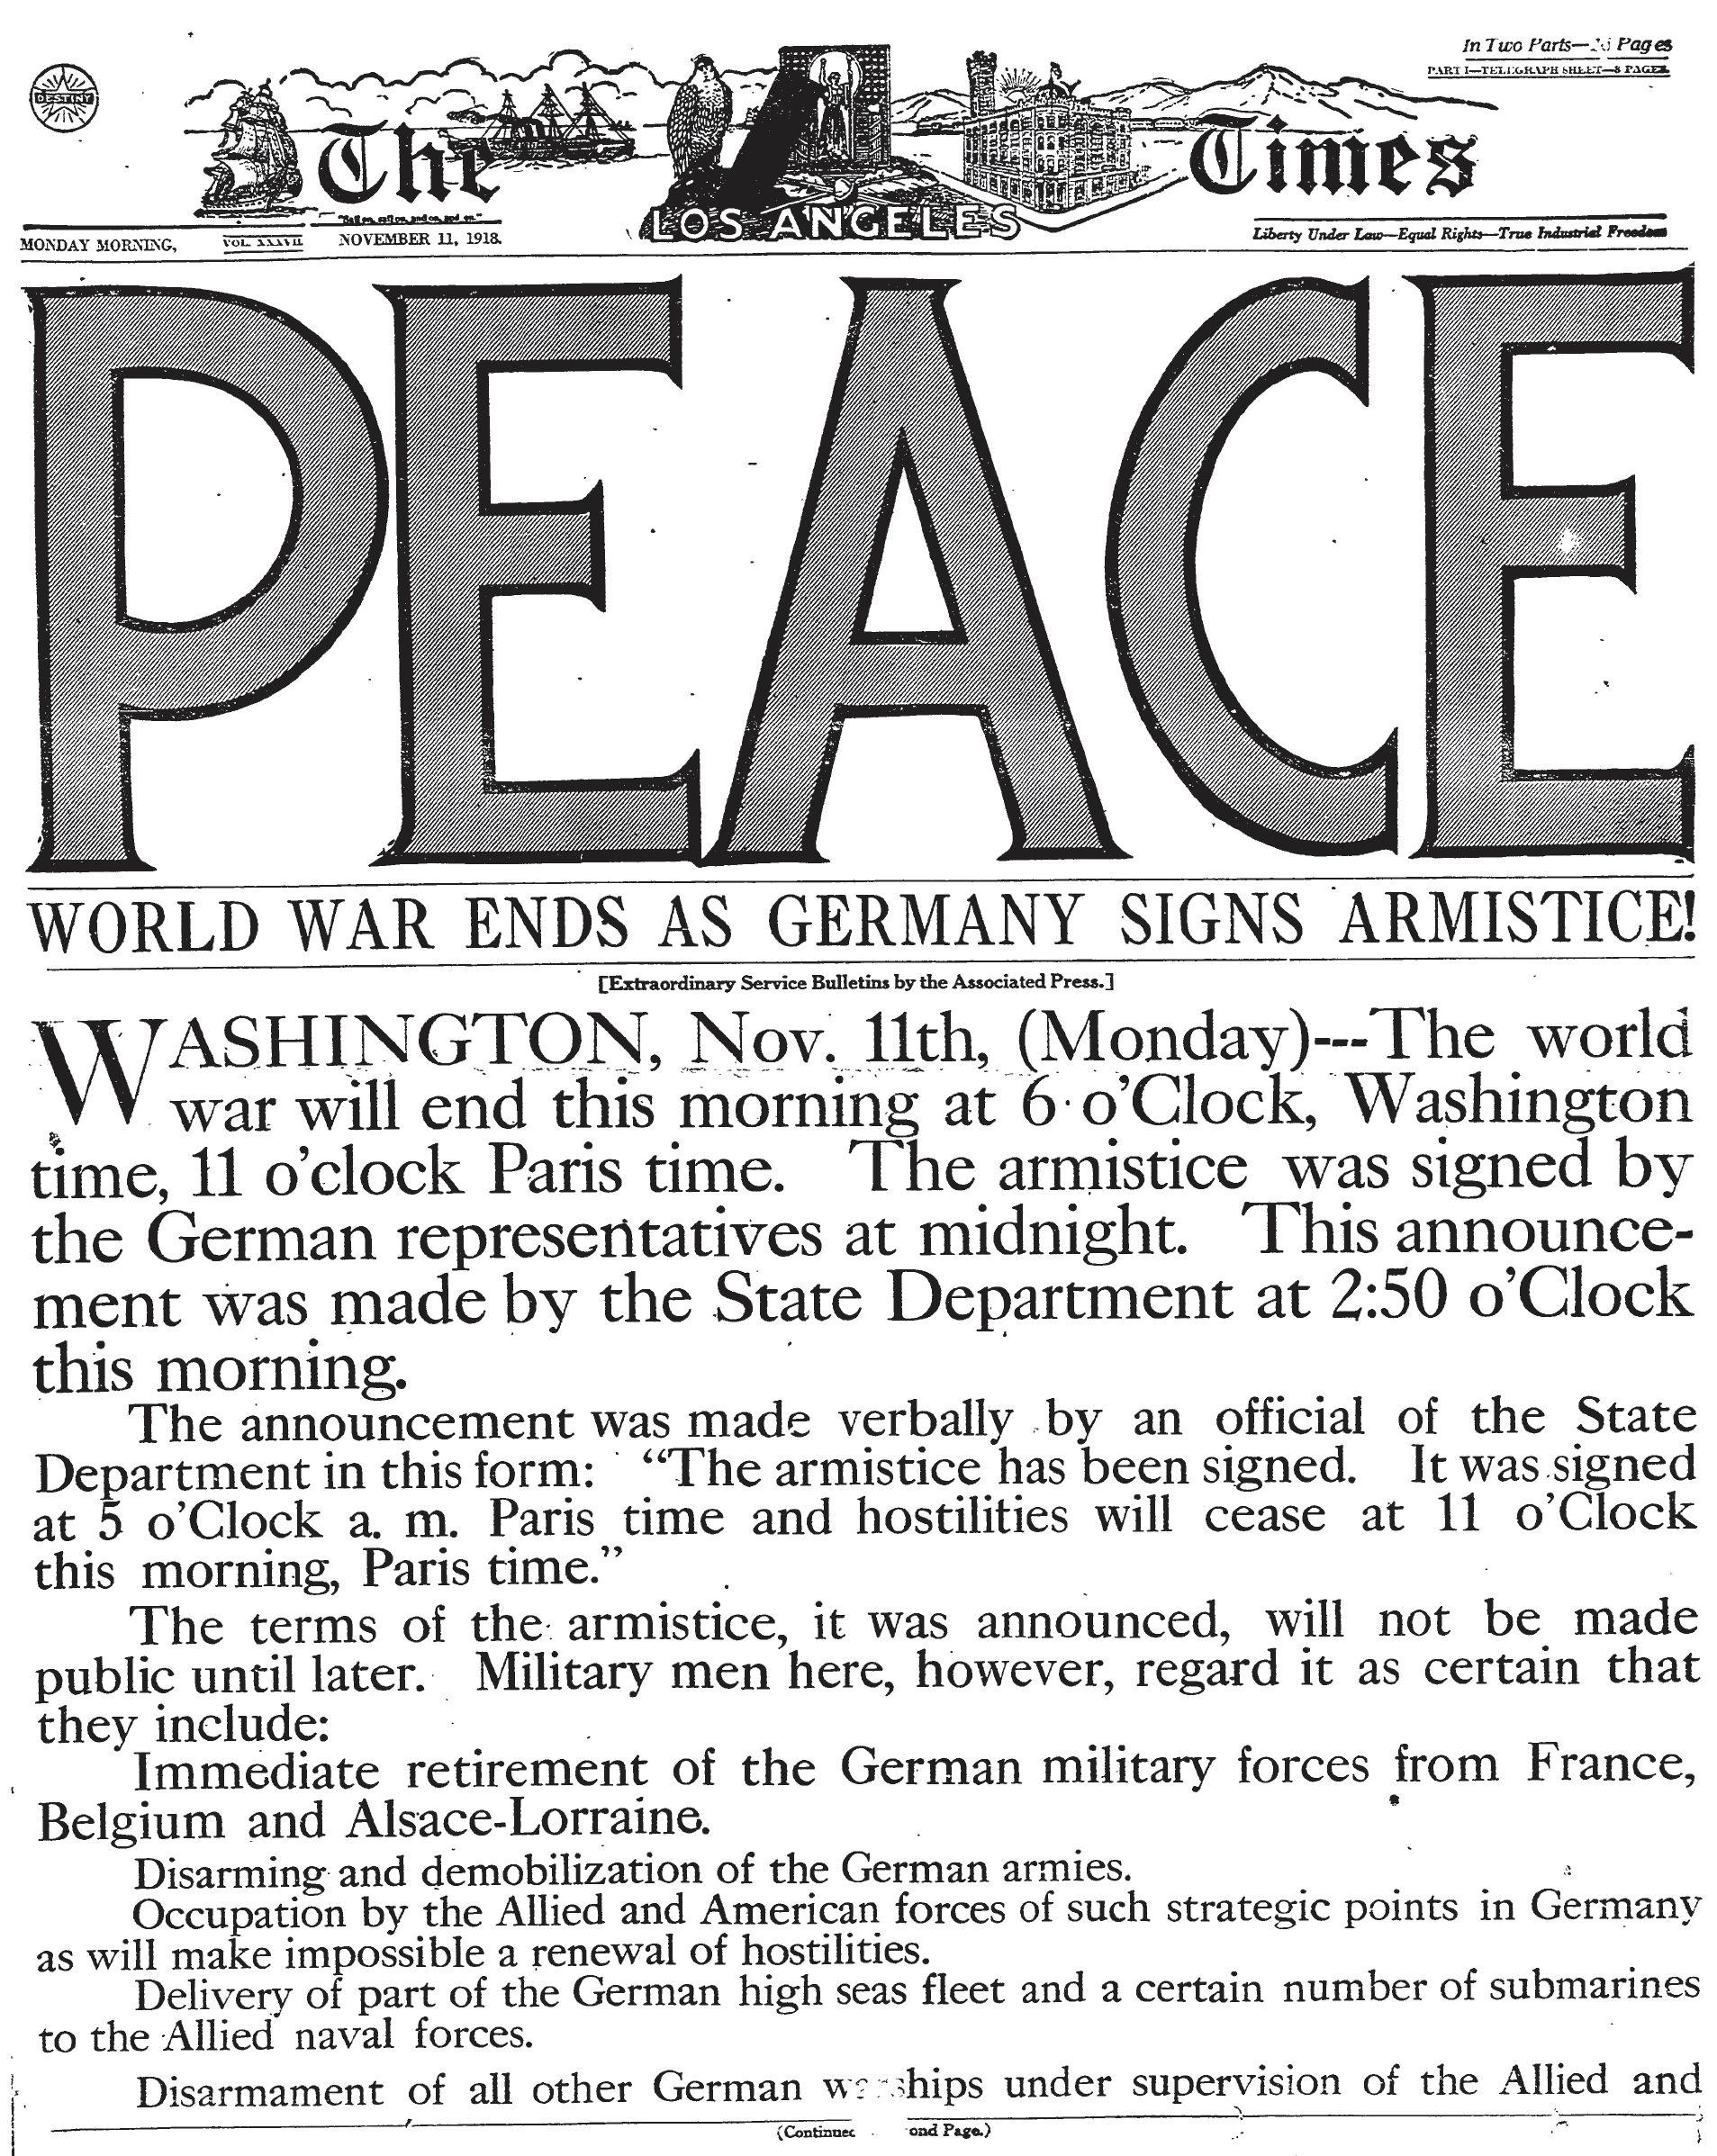
- When the war ended, farmers faced several problems.
1. Europe and the US government no longer needed to buy so much food. (drop in demand)
2. European farmers went back to work and grew food as well. (increase in supply)
3. As a result, the prices for foodstuffs went into freefall.

Slide 5
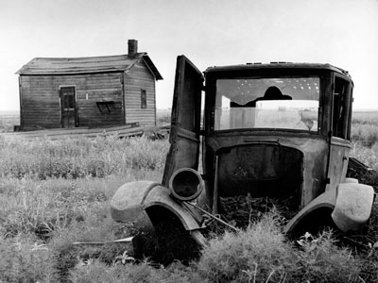
Farmers could not sell their crops for enough $ to be able to pay back their debts. Banks began to foreclose on farms.

Slide 6
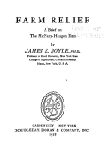
-Farmers got Congress to pass the McNary Haugen Bill twice between 1924 and 1928.
- Authorized the government to purchase surplus crops driving down supply and hopefully increasing prices.

Slide 7
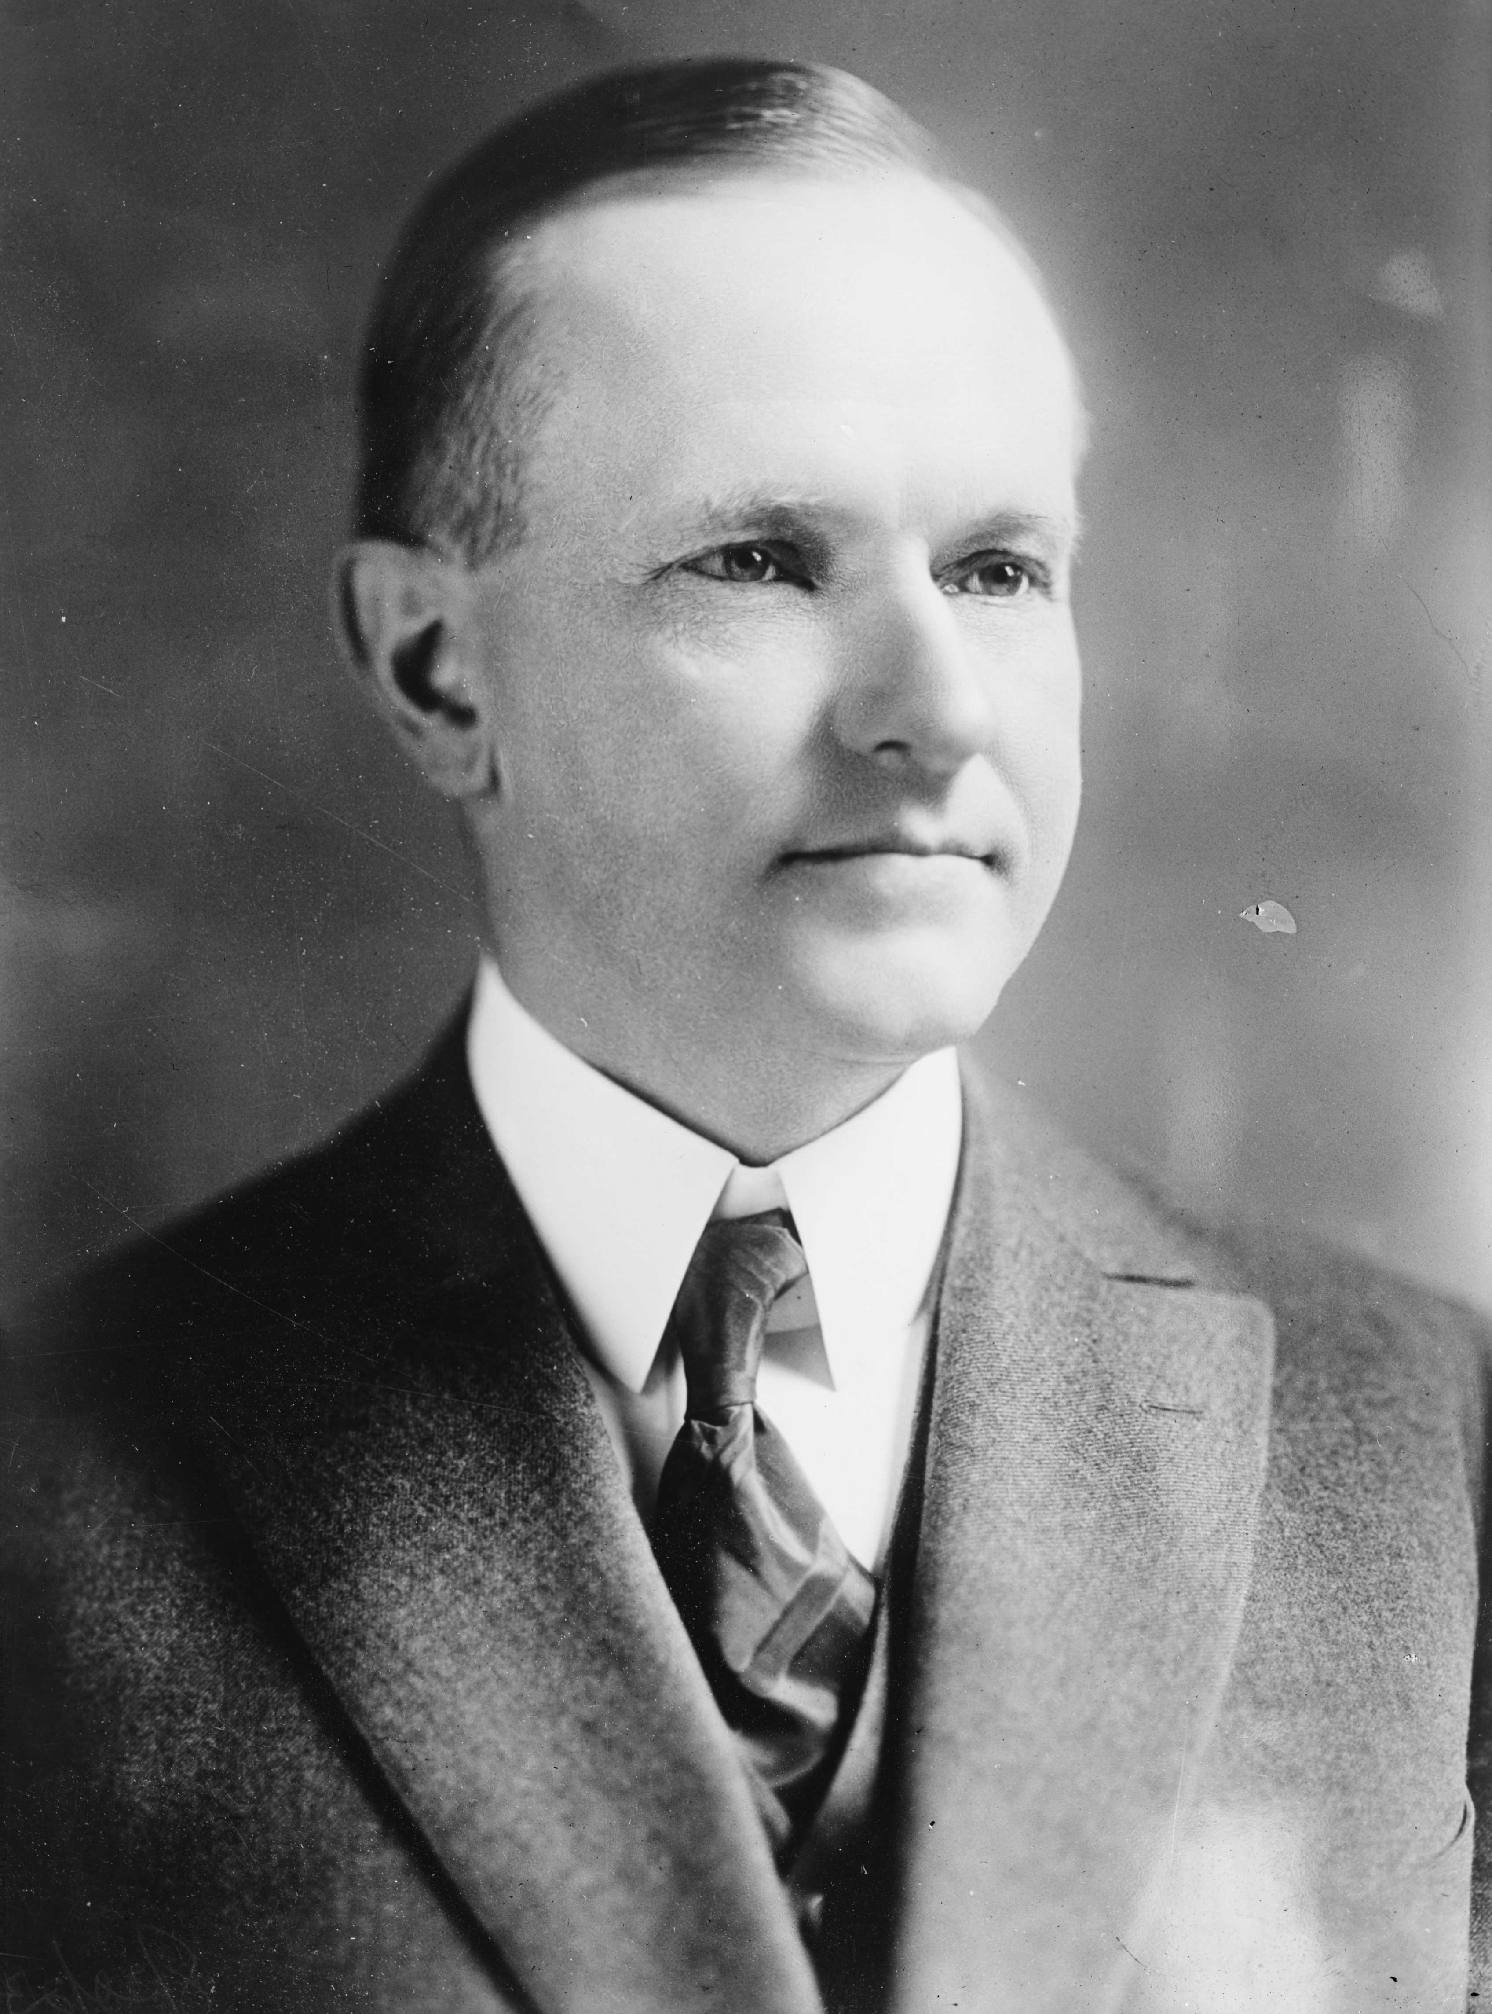
President Coolidge vetoed the bill both times.
With little or no help from the government, a growing number of farmers found themselves in trouble.

Slide 8
2. Uneven
Distribution
of Wealth

Slide 9
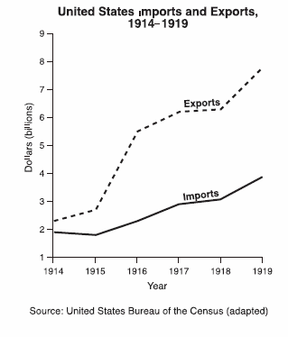
The U.S. economy had exploded with American entrance into WWI in 1917.

Slide 10
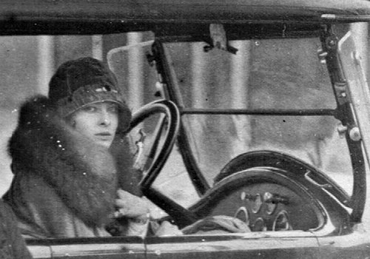
Business owners grew increasingly wealthy and began to live a life of luxury.

Slide 11
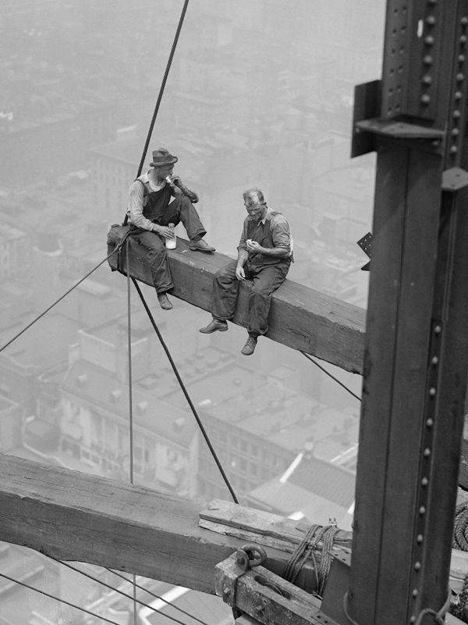
- Workers and the middle class looked at these wealthy business owners and were jealous. They wanted to live the good life too.
- The problem was workers and the middle class didn’t make enough to live the good life.
- How then did they go about meeting their desires?

Slide 12
3. Misuse /
Overuse
of
Credit

Slide 13
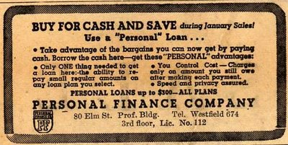
To live the good life, and to get what they wanted, Americans increasingly used credit.

Slide 14
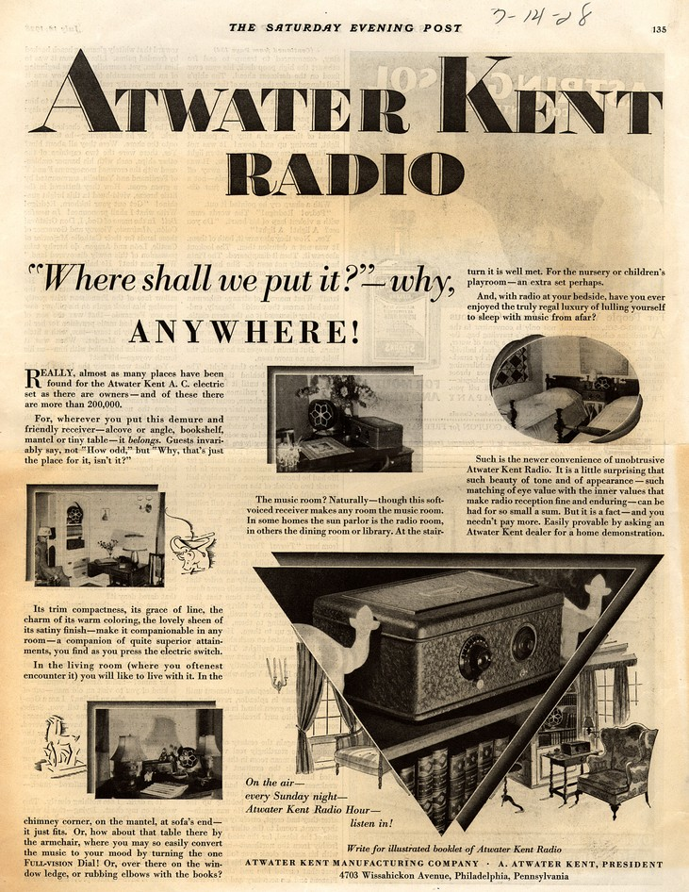
Because credit was fairly easy to get, and because of the growth of advertising, Americans bought lots of stuff.

Slide 15
As a result of this huge use of credit, many Americans eventually found themselves in massive debt.
When they realized how much debt they had, they cut back on spending. Problem?

Slide 16
4. Problems
for
Business
and
Industry

Slide 17
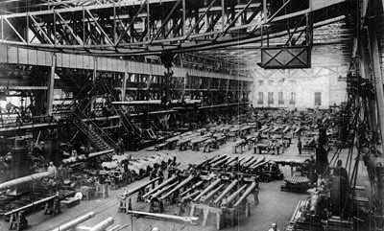
During WWI factories expanded like crazy to keep up with wartime demand.

Slide 18
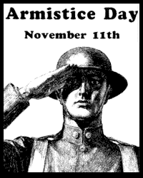
When the war ended and the government stopped spending, factories were concerned about profits.
However, as more and more people bought stuff on credit, profits didn’t fall, they went up!

Slide 19
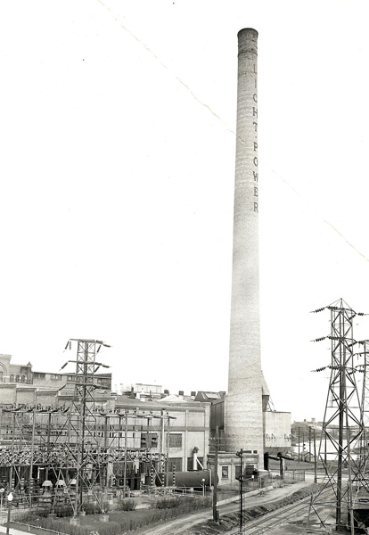
As more and more credit was being used, business owners expanded their factories and hired more workers to keep up with demand.
Business owners took out massive loans from banks and sold tons of stock to finance that expansion.

Slide 20
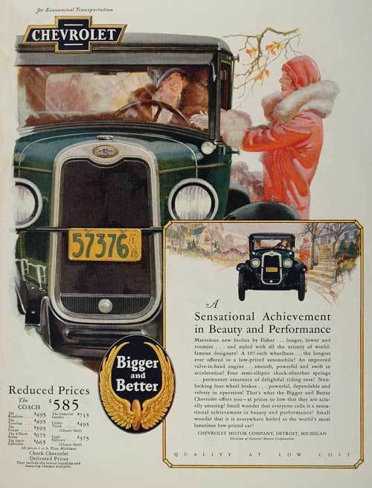
By 1929, American consumers began to realize how much debt they had and began to cut back on spending as a result.

Slide 21
When demand for industrial products began to fall, prices began to fall.
When prices began to fall, and when people began to buy less, factory profits began to fall as well.

Slide 22
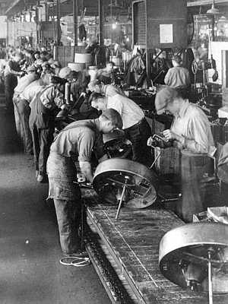
As profits fell, businesses found it difficult to pay back their loans. They also found it hard to pay all of their workers.
Some companies began to fire workers to cut costs. How did this actually make the problem worse?

Slide 23
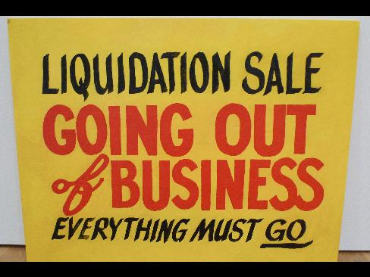
Other companies were forced to shut down altogether. Banks who had made loans to these companies lost their $.

Slide 24
5. The
Crash
of the
Stock
Market

Slide 25
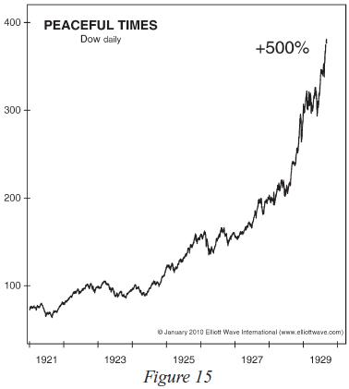
Stock prices had been going up for most of the 1920’s and companies had been paying lots of dividends to stockholders. This had all been driven by the success of American businesses.

Slide 26
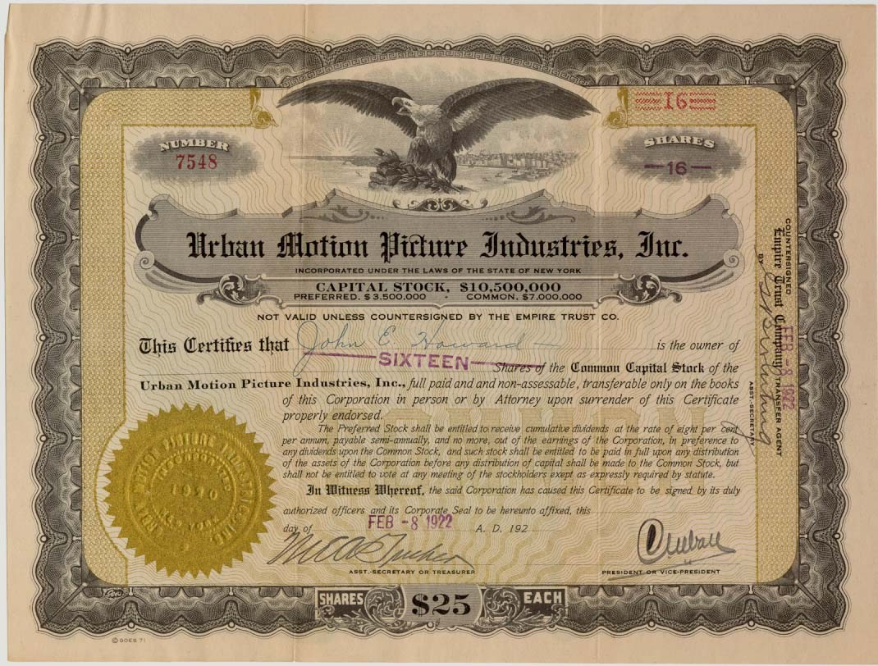
Every American who could wanted to invest in the market to make a profit. (high demand = high prices)

Slide 27
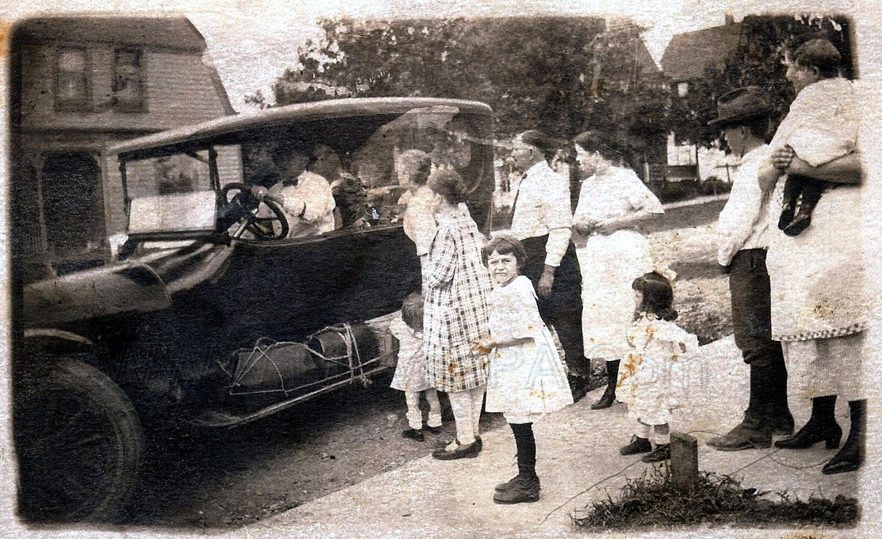
Not all Americans had the money to purchase stock. How could they get a piece of the action?

Slide 28
Buying on Margin- purchasing stock on credit
- Make a small down payment to buy a share of stock.
- Borrow the rest of the money to buy stock from the bank.
- As soon as the stock price goes up enough, investors sold their stock, paid off what they owed the bank, and kept the rest for themselves.
- For this system to work, stock prices had to keep going up. Why?

Slide 29
For most of the 1920’s stock prices kept going up, and everyone was happy.

Slide 30
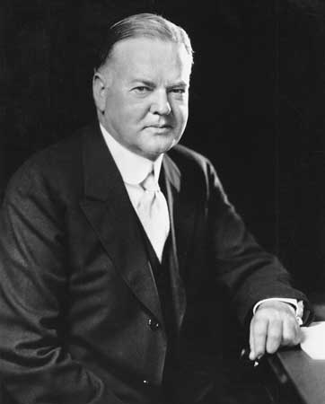
Some smart investors began to worry about the weakness in the economy.
- Farmers in trouble
- Consumers with too much debt cutting back on spending
- Businesses slowing down
- Banks with too many bad loans
- Potential decline in the stock market

Slide 31
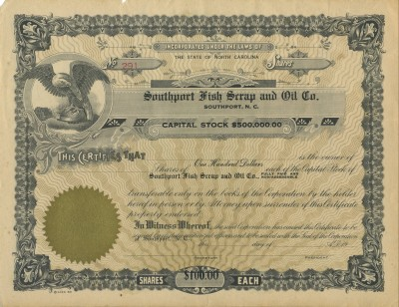
Worried about losing money, these investors began to sell their stock in late 1929. (increase in supply)

Slide 32
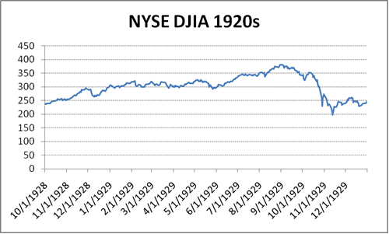
As a result, stock prices began to dip. Not a lot, but enough to make people concerned.

Slide 33
As stock prices began to fall, what did those who had bought stock on margin have to do?

Slide 34
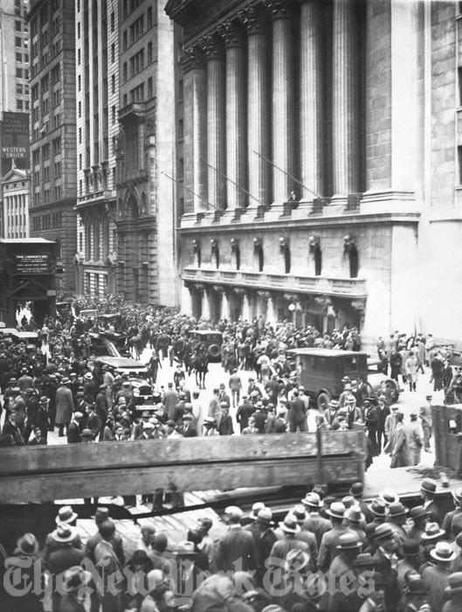
Things came to a head on October 29, 1929 (Black Tuesday)
1. Stock prices had begun to fall.
2. Those who had purchased stock on margin had to sell.
3. As demand for stock went down, and supply increased, stock prices fell even more, creating a panic of selling.

Slide 35
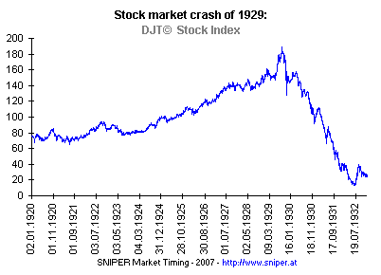
As prices continued to drop people found it increasingly difficult to find others who were willing to buy their stocks.

Slide 36
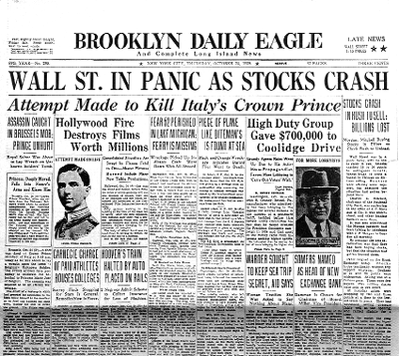
People who had invested in the market lost a total of $30 Billion by the end of 1929. Today that’s about $375 Billion.

Slide 37
6. The
Run on
Banks

Slide 38
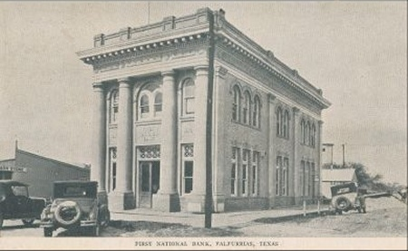
Farmers, factories, and people who bought stock on margin were unable to repay their loans.

Slide 39
Some banks had also been investing people’s money in the stock market. When the market collapsed, that money was lost.

Slide 40
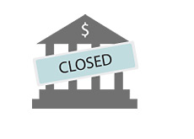
As a result, many Americans lost all of their money. Their bank had nothing to give them.

Slide 41
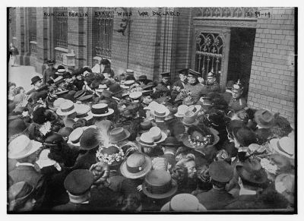
As people began to hear that some banks had literally run out of money, they panicked.

Slide 42
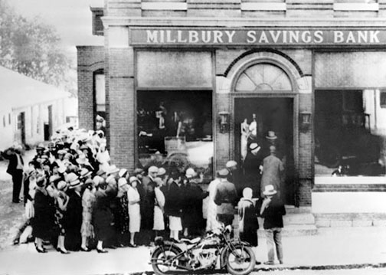
Lines formed at banks across America as people desperately attempted to withdraw their money. Even if their bank was okay, and hadn’t lost any money, people no longer trusted that their money was safe.

Slide 43
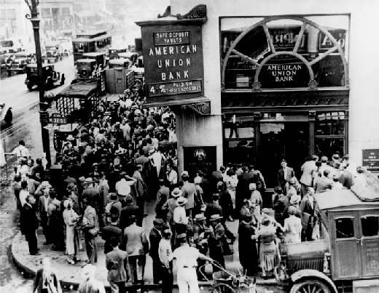
As this happened, banks that had been stable and had not played the market or made bad loans, found themselves running out of money as well.

Slide 44
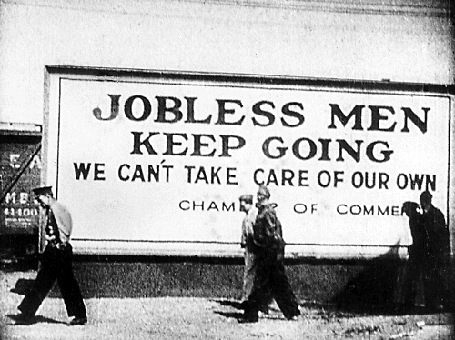
The culmination of all of these things was the beginning of the Great Depression.

Slide 45
Fin.

