Slide 1
WWII
Begins

Slide 2
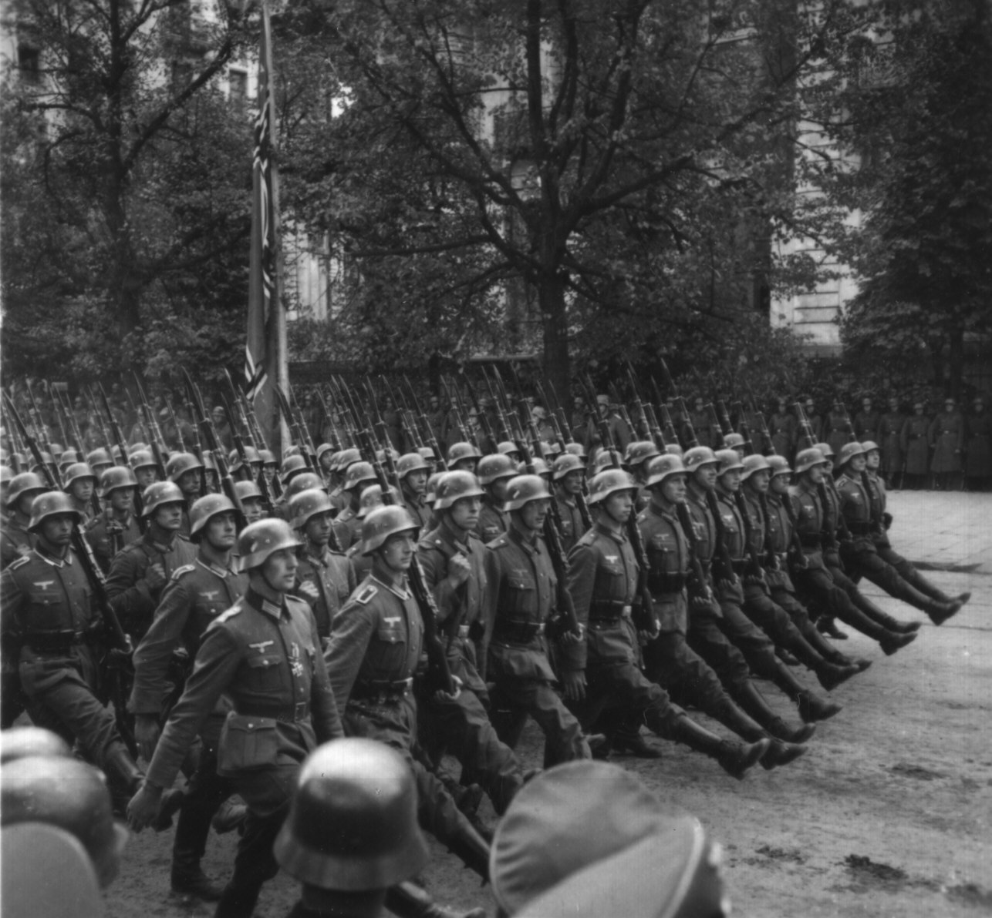
Adolf Hitler’s plan to help Germany escape from the effects of it’s own Great Depression involved a massive military build up and territorial expansion.

Slide 3
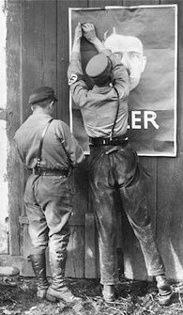
As the possibility of war grew in Europe throughout the first half of the 1930’s, America hoped to learn from the mistakes of its past.

Slide 4
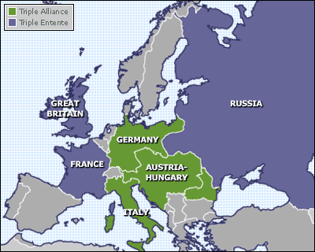
When World War I began in 1914, America hoped to stay out of the fighting.

Slide 5
Instead, US business interests hoped to trade with both England and Germany the two main sides in the war.

Slide 6
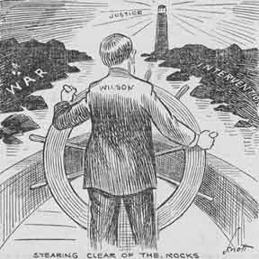
However, this posed a growing problem.
When the US traded with Germany, the English were upset.
When the US traded with England, Germany was upset.

Slide 7
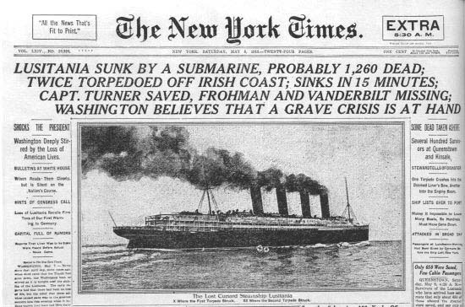
This eventually led America to war against Germany.

Slide 8
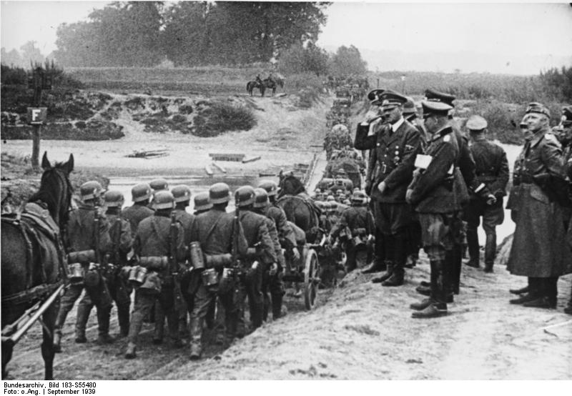
Thus, if war was going to happen in Europe again, America didn’t want to get sucked in.

Slide 9
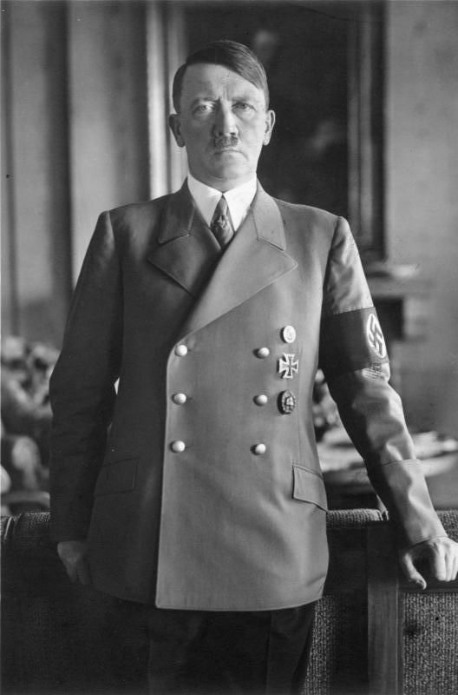
As Hitler began to possibly provoke a war, Congress wanted to make sure that the US didn’t follow the path that led America into WWI.

Slide 10
Neutrality Acts of 1935, 1936, & 1937
When the President proclaimed the existence of a foreign war, certain restrictions would automatically go into effect:
Prohibited sales of arms to belligerent nations.
Prohibited loans and credits to belligerent nations.
Forbade Americans to travel on vessels of nations at war [in contrast to WW I].
Non-military goods could be purchased on a “cash-and-carry” basis → pay when goods are picked up.

Slide 11
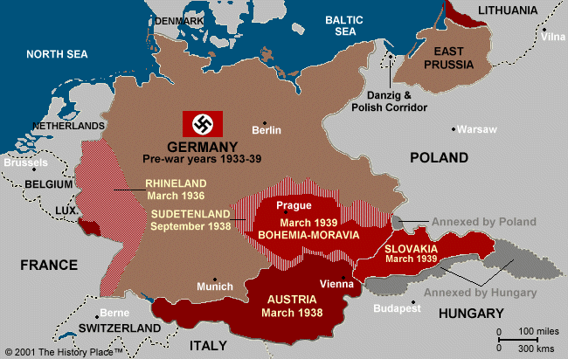
Hitler on the Move

Slide 12
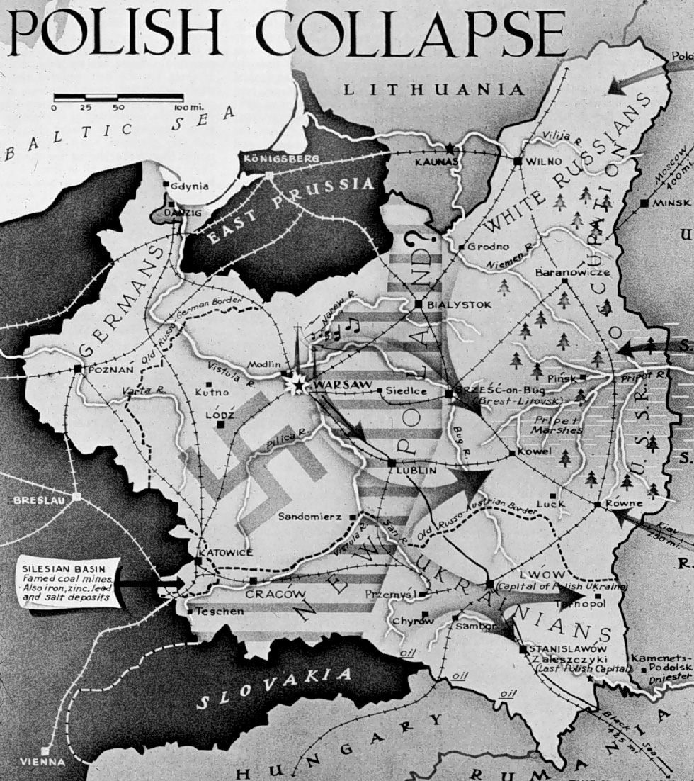
Hitler’s next target was Poland.

Slide 13
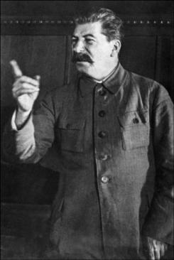
Hitler, and the world, knew that if Germany invaded into Poland, Joseph Stalin and the Soviet Union would be forced to take action against Nazi aggression.

Slide 14
Thus, Hitler had to first ensure that the Soviets would not repel a German invasion.
To that end Hitler and Stalin signed a non-aggression pact in August of 1939.
Both agreed to not attack the other and that Germany and the Soviet Union would split Poland amongst themselves.

Slide 15
Hitler invaded Poland Sept. 1, 1939.

Slide 16
Worried about Hitler’s future intentions, Britain and France declared war on Germany in response to the Nazi invasion of Poland. WWII was on.

Slide 17
When war broke out in September, 1939 the overwhelming majority of Americans were rooting for Britain and France.
So, the US government began to try and find ways to help them in their fight against the Nazis.

Slide 18
Neutrality Act of 1939
In response to Germany’s invasion of Poland.
Roosevelt got Congress to allow the US to aid European democracies in a limited way:
The US could sell weapons to the European democracies on a “cash-and-carry” basis.
FDR was authorized to proclaim danger zones which US ships and citizens could not enter.
Results of the 1939 Neutrality Act:
Aggressors could not send ships to buy US munitions.
The US economy improved as European demands for war goods helped bring the country out of the 1937-38 recession.

Slide 19
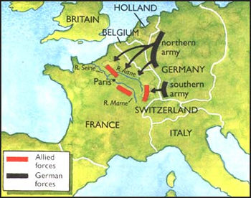
In the summer of 1940, Nazi forces stormed through Belgium and into the French countryside.

Slide 20
- The invasion began on May 10.
- Italy, allied with Germany, invaded from the South, as the Nazi army approached Paris.
- Paris fell on June 14th, and France officially surrendered to Germany on June 25th.

Slide 21
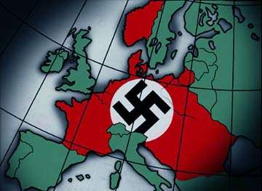
Britain Was Next!

Slide 22
To make matters worse, Germany, Italy, and Japan signed a formal alliance in September 1940 establishing what came to be known as. . .
The Axis
Powers

Slide 23
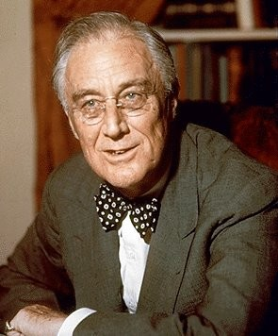
President Roosevelt believed that if Britain fell to the Nazis democracy in Europe might be lost forever. Not only that, but the U.S. might be next on the German agenda.

Slide 24
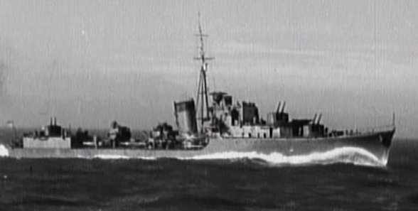
To provide quick assistance to Great Britain, the United States exchanged 50 old US destroyers that Britain could use to fight the Nazis, for access to British military bases in the Caribbean and Canada.

Slide 25
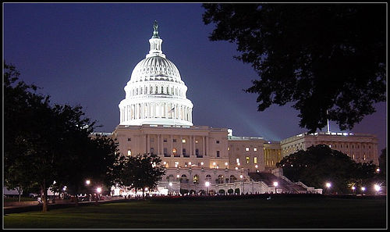
At the same time, Congress finally began to think about preparing America, in case war came despite our efforts to remain neutral.

Slide 26
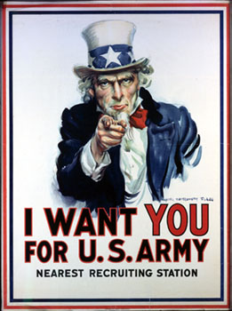
In the fall of 1940 Congress approved spending $37 Billion on naval and airplane construction.
Congress also passed the Selective Training and Service Act.
Forced 16 million men, ages 21-35 to register with the government.
Of those 16 million, 1 million would be selected to serve for a period of 1 year.

Slide 27
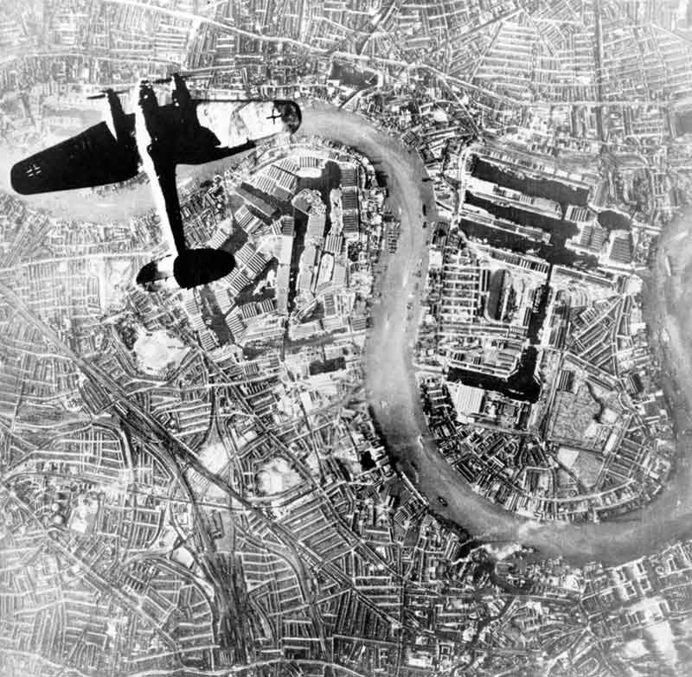
As Germany began to pound Britain from the air 1940-1941, Roosevelt urged Congress to do more to help.

Slide 28
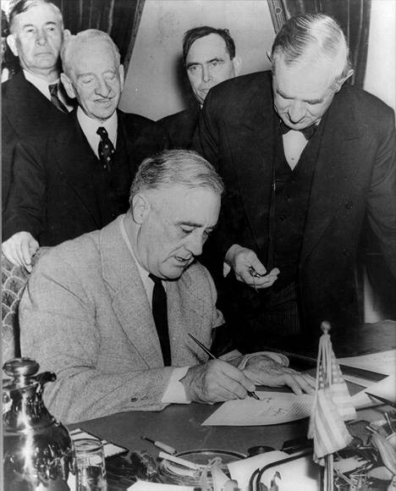
To that end, Congress passed the Lend Lease Act in March, 1941 that allowed the U.S. to lend weapons and supplies to “any country whose defense was vital to the United States.”

Slide 29
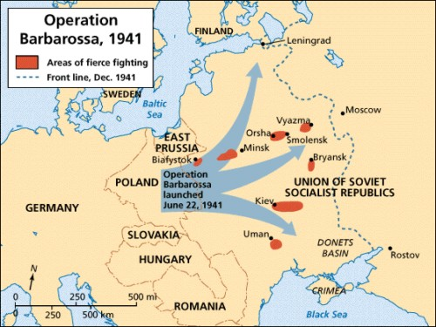
Hitler is a Dumbass!
In June of 1941, Hitler broke the non-aggression pact with the Soviet Union.
He did so in an effort to secure Soviet oil fields, and to capture Moscow before the Soviets could stop him.

Slide 30
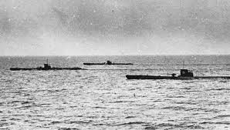
As a result, FDR began sending lend-lease supplies to the Soviet Union (USSR).
German U-boats traveled in “wolf packs” at night torpedoing weapon shipments headed for the Britain and the USSR.
FDR allowed U.S. warships to attack German U-boats in self-defense.

Slide 31
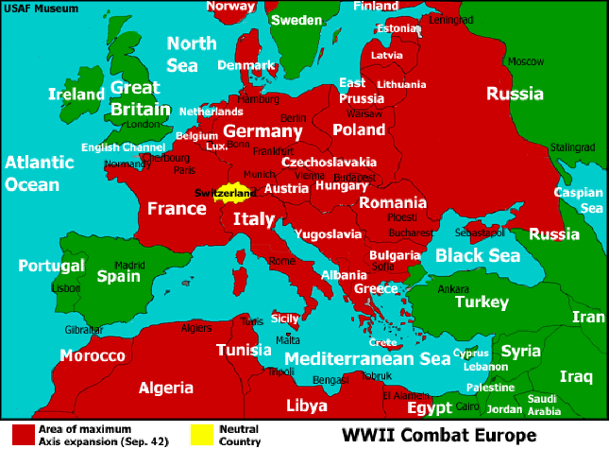
As 1941 drew to a close, America had been successful in staying out of the war. However, things didn’t look good for the future.

Slide 32
While all of this was going on, another storm was brewing across the Pacific.
Japan was beginning to plan its own course of action.

Slide 33
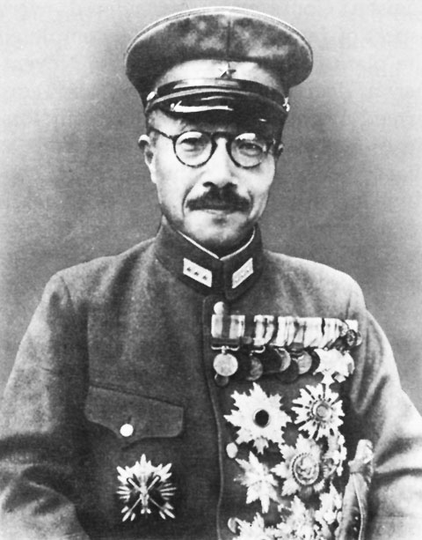
The Japanese government, led by Hideki Tojo, believed that a push for Japanese imperial expansion would help Japan deal with its own economic problems.

Slide 34
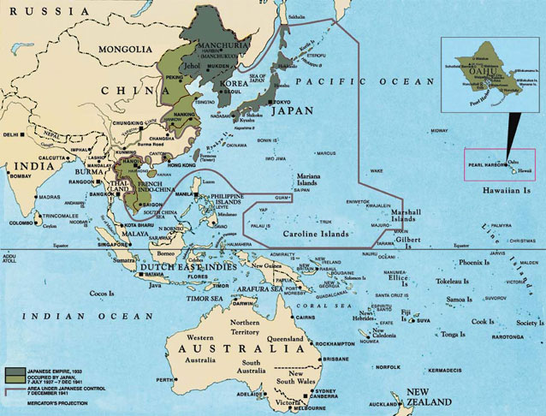
To that end, Japan invaded Manchuria in 1931 and into China in 1937.

Slide 35
Japan continued its expansion invading the French colony of Indochina in July, 1941.

Slide 36
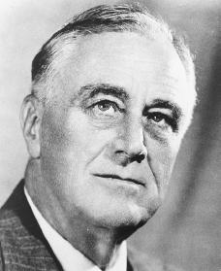
In response to the invasion of Indochina, America and Britain threatened to cut off trade with Japan if the Japanese did not withdraw from both Indochina and China itself.

Slide 37
The Japanese depended upon trade with America, especially for much of their oil.

Slide 38
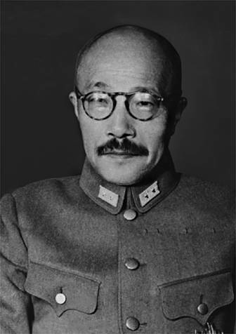
Japan had three possible responses to the British and U.S. action.
1. Withdraw in shame from China.
2. Stay in China but face possible economic ruin due to lack of imported natural resources.

Slide 39
3. Scare America and Great Britain into accepting even more Japanese expansion.

Slide 40
What choice did Japan make?

Slide 41
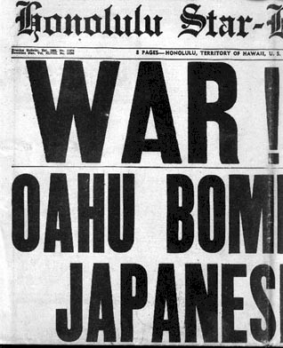
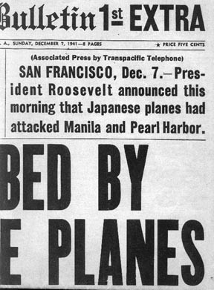
“ December 7th, 1941, a date which will live in infamy.”

Slide 42
Fin.

