Slide 1
The
Progressive
Era
1900-1920

Slide 2
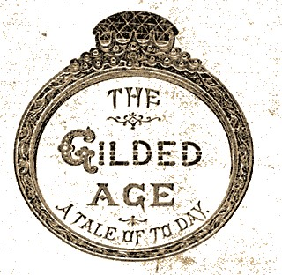
Over the course of the Gilded Age, a number of problems grew increasingly bad.

Slide 3
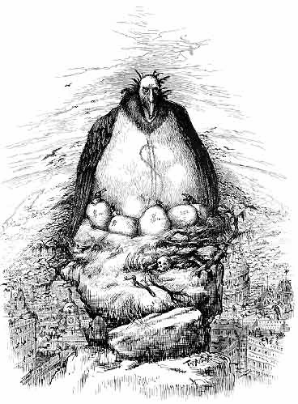
By 1900 they had grown so problematic that they could no longer be ignored. As such, Americans across the country began to take on the task of solving the problems that plagued the United States.

Slide 4
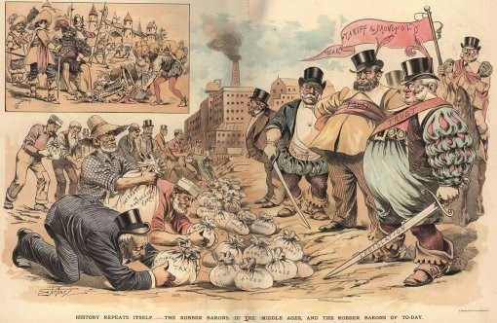
1. Government Corruption

Slide 5
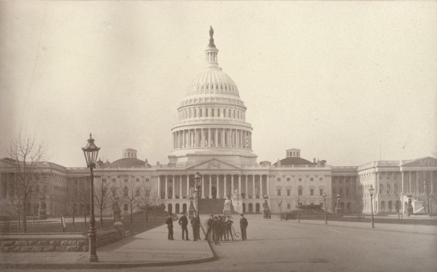
Throughout the Gilded Age, the government had, theoretically, been following the ideology of laissez faire.

Slide 6
However, in a true laissez faire system, the government really does nothing about business; it doesn’t restrict business, but it doesn’t help business either.

Slide 7
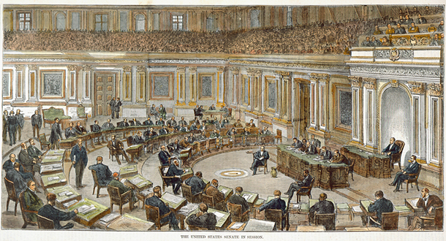
During the Gilded Age, the U.S. government totally helped business and industry make even more money!

Slide 8
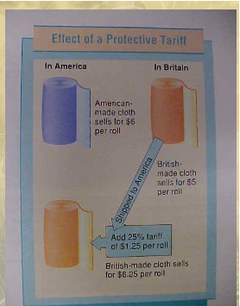
How?
1. Tariffs
- A tax placed upon goods brought into America from foreign nations.
- The goal is to make American products comparatively cheaper than foreign made goods. Why?
- Get people to buy American!

Slide 9
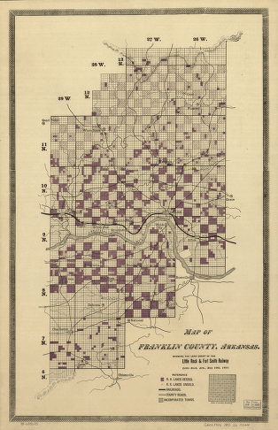
2. Railroad companies were given land grants by the government.
- Railroad construction companies were given tons of land. The government instructed these companies to sell that land in order to raise the necessary money to build the railroads.

Slide 10
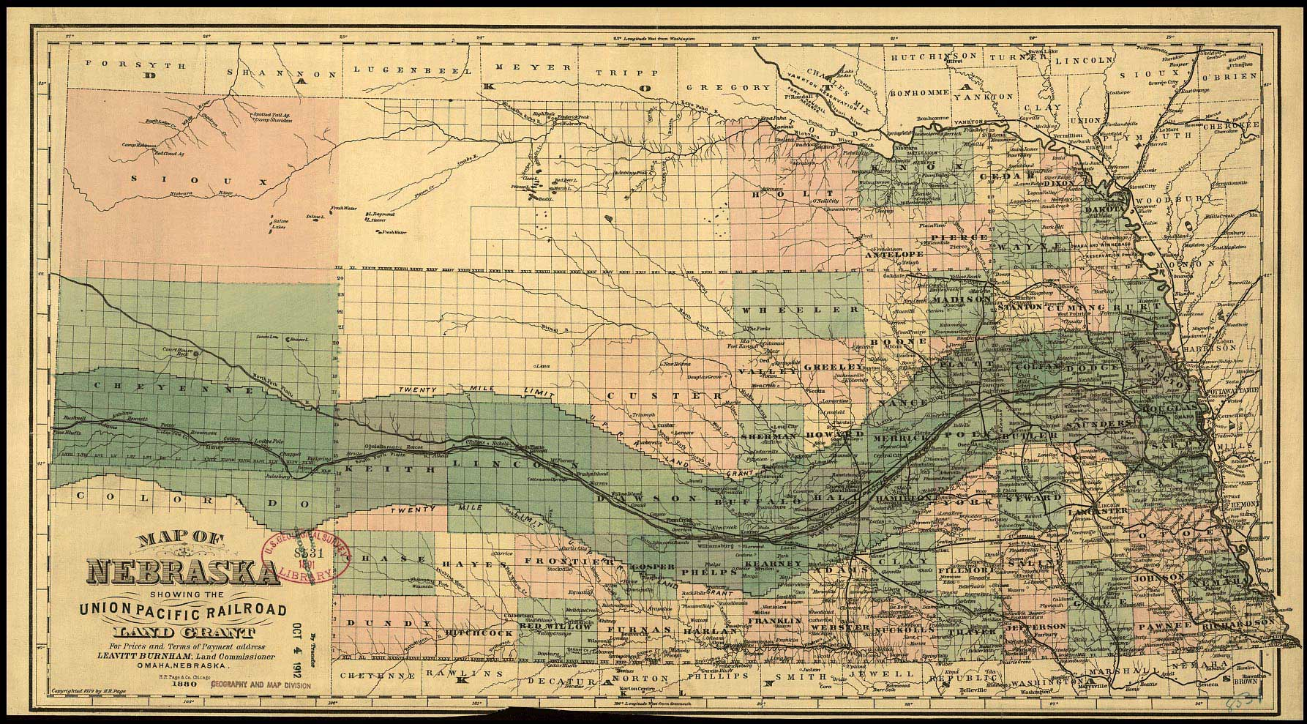
The amount of land given to Railroad companies more than paid for the construction of the railroads.

Slide 11
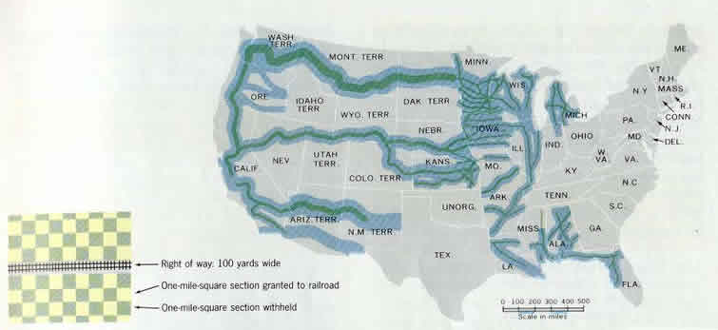
As a result, railroad companies had a lot of extra land that they could sell, and then keep all of the profit for themselves.

Slide 12
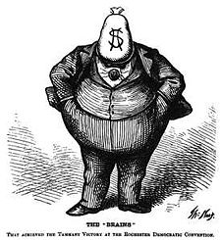
In order to convince the government to continue to actively support big business, companies openly bribed members of the U.S. Congress, and state legislatures across America.

Slide 13
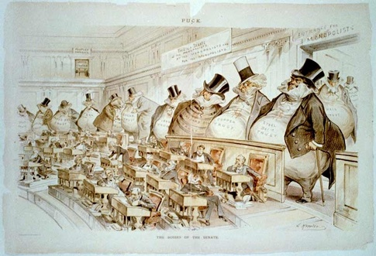
The bribery of state legislatures was particularly troubling in that it was the various state legislatures, and not the people themselves, who appointed members to the Unite States Senate. Why was this such a problem?

Slide 14
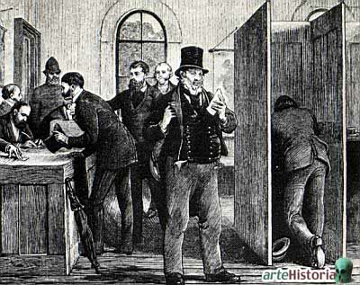
But even if the people themselves had the right to vote in Senators, it might not have mattered.

Slide 15
Votes were not secret! Anyone who wanted to know who you voted for could easily find out. Why was this a major problem?

Slide 16
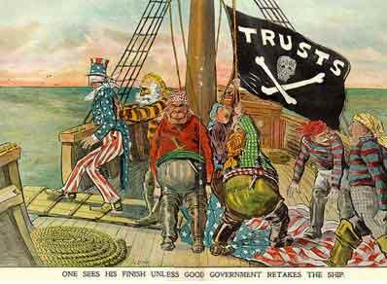
Perhaps the biggest problem of all then, was that government, at the state and national level, was dominated by wealthy business interests, at the expense of the poor and the working class.

Slide 17
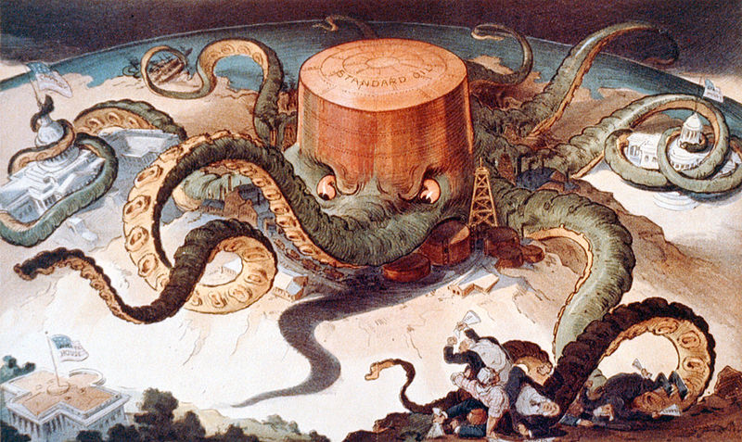
2. Power of Trusts

Slide 18
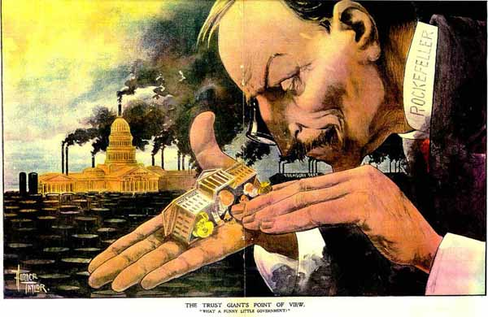
Trusts, wealthy business owners, dominated almost every element of society.

Slide 19
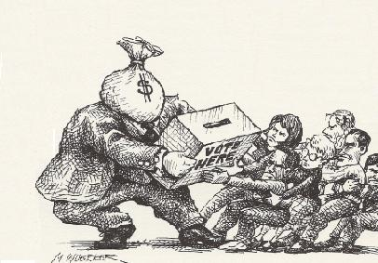
Responding to popular outcry, Congress, in 1890, passed the Sherman Anti-trust Act, designed to outlaw monopolies.

Slide 20
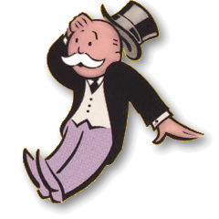
However, the government never fully enforced that law, and the power of trusts, monopolies continued. Remind me why monopolies aren’t a good thing?

Slide 21
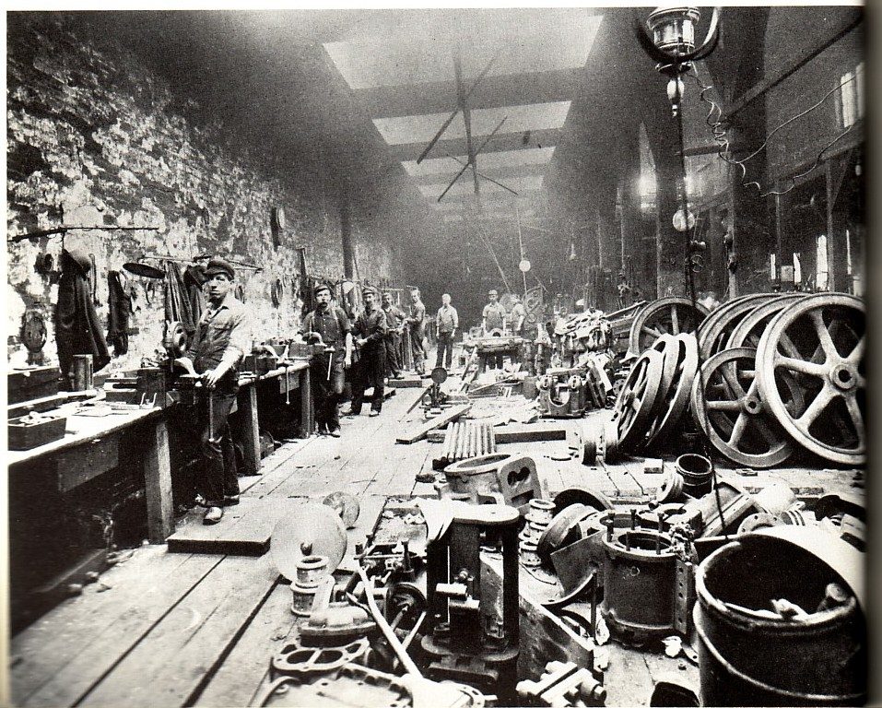
3. Working Conditions

Slide 22
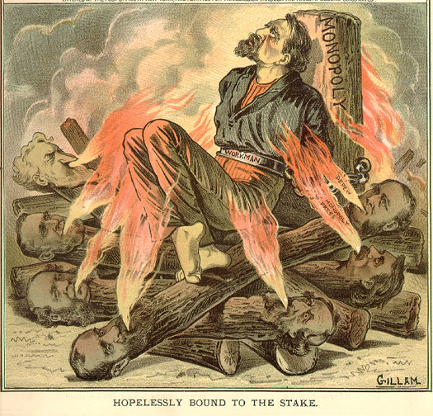
We can boil this down into three simple things, that everyone here should know:
- Wages were terrible.
- Hours were far too long.
- Safety was almost non-existent.

Slide 23
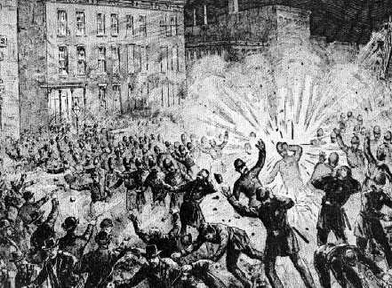
To make matters worse, unions had been actively stopped by the U.S. government as they pushed to change these things.

Slide 24
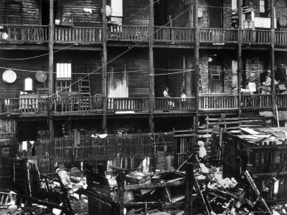
4. Tenements

Slide 25
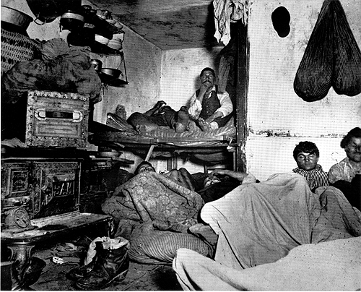
Duh!

Slide 26
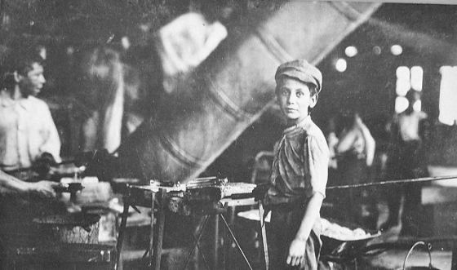
5. Child Labor

Slide 27
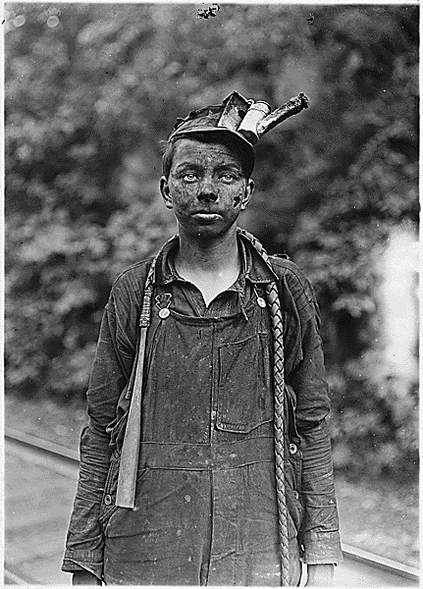
Duh!

Slide 28
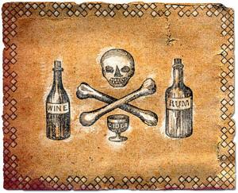
6. Alcohol Abuse

Slide 29
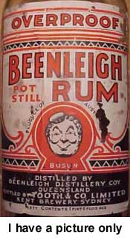
“Demon Rum” flowed freely from bars and saloons across America. Working class neighborhoods were filled with alcohol. Why?

Slide 30
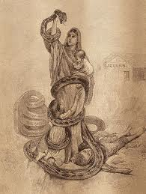
Heavy drinking caused a number of problems:
- Decreased the efficiency of workers.
- Drunk more workers more prone to accident.
- Increased domestic abuse.
- Cost families money they might otherwise have spent on food, clothing etc.

Slide 31
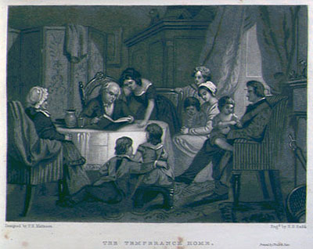
“The Temperance Home”

Slide 32
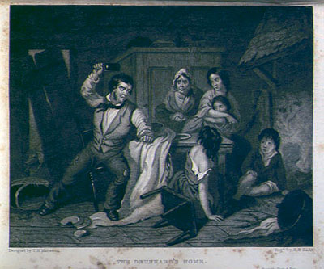
“The Drunkard’s Home”

Slide 33
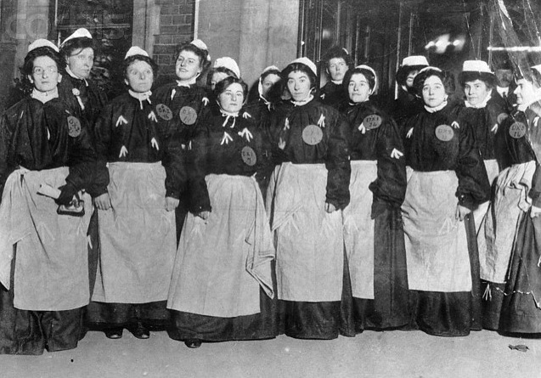
7. Women’s Rights

Slide 34
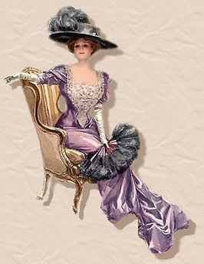
The problems of women generally varied by social class.

Slide 35
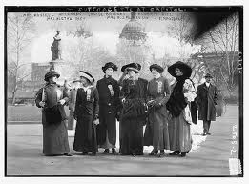
Upper class and middle class women were expected to stay at home and take care of their families. They were not supposed to go out and get a job.

Slide 36
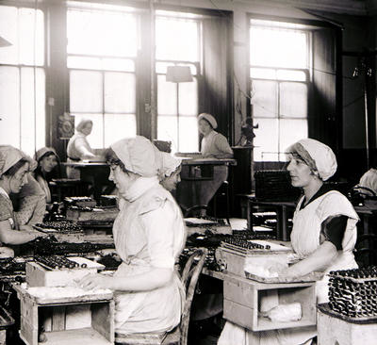
Lower class, working class women, had to work. They had no choice but to get a job to earn money to support their families. And for that work, they were paid less than men.

Slide 37
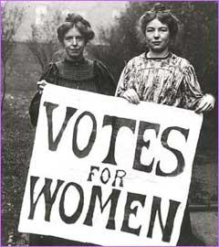
However, all women had one problem in common, regardless of whether they were rich, poor, or somewhere in between:
None of them could vote.

Slide 38
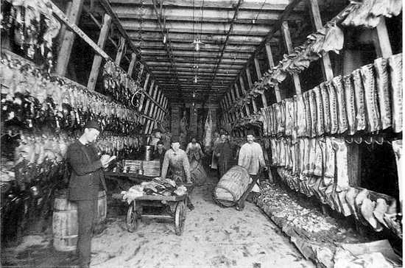
8. Consumer Safety

Slide 39
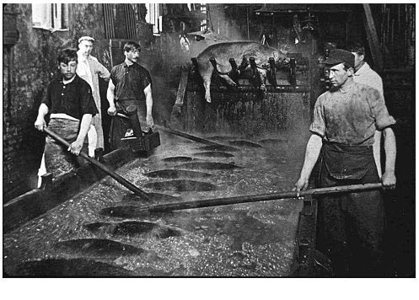
Because the government did not regulate the practices of business and industry, products were made and sold with no safety regulation.

Slide 40
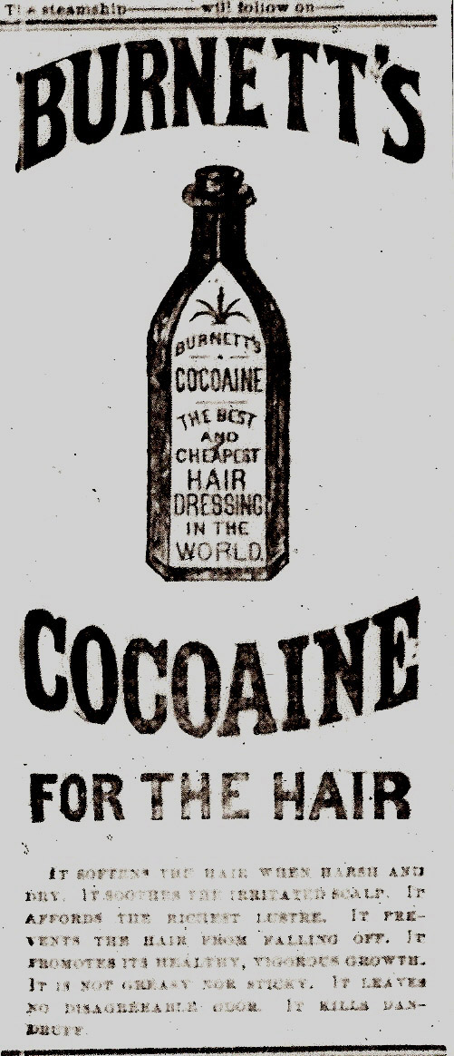
This was most problematic when it came to food and medicine.
Medicine manufacturers packed their products full of unhealthy things and made wild claims about what their products would do.
Food manufacturers were not regulated and got away with putting all sorts of horrible things into their products too.

Slide 41
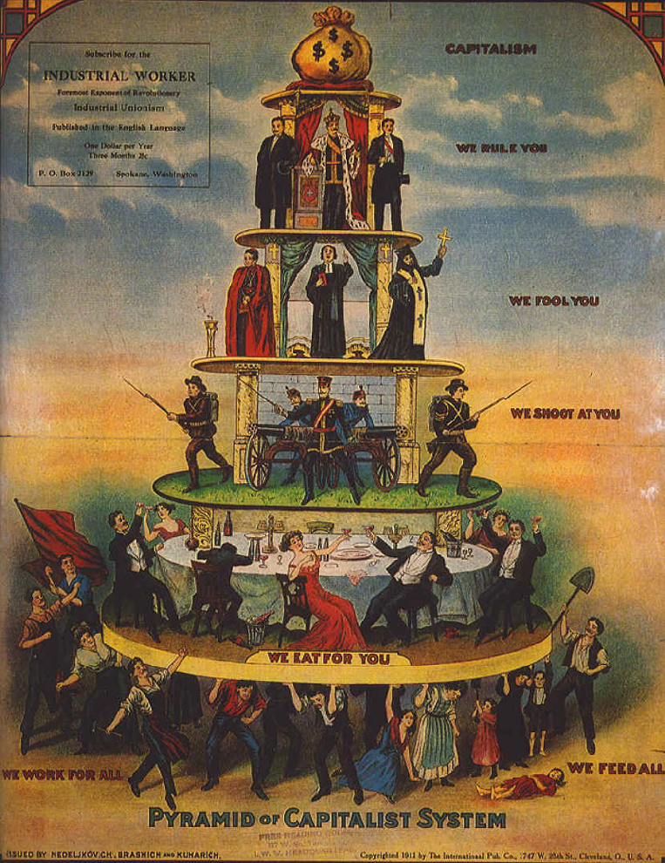
People had been talking about these problems for many years prior to the Progressive era.
The question we next need to answer, is why by 1900, did America get serious about cleaning itself up.

Slide 42
Fin.

